Slide 1

ML 24/25-10 Creating Text from Images with OCR API
Team_TechRookies
Akanksha Venkatesh Venkatesh Baitipuli- 1568316
Babitha Nadar -1566929
Date: 2025, March 25
M. Eng. Information Technology WS 24-25/ Prof. Damir Dobric / Software Engineering

Slide 2
Objective
To enhance OCR accuracy by applying various preprocessing techniques and evaluating their effectiveness using cosine similarity, dictionary-based accuracy, and confidence scores.
To develop a ranking method that selects the best preprocessing technique, ensuring improved text extraction from images of bills and passport documents ,car license plate.

Slide 3
TABLE OF CONTENTS
Introduction
Methodology
Implementation
Conclusion
Results

Slide 4
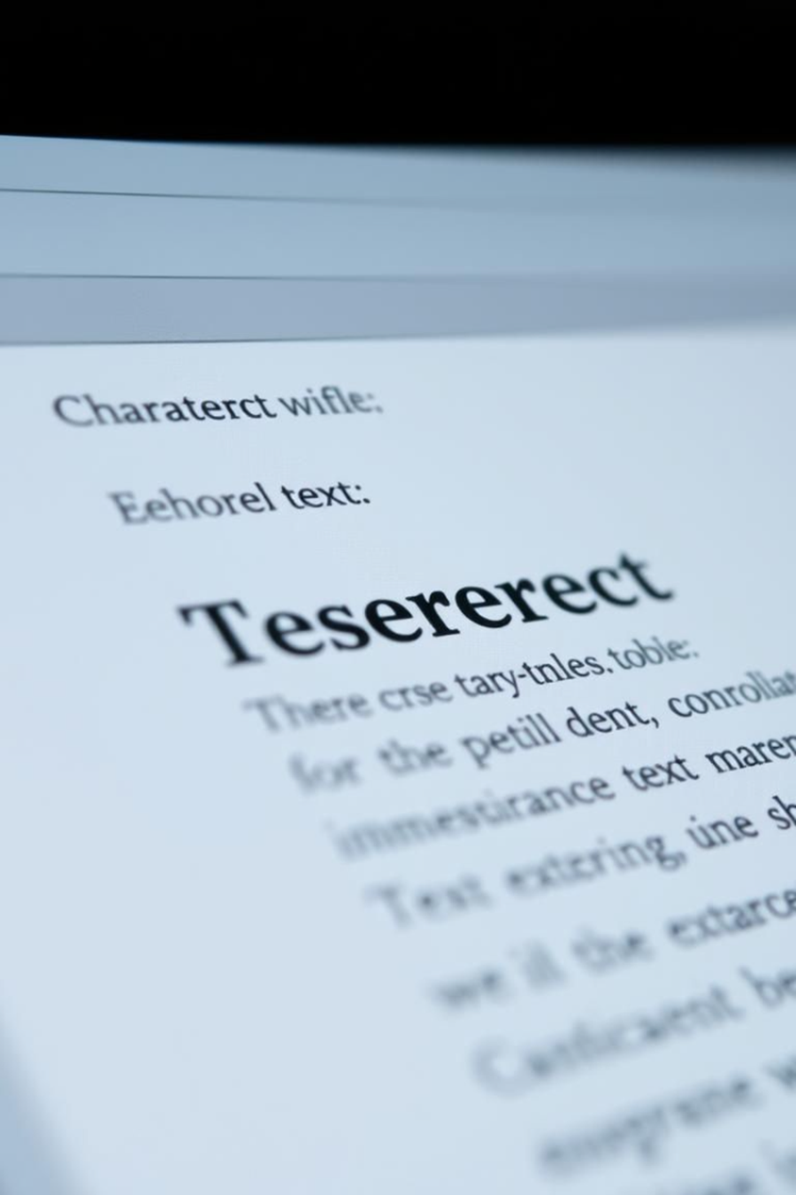
Introduction
Optical Character Recognition(OCR) converts text into digital format.
Extracts text from images(.Png, .jpg, jpeg),scanned documents.
Developed to store increasing data digitally.
Notes:
Vinay

Slide 5
Evolution Of OCR
Early OCR (IBM 1287) could only recognize handwritten numbers.
Tesseract OCR: Open-source, supports multiple languages and fonts.

Slide 6
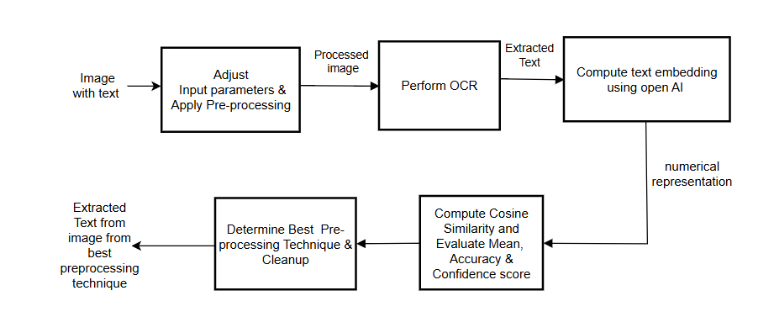
Methodology

Slide 7
Key Pre- Processing Technique
Image rotation & Skew correction
Binarization & Grayscale
Resizing & DPI Adjustment
Noise Removal & Morphological Operations
Inversion
Color Space Transformations
Notes:
Anil

Slide 8
Implementation
T1 - Rotation combined with Resize
T2 - CannyFilter combined with Invert
T3 - Grayscale combined with Binarization and with Resize
T4 - Hue Saturation Intensity Adjustment
T5 - Grayscale combined with Binarization
T6 - Invert
T7 - Mirror
Combining preprocessing technique to improve the accuracy of extracted text.
OCR text extraction and confidence scoring.
OpenAI Text Embedding (Semantic Meaning)
Metrics Calculation (Cosine Similarity, Dictionary Accuracy)
Eliminating false similarity
Computing Best Pre-processing Technique.
Notes:
Anil

Slide 9
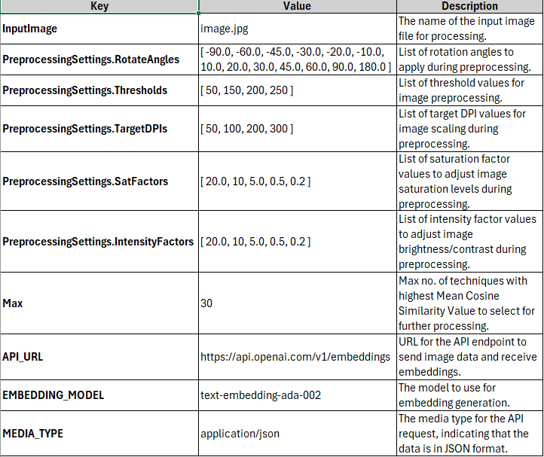
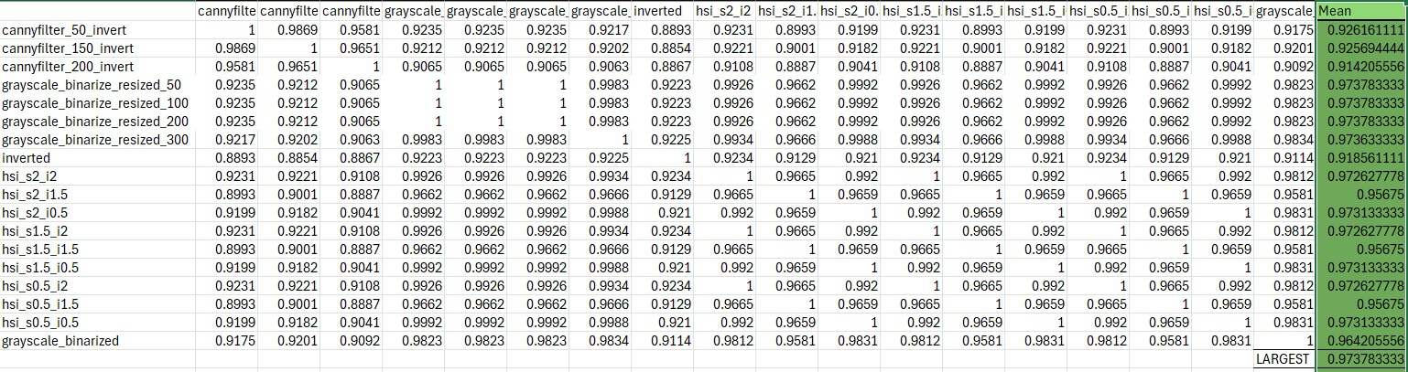
Adjustable input configuration
Cosine similarity matrix

Slide 10
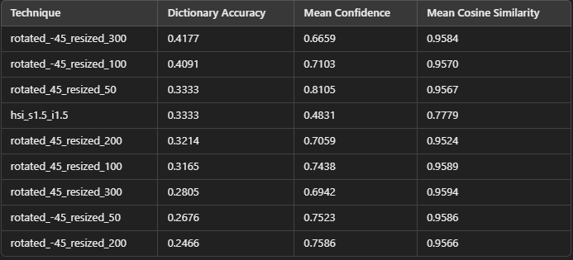
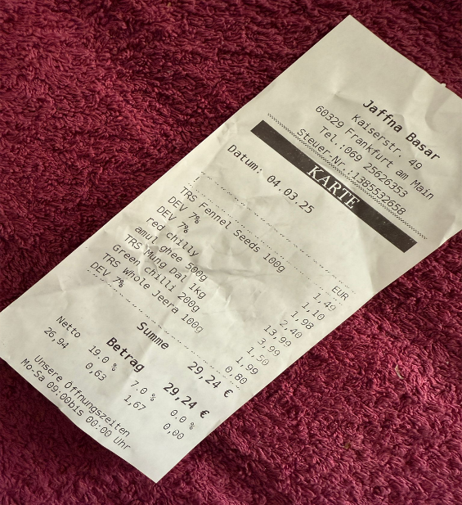
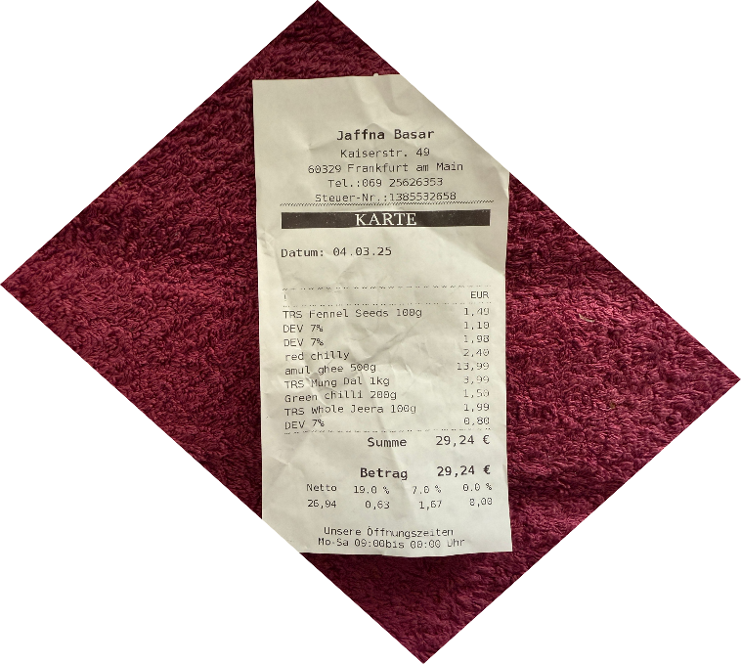
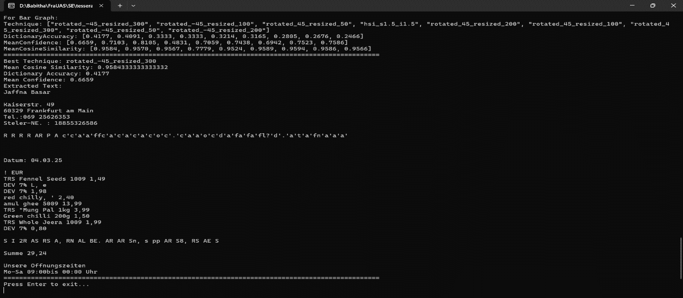
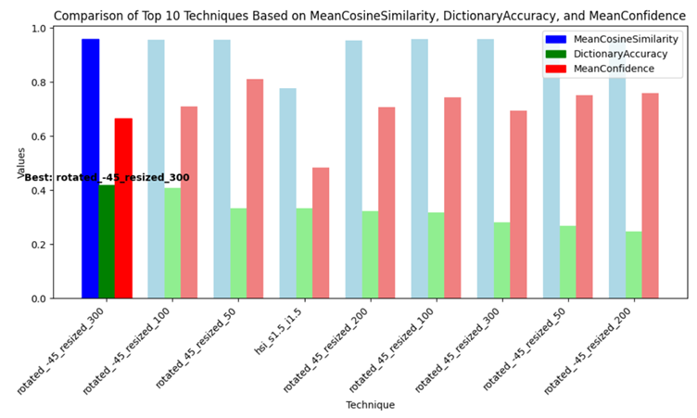
Result – Misaligned Bill
Performance Matrix
Original Image
Processed
Image
Console Output
Visual representation

Slide 11
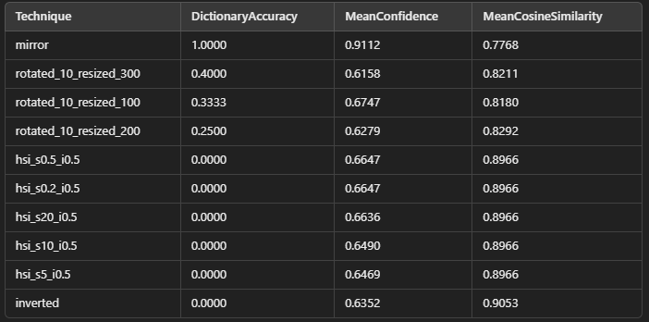
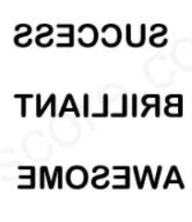

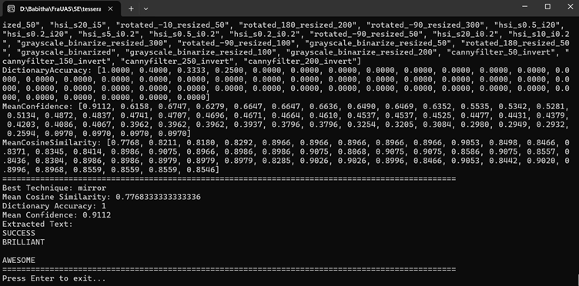
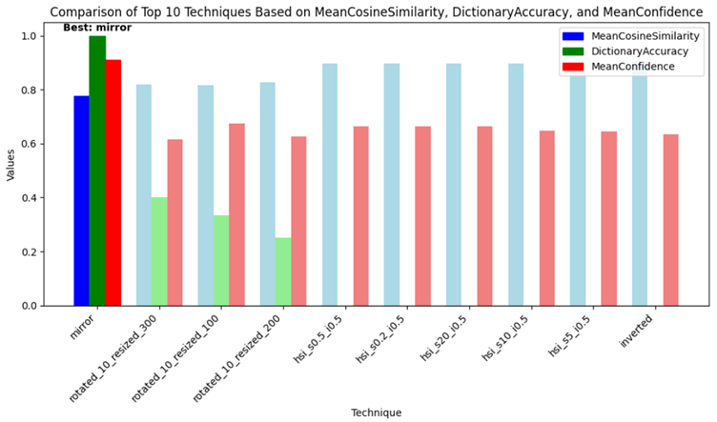
Result – Flipped Text
Performance Matrix
Original Image
Processed Image
Console Output
Visual representation

Slide 12
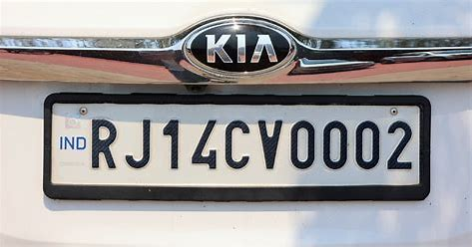
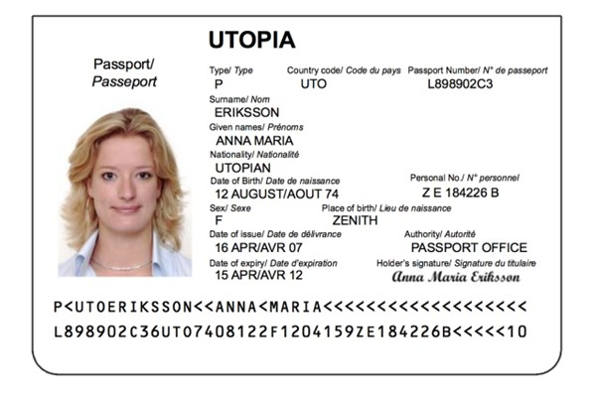
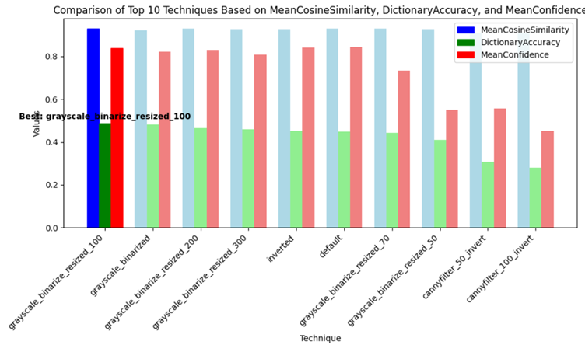
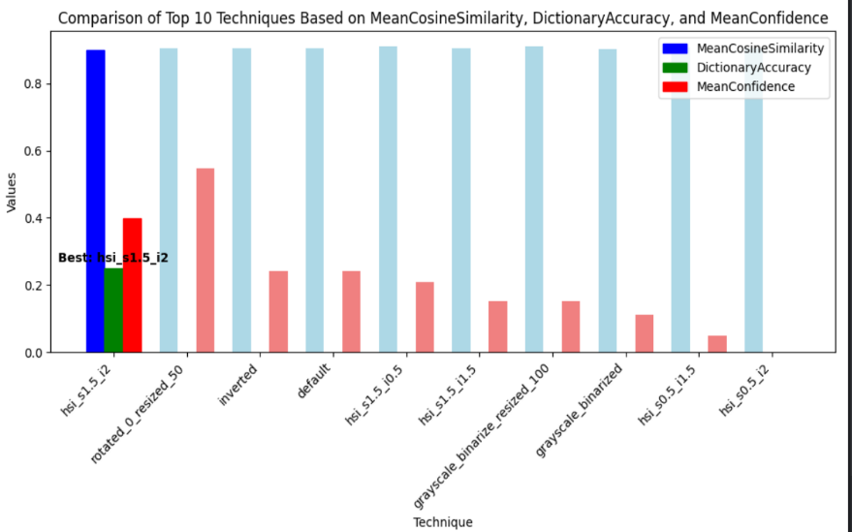
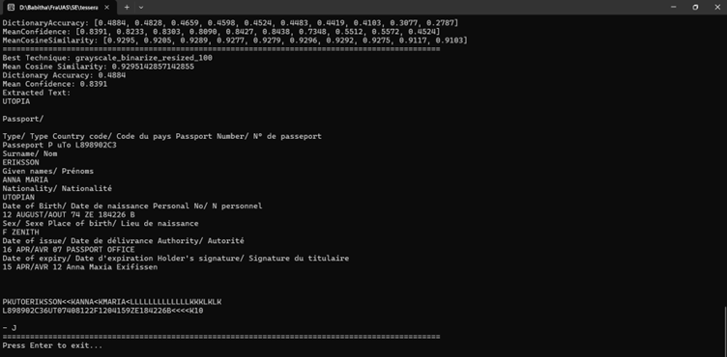
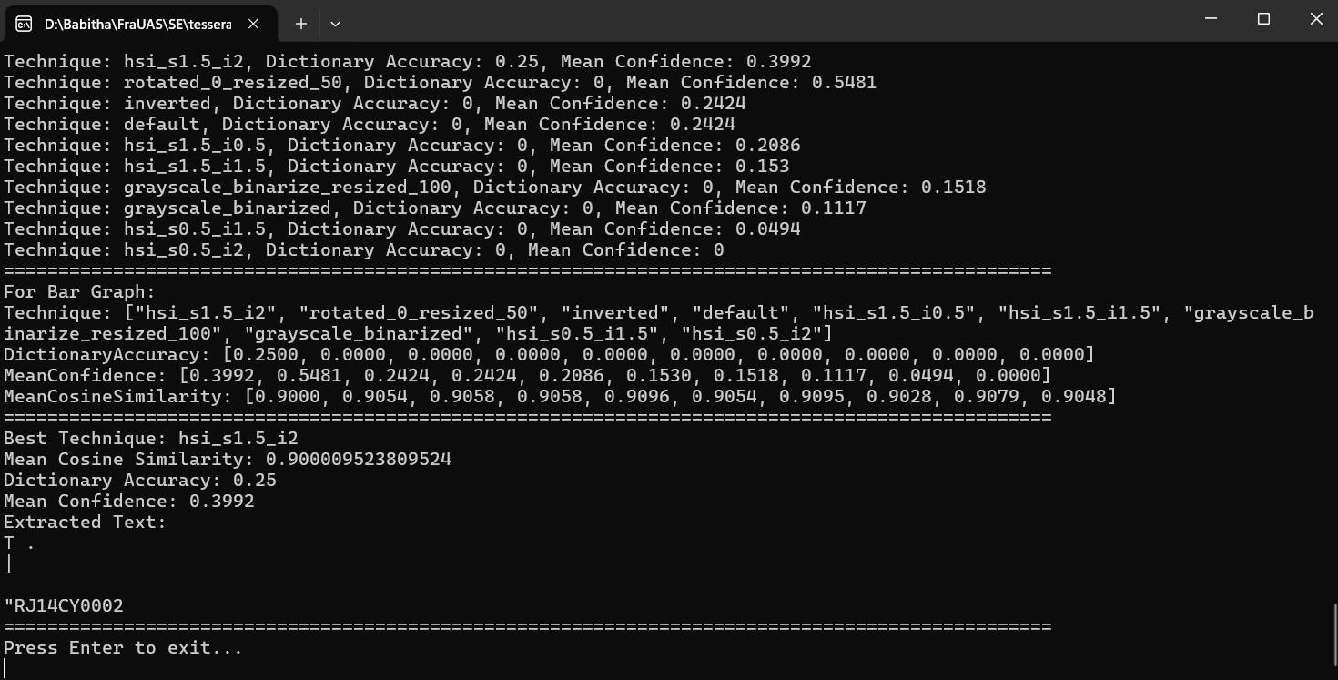
Result
Passport
License Plate
TextExtractionAPI_Team_TechRookies/Documentation/document_md/results.md at main · Babz-30/TextExtractionAPI_Team_TechRookies

Slide 13
Conclusion
The implemented text extraction API is a significant improvement over traditional OCR approaches due to the addition of advanced systematic pre-processing techniques which enhances OCR’s readability. Application of cosine similarity on text embeddings and dictionary metrics, ensures the extracted text is not just identical but accurate for the sample document. The system's ability to dynamically select the best pre-processing technique based on these performance metrics frees up computing capacity and maximizes efficiency.
In the future, it is possible to extend this methodology to handwritten text recognition, where there are further challenges due to differences in writing styles, distortions, and inconsistencies in letter formation. Furthermore, extending the OCR capability beyond English by implementing language-dependent preprocessing techniques, to support several languages, including those with complex scripts, will significantly increase its usability.

Slide 14
References
[1] S. L. a. H. T. R. Avyodri, "Optical Character Recognition (OCR) for Text Recognition and its Post-Processing Method: A Literature Review," in 1st International Conference on Technology Innovation and Its Applications (ICTIIA), 2022, Tangerang, Indonesia, 2022.
[2] R. M. a. A. Garg, "Text extraction using OCR: A Systematic Review,," in Second International Conference on Inventive Research in Computing Applications (ICIRCA), Coimbatore, India, 2020.
[3] N. &. I. Z. &. N. N. Islam, "A Survey on Optical Character Recognition System," ITB Journal of Information and Communication Technology, 2016.
[4] C. &. P. A. &. P. D. Patel, "Optical Character Recognition by Open source OCR Tool Tesseract: A Case Study," International Journal of Computer Applications, 2012.
[5] R. Smith, "An Overview of the Tesseract OCR Engine," in Ninth International Conference on Document Analysis and Recognition (ICDAR 2007), Curitiba, Brazil, 2007.
[6] G. K. K. Bhavesh Kumar Shukla, "An approach for Skew Detection using Hough Transform," in International Journal of Computer Applications (0975 – 8887), Uttar Pradesh , India, 2016.
[7] M. &. G. R. &. P. M. A. T. Brisinello, "Improving optical character recognition performance for low quality images," in 2021 28th Conference of Open Innovations Association (FRUCT), Italy, 2017.
[8] T. M. Breuel, "High Performance Text Recognition Using a Hybrid Convolutional-LSTM Implementation," in IAPR International Conference on Document Analysis and Recognition ICDAR), Kyoto, Japan, 2017.

Slide 15

Thank You Team_TechRookies

