Slide 1
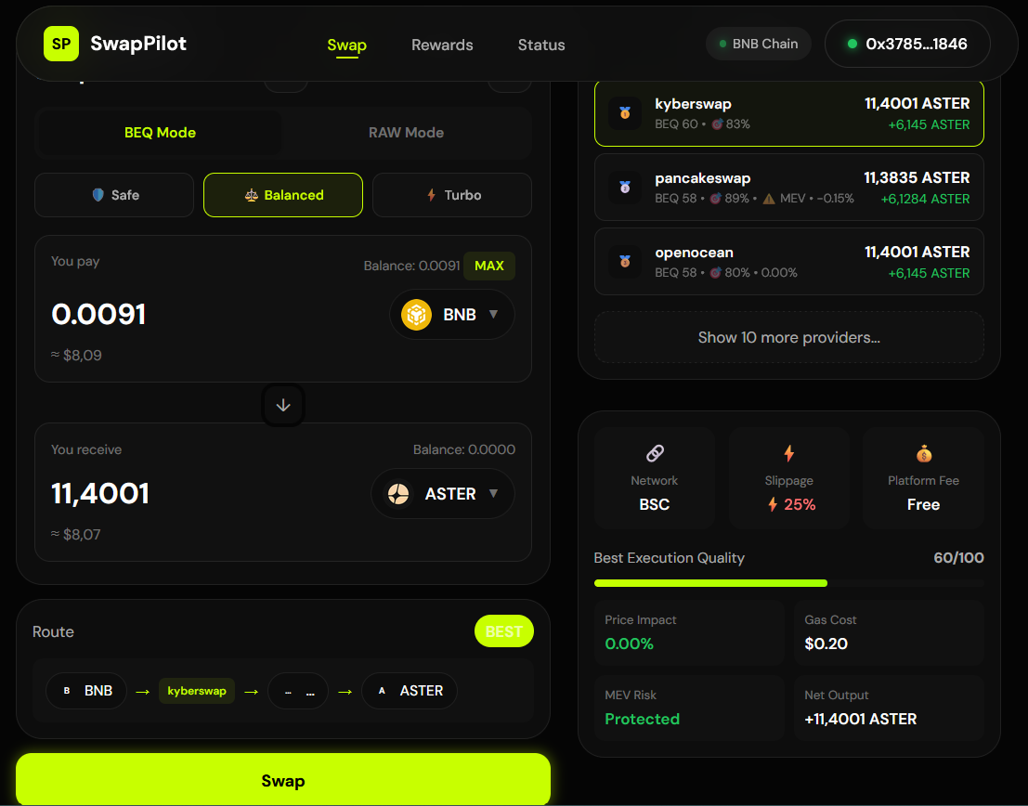
SP
SwapPilot
1 / 13
BNB Chain
BEQ Ranking
Non-custodial
app-swappilot.xyz
Safer swaps on
BNB Chain.
SwapPilot is a DEX aggregator that ranks quotes into BEQ (Best Executable Quote) and optimizes for execution safety before you sign.
Open app →
Read docs →
app-swappilot.xyz
·
x.com/swappilotdex
·
t.me/swapPilot
·
github.com/BacBacta/SwapPilot

Slide 2
SP
SwapPilot
2 / 13
PROBLEM
Swaps still feel
unpredictable.
🔀 Fragmented liquidity
Prices differ per DEX. Manual comparison is slow and error-prone. Users waste time checking multiple platforms.
Users can't reliably estimate what they will actually receive — especially on fee-on-transfer tokens and fast-moving routes.
💸 Hidden costs
Slippage + token transfer taxes reduce net output after execution. What you see is not what you get.
⚠️ Execution risk
Routes can fail; users need preflight signals and clear warnings before signing transactions.

Slide 3
SP
SwapPilot
3 / 13
SOLUTION
🏆 BEQ (Best Executable Quote)
One flow that
optimizes & explains.
Optimizes for executability first — then for output. Not just the highest number, but the safest path.
SwapPilot separates "best raw output" from "best executable" and documents every decision transparently.
🧾 Decision transparency
Every quote returns detailed reasoning: whyWinner · warnings · ranking rationale · assumptions.
🎚️ Risk modes
SAFE / NORMAL / DEGEN switch the BEQ weights — reasoning stays fully transparent.

Slide 4
SP
SwapPilot
4 / 13
PRODUCT
How a swap
happens
1. Quote
2. Rank
POST /v1/quotes
Fan-out to multiple providers in parallel on BSC (chainId 56).
Return rankedQuotes (BEQ) + bestRawQuotes + recommended provider.
Four steps — mapped to real API endpoints.
3. Explain
4. Execute
GET /v1/receipts/:id
whyWinner + warnings + assumptions in one artifact.
Use /v1/build-tx for ready-to-sign tx or open provider via deepLink.

Slide 5
SP
SwapPilot
5 / 13
COVERAGE
Providers on
BNB Chain
🔗 10+ Providers
⚙️ Capabilities
PancakeSwap · 1inch · OKX DEX · KyberSwap · ParaSwap · Odos · OpenOcean · 0x · Uniswap V2 · Uniswap V3
Quotes + ranking · buildTx where supported · deep-links as fallback · health endpoint /v1/providers/status
Top aggregators and DEX routers. BEQ prioritizes executability over the best-looking number.
🛡️ Risk signals
🔐 Non-custodial
Sellability · revert risk · MEV exposure · churn · optional token security (GoPlus / Honeypot.is)
Users sign in their wallet. SwapPilot does not hold keys or funds. Your keys, your crypto.

Slide 6
SP
SwapPilot
6 / 13
PROOF
A working system.
LIVE APP
PUBLIC API
app-swappilot.xyz
swappilot-api.fly.dev
Public app + public API. Every quote run returns detailed decision data for full auditability.
SWAGGER UI
OPENAPI SPEC
/documentation
/documentation/json
📋 Decision data includes
rankedQuotes · beqRecommendedProviderId · whyWinner · warnings · ranking.mode · preflight signals
QUOTES
BUILD TX
/v1/quotes
/v1/build-tx

Slide 7
SP
SwapPilot
7 / 13
BUSINESS MODEL
Revenue aligned
with usage.
💰 Fee engine (API)
Endpoints /v1/fees/calculate and /v1/pilot/tier compute fees and holding-based discounts dynamically.
Simple monetization primitives already built into the stack. No projections — just shipped code.
🔥 Fee distribution (Contracts)
FeeCollector contract: 15% buy & burn · 85% treasury distribution. Deployed on BSC.
🤝 Referral incentives (Contracts)
ReferralPool + ReferralRewards contracts support referral-based reward flows for growth.

Slide 8
SP
SwapPilot
8 / 13
DISTRIBUTION
Token allocation
Public Sale
35%
Treasury
20%
CEX & Marketing
12%
1B
Liquidity
12%
PILOT
Team
11%
Advisors
5%
Referral
5%
Fixed supply · No inflation · No mint function

Slide 9
SP
SwapPilot
9 / 13
TOKENOMICS
Key metrics
TOTAL SUPPLY
PUBLIC SALE PRICE
1,000,000,000
$0.0057
Clear, investor-ready figures from the tokenomics documentation.
FULLY DILUTED VALUATION
INITIAL MARKET CAP
$5.7M
$966K
TGE Circulating Supply
169.5M tokens (16.95%)

Slide 10
SP
SwapPilot
10 / 13
VESTING
Unlocks designed
for stability
Public Sale
25%
Liquidity
35%
TGE unlock percentage by allocation bucket. Gradual release prevents dumps.
CEX & Marketing
25%
📅 Milestones
Treasury
5%
16.95% at TGE
52.83% at Month 6
78.67% at Month 12
Team
0%
Advisors
0%
Referral
0%

Slide 11
SP
SwapPilot
11 / 13
ROADMAP
Execution milestones
PHASE 1 ✓
PHASE 2
PHASE 3
PHASE 4
Foundation
Q1 2026
Q2 2026
Q3–Q4 2026
Core aggregation engine
BSC mainnet
1inch/Kyber/Para/OKX
Wallet connect
Real-time monitoring
Multi-chain expansion
Ethereum, Arbitrum, Base
Analytics dashboard
Price alerts
Limit orders
Cross-chain swaps
DCA / recurring buys
Portfolio tracking
Mobile app iOS/Android
Public API & SDK
Developer widget
Institutional features
DAO governance

Slide 12
SP
SwapPilot
12 / 13
CALL TO ACTION
See it live.
Verify everything.
Try the app, read the documentation, and review the tokenomics.
Everything is public and verifiable.
Open app →
Read docs →
Twitter →
Telegram →
app-swappilot.xyz
·
x.com/swappilotdex
·
t.me/swapPilot
·
github.com/BacBacta/SwapPilot

Slide 13
SP
SwapPilot
13 / 13
LEGAL NOTICE
Important
disclosures
⚠️ Not financial advice
🔧 Technology risks
This document is for informational purposes only. Nothing herein constitutes investment advice.
Smart contracts carry inherent risks including bugs and exploits.
Please read carefully before participating in the Public Sale.
📉 No guarantees
🔮 Forward-looking statements
PILOT token value may fluctuate. Past performance is not indicative of future results.
Roadmap and projections are subject to change.
⚖️ Regulatory uncertainty
Cryptocurrency regulations vary by jurisdiction and are subject to change.
By participating in the Public Sale, you acknowledge that you have read and understood these disclosures.

