Slide 1
1:1 Meeting
Jun 6th, 2023

Slide 2
integration
Supply Room Center (+ access)
workday requisitions
Tick@lab
Dropbox setup
CH1 level mouse training (+ access)
handling, necropsy
HPC setup

Slide 3
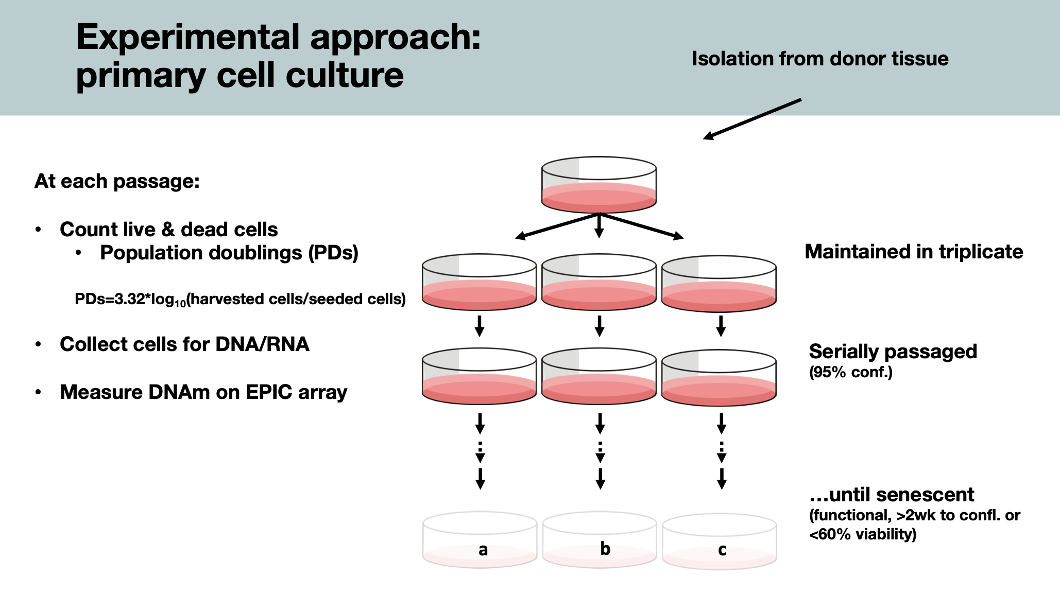

Slide 4
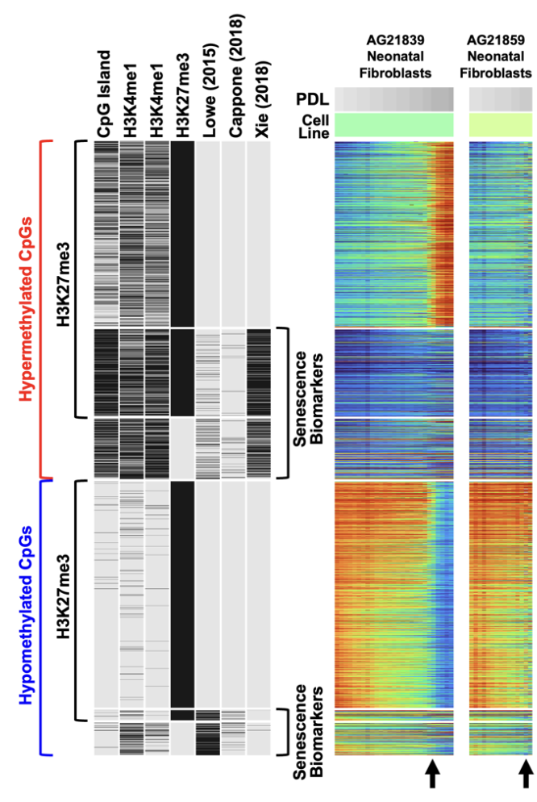
the ‘flip’ in AG21839
a drastic hypermethylation in PCGT
Polycomb Targets are “poised” (bivalent)
H3K4me3 + H3K27me3
Mostly comprised of CpG islands

Slide 5
AG21839; male fibroblast (foreskin)
Repository | NIA Aging Cell Culture Repository
Subcollection | Apparently Healthy Collection
Biopsy Source | Foreskin
Cell Type | Fibroblast
Tissue Type | Skin
Transformant | Untransformed
Family Member | 1
Relation to Proband | proband
Confirmation | Clinical summary/Case history
ISCN | 46,XY
Species | Homo sapiens
Common Name | Human
Remarks | Foreskin fibroblast cell culture; matching foreskin melanocyte and foreskin keratinocyte cultures from this same donor are AG21837 and AG21838, respectively
https://catalog.coriell.org/0/Sections/Search/Sample_Detail.aspx?Ref=AG21839
SNP profile changes???

Slide 6
Major Qs.
1. Can I replicate this figure?
2. What other features?
3. Can AG21839 serve as a control?

Slide 7
read the new Pfeifer paper
talk to Emily and do some math.
Novaseq10
4 additional analysis
making a “window” for peaks
SNP consistency across probes
AG21859 dataset analysis
aneuploidy or CNV analysis.
other suggestions;
talk to Kelly regarding ordering (quartzy cont.?)
HPC setup later (don’t crash)

Slide 8
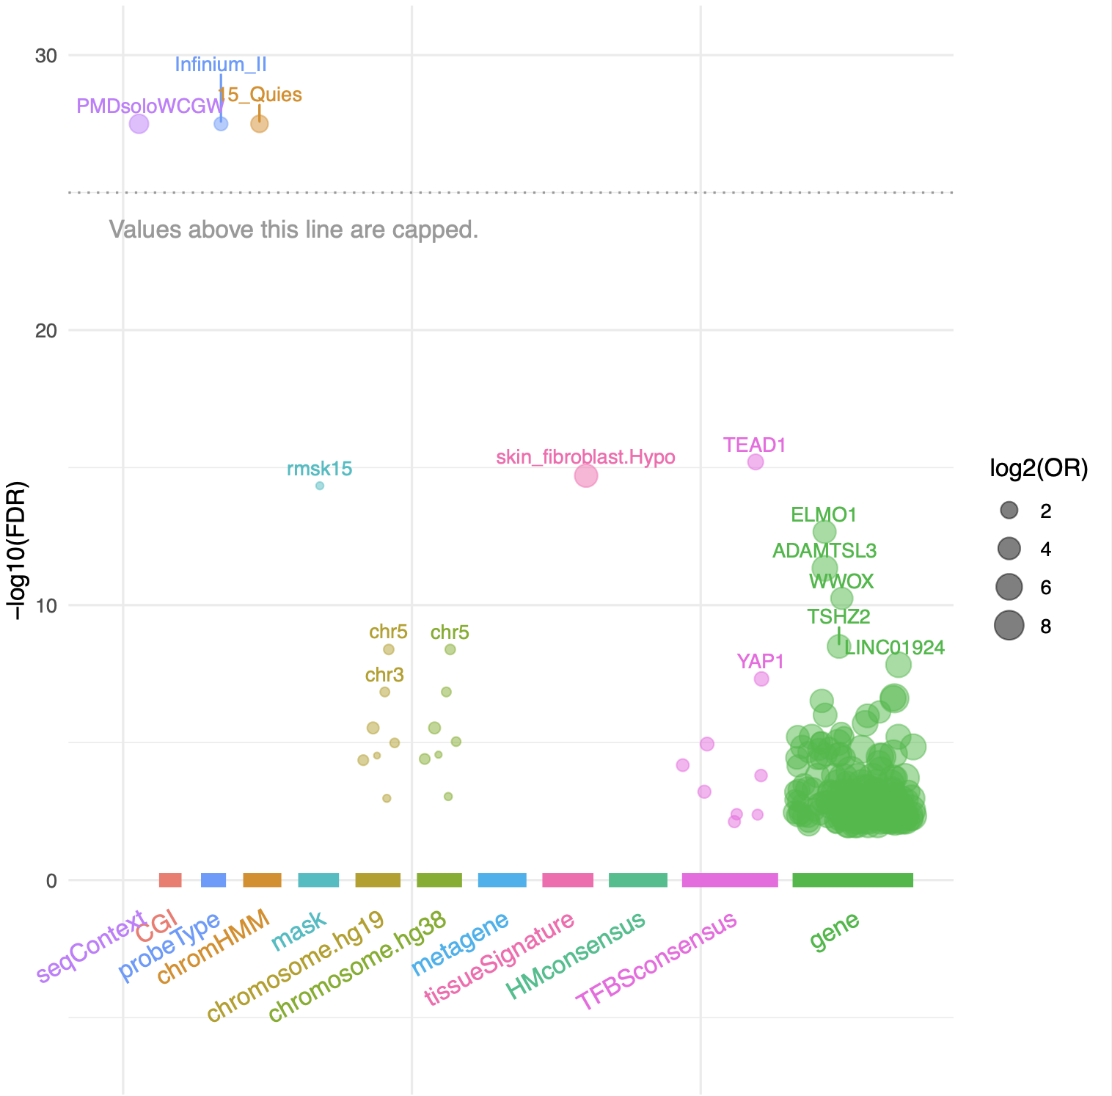
All_differentiated probes
probe
rearrange by chr.
CNV analysis order by loci.
type I,II;

Slide 9
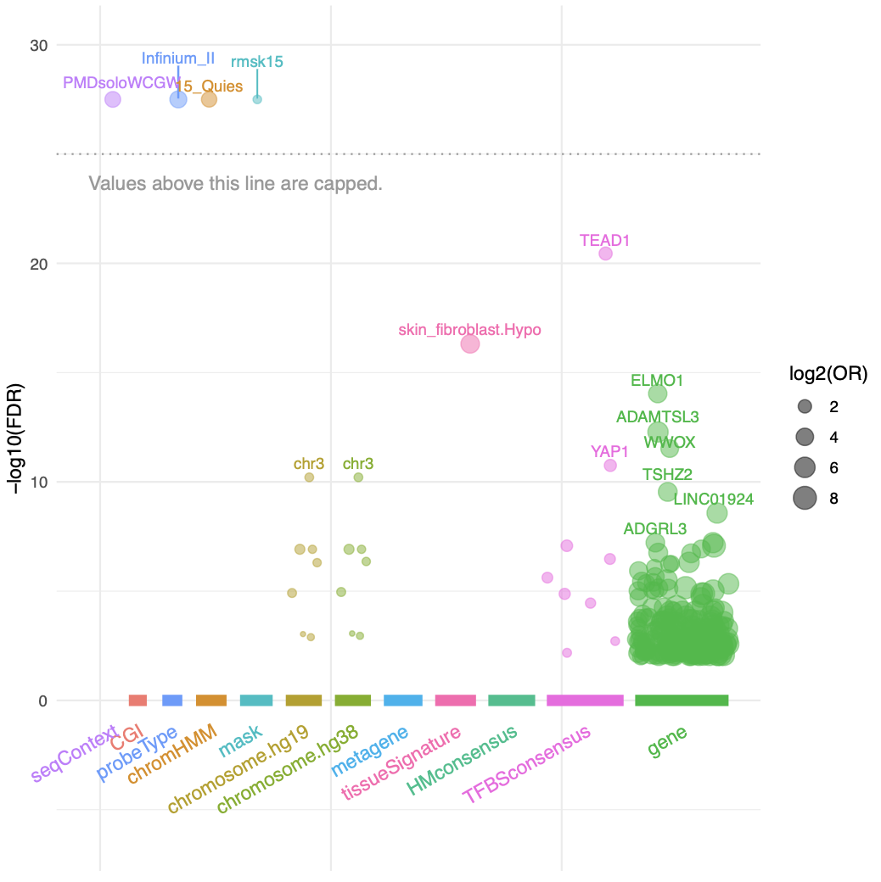
Hypo_methylated

Slide 10
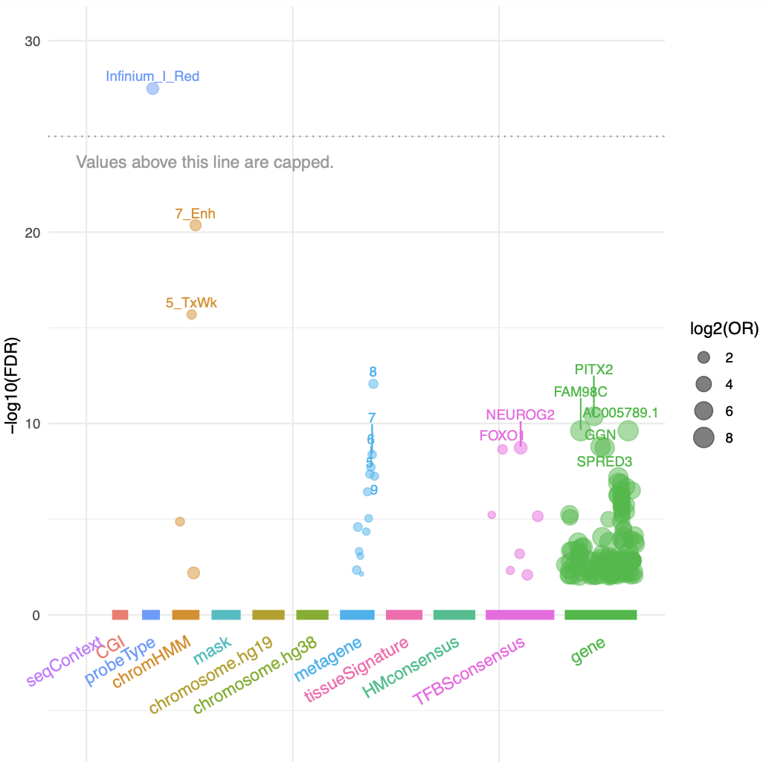
Hyper_methylated

Slide 11
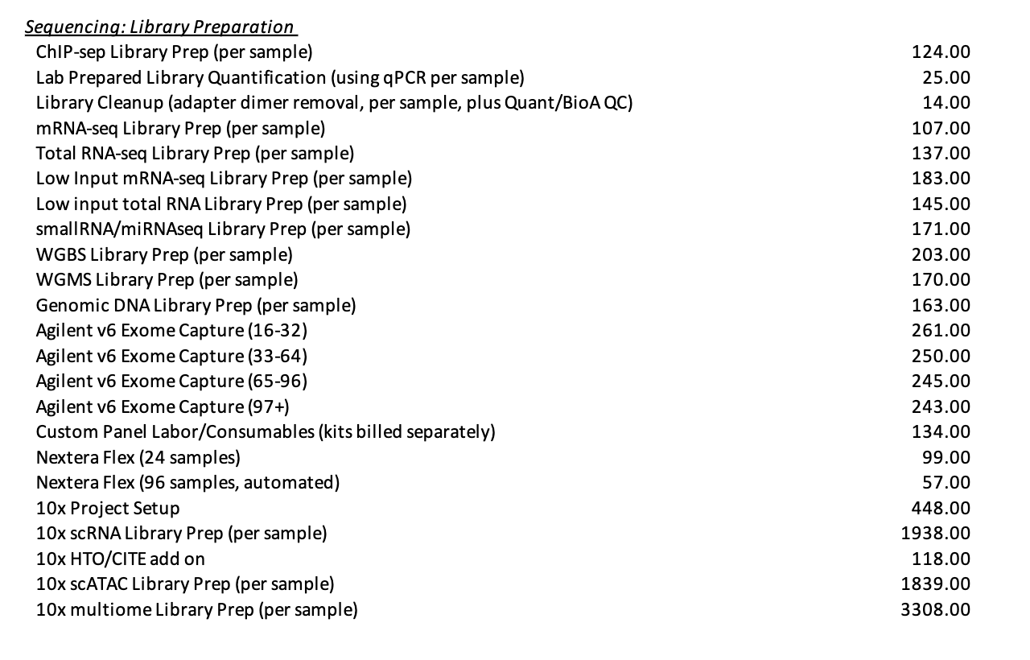
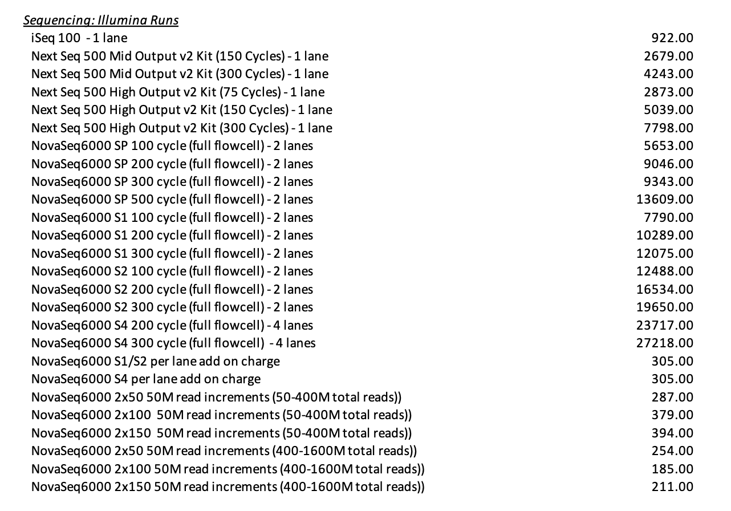
Pricing
S1 flowcell 1.6 billion sequences/run
S2 flowcell: 3 billion sequences/run
S4 flowcell: 10 billion sequences/run
https://vanandelinstitute.sharepoint.com/sites/genomics/SitePages/Rates.aspx

Slide 12
Main QnA
Novaseq 10
Fulgent / Novagene.
Emily.
but WASHU doesn’t do bisulfite.
4 time points;
Cost : gDNA vs. DNA library submission?
gDNA library submission may be better b/c our WGBS is homebrew
WGS vs. WGBS vs WGMS (TET enzyme version)
BisCUIT (can detect mutations from WGBS)
reference genome not needed.
considering this is an epigenetic phenotype, we would WANT the WGMS or WGBS. (only $40 more per sample prep)
Viability
(but 200 ng optimal, 10 ng minimal)
ChIP-seq? (bivalency; H3K27me3, H3K4me3)
relatively broad peaks and it will be cheaper b/c the readers are shorter.
how deep? 80x? 30x?
30X is deep enough for mutation detection;
how many time points?
3 time points. (= 3 samples) no replicates or experimental ctrls needed.
Timeline
1 mo. total.

