Slide 1
2023/07/04
indiv. meeting
Jae Min Park

Slide 2
AG06561; fetal fibroblasts
EPIC array data - several versions exist.
Baseline Profiling (a,b,c)
b = 15 being the longest.
TERT immortalized (a,b)
UHRF1 Overexpressed (a,b)
and puromycin ctrl (a,b)
UHRF1 KD (#352, #313)
and GFP control (#193)
DNMT

Slide 3
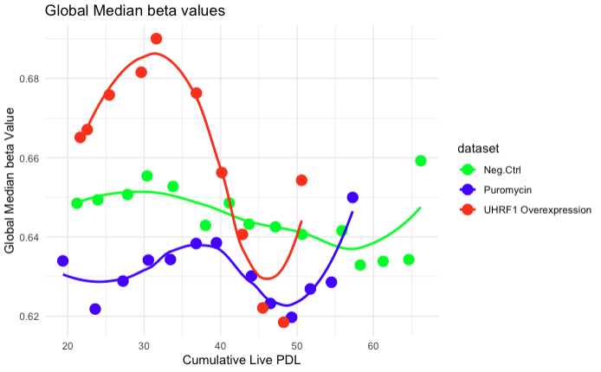
fetal fibroblast exhibits fluctuating global methylation beta values

Slide 4
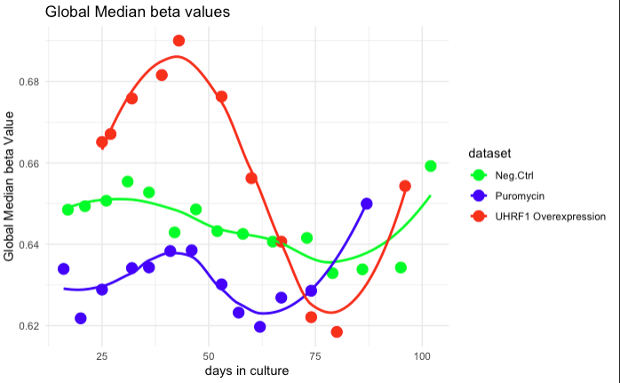
same figure but with days in culture.

Slide 5
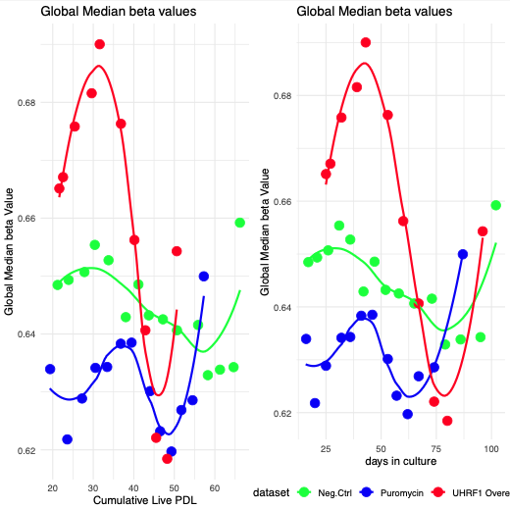

Slide 6
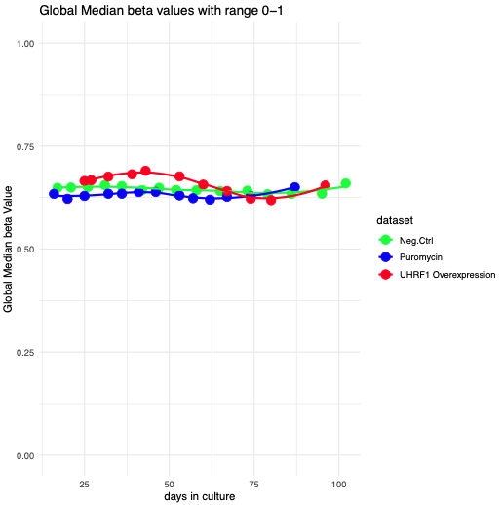
from afar

Slide 7
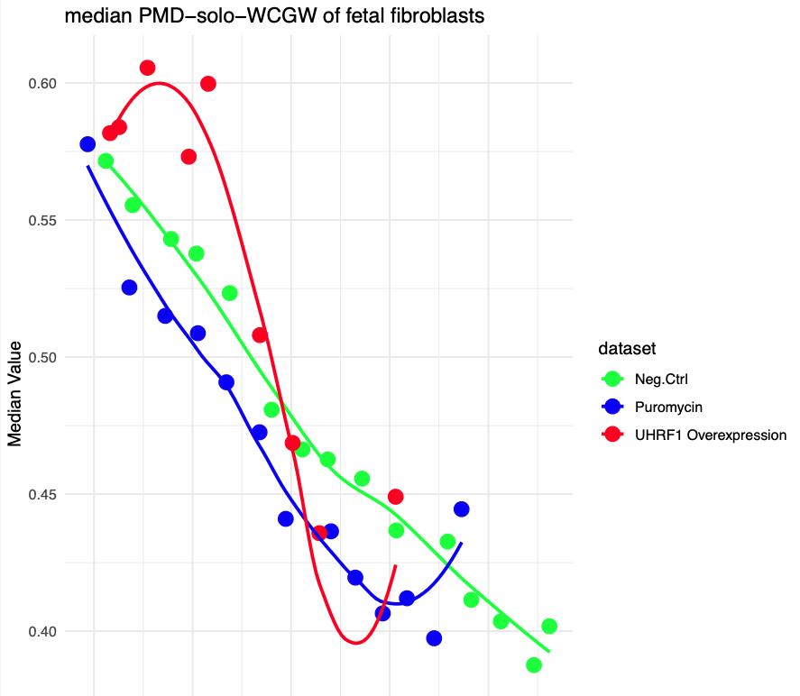
median PD-solo-WCGW of fetal fibroblasts show linear decline
UHRF1 OVX still shows a bit of fluctuation

Slide 8
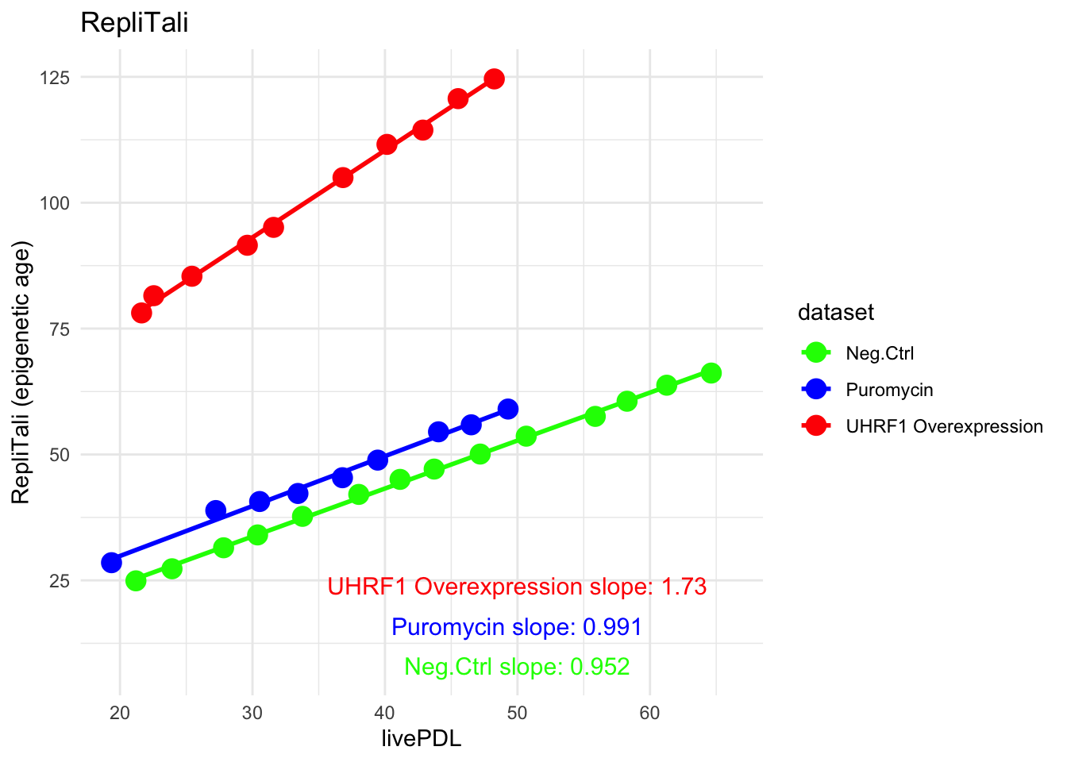
Replitali on fetal_fibroblasts
UHRF1 shows an “epigenetic age acceleration” phenotype

Slide 9





Jamie’s document system
changed HPC folder to jaemin.park
backed up in Dropbox
code : Quarto markdown format (script, figures)
git cloned;
database : public info
manifest, large datasets, etc.
library: papers (Zotero, Endnote compatible RIS format)
notes : experimental notes in pdf
presentations
indiv, lab, misc.
arranged by date
Protocols&Manuals : pdfs

Slide 10
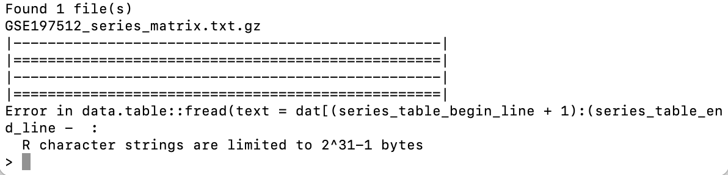
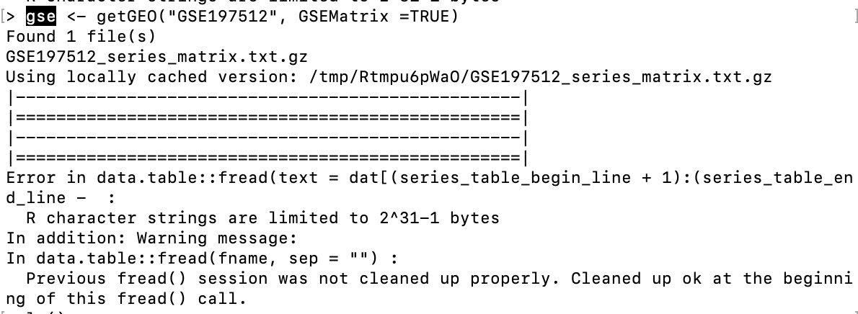
Organizing summarized experiment
the script still broken to download EPIC data from Endicott et al.,
making a SE object
Summarized experiment

Slide 11
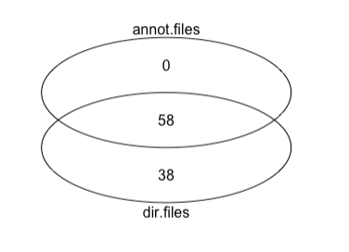
getting through some errors;
folder naming scheme inconsistent
all.primary? all.EPIC? 2022? some missing
same.name folder contains different files
2019.10 ≠ primary/2019/10
missing liveCDL in ~2019 tables
”baselineprofiling” different named folders
missing info;
“run.specific”??
HGPS as separate folder?

Slide 12
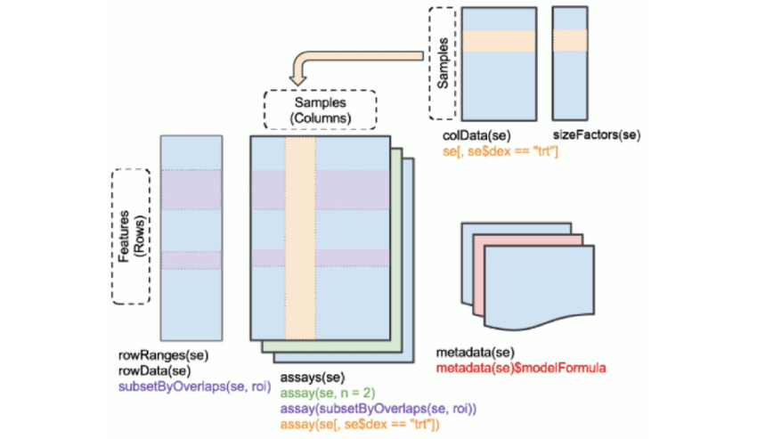
SE for EPIC data
rowData : beta tables processed by sesame
colData : meta info including Paula’s livePDL.

Slide 13
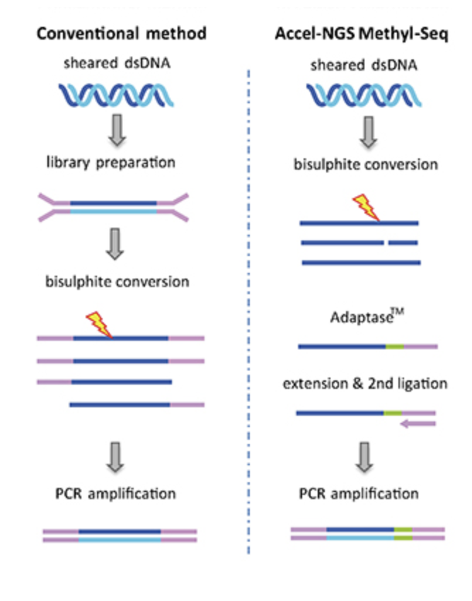
WGBS workflow
1. sonicate DNA to 330 bps (55uL)
COVARIS ME220
bioanalyzer HS ds_chip to QC
yield = ~50%. (50ngs-> 25ngs)
2. bisulfite conversion (20uL -> 10uL)
Zymo EZ_gold direct (3hrs)
results in ssDNA quantified via Qubit ssDNA
yield = ~75% (25ngs-> 37.5ng in ssDNA)
3. Swift kit; Xgen (input 15uL)
Adaptase
Extension
cleanup beads x2
ligation
cleanup beads
indexing PCR
cleanup beads

Slide 14
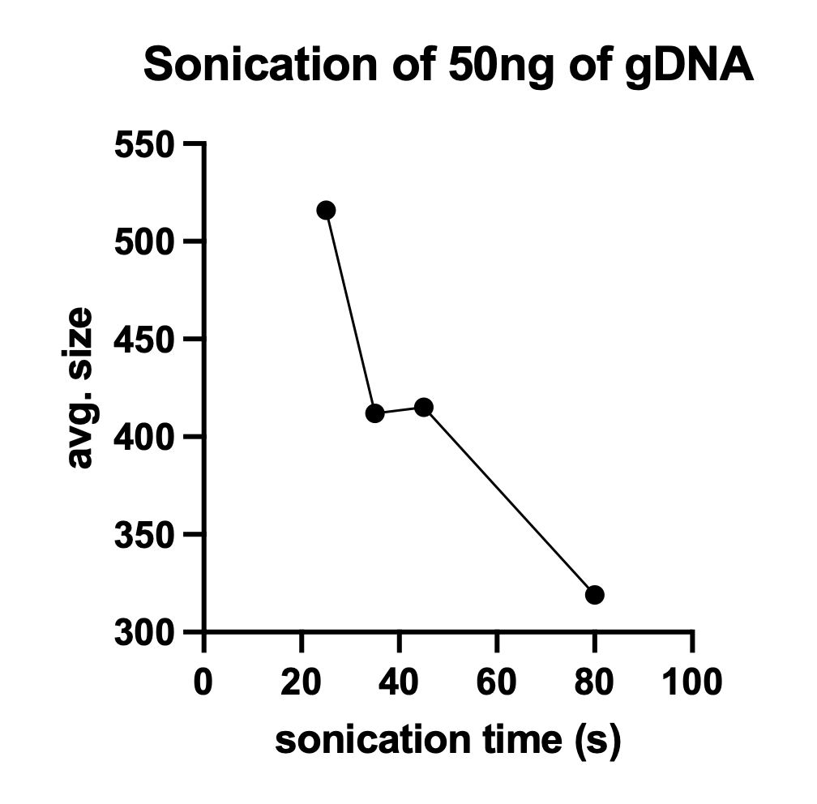
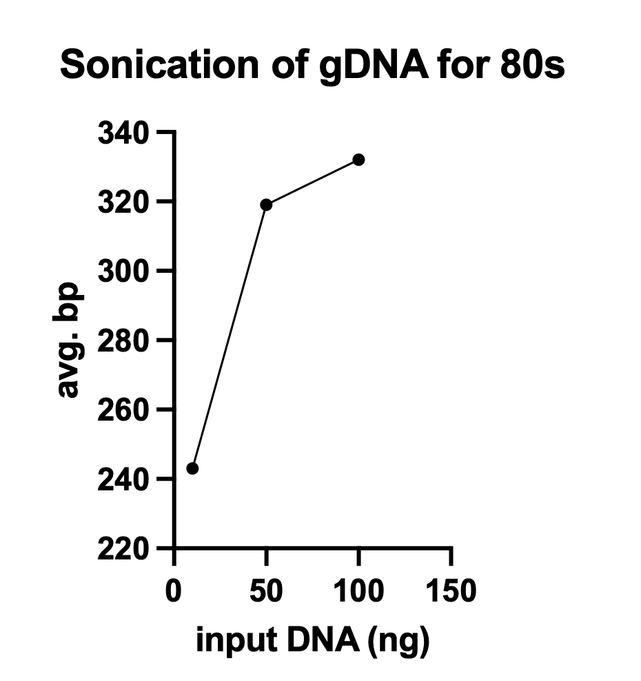
DNA shearing

Slide 15
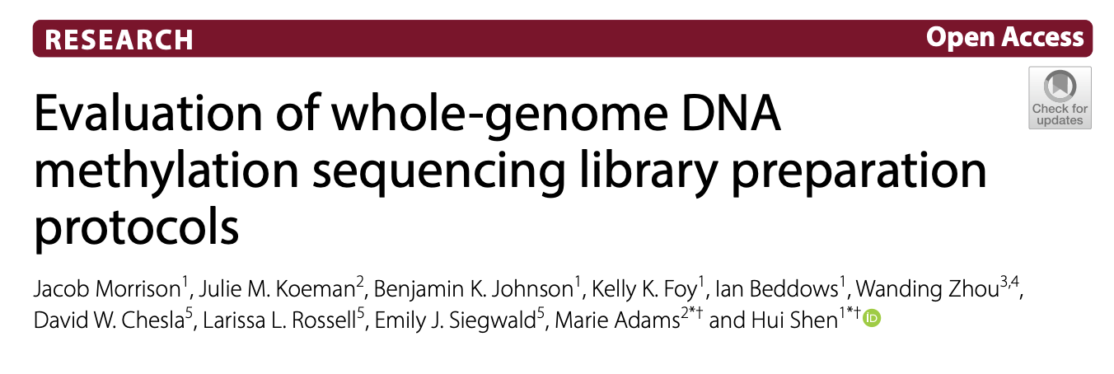
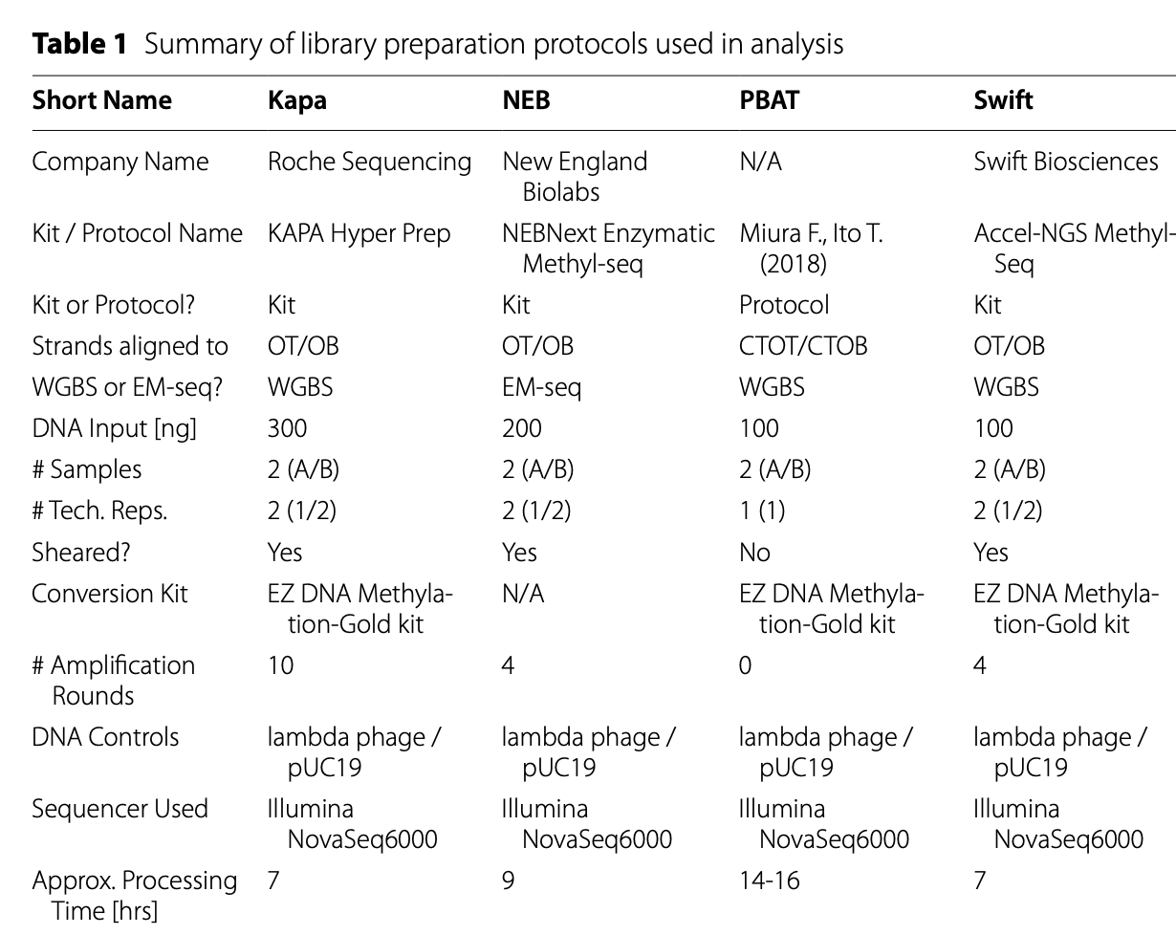
Morrison et al. Epigenetics & Chromatin (2021) 14:28 https://doi.org/10.1186/s13072-021-00401-y

Slide 16
5 questions
1. Are all PCTGs the same?
in terms of effect to carcinogenesis, which gene is most influential? HOX? NEURO?
2. PCGT hypermethylation prone-ability
in terms of cancer, which cancer is most prone?
checkable via TCGA
3. Is the PCGT hyper phenomenon, truly replication independent?
testable with the mitoC and serum depr experiment.
4. What other HM markers do PCTGs have, other than ‘EZH2-H3K27me’?
what about H3K36me2/3 or H2K119Ub.
5. Species conservability; Do mice also gain the same PCTGs?
6. Do other aging models show the same dynamics of PCGT hypermethylation?
Min : how do the H2O2 induced NURD complex cell model show diff.

Slide 17
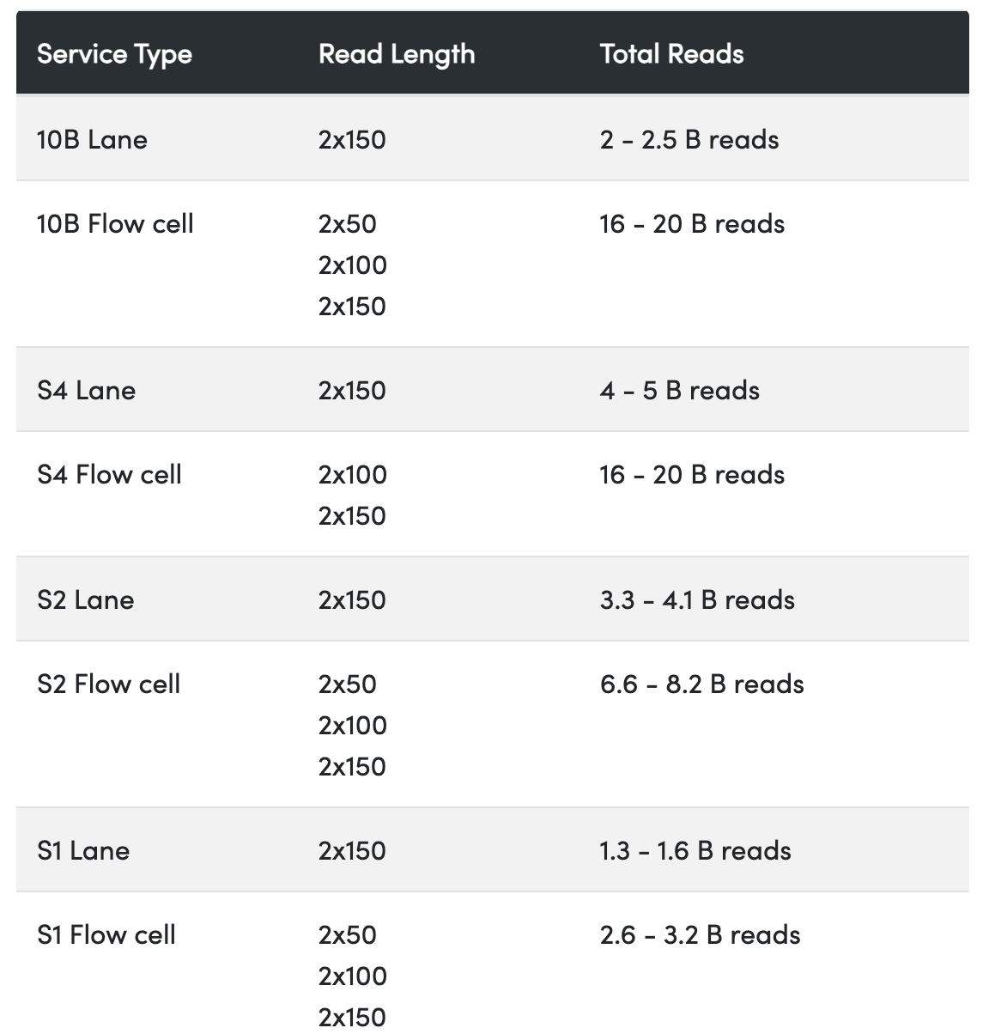
rent-a-lane Fulgent
pricing for 6000
NovaSeq 6000 S1 Lane (300 cycle) $4,795.20
NovaSeq 6000 S2 Lane (300 cycle) $8,555.77
NovaSeq 6000 S4 Lane (300 cycle) $6,482.23
Pricing for X
NovaSeq X 10B Flowcell (300 cycle): $17,134.08
NovaSeq X 10B Flowcell (200 cycle): $16,063.20
NovaSeq X 10B Flowcell (100 cycle): $12,672.08
NovaSeq X 10B Lane (300 cycle): $2,141.76

Slide 18
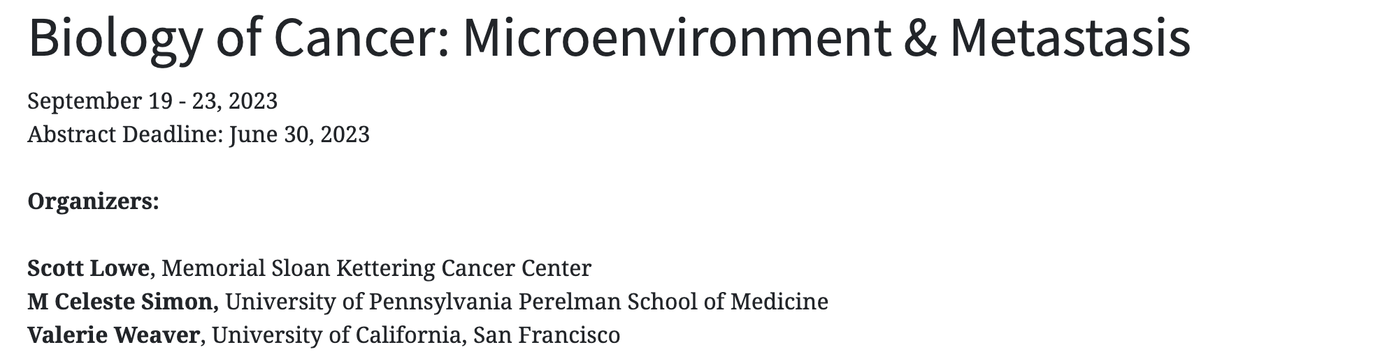
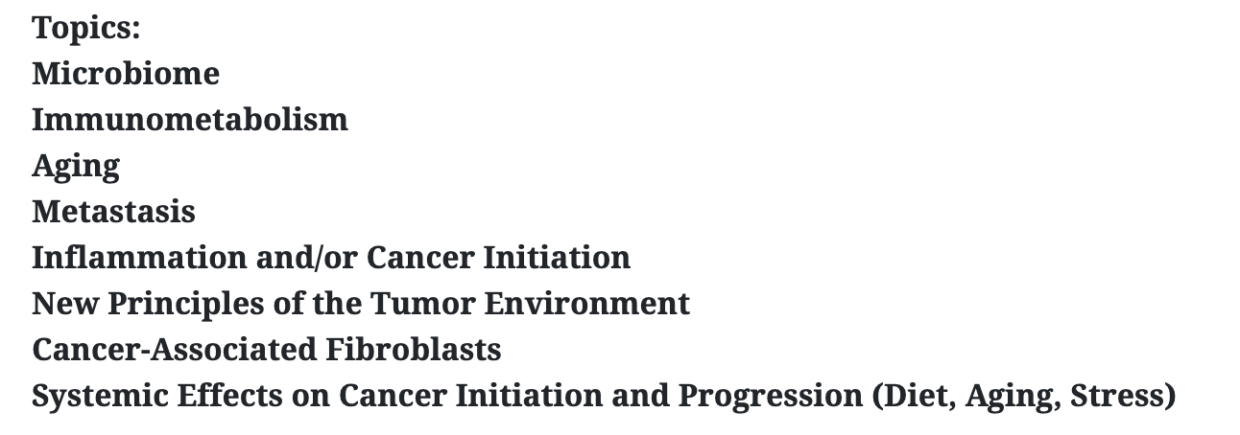
Cold Harbor Cancer TME.
I want to go to this one! https://meetings.cshl.edu/meetings.aspx?meet=TUMBIO&year=23

Slide 19
How do you identify DMPs in a time-series?
lmFit?
minfi::DMPhunter
limma::dmp
sesame::DML
How do you identify DMPs/VMPs in a methyaltion series;

