Slide 1
2023/07/21
indiv. meeting
Jae Min Park

Slide 2
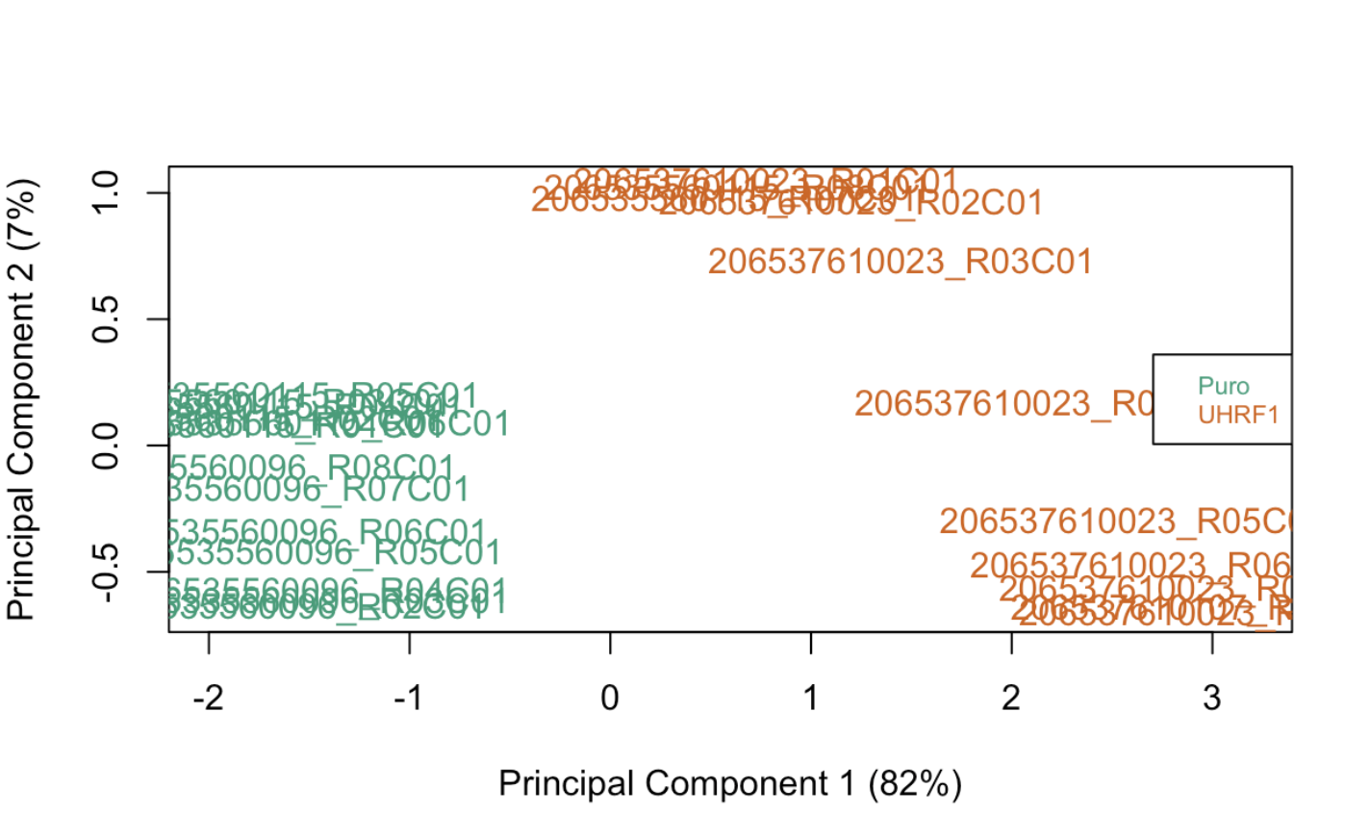
PCA plot of UHRF1_overexpression
Using 1000 common gene annotation to calculate PCA

Slide 3
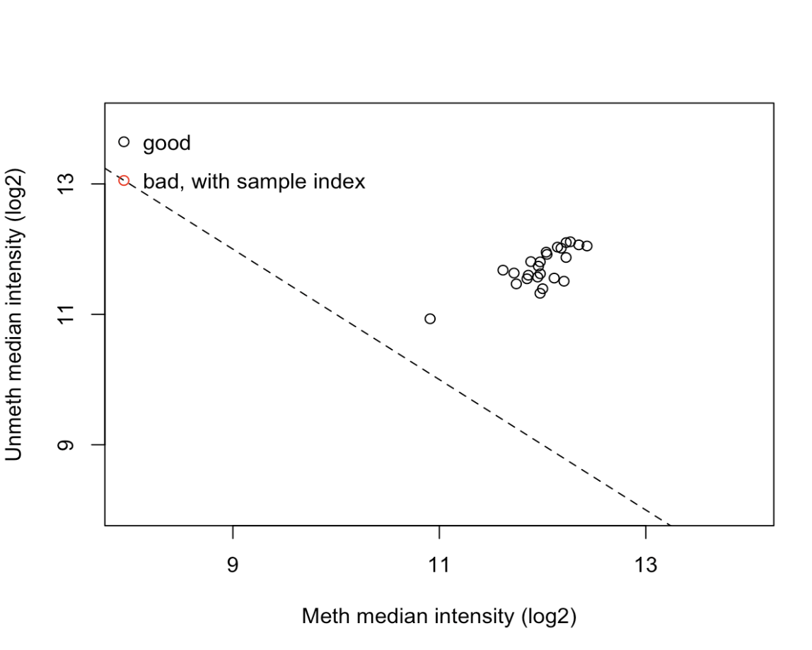
QC plot
RgSet -> ratio clustering
Most samples are clustered together.

Slide 4
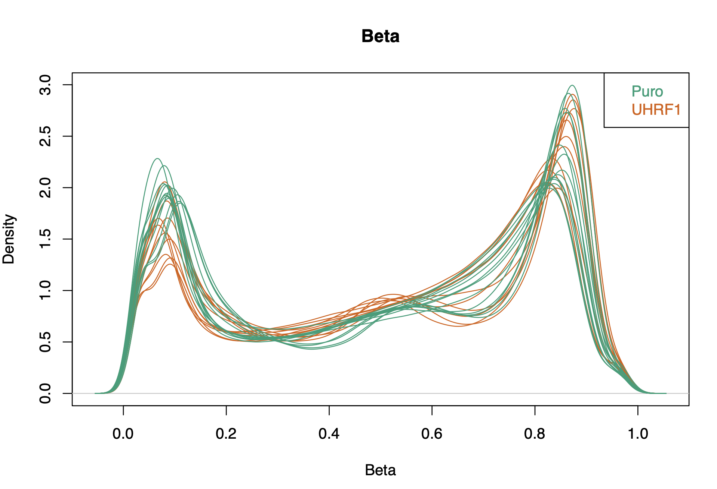
Density Plot of UHRF1_overexpression

Slide 5
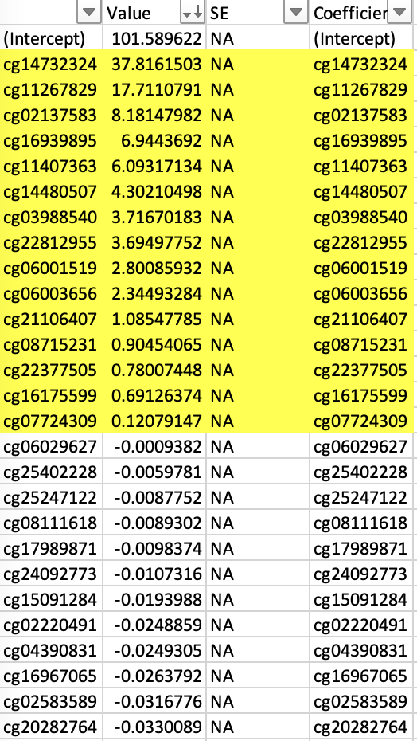
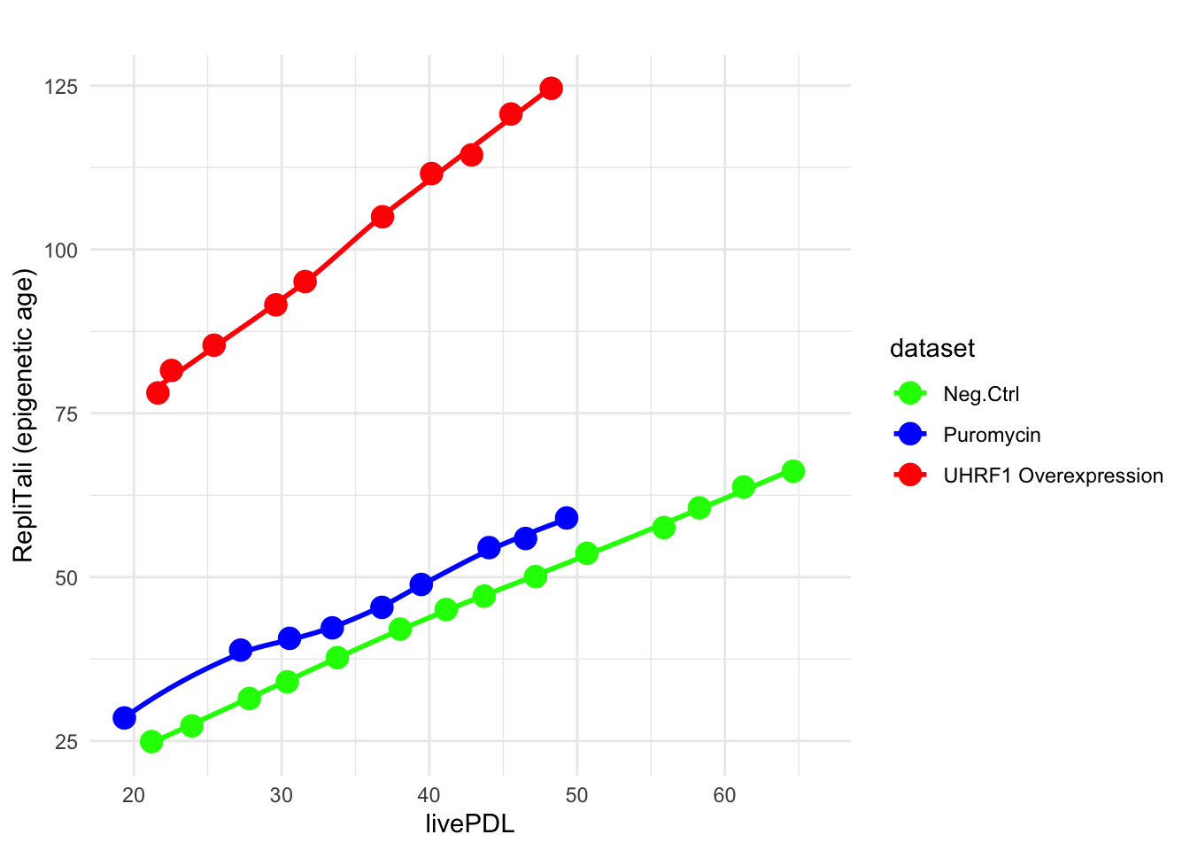
Why is the Y-intercept for UHRF1 so high?

Slide 6
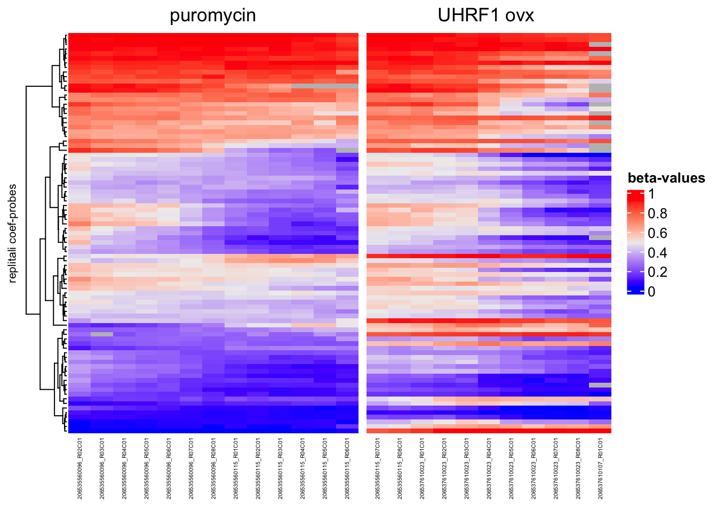
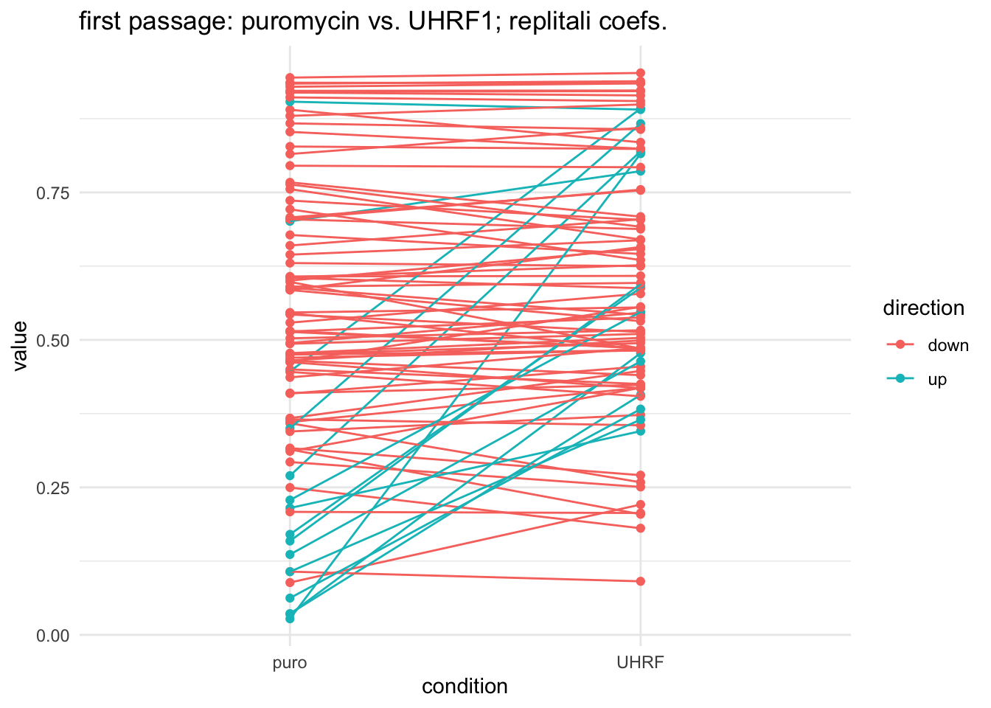
Why is the Y-intercept for UHRF1 so high?

Slide 7
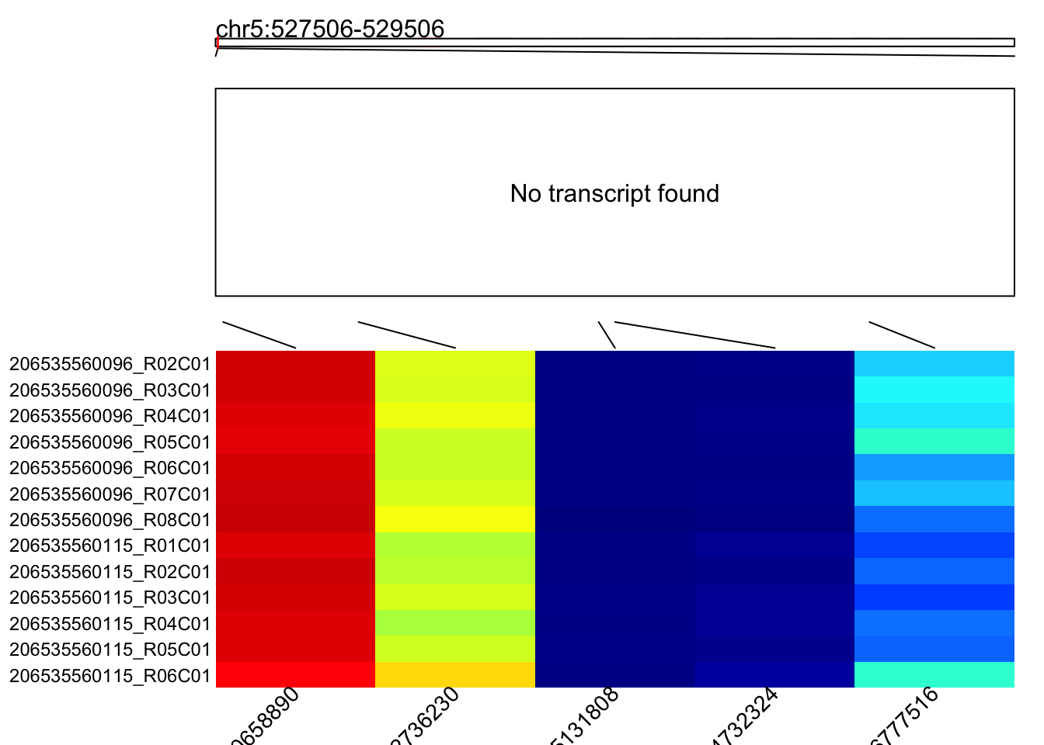
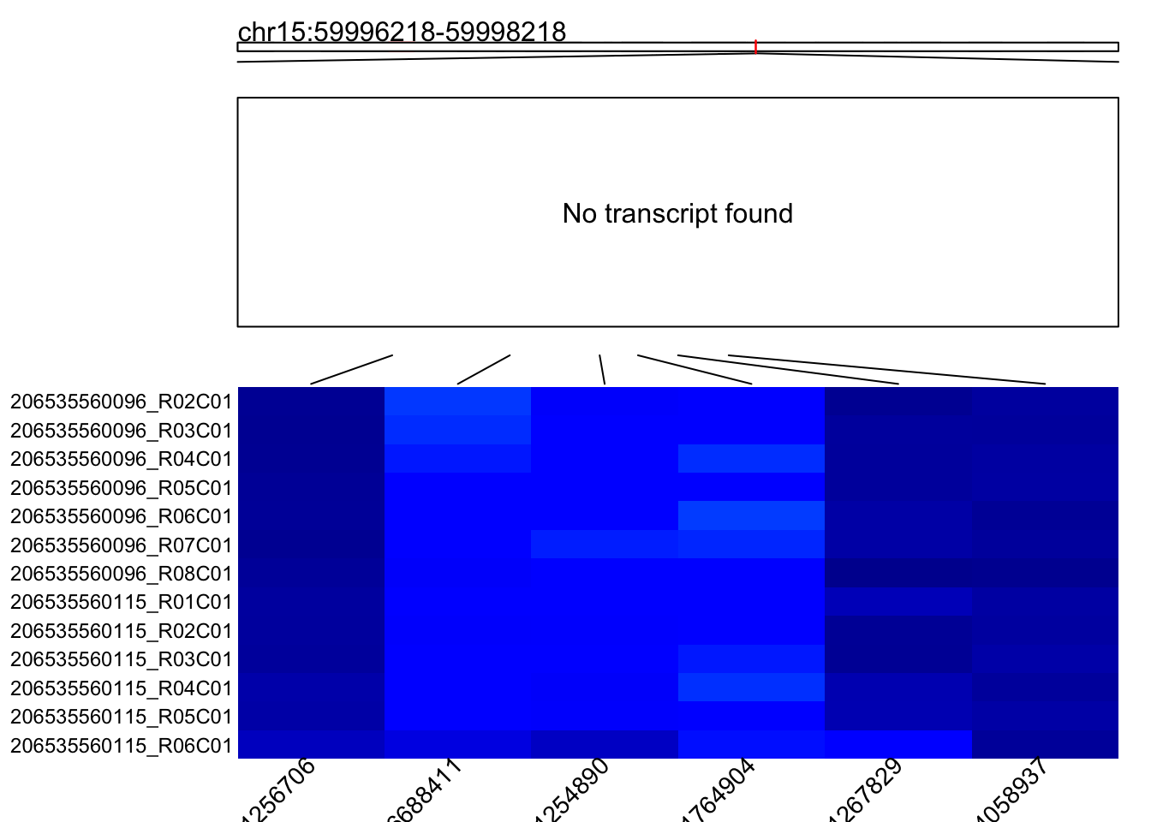
what are these ‘up’ probes in Replitali?
so not a gene region...

Slide 8
mixed linear regression of serially cultured fibroblast EPIC array
condition (UHRF1_OVX vs. Puromycin)
PDL as covariate

Slide 9
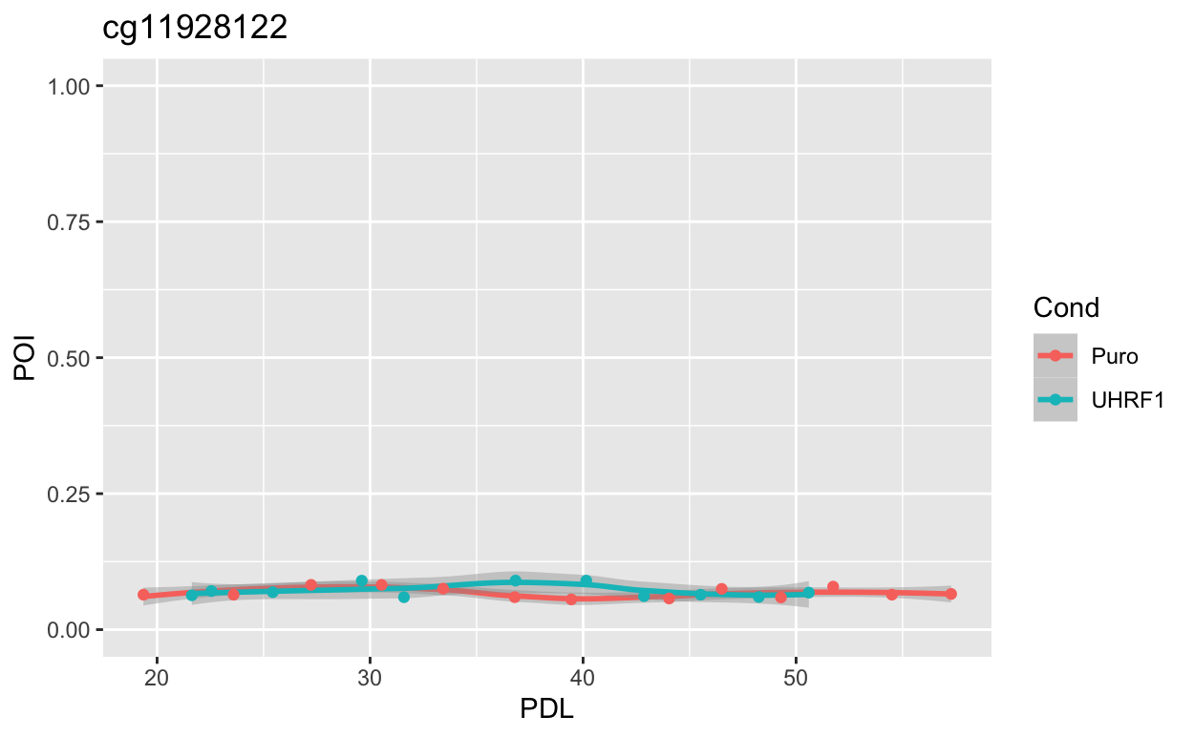
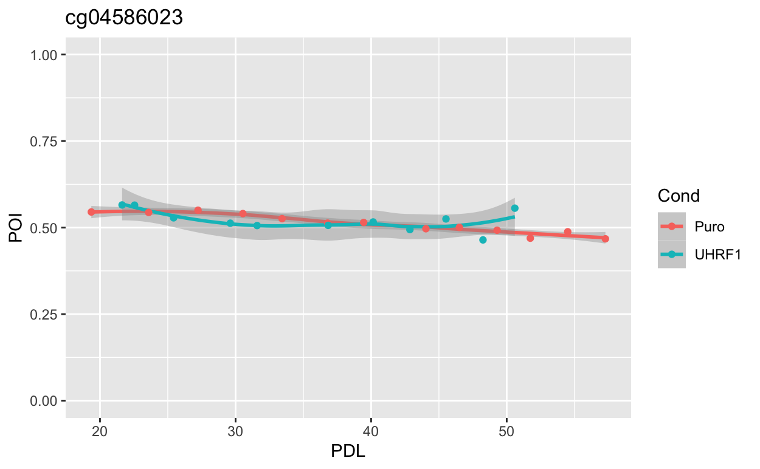
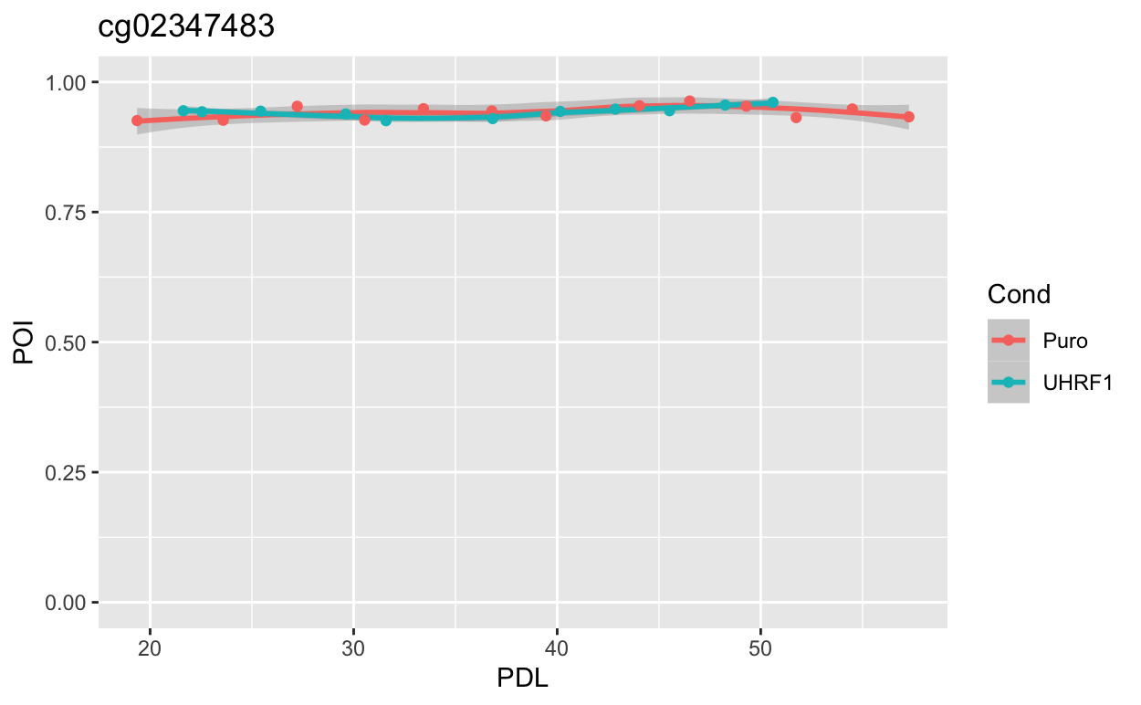
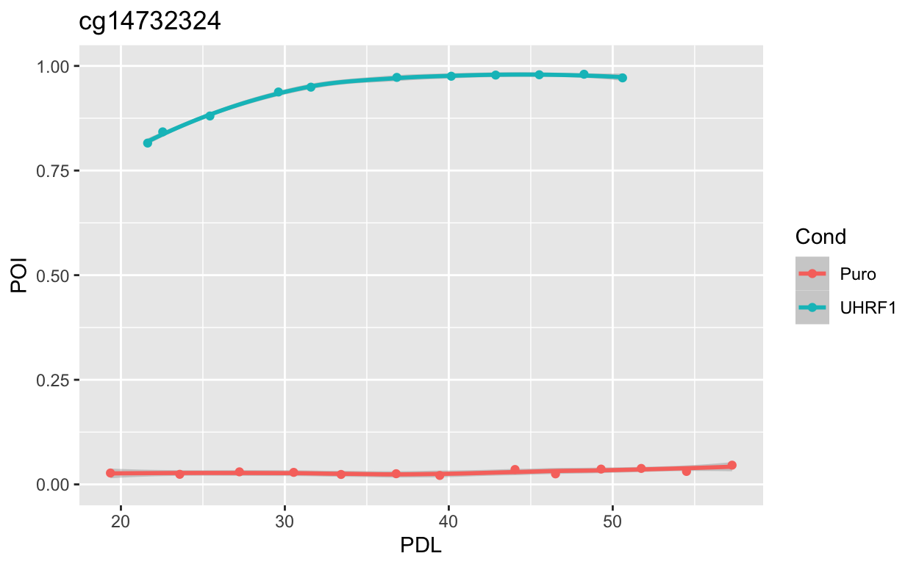
Variable Methylation Behaviors over time.

Slide 10
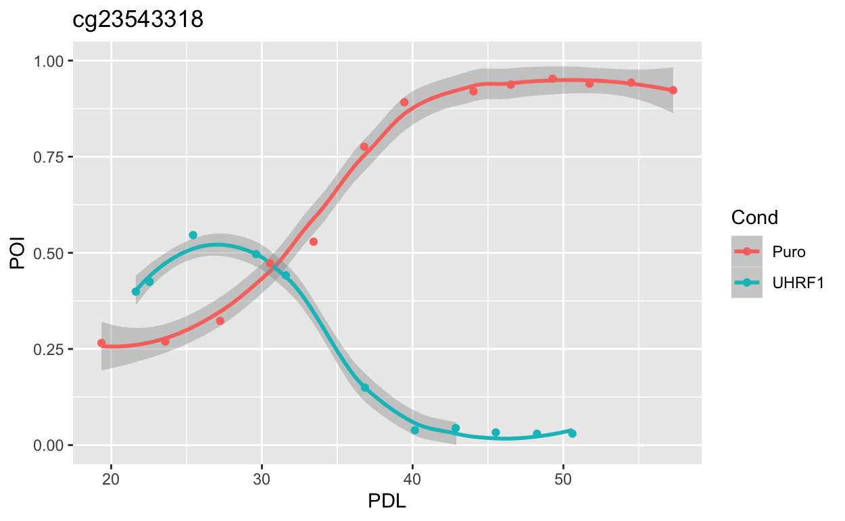
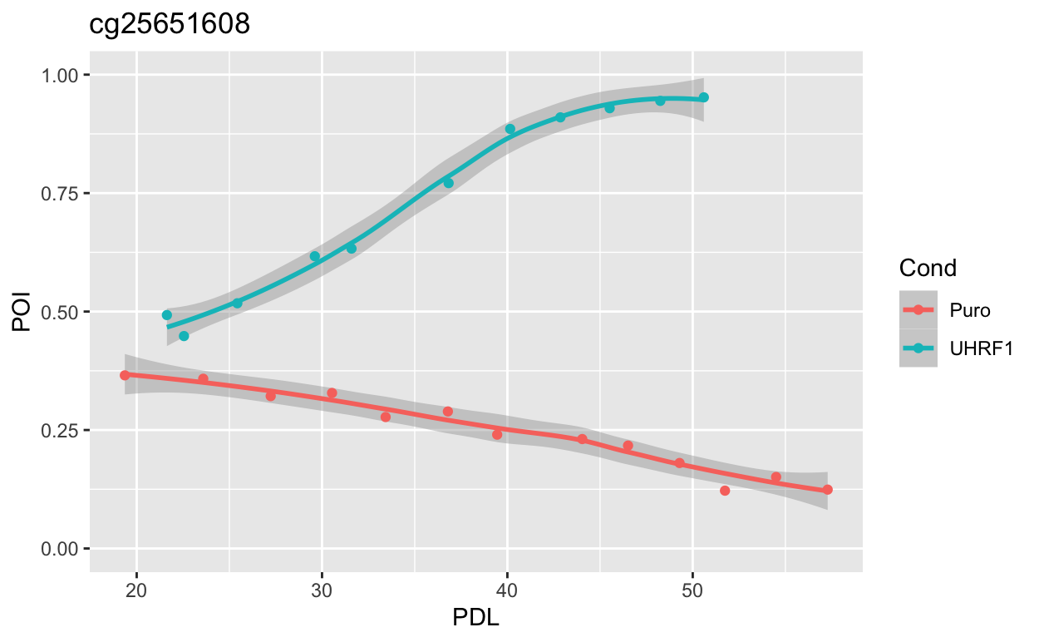
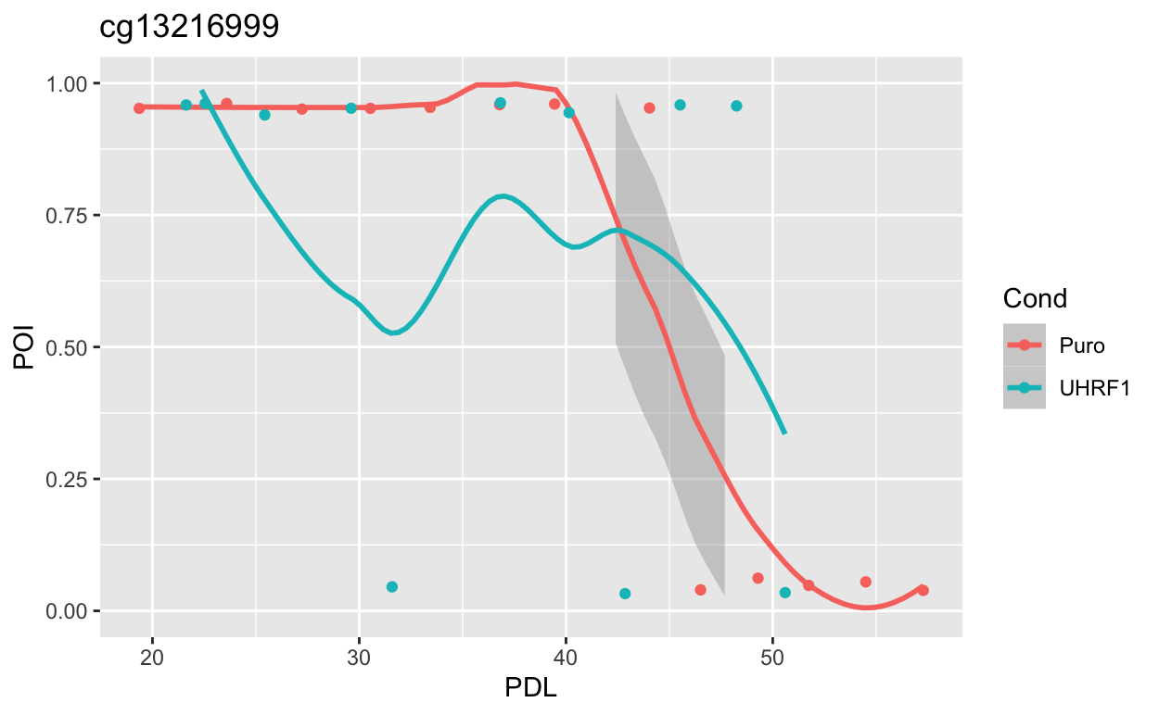
wacky behaviors in some probes

Slide 11
Specific Aims
Submitting an aims page.

Slide 12
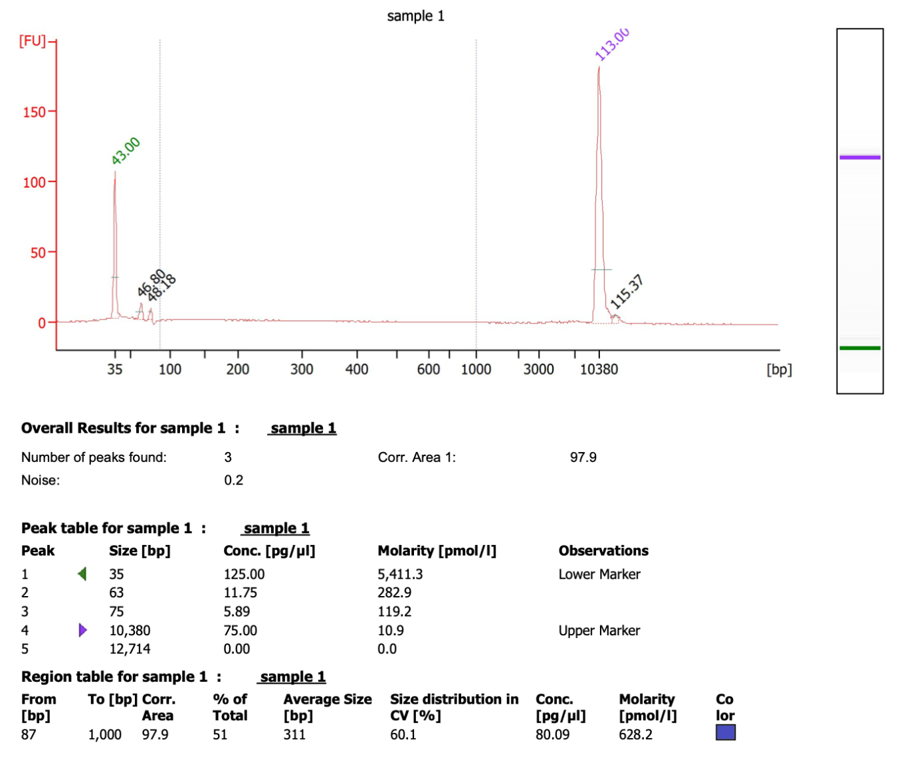
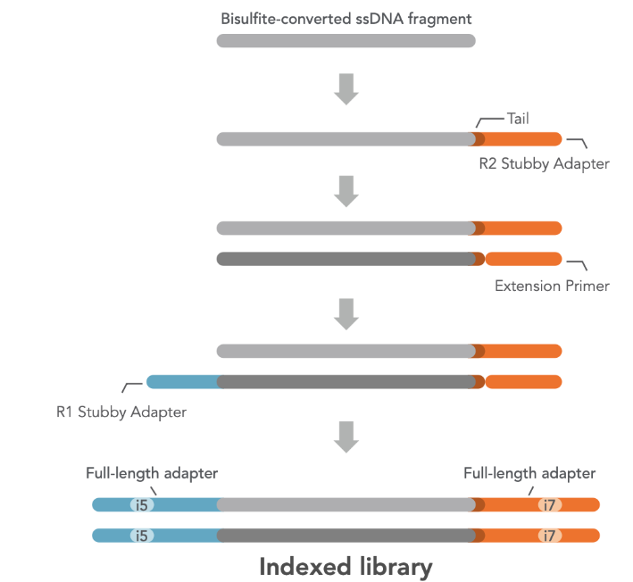
First Library Prep using ”Swift Kit”
ssDNA conc : (~0.13 ng/uL)
total amount : ~10ngs

Slide 14
pre-swift kit workflow
after shearing
sample | handler | Qubit Conc (ng/uL) | Bioanalyzer Conc (ng/uL) | DNA amount (ng) | avg fragment size (bp)
DIPG_KO_A | Emily | 1.04 | 1.11 | 54.1 | 342
DIPG_KO_B | Jamie | 0.80 | 0.93 | 42.4 | 344
after bisulfite
sample | ssDNA conc(ng/uL) | loss_from_bisulfite (%) | overall workflow yield (%)
A | 1.96 | 43 | 49
B | 1.47 | 57 | 37

Slide 15
What was different?
1. technical aspects
AFA50 tube sample insertion pipets. (Emily’s is less jankier)
PCR tubes -> plates
ssDNA measurement using Qubit.
elution using TE buffer
EZ-gold kit using adjusted ratio (900uL->600uL of water dilution)
*overall technical proficiency* (skill issue)

Slide 16
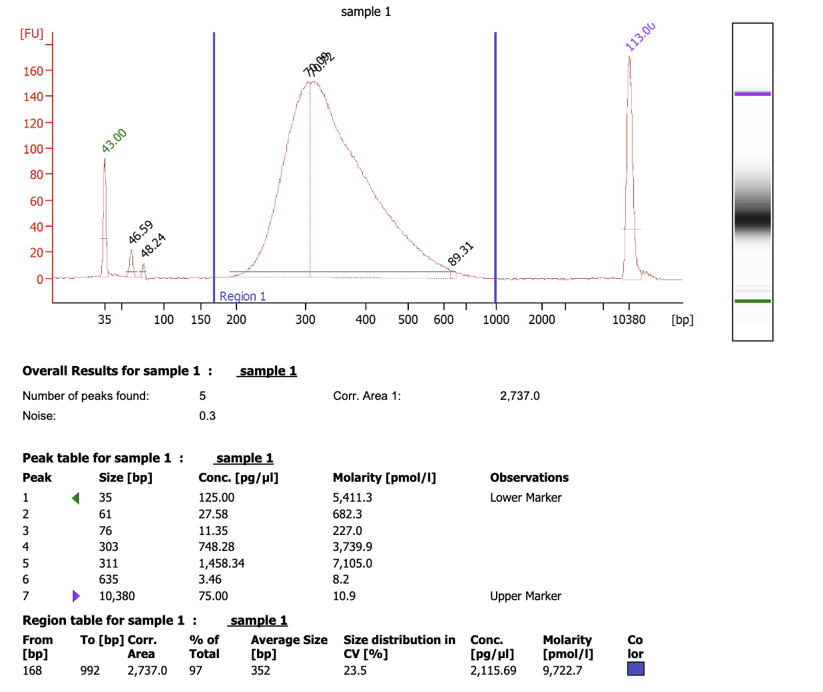
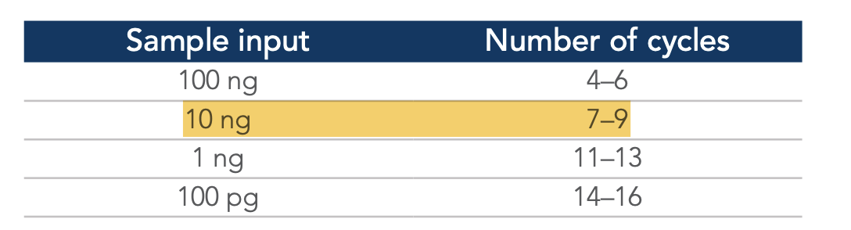
Emily’s Library (7 cycles) was successful
7 cycles.
did we overamplify?
primer clean up? (3%)

Slide 17
Misc. updates
Poster session for incoming grad students
Aug 23,24th 1-2 pm
TAPE station training with Emily from the Genomics Core
next Wednesday 3 pm
Cut&Run protocol contact with Alex (Krawczyk lab)
EpiCypher kit from Pfeifer Lab
Bioconductor conference (Aug 2nd –Aug 4th)
VAI Bioinformatics workshop (July 27^{th) 6}
Jamie is taking the Sequencing Course next semester
Jamie is now in the VAIGS Curriculum Committee

Slide 18
5 questions
1. Are all PCTGs the same?
in terms of effect to carcinogenesis, which gene is most influential? HOX? NEURO?
2. PCGT hypermethylation prone-ability
in terms of cancer, which cancer is most prone?
checkable via TCGA
3. Is the PCGT hyper phenomenon, truly replication independent?
testable with the mitoC and serum depr experiment.
4. What other HM markers do PCTGs have, other than ‘EZH2-H3K27me’?
what about H3K36me2/3 or H2K119Ub.
5. Species conservability; Do mice also gain the same PCTGs?
6. Do other aging models show the same dynamics of PCGT hypermethylation?
Min : how do the H2O2 induced NURD complex cell model show diff.

Slide 19
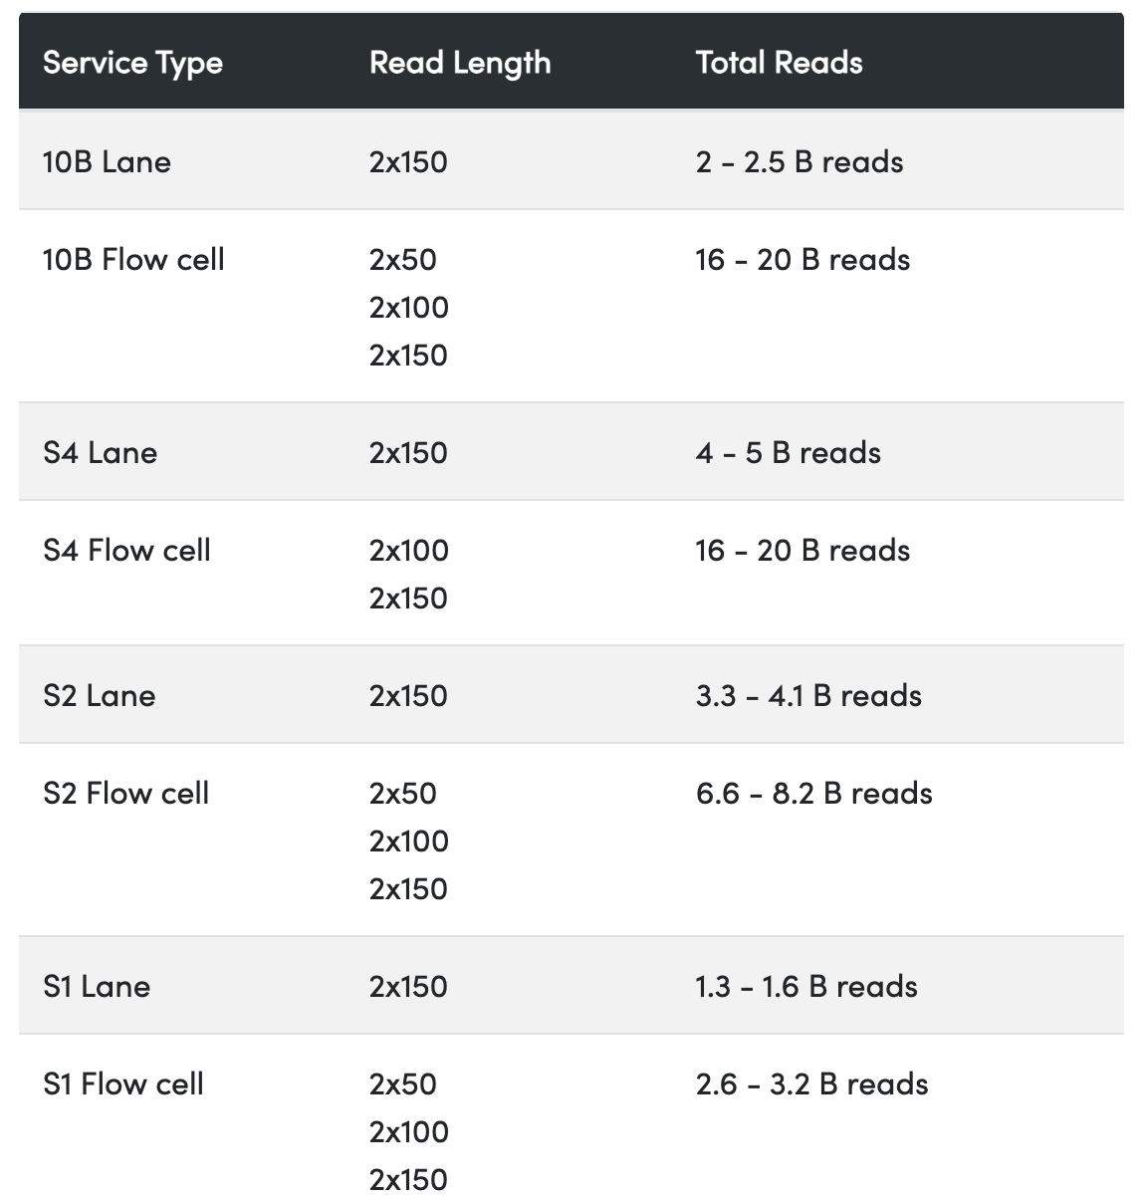
rent-a-lane Fulgent
pricing for 6000
NovaSeq 6000 S1 Lane (300 cycle) $4,795.20
NovaSeq 6000 S2 Lane (300 cycle) $8,555.77
NovaSeq 6000 S4 Lane (300 cycle) $6,482.23
Pricing for X
NovaSeq X 10B Flowcell (300 cycle): $17,134.08
NovaSeq X 10B Flowcell (200 cycle): $16,063.20
NovaSeq X 10B Flowcell (100 cycle): $12,672.08
NovaSeq X 10B Lane (300 cycle): $2,141.76

Slide 20
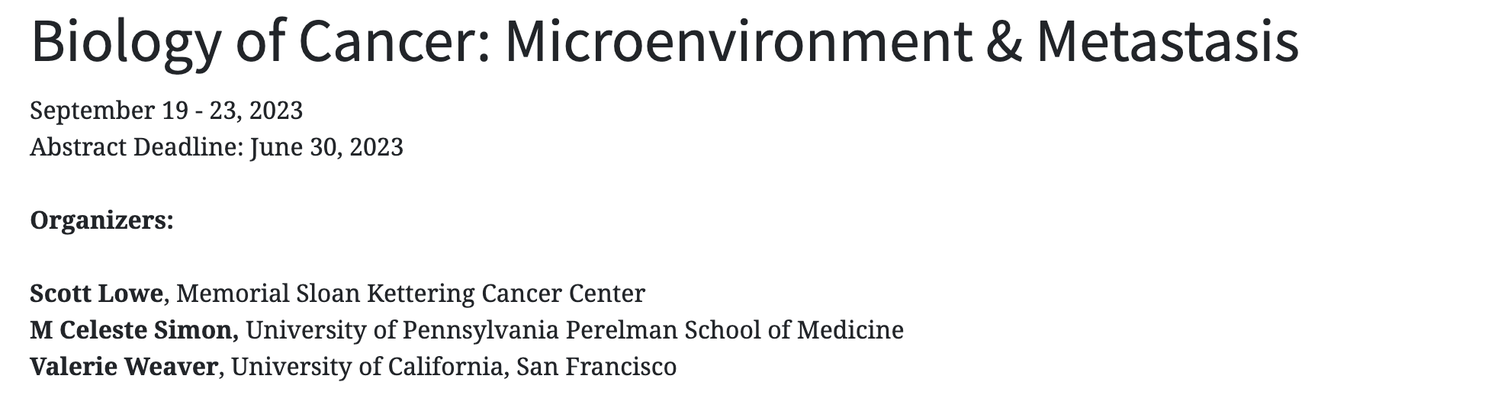
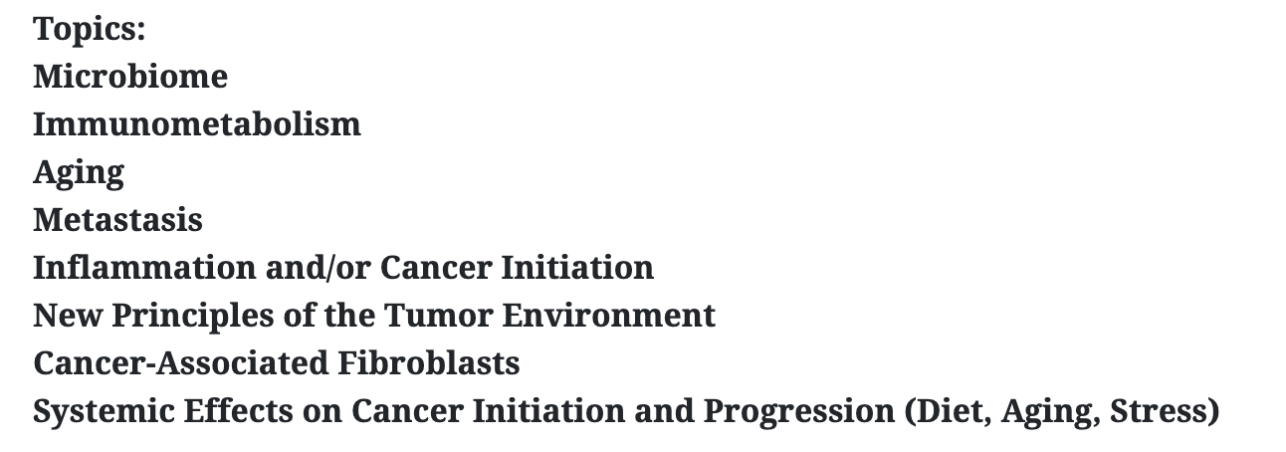
Cold Harbor Cancer TME.
I want to go to this one! https://meetings.cshl.edu/meetings.aspx?meet=TUMBIO&year=23

Slide 21
How do you identify DMPs in a time-series?
lmFit?
minfi::DMPhunter
limma::dmp
sesame::DML
How do you identify DMPs/VMPs in a methyaltion series;

