Slide 1
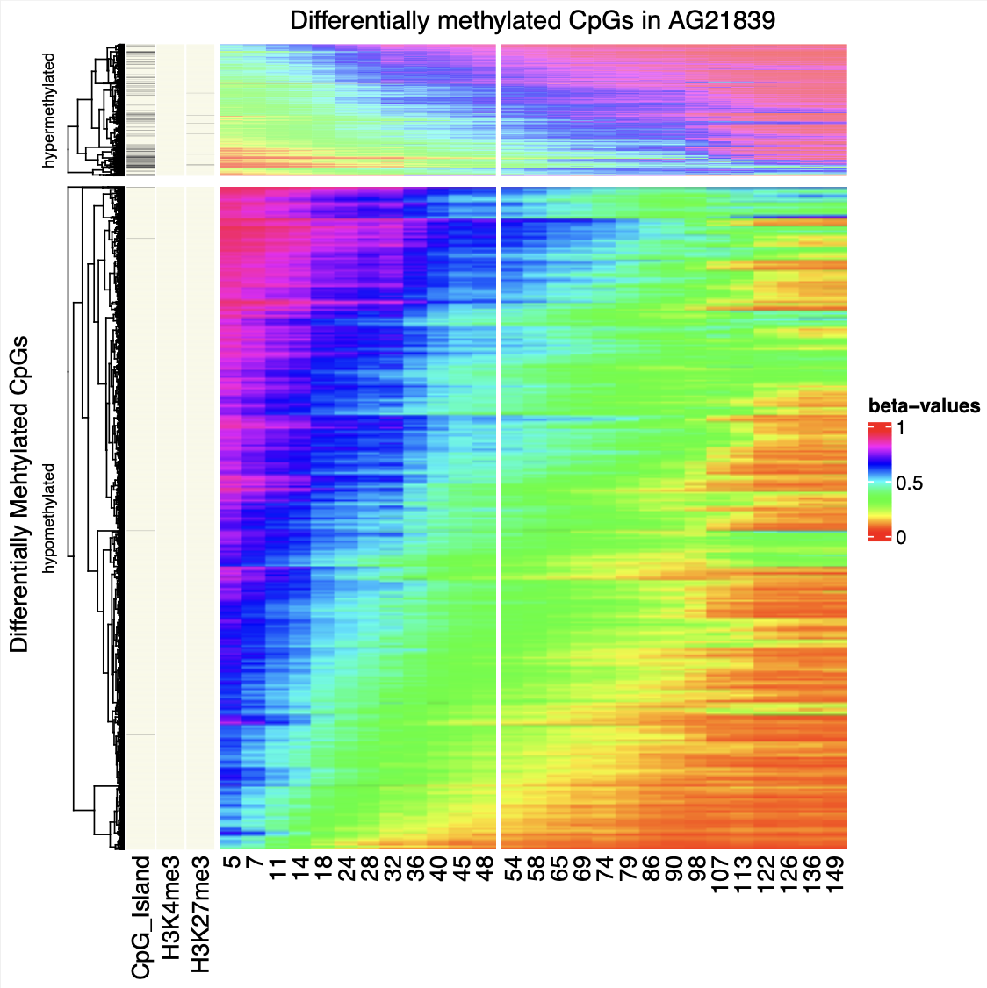
Laird lab meeting
Happy Pride Month!
Jamie 060623

Slide 2
Integration week!
desk monitor setup, lockers
Supply Room Center (+ access)
workday requisitions
(Quartzy?)
Tick@lab
Dropbox setup
biorender?
CH1 level mouse training (+ access)
handling, necropsy
Liquid N-tank, freezers, fridges
Conference ideas?
HPC setup

Slide 3
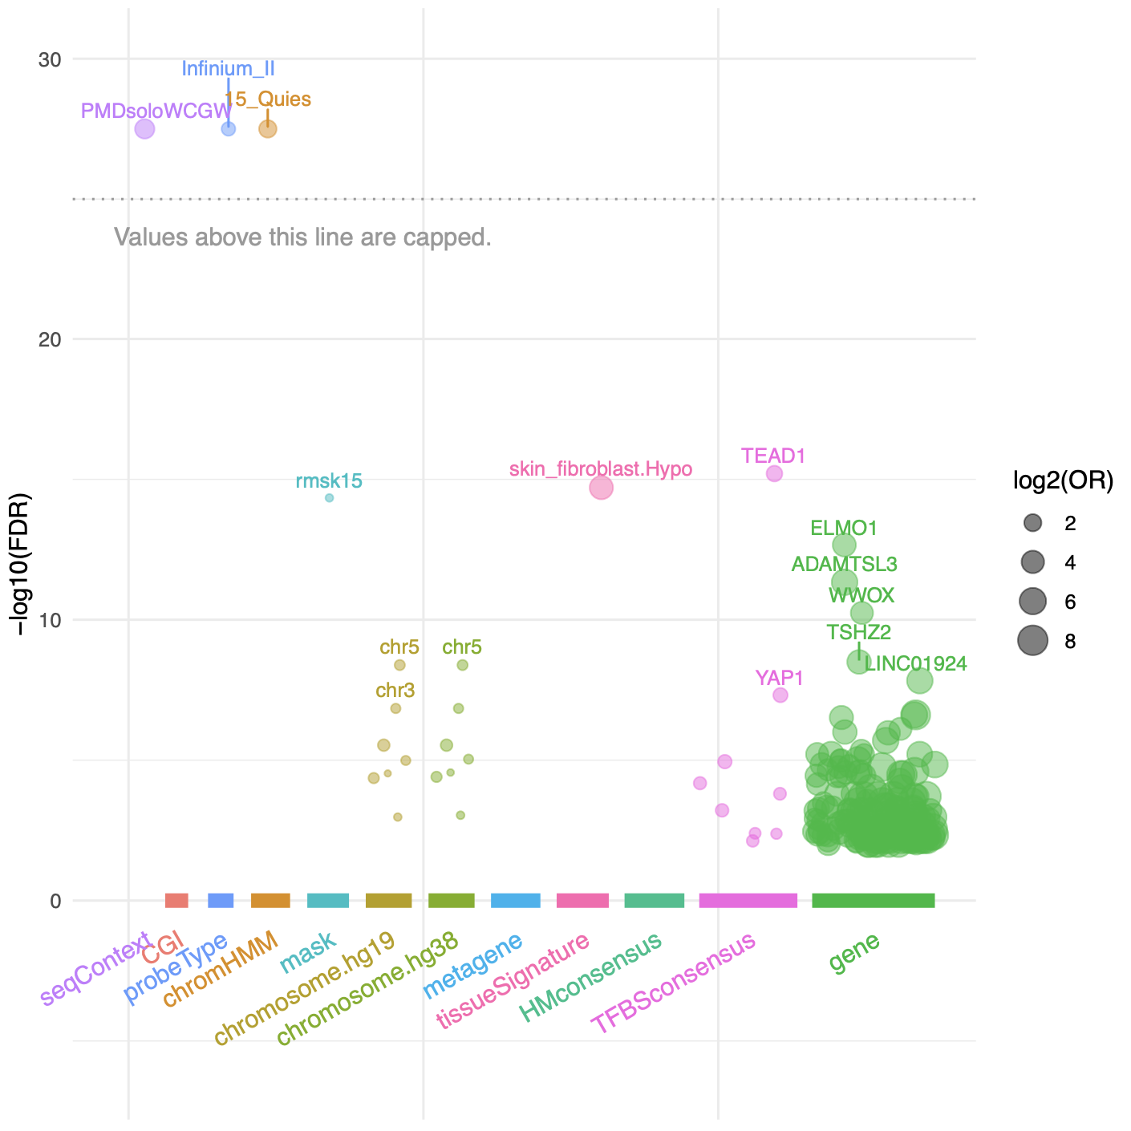
this week;
talk to Emily and do some math.
Fulgent(Novaseq10) vs. VAI core
can submit library?
4 additional analysis
making a “window” for peaks
epigenome_roadmap peak plugin.
SNP consistency across probes
population shift?
AG21859 dataset analysis
same individual; diff celltype
CNV analysis; “Chr3 and 5"

Slide 4
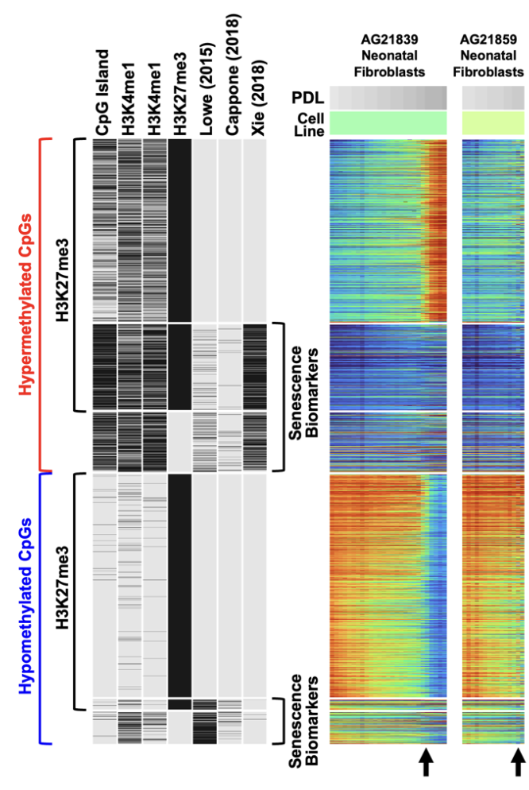
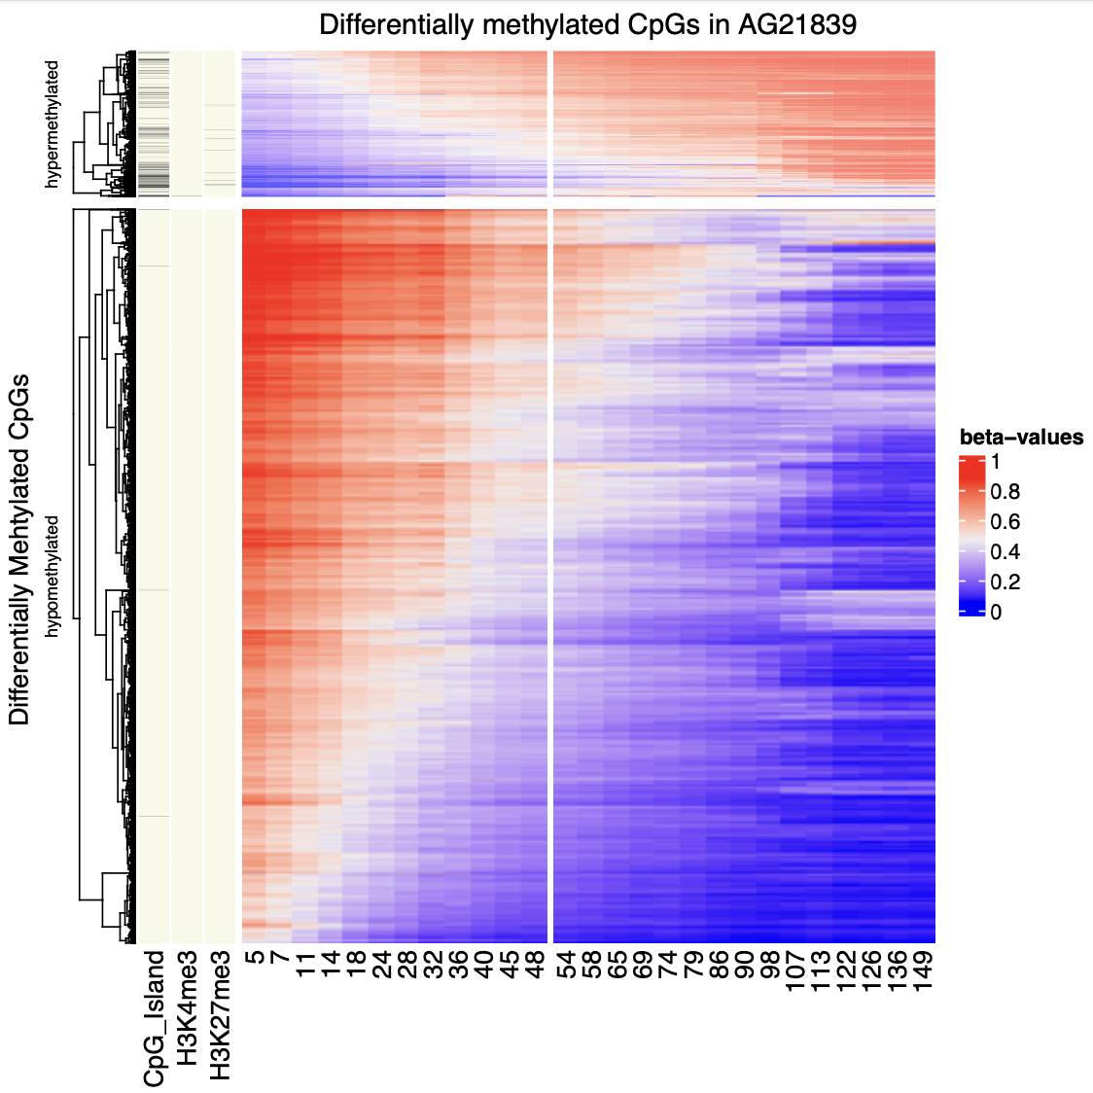
the ‘flip’ in AG21839
a drastic hypermethylation in PCGT
Polycomb Targets are “poised” (bivalent)
H3K4me3 + H3K27me3
Mostly comprised of CpG islands

