Slide 1
2023_06_20
Lab meeting

Slide 2
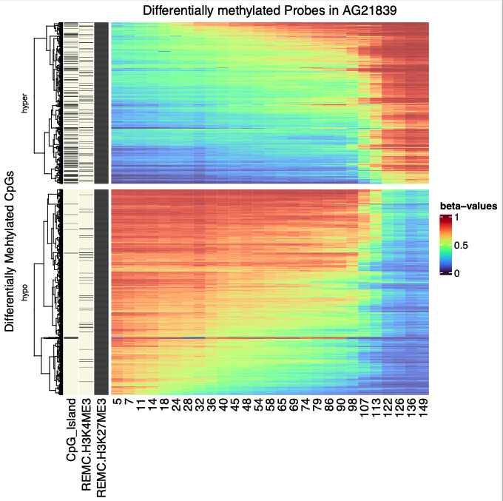
463 hyper
590 hypo
row clustered.
3 samples;
 | Internal ID | Total PDL | Days in culture | Conc(ng/uL) | Vol(estimate_uL)
1 | LGC250 | 7.24092391 | 5 | 17.8 | 10
2 | LGC251 | 9.27437506 | 7
3 | LGC252 | 13.048624 | 11
4 | LGC253 | 15.6351249 | 14
5 | LGC254 | 19.6393633 | 18
6 | LGC255 | 24.1982777 | 24 | 4.56 | 10
7 | LGC256 | 26.7580771 | 28
8 | LGC257 | 29.2826797 | 32
9 | LGC258 | 33.4851278 | 36 | 1.8 | 15
10 | LGC259 | 36.2959753 | 40 | 4.24 | 10
11 | LGC260 | 39.8850854 | 45
12 | LGC261 | 42.929847 | 48
13 | LGC262 | 45.9236761 | 54
14 | LGC263 | 49.0487733 | 58
15 | LGC264 | 54.0206665 | 65
16 | LGC265 | 56.5396774 | 69
17 | LGC266 | 59.6573593 | 74 | 4.42 | 10
18 | LGC267 | 62.865347 | 79
19 | LGC268 | 66.6126153 | 86
20 | LGC269 | 68.765693 | 90 | 16.1 | 15
21 | LGC317 | 73.7497993 | 98 | 34.2 | 25
22 | LGC318 | 77.0971598 | 107
23 | LGC319 | 80.1216224 | 113
24 | LGC320 | 84.1553184 | 122
25 | LGC321 | 85.2376792 | 126
26 | LGC322 | 89.9033481 | 136 | 25.6 | 20
27 | LGC323 | 91.8192931 | 149

Slide 3
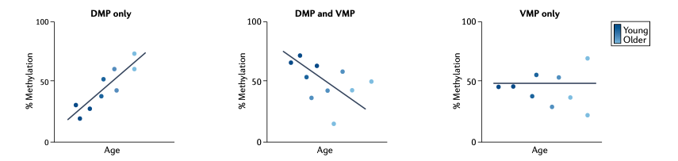
identifying age-associated DNAme CpG sites/regions
DMP vs. VMP
Differentially/Variably methylated probes
limma for DMP.
minifi for DMR
DMR vs. VMR
Differentially/Variably methylated regions
lmtest for VMP
minifi (change DMRcate) for VMR.
Correlation networks
WGCNA (weighted correlation network analysis)

Slide 4
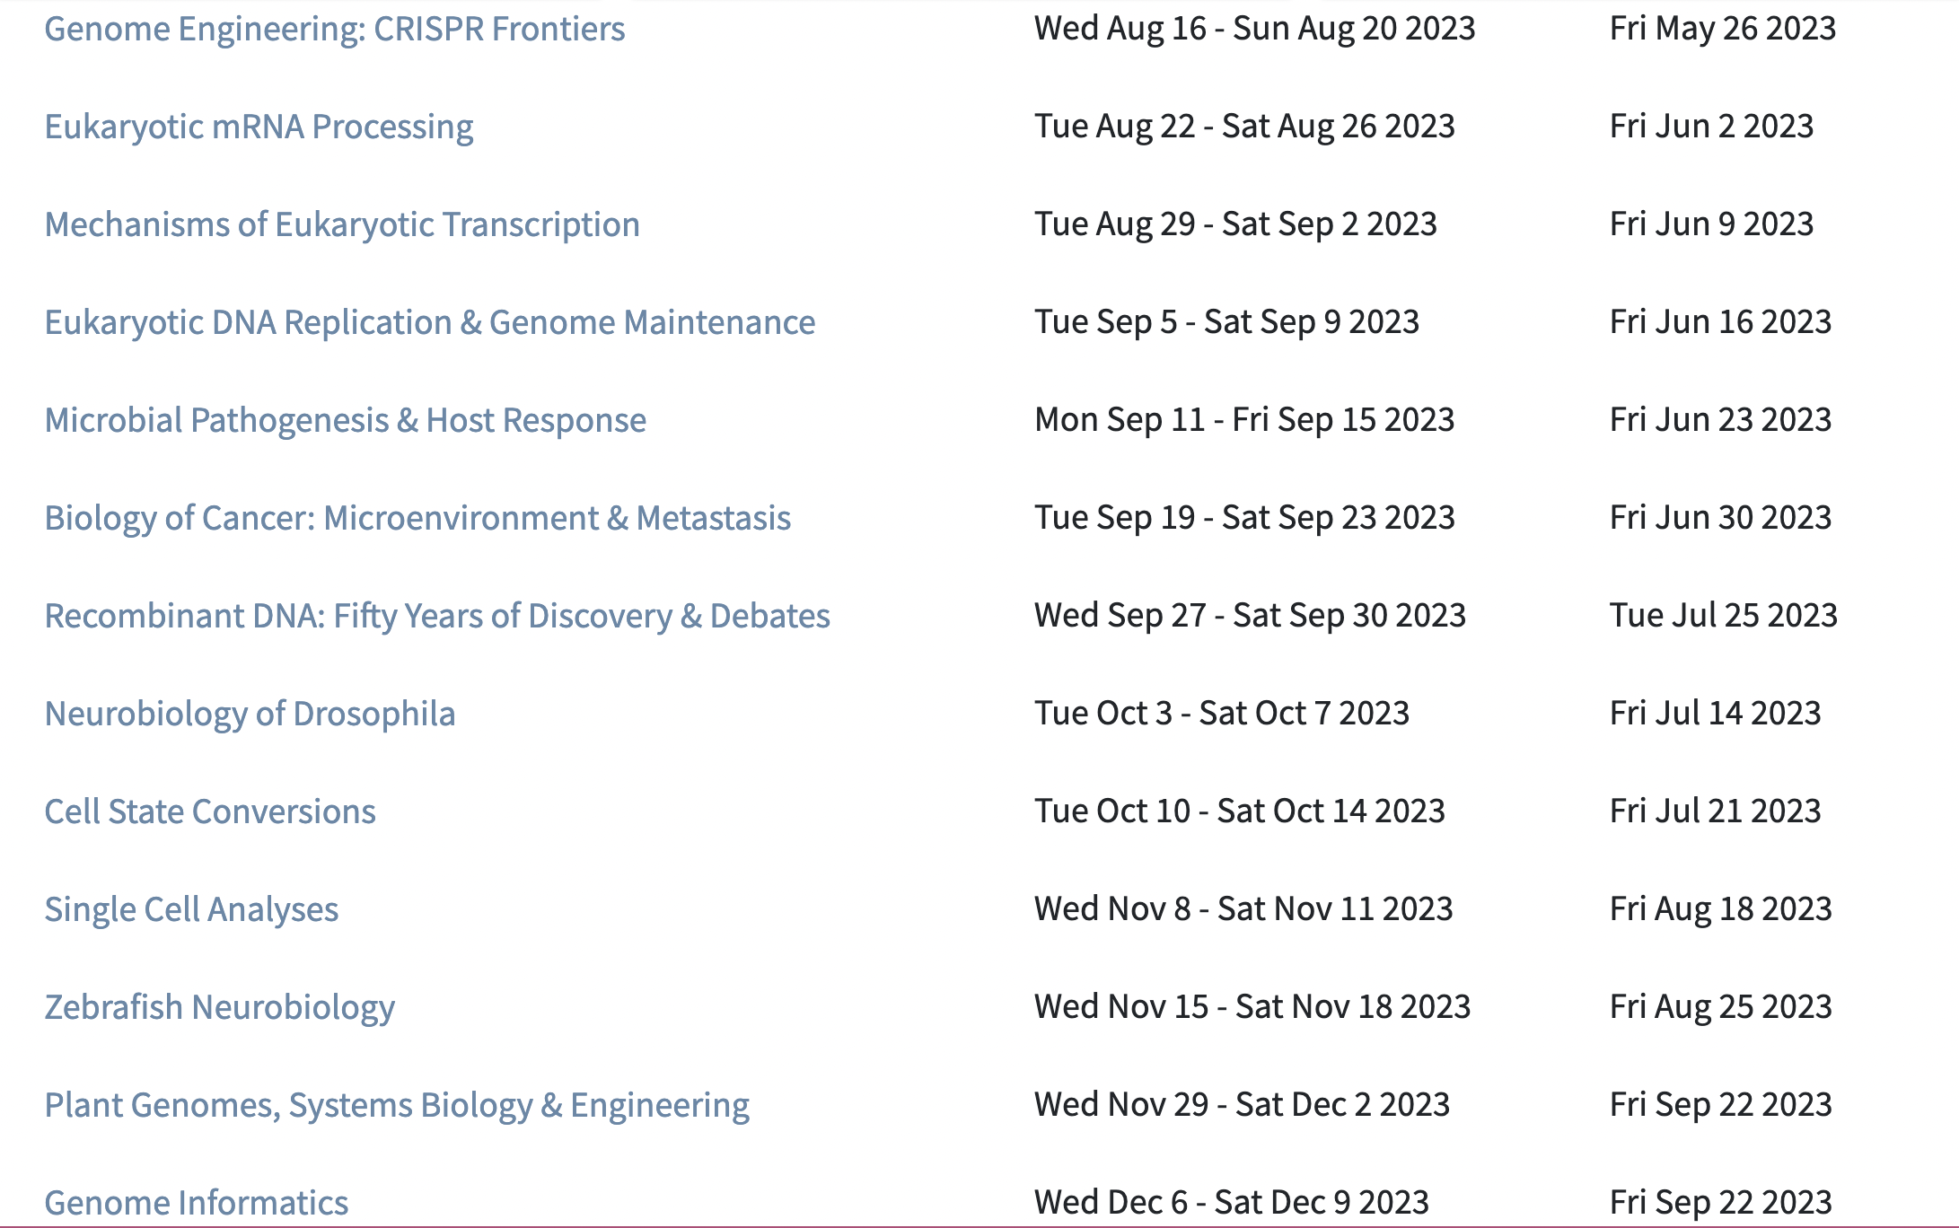
CSHL

Slide 5
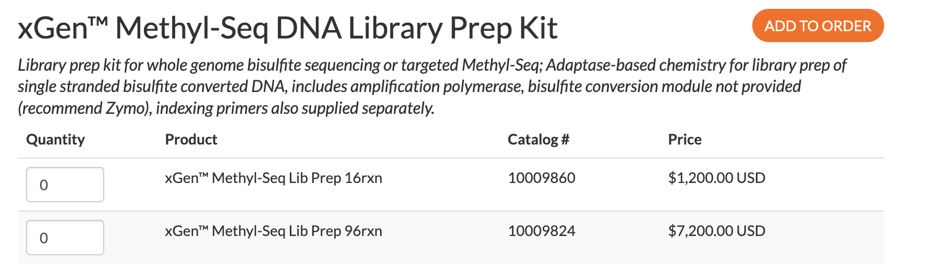
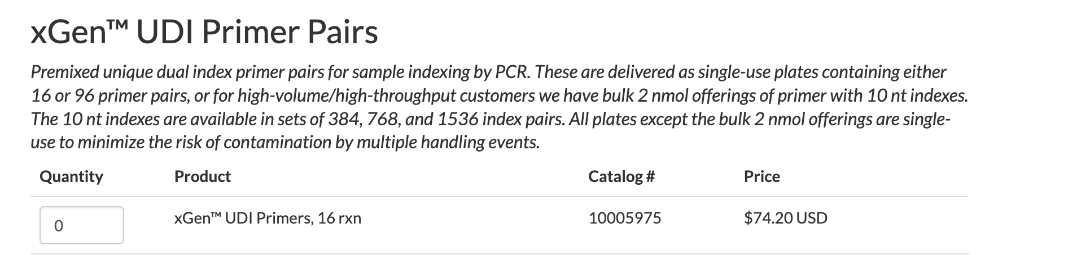
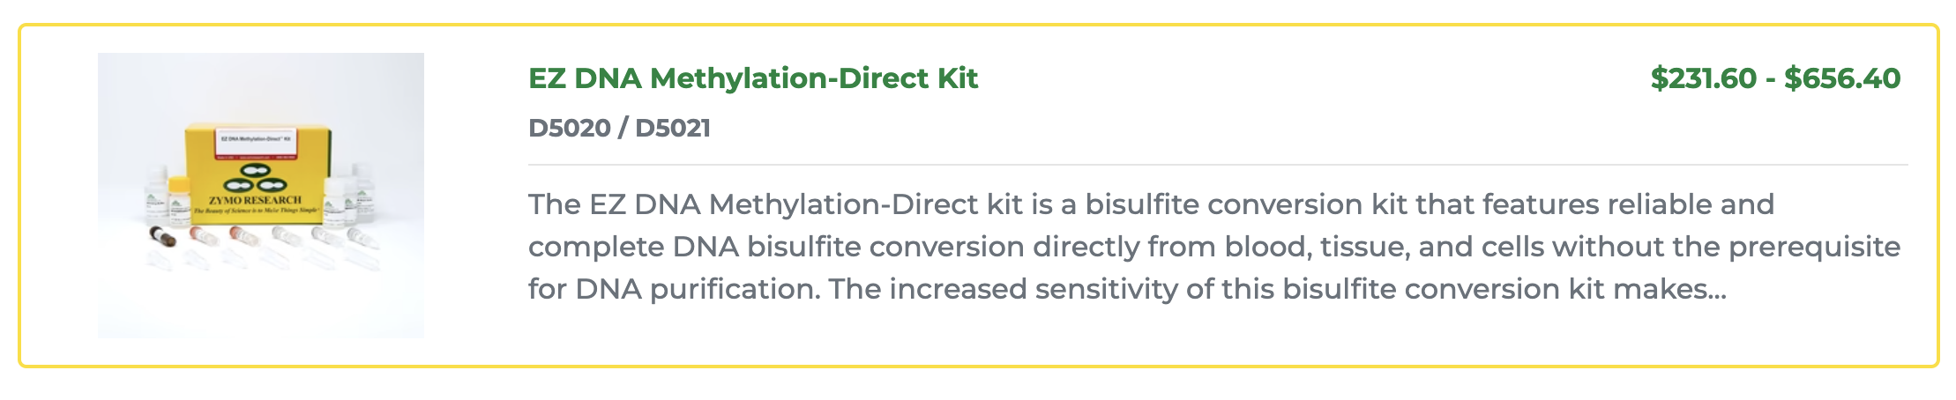
Kit pricing
we already have the zymo kit,
so in total $1,275.
Notes:
https://www.idtdna.com/pages/products/next-generation-sequencing/workflow/xgen-ngs-library-preparation/methyl-seq-dna-library-kit?utm_source=google&utm_medium=cpc&utm_campaign=00587_1c_03&utm_content=search&gclid=CjwKCAjwp6CkBhB_EiwAlQVyxXQOMYl2SrF_Vr8t-9VcCx-PZyCLgUfzEcc5yiGwctNuv7htK9dWChoC5SwQAvD_BwE

Slide 6
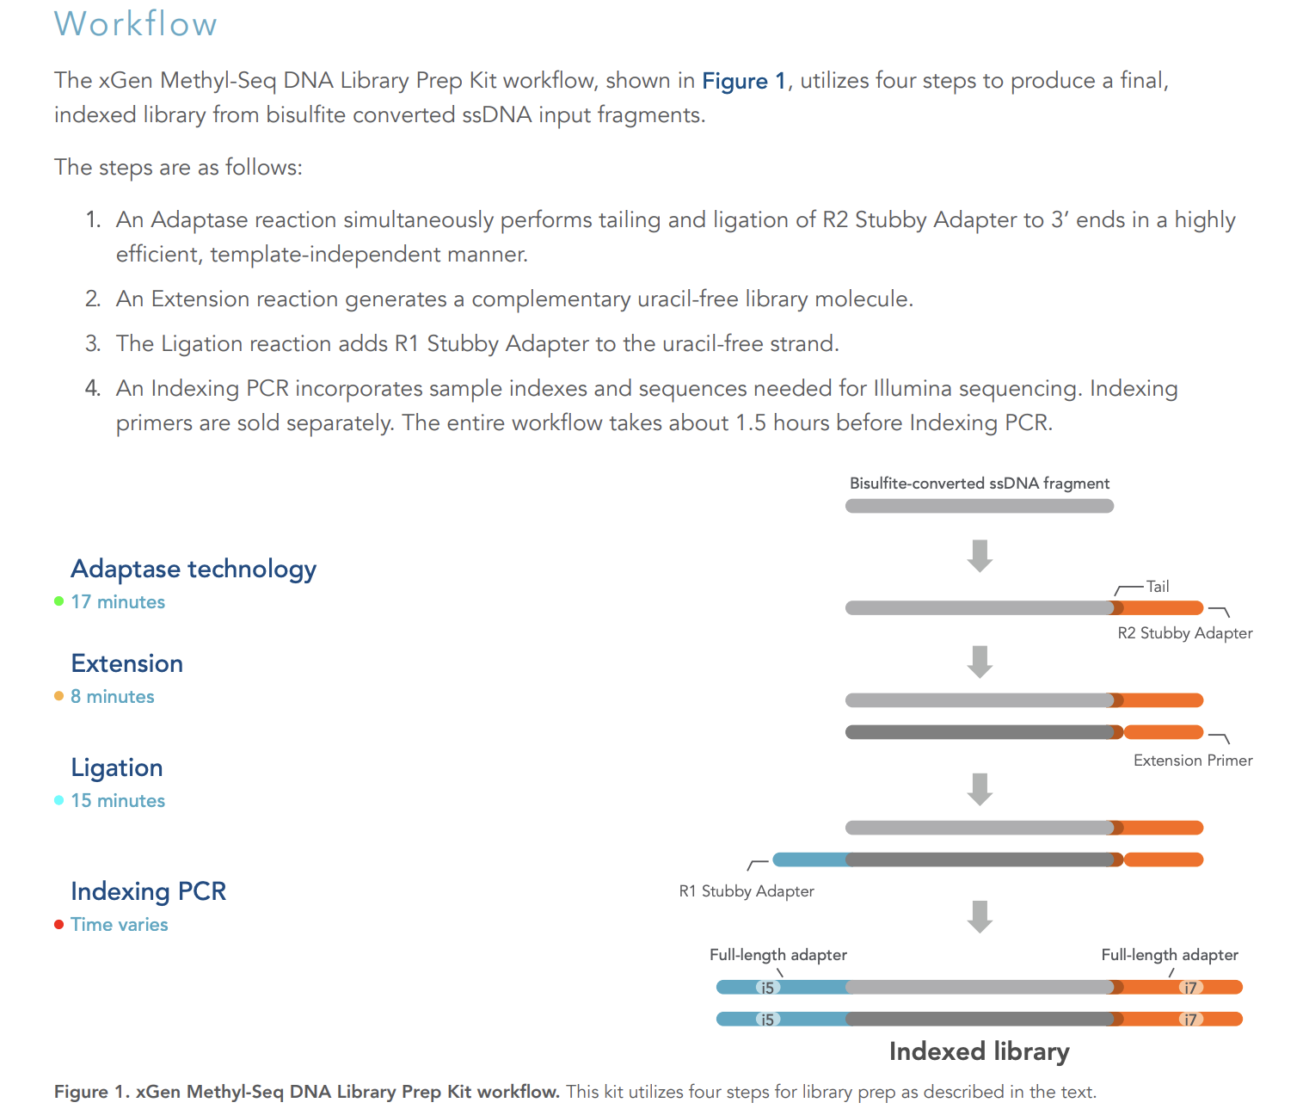

Slide 7
R21 CARLIN + scDEEP-meC + RepliTali

