Slide 1
Investigation of PCGT methylation “flip”
Jamie, Paula from Laird Lab

Slide 2
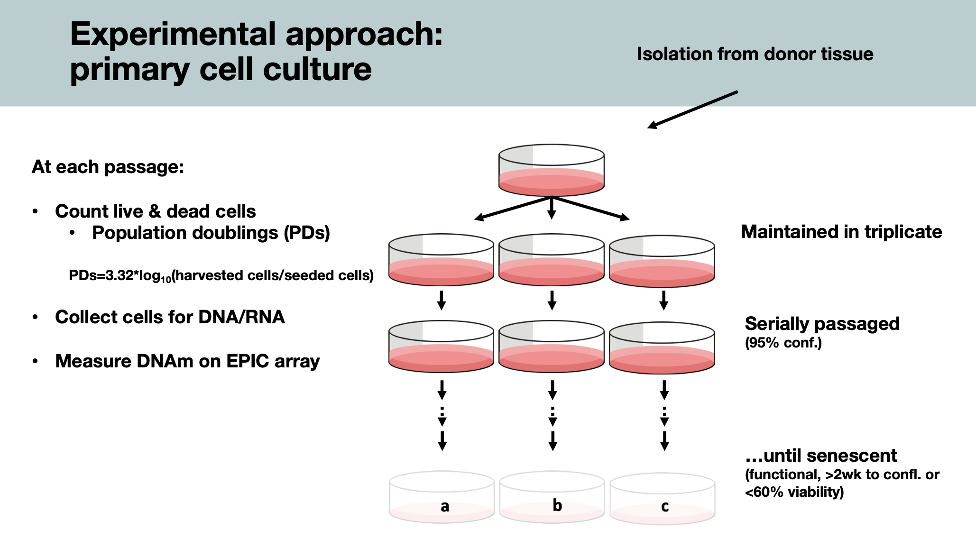

Slide 3
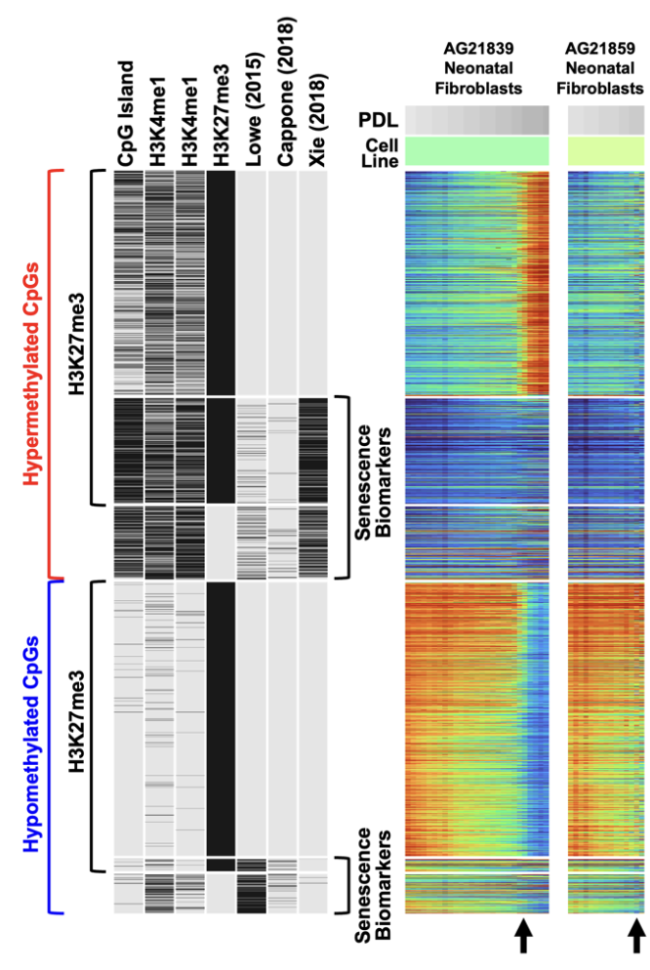
the ‘flip’ in AG21839
a drastic hypermethylation in PCGT
Polycomb Targets are “poised” (bivalent)
H3K4me3 + H3K27me3
Mostly comprised of CpG islands

Slide 5
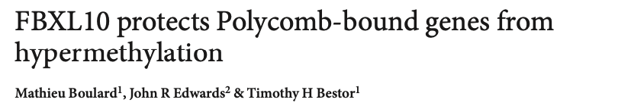
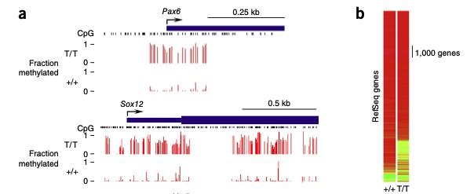
PCGT (polycomb gene targets)
as of current, with the exception of KDM2B(-/-), there has not been a PCGT specific-hypermethylation mechanism.
as of current, there is no human PRE (polycomb-responsive element). Therefore this drastic PcGT specific hypermethylation is bizzarre.

Slide 6
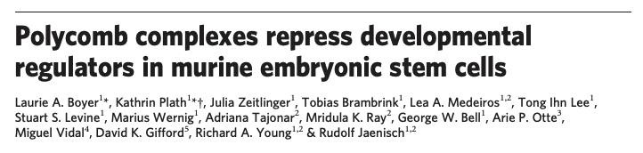
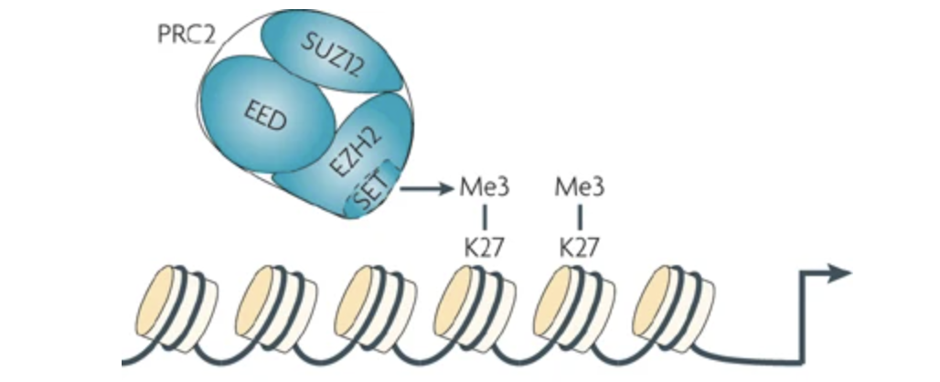
PRC1/2 are Transcriptional repressors
developmental/differential genes including Hox family genes.
EZH2 is a histone methyltransferase (H3K27me3) associated with heterochromatin.

Slide 7
Question
What are the genetic mutations that drive this phenomenon?
Does the dynamics make sense? (drastic switch)

Slide 8
AG21839; male fibroblast (foreskin)
Repository | NIA Aging Cell Culture Repository
Subcollection | Apparently Healthy Collection
Biopsy Source | Foreskin
Cell Type | Fibroblast
Tissue Type | Skin
Transformant | Untransformed
Family Member | 1
Relation to Proband | proband
Confirmation | Clinical summary/Case history
ISCN | 46,XY
Species | Homo sapiens
Common Name | Human
Remarks | Foreskin fibroblast cell culture; matching foreskin melanocyte and foreskin keratinocyte cultures from this same donor are AG21837 and AG21838, respectively
https://catalog.coriell.org/0/Sections/Search/Sample_Detail.aspx?Ref=AG21839

Slide 9
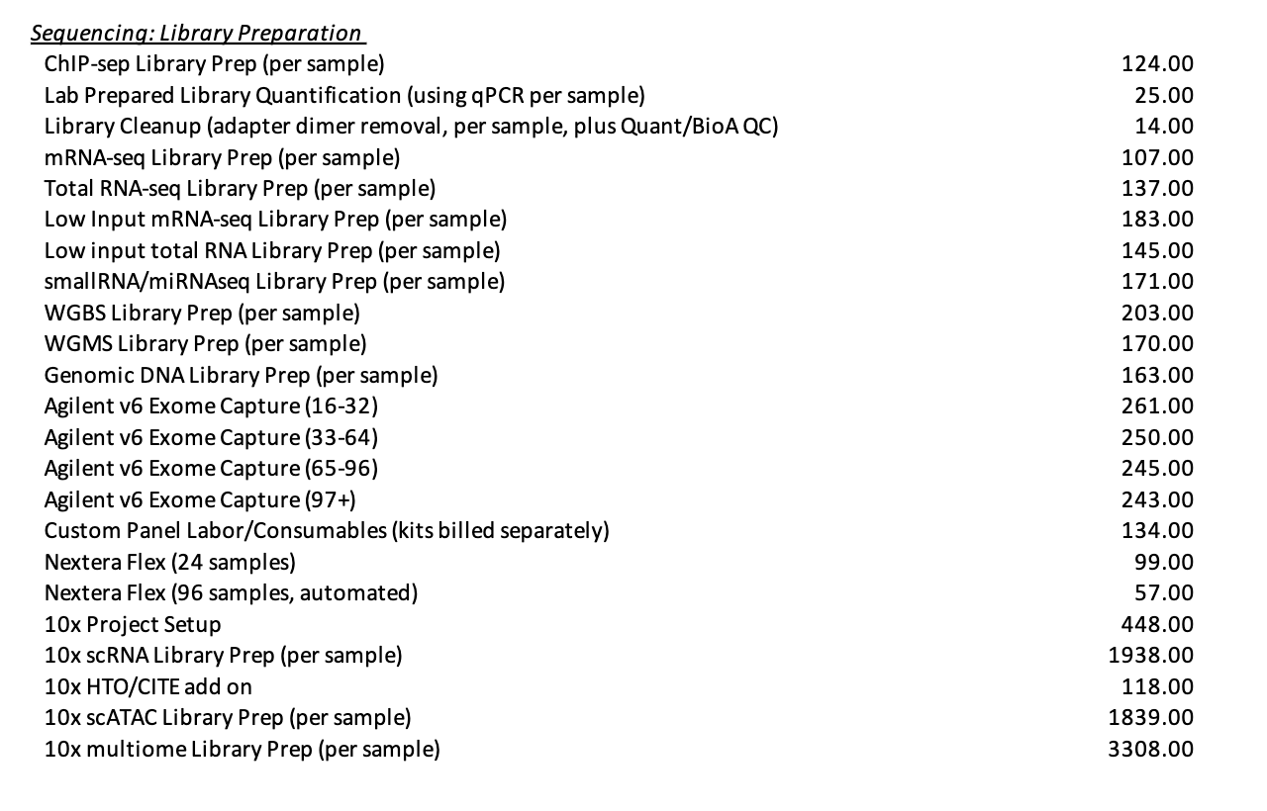
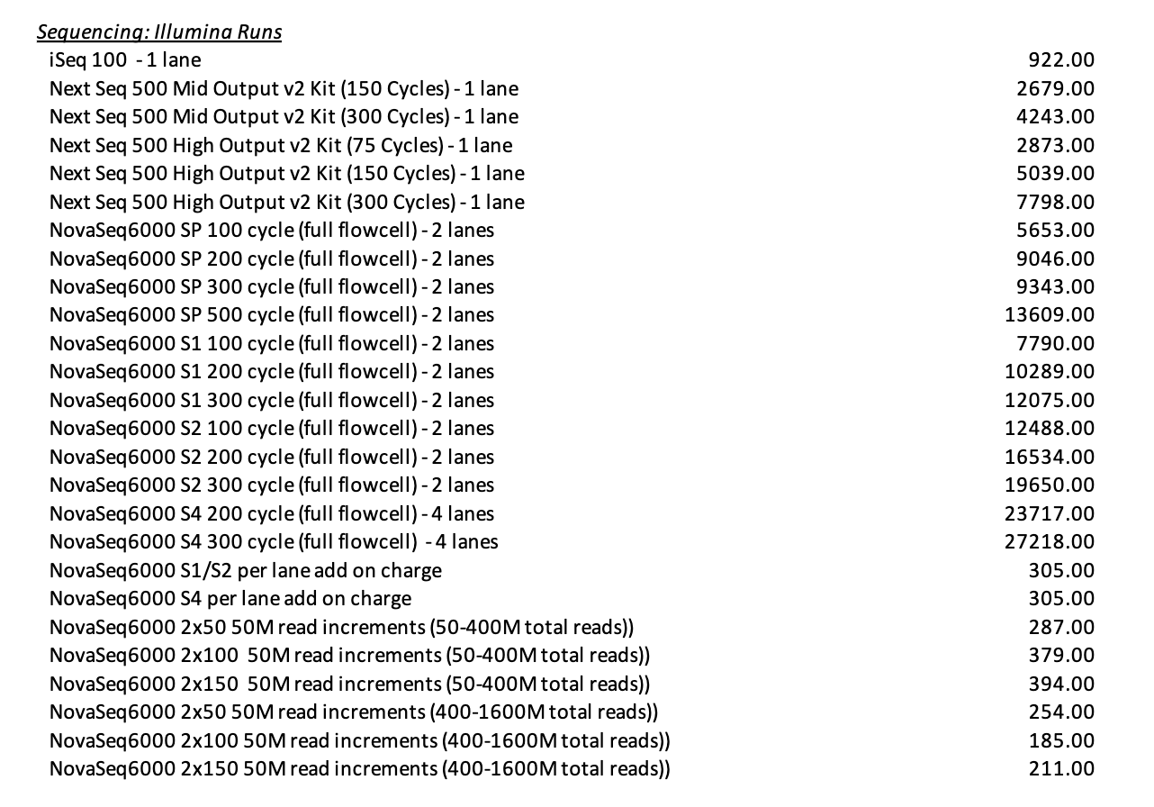
Pricing
S1 flowcell 1.6 billion sequences/run
S2 flowcell: 3 billion sequences/run
S4 flowcell: 10 billion sequences/run
https://vanandelinstitute.sharepoint.com/sites/genomics/SitePages/Rates.aspx

Slide 10
Main QnA
Cost : gDNA vs. DNA library submission?
gDNA library submission may be better b/c our WGBS is homebrew
WGS vs. WGBS vs WGMS (TET enzyme version)
BisCUIT (can detect mutations from WGBS)
reference genome not needed.
considering this is an epigenetic phenotype, we would WANT the WGMS or WGBS. (only $40 more per sample prep)
Viability
(but 200 ng optimal, 10 ng minimal)
ChIP-seq? (bivalency; H3K27me3, H3K4me3)
relatively broad peaks and it will be cheaper b/c the readers are shorter.
how deep? 80x? 30x?
30X is deep enough for mutation detection;
how many time points?
3 time points. (= 3 samples) no replicates or experimental ctrls needed.
Timeline
1 mo. total.

Slide 11
notes to myself
check all DNA samples present in LGC format in freezer

Slide 12
notes

