Slide 1
10 BM

Slide 2
10 Ctrl- BMs
Sample | Sex | Age | Sequencing
1 | F | 26 | CITE-Seq
2 | M | 39 | CITE-Seq
3 | F | 50 | CITE-Seq
4 | M | 20 | CITE-Seq
5 | M | 47 | CITE-Seq
0004 | M | 53 | CITE-Seq +scTCR-seq
0005 | M | 22 | CITE-Seq + scTCR-seq
0058 | M | 20 | CITE-Seq
0082 | M | 19 | CITE-Seq + scTCR-seq
4003 | M | 42 | CITE-Seq + scTCR-seq
0182 | M | 51 | scTCR-seq

Slide 3
20 adults and 22 pediatric AMLs
Gender | Age | Sequencing | Dx | DxELN_Cytogenetic | Cytogenetics | Overall survival
M | 64 | CITE-seq | AML | Adverse | 48,XY,+8,+8,i(8)(p10),t(9;15)(q33;q15),del(10)(q22.1q24),del(13)(q14q21) (cp14)/44-48,idem,add(13)(p11.2)(cp2) | 137
F | 77 | CITE-seq + scTCR-seq | AML | Adverse | 74-89<4n>,XXXX,-8,-9,-9,-12,-17,i(17)(q10),+mar1,+mar2,+dmin[cp18]/46,XX[2] .ish dmin(amp CMYC) | 47
M | 74 | CITE-seq | AML | Adverse | 46,XY[30] | 3
F | 71 | CITE-seq | AML | Intermediate | 46,XX | 1807
M | 57 | CITE-seq | AML | Favorable | 46,XY[19]/nonclonal[1] | 170
F | 32 | CITE-seq | AML+MS | Adverse | 46,XX,t(10;11)(p13;q21)[16]/46,XX[4].ish der(10)t(10;11)(5'KMT2A sep 3'KMT2A) | 1189
M | 62 | CITE-seq | sAML | Adverse | 47,XY,+8[5]/46,XY[5] | 61
M | 58 | CITE-seq | AML+MS | Favorable | 46,XY[19]/nonclonal[1] | 183
F | 64 | CITE-seq | AML | Adverse | 47,XX,+8[18]/46,XX[1]/nonclonal[1] | 1485
F | 70 | CITE-seq | sAML | Intermediate | 47,XX,del(5)(q22q35),+8[20] | 780
M | 64 | CITE-seq | sAML | Intermediate | 46, XY | 1196
M | 74 | CITE-seq | AML+MS | Adverse | 46, XY | 479
M | 78 | CITE-seq | AML | NA | 46,XY (17 metas), -Y in 3 metas | 631
F | 78 | CITE-seq + scTCR-seq | sAML | Adverse | 45,XX,del(5)(q13q33),der(8)add(8)(p11.2)add(8)(q24),dic(17;18)(p11.2;p11.2) ,dmin[16,two w/nonclonal abnormalities]/46,XX[4 | 42
M | 80 | CITE-seq | AML | Intermediate | 46,XY | 455
F | 65 | CITE-seq | tAML | Favorable | 46,XX | 491
M | 64 | CITE-seq | AML+MS | Favorable | 46,XY | 262
M | 73 | CITE-seq + scTCR-seq | AML+MS | Adverse | 46,XY | 141
F | 81 | CITE-seq | AML+MS | Adverse | 49,XX,+1,del(1)(p13),+8,+8[3]/50,sl,+5,del(5)(q13q33)[6,two w/nonclonal abnormalities]/51,sld1,+mar[3]/51,sdl1,+6[2]/46,XX[6,one is 4n] | 12
F | 55 | CITE-seq | AML+MS | Adverse | 46,XX,cryp der(7)t(7;11)(q22;q13).ish cryp der(7)t(7;11)(KMT2A+) .nuc ish(D7S486x1,D7Z1x2)[183/200] | 628
Site | Gender | Age | Sequencing
SJ | Male | 14 yrs 10 mos | CITE-Seq
SJ | Male | 3 yrs 3 mos | CITE-Seq + scTCR-seq
SJ | Male | 1 yr 7 mos | CITE-Seq + scTCR-seq
SJ | Female | 8 mos | CITE-Seq
SJ | Male | 4 yrs 6 mos | CITE-Seq + scTCR-seq
SJ | Male |  | CITE-Seq
SJ | Male | 19 yrs 7 mos | CITE-Seq
COG | Male | 9 yrs 11 mos | CITE-Seq
SJ | Female | 15 yrs 7 mos | CITE-Seq
SJ | Male | 14 yrs 2 mos | CITE-Seq
SJ | Male | 2 mos | CITE-Seq
SJ | Female | 21 yrs 1 mos | CITE-Seq
SJ | Female | 6 yrs 7 mos | CITE-Seq
SJ | Male | 2 yrs 11 mos | CITE-Seq
SJ | Female | 19 yrs 9 mos | CITE-Seq
SJ | Female | 11 yrs 10 mos | CITE-Seq
SJ | Female | 12 yrs 7 mos | CITE-Seq
SJ | Female | 16 yrs 11 mos | CITE-Seq

Slide 4
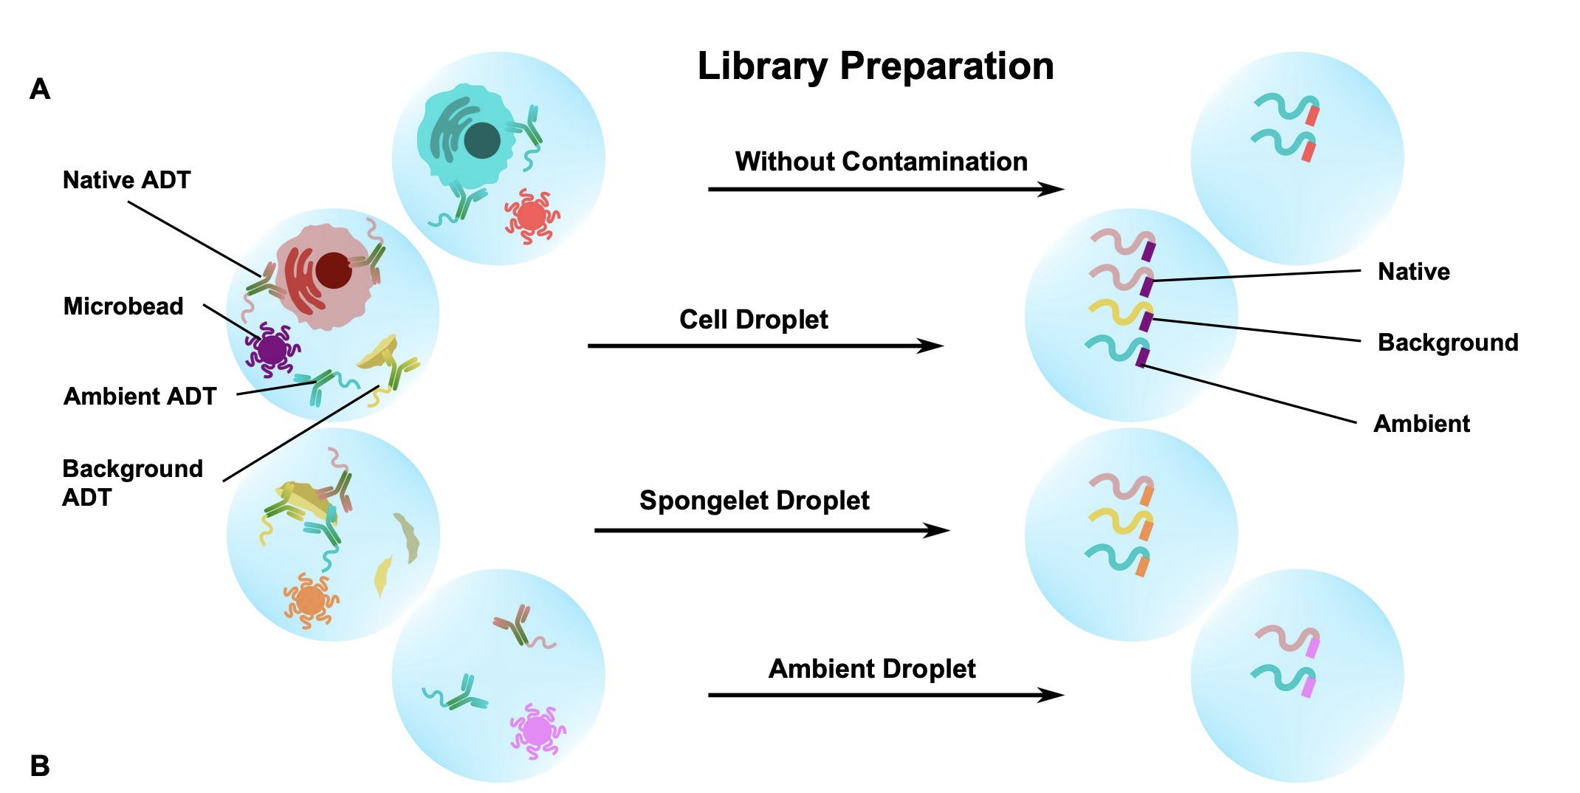
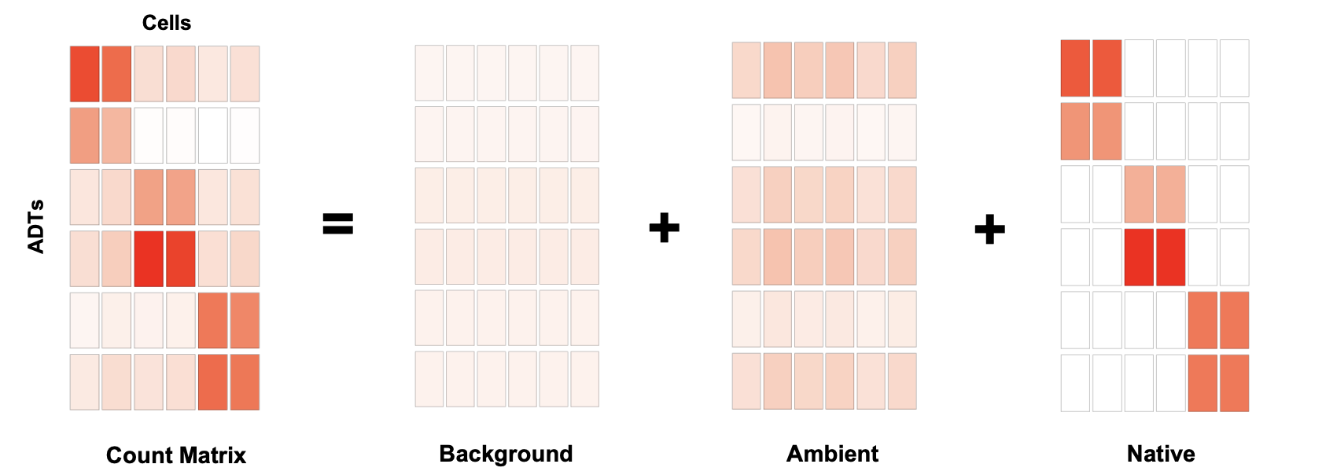
DecontPro removes contamination in CITE-seq datasets
Notes:
Spongelet droplets contain some non-specific distribution and an intermediary level of ADTs, while ambient droplets have a low level of ADTs attributed to the ambient material from the cell suspension. Native ADTs refer to those that bind to their target cell surface proteins in the appropriate cell population. Background ADTs represent those from contamination sources other than ambient such as spongelets or non-specific binding of ADTs

Slide 5
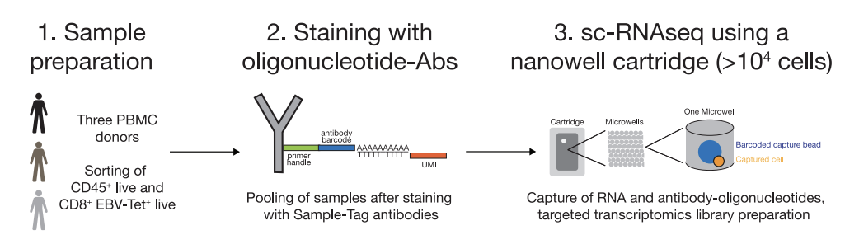
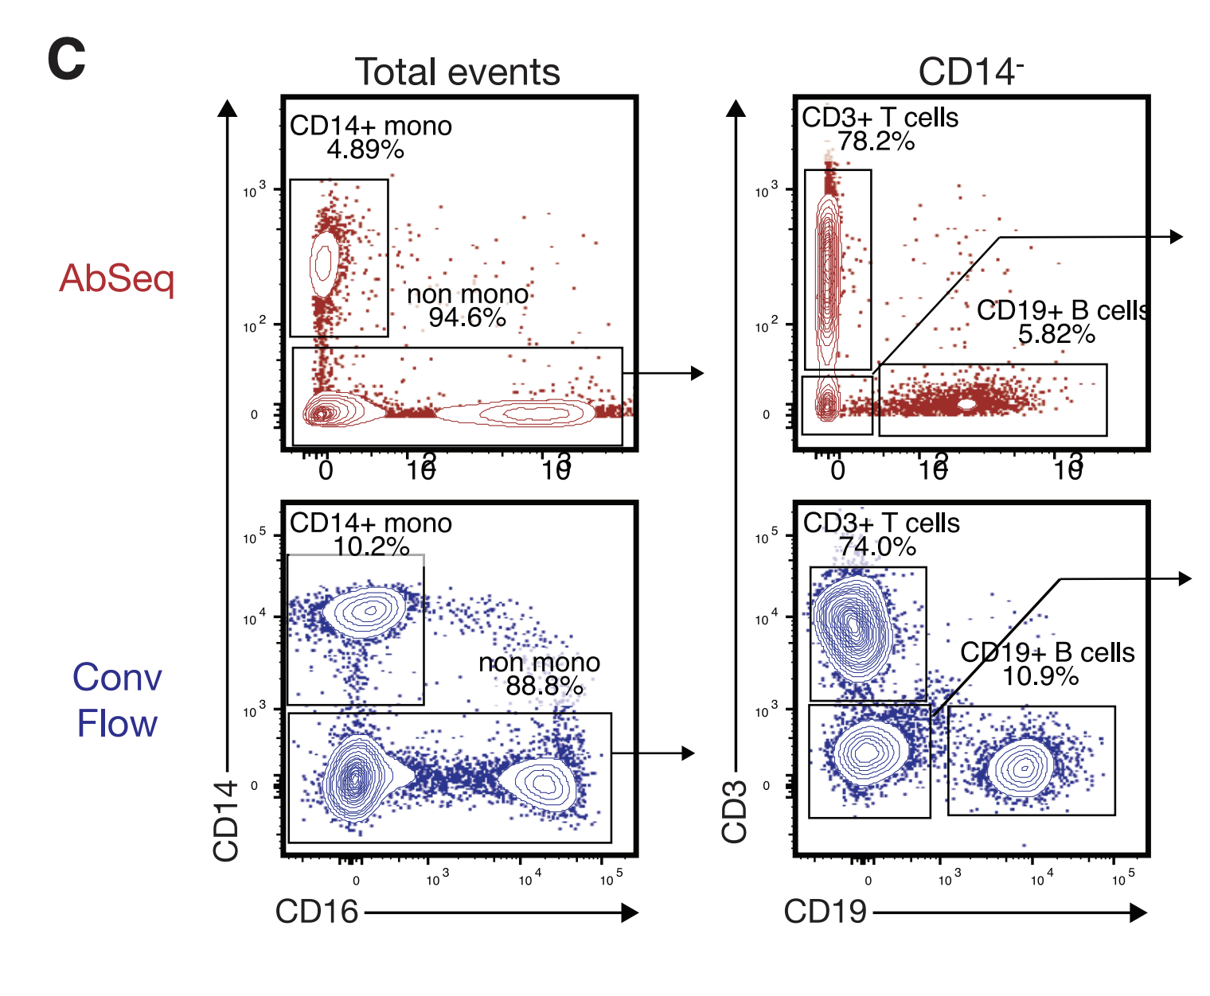
Mair et al., (Abseq)

Slide 7
Benchmark

