Slide 1
This course is brought to you by
Code Preach
Learn to code mobile and web applications

Slide 2
Introduction HTML

Slide 3
Understand the terminologies
Web: The part of the Internet that uses the HTTP protocol.
Webpage: A document written in HTML shared across the Web.
Website: A collection of Webpages on the same domain.
Browser: A program that can open Webpages in order to display them.

Slide 4
Definition: HTML
Hyper Text Markup Language = HTML
It consists of a series of codes used to structure texts, images, and other content to be displayed in a browser.

Slide 5
Anatomy of an HTML page
A web page is made up of 3 major sections:
head - You don’t see the content in here. Defines rules for the page.
body - Everything visible goes here. This is where most of your time will be spent.
html - Wraps around everything else. Head/Body go inside the html tag.

Slide 6
The skeleton/ Format
<!doctype html>
<html>
<head>
</head>
<body>
</body>
</html>

Slide 7
Course highlight
How the Web works
HTML documents
Nesting
Head elements
Layout elements
Basic Tags
Images
Videos
Lists(ul, ol)
Headings(H1-H6)
Paragraph (p)
Links (a)
Semantic Elements
HTML Comments

Slide 8
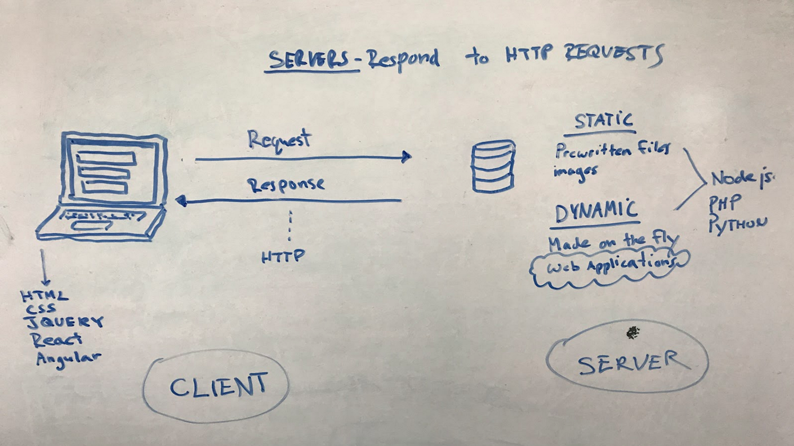
How do web pages work?

Slide 9
HTML Attributes
HTML attributes are used to provide additional information about HTML elements. Attribute has a name, followed by an equals sign(=) and a value placed inside the quotation marks("").
Syntax
<tag attribute="value">Your Text</tag>

Slide 10
HTML Basic Tags
Some HTML elements are used more frequently than others. They are:
The heading <h1>-<h6> elements
The paragraph <p> element
The image <img /> element
The anchor link <a> element

Slide 11
The heading <h1>-<h6> elements
The <h1> - <h6> tags are used to mark headings according to their importance
<h1>This is heading 1</h1>; <h2>This is heading 2</h2>
<h3>This is heading 3</h3>; <h4>This is heading 4</h4>
<h5>This is heading 5</h5> ; <h6>This is heading 6</h6>

Slide 12
The <p> element
The <p> </p> element is used for separating HTML paragraphs.
<p>This is some paragraph.</p>
<p>This is another paragraph <br/> with line break.</p>

Slide 13
The <img /> element
Images are like links, in that they require an attribute to work
Images use the 'src' attribute, which is short for ‘source’
e.g: <img src="images.png">

Slide 14
The <img /> element (continues)
Images are different from other elements, in that they are self-closing
<img src="images.png">
or
<img src="images.png" />

Slide 15
The <img /> element (continues)
Like links, we can point to external images by including the entire URL of the image
or we can point to images within our site by listing the name
<img src="images.png"> (internal)
<img src="https://website.com/images.jpg"> (external)

Slide 16
The <img /> element (continues)
Alt text = alternative if the image is not showing
Images are not valid without an 'alt' attribute.
The alt attribute is used to describe the image
<img src="nice-cat.png" alt="very cute cat">
Download attribute: <img src="nice-cat.png" alt="very cute cat">

Slide 17
The <img /> element (continues)
Download an image
You can download an image by clicking on it
<img src="nice-cat.png" alt="very cute cat” download>

Slide 18
Image format to choose for web
There are three main types of image formats supported by browsers:
GIF (Graphics Interchange Format)
JPG / JPEG (Joint Photographic Experts Group)
PNG (Portable Network Graphics)

Slide 19
The <a> link element
The <a> </a> Short for 'anchor’
Used to link either to a different location within the current page or to another page
But how do we tell it where to link to?
We use 'attributes' which are always in the opening tags
you can link to other pages within your site by simply putting thier file name
e.g: <a href="about-us.html">Click here</a>

Slide 20
The <a> element (continues)
Absolute paths:
If the page you are linking to is NOT part of your website, it must start with 'https://' or 'http://’
To let the browser know it is an external site that you are linking to
e.g: <a href="https://goolge.com">Click here</a>

Slide 21
Standard HTML & CSS Validators
HTML
https://validator.w3.org/
CSS
https://jigsaw.w3.org/css-validator/

Slide 22
Practice Time

Slide 23
HTML Lists
there are two types of lists:
Unordered Lists
Ordered Lists

Slide 24
Unordered Lists
Each bullet or numbered item is a list item <li></li>
<ul>
<li>list item 1 </li>
<li>list item 1 </li>
<li>list item 1 </li>
</ul>

Slide 25
Ordered Lists
Each bullet or numbered item is a list item <li></li>
<ol>
<li>list item 1 </li>
<li>list item 2 </li>
<li>list item 3 </li>
</ol>

Slide 26
HTML Comments
The HTML comments are used to indicate sections of a document or insert any notes explaining the code
For defining HTML comments we use:
<!-- ... --> tag.
The browsers ignore this tag and do not show its content to the users.

Slide 27
Nesting
HTML elements can contain other elements
<section>
<header>
<nav>
<ul>
<h2>Our Article</h2>
<p>Written by…</p>
</ul>
</nav>
</header>
</section>

Slide 28
Semantic Elements
They have intrinsic meaning, and convey that meaning to both the browser and the developer.
They clearly define what kind of content they contain

Slide 29
The <header> element
The <header> </header> element defines a header for the document or section. It contains a logo, search bar, navigation links, etc.
<header>
<nav>
<ul>
<li>Home</li>
<li>About us</li>
</ul>
</nav>
</header>

Slide 30
The <nav> element
The <nav> </nav> element defines a block of navigation links, either within the current document or to other documents
<nav>
<ul>
<li>Home</li>
<li>About us</li>
</ul>
</nav>

Slide 31
The <article> element
The <article> </article> element is used to define an independent, self-contained content (articles, blog posts, comments, etc.). The content of the element has its own meaning and it is easily differentiated from the rest of the webpage content.
<article>
<h1>Title of the article</h1>
<p>Text of the article</p>
</article>

Slide 32
The <section> element
The <section> </section> element is used to group standalone sections within a webpage containing logically connected content (news block, contact information etc.).
<section>
<p> Formal language, which is used as a description zone, formatting the appearance of a web page,
</p>
</section>

Slide 33
The <footer> element
The <footer> </footer> element defines the footer of a web page or a section. As a rule, it contains copyright information, contact details, navigation links, etc.
<footer>
<p>Company © W3docs. All rights reserved.</p>
</footer>

Slide 34
Add Video Files
The src attribute indicates the URL of the file, and the controls attribute is used to display control elements
<video controls>
<source src="/videos/arcnet.mp4" type=video/mp4>
</video>

Slide 35
Practice Time

Slide 36
The <form> element
The <form> </form> tag is used to add forms to the web page for user input.
Forms are used to pass data submitted by the user to the server.
The data is sent when the user presses the "Submit" button.
If there isn’t such button, the information is sent when the "Enter" key is pressed.

Slide 37
The <form> contains other tags
<input> defines a user input field.
<textarea> defines a form field to create a message.
<button> is used to place a button inside a form.
<select> sets up a control for creating a drop-down list box.
<option> shows the drop-down list set by the <select> tag.
<label> sets the text label for the <input> element.

Slide 38
Tables element
HTML tables are meant for tabular data only, which is any type of content that can be semantically arranged in rows and columns. It’s like having a spreadsheet in Excel.
Building a table in HTML requires a specific structure:
open a <table>
add rows with <tr>
add regular cells with <td> or heading cells with <th>

Slide 39
Tables element (continues)
This hierarchy is required, and all 3 elements are necessary to build a table.
When writing the code, you need to define your table cells from left to right, and then from top to bottom.
See an example on the next slide

Slide 40
Tables element (continues)
Example:
<table>
<tr>
<td>John Lennon</td>
<td>Rhythm Guitar</td>
</tr>
</table>

Slide 41
Project: File organization
The main folder is called our root folder
The homepage must be index.html
index.html must be in the root folder, and not a sub-folder
Other pages can be in subfolders, depending on how you want to stay organized
images should be placed in a sub folder for better organization

Slide 42
File naming
Keep file names short
They should be descriptive (e.g. 'page1.html' vs ''about-us.html)
No spaces, use underscores or hyphens instead
Use lower case ('About-Us.html' vs 'about-us.html')

Slide 43
End

