Slide 1

Searching for Chaos in Hurricane Intensity
Bach Kieu
Bloomington High School South
Mentors: Dr. Diya Kamnani

Slide 2

About Me
My name is Bach, and I’m a local high school senior at Bloomington South assisting the Hurricane Dynamic Lab!
Hobbies:
Math competitions!
Piano!
Video games!
Sports! (pole vaulting + swimming)
Study Objectives
Is chaos really present in hurricane intensity?
What are best methods to search for chaos with limited data?
Notes:
Underlying question: How far into the future can we forecast hurricanes?
Specifically, we’ll be addressing if chaos is really present in hurricane intensity.
Chaos in this context refers to the classical example of a butterfly’s wings in Brazil causing a tornado storm in Texas

Slide 3
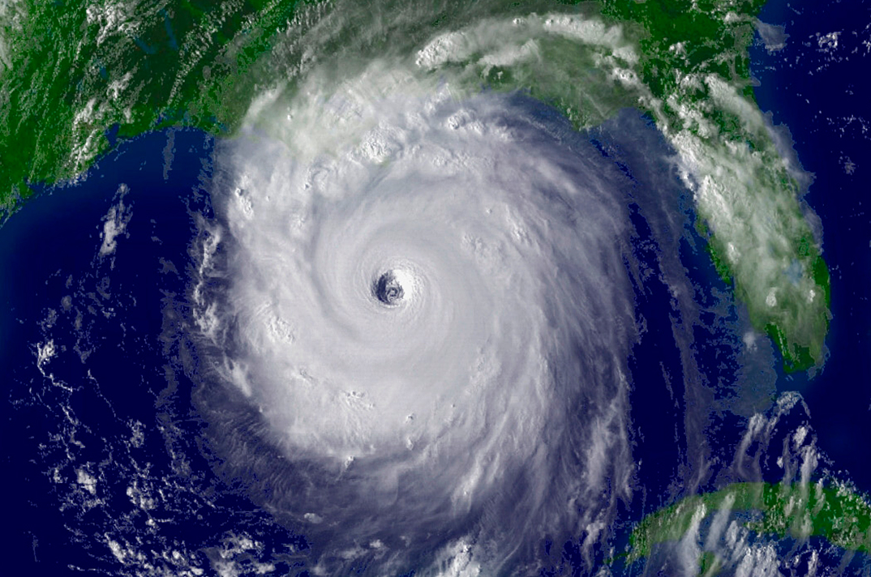
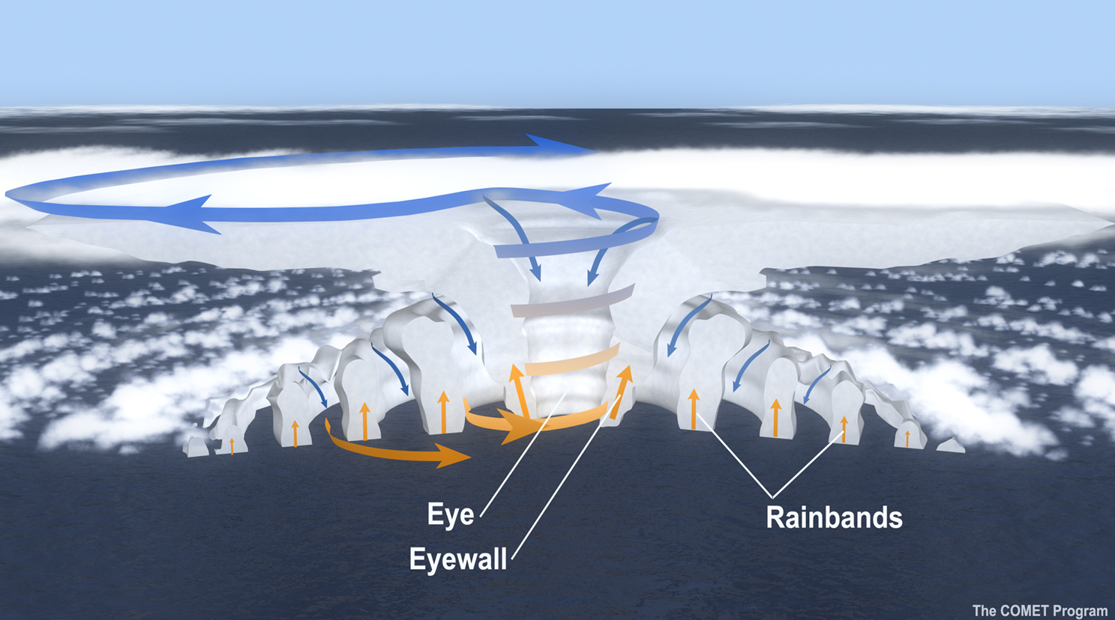
Inside Hurricanes
Facts:
Strong hurricanes always have an eye
The eye area has no clouds, and very calm winds
Top-down view
Cross-section view
Extremely heavy rainfall and strong winds near the eye, called eyewall region
Notes:
Some brief facts about hurricanes, top down -> cross section (more than meets the eye :O)) -> three labeled parts

Slide 4
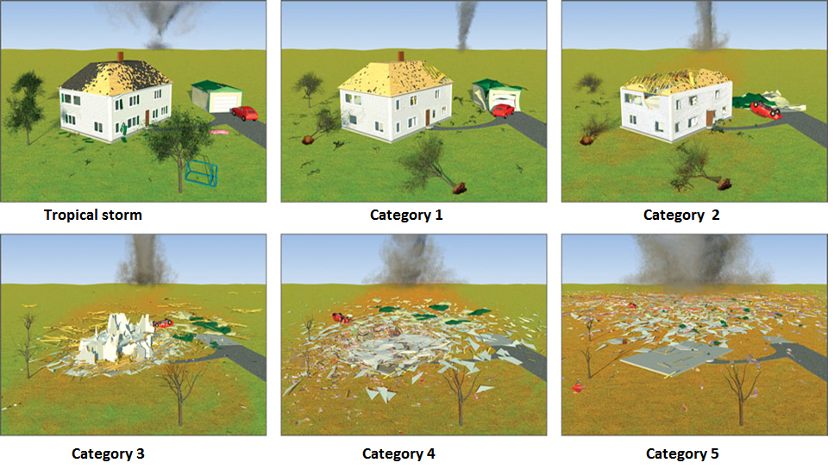
Hurricane Intensity
Facts:
Measured by how strong the wind at the surface is
There is only an established scale for hurricane strength between 1-5
Notes:
A system is called a tropical storm until it has a max surface wind speed of 74 mph, from there it progresses through the five established categories with cat 1 weakest cat 5 strongest

Slide 5

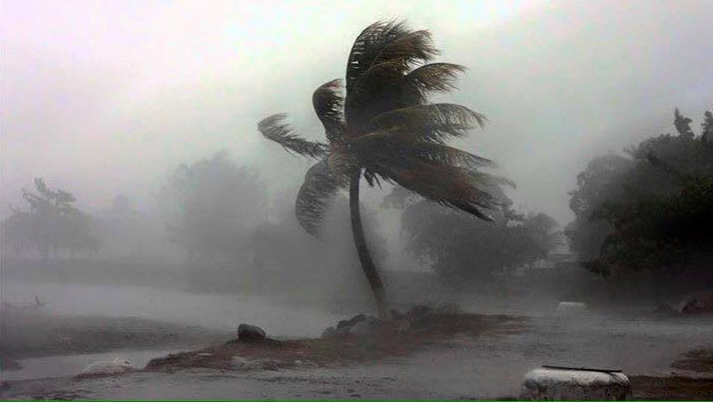
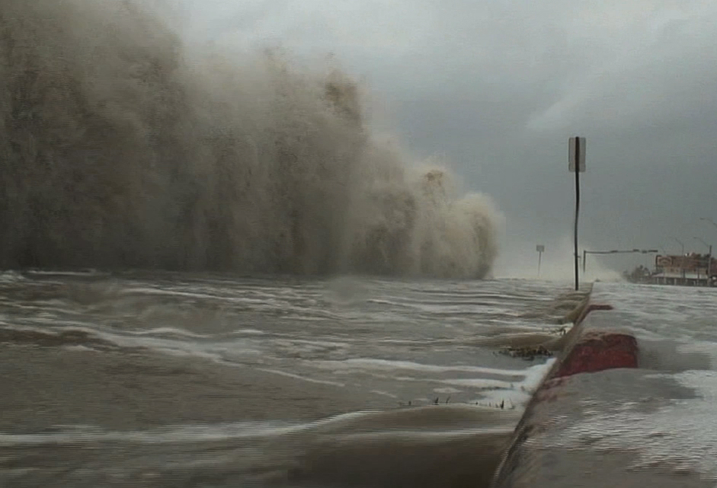
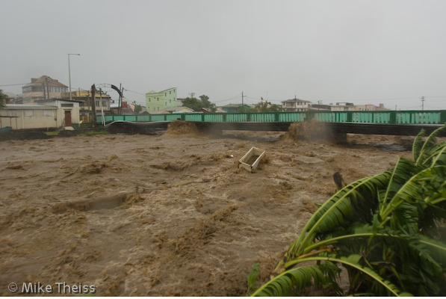
Hurricane Damage
Strong Wind
Heavy
Rainfall
Strong Winds
Storm Surge
Flash floods

Slide 6

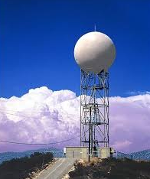

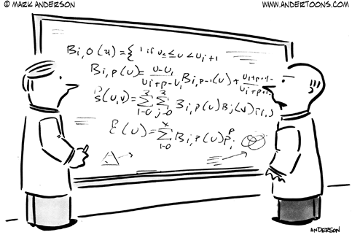

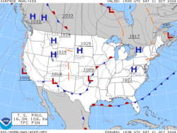
Can We Forecast Hurricane Intensity?
Well yes we can!
By experiences
By math/computer models
Irma is moving to Puerto Rico, so it must hit the US
Notes:
Though no two hurricanes are the same, internal mechanics are similar which makes past experiences quite valuable. Furthermore, math + computer models are reasonably accurate short-term.

Slide 7

But…
Not really,
due to
chaos!
Notes:
However, we can’t haven’t been able to forecast far because hurricanes exhibit chaotic behavior, which is what we’ll look to establish today.

Slide 8
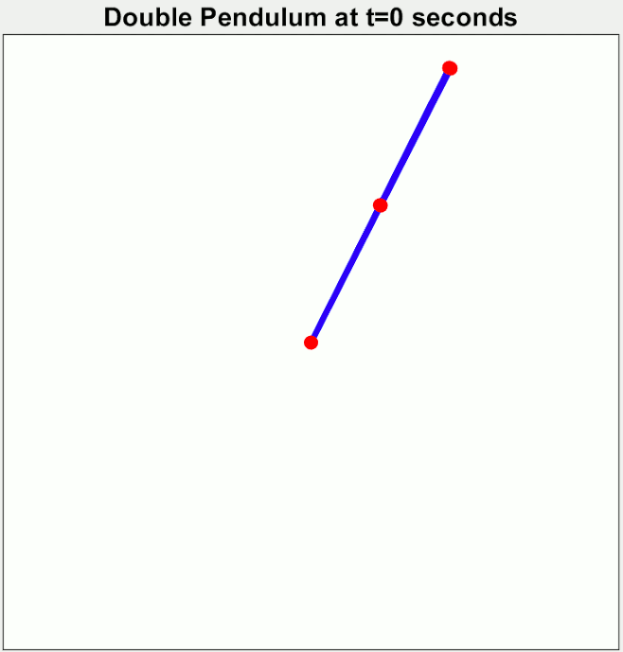
What is Chaos?
Deterministic: The system follows specific laws
Sensitive: Changes in the initial condition result in large errors.
Notes:
Before that, well what is chaos specifically?

Slide 9
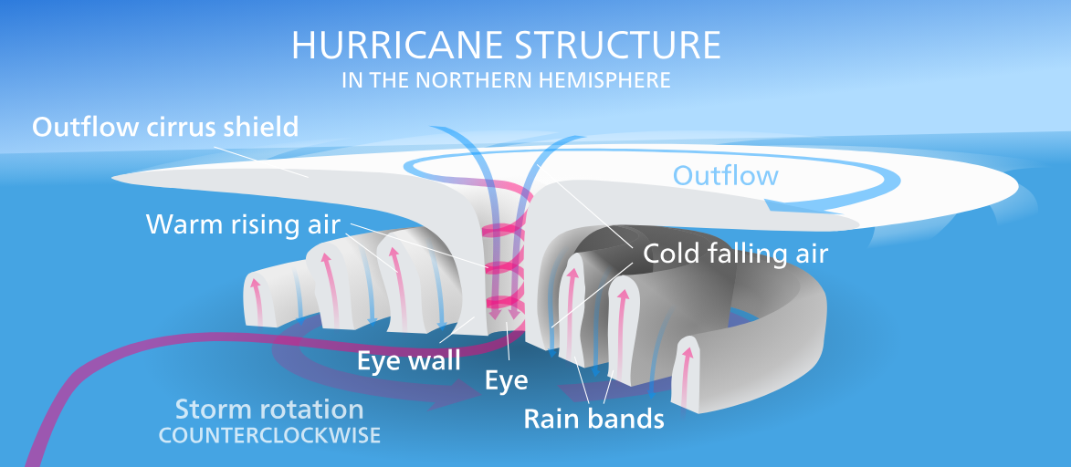
Is it Possible to Examine Intensity Chaos?
This is a challenging question, given that real observations from hurricane simulations contains only few main pieces of information such as:
Surface wind speed
Central pressure
Eye temperature
Vertical air speed
(~1 million data points)

Slide 10
How to Check for Chaos
How badly does the system predict?
Lyapunov Exponent
How many dimensions?
Embedding Dimension
Average Mutual Information
Find patterns in data
Is it all random?
Notes:
At its core, chaos measures how badly a system predicts and scientists mainly quantify chaos through a value called the lyapunov exponent (talk about pic)
To do this we need to know how many dimensions the system exists in, called the embedding dimension. For example, remember in the pendulum example we can see it’s 2-dimensional, but if we only had the x-coordinate of the pendulum at a time t, we would need to determine that it has two.

Slide 11
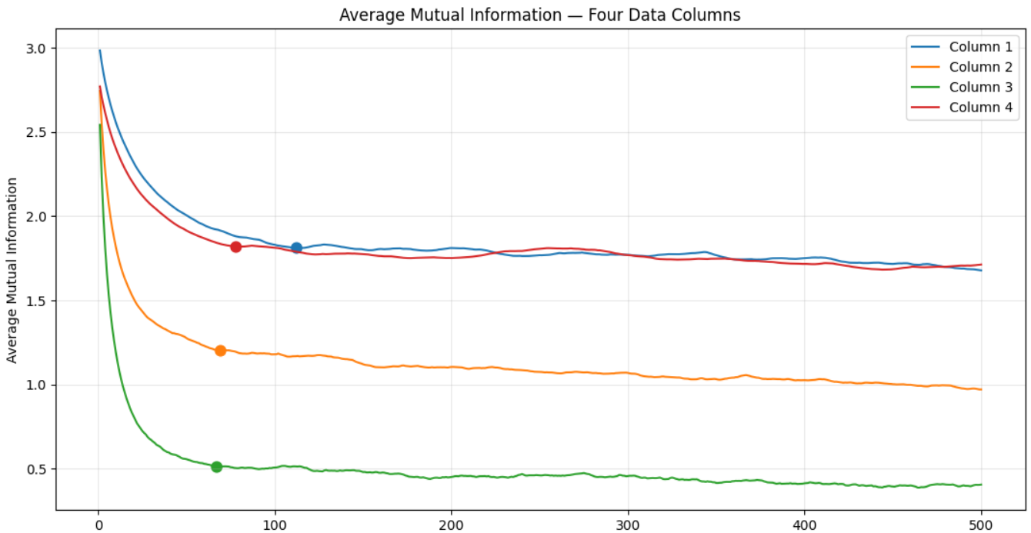
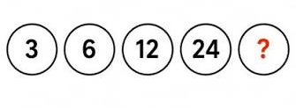
Lag

Slide 12
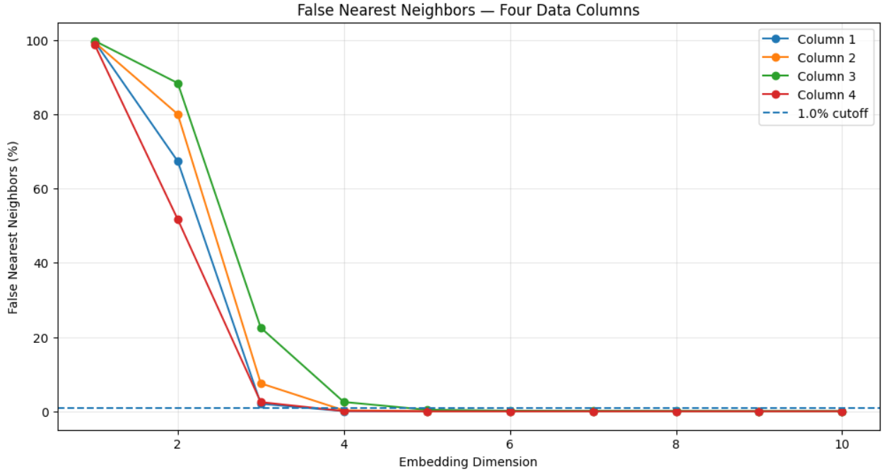
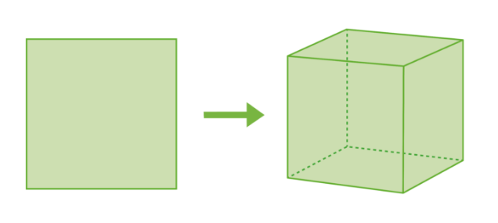

Slide 13
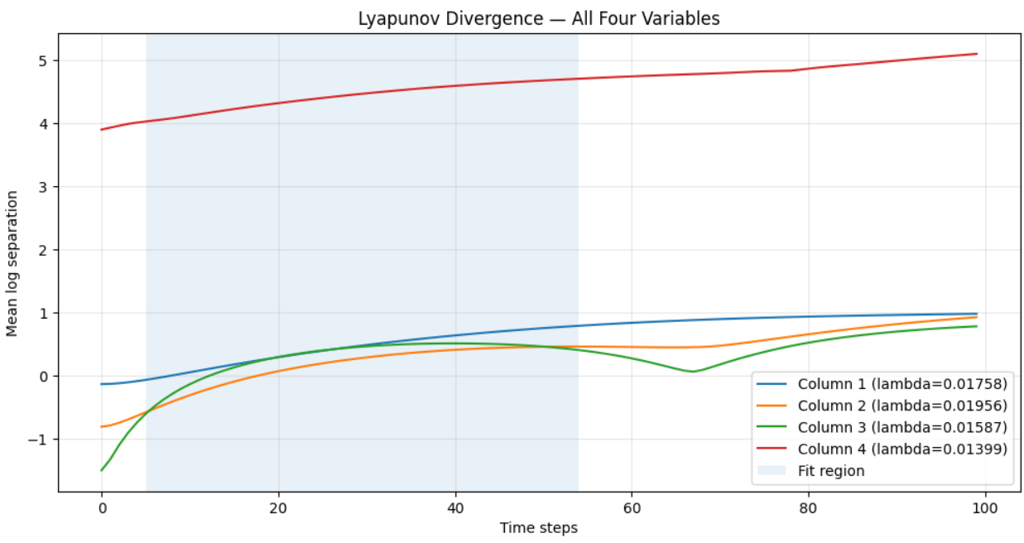

Slide 14

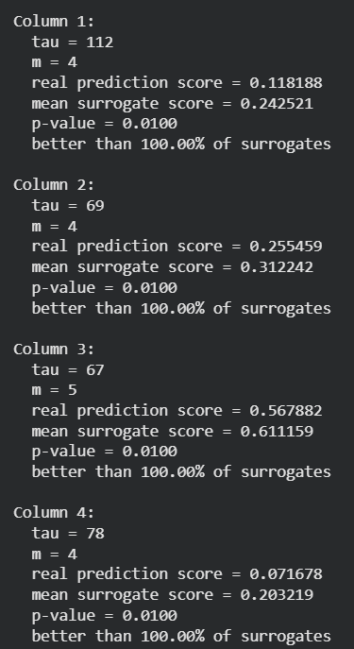

Slide 15
Implication
Again, we did not PROVE chaos exists, but the results from this research support confidence of its presence
Hurricane intensity forecasts likely have a maximum prediction horizon.

Slide 16
Thank you :O)

