Slide 1
Introduction
Tic Tac Toe is a popular two-player strategy game that involves playing on a 3 × 3 grid, whereby one player places an 'X' while the other player puts an 'O'. The players alternate placing marks in empty squares, and the winner is the first player to successfully put three of his/her symbols in a straight line horizontally, vertically, or diagonally. In case all the squares are occupied without either of the players meeting the winning criteria, the game ends in a tie. In this project, there will be an attempt to create a game of Tic Tac Toe using the C programming language to offer a fun gaming experience for the users while also mastering some basic principles of programming such as the use of arrays, functions, loops, file handling, and taking input from the user.

Slide 2
Problem statement
No Score Tracking
No User Identity
Manual Game Management
No Persistent History
No Visual Appeal
No Reset Mechanism
No Authentication

Slide 3
Objectives
To create a match statistics system
To develop a fully functional graphical Tic Tac Toe game
To implement a user authentication system (Sign Up and Login)
To automate the win/draw detection logic

Slide 4
Team members work
S.N. | Name of the Member | Work Assigned | Remarks
1. | Prakat Baral | Documentation and coding. Game logic. DFD design. Problem identification.
2. | Aabishkar Acharya | Documentation and coding. Login/Signup system. System design support. Flowchart design.
3. | Aakarshan Karki | Documentation and coding. Statistics module. Testing. Support in system design.

Slide 5
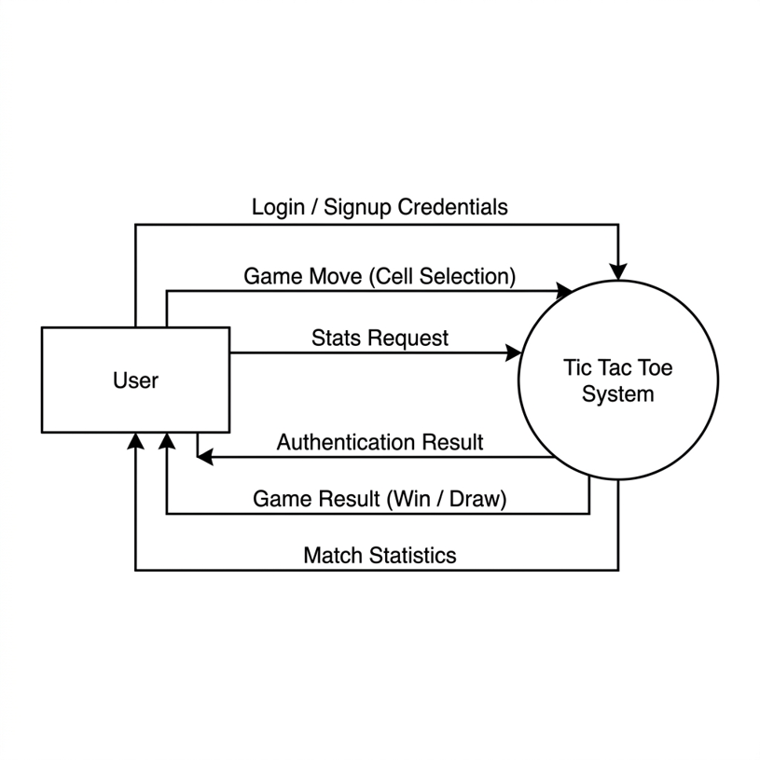
Level 0 Dataflow Diagram

Slide 6
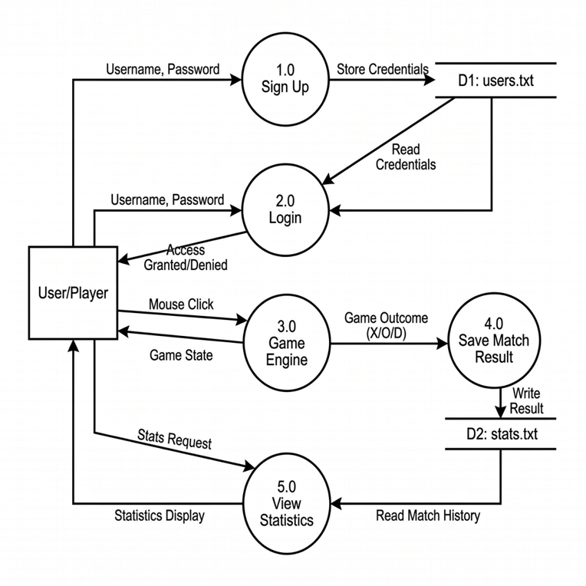
Level 1 Dataflow Diagram

Slide 7
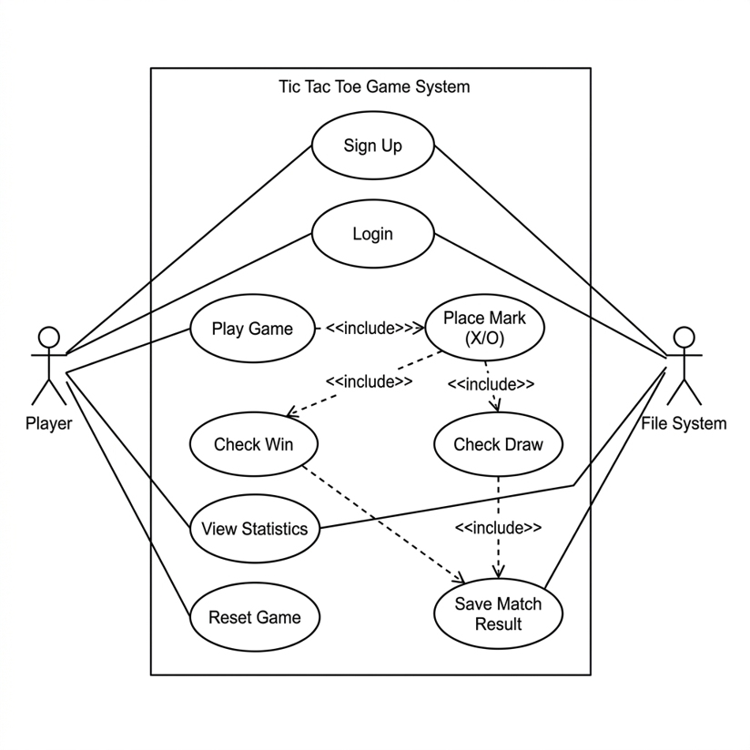
Use Case Diagram

Slide 8
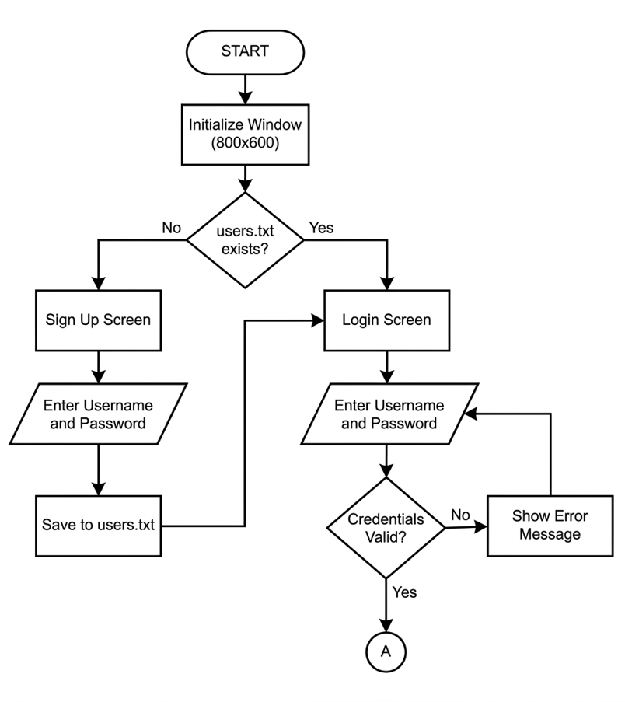
Flowchart

Slide 9
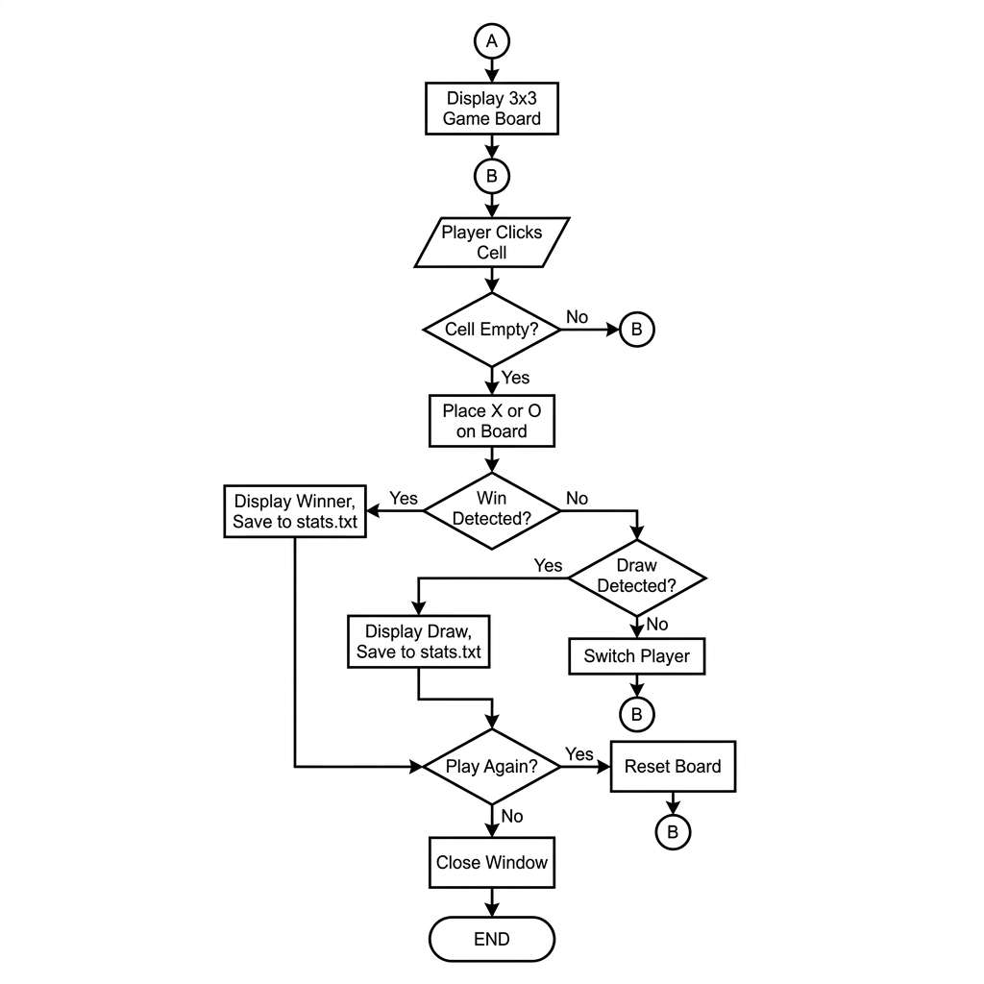

Slide 10
Conclusion
The Tic Tac Toe Game developed using the C programming language and the Raylib graphics library successfully demonstrates the application of fundamental programming concepts in a real-world project. The system provides an interactive graphical interface, secure user authentication through login and signup, and persistent match statistics using file handling.
Throughout the development of this project, we gained practical experience in modular programming, graphics programming, event handling, file management, and teamwork. The project also improved our problem-solving and debugging skills while giving us hands-on experience in software development. Overall, this project met its objectives and serves as a strong foundation for developing more advanced games and graphical applications in the future.

