Slide 1
Smart Way Sorter
Presented By:
Bachina Mahesh Babu (2203031240094)
Bonika Charan Teja (2203031240205)
Bhargavi Chitti (2203031240161)
Bollapu Manogna (2203031240193)
Guided By:
Sandeep Wadekar
Assistant professor
AI & AIDS Department
PIET, Parul University
Project Presentation, 2025

Slide 2
Content:
Introduction
Problem Statement
Flow chart of the system
Analysis
Functional Requirements
Use Case Diagrams
Non-functional requirements
Design:
UML diagrams
Class Diagram
Sequence Diagram
Activity Diagram
Conclusion
Future Work
References

Slide 3
INTRODUCTION:
The Smart Waste Sorter is an innovative web application designed to simplify waste sorting for users. Utilizing advanced image recognition technology, the app allows users to upload or capture photos of their waste. It then classifies the waste into one of eight categories: Light Bulbs, Paper, Plastic, Organic, Glass, Clothes, Metal, and E-Waste. Once identified, the app provides detailed recycling or disposal instructions, empowering users to make environmentally responsible decisions. Beyond just sorting waste, the Smart Waste Sorter also aims to raise awareness about the importance of responsible waste management and sustainability. By promoting eco-friendly habits, the app encourages users to reduce their environmental impact. The Smart Waste Sorter is a simple yet effective tool that contributes to a cleaner, greener world, making it easier for everyone to participate in waste management.

Slide 4
Problem Statement:
The Smart Waste Sorter is a web application that uses image recognition to classify and provide disposal instructions for various types of waste, promoting sustainability.
Image Recognition:-The app uses advanced image recognition technology to classify waste into one of eight categories by analyzing uploaded or captured photos.
Recycling and Disposal Instructions:-After classifying the waste, the app provides detailed instructions on how to properly recycle or dispose of the material.
Environmental Awareness:-The app promotes responsible waste management and sustainability by encouraging eco-friendly habits and reducing environmental impact.

Slide 5
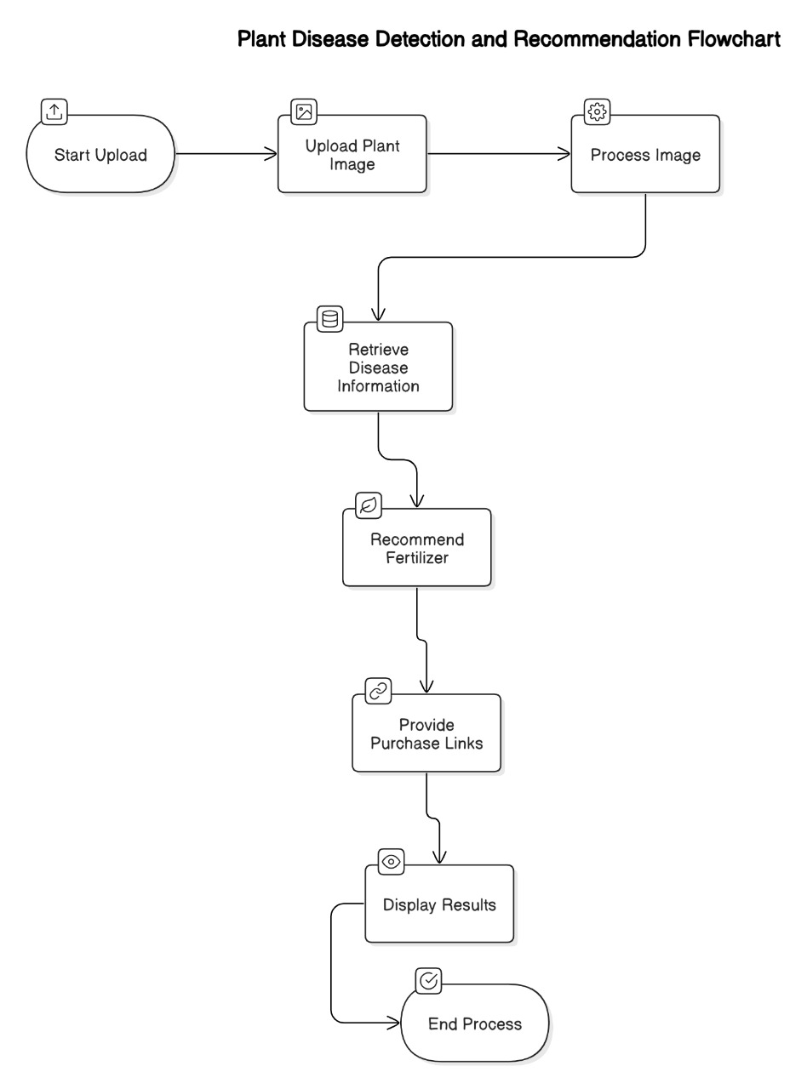
Flowchart of the system:

Slide 6
REQUIREMENT ANALYSIS:
Functional Requirements:
User Authentication
Photo Upload and Capture
Image Recognition
Recycling and Disposal Instructions
Educational Content
Feedback Mechanism
Admin Dashboard
User Interface

Slide 7
REQUIREMENT ANALYSIS:
Non-Functional Requirements:
Performance
Usability
Reliability
Usability
Compatibility
Maintainability
Accessibility
Efficiency

Slide 8
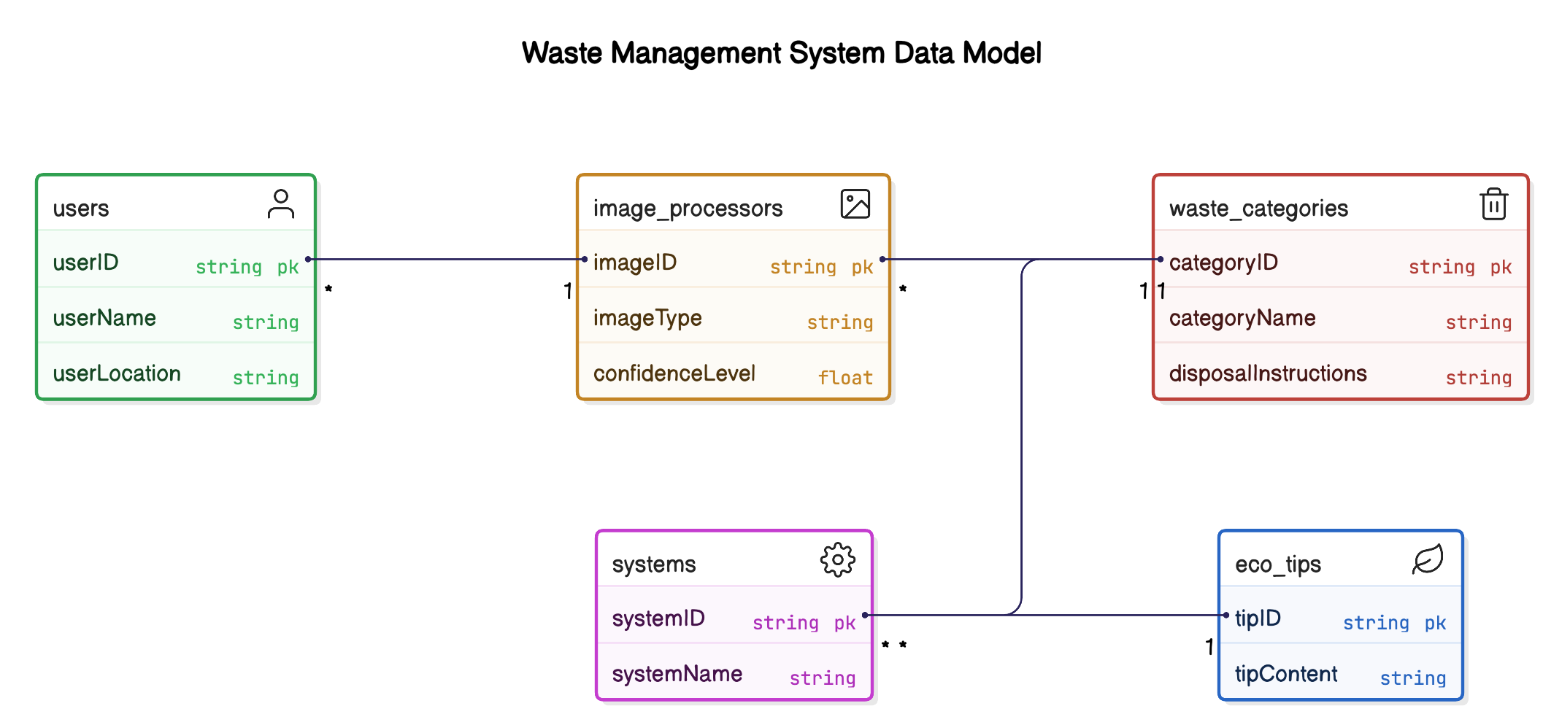
UML Diagrams:
Class and Relationship Diagram :

Slide 9
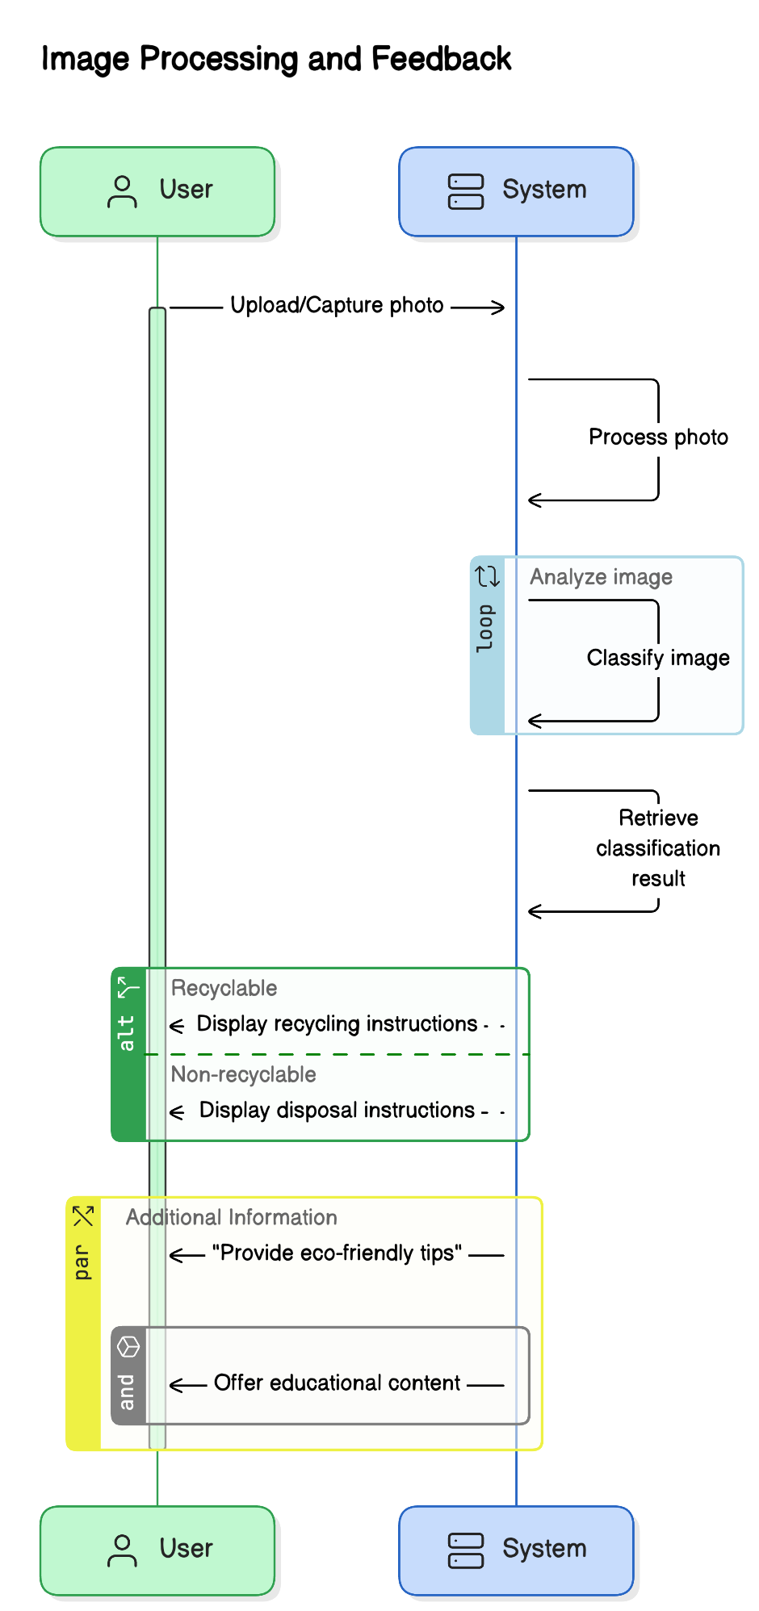
Sequence Diagram :
Project Presentation 2025

Slide 10
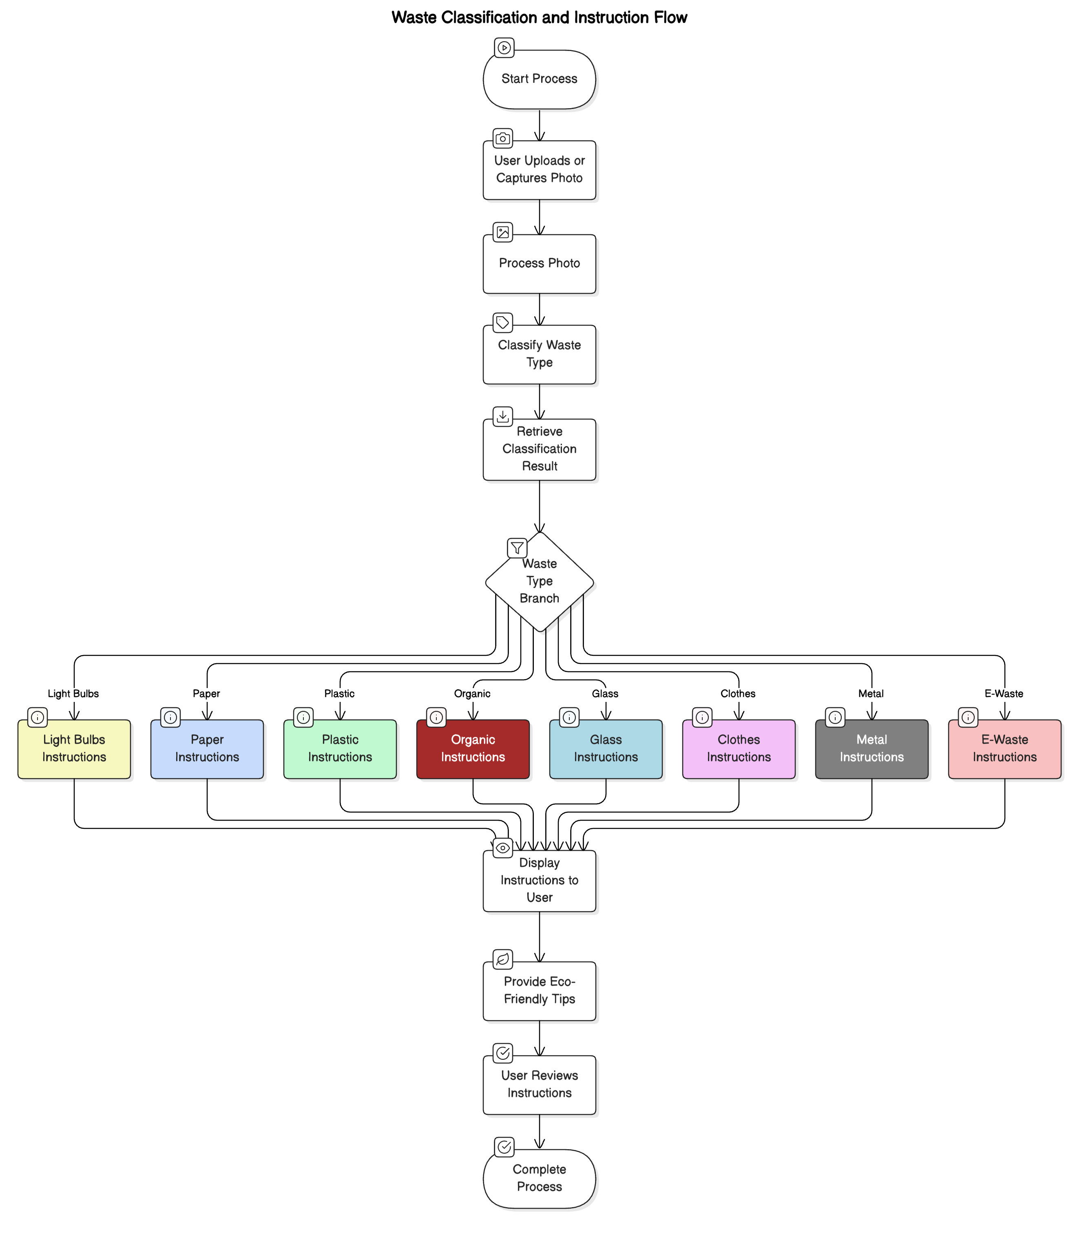
Activity Diagram :
Project Presentation 2023
Project Presentation 2023

Slide 11
Conclusion:
In conclusion, the Smart Waste Sorter project effectively leverages advanced image recognition technology to simplify waste sorting for users. By accurately classifying waste into specific categories and providing detailed recycling or disposal instructions, the system promotes responsible waste management practices. The comprehensive analysis, functional and non-functional requirements, and detailed UML diagrams ensure a robust and user-friendly application. Through this project, we aim to raise awareness about the importance of sustainability and encourage users to adopt eco-friendly habits. The Smart Waste Sorter not only addresses the immediate need for efficient waste sorting but also contributes to a cleaner, greener future.

Slide 12
Future Work:
Enhanced Image Recognition
Integration with IoT Devices
User Engagement and Gamification
Expanding Waste Categories
Localization and Multilingual Support
Community Features
Partnerships with Recycling Centers
Mobile Application Development

Slide 13
References:
"Handbook of Solid Waste Management" by George Tchobanoglous and Frank Kreith
"Waste Management Practices: Municipal, Hazardous, and Industrial" by John Pichtel
"Integrated Solid Waste Management: Engineering Principles and Management Issues" by George Tchobanoglous, Hilary Theisen, and Samuel Vigil
"Electronic Waste Management: Design, Analysis and Application" by R.E. Hester and R.M. Harrison
"Sustainable Solid Waste Management" by Ni-Bin Chang

Slide 14
Thank you

