Slide 1
Secure data hiding in images using steganography
Presented By: Dhruv Rameshbhai Vasava
Student Name : Dhruv Rameshbhai Vasava
College Name & Department : L.D. College of Engineering, Ahmedabad , IT department.

Slide 2
OUTLINE
Problem Statement
Technology used
Wow factor
End users
Result
Conclusion
Git-hub Link
Future scope

Slide 3
Problem Statement
This project focuses on secure data hiding using bit manipulation of the pixels in the images, the message is being converted to an ASCII value and then encrypted into the images pixel’s LSB bit. So the encrypted image isn’t distorted and identified that it is a stego image. Then the encrypted image is decrypted to get the secret message.

Slide 4
Technology used
Libraries used are :-
a). OpenCV
b). Os
c). Stegano
Programming languages used are :-
a). Python
Tools and Platforms used are :-
a). Jupyter Notebook / PyCharm / VS Code
b). Github / Gitlab

Slide 5
Wow factors
1). Not just hiding data, but securing it with encryption
2). Supports multiple formats (JPEG, PNG, BMP)
3).High capacity with minimal image distortion
4).User-friendly GUI/Web-based access
5).Anti-detection features to resist steganalysis

Slide 6
End users
Cybersecurity & Digital Forensics Experts
Government & Intelligence Agencies
Journalists & Whistleblowers
Military & Defense Organizations
Everyday Internet Users
Researchers & Academics
Corporate & Business Professionals

Slide 7
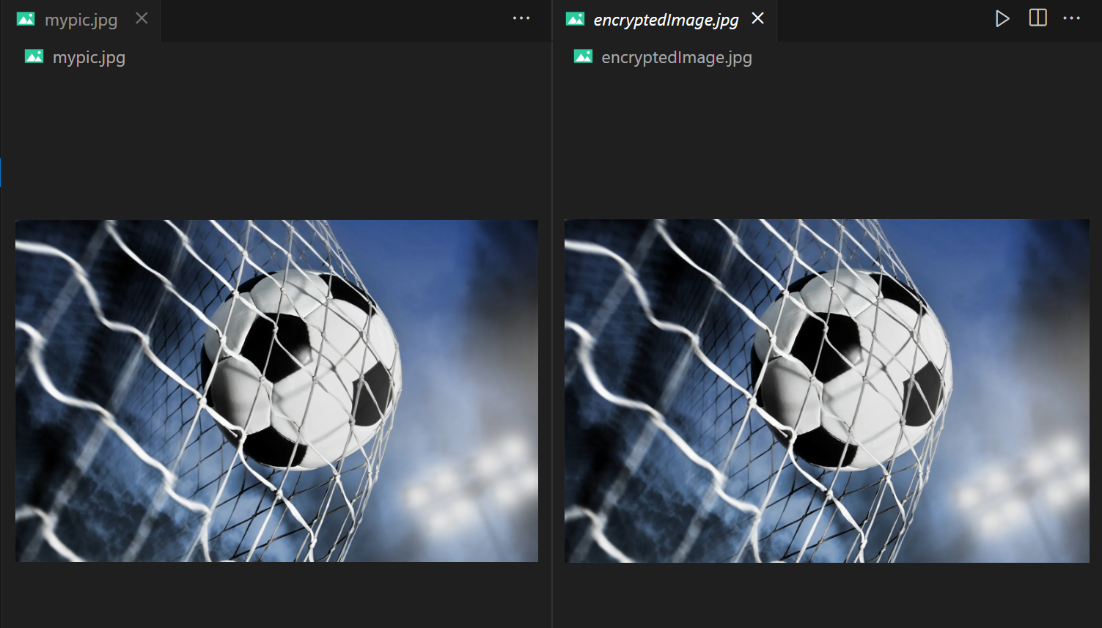
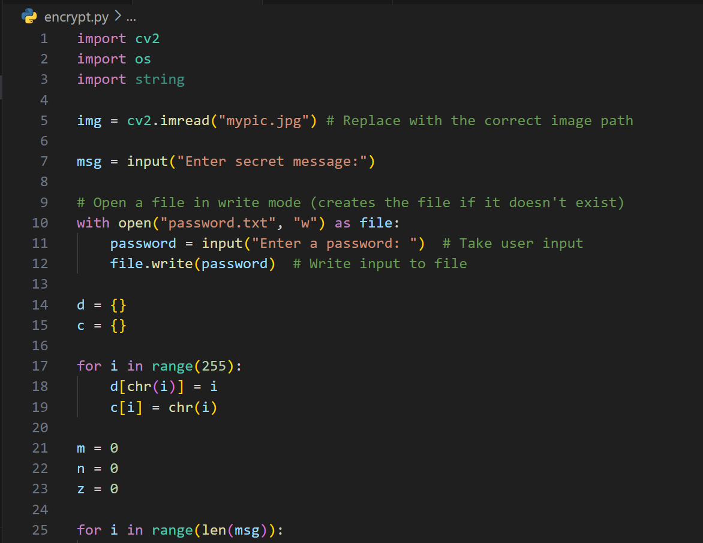
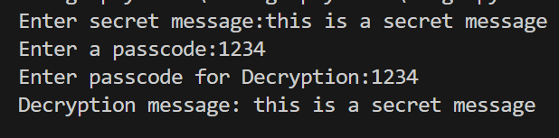
Results

Slide 8
Conclusion
This project ensures secure, undetectable data hiding using encryption (AES-256) and advanced steganography (LSB, DCT, DWT). It enhances privacy and security for cybersecurity, intelligence, and journalism. Future upgrades may include AI and blockchain integration for improved protection.

Slide 9
GitHub Link
https://github.com/Bachira-8/SteganoProject.git

Slide 10
Future scope(optional)
AI-Powered Steganography – Use machine learning to optimize data embedding and improve detection resistance.
🔹 Blockchain Integration – Store image hashes on a blockchain for enhanced data integrity and security.
🔹 Cloud-Based Steganography – Develop a web-based platform for secure remote data hiding and extraction.
🔹 Multi-Format Support – Extend steganography to videos, audio, and documents for wider applications.
🔹 Anti-Steganalysis Techniques – Implement advanced algorithms to evade detection by steganalysis tools.
🔹 Real-Time Steganography – Enable secure live communication by embedding messages in streaming images.
These advancements will enhance security, scalability, and usability, making steganography more reliable and practical for future applications.

Slide 11
THANK YOU

