Slide 1
Micro-services
There and Back Again

Slide 2
Who are you?
Software Developer for > 20 years
Worked mainly for ISVs
Reuters, SunGard, Misys, Huddle
Worked for a couple of MIS departments
DTI, Beazley
Microsoft MVP for C#
Interested in OO, SOA, EDA,, Messaging, REST
Interested in Agile methodologies and practices
No smart guys
Just the guys in this room

Slide 3

Intelligent collaboration for the Enterprise
The #1 SharePoint alternative in the cloud

Slide 4
Agenda
Managing Complexity
Implementing Microservices
Breaking up a Monolith
Operating Microservices
Q&A

Slide 5
Managing Complexity
Moves in complexity management as your software grows

Slide 6
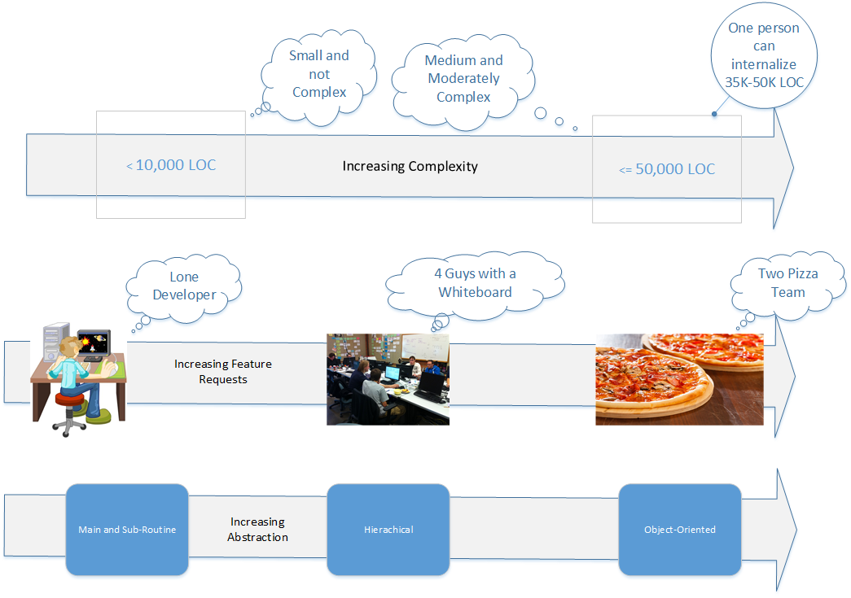

Slide 7
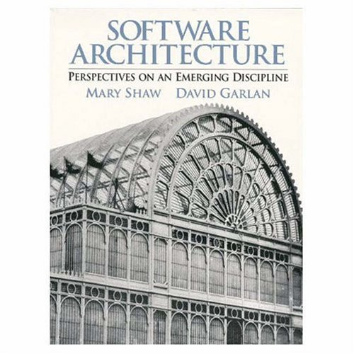
Architectural Styles
Working at Carnegie-Mellon in the ‘90s Shaw and Garlan begin identifying architectural styles.
Shaw and Garlan propose that the journey from craft to engineering is the creation of a body of knowledge that allows repeatable large scale production. Science provides the insights here that drive engineering.
Similar goal to the Design Patterns community – but at a different scale, capture knowledge on patterns of component interaction.

Slide 8
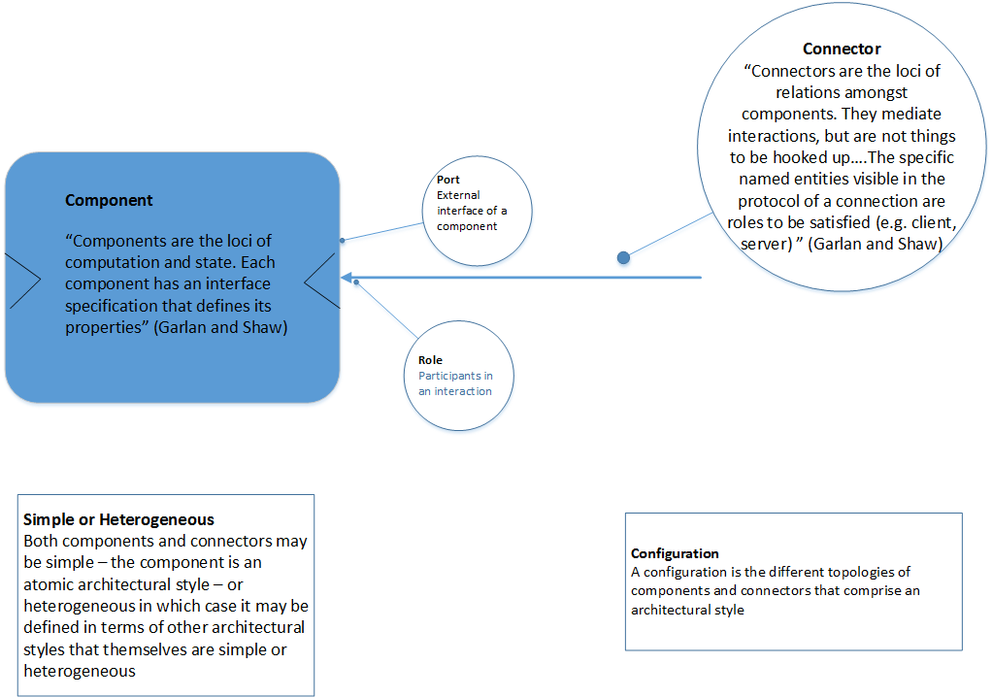

Slide 9
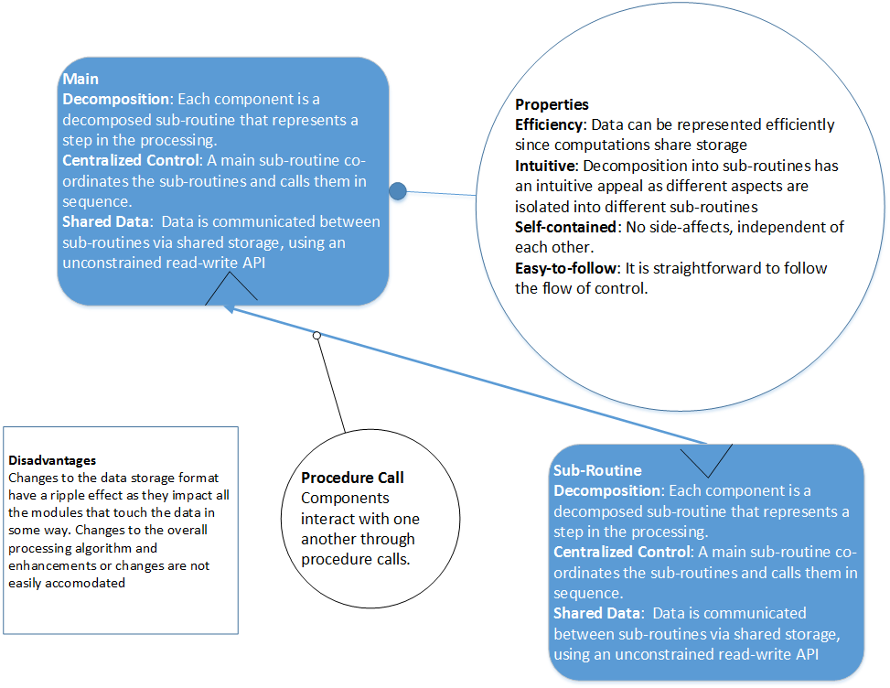

Slide 10
Principles
Decomposition – break a complex software solution into smaller parts that are easier to reason about
Loose Coupling – hide the details of the smaller parts from clients, allowing them to be changed without changing the clients i.e. encapsulation

Slide 11
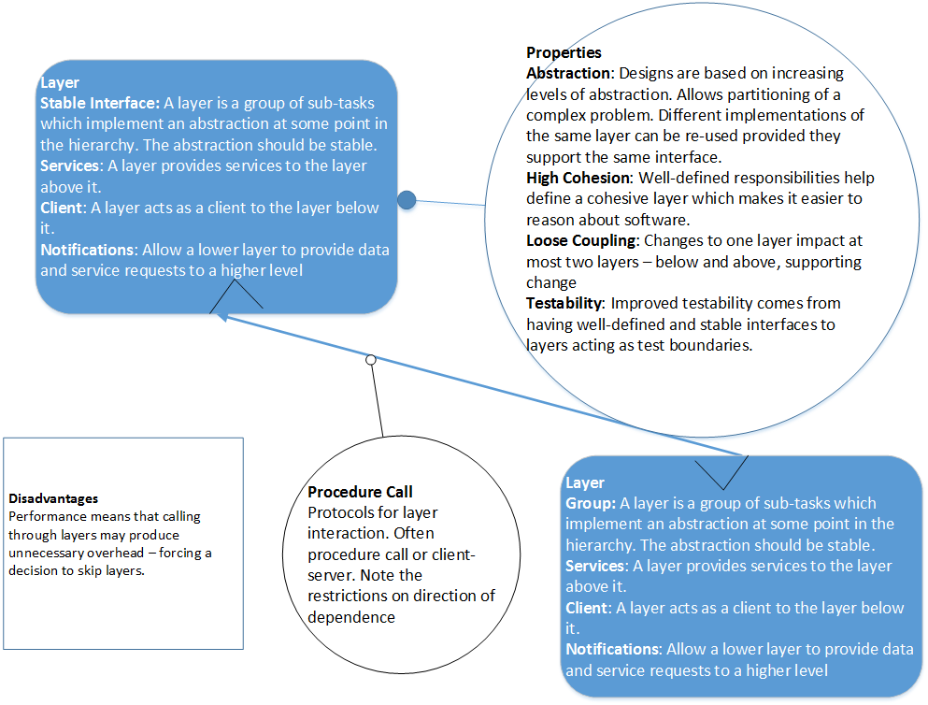

Slide 12
Principles
Decomposition – break a complex software solution into smaller parts that are easier to reason about
Loose Coupling – hide the details of the smaller parts from clients, allowing them to be changed without changing the clients i.e. encapsulation
Cohesion – group related code behind the stable interface to make it easier to reason about, as well as change in one place instead of many

Slide 13
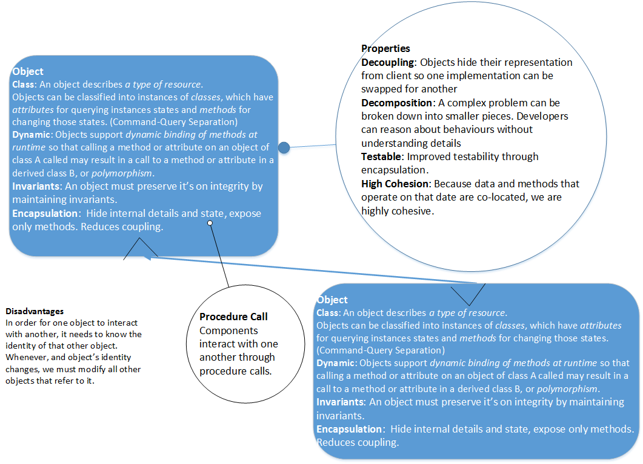

Slide 14
Principles
Decomposition – break a complex software solution into smaller parts that are easier to reason about
Loose Coupling – hide the details and state of the smaller parts from clients, allowing them to be changed without changing the clients i.e. encapsulation
Cohesion – group related code and state behind the stable interface to make it easier to reason about, as well as change in one place instead of many

Slide 15
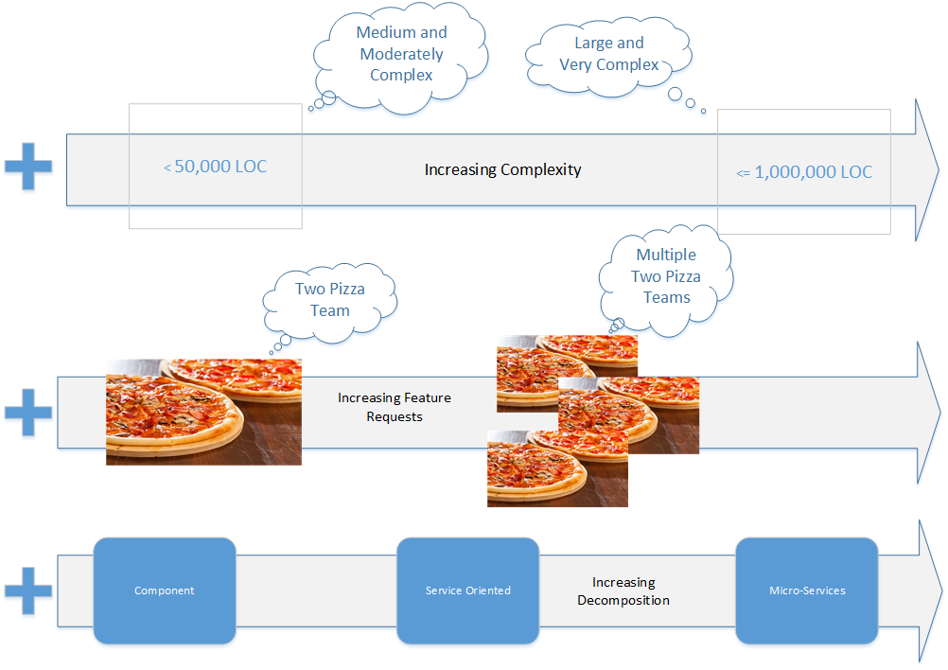

Slide 16
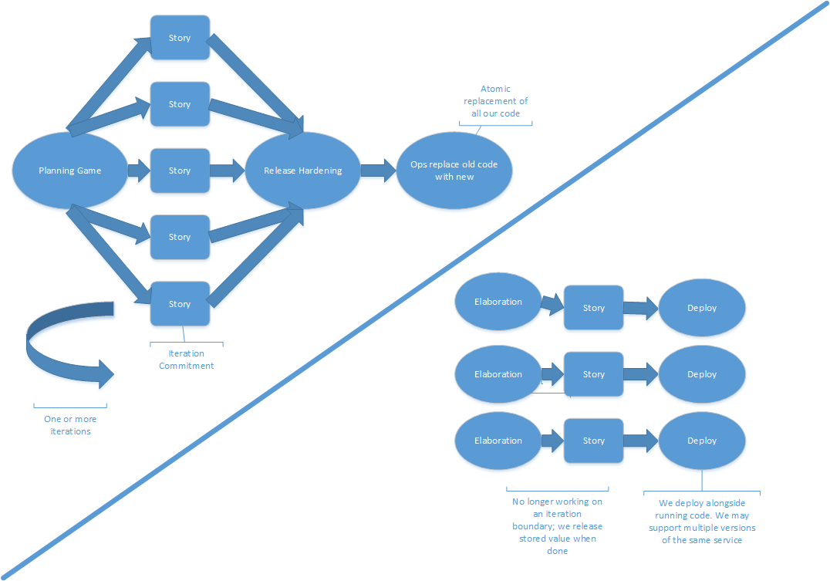

Slide 17
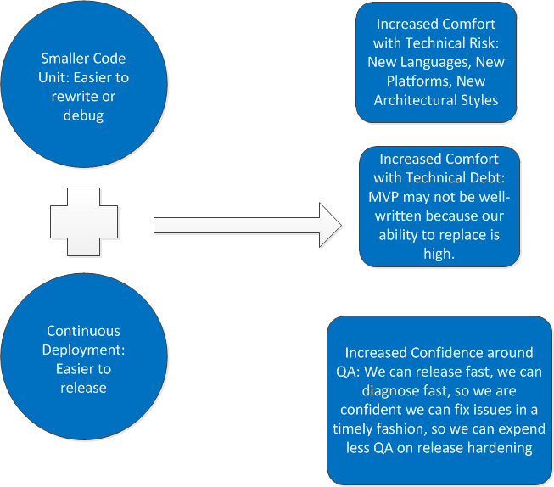

Slide 18
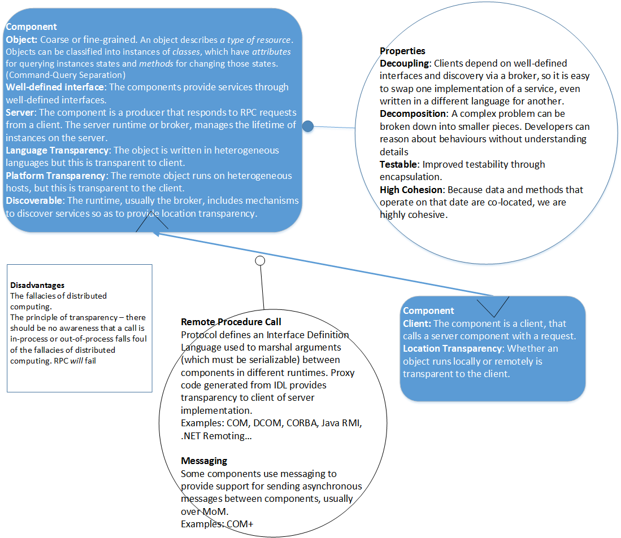

Slide 19
Principles
Decomposition – break a complex software solution into smaller parts that are easier to reason about
Loose Coupling – hide the details and state of the smaller parts from clients, allowing them to be changed without changing the clients i.e. encapsulation
Cohesion – group related code and state behind the stable interface to make it easier to reason about, as well as change in one place instead of many
Distribution – allow components to run in separate processes, either locally or across the network, that can be deployed independently of each other
Platform Independence – A system should not be constrained to a single language.

Slide 20
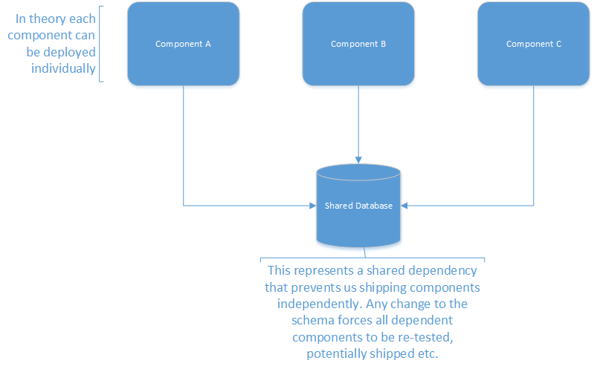

Slide 21
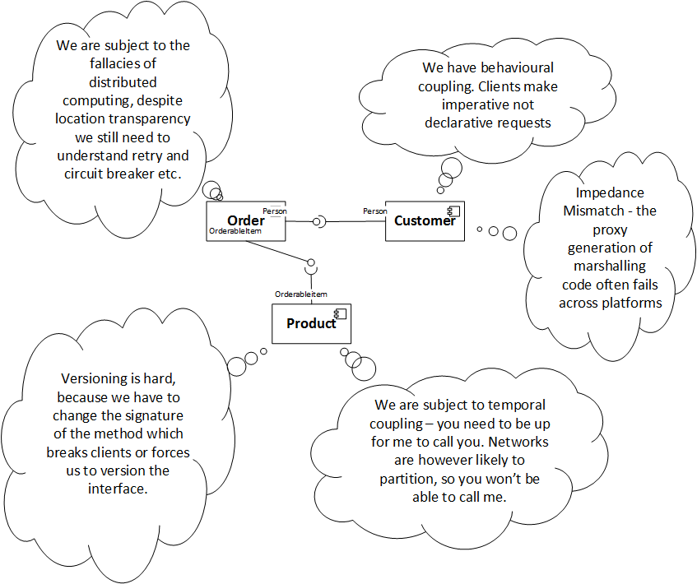

Slide 22
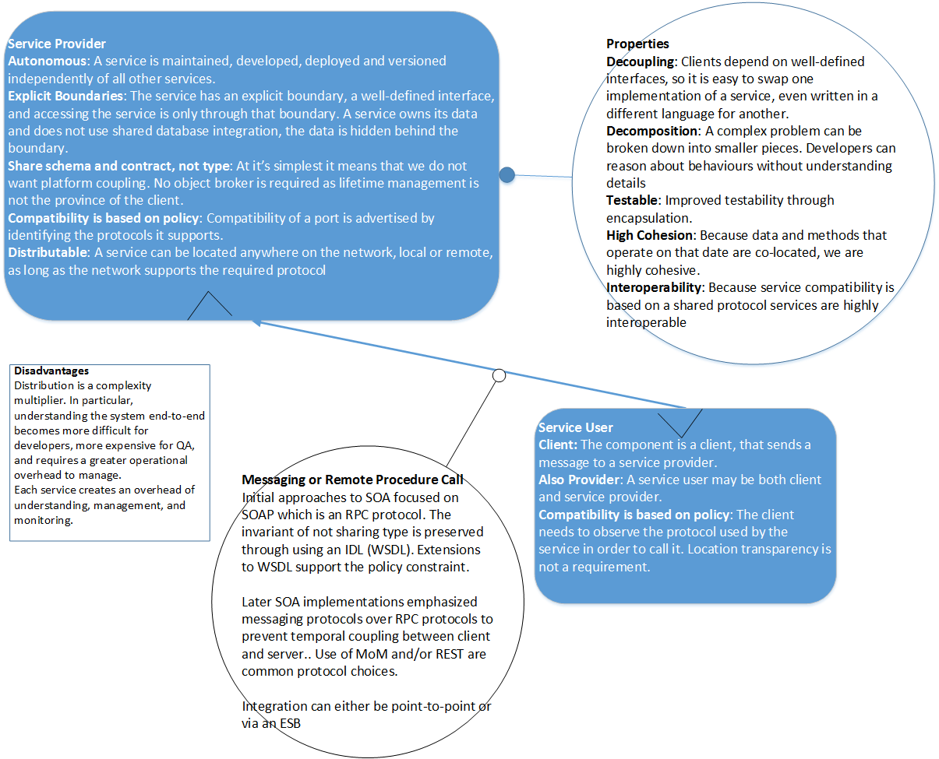

Slide 23
Principles
Decomposition – break a complex software solution into smaller parts that are easier to reason about
Loose Coupling – hide the details and state of the smaller parts from clients, allowing them to be changed without changing the clients i.e. encapsulation. Boundaries are explicit – access to details and state is only through the stable interface with no access to internals i.e. data.
Cohesion – group related code and state behind the stable interface to make it easier to reason about, as well as change in one place instead of many
Distribution – allow components to run in separate processes, either locally or across the network, that can be deployed independently of each other
Platform Independence – A system should not be constrained to a single language, runtime, or host OS.

Slide 24
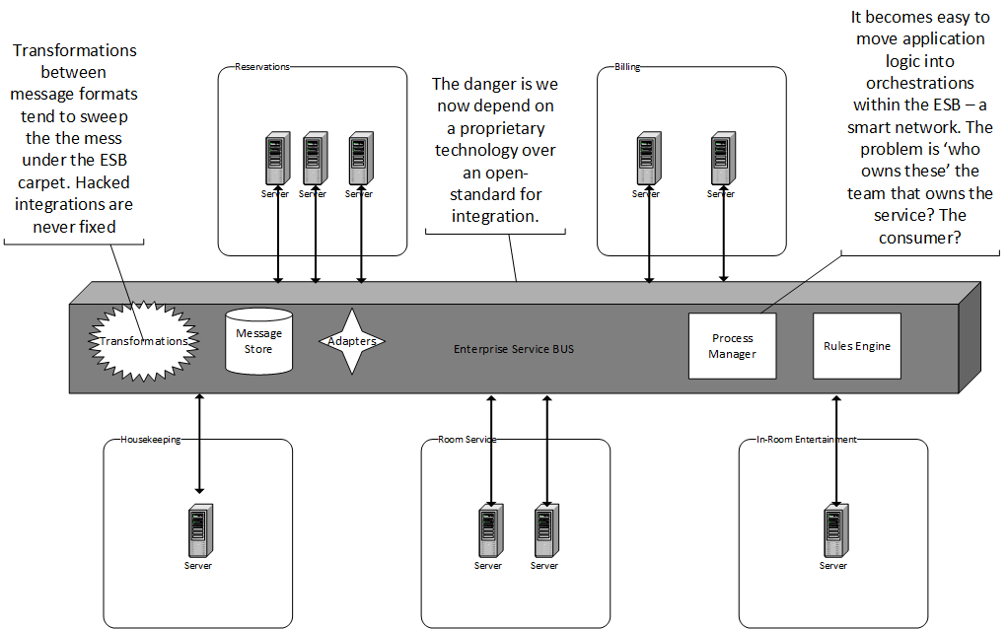

Slide 25
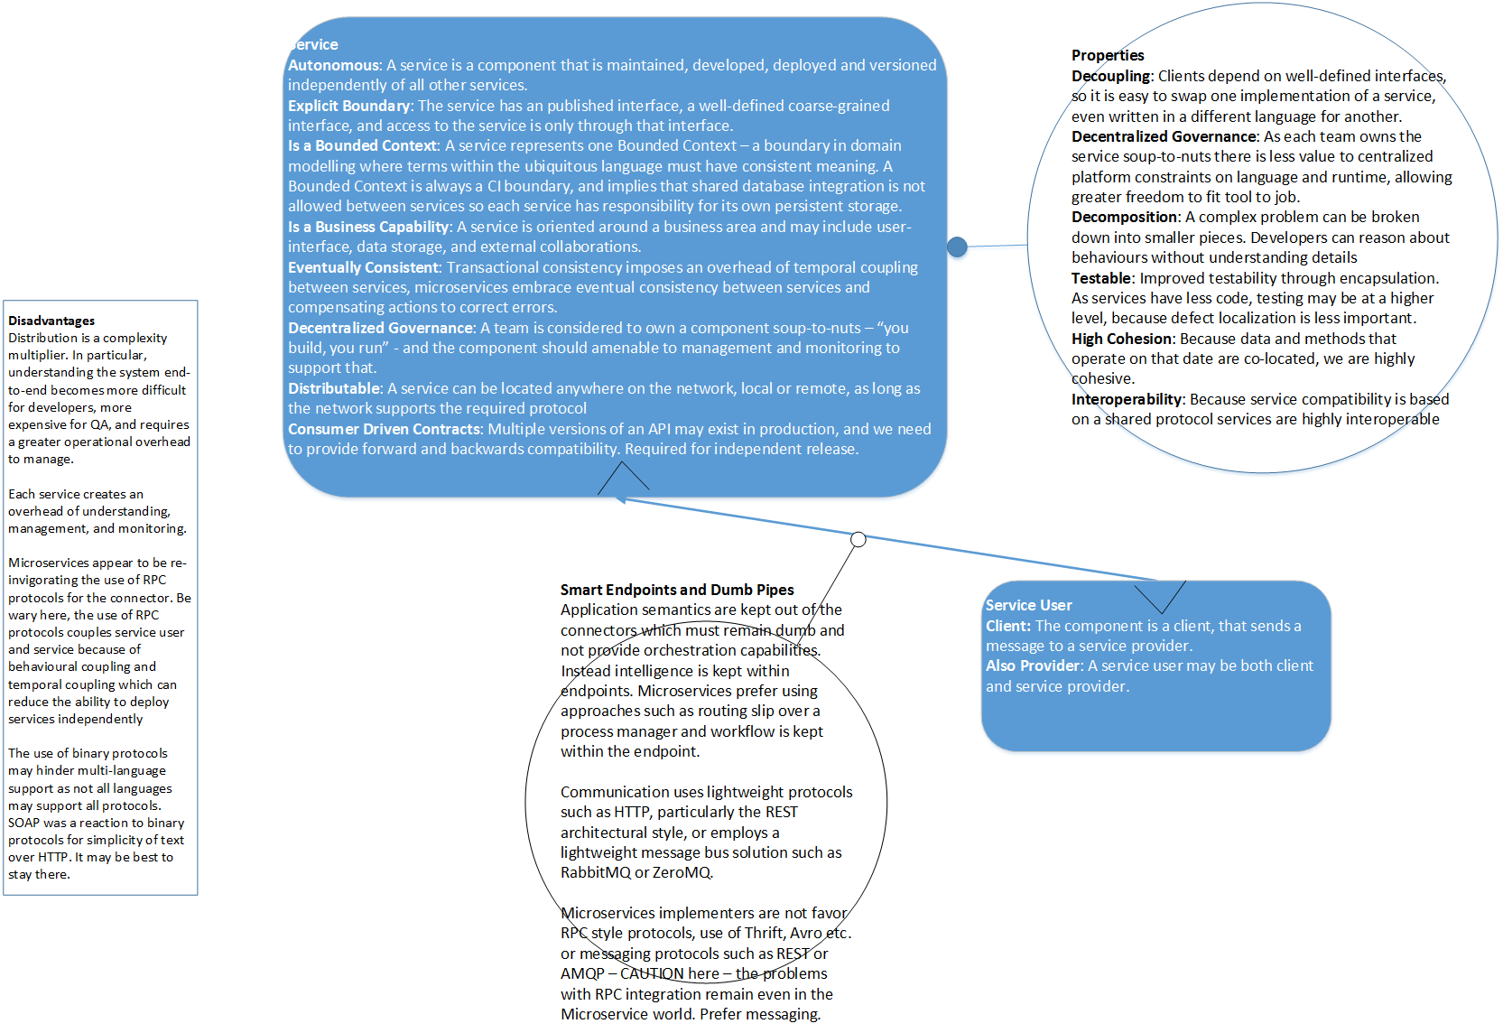

Slide 26
Principles
Decomposition – break a complex software solution into smaller parts that are easier to reason about. The optimal unit of decomposition for a service is a business capability, represented as a bounded context within the domain model. Loose Coupling – hide the details and state of the smaller parts from clients, allowing them to be changed without changing the clients i.e. encapsulation. Boundaries are explicit – access to details and state is only through the stable interface with no access to internals i.e. data.
Cohesion – group related code and state behind the stable interface to make it easier to reason about, as well as change in one place instead of many. Consumers define contracts to prevent abuse of downstream teams.
Distribution – allow components to run in separate processes, either locally or across the network, that can be deployed independently of each other. Connectors should be dumb, endpoints should be smart. Components should be eventually consistent. You built it, you own it. You own it, you deploy it and you monitor it.
Platform Independence – A system should not be constrained to a single language, runtime, or host OS.

Slide 27
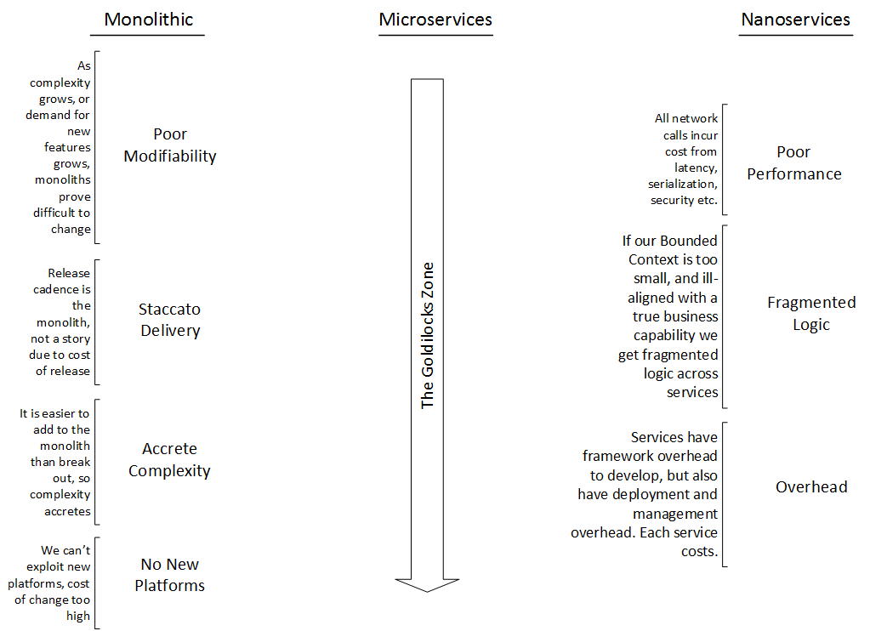

Slide 28
Implementing Microservices
How do we build a microservice

Slide 29
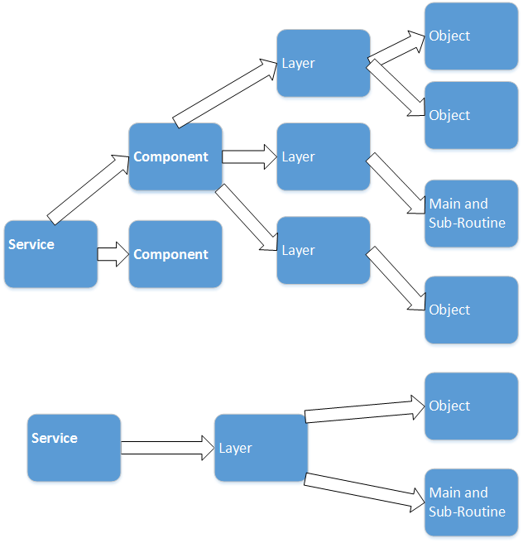

Slide 30
BC and AC
Reservations API
Bookings
Upsell
Accounts
Availability
BC
A business capability
Should be recognizable to the business as a broad set of functionality we support.
Things inside change from the same forces, at a similar rate
Logical not physical!
AC
An Autonomous Component
A schedulable unit
Physical not logical.
Can share domain and database.
Can use RPC style interaction over messaging if needed
One BC has many ACs
Reservations

Slide 31
Continuous Integration and Deployment
What is the CI boundary in Microservices?
The CI boundary is a Bounded Context by definition
Thus we build and deploy a microservice as a whole
This is a Business Capability, implemented by a number of Autonomous Components
Deploying the Acs individually is dangerous, because they share a model and change to one may impact another
The unit of deployment is also therefore the Business Capability
The domain model protected by unit tests is the focus of CI
System tests focus on protecting the consumer driven contracts
Rely on consumer driven-contracts to QA integrations
Don’t rely on expensive, brittle end-to-end tests

Slide 32
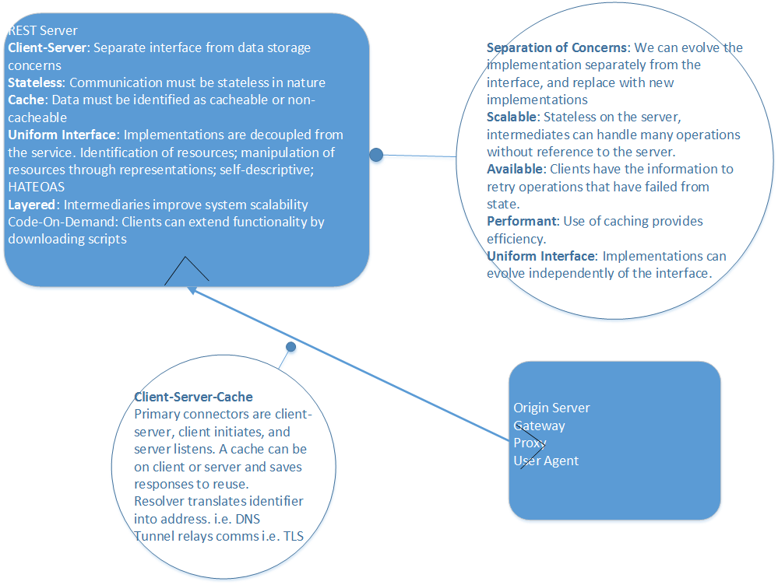
EAI with HTTP
REST
Easy to deliver as requires no MoM within the organization.
Communication is point-to-point.
Communication is frequently synchronous, but highly cacheable.
Can use status 202 and monitor a link for asynchronous approaches
Can be high-latency, especially if service A, calls B, calls C etc. Minimum time is controlled by latency of hops.
Can require considerable effort to build a client of the API that supports desired QoS attributes
No built in support for competing consumer or at least once patterns of message delivery.

Slide 33
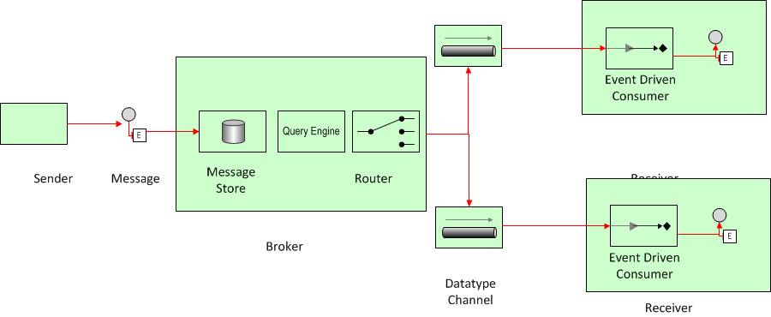
EAI with EDA
Sink
Agent
EDA
Event emitters (agents) raises events but does not know consumers
Event consumers (sinks) react to the event (but might just forward)
Event channels transmit events from emitters to consumers, contain all routing
Communication between services is by events
Compensating Events and/or Routing Slip preferred over distributed transactions or process managers.
Loose coupling
Broker
DB
App
Sink
DB
DB

Slide 34
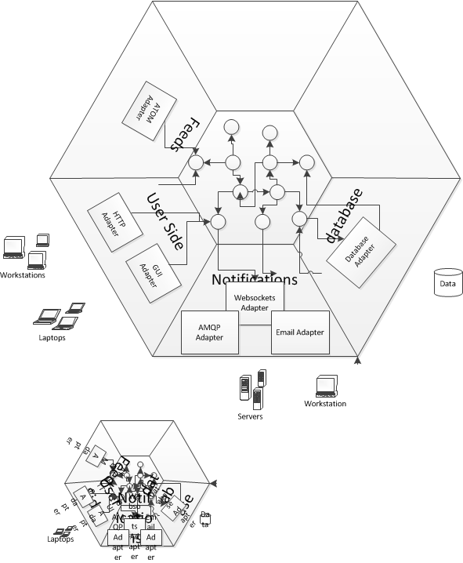
Hexagonal Architectures
Also called Ports and Adapters
Provides separation between Domain and Application Frameworks
Application Framework marshals request to Domain via Port
We use Brighter as a Port implementation
A Port is a use-case and transactional boundary, so usually associated with an aggregate in the domain.
A TDD framework is also an adapter that calls the Port.

Slide 35
Breaking up a Monolith

Slide 36
Asset Capture
Monolith
Service
Cut & Shunt
Event Interception
Reference Data
Monolith
Data Autonomy
Files

Slide 37
Operating Microservices

Slide 38
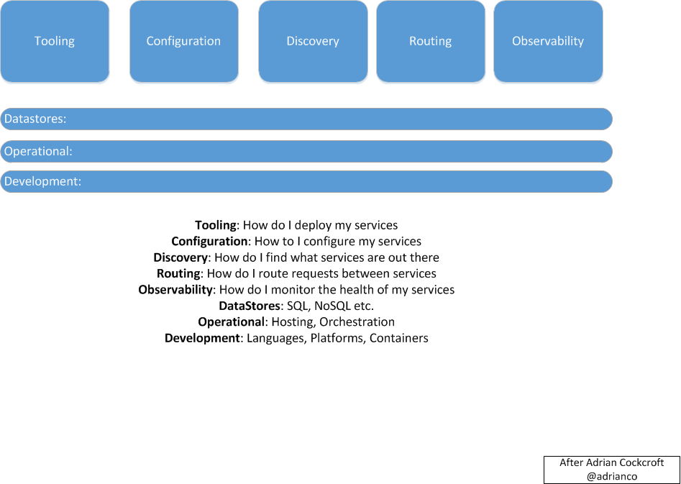

Slide 39
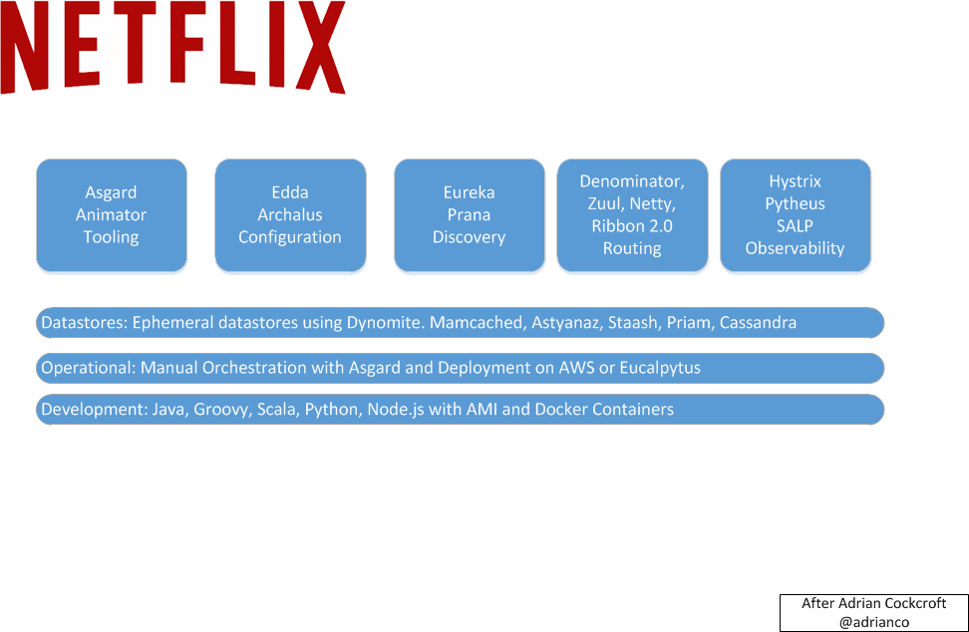

Slide 40
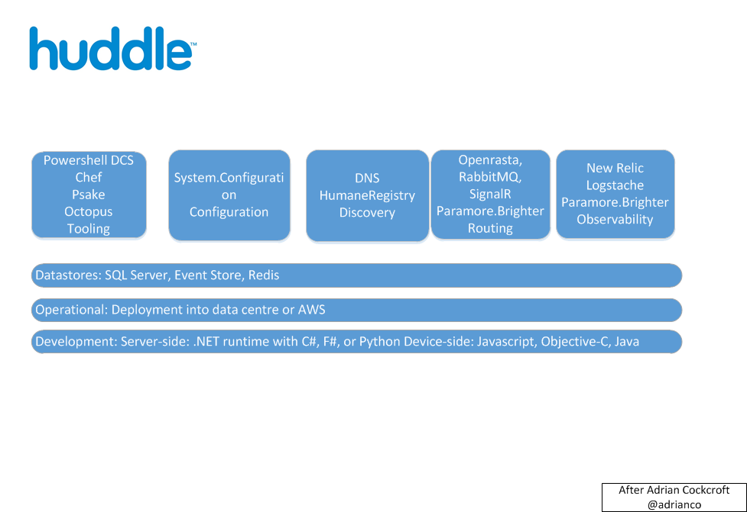

Slide 41
QA

