Slide 1
Tables
Dbo. | Department. | Exam. | Mtm.
Class | Branch | Exam | examQuestion
Course | Intake | Question | instructorClass
Instructor | track | choices | instructorExam
student |  |  | instructorWork
 |  |  | studentCourse
 |  |  | studentExamQusetion

Slide 2
view
Dbo.doExam Dbo.allMember

Slide 3
proc
Dbo. |  | examProc. | Instructor | Manager.
selectStudent | selectIntake | generateAnExam | deleteQuestion | deleteBranch | insertIntake
selectInstructor | selectQuestion | generateInstructorExam | insertChoices | deleteCourse | insertStudent
selectBranch | insertClass | getStudentModelAnswer | updateChoices | deleteInstructor | insertTrack
selectTrack | updateClass | numberOfQuestion | updateQuestion | deleteIntake | updateBranch
selectCourse |  | saveStudentExamAnswer | insertQustion | deleteStudent | updateCourse
selectClass |  | studentExamGrade |  | deleteTrack | updateIntake
 |  | takeExam |  | insertBranch | updateStudent
 |  |  |  | insertCourse | updateTrack
 |  |  |  | insertInstructor

Slide 4
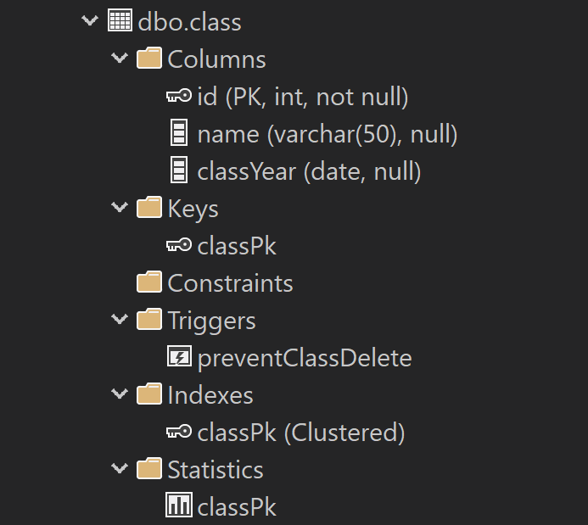

Slide 5
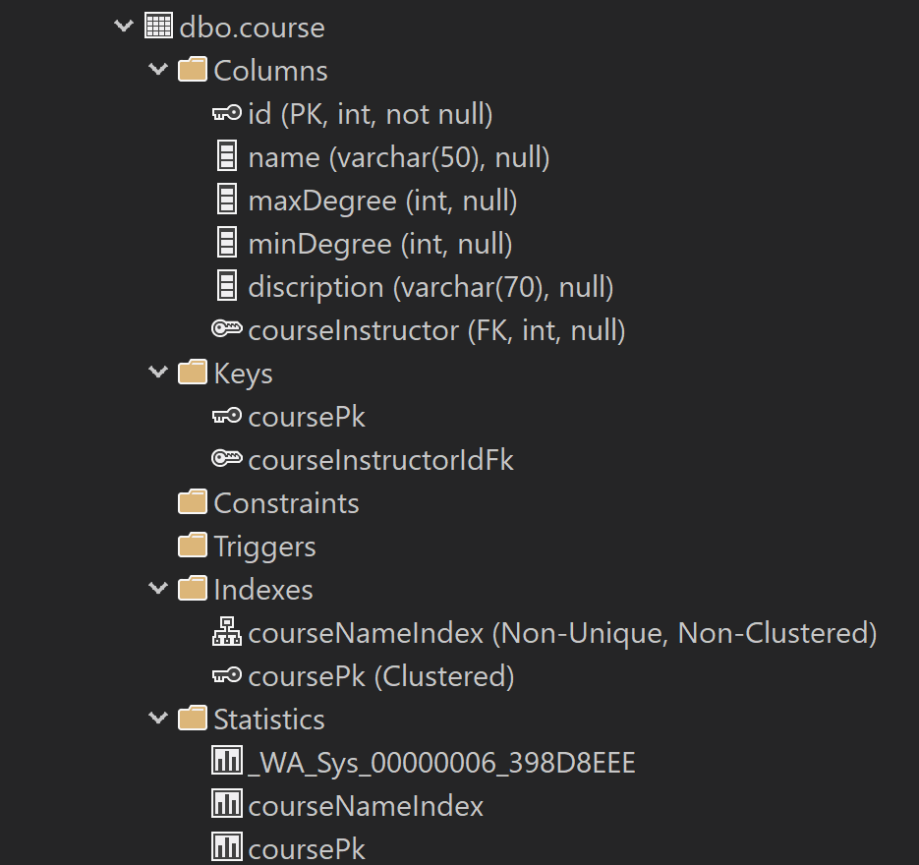

Slide 6
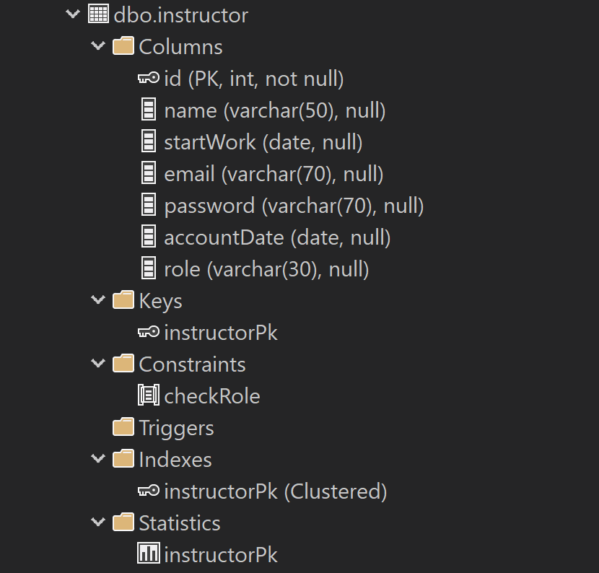

Slide 7
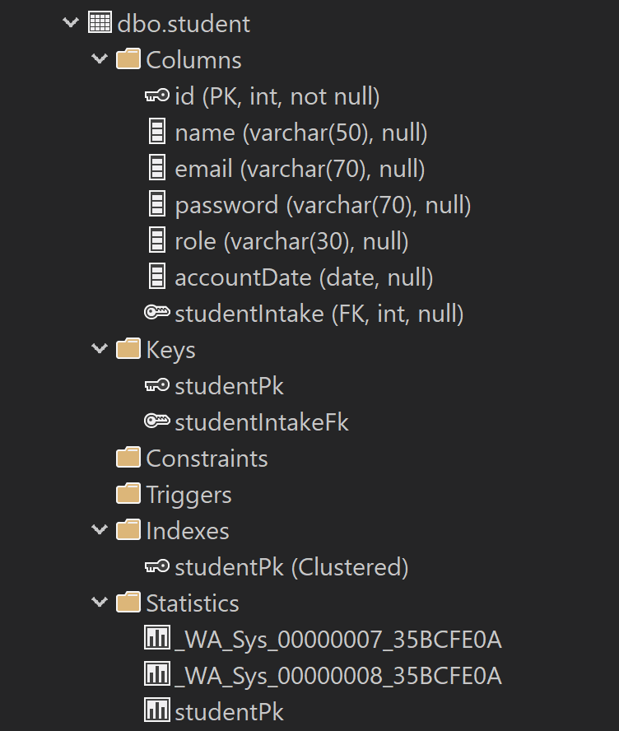

Slide 8
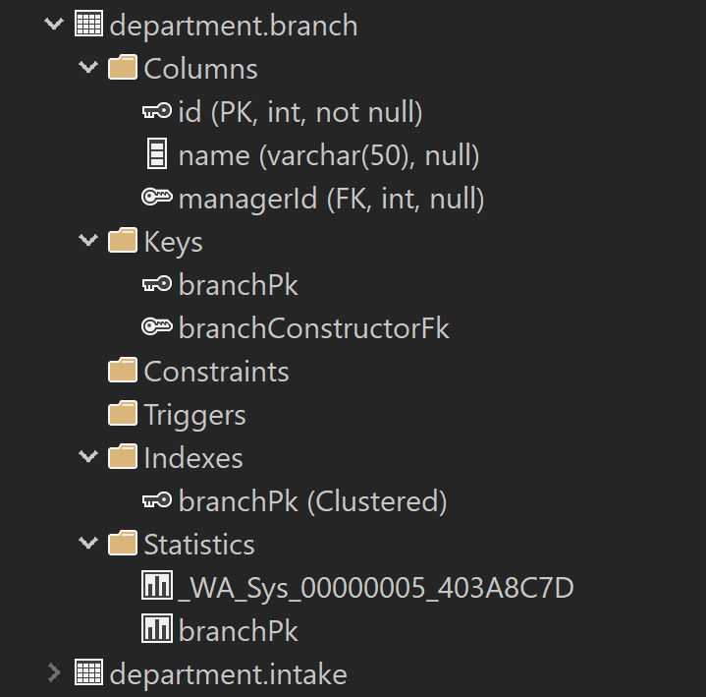

Slide 9
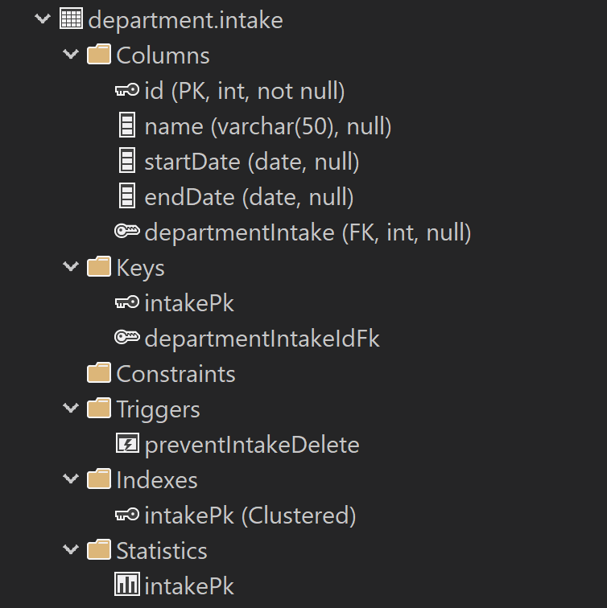

Slide 10
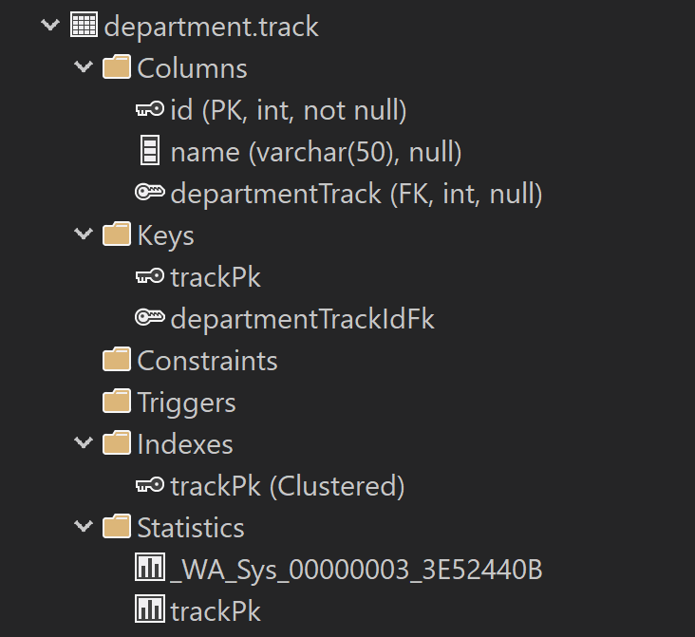

Slide 11
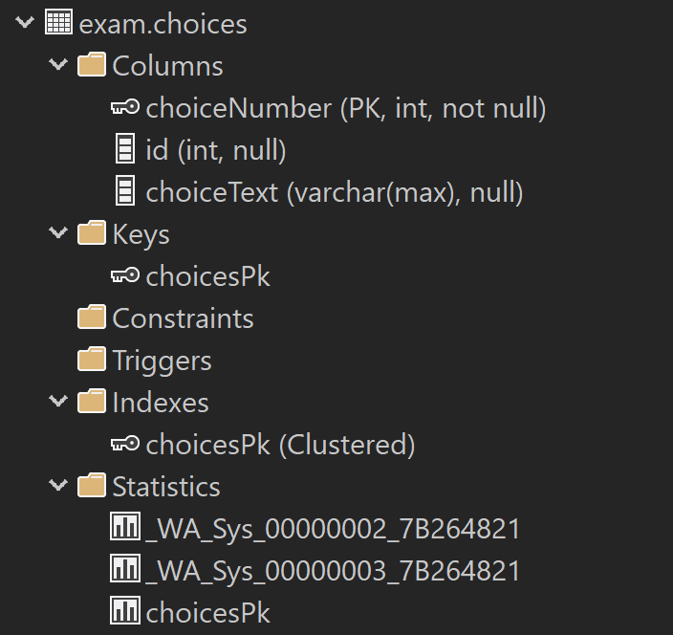

Slide 12
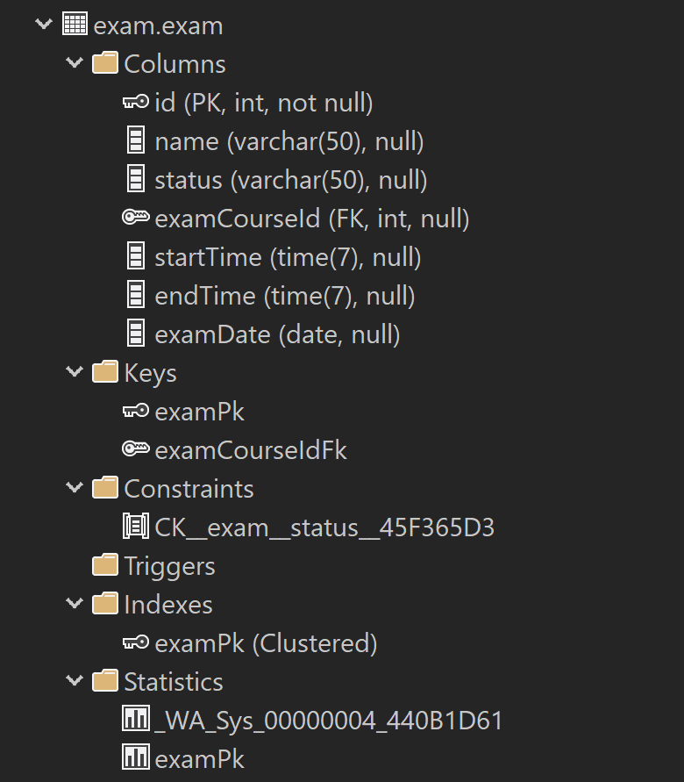

Slide 13
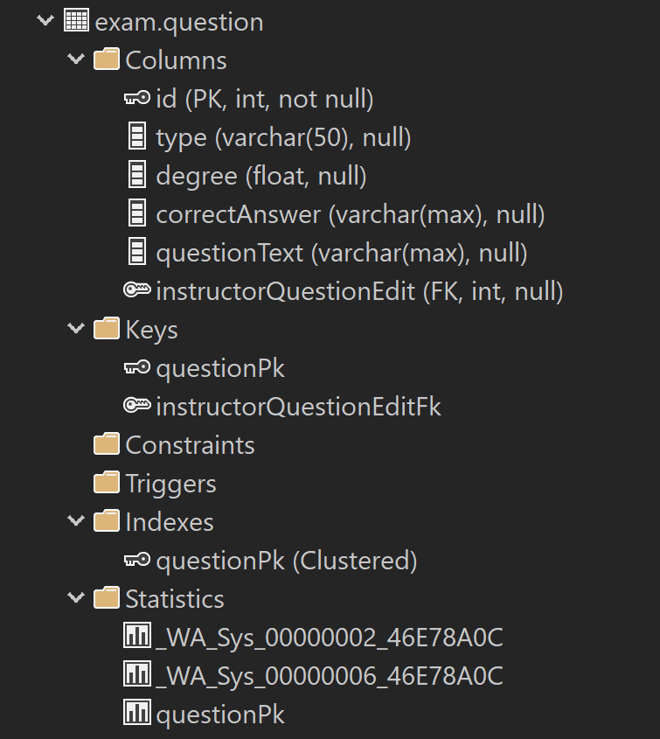

Slide 14
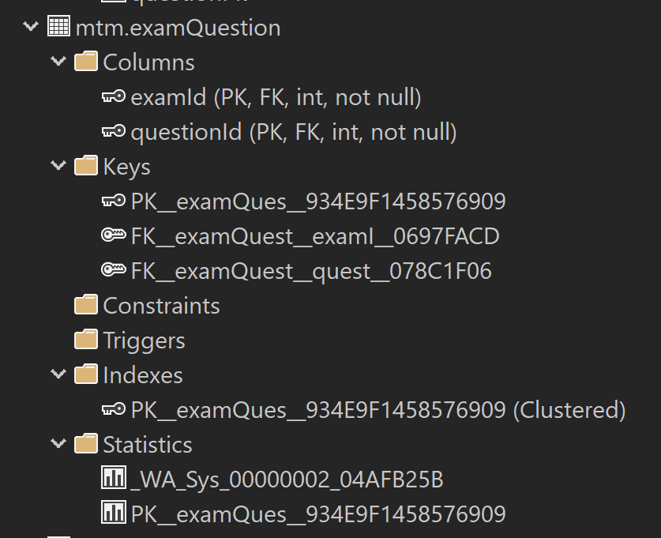

Slide 15
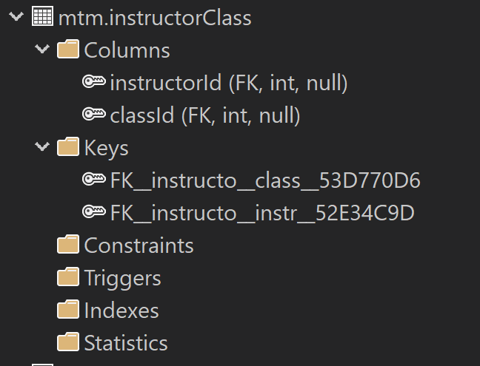

Slide 16
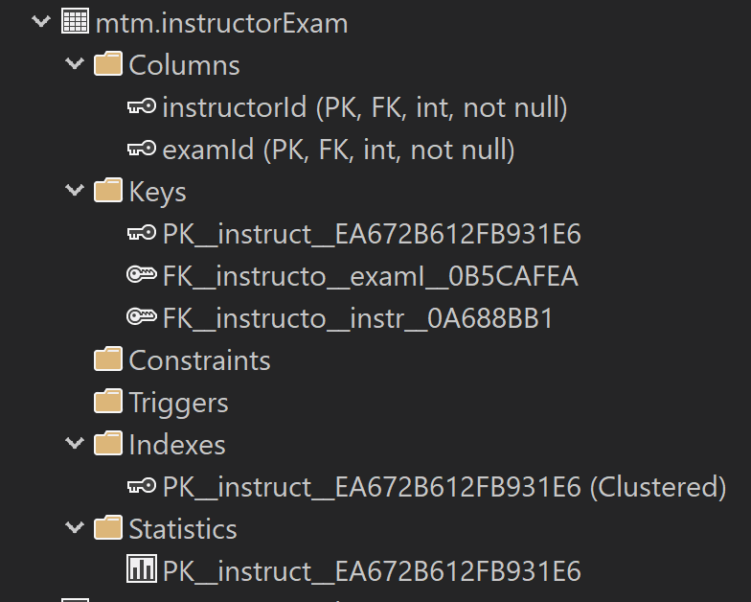

Slide 17
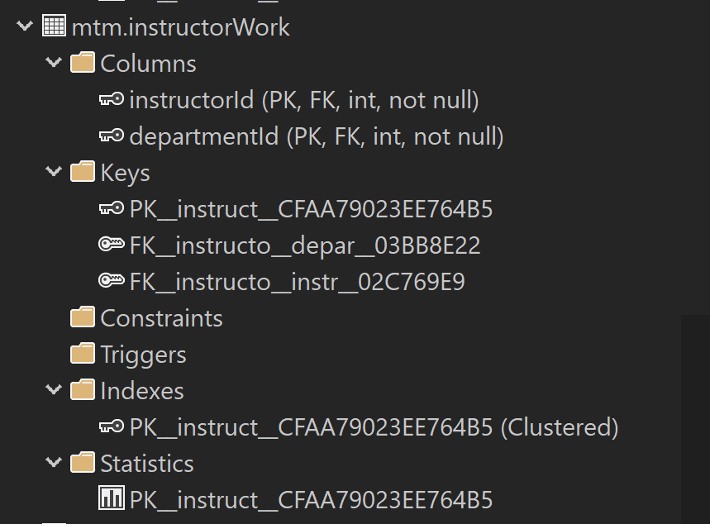

Slide 18
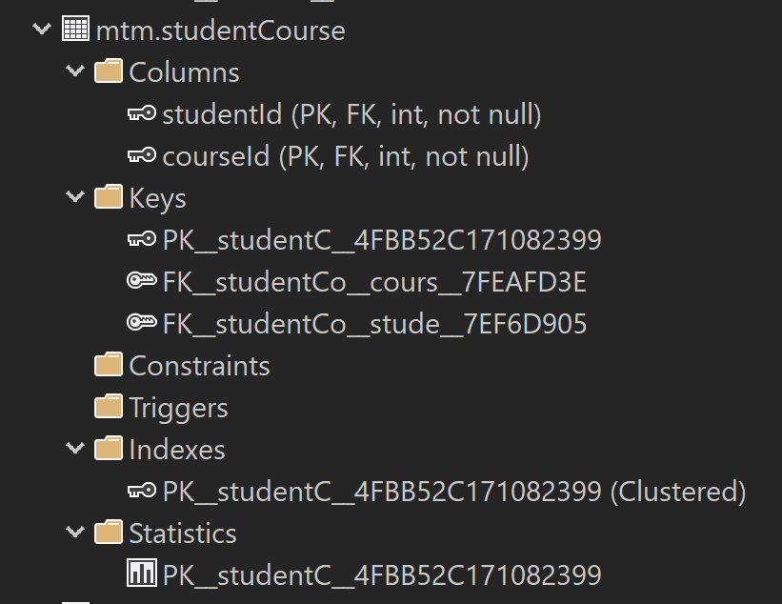

Slide 19
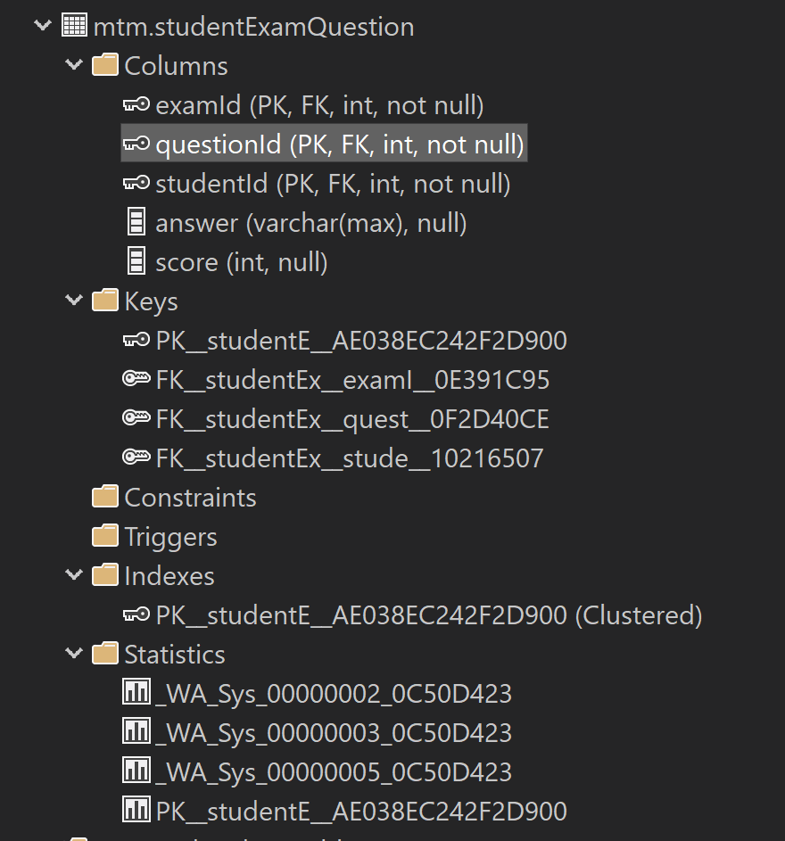

Slide 20
Stored procedure

Slide 21
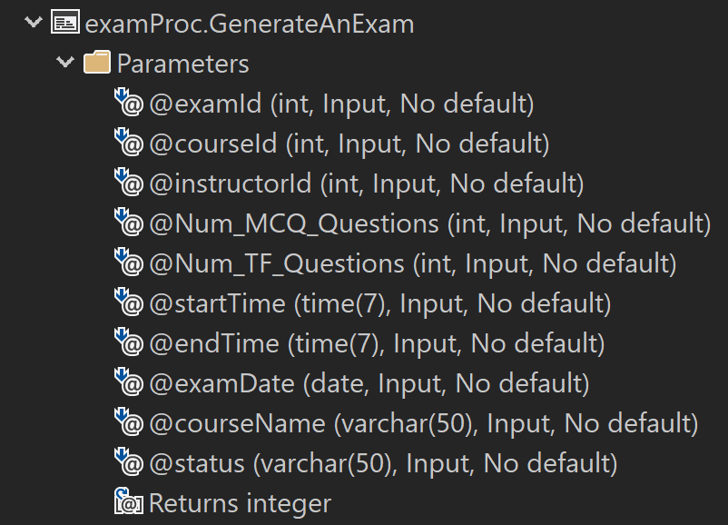

Slide 22
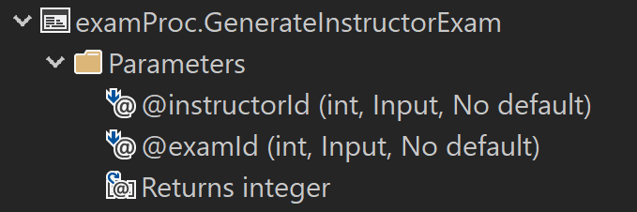

Slide 23
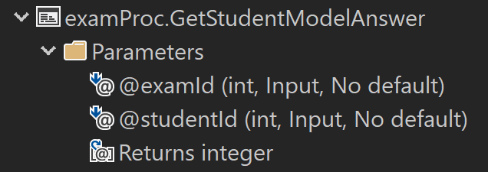

Slide 24
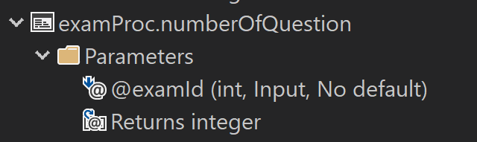

Slide 25
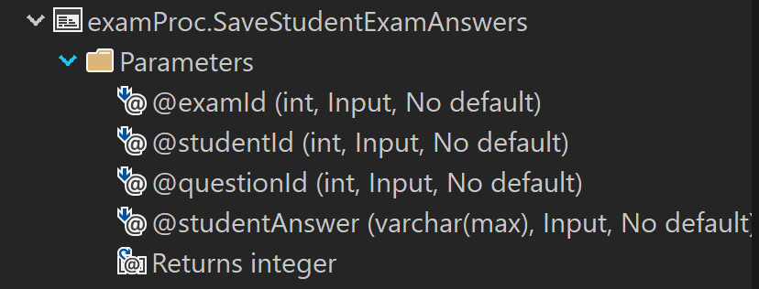

Slide 26
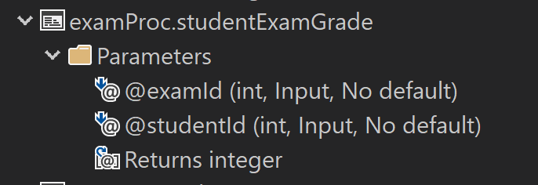

Slide 27
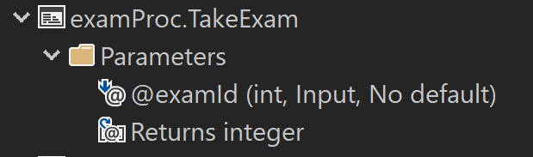

Slide 28
Project show data

Slide 29
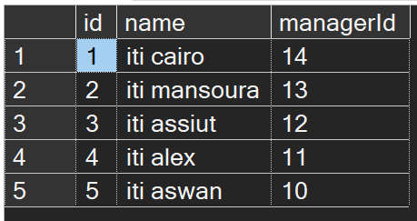

Slide 30
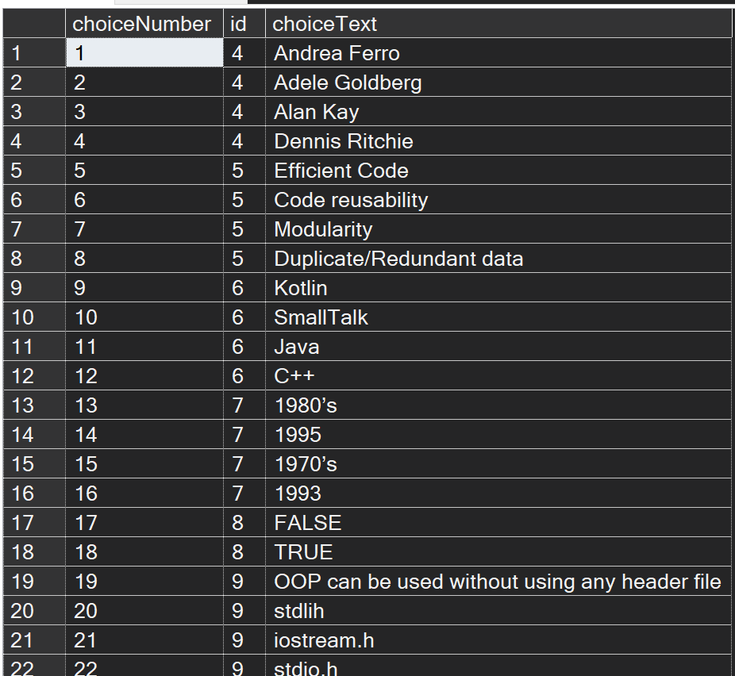

Slide 31
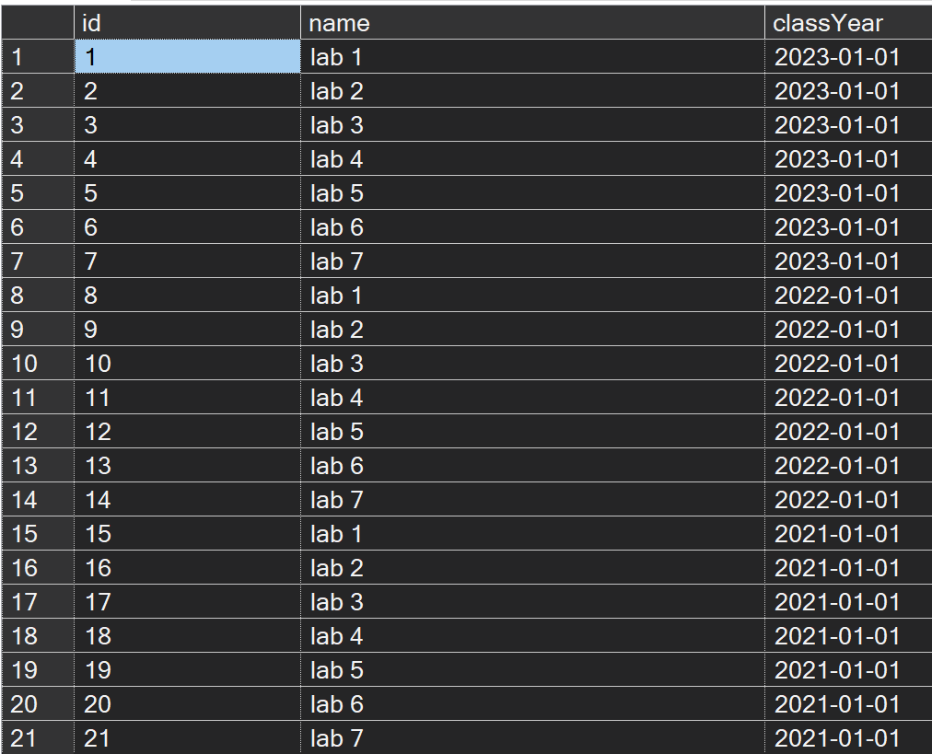

Slide 32
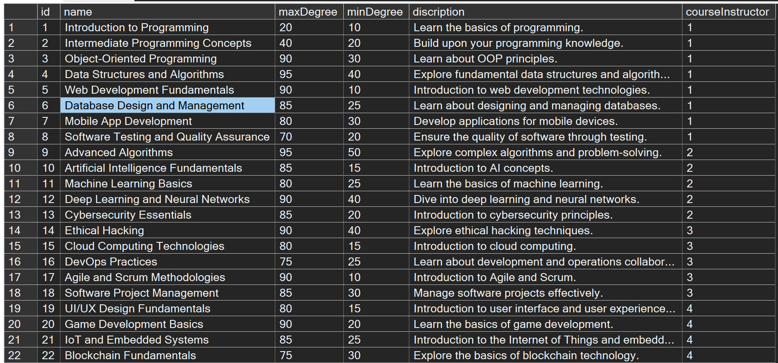

Slide 33
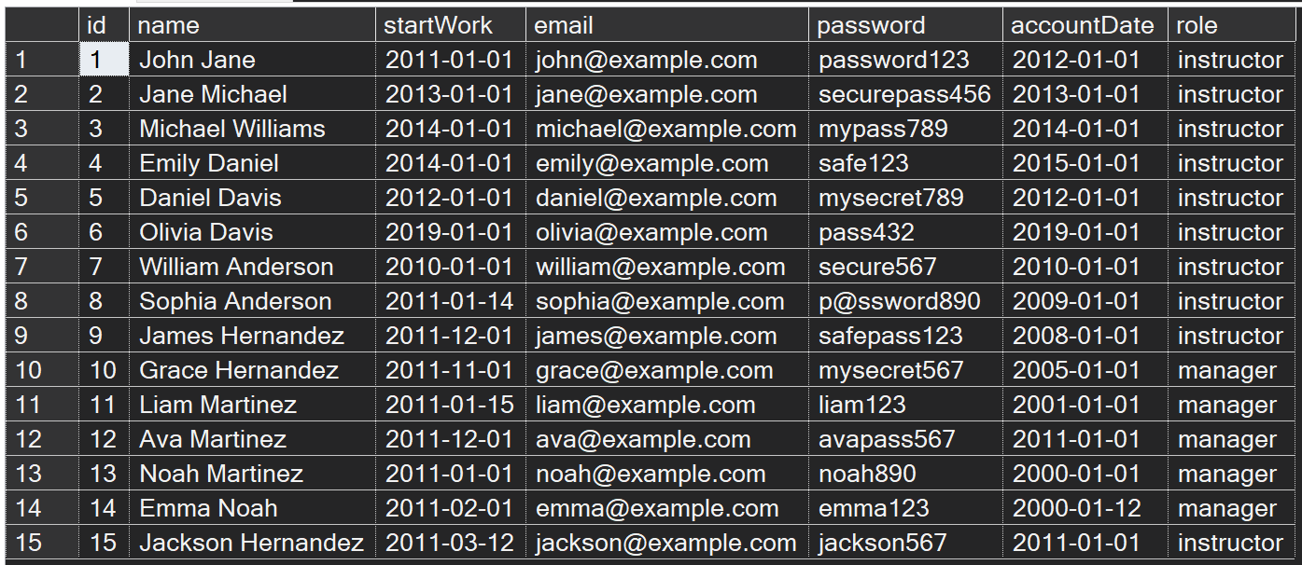

Slide 34
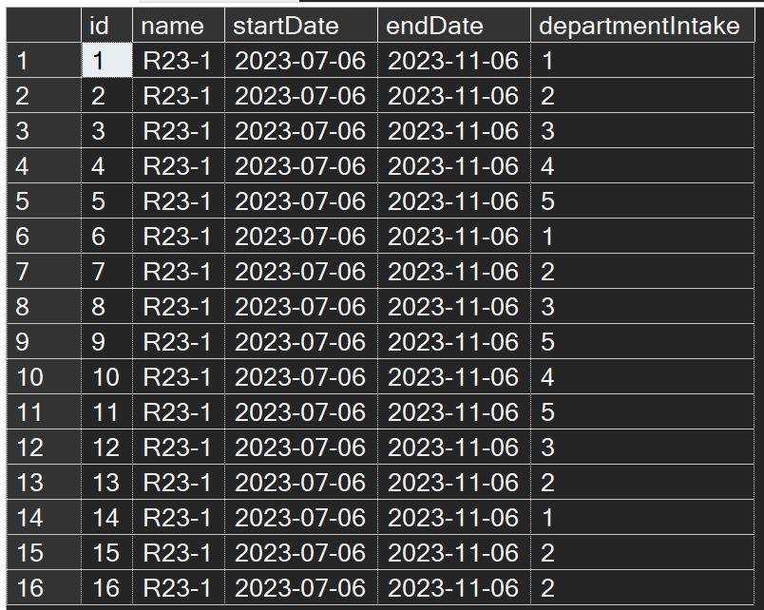

Slide 35
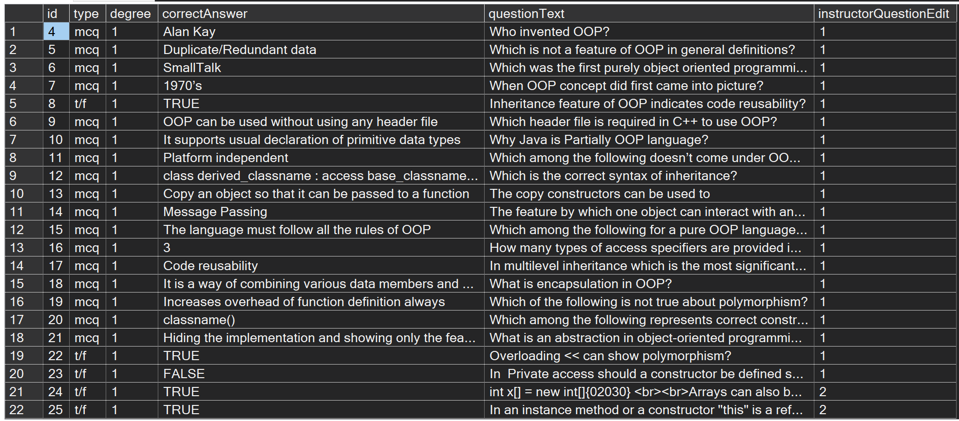

Slide 36
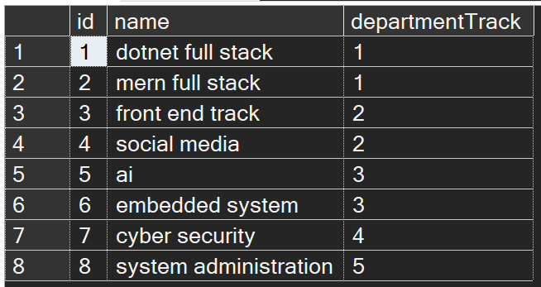

Slide 37
Take exam procedure

Slide 38
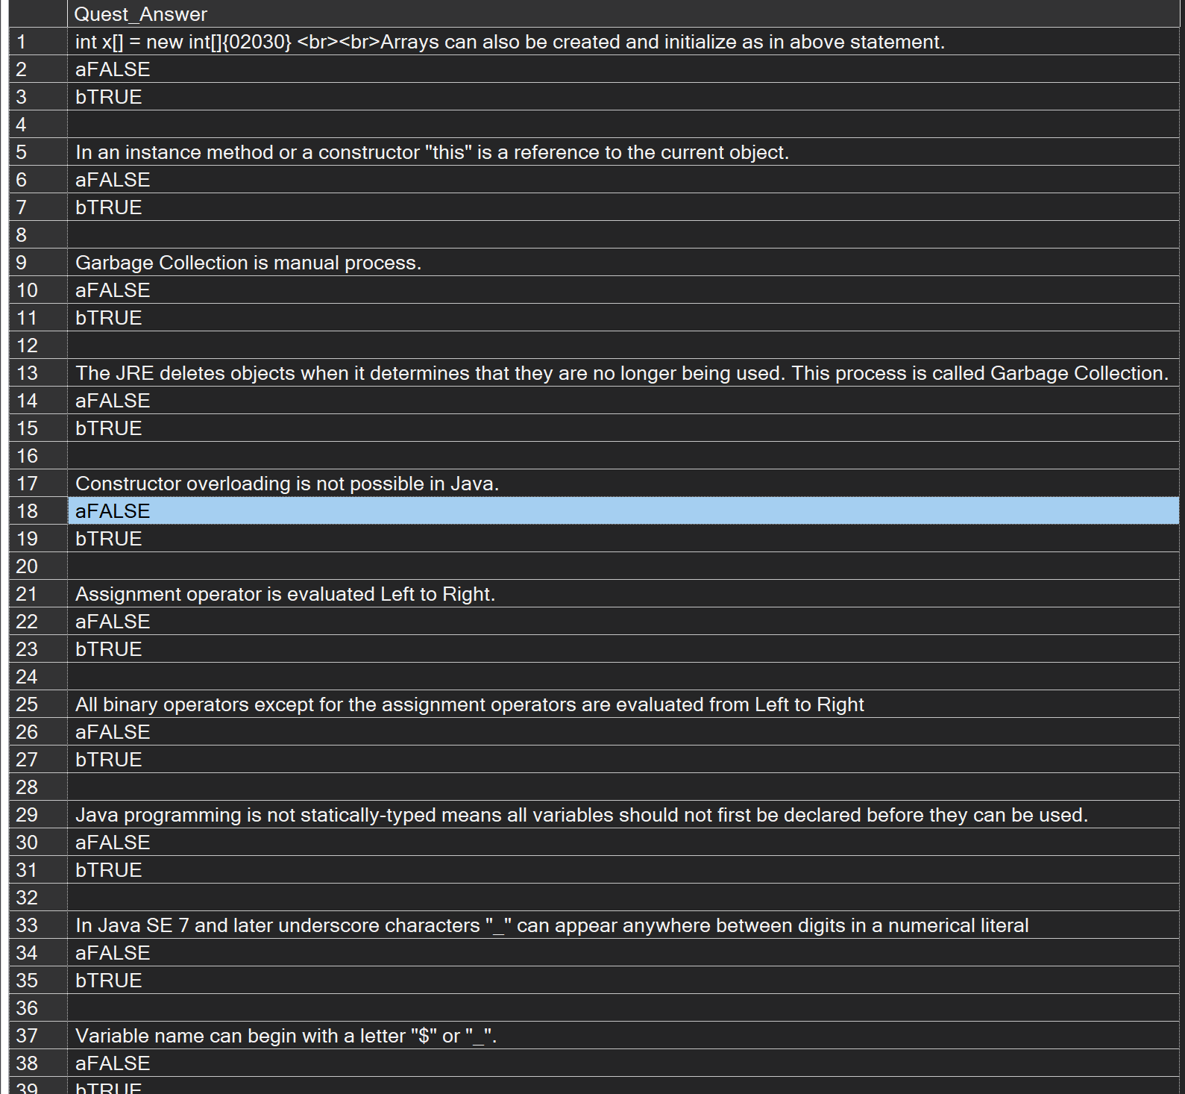

Slide 39
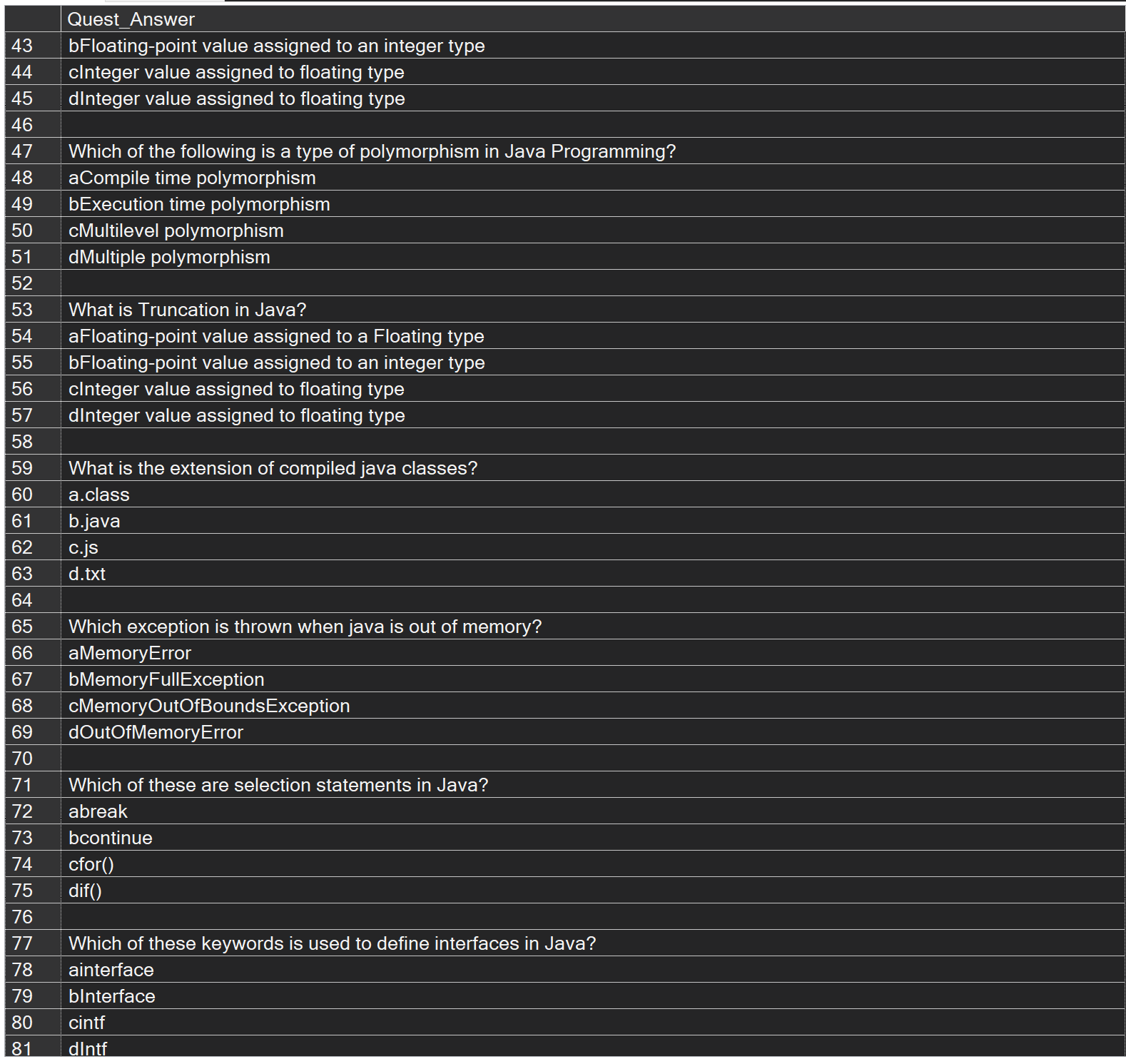

Slide 40
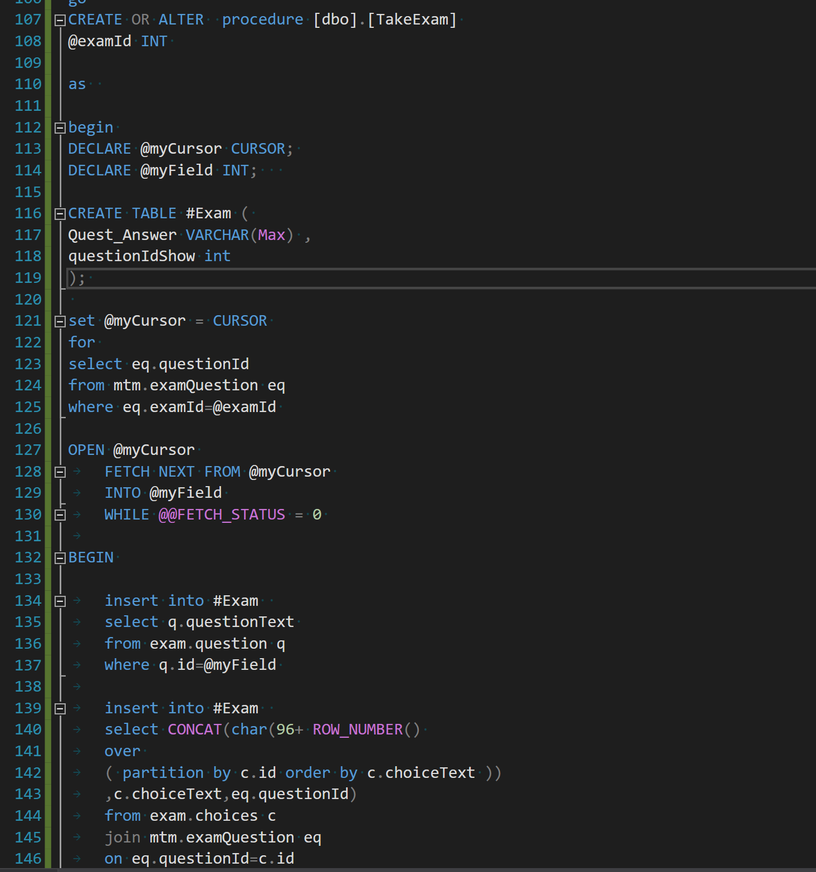

Slide 41
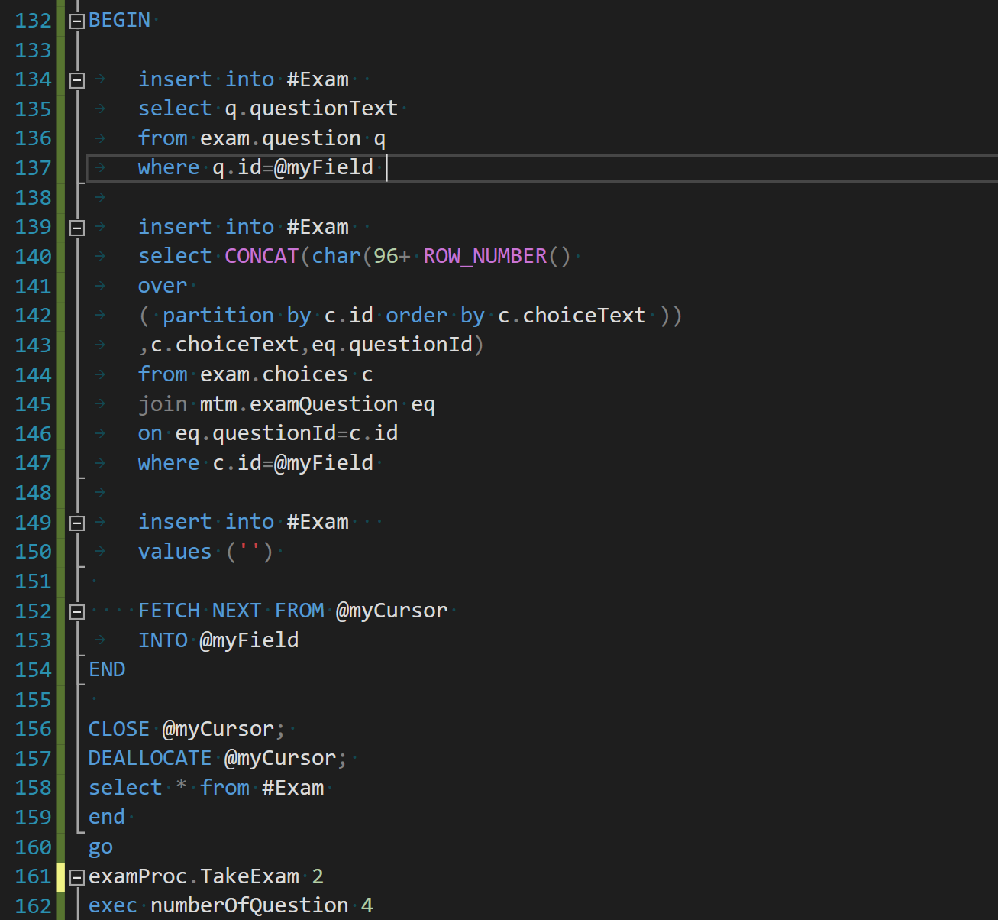

Slide 42
Get student answers

Slide 43
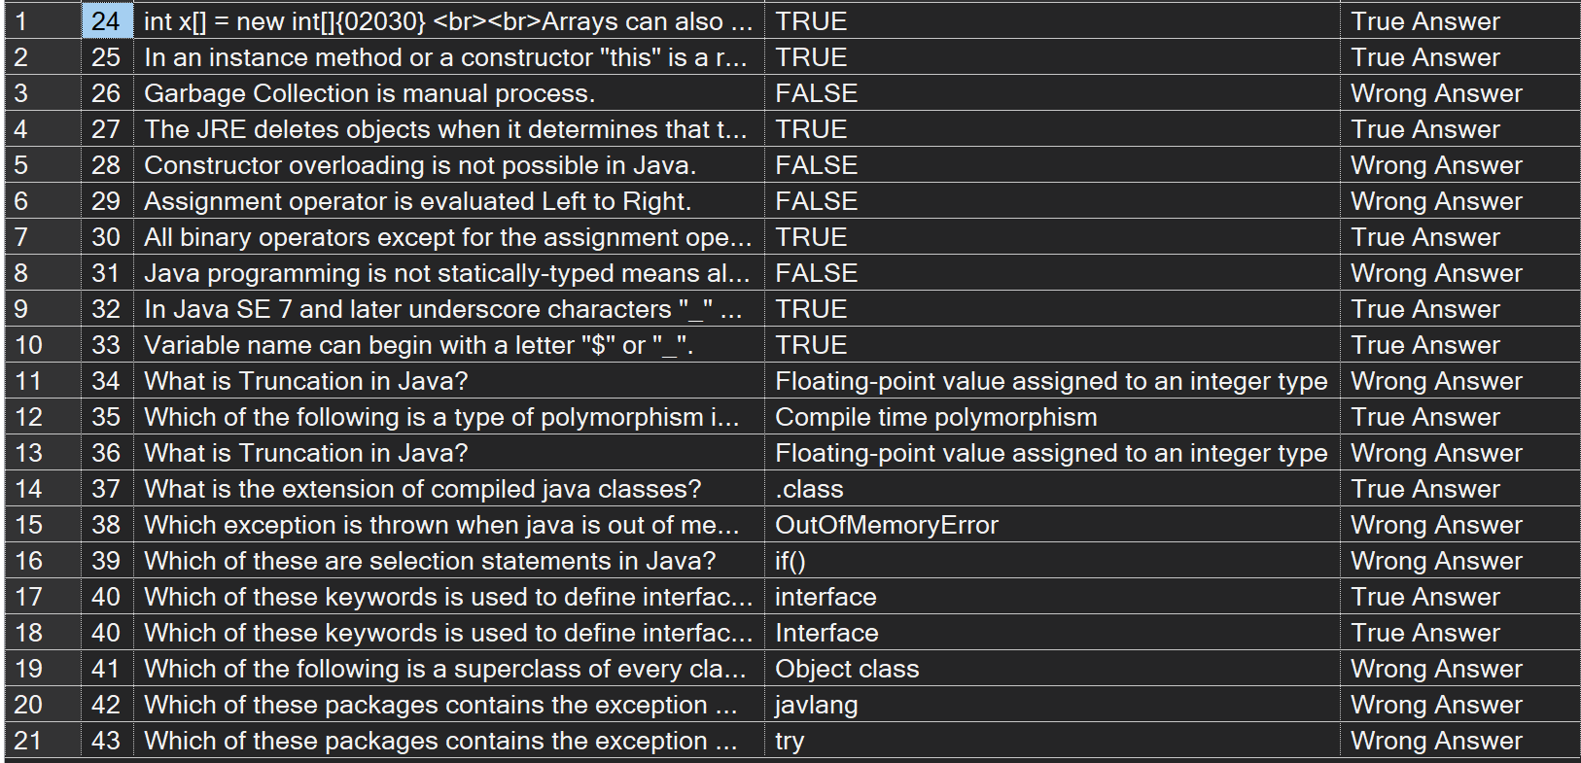

Slide 44
Exam score

Slide 45
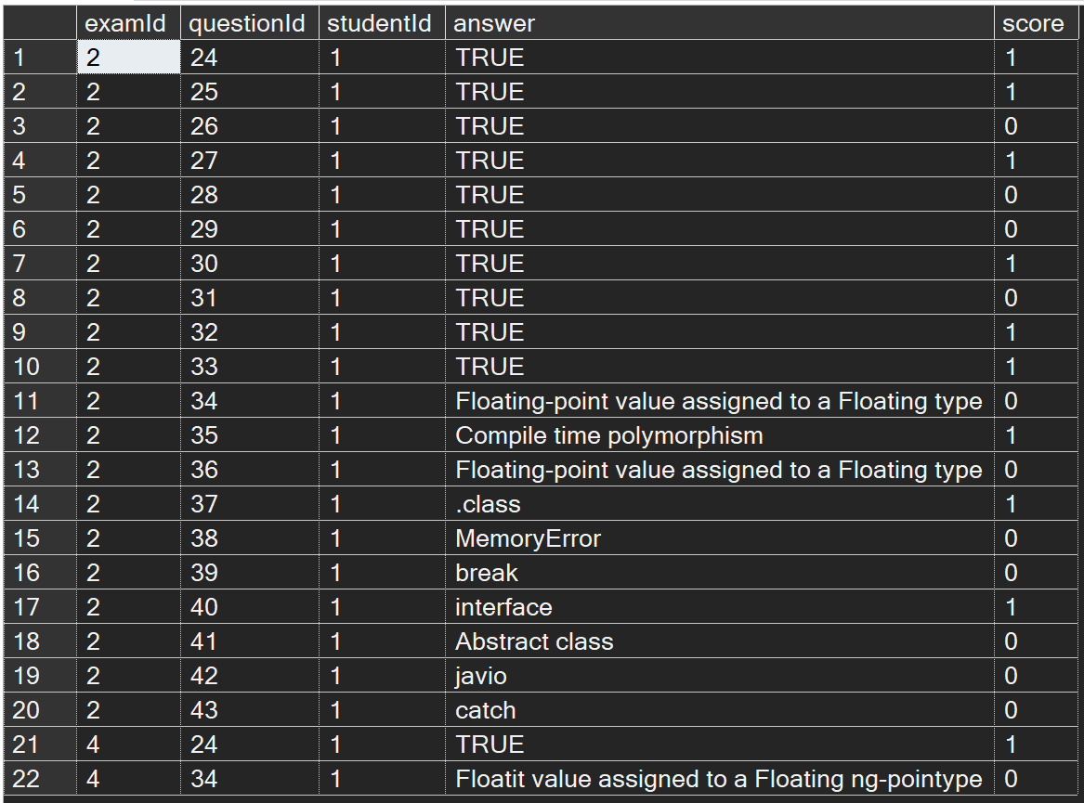

Slide 46


