Slide 1
Organizational Scope of an OWASP SAMM assessment
Dr. Carsten Huth, CISSP, CSSLP

Slide 2
Timeline plan
5 Min Carsten’s introduction:
12 years experience, work with Pravir Chandra, …
OpenSAMM assessments for customers while being at HP
Head of AppSec Advisory at Checkmarx now
5 Min – Introductions of the participants if < 8, if > 8 then drop some names
35 Min – workshop
5 Min closing/conclusions

Slide 3
Dr. Carsten Huth, CISSP, CSSLP
Life prior to AppSec ☺
University of Paderborn / University of Essex UK
Professional Services Consultant Macrovision / Flexera
AppSec Experience:
HP Fortify (2009 – 2016)
Professional Services Consultant
Working with Pravir Chandra
Practice Leader Professional Services
Checkmarx (2016 – present)
Technical Account Manager
Technical Account Management Team Leader
Global Head of AppSec Advisory

Slide 4
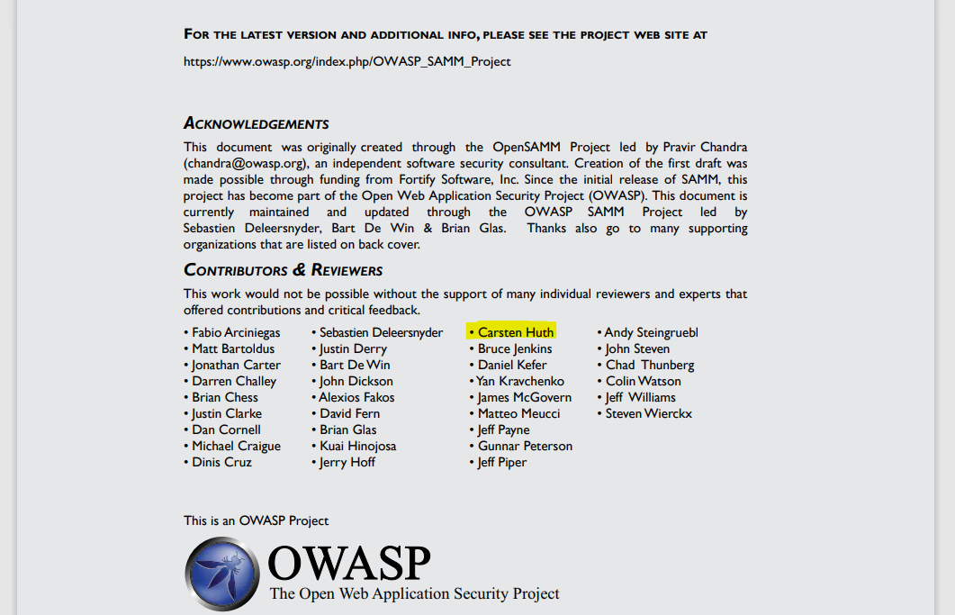

Slide 5
Introductions

Slide 6
Scope of SAMM Assessments
Scope range from one dev team to the whole organization
Practical Experiences?
Best Practices?
Notes:
E. g. different interviews with different roles or one session with different stakeholders present.

Slide 7
Split up Assessments?
Should assessments of with an application team include the complete OWASP SAMM assessment or only the parts that an application team can talk about with authority?
E.g. should Strategy and Metrics be excluded when performing an assessment with an application team?

Slide 8
Aggregate Assessments?
If several or all application development teams are assessed, should their results be qualitatively aggregated or averaged out to get an assessment result of the whole software development organisation?
E.g. should the importance of development teams, quantified by their risk ranking, be included?
Should different development teams have different desired states?
If each team has its own maturity level you would have to plan a program for each team?
But wait, isn’t that an overkill?
Notes:
E.g. record highest/lowest maturity level across different teams

Slide 9
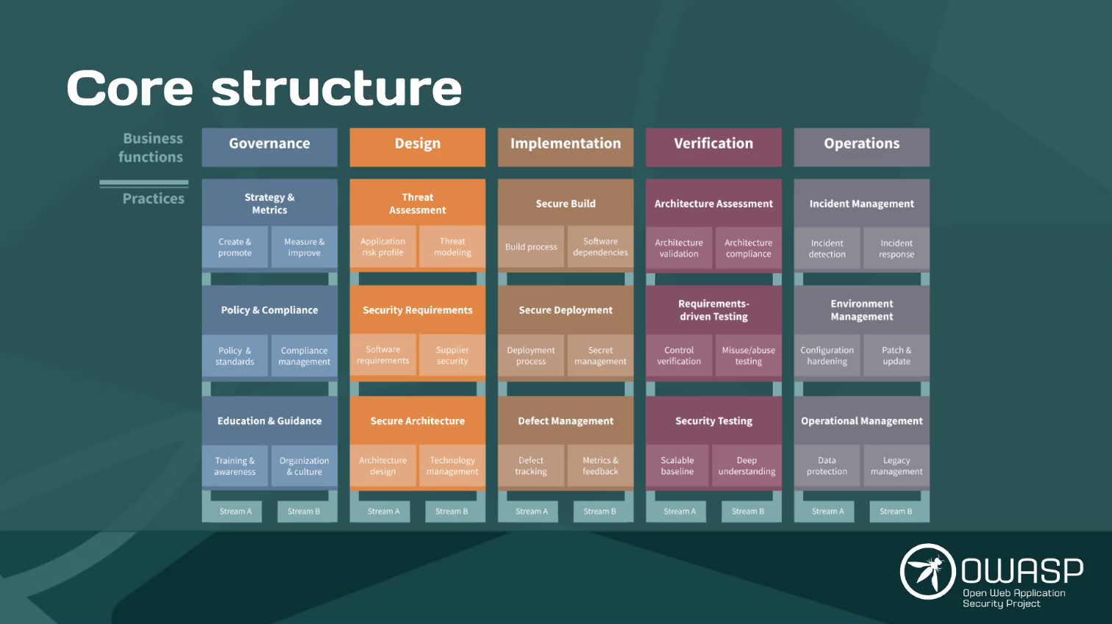

Slide 10
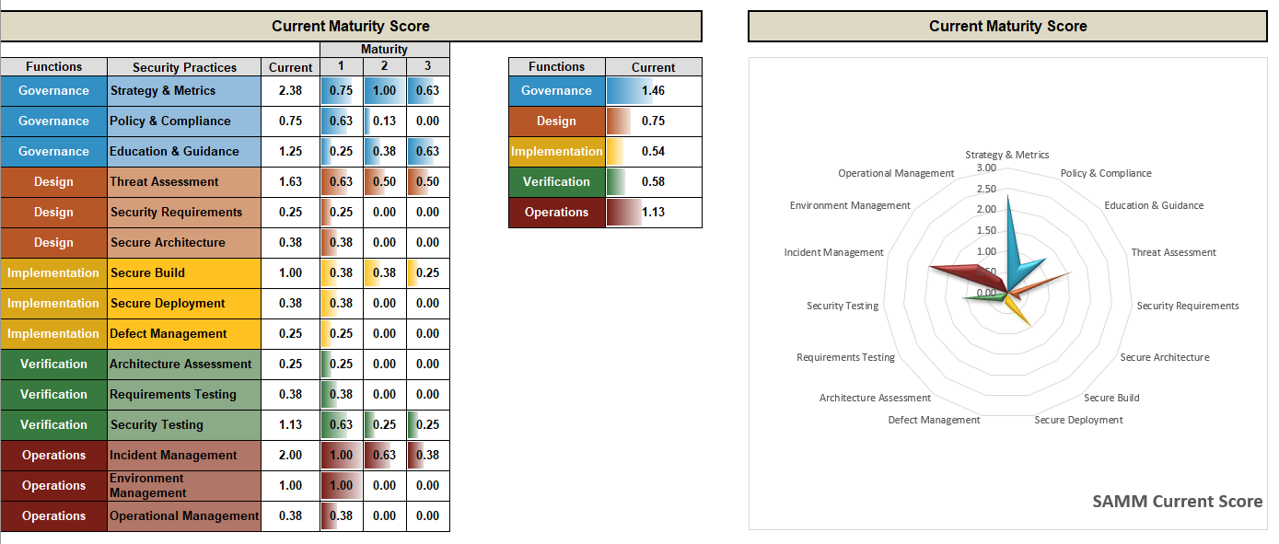
Maturity Scores – Current State

Slide 11
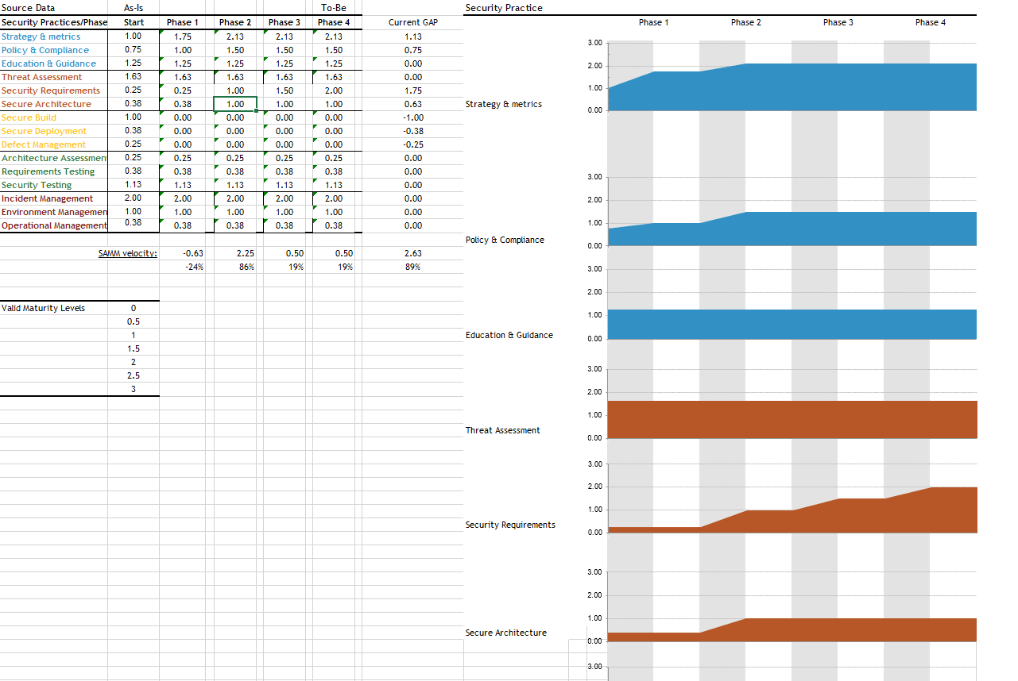
Roadmap Chart

Slide 12
Roles and SAMM Practices
Business Functions | SAMM Practice | Role Responsible?
Governance | Strategy and Metrics
 | Policy and Compliance
 | Education and Guidance
Design | Threat Assessment
 | Security Requirements
 | Security Architecture
Implementation | Secure Build
 | Secure Deployment
 | Defect Management
Verification | Architecture Assessment
 | Requirements-driven Testing
 | Security Testing
Operations | Incident Management
 | Environment Management
 | Operational Management

Slide 13
Roles and SAMM Practices – filled in during the workshop
Business Functions | SAMM Practice | Role Responsible?
Governance | Strategy and Metrics | CISO
 | Policy and Compliance | CISO / Head of AppSec / Legal Council / Product Manager
 | Education and Guidance | CISO
Design | Threat Assessment | Chief Architect / Architect / Product Managers / DevOps / Security Champions / Security Analyst
 | Security Requirements | Head of QA / QA Manager / Security Analyst / Product Owner
 | Security Architecture | Chief Architect / Architect
Implementation | Secure Build | DevOps* , Security Engineer
 | Secure Deployment | DevOps*
 | Defect Management | QA/Tester, Risk Manager
Verification | Architecture Assessment | Security Champions / Auditors
 | Requirements-driven Testing
 | Security Testing | AppSec Manager / DevOps* / QA/Tester
Operations | Incident Management | SOC Manager / SIEM Manager / Tech Support
 | Environment Management | Ops Manager / DevOps*
 | Operational Management | Ops Manager / DevOps*
Top Level Management
Board of Directors
Senior Management
CISO
Head of AppSec / AppSec Manager
Dev
Security Champion
Head of App Dev / Development Manager
Development Team Leader
DevOps
Head Of DevOps / DevOps Manager
Ops
Ops Manager
Head of Infrastructure
HR Executive
Product Management
*: Deployment pipeline team, Deployment manager

Slide 14
Roles and SAMM Practices – our prepared proposal
SAMM Practice | Role Responsible?
Strategy and Metrics | CISO or Board of Directors
Policy and Compliance | CISO
Education and Guidance | Head of AppSec
Threat Assessment | Head of AppSec
Security Requirements | Chief Architect
Security Architecture | Chief Architect
Secure Build | DevOps Manager
Secure Deployment | DevOps Manager
Defect Management | Head of AppDev
Architecture Assessment | Chief Architect
Requirements-driven Testing | Head of AppDev
Security Testing | Head of AppSec
Incident Management | Security Response Manager
Environment Management | Chief Architect or Operations Manager
Operational Management | Operations Manager

Slide 15
List of Relevant Organisational Roles
Top Level Management
Board of Directors
Senior Management
CISO
Head of AppSec / AppSec Manager
Dev
Security Champion
Head of App Dev / Development Manager
Development Team Leader
DevOps
Head Of DevOps / DevOps Manager
Ops
Ops Manager
Head of Infrastructure
HR Executive

Slide 16
Recap/Takeaways

