Slide 1
Deployment Automation

Slide 2
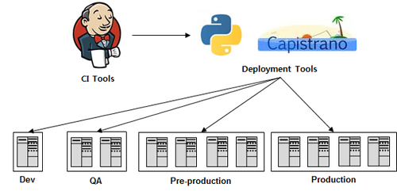
Deployment Automation Overview
CI에 배포의 개념을 더한 CD (Continuous Delivery 또는 Continuous Deployment)라는 개념이 유행하는데, 이는 빌드가 완료된 후, 배포까지 자동화 하는 방법이다.
http://bcho.tistory.com/777 [조대협의 블로그]
Notes:
빌드와 테스트까지 자동화 했으면 그 다음 문제는 배포이다.
수동으로 배포하는 경우 한 두개의 서버라면 별 걱정이 없겠지만, 개발,테스트,운영 환경과 같이 여러 환경에 또한 각 환경에 수십대의 서버에 배포를 해야 한다면, 문제는 달라진다.

Slide 3
Deployment Automation Overview
The ability to automatically and reliably deploy entire application runtime environments is a key factor to optimizing the average time it requires to take features from idea to the hands of your customers.
This minimization of feature cycle time or feature lead time is, after all, the primary goal of Continuous Delivery.
Notes:
전체 응용 프로그램 런타임 환경을 자동으로 안정적으로 배포하는 기능은
아이디어를 고객의 손으로 가져 가야하는 평균 시간을 최적화하는 핵심 요소입니다.
이러한 기능주기 시간 또는 기능 리드 타임의 최소화는 결국 연속적으로 제공되는 주요 목표입니다.

Slide 4
The Power of Automated Deployments
Production servers can be described as “grown works of art”: An unknown number of commands have been applied by various people over time, often in an ad-hoc manner, and written documentation is commonly outdated, if at all present
Due to the inability to fully understand and entirely reproduce such environments, companies periodically create full server backups to be prepared against server loss
restoring an environment from backups may consume considerable resources with uncertain success
Notes:
로덕션 서버는 "성장한 예술 작품"으로 묘사 될 수 있습니다. 많은 사람들이 알 수없는 명령을 종종 비정상적으로 여러 사람에게 적용했으며 서면으로 작성된 문서는 모든 경우에 일반적으로 시대에 뒤진 것입니다.
이러한 환경을 완전히 이해하지 못하고 완전히 복제 할 수 없기 때문에 회사는 주기적으로 서버 손실에 대비할 수 있는 전체 서버 백업을 만듭니다
백업으로 환경을 복원하는 것은 불확실한 성공으로 상당한 자원을 소비 할 수 있습니다

Slide 5
The Power of Automated Deployments
Continuous Delivery embraces automated deployments in various stages of the software delivery process and identifies manual deployments as one of the common release anti-patterns
over time, all deployments should be fully automated to make releasing software a repeatable and reliable push-button activity
Notes:
Continuous Delivery는 소프트웨어 배포 프로세스의 여러 단계에서 자동화 된 배포를 수용하고 수동 배포를 일반적인 릴리스 방지 패턴 중 하나로 식별합니다.
시간이 지남에 따라 모든 배포는 소프트웨어를 반복 가능하고 신뢰할 수있는 푸시 버튼 활동으로 만들기 위해 완전히 자동화되어야 합니다.

Slide 6
The Power of Automated Deployments
manual deployments are not consistent across environments
manual deployments are slow, neither repeatable nor reliable
manual deployments require extensive documentation (often outdated)
manual deployments hinder collaboration (usually conducted by a few experts)

Slide 7
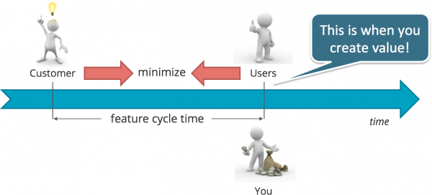
The Power of Automated Deployments
Create value quickly – Deployment Automation helps minimize your Feature Cycle Time

Slide 8
Main Benefits of Deployment Automation
Repeatability – Every deployment deploys the same
Fewer errors – Removing manual steps reduces human error
Anyone can deploy – eliminate bottlenecks by removing the need for experts to do the work
Work on what matters – developers can spend time working on new features, not on fixes for manual deployments
Customer satisfaction – frequent updates with new features addresses customer needs sooner and keeps organizations competitive
Lower costs – fewer errors, fewer human hours needed for deployments means lower costs

Slide 9
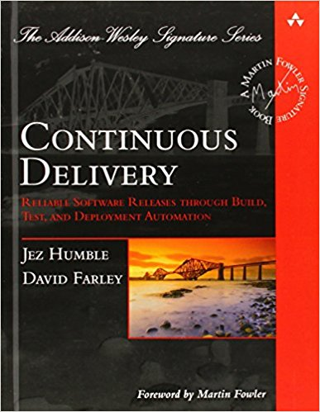
In the Continuous Delivery Deployment Pipeline
“A deployment pipeline is, in essence, an automated implementation of your application’s build, deploy, test and release process.”
Jez Humble and Dave Farley
http://www.yes24.com/24/goods/3613052?scode=032&OzSrank=16
Notes:
배포 파이프 라인은 응용 프로그램의 빌드, 배포, 테스트 및 릴리스 프로세스의 자동화 된 구현의 본질

Slide 10
In the Continuous Delivery Deployment Pipeline
The problem is then addressed with immediate and utmost attention and corrective measures are taken to minimize the possibility of making the same mistake ever again
a principle that is crucial in Agile Software Development
Notes:
파이프 라인 개념 자체는 Lean Manufacturing과 유사합니다. (결함이 발견 될 때마다 생산 라인이 중단)
린 생산방식의 핵심은 생산과정 안에 있는 낭비(Waste)적 요소들을 최대한 배제시키는 것인데, 이때 낭비적 요소는 노동력, 리드타임, 재고량, Lot size 등을 의미한다.
a principle that is crucial in Agile Software Development.
문제는 즉각적이고 최대한 주의를 기울여 해결되며 같은 실수를 다시 할 가능성을 최소화하기위한 것을 (Continuous Improvement) 라고함

Slide 11
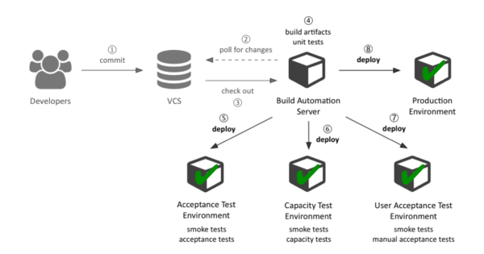
Exemplary Continuous Delivery Deployment Pipeline
Notes:
In general, the process is initiated whenever a developer commits code to a software repository inside the version control system (VCS) such as Subversion or Git
When the build automation server, which acts as the pipeline’s control center, such as Jenkins, observes a change in the repository, it triggers a sequence of stages which exercise a build from different angles via automated tests, but terminates immediately in case of failure
Only when a build passes all stages it is regarded to be of sufficient quality to be released into production.

Slide 12
Exemplary Continuous Delivery Deployment Pipeline
Stage #1: Commit Stage
The build automation server checks out the software repository into a temporary directory, compiles the code and executes any quick running, environment agnostic tests (mostly unit tests)
Stage #2: Acceptance Test Stage
Deployment automation scripts are executed to create an environment
Release artifacts are deployed and smoke tests are executed to verify that the application and related services are up and running
Automated acceptance tests are run to verify the application at the business level where it is asserted that the application conforms to business critical customer acceptance criteria
Notes:
After that, release artifacts such as installer packages are assembled and documentation is generated.
environment agnostic tests 환경에 독립적인 테스트
배포 자동화 스크립트가 실행되어이 단계의 나머지 단계에 전용으로 사용되는 환경을 생성합니다.
이 환경은 프로덕션 환경과 매우 유사하거나 반드시 동일하지는 않습니다
마지막으로 자동화 된 수락 테스트를 실행하여 응용 프로그램이 업무상 중요한 고객 수용 기준을 준수한다고 단언 된 비즈니스 수준에서 응용 프로그램을 확인합니다.

Slide 13
Exemplary Continuous Delivery Deployment Pipeline
Stage #3: Capacity Test Stage
Similar to stage two, but automated capacity tests, typically load tests, are run to verify that the system can serve a defined level of service under production-like load conditions
Stage #4: User Acceptance Test Stage
The customer performs manual user acceptance tests as a final verification step
Notes:
3. 응답 시간 및 처리량과 관련하여 애플리케이션이 비 기능적 관점에서 목적에 부합하는지 여부가 평가됩니다

Slide 14
Exemplary Continuous Delivery Deployment Pipeline
Stage #5: Release Stage
A successful build is made available in a binary repository, such as an Artifactory, from where it can be released into production whenever the business is ready

Slide 15
List of 21 Automated Deployment Tools
https://www.morpheusdata.com/blog/automated-deployment-tools
http://m.itdaily.kr/news/articleView.html?idxno=88905

Slide 16
Reference
https://www.borfast.com/blog/2016/08/29/basic-rules-for-software-deployment/
http://www.codefrenzy.net/2011/10/28/software-deployment-processes/
http://electric-cloud.com/wiki/display/releasemanagement/Deployment+Automation
https://www.dynatrace.com/news/blog/continuous-delivery-101-automated-deployments/
https://zachholman.com/posts/deploying-software
https://blog.xebialabs.com/2010/10/12/deployment-automation-vs-build-automation/
https://continuousdelivery.com/

Slide 17
SELECT question FROM you

