Slide 1
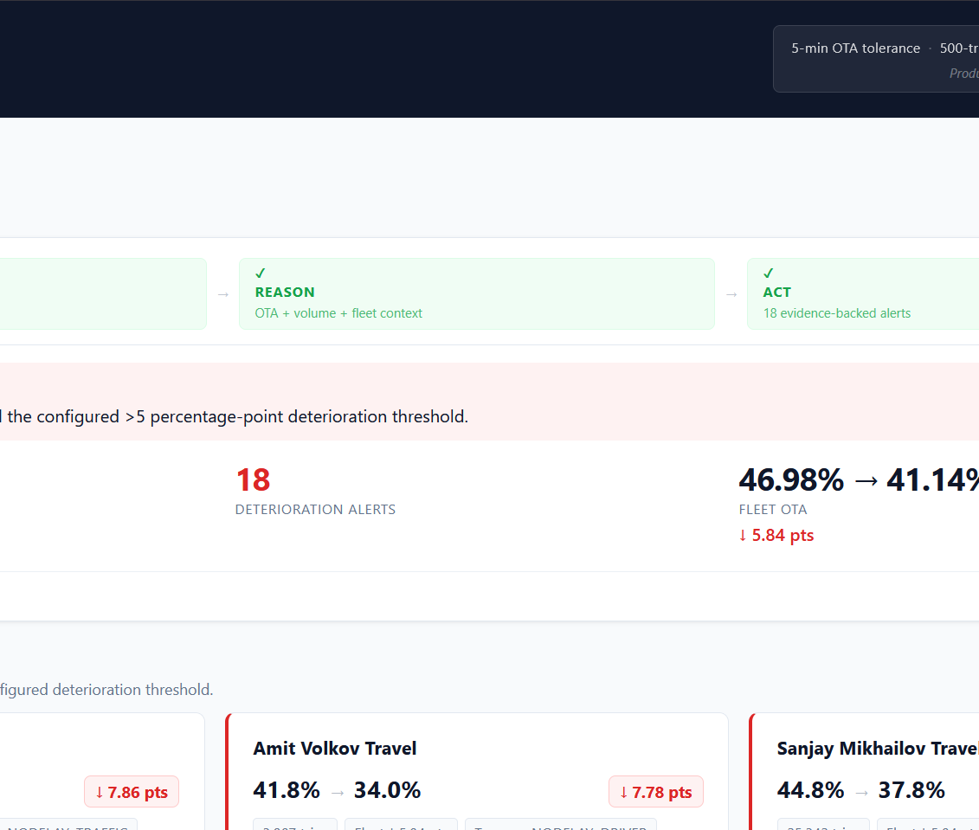
OTA Watchdog
Transport Operations Command Center
Agentic OTA monitoring that senses vendor deterioration, reasons over deterministic evidence, and produces an evidence-safe operational brief.
SENSE → REASON → ACT
254 tests
Commit 63b06ef
Evidence first. Claude second.
The LLM never decides the threshold crossing; it explains verified evidence only.

Slide 2
PROBLEM
Transport metrics arrive without operational context
Transport Managers need to know not just “what is OTA?”, but which vendor deteriorated, compared with what baseline, and what evidence supports action.
Before
Target experience
Outcome
Manual report assembly
Month-over-month context missing
Vendor escalation lacks evidence
LLM risk if facts are generated late
The agent automatically runs the selected analysis window and produces a structured, auditable vendor alert feed.
A manager sees the operational decision immediately: attention required, no material deterioration, or inspect the evidence.
DETERIORATION RULE
VOLUME GATE
>5 pts
500
No root-cause claims
No fabricated numbers
DECISION GAP
Configurable threshold
minimum trips
A metric alone does not tell the manager what to inspect next.
OTA Watchdog · MoveInSync hackathon demo
02

Slide 3
PRODUCT LOGIC
One repeatable agent cycle: Sense → Reason → Act
The interface makes the agent’s behavior visible while keeping all calculations deterministic.
✓
SENSE
✓
REASON
✓
ACT
Monthly ride evidence
OTA + volume + fleet context
Evidence-backed alerts
→
→
Load and normalize May–June–July ride data.
Compute eligible vendors, fleet movement, and threshold crossings.
Materialize alert candidates and generate a safe operational brief.
GUARDRAIL BUILT INTO THE PRODUCT
Claude receives structured evidence after the decision is final; unsafe or unsupported narrative text fails closed to a deterministic fallback.
OTA Watchdog · MoveInSync hackathon demo
03

Slide 4
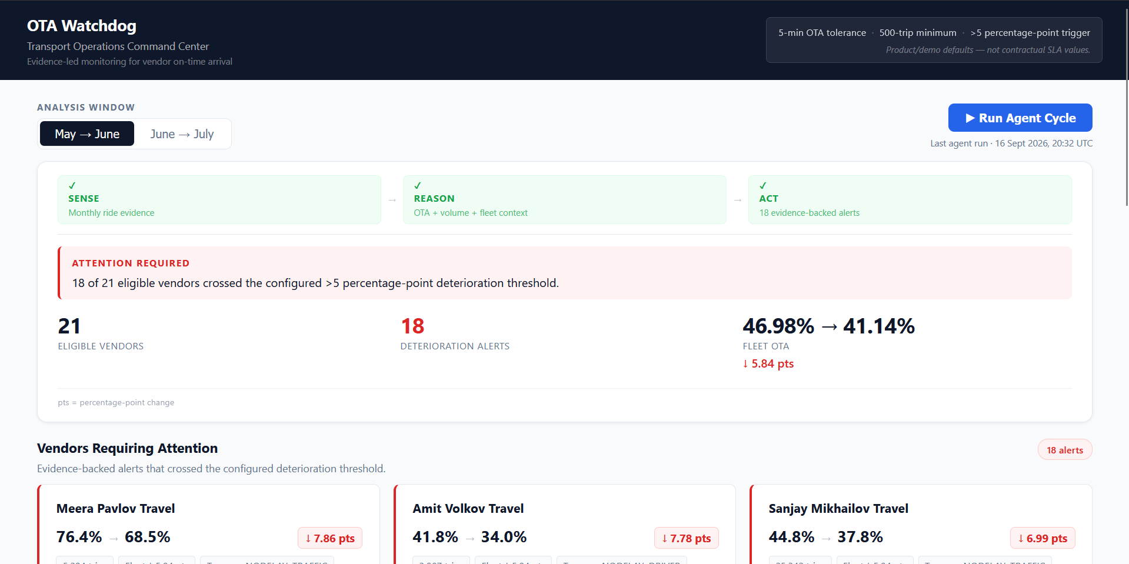
DEMO PROOF
May → June: attention required
The watchdog detects material vendor deterioration and immediately gives the manager a prioritized evidence feed.
SIGNAL
18 of 21 eligible vendors crossed the configured >5 percentage-point threshold.
ELIGIBLE VENDORS
ALERTS
21
18
comparison cohort
evidence-backed
FLEET OTA
46.98% → 41.14%
↓ 5.84 pts
OTA Watchdog · MoveInSync hackathon demo
04

Slide 5
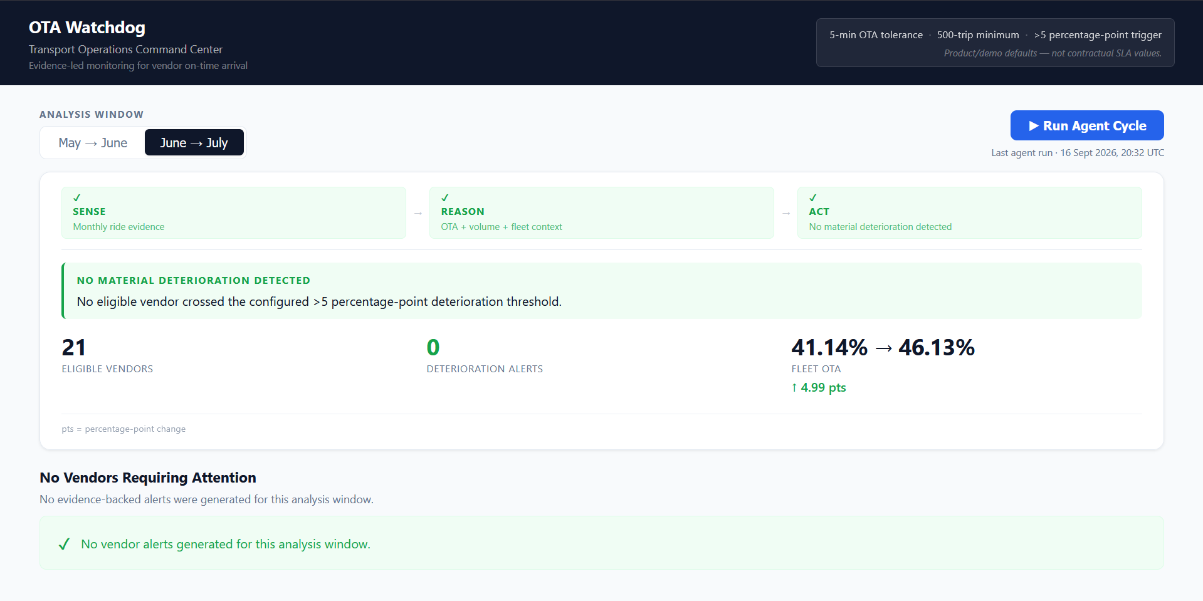
CONTROL PROOF
June → July: no false-positive alerting
The same engine can produce a clear zero-alert state when no eligible vendor crosses the deterioration threshold.
CLEAN OUTCOME
No eligible vendor crossed the configured >5 percentage-point deterioration threshold.
DETERIORATION ALERTS
0
no vendor alerts generated
FLEET OTA
41.14% → 46.13%
↑ 4.99 pts
OTA Watchdog · MoveInSync hackathon demo
05

Slide 6
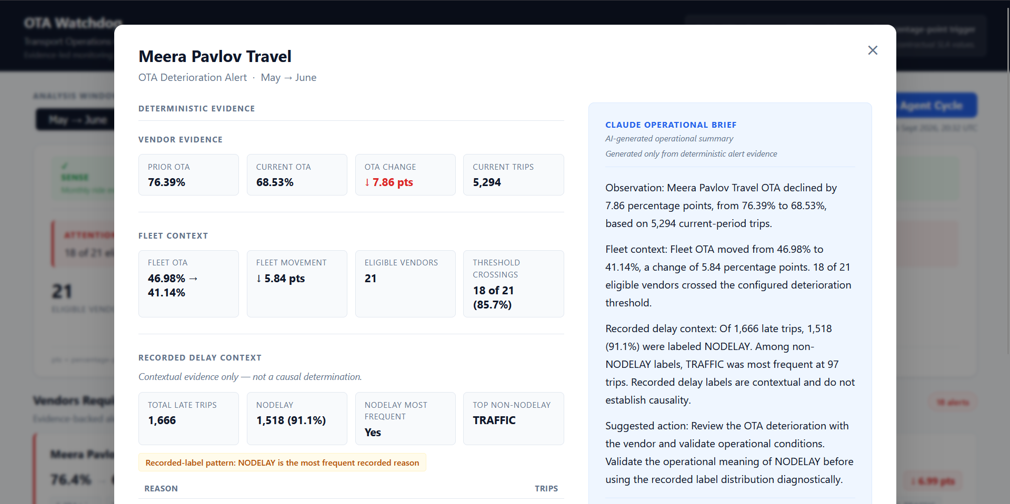
EVIDENCE-SAFE AI
Deterministic evidence decides; Claude explains
The modal makes the boundary visible: left side is computed evidence, right side is the operational brief.
DETERMINISTIC ENGINE
Prior OTA, current OTA, threshold crossings, fleet context, delay labels and policy are computed before the LLM runs.
CLAUDE ROLE
Summarize evidence only. It cannot alter OTA, invent numbers, infer root cause, or decide whether an alert exists.
FAIL CLOSED
Unsafe wording or unsupported numeric values automatically fall back to a deterministic brief.
OTA Watchdog · MoveInSync hackathon demo
06

Slide 7
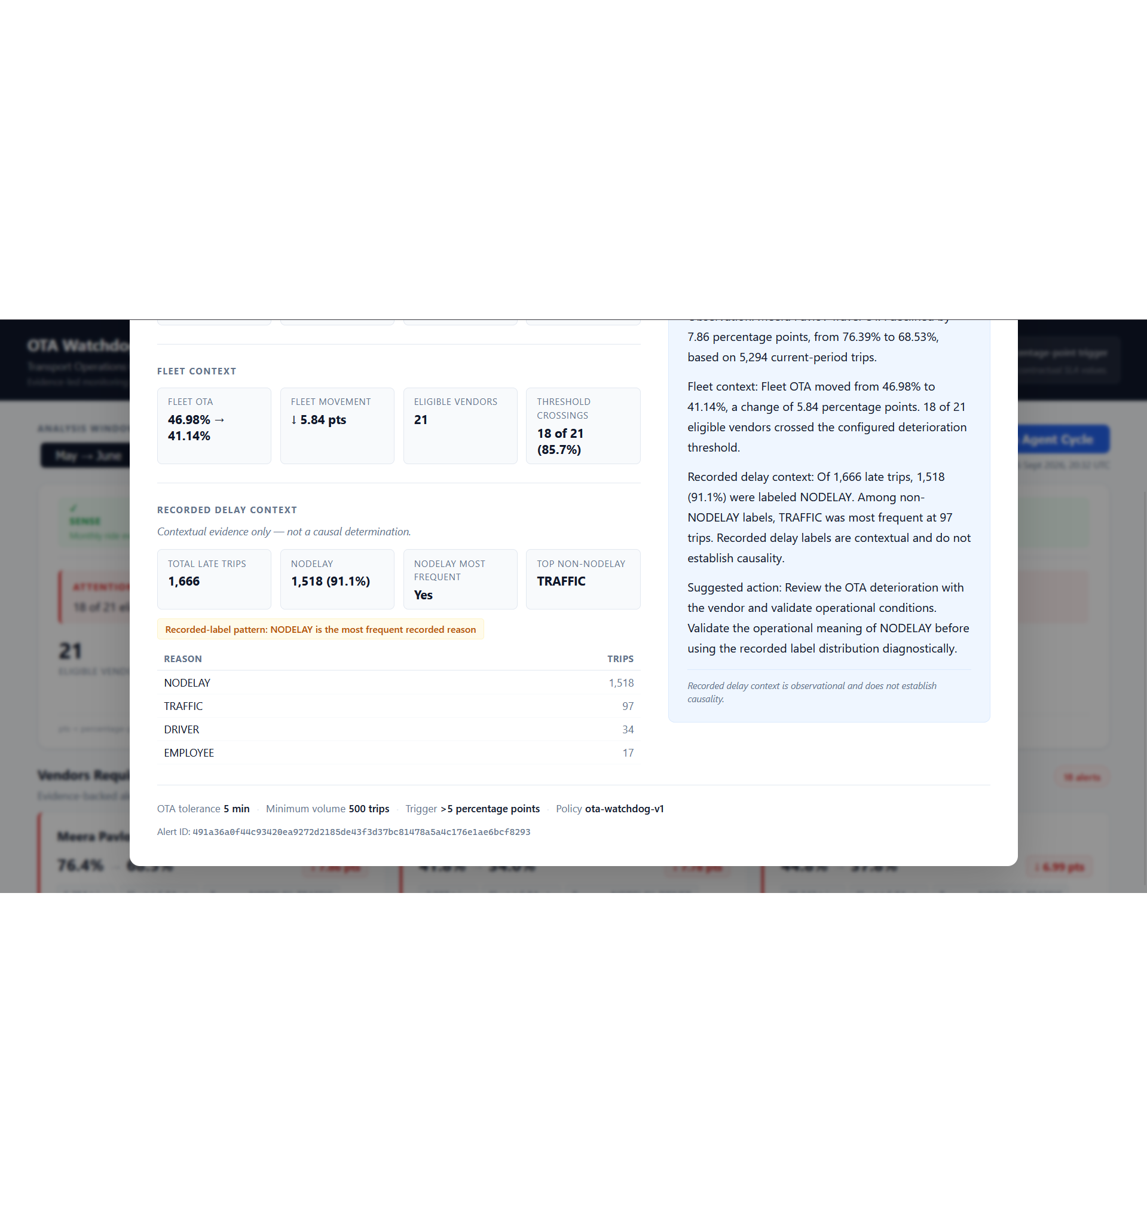
Ready for judge demo
A complete end-to-end MVP: deterministic analytics, command-center UI, Bedrock narrative generation, and fail-closed evidence validation.
5
254
MILESTONES COMPLETED
AUTOMATED TESTS PASSED
42
63b06ef
UNSAFE-LANGUAGE PATTERNS
FINAL COMMITTED BASELINE
Demo path
1. Show May → June attention state
2. Open Meera evidence modal
3. Switch to June → July zero-alert proof
github.com/BackendArchitectX/MoveInSync-App

