Slide 1
Working with Git
Distributed Version Control
Bill Fairfield CSP-D, REP
bill@fairfieldco.com

Slide 2
When I work alone ……
Life is simple!
I write a test
I write my code
I save my code
I run the test and my code passes
And then I am done!
Notes:
And I really don’t think about this process at all.
The code is saved on my hard drive.

Slide 3
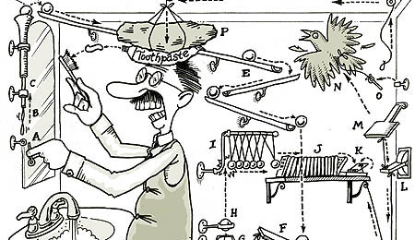
But when I collaborate….
Life is complicated
We are all writing code for the same project
I don’t want anyone to use what I have done until I know it works
I need their changes and additions …. But only after they are known working
What if we both change the same part of the code?
What if somebody screws up?
This Photo by Unknown Athor is licensed under CC BY-NC-ND

Slide 4

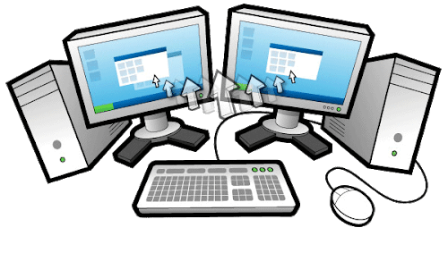

Working with Git
The local repository is on your machine
One core concept when working with Git is a Repository (aka Repo)
Git is an example of a distributed Version Control System, so there are always at least two repos involved:
Local
Remote
The remote repository is on a tropical island somewhere*
*OK, maybe it isn’t really on a tropical island. But I like to think of my code relaxing on a beach after a hard day’s work!

Slide 5
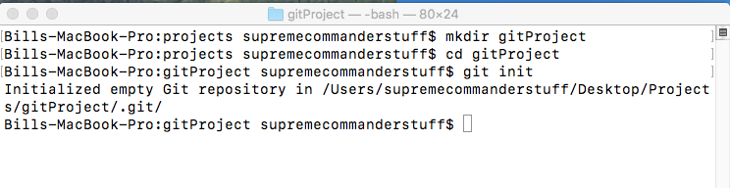
Creating a Git Project
1
2
3
Steps:
Create a directory for your new project (I named mine “gitProject”) (This step isn’t necessary if you already have a directory)
Navigate to that directory
Run $ git init

Slide 6
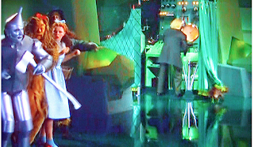
Behind the scenes …. Part 1
The $git init command tells git that this directory should be tracked by git
Git puts a hidden file (.git) into your directory
All of the changes will be recorded in this file.

Slide 7
Behind the scenes …. Part 2
Working Tree
Staging Area
(Index)
Local
Repo
Remote
Repo
.git directory
Notes:
We haven’t built the part on the tropical island yet

Slide 8
Behind the scenes …. Part 2
Working Tree
Staging Area
(Index)
Local
Repo
Remote
Repo
Your machine
Tropical Island
Notes:
No one else has access to the code on my machine.
Note that we have not yet told git about the tropical island. That will be coming later.

Slide 9
Behind the scenes …. Part 2
Working Tree
Staging Area
(Index)
Local
Repo
Remote
Repo
We work here
Edit
Create
Delete
etc
We move finished work we want to commit to the repository here
This contains a complete record of our commit history
This contains files we want to share with others
Notes:
When we save our work, it does not go to the staging area or to the local repository!

Slide 10
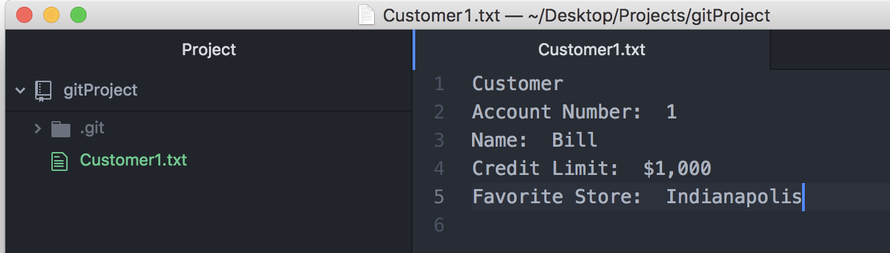
The Working Area
Open a text editor and create a new file for our project. (I made Customer1.txt)
Save the file

Slide 11
Customer1 created and Saved
Working Tree
(gitProject)
Staging Area
(Index)
Local
Repo
Remote
Repo
Customer1
Git considers Customer1 to be “Untracked”, since we haven’t previously committed it
Notes:
Customer1 is on my local machine, in the working tree. There are no copies of it anywhere else

Slide 12
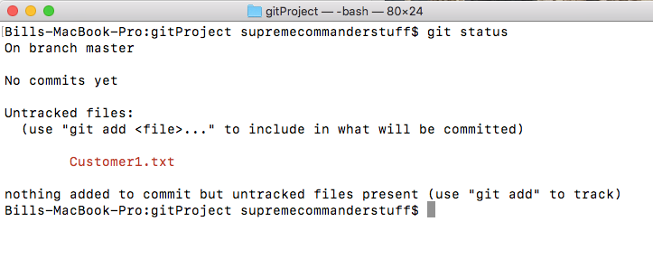
Git Status command
Running the git status command
Git tells us we have one untracked file
Git tells us what to do next

Slide 13
Add the file to the staging area with $git add
Working Tree
(gitProject)
Staging Area
Local
Repo
Remote
Repo
Customer1
Customer1
After running $git add Customer1
Customer1 is now a tracked file, and there is a copy of it in the staging area
Notes:
Syntax notes
We specifically identified the file to be added by using this command:
git add Customer1.txt
We can add all of the files in the working tree to the stagine area wh the command:
git add .

Slide 14
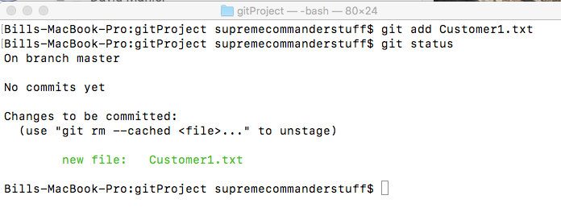
Re-running $git status
$git status tells us that there is a new file that can be committed to the repository (ie, a file has been staged)
It also tells us how to remove the file from the staging area if we don’t want to commit it

Slide 15
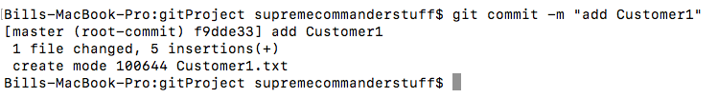
Move the file to the local repository with $git commit
$git commit –m moves everything in the staging area to the local repository
The –m is for adding a message to the commit
Git creates a 40 digit SHA-1 hash to identify this commit action. It displays the first 7 digits
Notes:
Go over the –m syntax here
It is a good idea to add a message to the commit command describing the changes.
If you don’t use the –m, git will assume you really wanted to but just forgot. It will open a vi editor for you to type your message.
Do you know how to close a vi editor? If not, then don’t foget the –m and to include a message!

Slide 16
Committing the change to the local repo with $git commit -m
Working Tree
(gitProject)
Staging Area
Local
Repo
Remote
Repo
Customer1
Customer1
Customer1

Slide 17
Recap 1
gitProject
Step 1: We created the directory that
will hold all of our files and subdirectories

Slide 18
Recap 2
Step 2: We told git to track this directory with $git init
Git created the .git directory, and the corresponding staging area and local repo.
The remote island doesn’t exist yet
Working Tree
(gitProject)
Staging Area
Local
Repo
Remote
Repo
Notes:
Note that these are all empty at the moment.

Slide 19
Recap 3
Step 3: we created a new file in our working tree (gitProject)
gitProject
Staging Area
Local
Repo
Remote
Repo
Customer1

Slide 20
Recap 4
Step 4: We added the file to the staging area in a two commands
$git status to see if there were any untracked changes
$git add Customer1.txt to stage the file
gitProject
Staging Area
Local
Repo
Remote
Repo
Customer1
Customer1
© 2021 Fairfield & Company

Slide 21
Recap 5
Step 5: we ran $git commit
to commit all of the files in the staging area to the local repo. The local repo created a record of this commitment
gitProject
Staging Area
Local
Repo
Remote
Repo
Customer1
Customer1
Customer1

Slide 22

Question …..
What would you expect to happen if we ran
$git status
after we committed our changes?

Slide 23
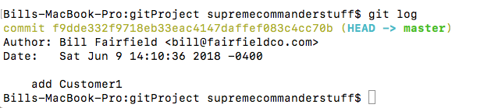
$git log
$git log
is used to display the history of commits to our local repository
So far, there has only been one commit made
Local
Repo
40 digit hash
Author name,
email and date
What was changed
Customer1

Slide 24
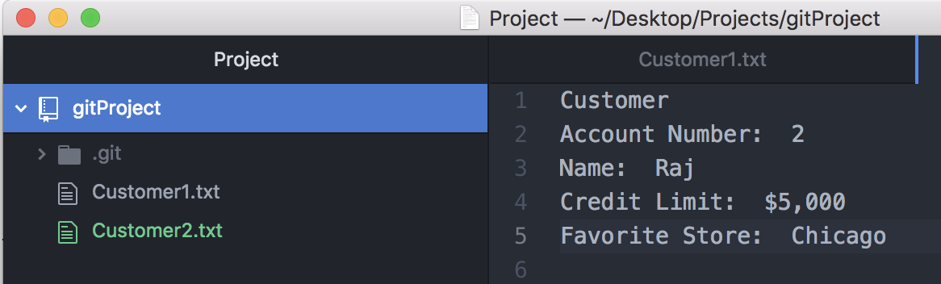
Adding another file
Create a second file in our project in your text editor
I named mine “Customer2.txt”
Put some information in your new file

Slide 25
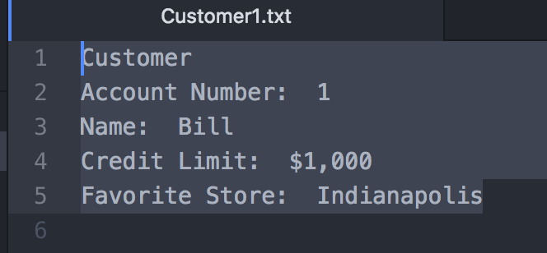
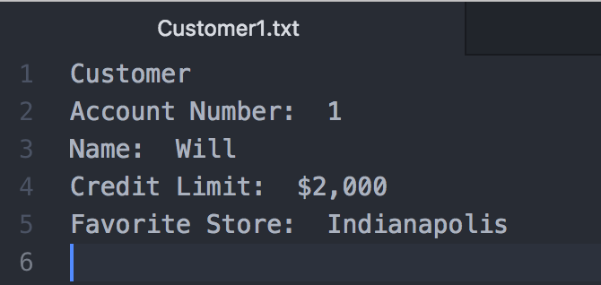
Editing the first file
Changes to Customer1
Original
The name and the credit limit have been changed
Revised

Slide 26
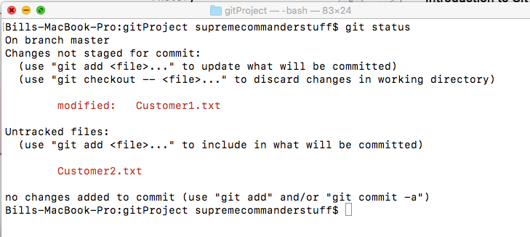
Running $git status
As expected, git tells us that we have one modified file, and one new (untracked) file

Slide 27
Current state of the project
gitProject
Staging Area
Local
Repo
Remote
Repo
Customer1
Revised Customer1
Customer2
Customer1
© 2021 Fairfield & Company

Slide 28
What did we change?
gitProject
Staging Area
Customer1
$git diff
Customer1
Customer2

Slide 29
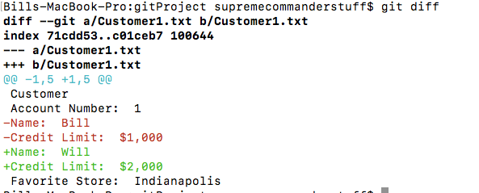
What’s different in our modified file?
In order to see the differences between a file in our working tree and one currently in the staging area, we can use:
$git diff
Note that $git diff
didn’t mention anything about Customer2.txt
Why not?

Slide 30
Staging the files
When we ran $git status (slide 26) it showed one changed file and one untracked file
We would like to stage these files so that we can commit our changes
Option 1:
$git add Customer1.txt Customer2.txt
Option 2:
$git add .
(add .) means to add all new and changed files in the working tree to the staging area
Option 3:
$git add Cust*
The * is a wild card. Any file that begins with “Cust” in the working tree will be staged

Slide 31
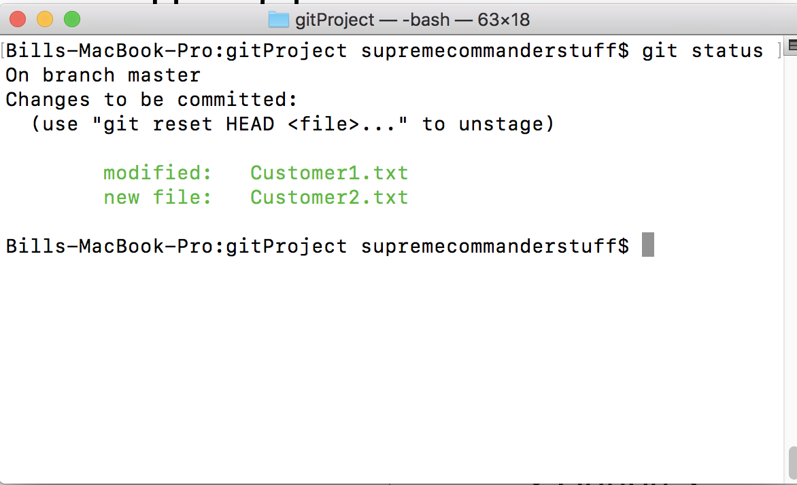
Quick Check
Stage the 2 files using any of the options on the previous slide
What will happen when we run $git status

Slide 32
Current state of the project
What would happen if we ran
$git diff
gitProject
Staging Area
Local
Repo
Remote
Repo
Revised Customer1
Customer 2
Revised Customer1
Customer2
Customer1

Slide 33

Executing the commit
We commit our files the same way we did before:
$git commit -m
Note that we do not have to tell git which files to commit
It will commit everything in the staging area.
Notes:
But we did need to include a real message! Otherwise, the vi editor opened up for us!

Slide 34
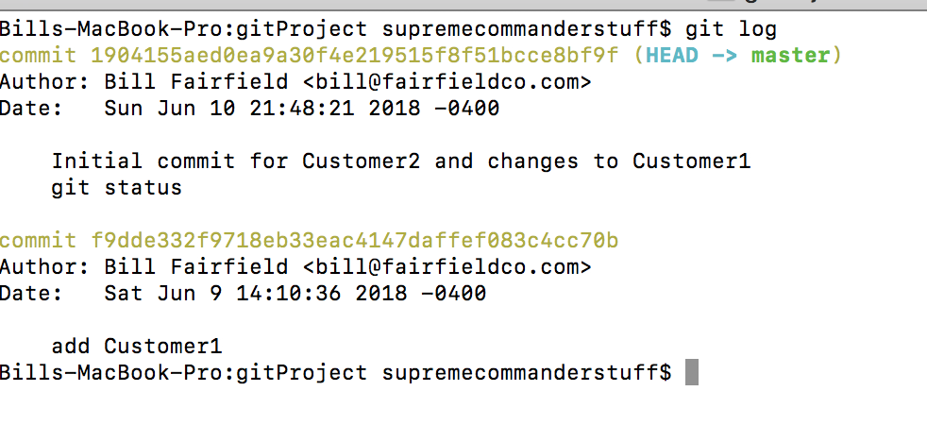
Close-up of the Local Repo
Local
Repo
Revised
Customer1
Customer2
Customer1

Slide 35
Removing a file from the Repo
$git rm filename
Is the command to remove a file from the repository
This command
Removes the file from the Working Tree
It also stages the removal so that the change removing the file can be committed
What would be the sequence of commands to remove Customer2 from the repository?

Slide 36
$git rm Customer2.txt
gitProject
Staging Area
Local
Repo
Remote
Repo
Customer1
Customer1
Customer2
Customer1
Customer1

Slide 37
$git commit
gitProject
Staging Area
Local
Repo
Remote
Repo
Customer1
Customer1
Customer1
Customer2
Customer1
Customer1

Slide 38
Undoing changes in the working tree
Suppose I have made changes to a file in my working tree and saved them
Then I decide I don’t like what I just did
What can I do?
Option 1
$git diff
This command will show me the differences between the file in my working tree and the file in the staging area.
But I would have to make the changes manually.

Slide 39
$git checkout --filename
gitProject
Staging Area
Customer1
Checkout resets the contents of a file to match the currently staged version of that file
Customer1
$git checkout -- filename
© 2021 Fairfield & Company

Slide 40
Undoing changes in the staging area
Suppose I have made changes to a file in my working tree and saved them
And then I staged them with $git add
Now I realize that those changes weren’t a good idea
What can I do?
The command
$git reset HEAD filename
Will reset the contents of a file in the staging area to the contents of that file in the local repository

Slide 41
$git checkout --filename
gitProject
Staging Area
Local
Repo
Customer1
Customer1
Customer1
Customer2
Customer1
Customer1
$git checkout -- filename
$git reset HEAD filename

Slide 42


Setting up the remote repository
The remote repository must be created on the git website.
When you create the remote repository, Git will give you its URL
Then, we must connect the remote repository with our local repository
We do this with the following command:
$git remote add origin <url of remote repository>
Notes:
Note: You can get the URL of the newly created repository from the site.

Slide 43
Pushing the project to git
Once the remote repository has been set up and linked to the project, we can push the code to the remote with the following command:
$git push remote master

Slide 44
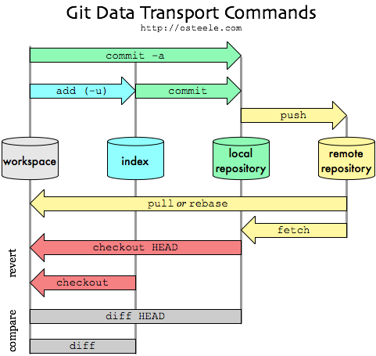
Summary
© 2021 Fairfield & Company

