Slide 1
CONTENTS
CERTIFICATE
ACKNOWLEDGE
HARDWARE AND SOFTWARE USED
ABOUT PROJECT
INTRODUCTION
AIM
WORKING
OUTCOME
ADVANTAGE
SOURCE CODE
SQL TABLE
OUTPUT
REFERENCE

Slide 2
HARDWARE AND SOFTWARE REQUIREMENTS
Hardware:
This project can run on any basic computer system with a minimum of 4GB RAM, a dual-core processor, and around 500MB of free storage space. A standard keyboard and mouse are sufficient for operating the program. The project works on commonly used operating systems like Windows, macOS, or Linux.
Software used:
The project requires Python 3.x, MySQL Server, and the MySQL Connector library to enable database connectivity. The cryptography module is used for encrypting and decrypting passwords securely. A code editor such as VS Code, PyCharm, or Python’s IDLE can be used to write and execute the program.

Slide 3
INTRODUCTION
CipherSafe: Encrypted Password Manager
In today’s world, almost every online service requires a password, making it difficult for users to remember multiple secure passwords. Many people reuse the same password everywhere, which is unsafe and can lead to hacking or unauthorized access. To solve this problem, a Password Manager helps store all passwords safely in one place.
This project is a simple and secure Password Manager created using Python and MySQL. It allows users to add, view, and manage their passwords easily. All passwords are stored in encrypted form using the Fernet encryption technique, ensuring complete safety even if someone accesses the database.
The project is easy to use, efficient, and demonstrates practical concepts like database connectivity, encryption, and backend programming. It aims to help users store strong and unique passwords without worrying about remembering all of them manually.

Slide 4
AIM OF THE PROJECT
In today’s world, almost every online service requires a password, making it difficult for users to remember multiple secure passwords. Many people reuse the same password everywhere, which is unsafe and can lead to hacking or unauthorized access. To solve this problem, a Password Manager helps store all passwords safely in one place.
This project is a simple and secure Password Manager created using Python and MySQL. It allows users to add, view, and manage their passwords easily. All passwords are stored in encrypted form using the Fernet encryption technique, ensuring complete safety even if someone accesses the database.
The project is easy to use, efficient, and demonstrates practical concepts like database connectivity, encryption, and backend programming. It aims to help users store strong and unique passwords without worrying about remembering all of them manually.

Slide 5
WORKING OF THE PROJECT
The Password Manager works by allowing the user to store, retrieve, and manage passwords through a simple menu-based interface. When the program starts, it automatically connects to the MySQL database and creates the required table if it does not already exist. The user can then choose actions such as adding a new password, generating a strong password, viewing saved passwords, or listing all stored services.
Whenever a password is added or generated, the program encrypts it using the Fernet encryption method before storing it in the database. This ensures that even if someone opens the database, the passwords remain unreadable. During retrieval, the program decrypts the stored password using the same key and displays it securely to the user.
All operations—adding, viewing, generating, and listing—are handled through Python functions that interact with the MySQL database. This makes the project smooth, secure, and easy to use while demonstrating practical concepts like encryption, database connectivity, and CRUD operations.

Slide 6
OUTCOMES
This project helped in understanding how Python can be used to build secure and practical applications. By developing the Password Manager, I learned how to connect Python with MySQL and perform important operations like storing, retrieving, and managing data efficiently. The project also strengthened my understanding of encryption and why it is important to protect sensitive information like passwords.
Working on this project improved my skills in backend programming, database handling, and secure data storage. I also gained hands-on experience with libraries such as mysql.connector and cryptography, which are commonly used in real-world applications. The project shows how a simple program can become powerful when combined with proper security methods.
Overall, the Password Manager successfully achieves its goal of storing passwords securely and making the user experience easy and reliable. It demonstrates the practical use of programming concepts in solving everyday problems related to password management.

Slide 7
ADVANTAGES
The Password Manager offers a secure and convenient way to store and manage multiple passwords. Since all passwords are encrypted before being saved, users can be confident that their data remains protected even if someone accesses the database. This reduces the risk of hacking and improves overall digital safety.
The project also saves time by eliminating the need to remember several complex passwords. Users can easily add new passwords, generate strong ones automatically, and retrieve them whenever needed through a simple menu interface. This makes the system user-friendly and suitable for everyday use.
Another major advantage is that the project requires very minimal system resources and works smoothly on most computers. It demonstrates how Python and MySQL can be combined to create efficient, secure, and practical applications, making it a useful learning tool for understanding real-world programming concepts.

Slide 8
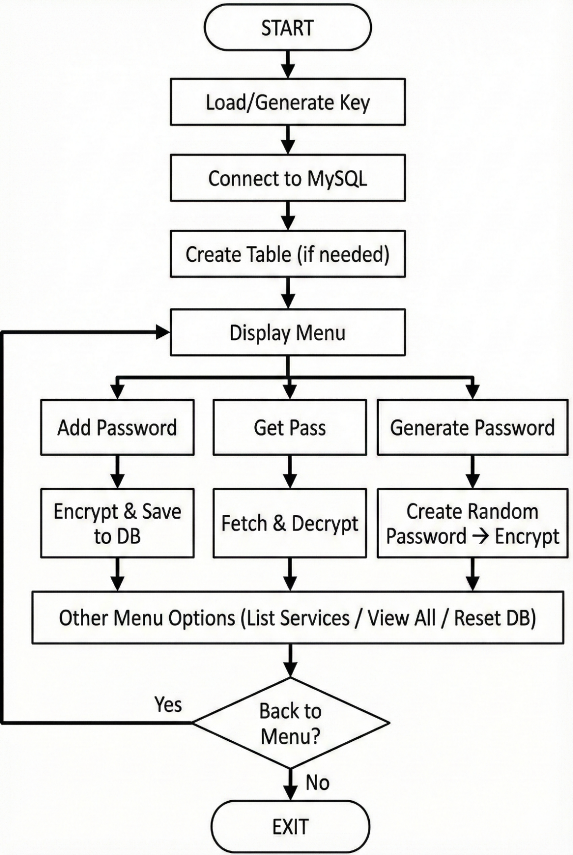
FLOWCHART OF THE CODE

Slide 9
REFERENCE
NCERT – Informatics Practices (Class XII)
Concepts of Python, MySQL connectivity, and database operations.
Python Official Documentation
https://docs.python.org
Used for understanding Python syntax, modules, and functions.
MySQL Official Documentation
https://dev.mysql.com/doc
Referred for SQL commands, table creation, and database connectivity.
Cryptography Library Documentation
https://cryptography.io
Used to understand the Fernet encryption technique.
W3Schools – Python & SQL Tutorials
https://www.w3schools.com
Referred for basic examples of Python-MySQL integration and SQL queries.
Stack Overflow
Used only for minor debugging and clarifications during project development.

Slide 10
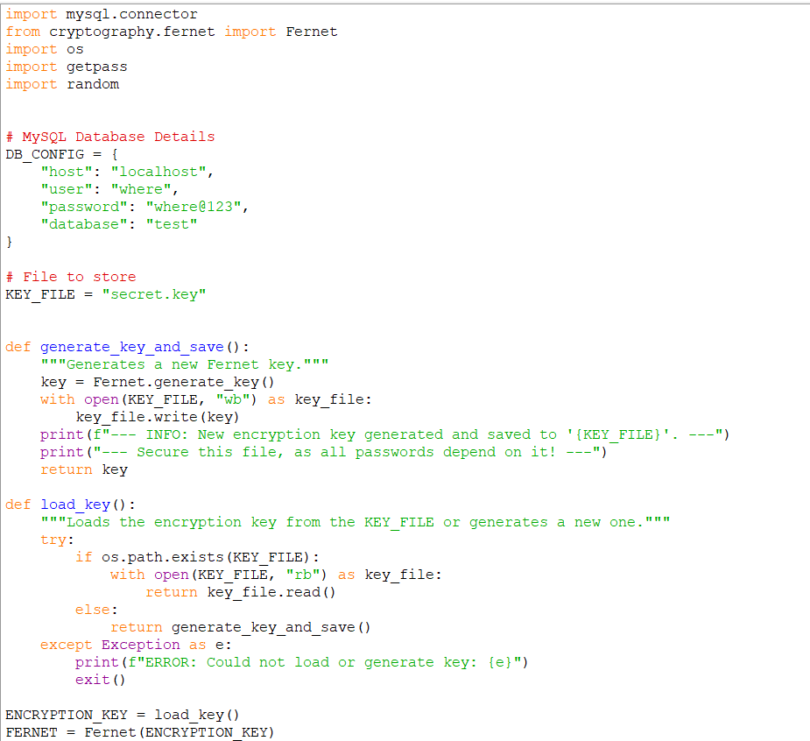
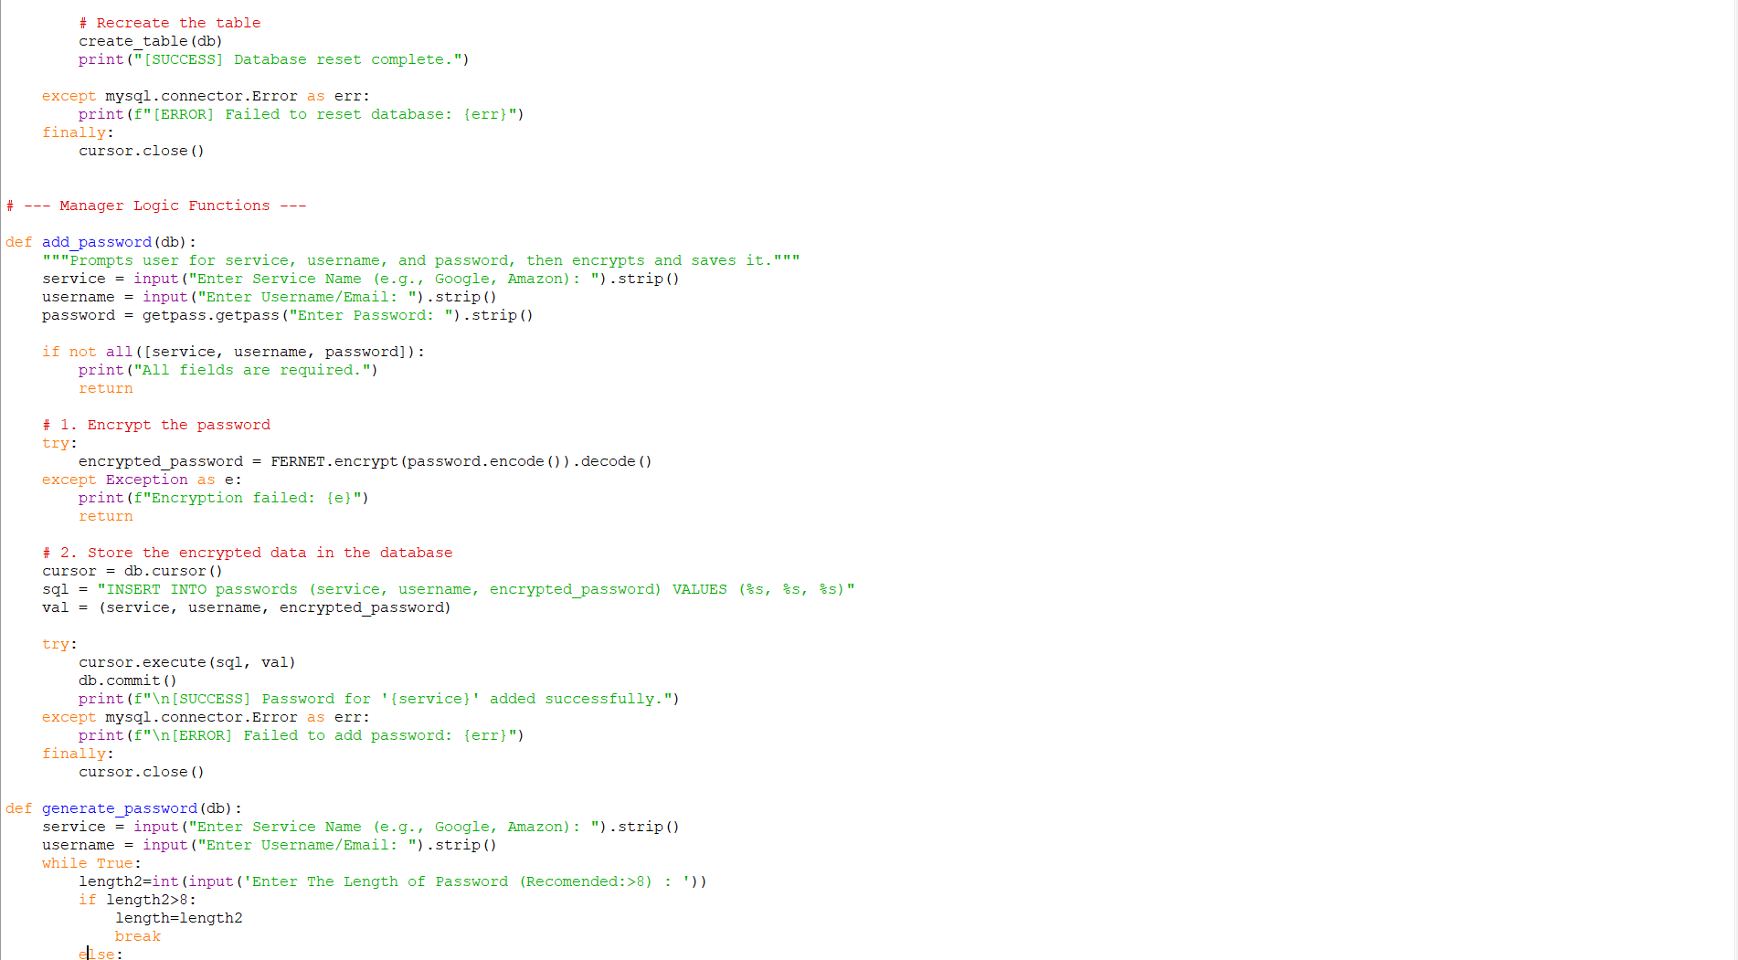
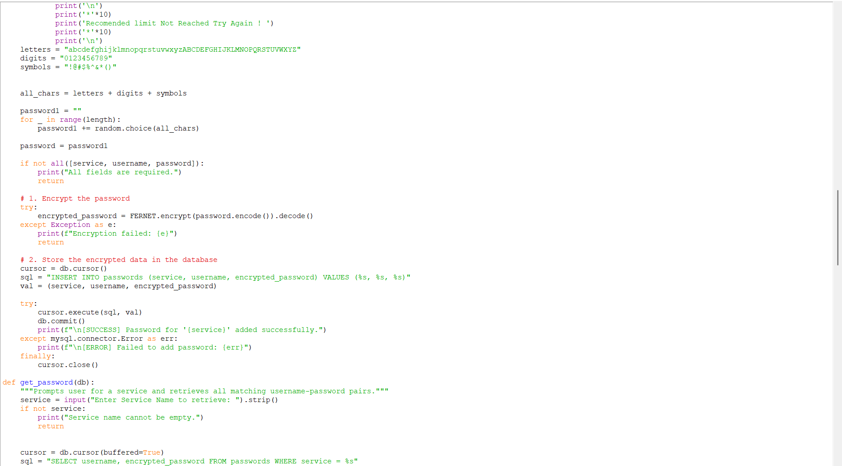
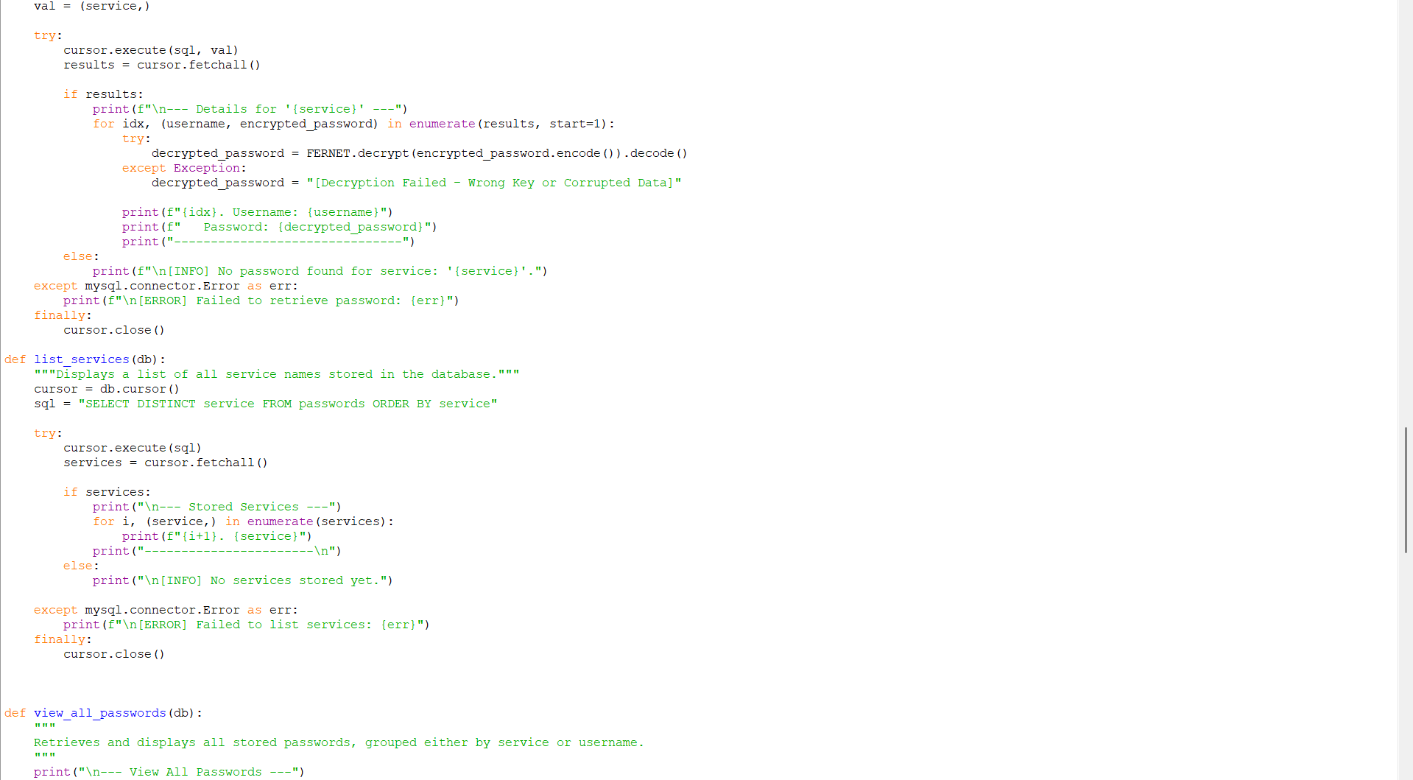
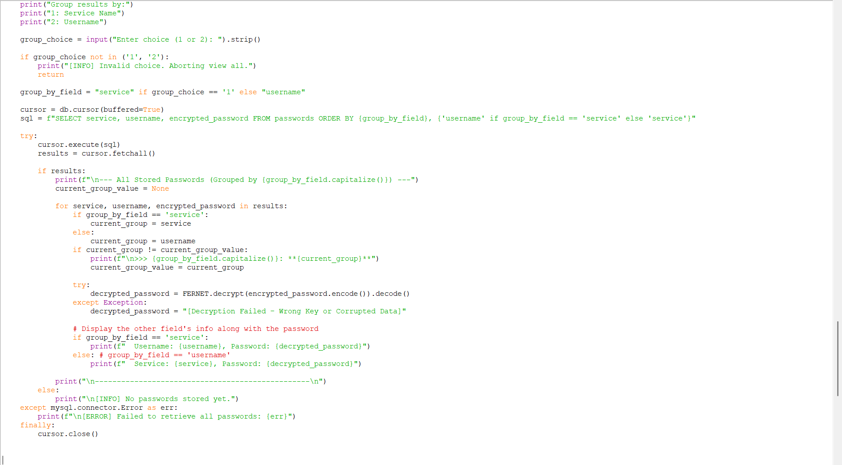
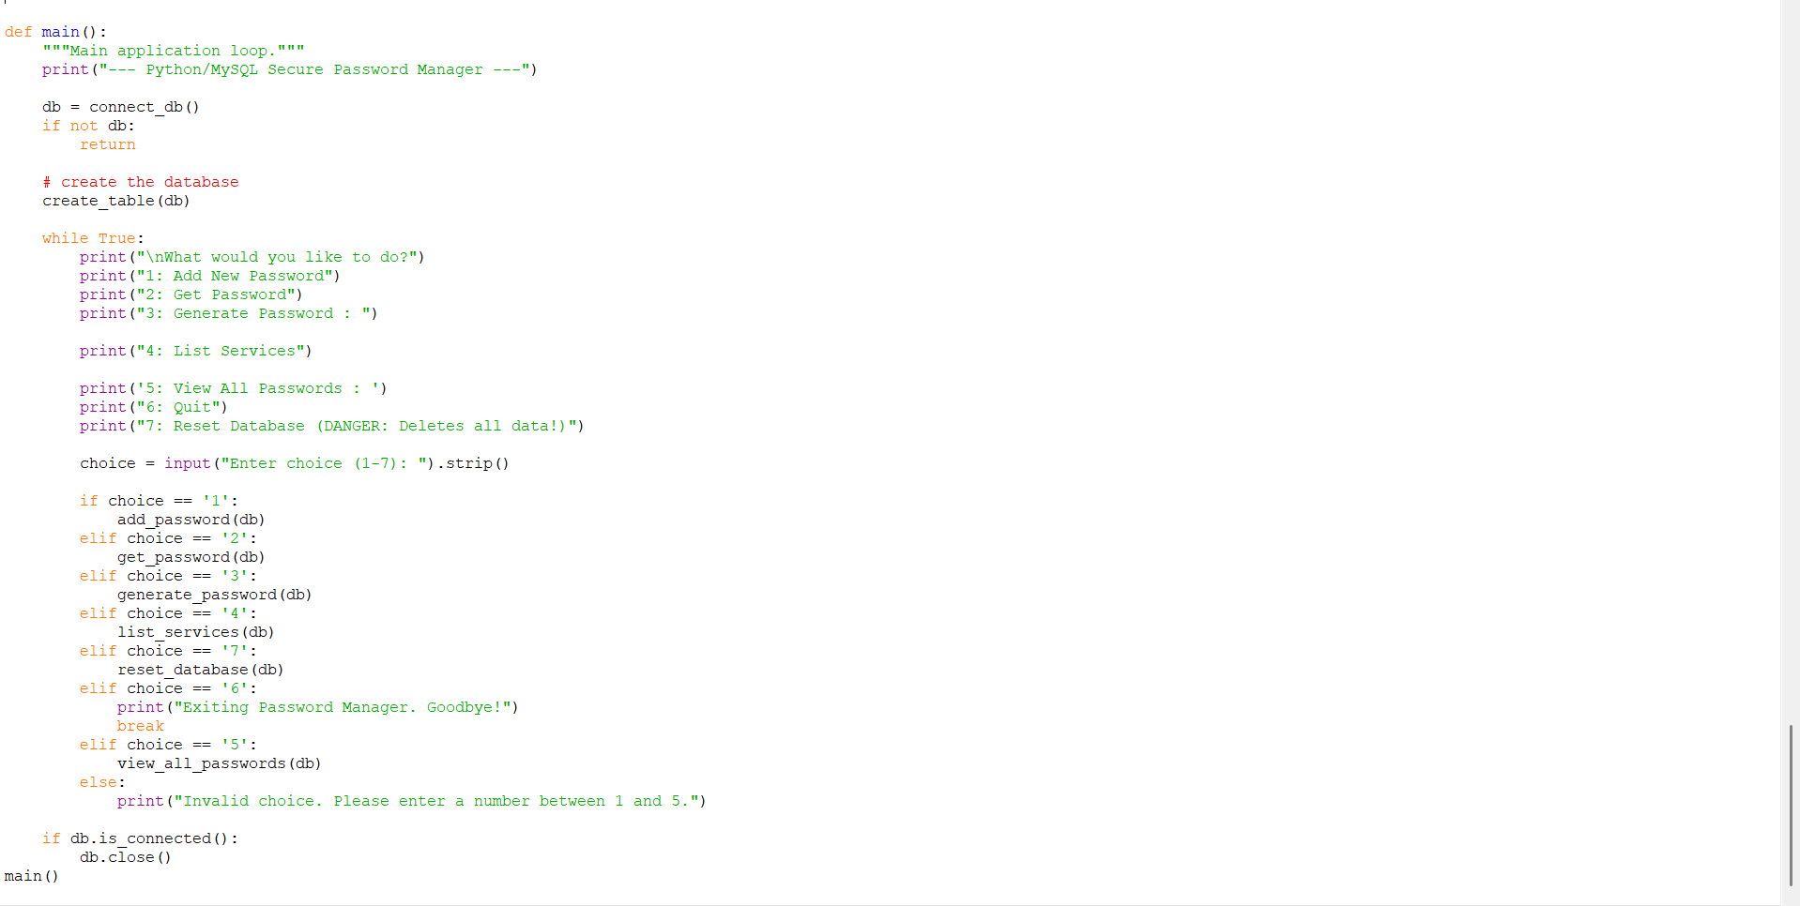
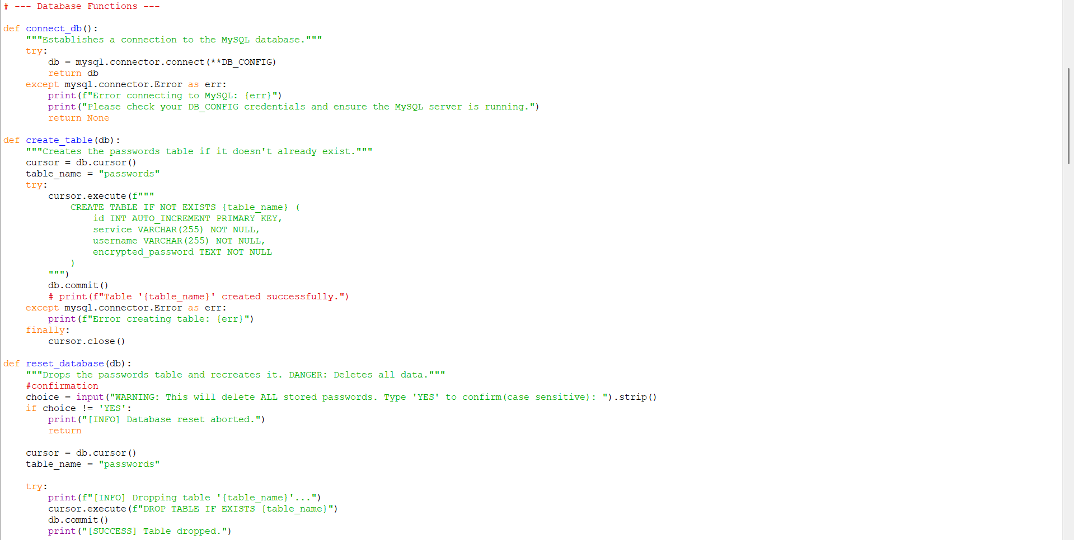
SOURCE CODE

Slide 14
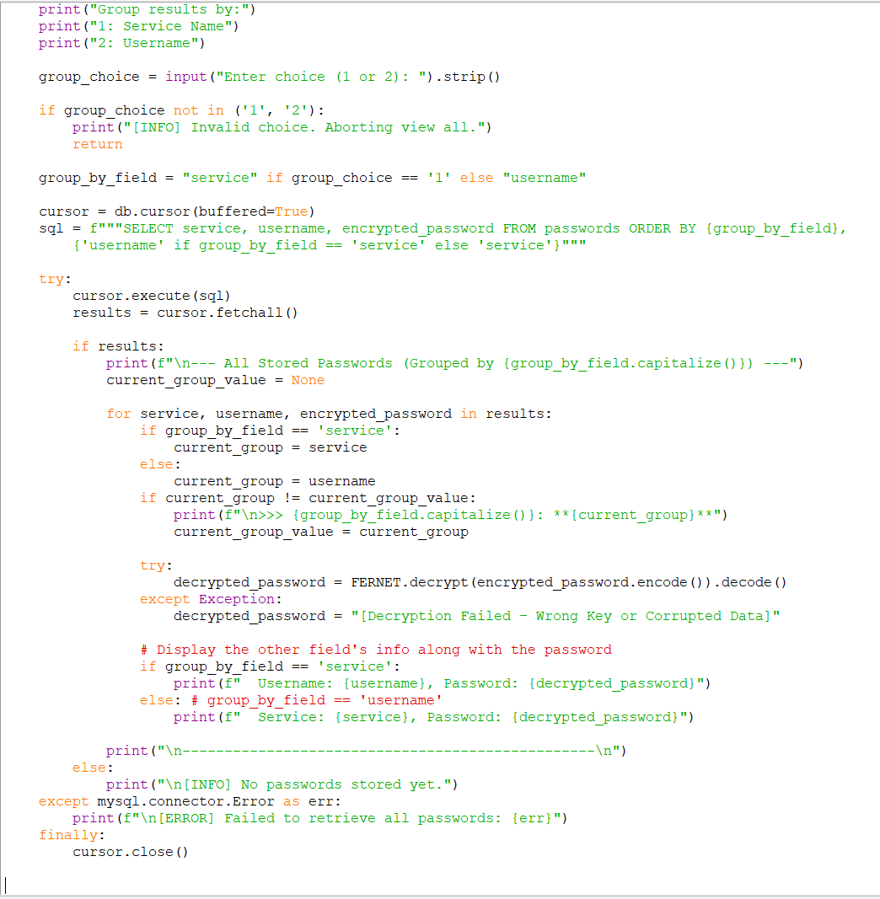

Slide 16
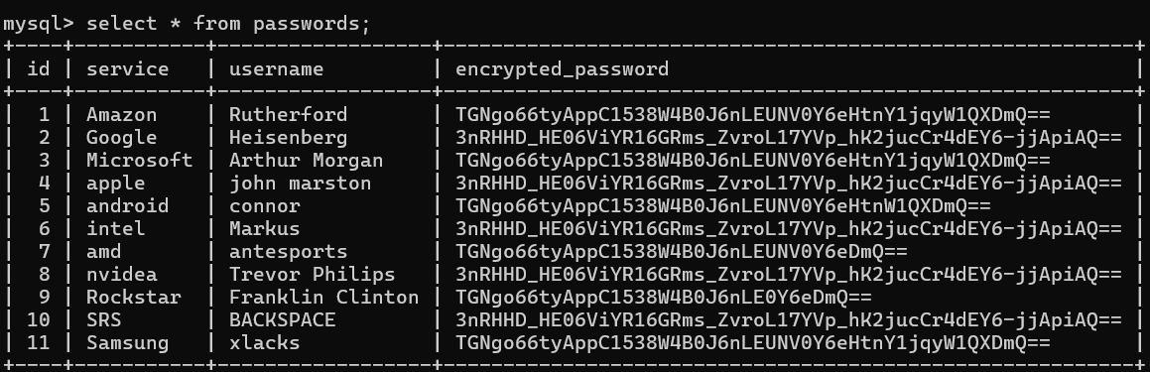
MYSQL TABLE
ID | Service | Username | Encrypted Password
1 | Amazon | Rutherford | TGNG66tyAppC1538W4B0J6NLEUNV0Y6eHTNY1jqyW1QXDMQ==
2 | Google | Heisenberg | 3nRHHD_HE06ViYR16GRms_Zvr01I7YVp_hK2jucCr4dEY6-jjApiAQ==
3 | Microsoft | Arthur Morgan | TGNG66tyAppC1538W4B0J6NLEUNV0Y6eHTNY1jqyW1QXDMQ==
4 | Apple | John Marston | 3nRHHD_HE06ViYR16GRms_Zvr01I7YVp_hK2jucCr4dEY6-jjApiAQ==
5 | Android | Connor | TGNG66tyAppC1538W4B0J6NLEUNV0Y6eHTNY1jqyW1QXDMQ==
6 | Intel | Markus | 3nRHHD_HE06ViYR16GRms_Zvr01I7YVp_hK2jucCr4dEY6-jjApiAQ==
7 | AMD | antesports | TGNG66tyAppC1538W4B0J6NLEUNV0Y6eDmQ==
8 | Nvidia | Trevor Philips | 3nRHHD_HE06ViYR16GRms_Zvr01I7YVp_hK2jucCr4dEY6-jjApiAQ==
9 | Rockstar | Franklin Clinton | TGNG66tyAppC1538W4B0J6NLE0Y6eDmQ==
10 | SRS | BACKSPACE | 3nRHHD_HE06ViYR16GRms_Zvr01I7YVp_hK2jucCr4dEY6-jjApiAQ==
11 | Samsung | xlacks | TGNG66tyAppC1538W4B0J6NLEUNV0Y6eHTNY1jqyW1QXDMQ==

