Slide 1
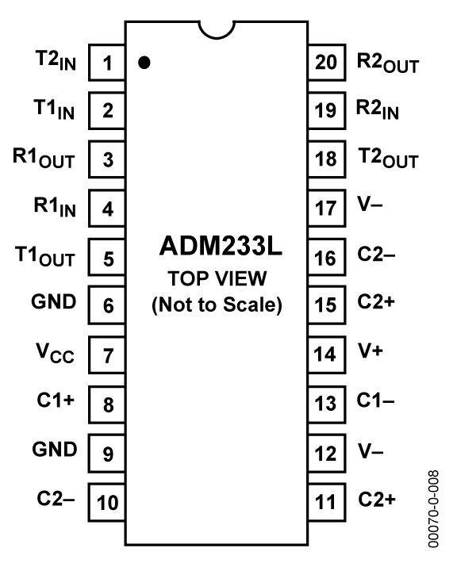
PD3
PD2
Pin 1 on Serial
Pin 2 on Serial
+5v
Notes:
The ADM33L chip is intended for use with transmitting and receiving devices. We use it for RS-232 transmission of data from the AT90 to a serial connection on a HyperTerminal running on the computer. This chip has an on board voltage converter to allow it to run from a single 5 volt power supply.

Slide 2
Serial Cable Connector
To Pin 2 on
ADM233L
To Pin 3 on
ADM233L

Slide 3
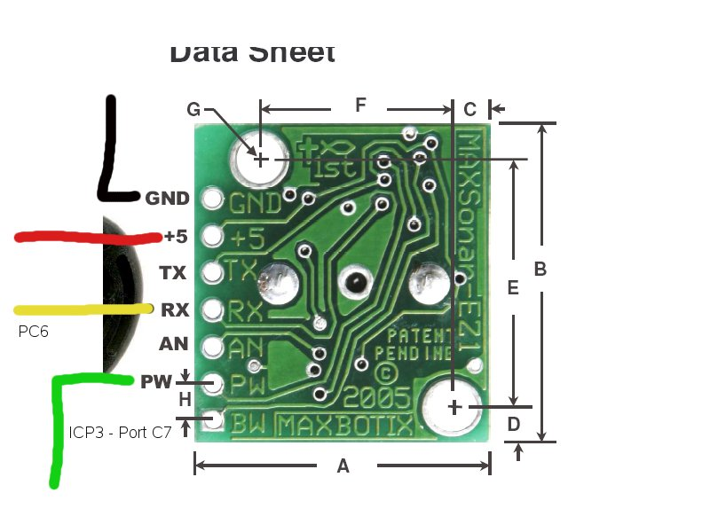
Notes:
The Max Sonar EZ-1 can detect objects from 0 to 254 inches away and can give range information on

