Slide 1
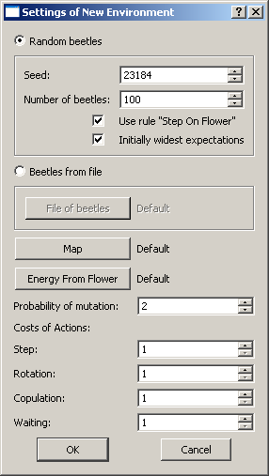
Beetles are created randomly
B eetles are loaded from a file of beetles. File format is the same as the format of any file “name_btl.txt”, which is a part of saved environment.
Seed for generator of pseudorandom numbers
Initial number of beetles. If set to –1, then one fourth of emty cells is filled with beetles.
Map of the environment in bmp format. It should contain walls (red color=255,0,0) and free cells (black=0,0,0). The free cells can have some amount of green, then flowers grow in them (green = 0,1,0 – 0,255,0).
Random beetles are created so, that they make step whenever there is a flower in the front. It helps during the first generations to keep population alive.
Function Energy From Flower should be a bmp file with size 100x50 pixels. Black line states how much energy get a beetle from a flower. See default_eff.bmp for example.
Random beetles have expectations on partner set to maximal intervals. It helps during the first generations to keep population alive.
Probability of mutation states, how it is probable for the genome of a newborn beetle that on of his features inherited from parents undergoes mutation.
How much energy does every beetle consume on these actions.

Slide 2
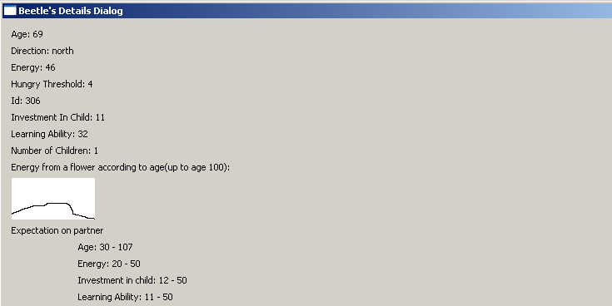
Age of the beetle, not restricted. But length of life is influenced by energy from flower function.
Direction is be up=north, down=south, left=east and right=west relative to the top of the window.
Energy is within range 0-50.
Hungry threshold is within range 0-50.
Id of the beetle.
Investment in child states, how much energy gives this beetle to his new child at birth.
Learning ability states the probability that the beetle learns something on meeting with a beetle that has more energy.
Function energy from flower used for all beetles. See section “Energy from flowers function
Expectations on a partner: ranges within which must a met partner have its features to be attractive for this beetle.

Slide 3
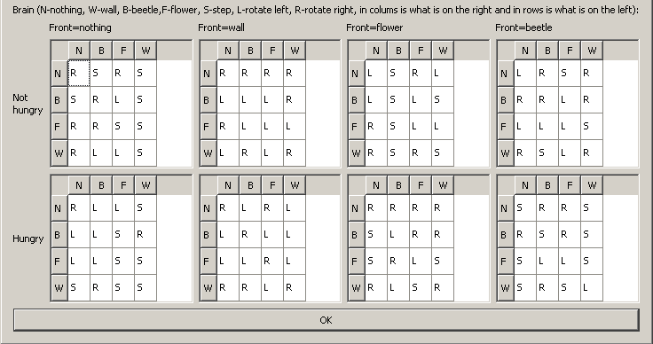
What is on the left of the beetle
What is on the right of the beetle

Slide 4
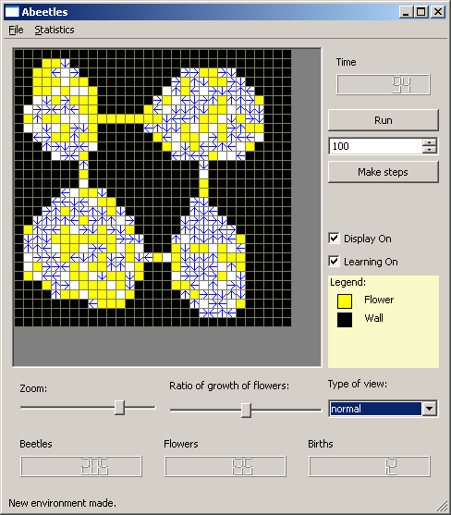
Environment widget - beetles are blue arrows and flowers are yellow cells. Walls are black. The layout of the environment is set by its input map.
See section “Map of environment”.
Number of actual update. Maximum is 2147483647, then application terminates.
Starts unbounded run of the life. The button is checkable, thus unchecking stops the run.
Influences growth of flowers. The middle position does not influence the growth, flowers grow according to map.
Left possitions reduce the growth, the left most one stops the growing totally. Right possitions multiplies the growth set by the map, the right most possition triggers growing of flowers everywhere without dying.
Number of updates of environment to make.
This buttons starts to make the number of steps set in the spin box
Turns on or off display of the run in the left widget. If the display is off, simulator runs much faster.
Turns on or off mutual learning of beetles.
Zoom of the view of the environment has 5 steps.
Describes meaning of colors in the environment widget.
Numbers of beetles, flowers and births in the actual update.
Sets the type of view in the environment widget. Legend explains individual types of view.
See section “Types of view”.

