Slide 1

Code Generation
Strategies for Success
San Diego .NET Architecture SIG
7-12-2006
jacob.eggleston@yahoo.com
http://ch3etah.sf.net/docs.html

Slide 2

Reactions to code generation
Will it put programmers out of work?
Sounds too complicated
It’s a code smell
Code generation is like ogres!

Slide 3
What is Code Generation, Really?
“Code that writes code”
Every-day Examples
  Forms designer
  XSD / Strongly-typed datasets
  WSDL generators
  Compilers
Your Own Personal Junior Programmer / Code Slave

Slide 4
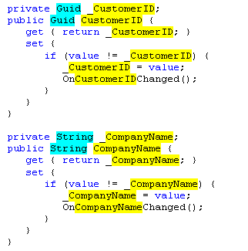
Template Based Code Generation
Separate the things that change from the things that stay the same.
Things that change become metadata
Things that stay the same become templates
What changes between these two properties?
  Name / Type
  CustomerID / Guid
  CompanyName / String

Slide 5
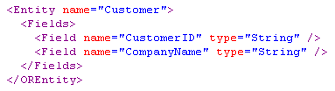
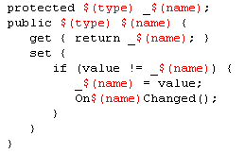
Template Based Code Generation
(Continued…)
Describe my object…
Voilà!
Apply a transformation…

Slide 6

Reasons For Failure
Vendor / framework lock-in
(Lack of) Flexibility in code output
(Lack of) Customization of generated code
Non-active generation
Results: Mountains of code to maintain by hand
How did we get into this mess?!!

Slide 7

Principles for Success
From “Code Generation in Microsoft .NET” by Kathleen Dollard
  You control the process and templates
  You control the metadata
  Repeatable, one-click process
  Handcrafted code is protected
  Generated code is high quality

Slide 8
1. Process and Templates
Framework vendors can’t predict all your needs
Change happens – requirements, technologies
  How do you handle edge cases, new artifacts, performance issues, design constraints, etc?
I don’t like template language lock-in either
You must be able to control and customize every aspect of code generation, from the metadata to the templates and everything in between.

Slide 9
2. Metadata
Should exist and evolve independently
You should be able to control the structure
XML is technology independent
There are other forms of metadata

Slide 10
3. Repeatable Process
Code generation MUST be “active”
Can be part of the build process
Vital to maintainability
One click (Drop-dead simple - path of least resistance)
I’m lazy / scripting sucks!

Slide 11
4. Protect Handcrafted Code
Isolate “driving factors”
  Using regions, partial classes, abstract classes, etc.
Content hashing
  Warnings, humiliation not enough
It should be easy to evolve generated code and custom code independently, for the entire life of the project

Slide 12
Example: Isolating Driving Factors
Business Objects
  Custom logic
UI
  Layout
  Custom logic
Generated Class
Layout Class
Custom Logic Class
Generated Class
Custom Logic Class

Slide 13
5. High Quality
Should meet or exceed hand coding
Start with hand coding and find patterns
Templates can evolve – start simple
Able to improve quality retroactively

Slide 14
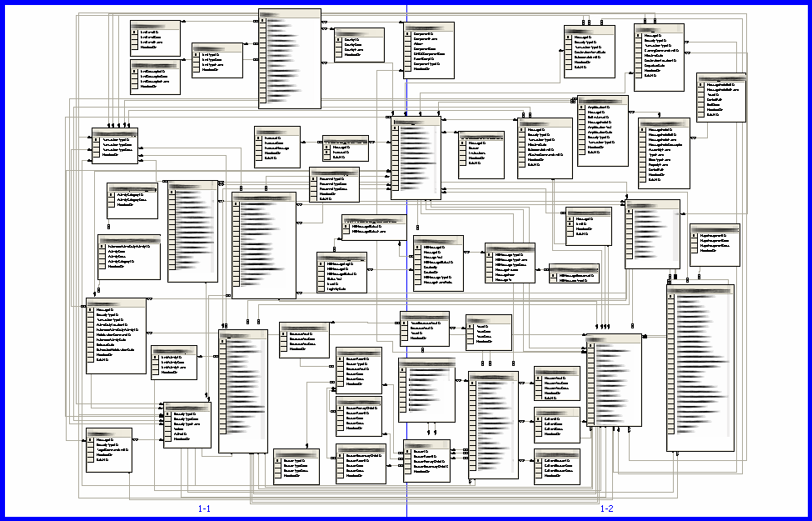
Agility - Responding to Change
Original database schema…

Slide 15
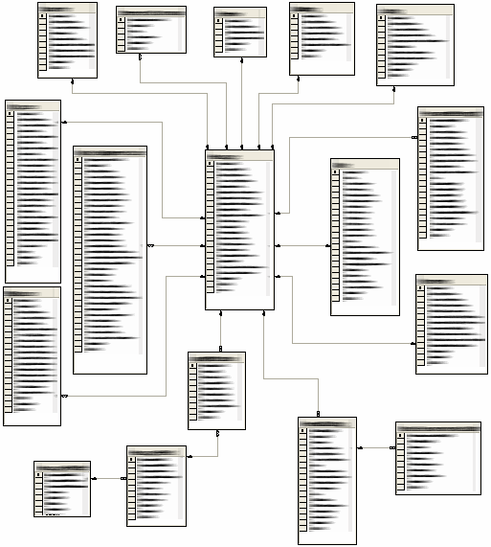
Agility - Responding to Change
New schema…
From 50 to 17 objects
One person
One day

Slide 16
Evolving Your Architecture
Example of creating new artifacts:
One of many cryptic exceptions that NHibernate throws:
  Operand type clash: uniqueidentifier is incompatible with int
Many times it doesn’t tell you which object or property is the problem
What to do?

Slide 17
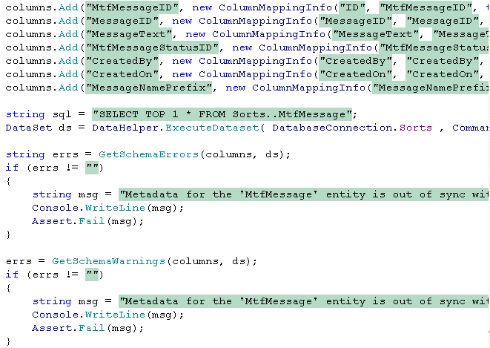
Evolving Your Architecture
Unit tests to verify that schema is up to date

Slide 18
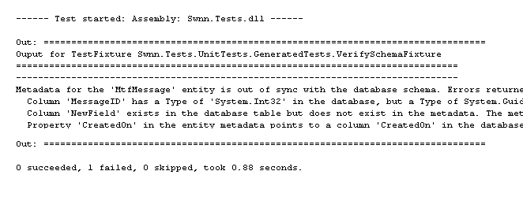
Evolving Your Architecture
Now we have a precise report of schema mismatches for every column in every entity
Very quick and simple to implement

Slide 19
One Description – Many Artifacts
Examples of artifacts you could generate:
  Data Tier Objects
  Collections
  NHibernate Mapping Files
  Stored Procedures
  Strongly-Typed Datasets
  Web Services
  Prototype / Simple UIs
  User Interface plumbing (Web / Win)
  Integration / Sanity Tests for Data Tier

Slide 20
Code Generation Can…
(when used correctly)
Increase productivity
Improve quality
Improve consistency
Cross pollination
Improve maintainability
Make users happier
Solve world hunger (YMMV)

Slide 21
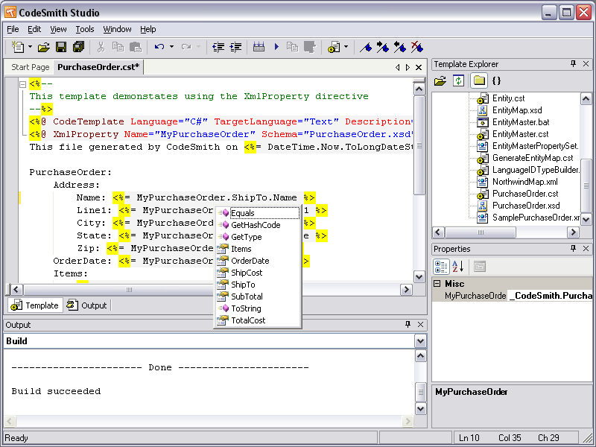
Tools - CodeSmith
Extensive template library
Familiar template syntax
Great template editor
Expensive
Poor support for active generation

Slide 22
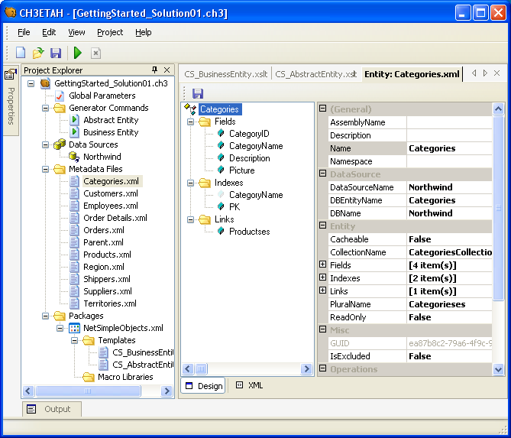
Tools – CH3ETAH
Flexible metadata
Strong typing
Flexible templates
Template language engines
Active generation
Open Source
Not very intuitive
Poorly documented

Slide 23
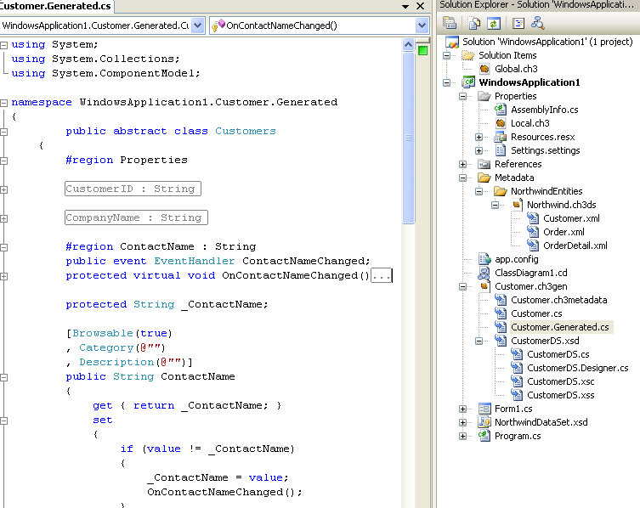
Tools – CH3ETAH
In progress…
Integration with MSBuild and Visual Studio
Increased ease and flexibility
Better documentation

Slide 24
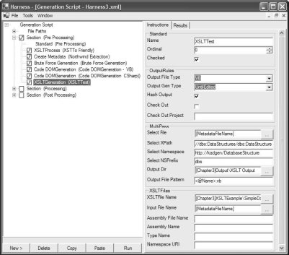
Tools – Code Gen Harness
From “Code Generation in .NET”
Flexible metadata
Flexible templates
Templates for CSLA
Active generation
Great documentation
Complicated / difficult to use
XSLT only

Slide 25
Tools - Summary
CodeSmith (www.codesmith.com)
CH3ETAH (ch3etah.sourceforge.net)
Generation harness from Kathleen Dollard’s book
Others (mostly template engines)

Slide 26
Resources
“Code Generation in Microsoft .NET” by Kathleen Dollard
“Code Generation in Action” by Jack Herrington
http://www.codegeneration.net
This presentation / CH3ETAH tutorial:
  http://ch3etah.sf.net/docs.html

