Slide 1
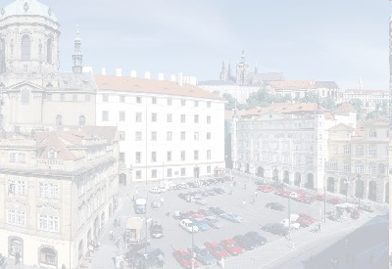
Experiments with Czech Linguistic Data and ILP
18th International Conference
Inductive Logic Programming Prague 2008
Jan Dědek, Alan Eckhardt, Peter Vojtáš
Department of Software Engineering, Charles University in Prague
Czech Republic
Institute of Computer Science, Czech Academy of Science

Slide 2
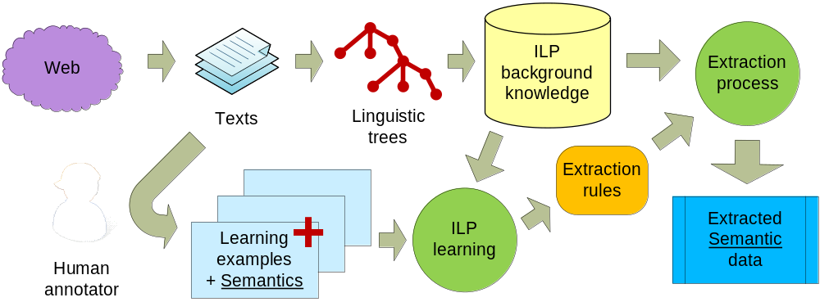
Context of Our Experiments Semantic Web & Semantic Data Extraction
Get semantics form Web of today
Czech pages, Czech texts
Czech linguistic tools
Domain of traffic accidents
Semantics given by human
Generalized & extracted by ILP

Slide 3

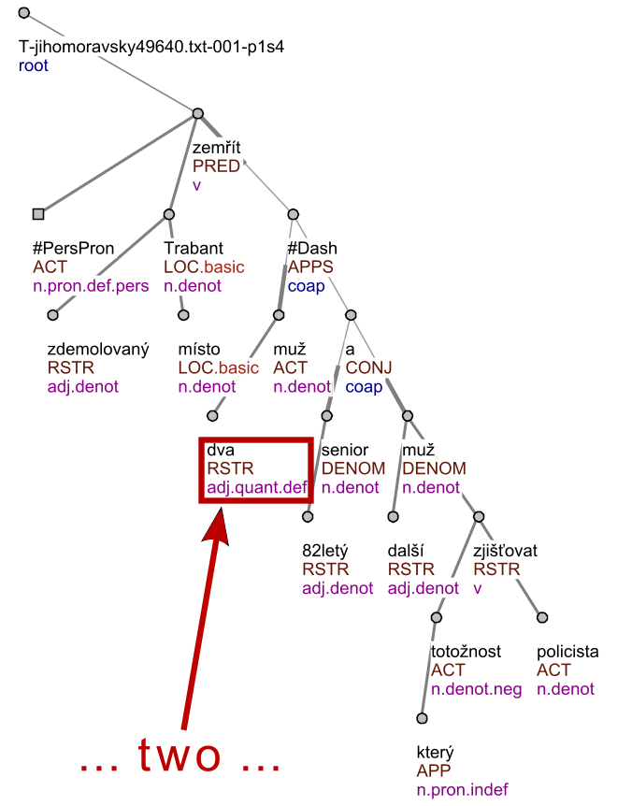
tree_root(node0_0). node(node0_0).
id(node0_0, t_jihomoravsky49640_txt_001_p1s4).
%%%%%%%% node0_1 %%%%%%%%%%%%%%%%%%
node(node0_1).
functor(node0_1, pred).
gram_sempos(node0_1, v).
t_lemma(node0_1, zemrit).
%%%%%%%% node0_2 %%%%%%%%%%%%%%%%%%
node(node0_2).
functor(node0_2, act).
gram_sempos(node0_2, n_pron_def_pers). t_lemma(node0_2, x_perspron).
%%%%%%%% node0_3 %%%%%%%%%%%%%%%%%%%
node(node0_3). id(node0_3,
functor(node0_3, loc).
gram_sempos(node0_3, n_denot).
t_lemma(node0_3, trabant).
...
edge(node0_0, node0_1). edge(node0_1, node0_2).
edge(node0_1, node0_3). edge(node0_3, node0_4).
edge(node0_4, node0_5). edge(node0_3, node0_6).
edge(node0_3, node0_7). edge(node0_3, node0_8).
...
Logic representation
Source web page
Linguistic trees

