Slide 1
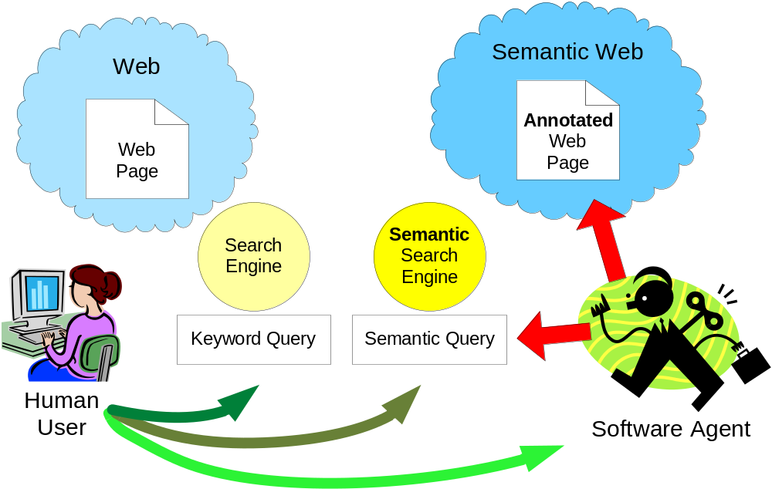
Looking for information on the Web

Slide 2
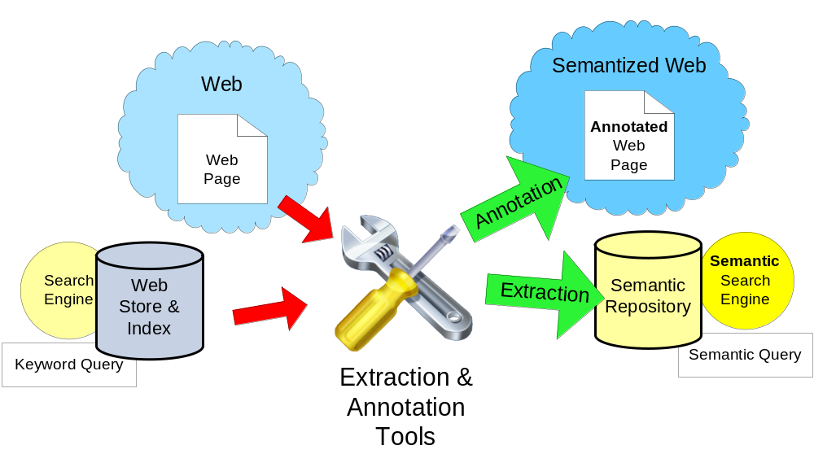
Web Semantization – using Automated Web Information Extraction Tolls

Slide 3
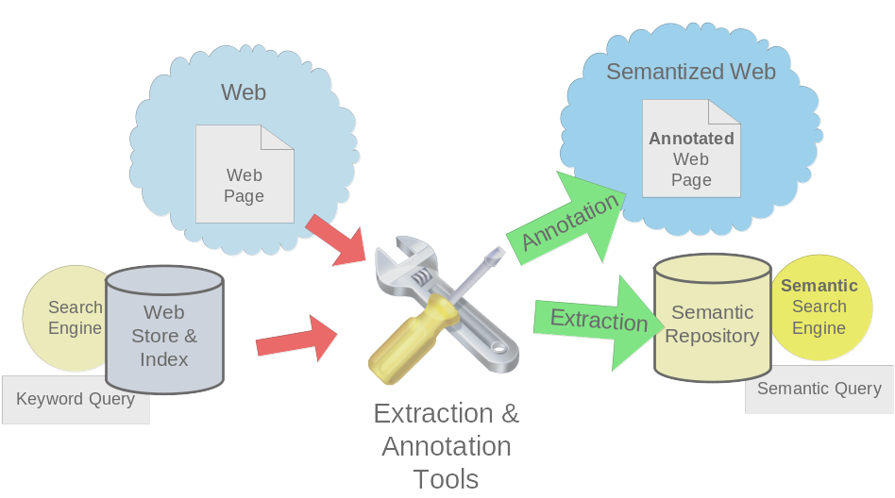
WIE – our approach – phases of annotation
Classification
  Tabular page ~ Textual Page, Domain, etc.
General domain independent intermediate annotation
  Different for tabular pages and textual pages
Domain dependent annotation

Slide 4
Our Methods of Semantic Annotation
1
2
Generally applicable
Domain independent
Intermediate
Automated
Created by
human experts
Domain dependent
Adjusted by
unskilled user
Two different approaches:
Textual pages
Tabular pages

Slide 5
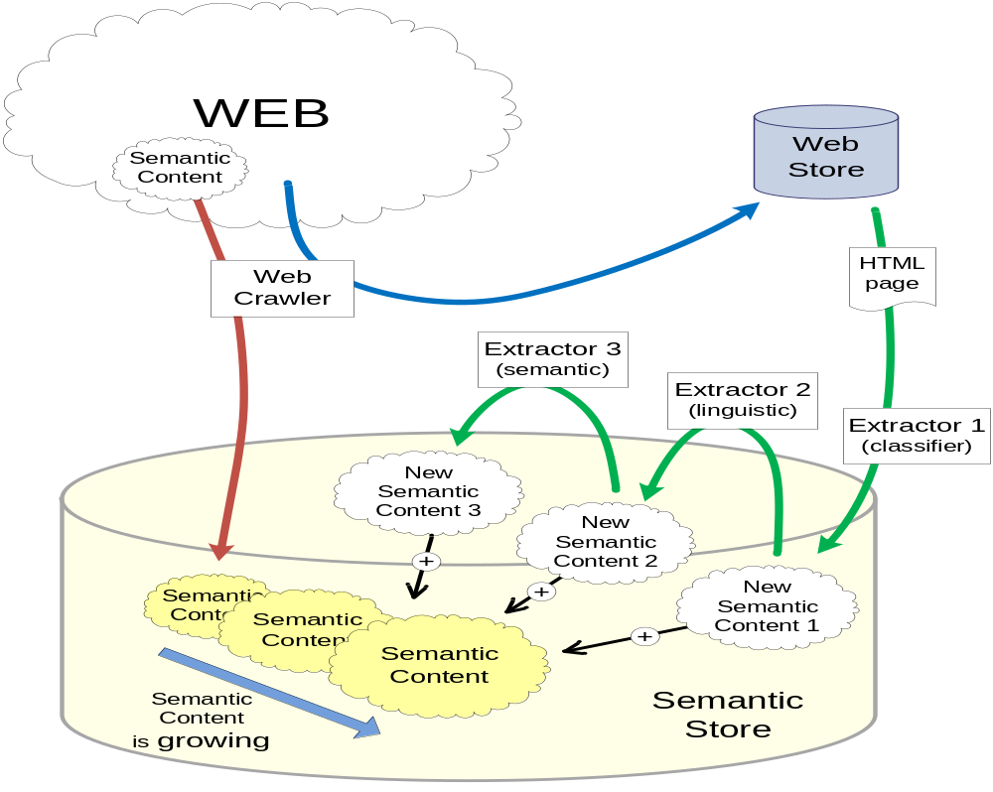
Gradual Semantization of the Web - Architecture
Notes:
Ako urobit aby som tieto poznamky videl a na obrazovke neboli

Slide 6
Semantic Annotation
semantization through annotation (third party)
annotation through WIE – automated web information extraction (assisted learning)
domain dependent / independent (ontology)
tabular (product) resources/ textual resources

Slide 7
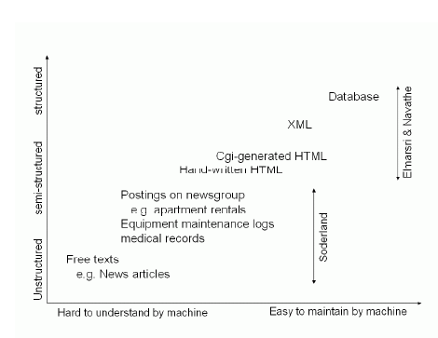
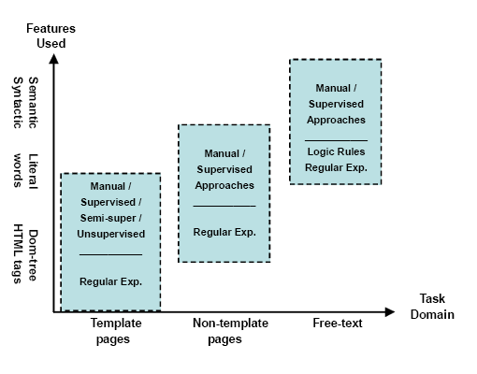
Chang et al. A Survey of Web Information Extraction Systems, TKDE
Task difficulty
Technique used
Degree of automation
Adaptability
Notes:
Ako urobit aby som tieto poznamky videl a na obrazovke neboli

Slide 8
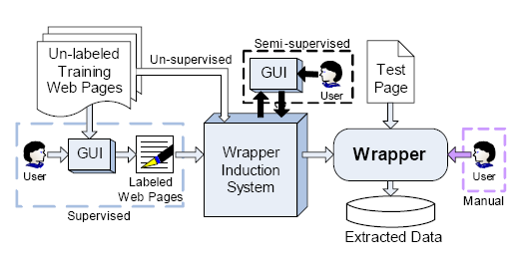
Degree of automation – user skills
Notes:
Ako urobit aby som tieto poznamky videl a na obrazovke neboli

Slide 9
Our division of annotation tasks
Type of annotation | Tabular pages | Textual pages
Intermediate general domain independent | ? | ?
Domain dependent | ? | ?

Slide 10
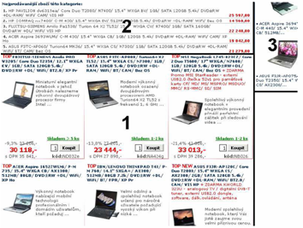
Dom. indep. – data region detection
Notes:
Ako urobit aby som tieto poznamky videl a na obrazovke neboli

Slide 11
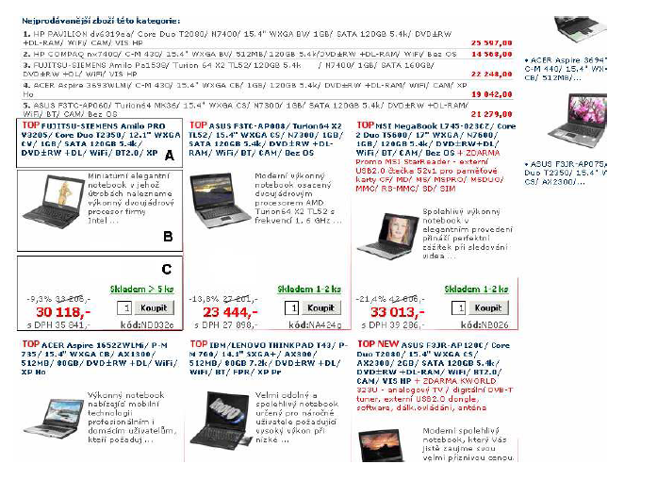
Dom. indep. – data record detection
Suitable for cumulative summary pages – use of repetitions.
Notes:
Ako urobit aby som tieto poznamky videl a na obrazovke neboli

Slide 12
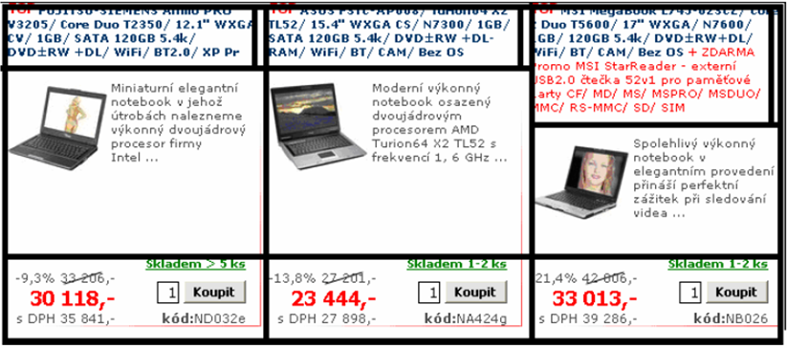
Dom. indep. – one record in many table cells
Notes:
Ako urobit aby som tieto poznamky videl a na obrazovke neboli

Slide 13
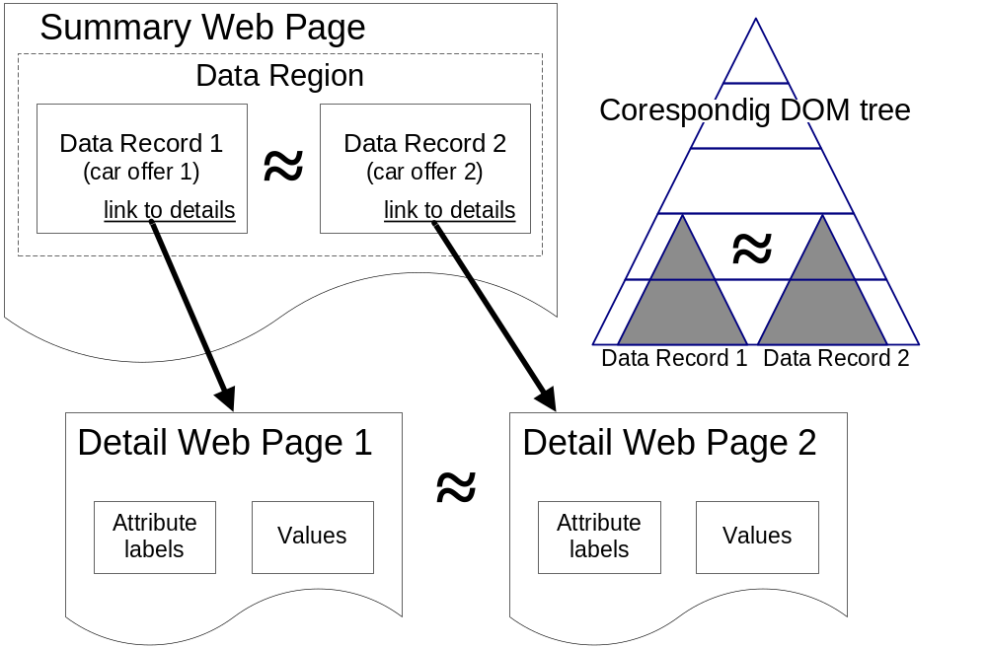
Dom. indep. – intermediate annotation of tabular pages
Notes:
Ako urobit aby som tieto poznamky videl a na obrazovke neboli

Slide 14
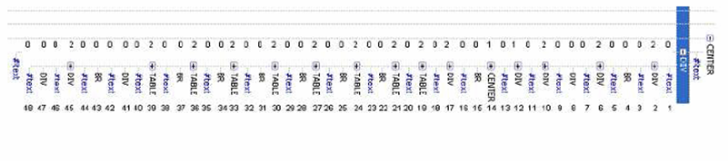
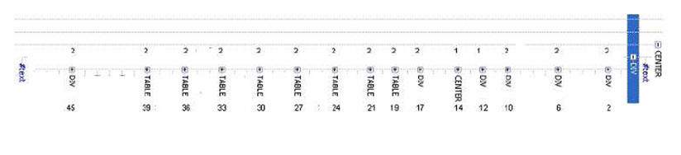
Dom. indep. – DOM model, relevant nodes, similarity
Notes:
Ako urobit aby som tieto poznamky videl a na obrazovke neboli

Slide 15
Observed inversion in annotation tasks
Type of annotation | Tabular pages | Textual pages
Intermediate general domain independent | Uses similarities | Does not use similarities
Domain dependent | Does not use similarities | Uses similarities

Slide 16
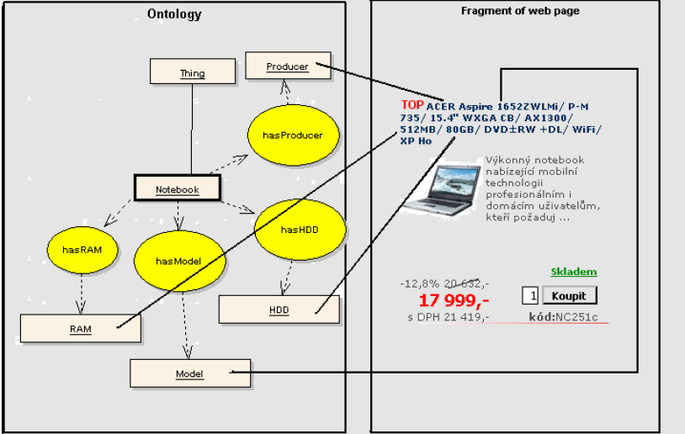
Domain dependent annotation
Notes:
Ako urobit aby som tieto poznamky videl a na obrazovke neboli

Slide 17
.../notebook.html – annotated
<a href='...' ...><span about="#MSI" property="dc:title“>MSI MegaBook </span>
</ L720-004/ C-M 380/ 17" WXGA+/ ...><span about="#MSI" property=“ex:memory"> 1GB
</span>/ 80GB/ DVD±RW+DL/ WiFi/…a> </td> <td … >
<a href='...' ...><span about="#LENOVO" property="dc:title"> LENOVO 3000 N100</span>/
Core Duo T2350/ 15.4" WXGA VV/ <span about="#LENOVO" property="dc:title">1GB</span>
/ SATA 120GB 5.4k/ …</a> </td> ................... </tr>
.................
<span class="bestActPrz" about="#MSI" property="mff:FirstPrice">22 853,-</span>
<div class="prize" about="#MSI" property="mff:ActualPrice">19 249,-</div>
<span about="#MSI" property="mff:ActualPrice+Tax">s DPH 22 906,-</span>
< about="#MSI" property=“ex:tool" content=“vidome“
property=“ex:ontology" content=“\vidomeBack\ontology\vidomeontology.owl“ /td>
<td ...>
<span class="bestActPrz" about="# LENOVO " property="mff:FirstPrice">24 719,-</span>
<div class="prize" about="# LENOVO " property="mff:ActualPrice">18 199,-</div>
<span about="# LENOVO " property="mff:ActualPrice+Tax">s DPH 21 657,-</span>
< about="#LENOVO" property=“ex:tool" content=“vidome“
property=“ex:ontology" content=“\vidomeBack\ontology\vidomeontology.owl“ /td> .......</tr>
Notes:
V jistém smyslu tam ALZA svoji ontologii má, použít ještě jednou pro mapování ontologií
Také jsou jiná možná řešení jak tam sémantiku zadefinovat

Slide 18
Experiments: cars – extracted data
Manufacturer | Car model | Price (CZK) | Consumption [l/100km] | Airbag number
Škoda | 120 | 3 000,- | 7 | 0
Trabant | Kombi | 8 000,- | 7 | 0
Audi | A4 | 85 000,- | 6,5 | 6
Fiat | Punto 1,1i | 32 900,- | 6 | 2
Tatra | T613 | 48 000,- | 12 | 0
Kia | Joice | 140 000,- | 10 | 2
Ford | Focus 1.6i | 45 000,- | 6,2 | 6
Notes:
Ako urobit aby som tieto poznamky videl a na obrazovke neboli

Slide 19
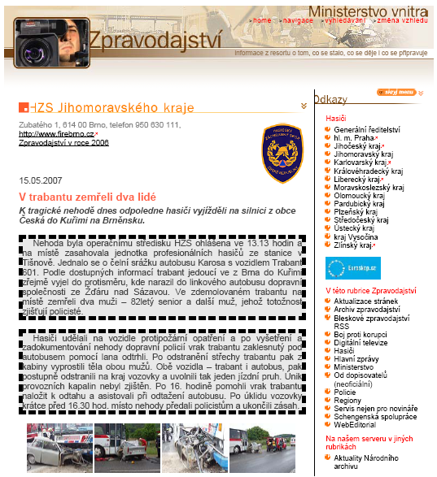
Machine processing of texts – J. Dědek
Dangerous roads detection,
How many people dyed,…
Which cars are dangerous?
…
Notes:
Ako urobit aby som tieto poznamky videl a na obrazovke neboli

Slide 20
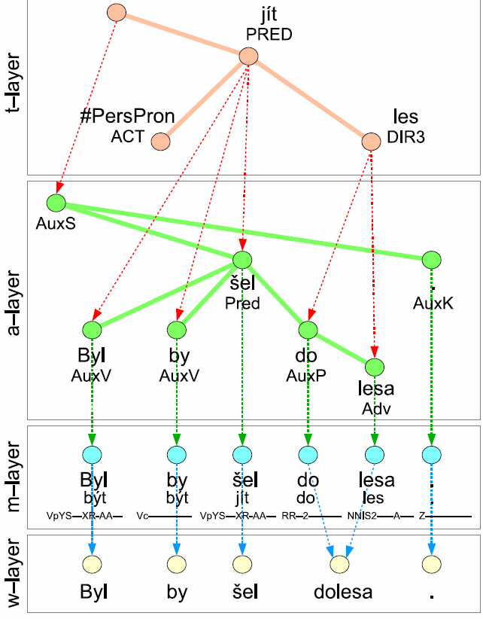

Dom. indep. – Linguistic annotation “UFALware”
Notes:
Ako urobit aby som tieto poznamky videl a na obrazovke neboli

Slide 21
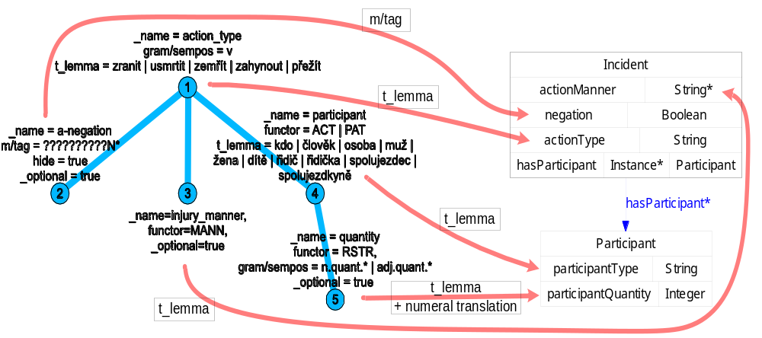
Domain dependent annotation of texts
Notes:
Ako urobit aby som tieto poznamky videl a na obrazovke neboli

Slide 22
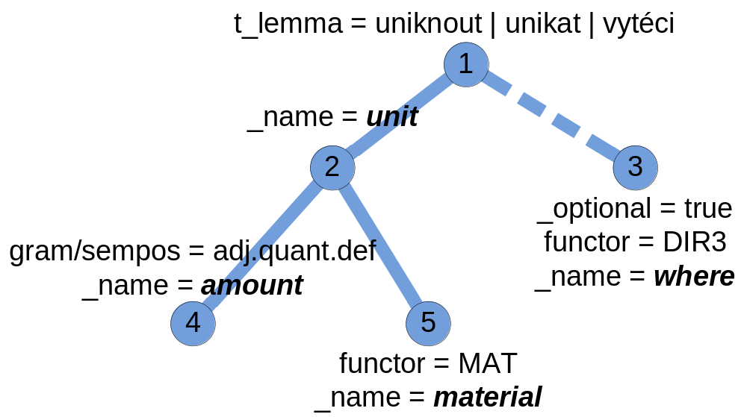
Another example of extraction rule - domain: environment protection

Slide 23
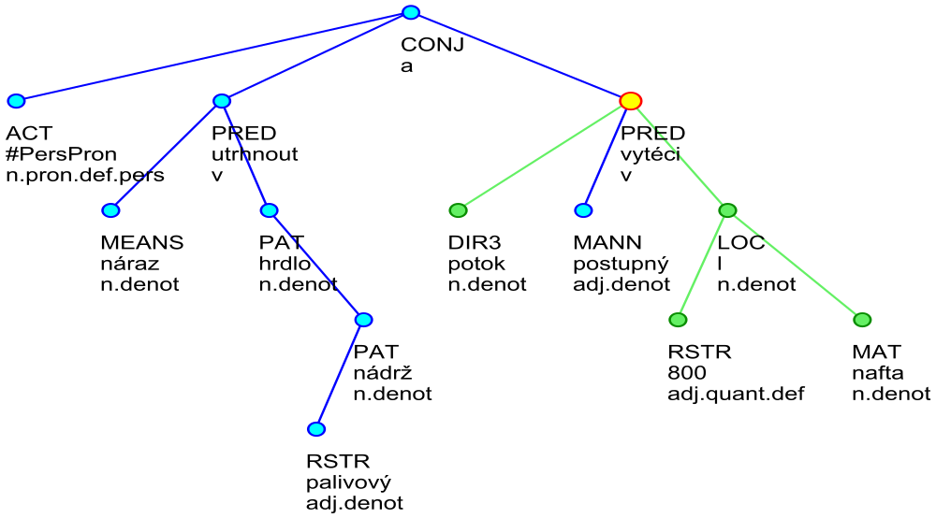
Example of a linguistic tree
"Due to the clash the throat of fuel tank tore off and 800 litres of oil (diesel)
has run out to a stream."
“Nárazem se utrhl hrdlo palivové
nádrže a do potoka postupně vyteklo na 800 litrů nafty.”
jihmor56559.txt-001-p1s3
(1)
(2)
litre
(3)
(5)
diesel
(4)
"into" water stream

Slide 24
Experimental results – extracted data
  <QueryMatches>
  <Match root_id="jihmor56559.txt-001-p1s3" match_string="15:0,16:4,22:1,23:2,27:3">
  <Sentence>Nárazem se utrhl hrdlo palivové nádrže a do potoka postupně vyteklo na 800 litrů nafty.</Sentence>
  <Data>
  <Value variable_name="amount" attribute_name="t_lemma">800</Value>
  <Value variable_name="unit" attribute_name="t_lemma">l</Value>
  <Value variable_name="material" attribute_name="t_lemma">nafta</Value>
  <Value variable_name="where" attribute_name="t_lemma">potok</Value>
  </Data>
  </Match>
  <Match root_id="jihmor68220.txt-001-p1s3" match_string="3:0,12:4,21:1,22:2,27:3">
  <Sentence>Z palivové nádrže vozidla uniklo do půdy v příkopu vedle silnice zhruba 350 litrů nafty, a proto byli o události informováni také pracovníci odboru životního prostředí Městského úřadu ve Vyškově a České inspekce životního prostředí.</Sentence>
  <Data>
  <Value variable_name="amount" attribute_name="t_lemma">350</Value>
  <Value variable_name="unit" attribute_name="t_lemma">l</Value>
  <Value variable_name="material" attribute_name="t_lemma">nafta</Value>
  <Value variable_name="where" attribute_name="t_lemma">půda</Value>
  </Data>
  </Match>
  ...
litre
water stream
diesel
soil

Slide 25
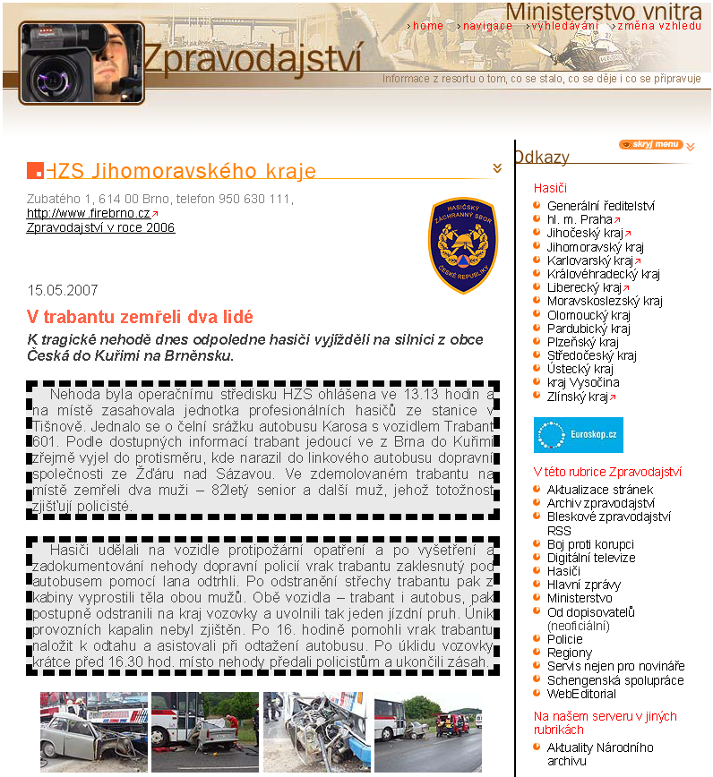
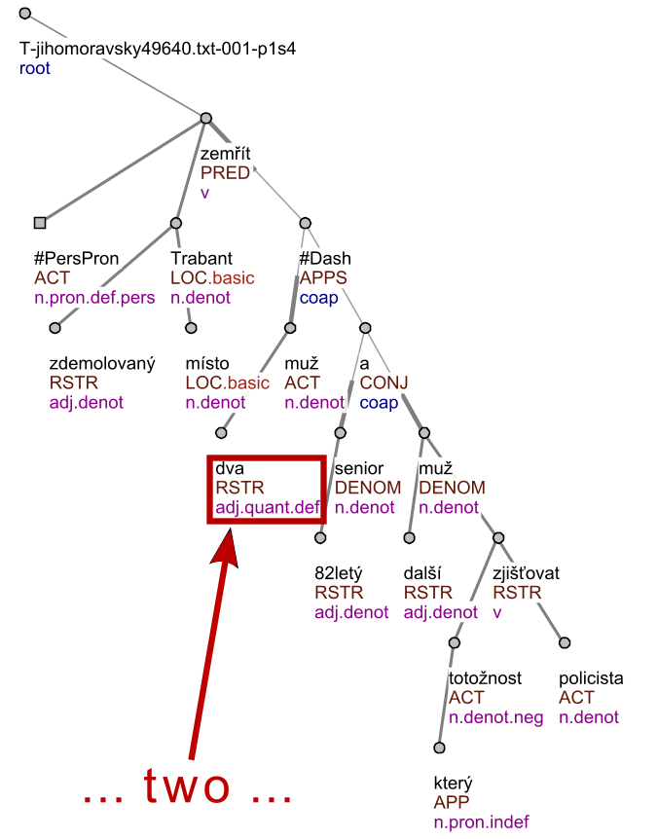
tree_root(node0_0). node(node0_0).
id(node0_0, t_jihomoravsky49640_txt_001_p1s4).
%%%%%%%% node0_1 %%%%%%%%%%%%%%%%%%
node(node0_1).
functor(node0_1, pred).
gram_sempos(node0_1, v).
t_lemma(node0_1, zemrit).
%%%%%%%% node0_2 %%%%%%%%%%%%%%%%%%
node(node0_2).
functor(node0_2, act).
gram_sempos(node0_2, n_pron_def_pers). t_lemma(node0_2, x_perspron).
%%%%%%%% node0_3 %%%%%%%%%%%%%%%%%%%
node(node0_3). id(node0_3,
functor(node0_3, loc).
gram_sempos(node0_3, n_denot).
t_lemma(node0_3, trabant).
...
edge(node0_0, node0_1). edge(node0_1, node0_2).
edge(node0_1, node0_3). edge(node0_3, node0_4).
edge(node0_4, node0_5). edge(node0_3, node0_6).
edge(node0_3, node0_7). edge(node0_3, node0_8).
...
Logic representation
Source web page
Linguistic trees

Slide 26
Dom. dep. – ILP learning of linguistic rules
• Positive examples E+
– examples with desired properties.
• Negative examples E-
– examples with opposite properties.
• Background knowledge
– additional data describing the examples
and domain
Notes:
Ako urobit aby som tieto poznamky videl a na obrazovke neboli

Slide 27
Rules found by ILP
[Rule 1] [Pos cover = 14 Neg cover = 0] damage_root(A) :- lex_rf(B,A), has_sempos(B,'n.quant.def'), tDependency(C,B), tDependency(C,D), has_t_lemma(D,'investigator').
[Rule 2] [Pos cover = 13 Neg cover = 0] damage_root(A) :- lex_rf(B,A), has_functor(B,'TOWH'), tDependency(C,B), tDependency(C,D), has_t_lemma(D,'damage').
[Rule 1] [Pos cover = 7 Neg cover = 0] injuries(A) :- lex_rf(B,A), has_functor(B,'PAT'), has_gender(B,anim), tDependency(B,C), has_t_lemma(C,'injured').
[Rule 8] [Pos cover = 6 Neg cover = 0] injuries(A) :- lex_rf(B,A), has_gender(B,anim), tDependency(C,B), has_t_lemma(C,'injure'), has_negation(C,neg0).
Notes:
Ako urobit aby som tieto poznamky videl a na obrazovke neboli

Slide 28
Evaluation on test set – damage, injuries
task/Metod | matching | missing | excessive | overlap | prec.% | recall% | F1.0%
damage/ILP | 14 | 0 | 7 | 6 | 51.85 | 70.00 | 59.57
damage/ILP – lenient measures | 14 | 0 | 7 | 6 | 74.07 | 100.00 | 85.11
dam./ILP-roots | 16 | 4 | 2 | 0 | 88.89 | 80.00 | 84.21
damage/Paum | 20 | 0 | 6 | 0 | 76.92 | 100.00 | 86.96
injuries/ILP | 15 | 18 | 11 | 0 | 57.69 | 45.45 | 50.85
injuries/Paum | 25 | 8 | 54 | 0 | 31.65 | 75.76 | 44.64
inj./Paum-afun | 24 | 9 | 38 | 0 | 38.71 | 72.73 | 50.53
Name of the tool | Precision
Morphological tagging | 93 % (see in [18] and [14])
Collins' parser (Czech adaptation) | 81.6 % (see in [15])
Analytical function assignment | 92 % (in [18])
Tectogrammatical analysis | dependences: 90.2 % f-tags assignment: 86.5% (in [16])
Notes:
Ako urobit aby som tieto poznamky videl a na obrazovke neboli

Slide 29
Experiments made so far (work in progress)
Textual pages
  Fire and car accidents
    800 articles
    1.2 MB of textual data
    10 MB of ling. annotations
      3.5 hours run time
  Environment protection
  Bankrupts Evidence
  ILP learning
    50 articles (manually annotated)
Tabular pages
  Notebooks
  Cars
  Hotels
  Dozens of pages
Notes:
Ako urobit aby som tieto poznamky videl a na obrazovke neboli

