Slide 1
Web Semantization design and principles
AWIC 2009
6th Atlantic Web Intelligence Conference
J. Dědek, A. Eckhardt, P. Vojtáš
Charles University, Prague, Czech Republic
Institute of Computer Science, Academy of Sciences of the Czech Republic

Slide 2
Outline
Motivation examples
The Idea of Web Semantization
  Semantic Web and Web Semantization
  Domain independent intermediate annotation followed by domain dependent annotation
  Proposed architecture of the system, repositories
Methods of Semantic Annotation
  Based on web page structure
  Based on linguistics and text structure
User Agents on the Semantic Web
SemWeX team members and cooperation on the problem

Slide 3
Motivation example 1 – buying a car
User (foreigner coming to ČR) wants to buy a car.
Requirements - safety, reliability, consumption, price,
information about dangerous roads.
Data extracted form internet shops.
Information about car accidents and potential injuries
are hidden in textual reports from fire departments.
Semantic repository contains this information
semantically annotated (it cannot be done in query time).
Agent can query for this information and aggregate it
according to user preferences.
Notes:
Ako urobit aby som tieto poznamky videl a na obrazovke neboli

Slide 4
Motivation example 2 – buying a notebook
User (me or maybe my sister) wants to buy a notebook.
Requirements - CPU, memory, HDD, display, size,
weight, manufacturer, design, color, price, etc.
Also interested in used notebooks and
other users comments and reviews.
Semantic repository contains semantically annotated
information form web shops, online auctions,
user textual comments (sentiment analysis), blogs, etc.
Agent can compare offers with respect to all aspects:
e.g.: new ~ used, good reviewed ~ bad reviewed, etc.
Notes:
Ako urobit aby som tieto poznamky videl a na obrazovke neboli

Slide 5
Goals and Contributions
Web Repository based on web crawler and
document store with classification and indexing.
Automated, domain independent annotation of
suitable pages form the Web Repository.
Automated domain dependent annotation with extraction ontology and ILP learning of linguistic rules.
Semantic Repository – a sample of semantized web and a seed of the semantic web.
Intelligent agent for information lookup and aggregation with user preferences.

Slide 6
The Idea of Web Semantization
a gradual process, making a bigger part of web content semantic
increasing degree of automated web content processing
third party semantization
Yes, we know there is Google, Semantic web initiative, Web2.0, social web, …

Slide 7
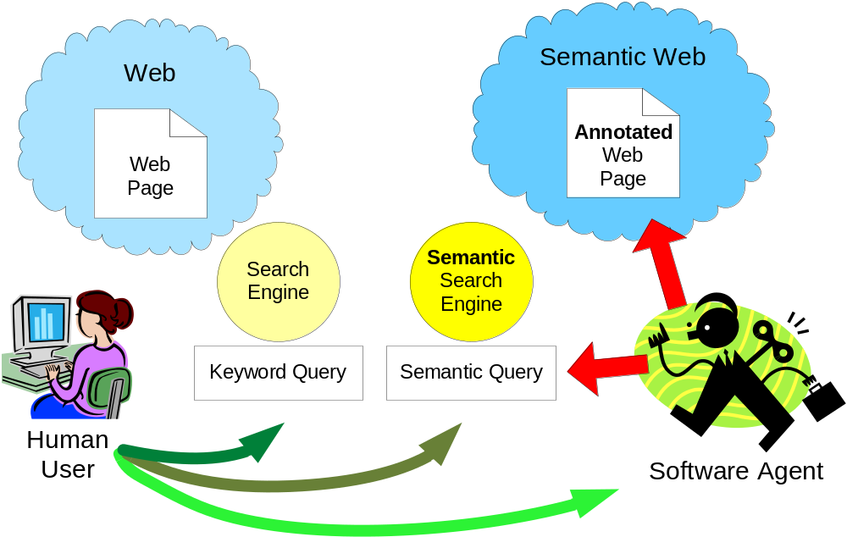
Looking for information on the Web

Slide 8
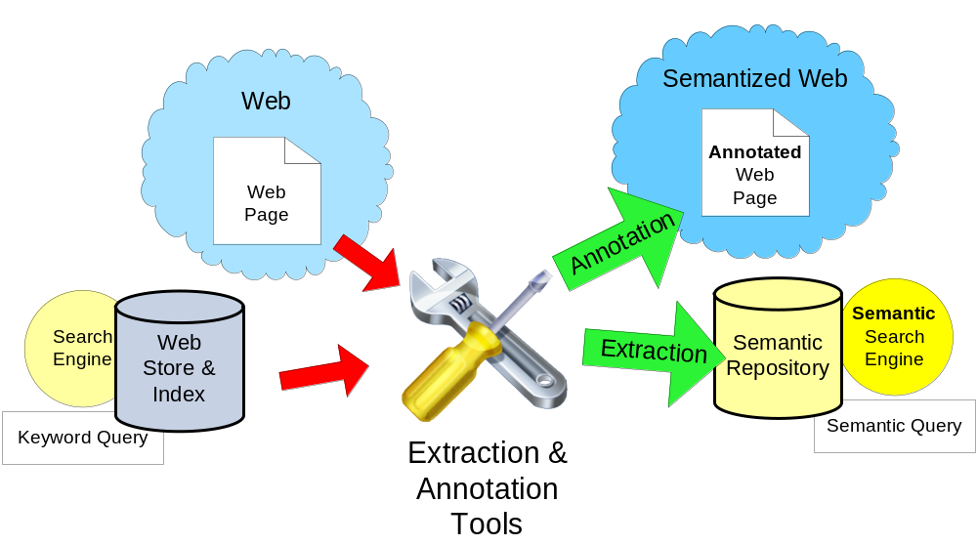
Web Semantization – using Automated Web Information Extraction Tolls

Slide 9
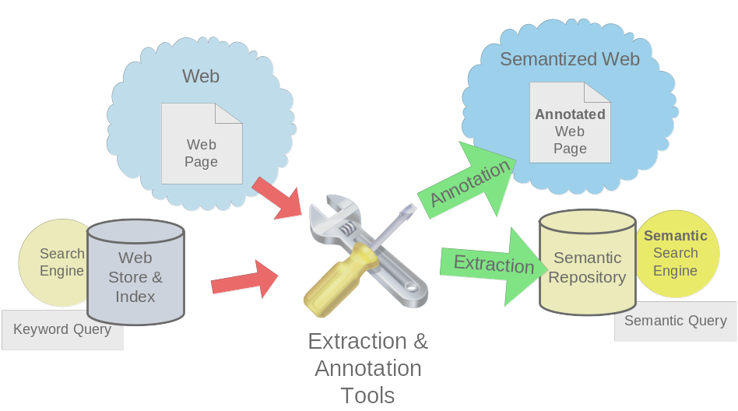
WIE – our approach – phases of annotation
Classification
  Tabular page ~ Textual Page, Domain, etc.
General domain independent intermediate annotation
  Different for tabular pages and textual pages
Domain dependent annotation

Slide 10
Our Methods of Semantic Annotation
1
2
Generally applicable
Domain independent
Intermediate
Automated
Created by
human experts
Domain dependent
Adjusted by
unskilled user
Two different approaches:
Textual pages
Tabular pages

Slide 11
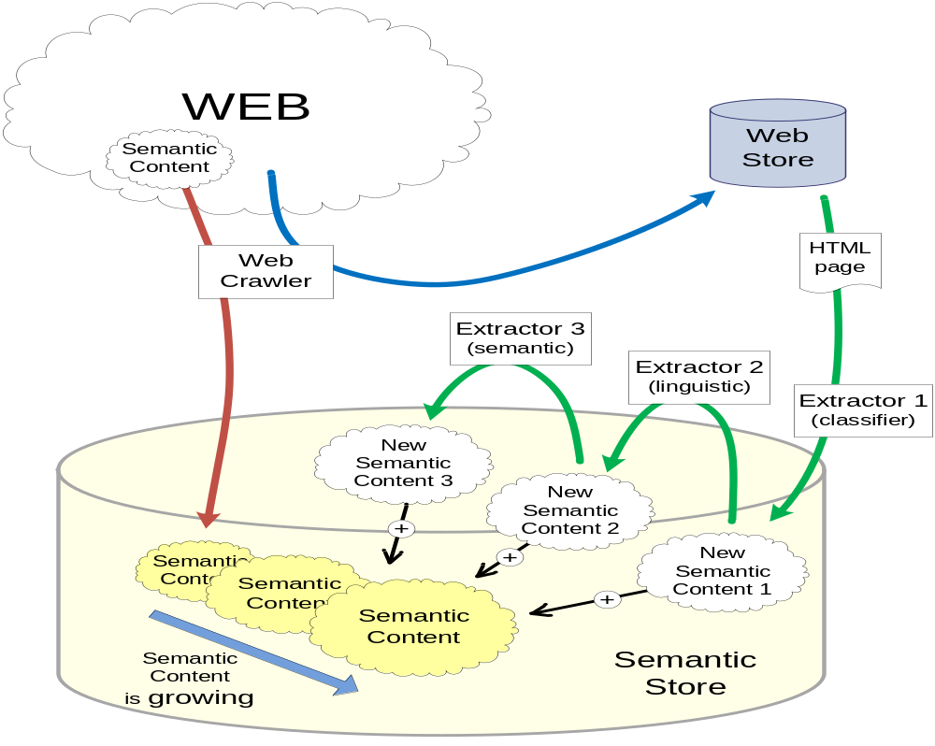
Gradual Semantization of the Web - Architecture
Notes:
Ako urobit aby som tieto poznamky videl a na obrazovke neboli

Slide 12
Semantic Annotation
semantization through annotation (third party)
annotation through WIE – automated web information extraction (assisted learning)
domain dependent / independent (ontology)
tabular (product) resources/ textual resources

Slide 13
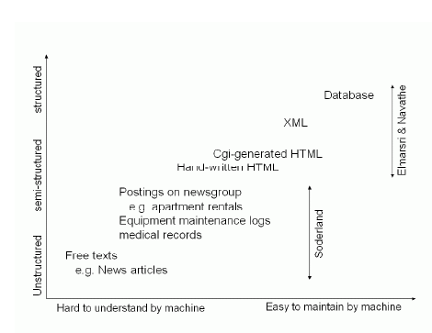
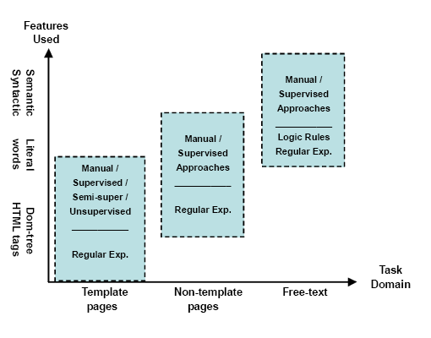
Chang et al. A Survey of Web Information Extraction Systems, TKDE
Task difficulty
Technique used
Degree of automation
Adaptability
Notes:
Ako urobit aby som tieto poznamky videl a na obrazovke neboli

Slide 14
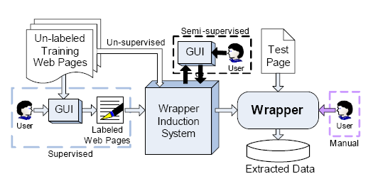
Degree of automation – user skills
Notes:
Ako urobit aby som tieto poznamky videl a na obrazovke neboli

Slide 15
Our division of annotation tasks
Type of annotation | Tabular pages | Textual pages
Intermediate general domain independent | ? | ?
Domain dependent | ? | ?

Slide 16
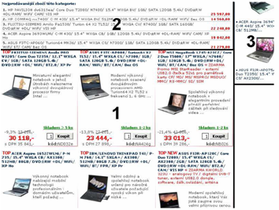
Dom. indep. – data region detection
Notes:
Ako urobit aby som tieto poznamky videl a na obrazovke neboli

Slide 17
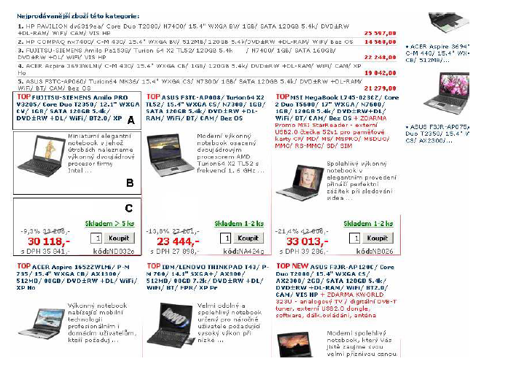
Dom. indep. – data record detection
Suitable for cumulative summary pages – use of repetitions.
Notes:
Ako urobit aby som tieto poznamky videl a na obrazovke neboli

Slide 18
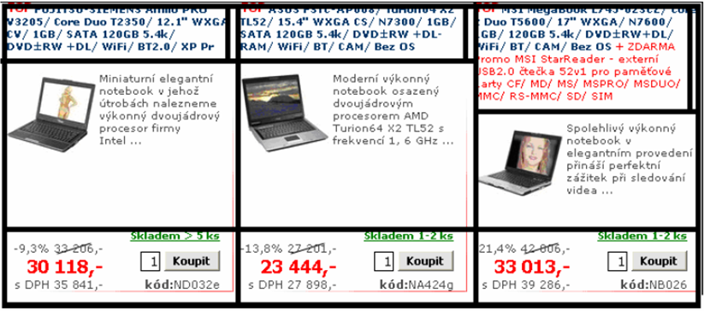
Dom. indep. – one record in many table cells
Notes:
Ako urobit aby som tieto poznamky videl a na obrazovke neboli

Slide 19
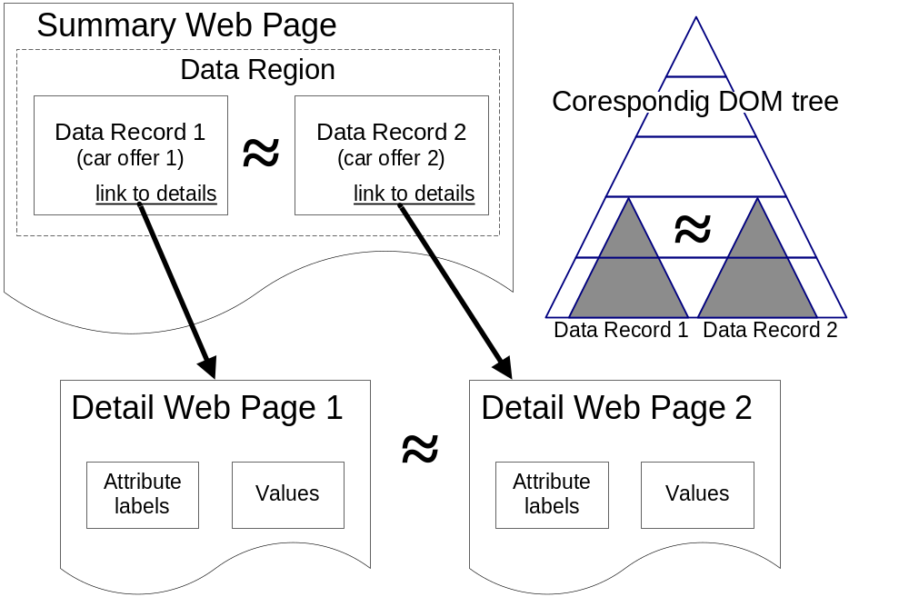
Dom. indep. – intermediate annotation of tabular pages
Notes:
Ako urobit aby som tieto poznamky videl a na obrazovke neboli

Slide 20
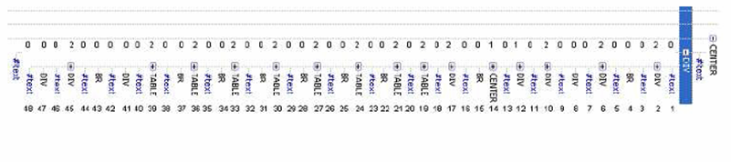
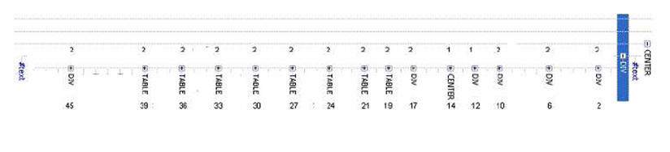
Dom. indep. – DOM model, relevant nodes, similarity
Notes:
Ako urobit aby som tieto poznamky videl a na obrazovke neboli

Slide 21
Observed inversion in annotation tasks
Type of annotation | Tabular pages | Textual pages
Intermediate general domain independent | Uses similarities | Does not use similarities
Domain dependent | Does not use similarities | Uses similarities

Slide 22
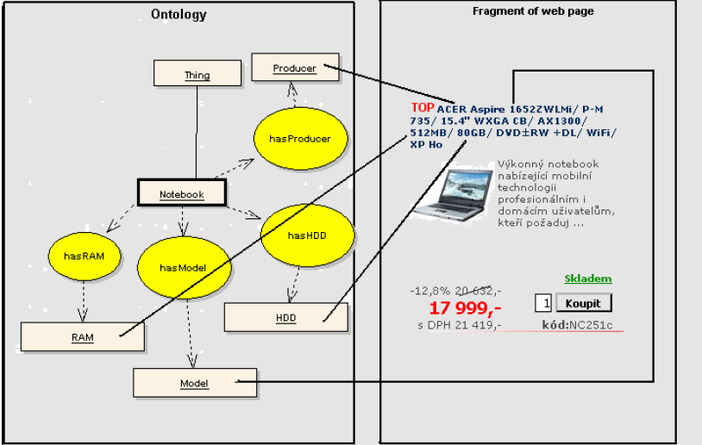
Domain dependent annotation
Notes:
Ako urobit aby som tieto poznamky videl a na obrazovke neboli

Slide 23
.../notebook.html – annotated
<a href='...' ...><span about="#MSI" property="dc:title“>MSI MegaBook </span>
</ L720-004/ C-M 380/ 17" WXGA+/ ...><span about="#MSI" property=“ex:memory"> 1GB
</span>/ 80GB/ DVD±RW+DL/ WiFi/…a> </td> <td … >
<a href='...' ...><span about="#LENOVO" property="dc:title"> LENOVO 3000 N100</span>/
Core Duo T2350/ 15.4" WXGA VV/ <span about="#LENOVO" property="dc:title">1GB</span>
/ SATA 120GB 5.4k/ …</a> </td> ................... </tr>
.................
<span class="bestActPrz" about="#MSI" property="mff:FirstPrice">22 853,-</span>
<div class="prize" about="#MSI" property="mff:ActualPrice">19 249,-</div>
<span about="#MSI" property="mff:ActualPrice+Tax">s DPH 22 906,-</span>
< about="#MSI" property=“ex:tool" content=“vidome“
property=“ex:ontology" content=“\vidomeBack\ontology\vidomeontology.owl“ /td>
<td ...>
<span class="bestActPrz" about="# LENOVO " property="mff:FirstPrice">24 719,-</span>
<div class="prize" about="# LENOVO " property="mff:ActualPrice">18 199,-</div>
<span about="# LENOVO " property="mff:ActualPrice+Tax">s DPH 21 657,-</span>
< about="#LENOVO" property=“ex:tool" content=“vidome“
property=“ex:ontology" content=“\vidomeBack\ontology\vidomeontology.owl“ /td> .......</tr>
Notes:
V jistém smyslu tam ALZA svoji ontologii má, použít ještě jednou pro mapování ontologií
Také jsou jiná možná řešení jak tam sémantiku zadefinovat

Slide 24
Experiments: cars – extracted data
Manufacturer | Car model | Price (CZK) | Consumption [l/100km] | Airbag number
Škoda | 120 | 3 000,- | 7 | 0
Trabant | Kombi | 8 000,- | 7 | 0
Audi | A4 | 85 000,- | 6,5 | 6
Fiat | Punto 1,1i | 32 900,- | 6 | 2
Tatra | T613 | 48 000,- | 12 | 0
Kia | Joice | 140 000,- | 10 | 2
Ford | Focus 1.6i | 45 000,- | 6,2 | 6
Notes:
Ako urobit aby som tieto poznamky videl a na obrazovke neboli

Slide 25
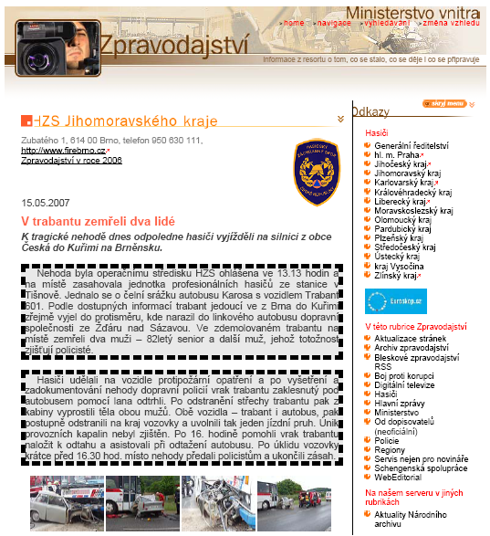
Machine processing of texts – J. Dědek
Dangerous roads detection,
How many people dyed,…
Which cars are dangerous?
…
Notes:
Ako urobit aby som tieto poznamky videl a na obrazovke neboli

Slide 26
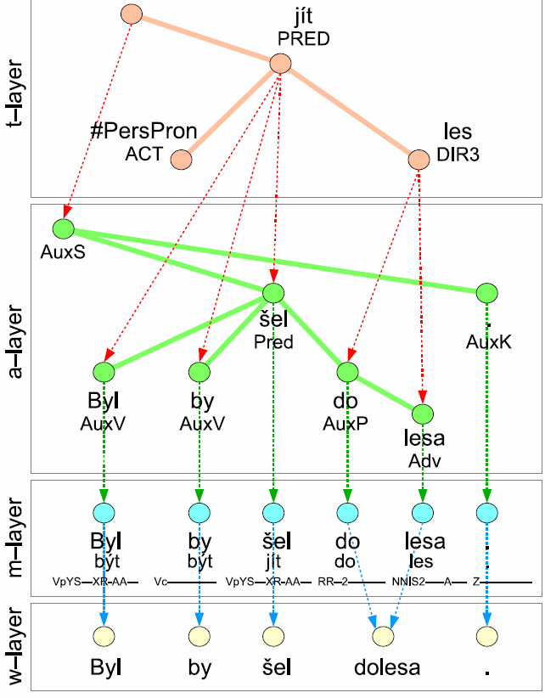

Dom. indep. – Linguistic annotation “UFALware”
Notes:
Ako urobit aby som tieto poznamky videl a na obrazovke neboli

Slide 27
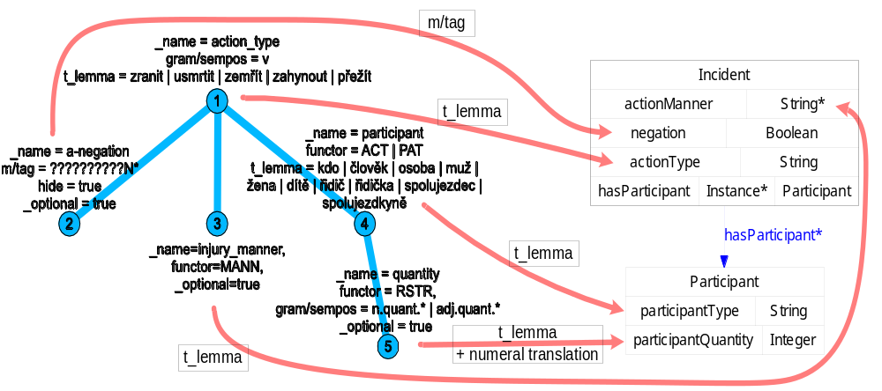
Domain dependent annotation of texts
Notes:
Ako urobit aby som tieto poznamky videl a na obrazovke neboli

Slide 28
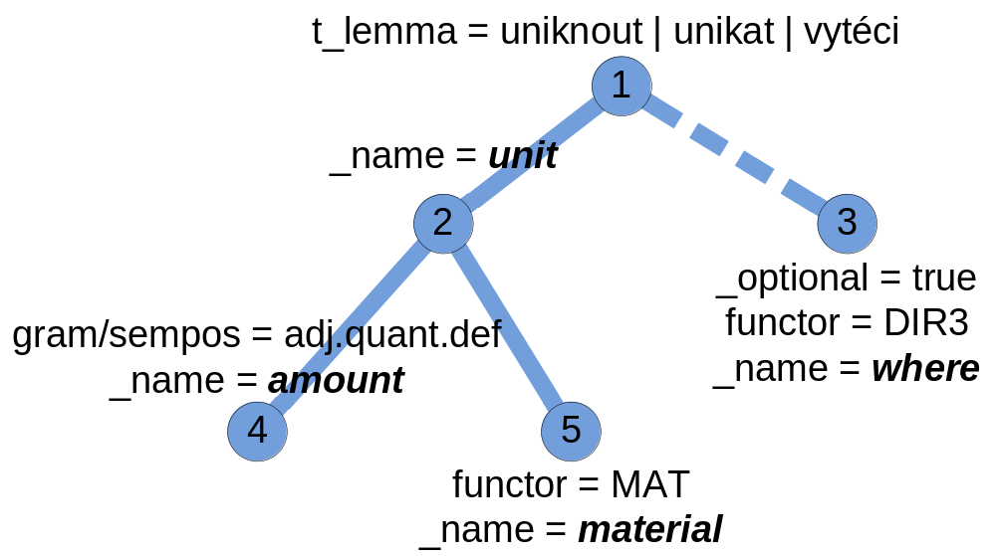
Another example of extraction rule - domain: environment protection

Slide 29
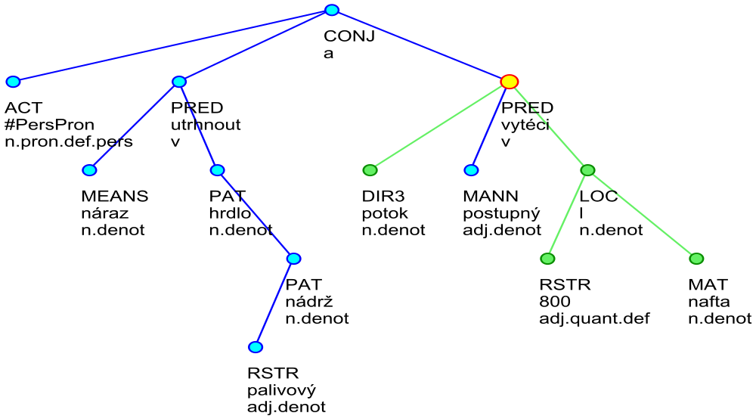
Example of a linguistic tree
"Due to the clash the throat of fuel tank tore off and 800 litres of oil (diesel)
has run out to a stream."
“Nárazem se utrhl hrdlo palivové
nádrže a do potoka postupně vyteklo na 800 litrů nafty.”
jihmor56559.txt-001-p1s3
(1)
(2)
litre
(3)
(5)
diesel
(4)
"into" water stream

Slide 30
Experimental results – extracted data
  <QueryMatches>
  <Match root_id="jihmor56559.txt-001-p1s3" match_string="15:0,16:4,22:1,23:2,27:3">
  <Sentence>Nárazem se utrhl hrdlo palivové nádrže a do potoka postupně vyteklo na 800 litrů nafty.</Sentence>
  <Data>
  <Value variable_name="amount" attribute_name="t_lemma">800</Value>
  <Value variable_name="unit" attribute_name="t_lemma">l</Value>
  <Value variable_name="material" attribute_name="t_lemma">nafta</Value>
  <Value variable_name="where" attribute_name="t_lemma">potok</Value>
  </Data>
  </Match>
  <Match root_id="jihmor68220.txt-001-p1s3" match_string="3:0,12:4,21:1,22:2,27:3">
  <Sentence>Z palivové nádrže vozidla uniklo do půdy v příkopu vedle silnice zhruba 350 litrů nafty, a proto byli o události informováni také pracovníci odboru životního prostředí Městského úřadu ve Vyškově a České inspekce životního prostředí.</Sentence>
  <Data>
  <Value variable_name="amount" attribute_name="t_lemma">350</Value>
  <Value variable_name="unit" attribute_name="t_lemma">l</Value>
  <Value variable_name="material" attribute_name="t_lemma">nafta</Value>
  <Value variable_name="where" attribute_name="t_lemma">půda</Value>
  </Data>
  </Match>
  ...
litre
water stream
diesel
soil

Slide 31

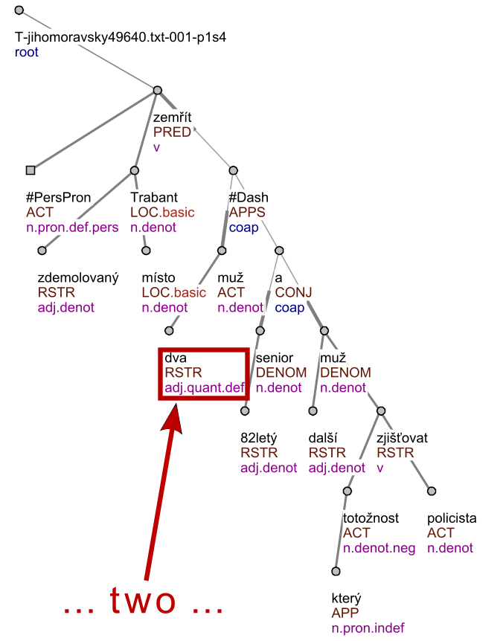
tree_root(node0_0). node(node0_0).
id(node0_0, t_jihomoravsky49640_txt_001_p1s4).
%%%%%%%% node0_1 %%%%%%%%%%%%%%%%%%
node(node0_1).
functor(node0_1, pred).
gram_sempos(node0_1, v).
t_lemma(node0_1, zemrit).
%%%%%%%% node0_2 %%%%%%%%%%%%%%%%%%
node(node0_2).
functor(node0_2, act).
gram_sempos(node0_2, n_pron_def_pers). t_lemma(node0_2, x_perspron).
%%%%%%%% node0_3 %%%%%%%%%%%%%%%%%%%
node(node0_3). id(node0_3,
functor(node0_3, loc).
gram_sempos(node0_3, n_denot).
t_lemma(node0_3, trabant).
...
edge(node0_0, node0_1). edge(node0_1, node0_2).
edge(node0_1, node0_3). edge(node0_3, node0_4).
edge(node0_4, node0_5). edge(node0_3, node0_6).
edge(node0_3, node0_7). edge(node0_3, node0_8).
...
Logic representation
Source web page
Linguistic trees

Slide 32
Dom. dep. – ILP learning of linguistic rules
• Positive examples E+
– examples with desired properties.
• Negative examples E-
– examples with opposite properties.
• Background knowledge
– additional data describing the examples
and domain
Notes:
Ako urobit aby som tieto poznamky videl a na obrazovke neboli

Slide 33
Rules found by ILP
injured(A) :- id(B,A), id(B,t_plzensky57770_txt_001_p5s2).Trivial
injured(A) :- id(B,A), id(B,t_plzensky60375_txt_001_p1s6). Trivial
injured(A) :- id(B,A), id(B,t_plzensky57870_txt_001_p8s2). Trivial
injured(A) :- id(B,A), id(B,t_plzensky57870_txt_001_p1s1). Trivial
injured(A) :- id(B,A), edge(B,C), edge(C,D), t_lemma(D,zranit).
injured(A) :- id(B,A), edge(B,C), edge(C,D), t_lemma(D,nehoda).
Notes:
Ako urobit aby som tieto poznamky videl a na obrazovke neboli

Slide 34
Evaluation on test set – injured(A)
 | Correct + | Correct -
Predicted + | 11 | 1
Predicted - | 4 | 22
 | Precision | Recall
Positive | 91.7% | 73.3%
Negative | 84.6% | 95.7%
All | 86.8%
Name of the tool | Precision
Morphological tagging | 93 % (see in [18] and [14])
Collins' parser (Czech adaptation) | 81.6 % (see in [15])
Analytical function assignment | 92 % (in [18])
Tectogrammatical analysis | dependences: 90.2 % f-tags assignment: 86.5% (in [16])
Notes:
Ako urobit aby som tieto poznamky videl a na obrazovke neboli

Slide 35
Experiments made so far (work in progress)
Textual pages
  Fire and car accidents
    800 articles
    1.2 MB of textual data
    10 MB of ling. annotations
      3.5 hours run time
  Environment protection
  Bankrupts Evidence
  ILP learning
    Dozens of articles
Tabular pages
  Notebooks
  Cars
  Hotels
  Dozens of pages
Notes:
Ako urobit aby som tieto poznamky videl a na obrazovke neboli

Slide 36
User Agents on the Semantic Web
Different users with different preferences
So far no experiments with human users
How to evaluate the degree of semantization?

Slide 37
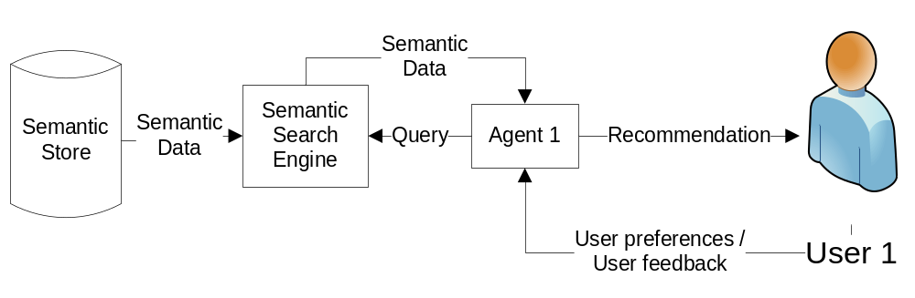
Querying by user agent – A. Eckhardt
Notes:
Ako urobit aby som tieto poznamky videl a na obrazovke neboli

Slide 38
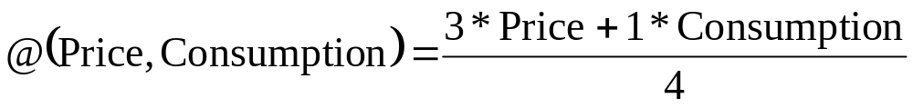
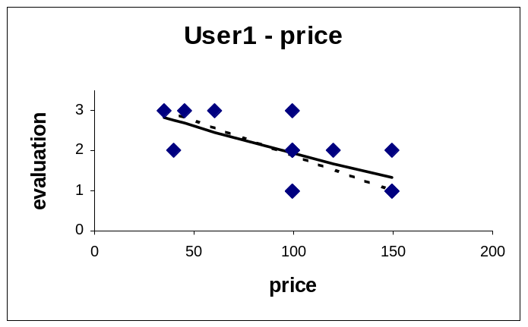
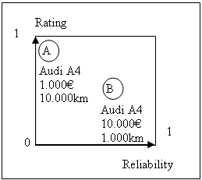
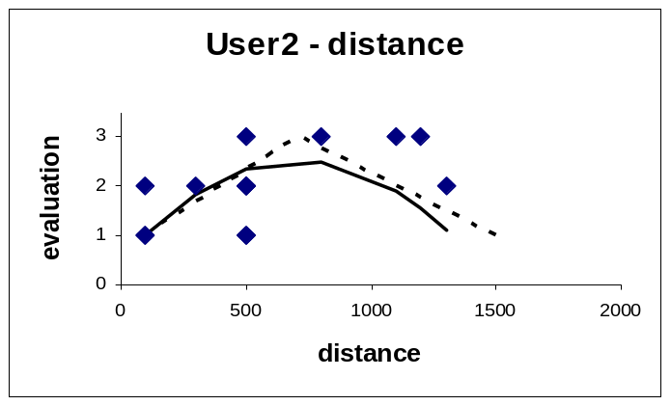
User agent design
Notes:
Ako urobit aby som tieto poznamky videl a na obrazovke neboli

Slide 39
Nominal attributes
According to the importance of particular values
Number of objects
100
Red
Black
1
Object evaluation
Blue
Green
Orange
Domain of attribute
„Distinctive“ objects
„Common“ objects
Average importance of values gives
importance of particular attribute

Slide 40
Related Works
IBM research: Semtag and seeker: bootstrapping the semantic web via automated semantic annotation. 2003
Liu et al. Mining Data Records in Web Pages. 2003
KIM - A Semantic Platform For Information Extraction and Retrieval. 2004
Cimiano et al. Towards the self-annotating web. 2004
Zhao et al. Fully automatic wrapper generation for search engines. 2005
SOBA: Ontology-based information extraction and integration from heterogeneous data sources. 2008
Larvet et al. Semantization of Legacy Web Services: From WSDL to SAWSDL. 2008
Notes:
Ako urobit aby som tieto poznamky videl a na obrazovke neboli

Slide 41
Conclusion
Gradual semantization is possible!
Goals
- minimalization of human assistance
- minimalization of human expert assistance
Suitable for low frequently changing content.
- monthly?
Work in progress, now just a „proof of concept“.
Key issue – scalability
How to measure the success of web semantization?
Notes:
Ako urobit aby som tieto poznamky videl a na obrazovke neboli

Slide 42


Web Semantization Research Group
http://www.ksi.mff.cuni.cz/semwex/
Thank you for your attention!
Questions?

Slide 43
Web semantization today
Formal models
Dvořáková
Web (3TB of *.cz)
Crawler (L. Galambos)
Repository (J. Pokorný)
WIE (J. Dědek)
Semantic processing (F. Zavoral,
D. Bednárek, J. Dokulil)
User profile (A. Eckhardt)
User (agent, service)
(I.Mlýnková, M.Nečaský)
Trust and reputation Novotný
Security Tykal, Knap
Paralel Yaghob
Paralel Yaghob
Lobotic Ploblems Obdržálek

Slide 44
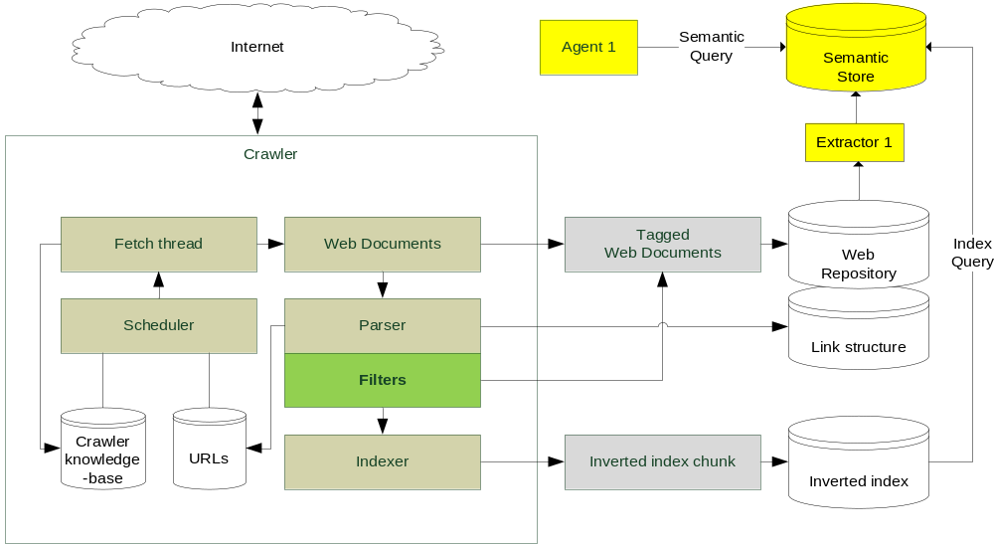
Web Store proposal – related project Egothor
Notes:
Ako urobit aby som tieto poznamky videl a na obrazovke neboli

Slide 45
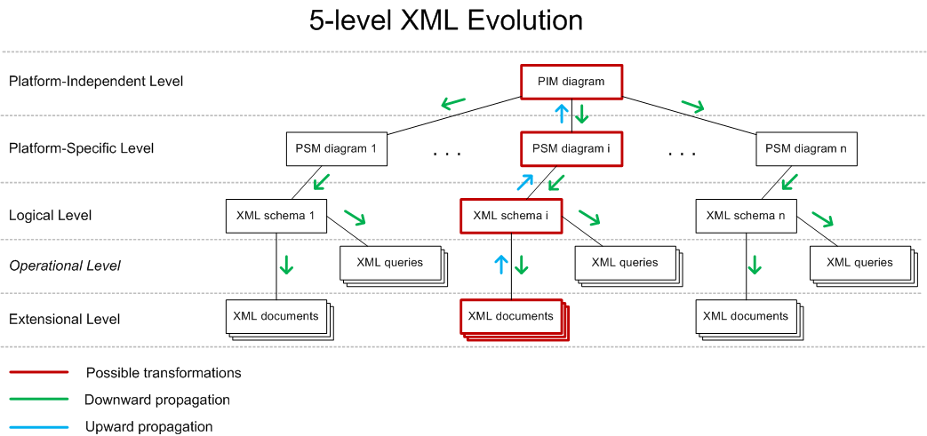
New XML Conceptual model - Nečaský
A
a
Notes:
Ako urobit aby som tieto poznamky videl a na obrazovke neboli

Slide 46
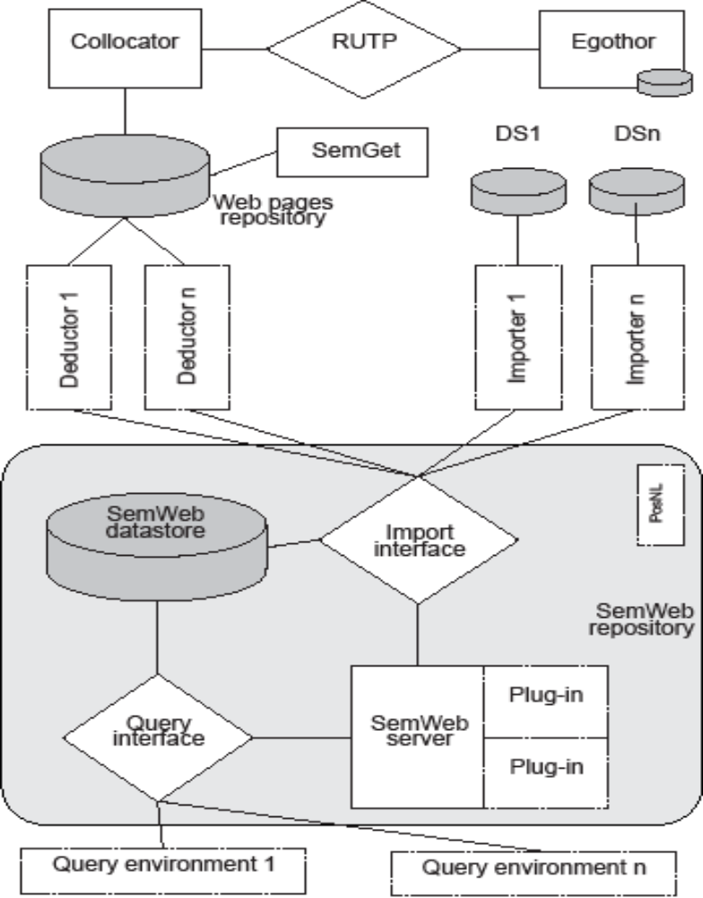
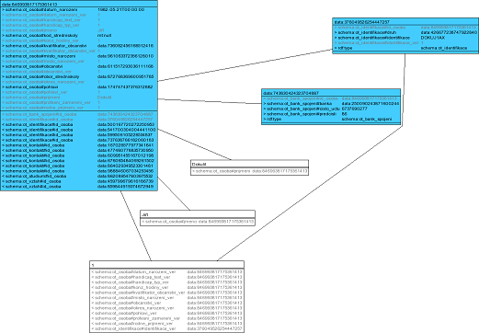
Semantic repository and RDF visualization
Zavoral,
Dokulil
a
Notes:
Ako urobit aby som tieto poznamky videl a na obrazovke neboli

Slide 47
Thank you for your attention!
Questions?
Notes:
Ako urobit aby som tieto poznamky videl a na obrazovke neboli

