Slide 1



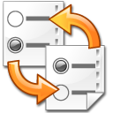
repository enabled
application (n)
remote repository (n)
local repository
cache (1)

