Slide 1
NEXiWAVE.COM CMUSphinx.org
The Use of Open Source Speech Recognition
Nickolay Shmyrev
VP of Research

Slide 2
The state of speech-related open source products
AT&T Crystal vs Flite Kal
Voxeo Prophecy vs JVoiceXML
G729 vs Speex

Slide 3
The reasons for such difference are complex
Lack of resources
Lack of knowledge
Patents (PSOLA, US Patent 6766295, ...)

Slide 4
Even open source projects exist, it's hard to use them
Always a prototype
No documentation
No support/community
No releases
Single-person knowledge

Slide 5
You could do many very intersting things
Intelligent dialog management
Talk topic detection (speech adsense, anti-advertising)
Transcription of the talks/voicemail
System integration
Accurate conference transcription
Real-Time transcription

Slide 6
It's quite common to see the following
User on CMUSphinx forum:
We need someone to help us get things going with Sphinx. We are looking for sequences of numbers within an audio file and returning the Timed Results to be analyzed by an external program.
Just using the basic "what you get when you download" sphinx 4 we have a proof of concept, but when it comes to working with the actual grammars/models we are completely lost.

Slide 7
It's enjoying to see that computer can understand some of your commands
Download the package
Setup it with a lot of pain
Make sure it doesn't work (for example it's very hard to recognize a single word)
Do you know what is "fMPE discriminative training, lextree search, count-based language model"? You shouldn't know that.

Slide 8
It's a huge amount of work
Collect test/train database
Tune and adapt the system
Test extensively

Slide 9
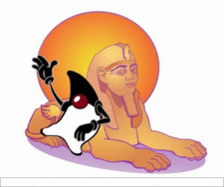
The Plan
Stable and frequent releases
Packages
Stable and usable API
Good documentation/website
Online support (#cmusphinx @ freenode)
Pure BSD license (no JSAPI)
IVR in Freeswitch
Missing part implementation
Commercial support
http://cmusphinx.org

Slide 10
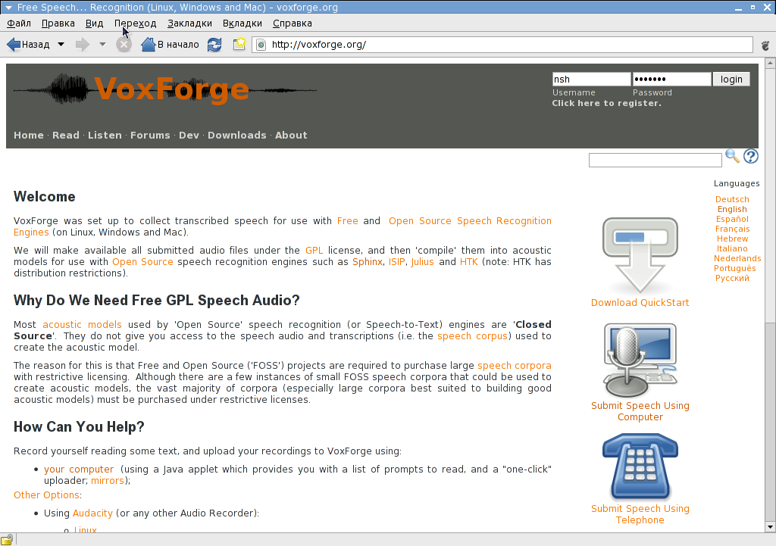
Voxforge, The Free Speech Database
http://voxforge.org
Free speech recordings, ready for processing
Acoustic databases
Many languages
Free acoustic models

Slide 11
The Plan for TTS
Support OpenMARY (http://mary.dkfi.de)
or
Develop a usable practical TTS, mostly from scratch

Slide 12
What If You Want It Now
Visit
http://nexiwave.com
Customizable speech recognition, boxes, appliances, web-services
Try it for free
http://searchmymeeting.com

