Slide 1
Monitoring API
Example applications using the “common” way and the “mapi” way.
A theoretical comparison between the two ways.
Implemented functions.
Comparing the two ways in practice.
Implementation details.

Slide 2
The “common” way
#define RBUF_SIZE 1500
void count_bytes()
{
char buffer[RBUF_SIZE];
int sock, n;
long long sum = 0;
sock = socket(PF_PACKET,RBUF_SIZE,htons(ETH_P_ALL));
while(1)
{
n = recvfrom(sock,buffer,RBUF_SIZE,0,NULL,NULL);
sum += n;
}
}

Slide 3
The “mapi” way
#include <mapiioctl.h>
int sock;
struct count_bytes_struct cbs;
void count_bytes()
{
sock = socket(PF_PACKET,SOCK_RAW,htons(ETH_P_ALL));
ioctl(sock,SIOCSCOUNT_BYTES,&cbs);
sleep(60);
ioctl(sock,SIOCGCOUNT_BYTES,&cbs) ;
printf("Total bytes = %ld\n",cbs.counter);
}

Slide 4
Comparing the two ways (1/2)
The “common” way.
  For every packet arriving to NIC two context switches (kernel -> user and user -> kernel) and one copy of the packet from kernel to user space.
  Not necessary because we only want to count the bytes of the packet.We are not interested of the contents.
  As will be shown later this is too inefficient if we have too many processes requesting the packet.
  For example, for 50 processes we will have 100 context switches and 50 copies from user to kernel space for every packet arriving to NIC!

Slide 5
Comparing the two ways (2/2)
The “mapi” way.
  One context switch when “registering” the function to apply to packets.
  Two context switches when requesting the results from the kernel.
  The number of context switches depends only to the number of processes and not to the number of packets arriving to NIC.
  Only one copy from user to kernel space for setting the parameters of the function to apply.
  Only one copy from kernel to user space for giving the results to the process.

Slide 6
Implemented functions
Count packets.
Count bytes.
Additive and rotating hash.
Log packets to file using libpcap format.
Sample packets.
Sub-string search using Boyer-Moore.
Cook packets.
Sub-flows.

Slide 7
Sample packets function
Three modes for sampling.
  Get all. Send all packets to user space.
  Deterministic sampling.
  Probabilistic sampling.
If a process wants to read packets, the only way to do this is by registering the sampling function (or a similar one) to be applied to packets. Otherwise, a recv does nothing.
Why to do it this way? If a process knows that it does not want to receive packets then is better for kernel not to append the packets in the socket’s receive queue. Kernel saves CPU cycles and memory!

Slide 8
Sub-string search function
The sub-string search function currently implemented in MAPI is using the Boyer-Moore algorithm.
If a process wants to get only the packets containing a specified pattern in its payload can register this function. Subsequent recv from the socket will return only the packets containing the specified payload.
This function can be used in parallel with the sampling function in order not to search all packets but a portion of them.

Slide 9
Cook packets function
With this function the packets are reassembled into a data stream.
The packets are processed according to the protocol stated in the packet header. For example, this function recombines fragmented IP packets.
For now, the protocols supported are IP and UDP. Soon, TCP will be added.
Implementing the reassembly of packets as a common function has the following advantages.
  New protocols can be added without changing the core MAPI code.
  New protocols can be added at “run-time”.

Slide 10
Sub-flows function (1/2)
This function implements the hierarchical network flows. A hierarchical flow differs from regular network flows in that is composed of several sub-flows.
A sub-flow is defined to contain all packets that have a common quadruple of src IP, dst IP, src Port, dst Port.
Implementing the sub-flows as a common function has the following advantages.
  A regular network flow can “become” an hierarchical network flow and vice-versa without destroying the current socket.
  If someone write a better implementation of sub-flows can add it to MAPI without changing the core MAPI code.
  In fact he/she can alter the two implementations at “run-time”.

Slide 11
Sub-flows function (2/2)
Two ways for a process to get sub-flows information.
  Read one expired sub-flow at a time and possibly block.
  Register a signal handler which will catch the signal SIGIO. Every time a sub-flow expires the kernel will send an SIGIO to the process. Then the process can read a sub-flow without blocking.

Slide 12
Comparing the two ways in practice
In these measurements the protocol used was UDP.
The program used for sending and receiving packets was iperf.
All processes ran for three minutes.
The processor used was Pentium III at 733MHZ.
RAM 384 Mbytes.
The functions used was the count_packets and substring_search.
Unless otherwise noticed the results are for the “common” way.
The “mapi” way starts loosing packets at eighty processes.

Slide 13
Two Processes
count_packets
Packets received = 1.292.214
Packets dropped = 47.915
Idle = 70%
Each process got 96.5% of the packets that NIC received.
substring_search
Packets received = 1.284.491
Packets dropped = 61.155
Idle = 67%
Each process got 95.5% of the packets that NIC received.

Slide 14
Six Processes
count_packets
Packets received = 1.404.383
Packets dropped = 74.006
Idle = 52%
Each process got 95% of the packets that NIC received.
substring_search
Packets received = 1.393.015
Packets dropped = 101.410
Idle = 41%
Each process got 93% of the packets that NIC received.

Slide 15
Ten Processes
count_packets
Packets received = 1.410.870
Packets dropped = 78.663
Idle = 31%
Each process got 94% of the packets that NIC received.
substring_search
Packets received = 1.412.425
Packets dropped = 71.710
Idle = 1%
Each process got 93% of the packets that NIC received.

Slide 16
Twenty Processes
count_packets
Packets received = 783.041
Packets dropped = 695.917
Idle = 0.3%
Each process got 52% of the packets that NIC received.
substring_search
Packets received = 650613
Packets dropped = 833219
Idle = 0%
Each process got 43% of the packets that NIC received.

Slide 17
Fifty Processes
count_packets
Packets received = 192.901
Packets dropped = 1.297.816
Idle = 0%
Each process got 13% of the packets that NIC received.
substring_search
Packets received = 175.157
Packets dropped = 1.288.419
Idle = 0%
Each process got 11.9% of the packets that NIC received.

Slide 18
Eighty Processes
count_packets
Packets received = 92.255
Packets dropped = 1.381.026
Idle = 0%
Each process got 6% of the packets that NIC received.
substring_search
Packets received = 79.143
Packets dropped = 1.404.172
Idle = 0%
Each process got 5% of the packets that NIC received.

Slide 19
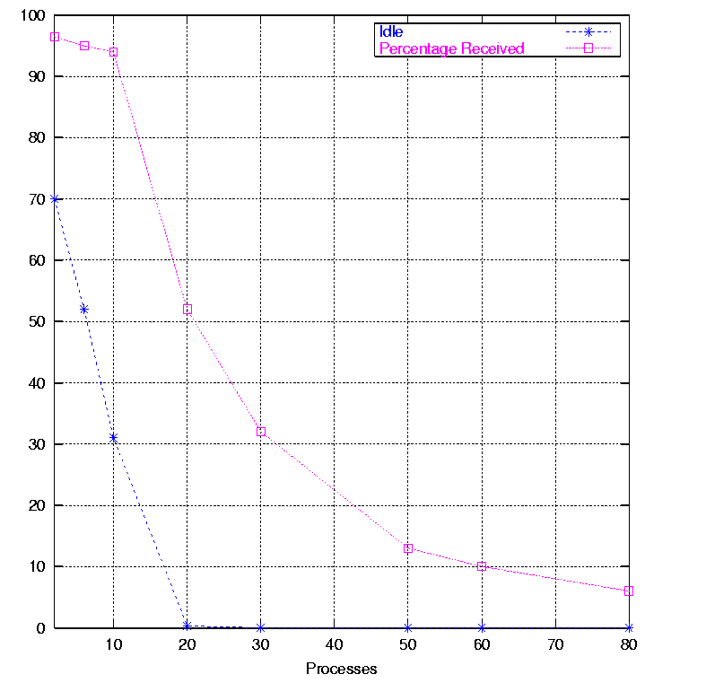
Graph for count_packets

Slide 20
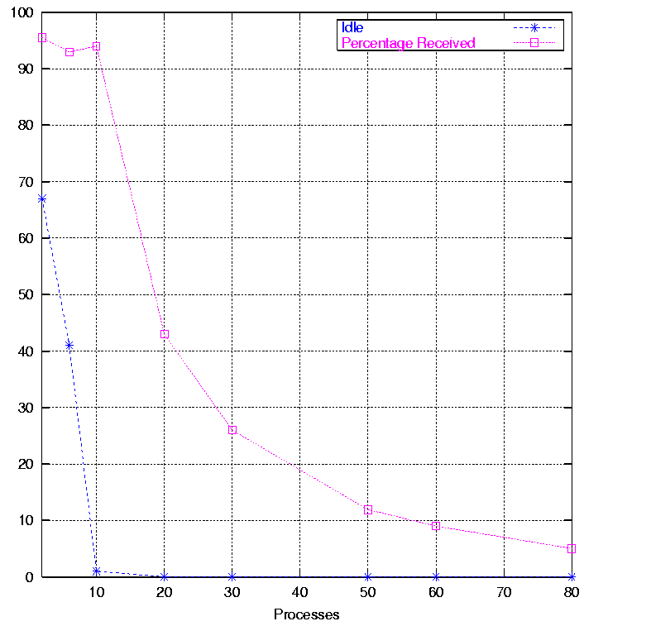
Graph for substring_search

Slide 21
Implementation details
MAPI core is implemented as a module inside Linux Kernel (version 2.4) above the PF_PACKET protocol family. In reality, we extend the already existent module for PF_PACKET protocol family.
Also, every function implemented in MAPI is a separate module that can be loaded and unloaded without affecting the other functions.
  We can load a function only when it is necessary and unload when we are done.

Slide 22
What is the PF_PACKET protocol family?
This protocol family allows a process to send and receive packets dealing directly with the NIC driver, thus avoiding the usual protocol stack handling.
That is, any packet sent through the socket will be directly passed to the NIC, and any packet received through the NIC will be directly passed to the process.
PF_PACKET protocol family supports two socket types.
  SOCK_DGRAM : Leaves to the kernel the burden of adding and removing link level headers.
  SOCK_RAW : Gives the process complete control over link level header.

Slide 23
The various layers
BSD socket
INET socket
INET socket
TCP/UDP
PACKET
IP
(Link)
(Physical)

Slide 24
Protocol handlers (1/2)
Protocol handlers is nothing more than common C functions.
The Linux kernel has two lists with protocol handlers to be called for every possible protocol type.
The two lists are called ptype_all and ptype_base and contain, respectively, protocol handlers for generic packets and for specific packet types.
Protocol handlers for the PF_PACKET protocol family register themselves when a particular socket type is created, declaring which protocol type they can handle.
If we create a packet socket to get all packets then our handler will be added to ptype_all. But if, for example, we create a packet socket for only the IP packets then our handler will be hashed into the ptype_base list.

Slide 25
Protocol handlers (2/2)
So, if we have for example 50 open packet sockets we will have 50 protocol handlers.
Is something wrong with that?
  Every packet has to be copied 50 times.
  Don’t worry. We have to copy only some pointers, not the data (Inside Linux Kernel every packet is represented by a struct sk_buff which has the data and some pointers which point for example to the Ethernet header, the IP header etc.).
Even if we apply a BPF filter, the packet will be dropped after have been copied.
Possibly, we can improve this by requiring only one copy for the common case that we don’t modify the headers of the packet but it is not easy.

Slide 26
Applying functions
Eventually, the protocol handler for the PF_PACKET protocol family will be called with the packet as argument.
The functions that will be applied to the packet are organized as a list named pfunc_list.
Before the protocol handler exits, calls all the functions in the pfunc_list with the packet as an argument. The functions have the ability to modify or drop the packet. If a packet is dropped the functions following will not be called.
Because the functions can modify or drop packets the sequence in which they will be called does matter.

