Slide 1
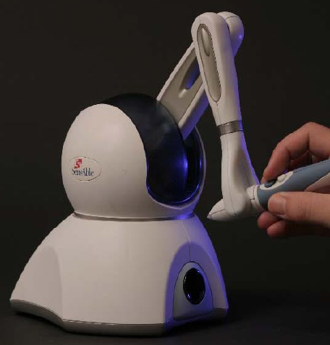
SensAble Phantom
Haptic support for
Interaction with graphs

Slide 2
3rd Presentation - overview
Review
Development steps
Current Revision
Timetable

Slide 3
1. Review
Haptic Support for Graphviewing and
-manipulation
Using the Phantom Device
  Navigation in 3D space
  Interaction by force feedback effects

Slide 4
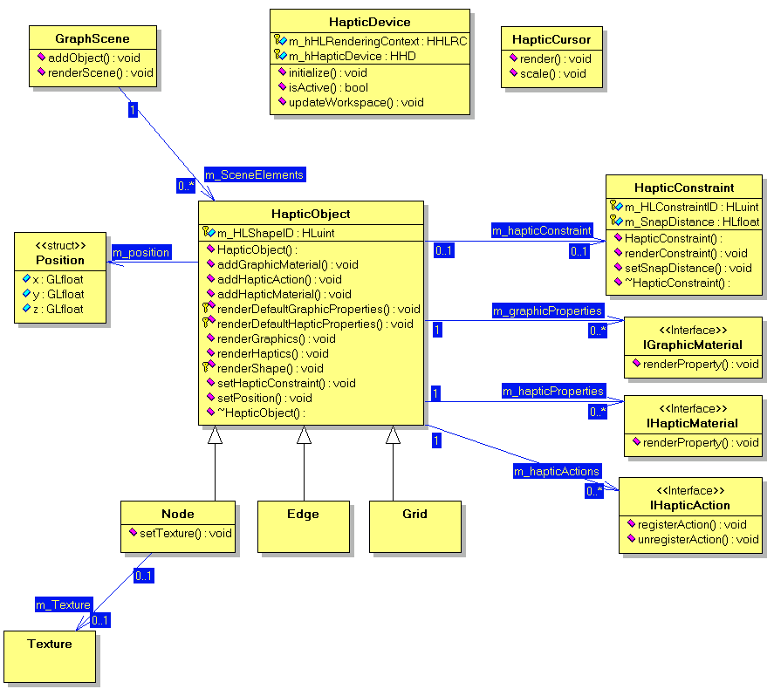
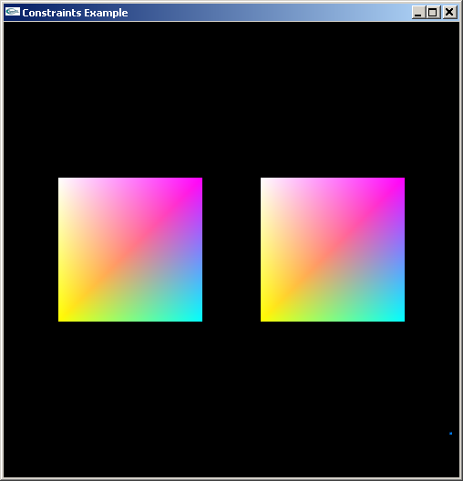
1. Review
Framework concept
Testapplication
Document Type Definition for graphs
<?xml version="1.0" encoding="UTF-8"?>
<!DOCTYPE Nodes [
<!ELEMENT Node (previous+, next+, name?, …)>
<!ATTLIST Node
nr ID #REQUIRED
surface (1|2|3) "n">
…
<!ELEMENT previous ID>
<!ELEMENT next ID>
…
]>

Slide 5
3rd Presentation - overview
Review
Development steps
Current Revision
Timetable

Slide 6
2. Development steps
Frameworkclass implementation
Businesslogic development
Interfaces between graphic / haptic and businesslogic

Slide 7
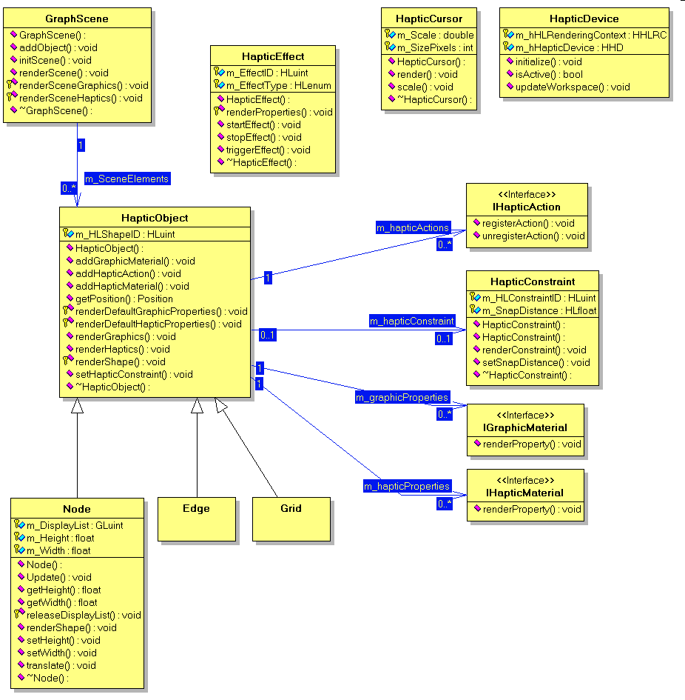
2. Development steps
2.1 Frameworkclass implementation
HapticObject:
Objects with graphical and haptical representation
Flexible assignment of features and actions

Slide 8
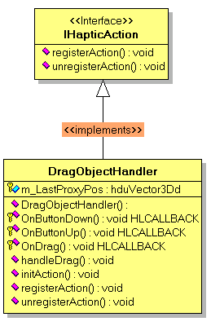
2. Development steps
2.1 Frameworkclass implementation
IHapticAction:
Eventhandler for Interaction with HapticObjects
Example: DragObjectHandler registers and handles the required events to make Objects follow the Phantom Device

Slide 9
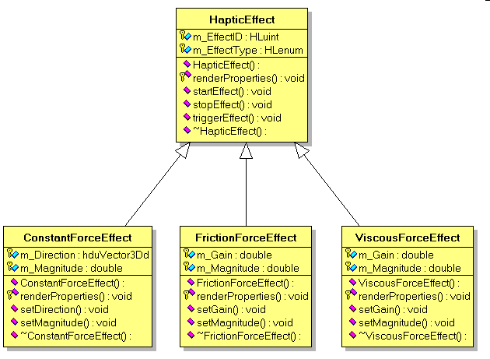
2. Development steps
2.1 Frameworkclass implementation
HapticEffect:
Represents an ambient force sensation
Example: FrictionForceEffect makes it harder to move the Phantom around

Slide 10
2. Development steps
Frameworkclass implementation
Businesslogic development
Interfaces between graphic / haptic and businesslogic

Slide 11
2. Development steps
2.2 Businesslogic
Basis for our demonstration software is a project graph for building a house
Main object for the projects business logic – the task
Mainly defined by
  end date
  duration
  finished at the latest date of
Notes:
Our Demo Project – Introduction
Projekt for building a house
Defined by tasks which must be done sequentiell one after another, whereby someother tasks can be done paralell to others.
Explain dates, duration, latest date of, pushing back tasks

Slide 12
2. Development steps
Frameworkclass implementation
Businesslogic development
Interfaces between graphic / haptic and businesslogic

Slide 13
2. Development steps
2.3 Haptic - Businesslogic Interfaces
Graphical objects and tasks themselves are separated
Calculation of task is managed by business logic
Graphical presentation and haptic output is calculated individually

Slide 14
2. Development steps
2.3 Haptic - Businesslogic Interfaces
Graphical objects representing a task use interfaces to get information from the corresponding task when they are drawn on the scene
Graphical objects send changed information to the interface for task recalculation
Changed tasks send an update request to the scene objects, which call the new task information for redrawing
Notes:
1. Get position data and forces for drawing and moving objects

Slide 15
3rd Presentation - overview
Review
Development steps
Current Revision
Timetable

Slide 16
3. Current Revision
Task calculation
Framework classes
Interfaces

Slide 17
4. Timetable
Following work has to be done for the project demonstration:
Completing the interface classes
Some task member functions need to be completed
Framework classes have to be finished

Slide 18
Questions?

