Slide 1
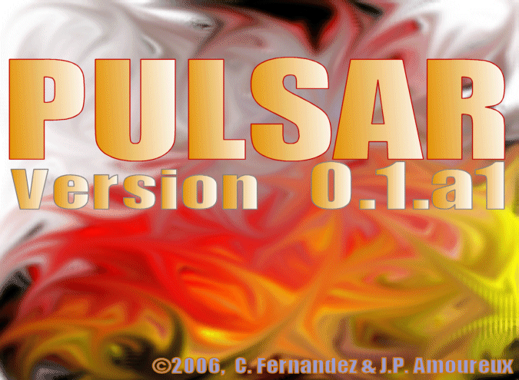
Version 0.1.rc1
pyPULSAR
pyPULSAR
© 2006-2007, C.Fernandez & J.P. Amoureux
Version 0.1.rc1
© 2006-2007
C. Fernandez
&
J.-P. Amoureux
pyPULSAR

Slide 2
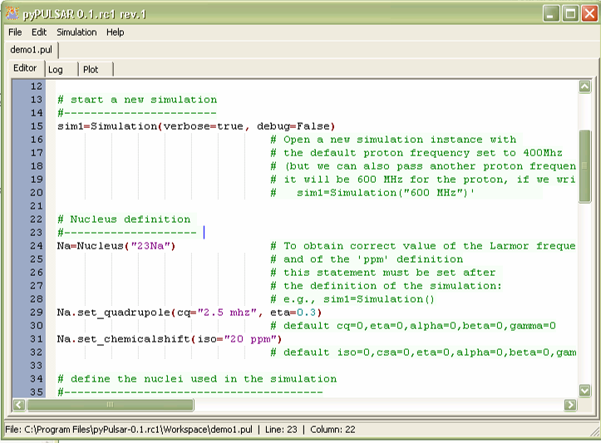

Slide 3
