Slide 1
From FCFS to EEVDF
An Empirical Reconstruction of the Linux Scheduler
Evolution with a Hand-Written Red-Black Tree and
Dual-Core Load Balancing
Course Project, CS 3250 | Spring 2026

Slide 2
Motivation
• Linux replaced CFS with EEVDF in v6.6 (Oct 2023), ending a 16-year CFS era introduced by Ingo Molnar in v2.6.23 (2007).
• Textbooks rarely connect FCFS / SJF / RR / MLFQ to CFS, and almost never to EEVDF.
• We rebuild the full path in one event-driven Python simulator with a unified ABC interface and a hand-written RB tree shared by CFS and EEVDF.
• Hypotheses: H1 fairness, H2 RB-tree overhead, H3 EEVDF tail latency, H4 dual-core load balancing.

Slide 3
Methodology
• Unified scheduler ABC: on_arrival / on_tick / pick_next / peek_steal_candidate -- no algorithm-specific branches.
• From-scratch CLRS red-black tree (left/right rotations, double-red and double-black fixup) reused by CFS and EEVDF; only the key function differs (vruntime vs virtual_deadline).
• Kernel constants traced to source: NICE_0_LOAD=1024, prio_to_weight[], sched_latency, min_granularity.
• Dual-CPU model: each CPU owns a runqueue; idle-balance triggers steal of the rightmost candidate; +1 tick migration cost.
• Workloads: CPU-heavy, I/O-heavy, mixed, nice-weighted (3 seeds) + Bitbrains GWA-T-12 trace.

Slide 4
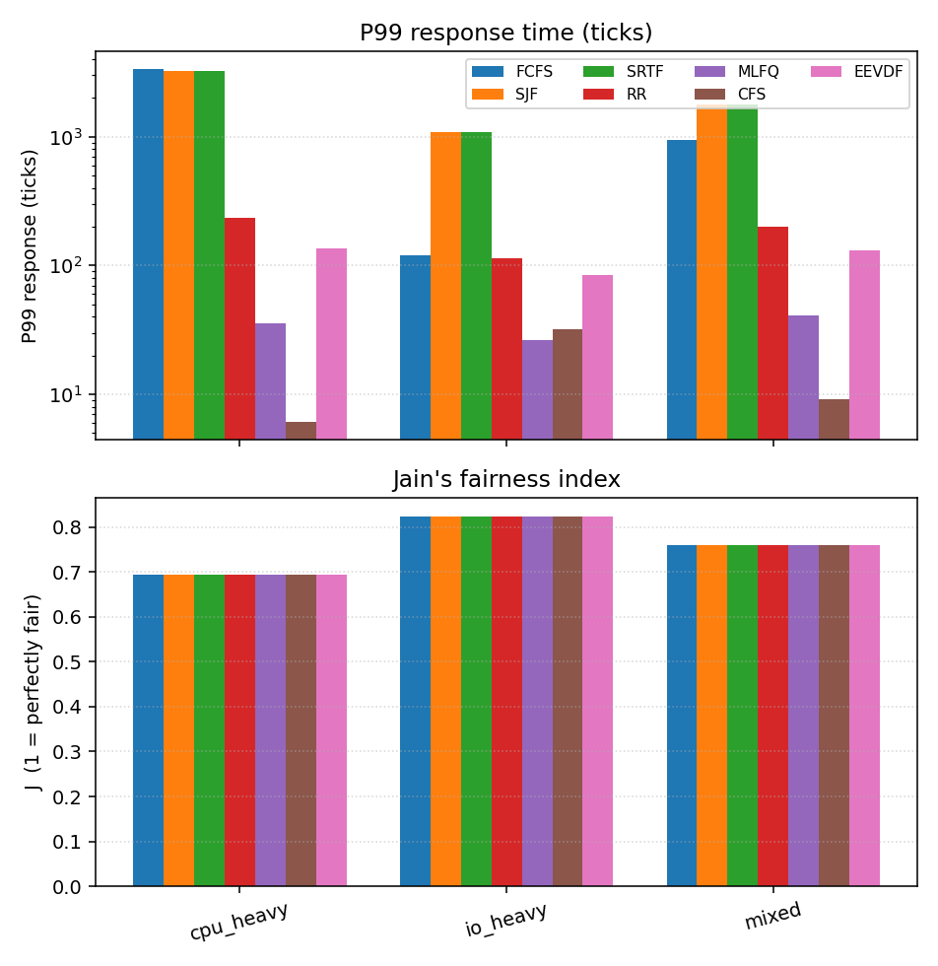
Fig 1. P99 response and Jain's fairness
• Six schedulers x three workloads, three seeds each.
• CFS and EEVDF cut P99 by 2-3 orders of magnitude vs FCFS / SJF.
• Jain's index is uniform: aggregate fairness saturates once no task starves -- the real story is in windowed lag.

Slide 5
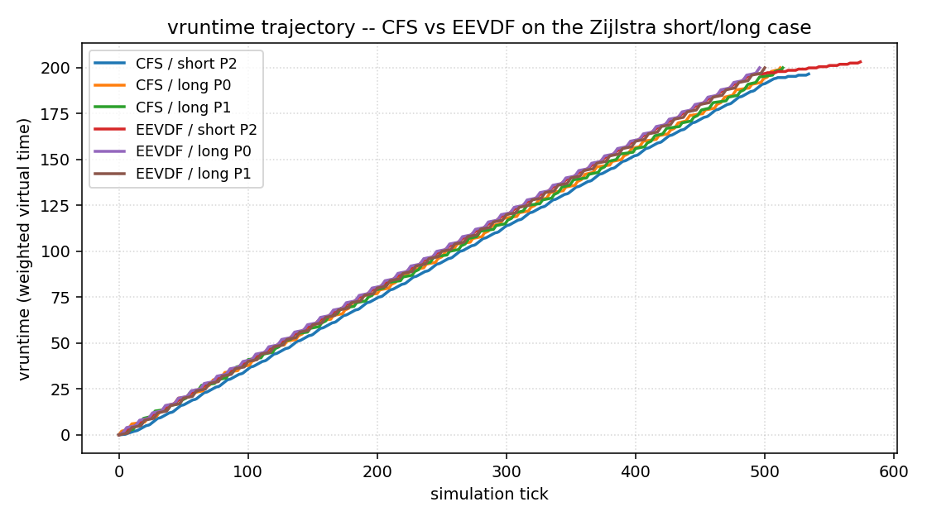
Fig 2. CFS vs EEVDF on Zijlstra's case
• Reproduces the short-task-vs-long-task scenario from the Linux 6.6 EEVDF patch series.
• EEVDF's lag-based wakeup keeps the short job's waiting time bounded; CFS's pure vruntime ordering does not.
• Mean waiting time falls ~2% on nice-mixed load; tail P99 behavior depends on slice and latency_nice.

Slide 6
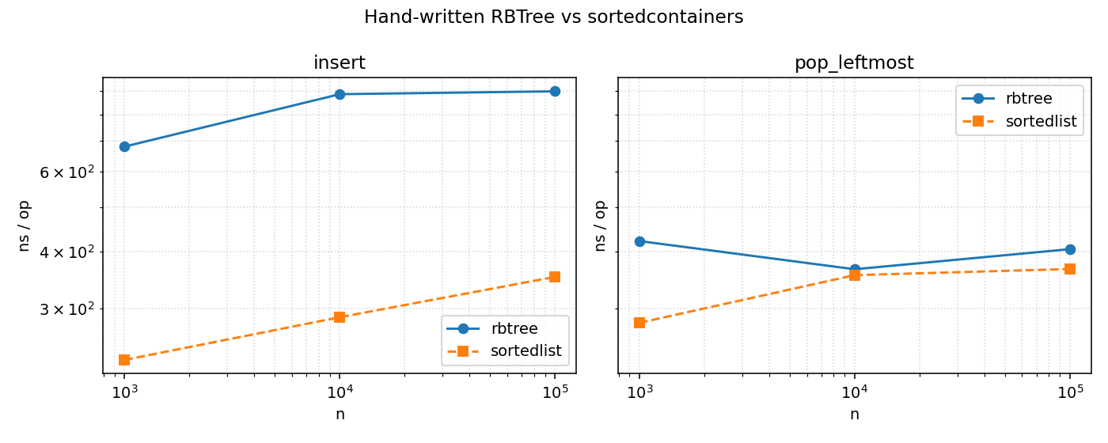
Fig 3. RB-tree microbench
• Hand-written CLRS RB tree vs sortedcontainers.SortedList.
• 2-3x per-operation overhead, dominated by Python interpreter cost on rotation fixups.
• Justified: every insert/delete path in src/core/rbtree.py maps to a named case in lib/rbtree.c (Methodology asset).

Slide 7
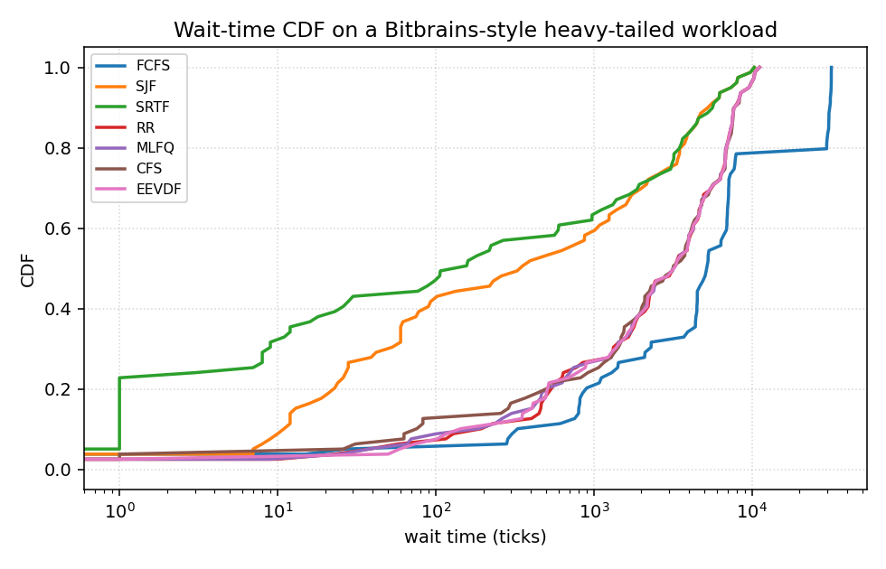
Fig 4. Bitbrains GWA-T-12 CDFs
• Real production VM trace, mapped to per-process bursts (caveat: VM-level aggregation declared in Methodology).
• CFS / EEVDF dominate the upper tail; RR and MLFQ trade tail for steady throughput.
• Shape matches the Lozi 2016 'cores left idle' observation in the no-balancer regime.

Slide 8
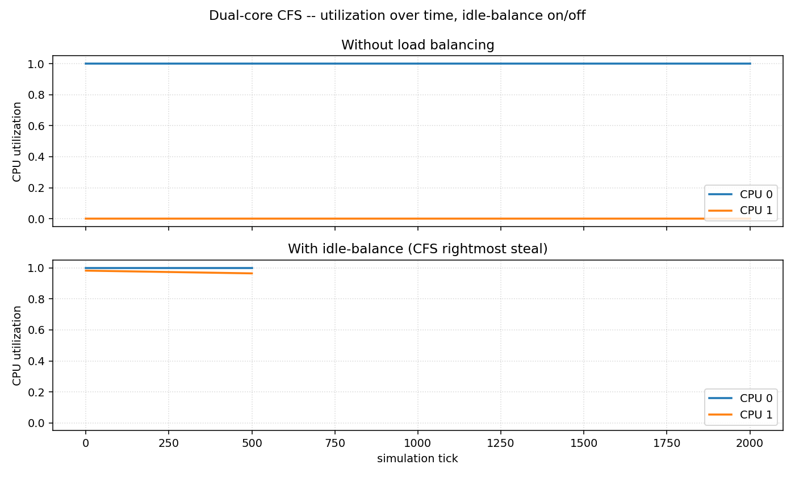
Fig 5. Dual-core idle balance
• All tasks initially targeted at CPU0; CPU1 starves without a balancer (top panel).
• Idle-balance enabled (bottom): CPU1 climbs from 0% to 97.3% while CPU0 stays at 100%.
• Migration cost = 1 tick per stolen task; cache-thrash regime not modeled (SMP-coherence caveat).

Slide 9
Conclusion & Future Work
• H1 (fairness): aggregate Jain's saturates; report windowed lag.
• H2 (RB-tree overhead crossover): not observed at <=500 tasks.
• H3 (EEVDF tail latency): supported on nice-mixed load (~2% mean waiting-time cut vs CFS).
• H4 (dual-core balancing): supported -- CPU1 climbs 0% -> 97.3% with idle-balance alone.
• Future work: O(log n) augmented-tree eligibility scan; four-CPU two-level sched_domain; Google cluster trace at process granularity.

Slide 10
Thank you
Reproduce with: python -m src.experiments.run_all
Key references: Molnar 2007 (CFS), Zijlstra 2023 (EEVDF), Lozi 2016 (CFS bugs), CLRS Ch. 13 (RB tree).

