Slide 1



Minimum Spanning Trees in Genomics Epidemiology: The Importance of models and metadata integration
João André Carriço, PhD
Microbiology Institute/Institute for Molecular Medicine
Faculty of Medicine, University of Lisbon
Portugal
U Helsinki, 20 May 2016
http://im.fm.ul.pt
http://imm.fm.ul.pt
http://www.joaocarrico.info
Twitter: @jacarrico

Slide 2
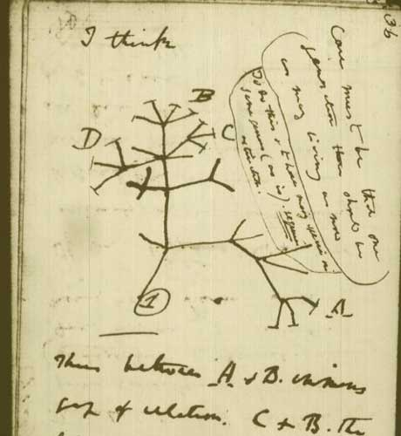
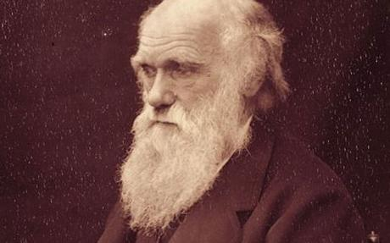
Darwin and the tree of life
Charles Darwin ‘s “tree of life” in Notebook B, 1837-1838

Slide 3
Phylogenetic Inference
Phylogenetics methods aim to infer the relationships between the taxa trying to define the common ancestors between taxa
Assumptions: the characters being compared are homologous and independent, i.e. they had shared a common ancestor and each character suffered evolutive forces individually
AT?GGGG
ATTGGGG
ATGGGGG

Slide 4
Algorithms for Phylogenetic Inference
Based on the distance matrix:
Hierarchical clustering : UPGMA, Single Linkage and Complete linkage
Neighbor-joining
Minimum Spanning Trees
Maximum Parsimony methods
Based on rules (Graphic Matroids)
goeBURST
Maximum Likelihood methods
Bayesian inference methods
Allelic Profiles
Sequence alignments
Sequence alignments
Allelic Profiles
Sequence alignments
Sequence alignments

Slide 5

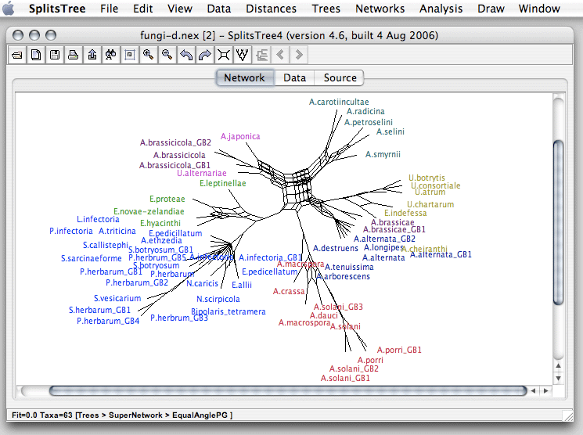



Software for Phylogenetic trees:
based on sequence alignments
MEGA
http://www.megasoftware.net/
Splitstree
http://www.splitstree.org/
Geneious (http://www.geneious.com/)
www.geneious.com
FastTree
http://www.microbesonline.org/fasttree
RAxML
http://sco.h-its.org/exelixis/web/software/raxml/index.html
PHYLIP
http://evolution.genetics.washington.edu/phylip.html
BEAST
http://beast.bio.ed.ac.uk/
And many many others…

Slide 6
Sequence Alignment methods
Caveats:
Computationally intensive: some methods can’t be applied to hundreds to thousands of strains
Require specialized method and software knowledge for parameter definition
Some genetic phenomena violate the assumptions (homoplasy: recombination, convergent evolution,…)
Maximum Likelihood tree of concatenated SICOs

Slide 7
Sequence Based Typing Methods
Strain genomic information encoded as a numeric sequence : Allelic profile
Sanger sequencing:
MLST: Gene allele identifier
MLVA: Number of repeats
NGS approaches:
Gene-by-Gene / allele based:
wgMLST: core + acessory genome
cgMLST: core genome
SNP Typing : Polymorphism

Slide 8
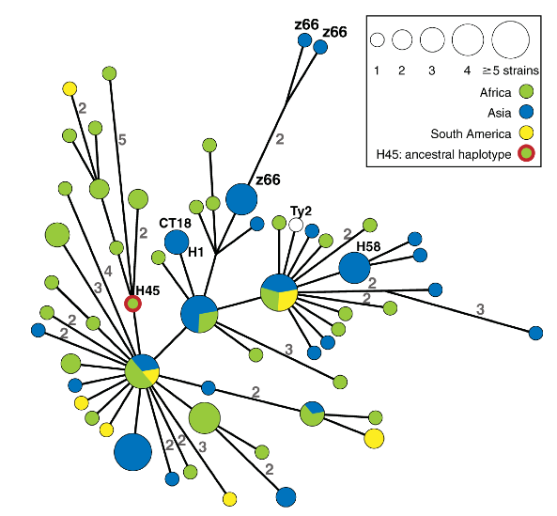
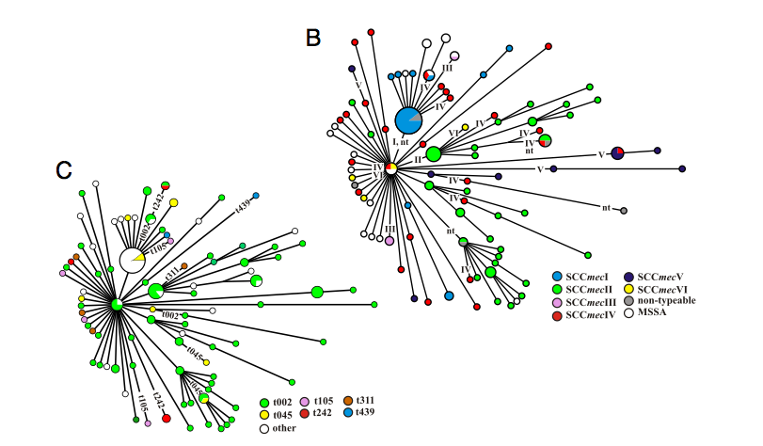
MST: Unique solutions ?
MST : Minimum Spanning Tree
Nübel, U., et al. (2008). Frequent emergence and limited geographic dispersal of methicillin-resistant Staphylococcus aureus. Proceedings of the National Academy of Sciences, 105(37), 14130.
Roumagnac, P., et al. (2006). Evolutionary History of Salmonella Typhi. Science, 314(5803), 1301–1304. http://doi.org/10.1126/science.1134933

Slide 9
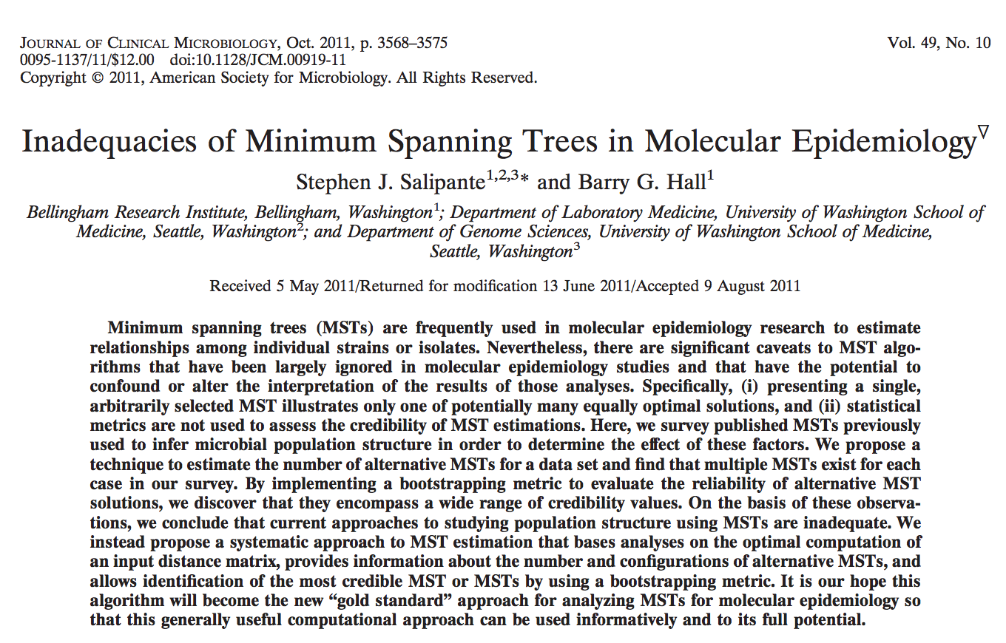
How reliable are the trees?

Slide 10
Infering phylogeny from allelic profiles
Assume that you have only 3 genes and each number corresponds to a different allele for each gene. The minimum assumption is assuming that a SLV may correspond to a possible phylogenetic descent.
SLV
SLV
SLV
1-1-1
1-1-2
1-2-1
1-2-2
1-2-3
SLV
SLV
SLV
11 possible trees….

Slide 11
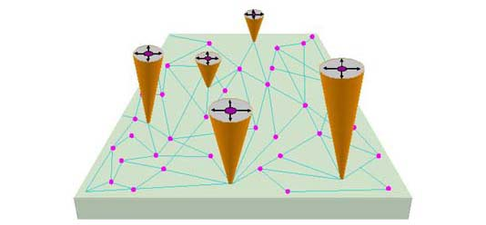
eBURST model
More similar STs should denote closely related strains from an evolutionary point of view.
STs with more SLVs can be regarded has a common ancestor.
Links between STs depict descent relations.
With these assumptions, connected STs should share an evolutionary path.
eBURST
Feil E. et al, J Bac 2004
Maynard Smith J., et al. 2000. Bioessays 22:1115-22

Slide 12
goeBURST
Francisco et al, BMC Bioinf, 2009
#SLV #DLVs #TLV Freq STid
1-1-1
2 2 0 1 1
1-1-2
2 2 0 1 2
Connects to ST4 because
#SLVs
1-2-1
3 1 0 1 3
More SLVs / lower ID
1-2-2
3 1 0 1 4
1-2-3
2 2 0 1 5
Final goeBURST tree :
unique solution guaranteed
Implementation of the eBURST rules as a graphic matroid problem, allows for a globally optimal solution of the placement of the ST links.

Slide 13
Applying goeBURST
SLV
SLV
SLV
1-1-1
1-1-2
1-2-1
1-2-2
1-2-3
SLV
SLV
SLV
11 possible trees….
All these are valid goeBURST solutions. The tie break would need to be the ST ID if all of them would have the same frequency in the dataset

Slide 14
How reliable are the trees?

Slide 15
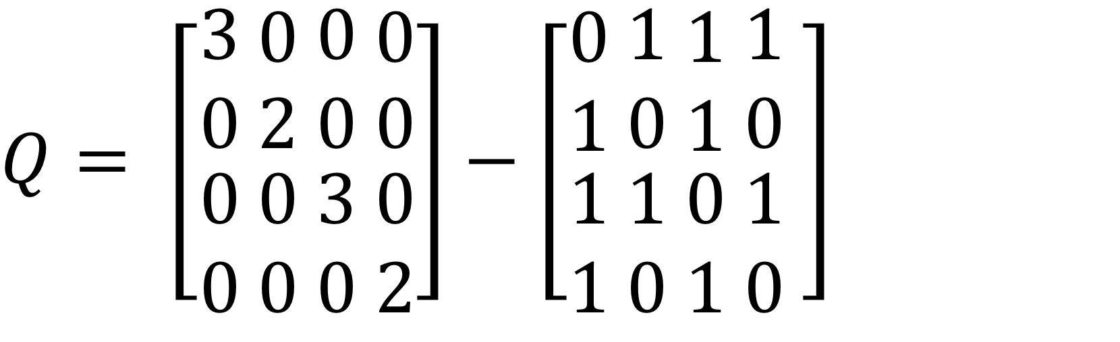
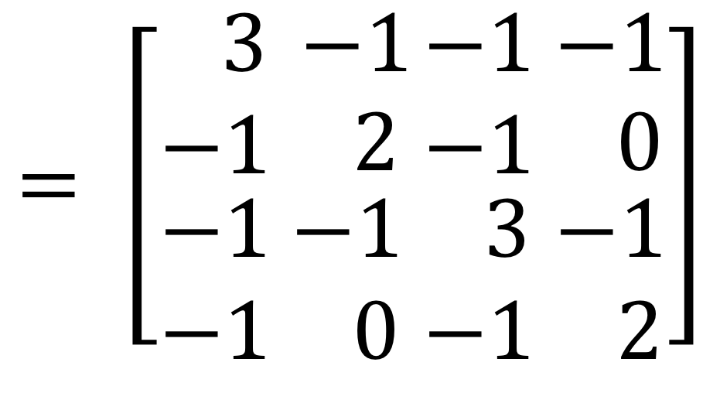
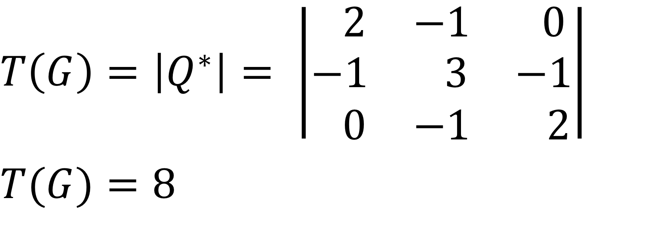
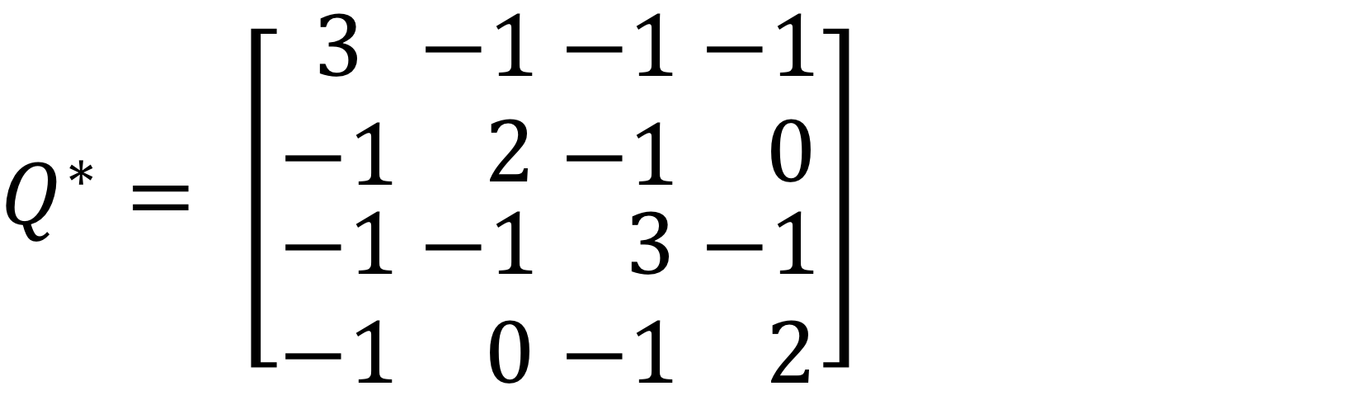
Counting the trees
Kirchhoff's Matrix Tree theorem
0
3
Graph
G
1
2
Laplacian of G
Degree mtx
Adjacency mtx

Slide 16
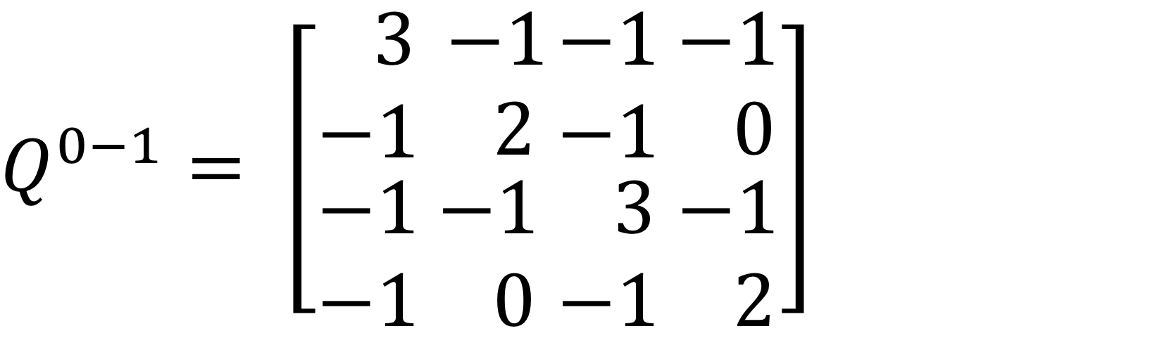
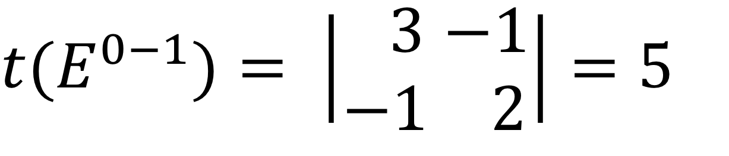
Counting edges in trees
0
3
To calculate the number of times an edge is present in all possible trees, the lines and columns corresponding to the nodes of the edge, must be deleted on the Laplacian Q and the determinant of the resulting matrix calculated.
Graph
G
1
2
Spanning Edge Betweeness
Similar to bootstrap but without ressampling!

Slide 17

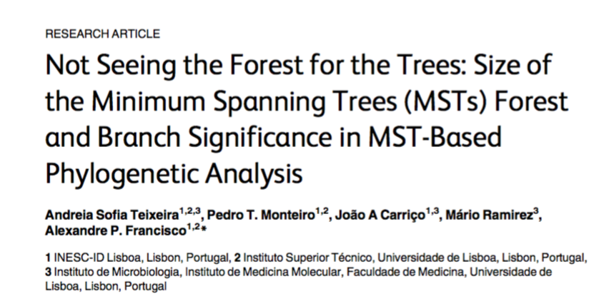

Slide 18
Streptococcus pneumoniae CC 3518
# STs = 19
# drawn edges = 27
# edges without ties = 6
# tiebreaks by SLV = 8
# tiebreaks by DLV = 4
# tiebreaks by ID = 2
This is the tree selected by goeBURST.
How many trees can this data produce?

Slide 19
Streptococcus pneumoniae CC 3518
67
MSN : 6912 trees
67
67
50
100
The values represented on the edges are
the percentage of the total number of trees where the link was present, calculated by the adapted Kirchhoff theorem.
50
#SLVs rule
50
100
50
50
50
50
16 trees
50
50
50
50
50
#DLVs rule
2 trees
67
100
100
67
STID rule
67
67
67
100
67
1 tree
100

Slide 20
Campylobacter jejuni CC 177
# STs = 68
# drawn edges = 67
# edges without ties = 13
# tiebreaks by SLV = 44
# tiebreaks by DLV = 9
# tiebreaks by TLV = 1

Slide 21
Campylobacter jejuni CC 177
# STs = 68
# SLV links = 100
# edges without ties = 13
# tiebreaks by SLV = 44
# tiebreaks by DLV = 9
# tiebreaks by TLV = 1
MSN :
4.03x10¹⁶ trees
#SLVs rule
1280 trees
#DLVs rule
2 trees
#TLVs rule
1 tree

Slide 22
Staphylococcus aureus CC89
# STs = 23
# drawn edges = 22
# edges without ties = 2
# tiebreaks by SLV = 18
# tiebreaks by DLV = 2

Slide 23
Staphylococcus aureus Clonal Complex 10
# STs = 23
# SLV links = 38
# edges without ties = 2
# tiebreaks by SLV = 18
# tiebreaks by DLV = 2
MSN : 7.7*10^6 trees
#SLVs rule
4 trees
#DLVs rule
1 trees

Slide 24
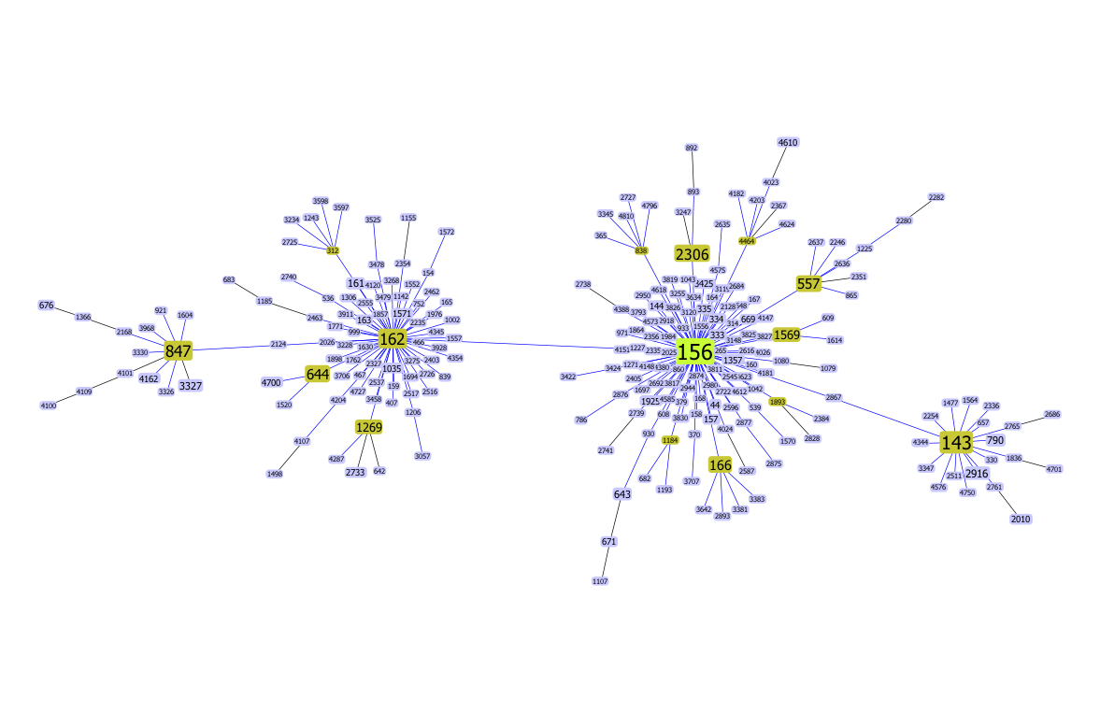
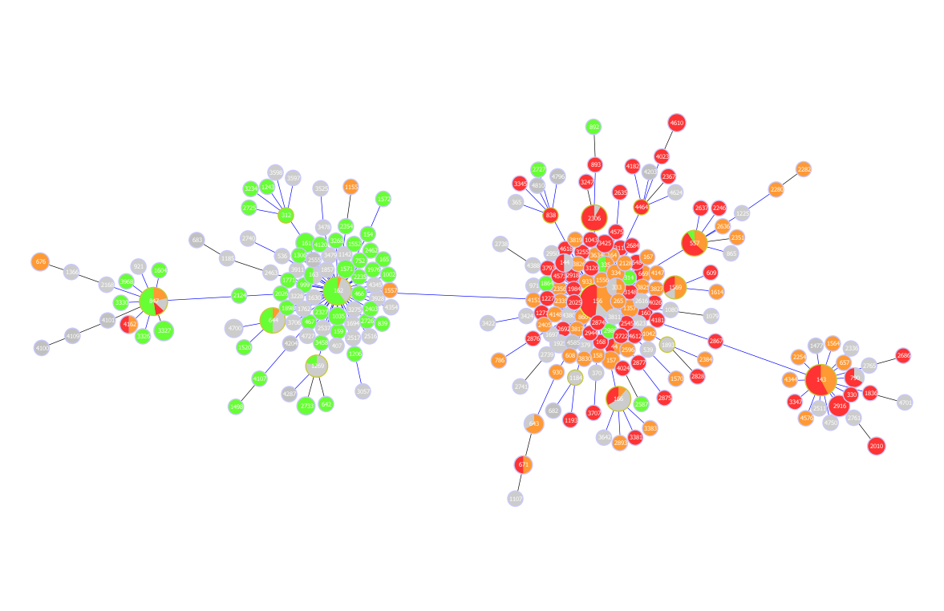
Integrating Data Analysis and Visualization
Accessory data
(“metadata”)
Allelic profiles
Antibiogram
Analysis
(goeBURST)
Serotype
Origin info (patient)
Other typing method
….
Present the data in a meaningful way

Slide 25
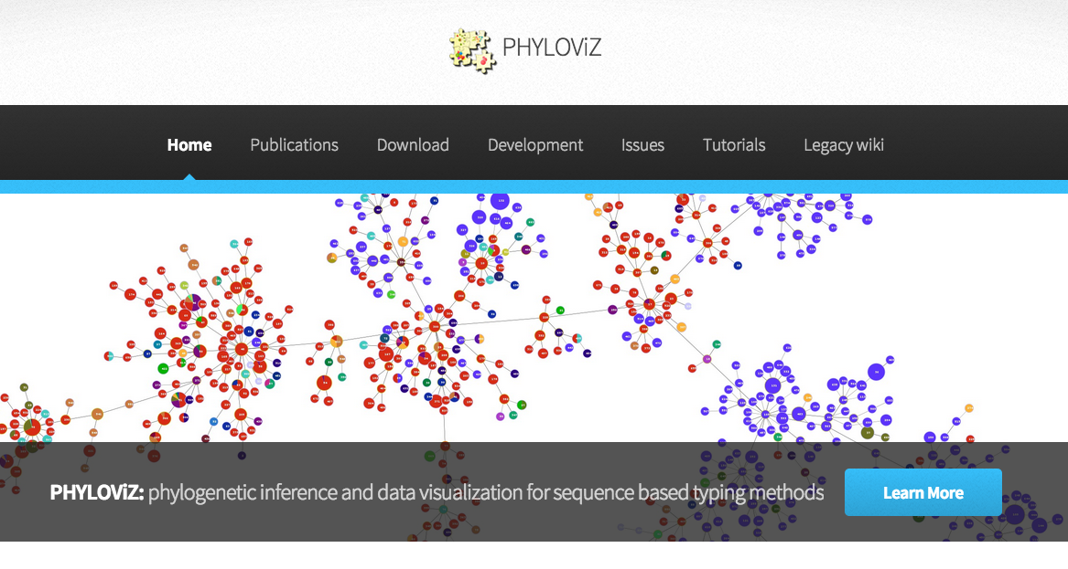


Using PHYLOViZ
(http://www.phyloviz.net)

Slide 26
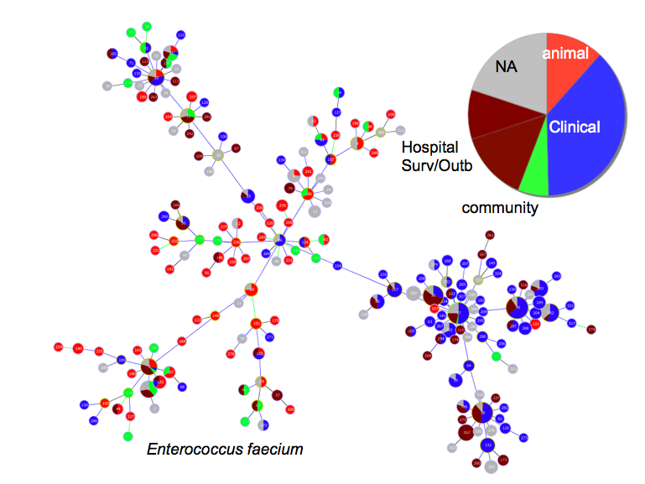
PROs:
Handles thousands of profiles
Fast calculation
Easy to annotate and explore metadata
Allows for basic statistics on profiles and metadata
Allows for advanced statistics on MSTs
(PLoS One. 2015 Mar 23;10(3):e0119315)
Exports high quality graphical formats
Allows plugin development
CONs:
goeBURST and goeBURST MST only
(Neighbour Joining and UPGMA soon)
JAVA knowledge to code new plugins

Slide 27
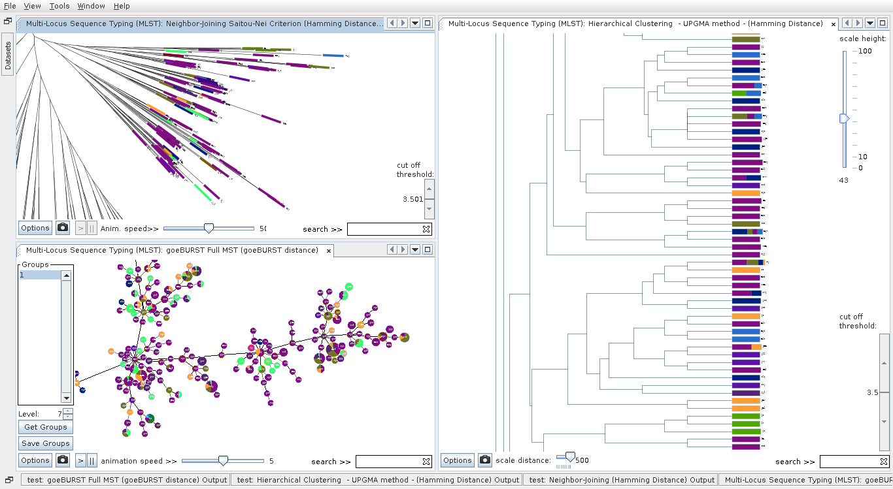
PHYLOViZ 2.0

Slide 28
Conclusions
Be aware of the limitations of the MST representation
goeBURST full MST gives an unique solution as an expansion of the eBURST algorithm for any number of loci
PHYLOViZ can be used to estimate the number of trees for a given goeBURST representation and the Spanning Edge Betweeness
The spanning edge betweenness can be used for the same purpose, with re- sults that are similar to those of the bootstrap procedure used frequently to support the grouping of taxa on trees
Metadata can have the final saying in the correctness and limitations of the model used for the MST construction

Slide 29


Acknowledgements
Andreia Sofia Teixeira
Alexandre Francisco
Cátia Vaz
Pedro Monteiro
Bruno Gonçalves
Mário Ramirez
José Melo-Cristino
Initial PHYLOViZ funding from Fundação para a Ciência e Tecnologia, Portugal

