Slide 1


mothur Schloss, P.D., et al., Introducing mothur: Open-source, platform-independent, community-supported software for describing and comparing microbial communities. Appl Environ Microbiol, 2009. 75(23):7537-41
Univ. -Ass. Dr. Kaisa Koskinen
Kaisa.Koskinen@medunigraz.at
Department of Internal Medicine
Medical University of Graz
16.5.2016

Slide 2
mothur
Implements existing algorithms:
DOTUR, SONS, TreeClimber, LIBSHUFF, ∫-LIBSHUFF (Schloss)
+ UniFrac, different aligners, and clustering algorithms, and many others
New releases and features regularly
Kaisa Koskinen, Medical University of Graz

Slide 3
mothur
Schloss PD,Westcott SL, Ryabin T, Hall JR, Hartmann M, Hollister EB, Lesniewski RA, Oakley BB, Parks DH, Robinson CJ, Sahl JW, Stres B, Thallinger GG, Horn DJV,Weber CF. 2009: Introducing mothur: open-source, platform-independent, community-supported software for describing and comparing microbial communities. Applied and Environmental Microbiology 75:7537–7541 DOI 10.1128/AEM.01541-09 Schloss PD, Gevers D,Westcott SL. 2011: Reducing the effects of PCR amplification and sequencing artifacts on 16S rRNA-based studies. PLoS ONE 6:e27310 DOI 10.1371/journal.pone.0027310. Westcott and Schloss 2015: De novo clustering methods outperform reference-based methods for assigning 16S rRNA gene sequences to operational taxonomic units. PeerJ, DOI 10.7717/peerj.1487
Kaisa Koskinen, Medical University of Graz

Slide 4
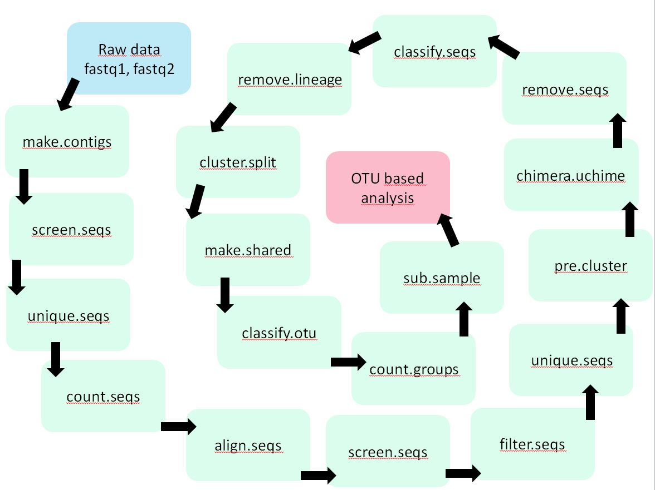
mothur
Reducing sequencing and PCR errors
Processing improved sequences
Aligning
OTU-based analysis
Clustering
Alpha-diversity
Beta-diversity
Taxonomies
Kaisa Koskinen, Medical University of Graz

Slide 5
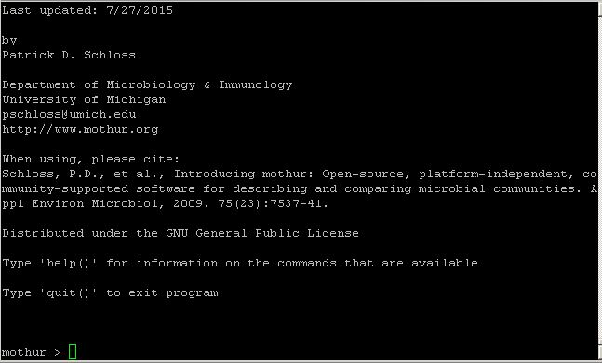
General operations
Installation
Quick and Easy Install
Mac, Linux, Windows
Execution
terminal program
command line
Available modes
Interactive mode
mothur > make.contigs(file=mydata.txt)
Batch mode
../mothur/mothur batchfile
cluster(phylip=98_sq_phylip_amazon.dist, cutoff=0.1)
collect.single()
rarefaction.single()
Command line mode
mothur "#read.dist(phylip=98_sq_phylip_amazon.dist, cutoff=0.1); cluster(); collect.single(); rarefaction.single()"
Kaisa Koskinen, Medical University of Graz

Slide 6

MiSeq SOP
Getting started
Sequence data (fastq) paire end reads
Tab-delimited file listing the sample names and fastq file names
Metadata (temperature, pH, location, treatment/control…)
http://www.mothur.org/wiki/MiSeq_SOP
Kaisa Koskinen, Medical University of Graz

Slide 7
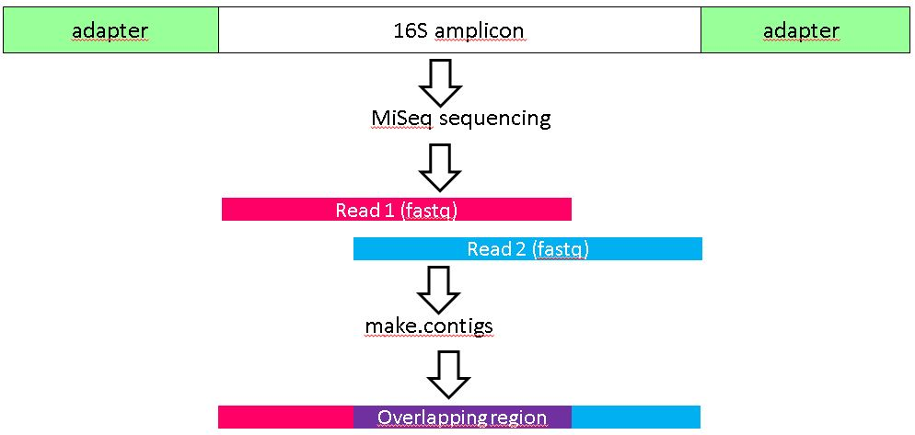
MiSeq SOP
Reducing sequencing and PCR errors
mothur > make.contigs(file=mydata.txt, processors=4)
reads a forward and reverse fastq files
outputs new fasta file where the reads are combined
.groups file: which sequence belongs to which sample
scrap files: discarded data due to bad quality
.report: reports the details of combining the reads
gives information on the number of sequences / sample
Kaisa Koskinen, Medical University of Graz

Slide 8
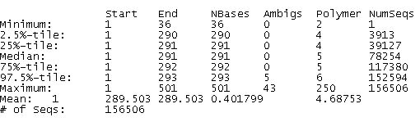
MiSeq SOP
mothur > make.contigs(file=mydata.txt, processors=4)
reads a forward and reverse fastq files
outputs new fasta file where the reads are combined
.groups file: which sequence belongs to which sample
scrap files: discarded data due to bad quality
.report: reports the details of combining the reads
gives information on the number of sequences / sample
mothur > summary.seqs(fasta=mydata.trim.contigs.fasta)
Kaisa Koskinen, Medical University of Graz

Slide 9
MiSeq SOP
mothur > screen.seqs(fasta=mydata.trim.contigs.fasta, group=mydata.contigs.groups, summary=mydata.trim.contigs.summary, maxambig=0, maxlength=295, minlength=200)
Kaisa Koskinen, Medical University of Graz

Slide 10
MiSeq SOP
mothur > screen.seqs(fasta=mydata.trim.contigs.fasta, group=mydata.contigs.groups, summary=mydata.trim.contigs.summary, maxambig=0, maxlength=295, minlength=200)
mothur > summary.seqs(fasta=mydata.trim.contigs.fasta)
→ No ambiguous sequences or sequences with wrong length along
Kaisa Koskinen, Medical University of Graz

Slide 11
MiSeq SOP
Processing improved sequences
mothur > unique.seqs(fasta=mydata.trim.contigs.fasta)
→ identical sequences will be merged to reduce the amount of sequences
.unique.fasta
.names
Kaisa Koskinen, Medical University of Graz

Slide 12
MiSeq SOP
Processing improved sequences
mothur > unique.seqs(fasta=mydata.trim.contigs.fasta)
→ identical sequences will be merged to reduce the amount of sequences
.unique.fasta
.names
Combine names and groups files:
mothur > count.seqs(name=my.data.names, group=my.data.groups)
count_table
mothur > summary.seqs(fasta=, count=)
Kaisa Koskinen, Medical University of Graz

Slide 13
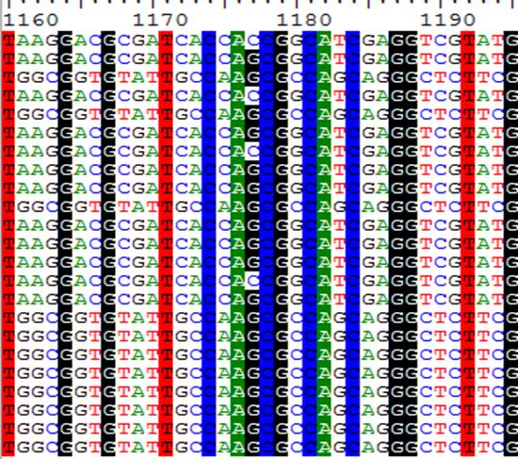
MiSeq SOP
Alignment
Alignment to a reference
Unsupervised alignment
Pairwise alignment
Multiple sequence alignment (MSA)
Kaisa Koskinen, Medical University of Graz

Slide 14
MiSeq SOP
mothur > align.seqs(fasta=, reference=)
Kaisa Koskinen, Medical University of Graz

Slide 15
MiSeq SOP
mothur > align.seqs(fasta=, reference=)
mothur > summary.seqs(fasta=, count=)
Kaisa Koskinen, Medical University of Graz

Slide 16
MiSeq SOP
mothur > align.seqs(fasta=, reference=)
mothur > summary.seqs(fasta=, count=)
mothur > screen.seqs(fasta=, count=, summary=, start=, end=, maxhomop=8)
Kaisa Koskinen, Medical University of Graz

Slide 17
MiSeq SOP
mothur > filter.seqs(fasta=, vertical=T, trump=.)
Kaisa Koskinen, Medical University of Graz

Slide 18
MiSeq SOP
mothur > filter.seqs(fasta=, vertical=T, trump=.)
mothur > unique.seqs(fasta=, count=)
Kaisa Koskinen, Medical University of Graz

Slide 19
MiSeq SOP
mothur > pre.cluster(fasta=, count=, diffs=2)
Kaisa Koskinen, Medical University of Graz

Slide 20
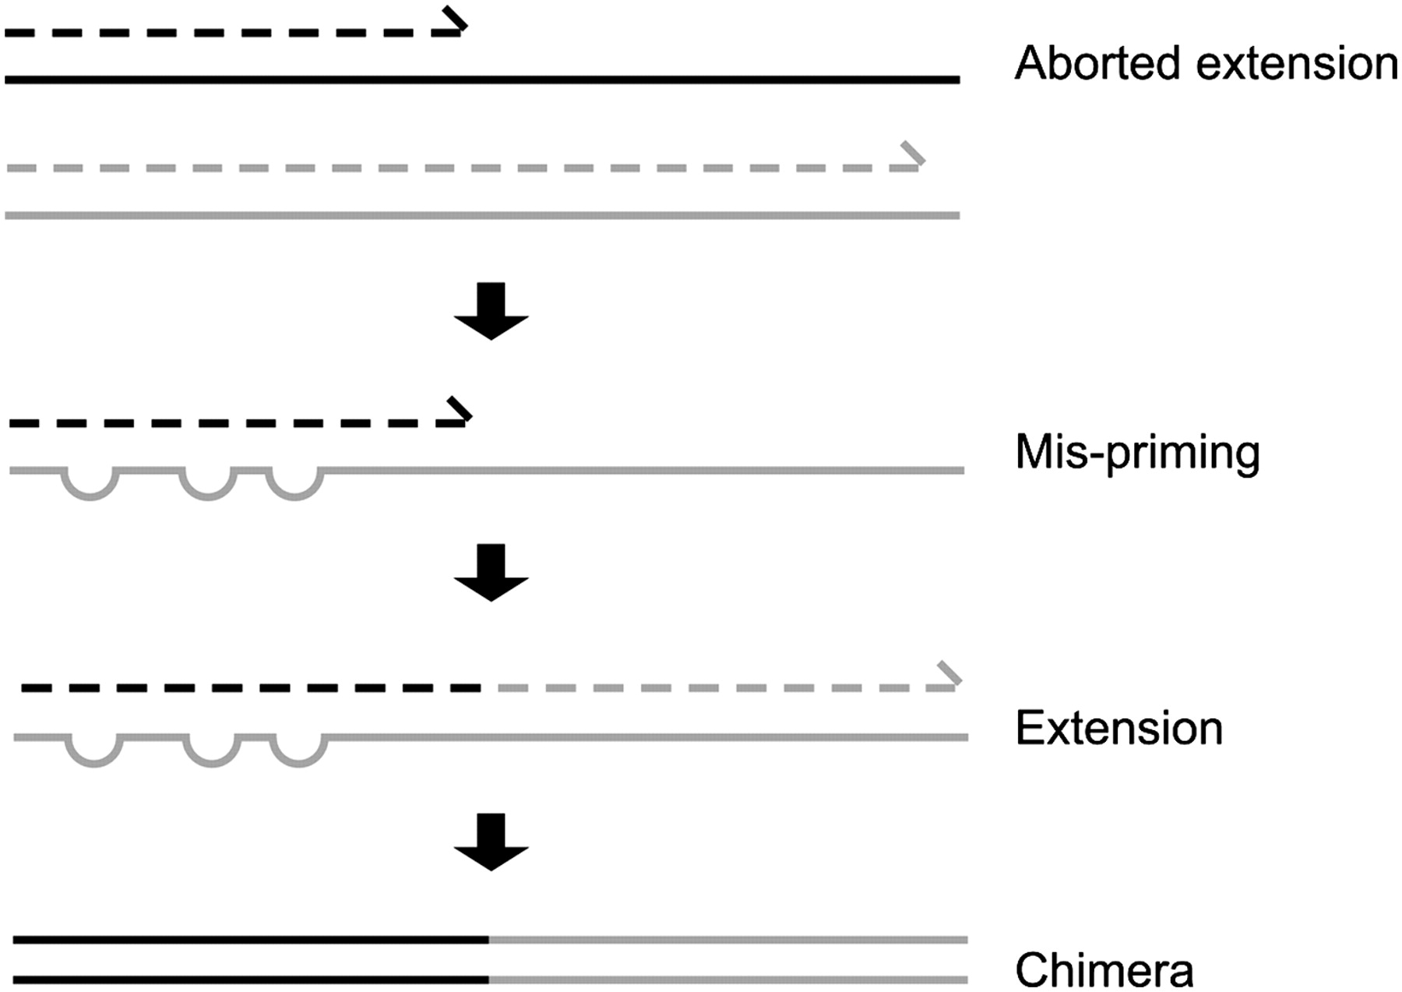
MiSeq SOP
Chimeric sequences
Hybrid products formed during PCR
Several factors may influence the formation
pairwise sequence identity between the target genes
relative abundance of PCR templates in the sample
the number of PCR cycles
Chimera identification
comparing it against a curated reference database
comparing against the abundant sequences in the same dataset
Brian J. Haas et al. Genome Res. 2011;21:494-504
Kaisa Koskinen, Medical University of Graz

Slide 21
MiSeq SOP
Chimeric sequences
mothur > chimera.uchime(fasta=, count=, dereplicate=t)
Kaisa Koskinen, Medical University of Graz

Slide 22
MiSeq SOP
Chimeric sequences
mothur > chimera.uchime(fasta=, count=, dereplicate=t)
mothur > remove.seqs(fasta=, accnos=)
Kaisa Koskinen, Medical University of Graz

Slide 23
MiSeq SOP
Chimeric sequences
mothur > chimera.uchime(fasta=, count=, dereplicate=t)
mothur > remove.seqs(fasta=, accnos=)
mothur > summary.seqs(fasta=, count=)
Kaisa Koskinen, Medical University of Graz

Slide 24
MiSeq SOP
Taxonomic assignment
Identification of microbes present in studied environment
Querying the sequence reads against a reference sequence database
3 major sequence data repositories (all the submitted genome and gene sequences of all organisms sequenced)
National Center for Biotechnology Information (NCBI)
European Bioinformatics Institute (EBI) at the European Molecular Biology Laboratory (EMBL)
DNA Databank of Japan (DDBJ)
16S rRNA sequence databases
SILVA
Ribosomal Database Project database (RDP)
Greengenes
Kaisa Koskinen, Medical University of Graz

Slide 25
MiSeq SOP
Taxonomic assignment
mothur > classify.seqs(fasta=, count= reference=, taxonomy=, cutoff=80)
Kaisa Koskinen, Medical University of Graz

Slide 26
MiSeq SOP
Taxonomic assignment
mothur > classify.seqs(fasta=, count= reference=, taxonomy=, cutoof=80)
mothur > remove.lineage(fasta=, count=, taxonomy=, taxon=unknown-Eukaryota-Archaea)
Kaisa Koskinen, Medical University of Graz

Slide 27
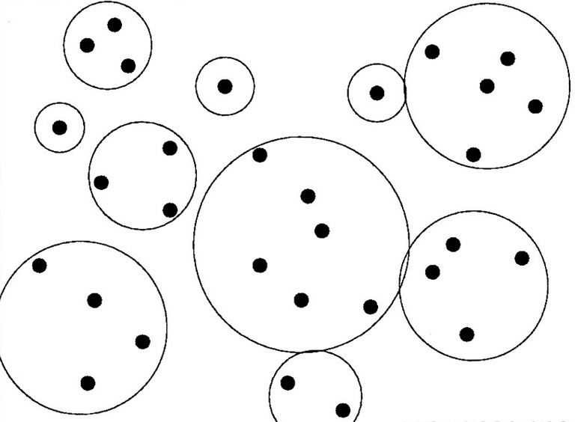
MiSeq SOP
Clustering
4 classic hierarchical clustering algorithms
nearest neighbor (single-linkage)
furthest neighbor (complete linkage)
weighted
average neighbor
Computationally intensive
Heuristics
ESPRITTree
CD-HIT
Uclust
Erik van Nimwegen et al. PNAS 2002;99:7323-7328
Kaisa Koskinen, Medical University of Graz

Slide 28
MiSeq SOP
Clustering
mothur > dist.seqs(fasta=, cutoff=0.20)
Erik van Nimwegen et al. PNAS 2002;99:7323-7328
Kaisa Koskinen, Medical University of Graz

Slide 29
MiSeq SOP
Clustering
mothur > dist.seqs(fasta=, cutoff=0.20)
mothur > cluster(column=, count=)
Erik van Nimwegen et al. PNAS 2002;99:7323-7328
Kaisa Koskinen, Medical University of Graz

Slide 30
MiSeq SOP
mothur > make.shared(list=, count=, label=0.03)
Kaisa Koskinen, Medical University of Graz

Slide 31
MiSeq SOP
mothur > make.shared(list=, count=, label=0.03)
mothur > classify.otu(list=, count=, taxonomy=, label=0.03)
Kaisa Koskinen, Medical University of Graz

