Slide 1
Navigation, Links, and Routes
Galia Traub
Notes:
Webapps are special. Yay URLs. Directlyin the bowser, links, buttons, whatevs. Yay urls

Slide 2


http://myapp.herokuapp.com/topics
myapp.herokuapp.com
http://localhost:3000/topics
localhost:3000
Notes:
What happens when you go to this URL? You get a webpage with a list of topics

Slide 3
http://myapp.herokuapp.com/topics
myapp.herokuapp.com
http://localhost:3000/topics
localhost:3000
Notes:
The first part. Address example. http/https/git

Slide 4
http://myapp.herokuapp.com/topics
myapp.herokuapp.com
http://localhost:3000/topics
localhost:3000
Notes:
This second part is what the web server cares about.

Slide 5
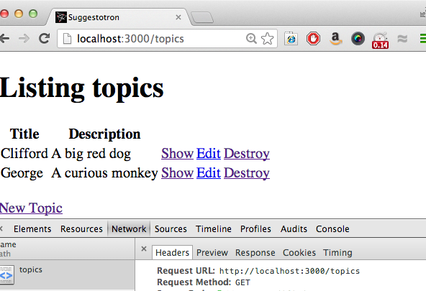
Notes:
2 things, url & method
http methods. More on that later.
So great. You go to the server and say that you want to GET topics… what next?

Slide 6
Request URL: http://localhost:3000/topics
Request Method: GET
Notes:
2 things, url & method
http methods. More on that later.
So great. You go to the server and say that you want to GET topics… what next?

Slide 7
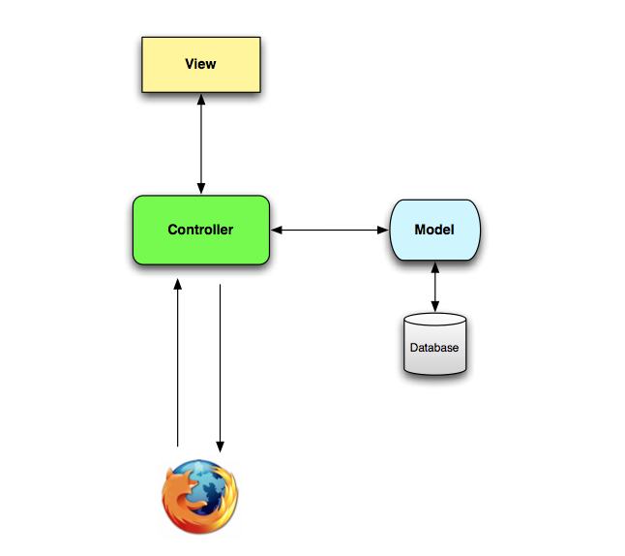
Browser requests:
GET topics
Notes:
Controller calls the model to get data about Topics
Controller calls the view, it passing data from the models

Slide 8
Controller calls the Topic model to get data
Notes:
Controller calls the model to get data about Topics
Controller calls the view, it passing data from the models

Slide 9
Controller calls the view, it passing data from the models
Notes:
Controller calls the model to get data about Topics
Controller calls the view, it passing data from the models

Slide 10

Topics Controller
Votes Controller
?
Notes:
How does the browser know what controller to call?

Slide 11

The Dispatcher
Notes:
Take incoming requests desicdes who’s going to handle them

Slide 12
Topics Controller
Votes Controller

Slide 13
> rake routes
votes GET /votes(.:format) votes#index
POST /votes(.:format) votes#create
new_vote GET /votes/new(.:format) votes#new
edit_vote GET /votes/:id/edit(.:format) votes#edit
vote GET /votes/:id(.:format) votes#show
PUT /votes/:id(.:format) votes#update
DELETE /votes/:id(.:format) votes#destroy
topics GET /topics(.:format) topics#index
POST /topics(.:format) topics#create
new_topic GET /topics/new(.:format) topics#new
edit_topic GET /topics/:id/edit(.:format) topics#edit
topic GET /topics/:id(.:format) topics#show
PUT /topics/:id(.:format) topics#update
DELETE /topics/:id(.:format) topics#destroy

Slide 14
Column One: Route Name
topics GET /topics(.:format) topics#index
POST /topics(.:format) topics#create
new_topic GET /topics/new(.:format) topics#new
edit_topic GET /topics/:id/edit(.:format) topics#edit
topic GET /topics/:id(.:format) topics#show
PUT /topics/:id(.:format) topics#update
DELETE /topics/:id(.:format) topics#destroy
Create a URL/path by appending ‘_url’ or ‘_path’ to the route name.
For example, in app/views/topics/show.html.erb:
<%= link_to 'Edit', edit_topic_path(@topic) %>
<%= link_to 'Back', topics_path %>

Slide 15
Column Two: HTTP Verb
topics GET /topics(.:format) topics#index
POST /topics(.:format) topics#create
new_topic GET /topics/new(.:format) topics#new
edit_topic GET /topics/:id/edit(.:format) topics#edit
topic GET /topics/:id(.:format) topics#show
PUT /topics/:id(.:format) topics#update
DELETE /topics/:id(.:format) topics#destroy
topics GET /topics(.:format) {:action=>"index", :controller=>"topics"}
POST /topics(.:format) {:action=>"create", :controller=>"topics"}
new_topic GET /topics/new(.:format) {:action=>"new", :controller=>"topics"}
edit_topic GET /topics/:id/edit(.:format) {:action=>"edit", :controller=>"topics"}
topic GET /topics/:id(.:format) {:action=>"show", :controller=>"topics"}
PUT /topics/:id(.:format) {:action=>"update", :controller=>"topics"}
DELETE /topics/:id(.:format) {:action=>"destroy", :controller=>"topics"}
topics GET /topics(.:format) index
POST /topics(.:format) create
Request URL: http://localhost:3000/topics
Request Method: GET
Notes:
/topics can show all topics or create a new topic. What should happen is you go to /topics?

Slide 16
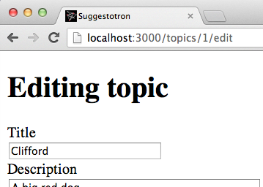
Column Three: URL Pattern
topics GET /topics(.:format) topics#index
POST /topics(.:format) topics#create
new_topic GET /topics/new(.:format) topics#new
edit_topic GET /topics/:id/edit(.:format) topics#edit
topic GET /topics/:id(.:format) topics#show
PUT /topics/:id(.:format) topics#update
DELETE /topics/:id(.:format) topics#destroy
(.:format) = .html
:id = the id of the topic

Slide 17
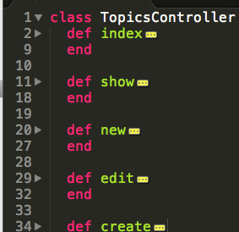
Column Four: Where this routes
topics GET /topics(.:format) topics#index
POST /topics(.:format) topics#create
new_topic GET /topics/new(.:format) topics#new
edit_topic GET /topics/:id/edit(.:format) topics#edit
topic GET /topics/:id(.:format) topics#show
PUT /topics/:id(.:format) topics#update
DELETE /topics/:id(.:format) topics#destroy
Votes
Topics
Notes:
Other methods in another class: bake stir

Slide 18
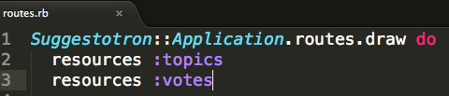
config/routes.rb
votes GET /votes(.:format) votes#index
POST /votes(.:format) votes#create
new_vote GET /votes/new(.:format) votes#new
edit_vote GET /votes/:id/edit(.:format) votes#edit
vote GET /votes/:id(.:format) votes#show
PUT /votes/:id(.:format) votes#update
DELETE /votes/:id(.:format) votes#destroy
topics GET /topics(.:format) topics#index
POST /topics(.:format) topics#create
new_topic GET /topics/new(.:format) topics#new
edit_topic GET /topics/:id/edit(.:format) topics#edit
topic GET /topics/:id(.:format) topics#show
PUT /topics/:id(.:format) topics#update
DELETE /topics/:id(.:format) topics#destroy

Slide 19
resources :topics
HTTP Verb | Path | Action | Used for
GET | /topics | index | display a list of all topics
GET | /topics/new | new | return an HTML form for creating a new topic
POST | /topics | create | create a new topic
GET | /topics/:id | show | display a specific topic
GET | /topics/:id/edit | edit | return an HTML form for editing a topic
PUT | /topics/:id | update | update a specific topic
DELETE | /topics/:id | destroy | delete a specific topic

