Slide 1
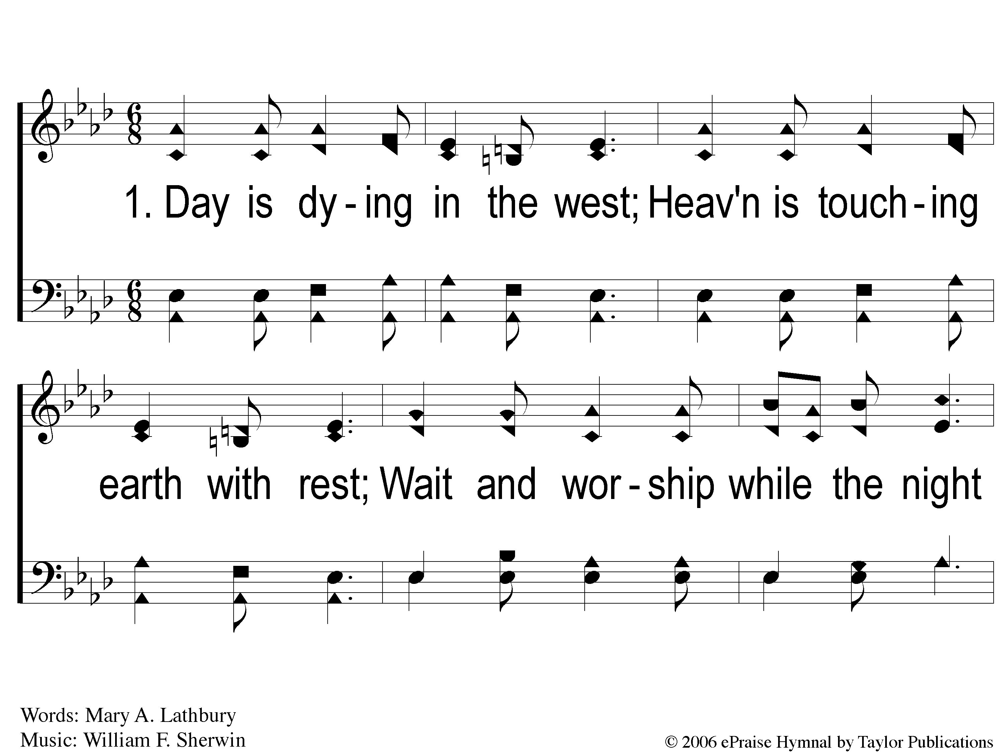
1-1 Day is Dying in the West
Day is Dying in the West
13

Slide 2
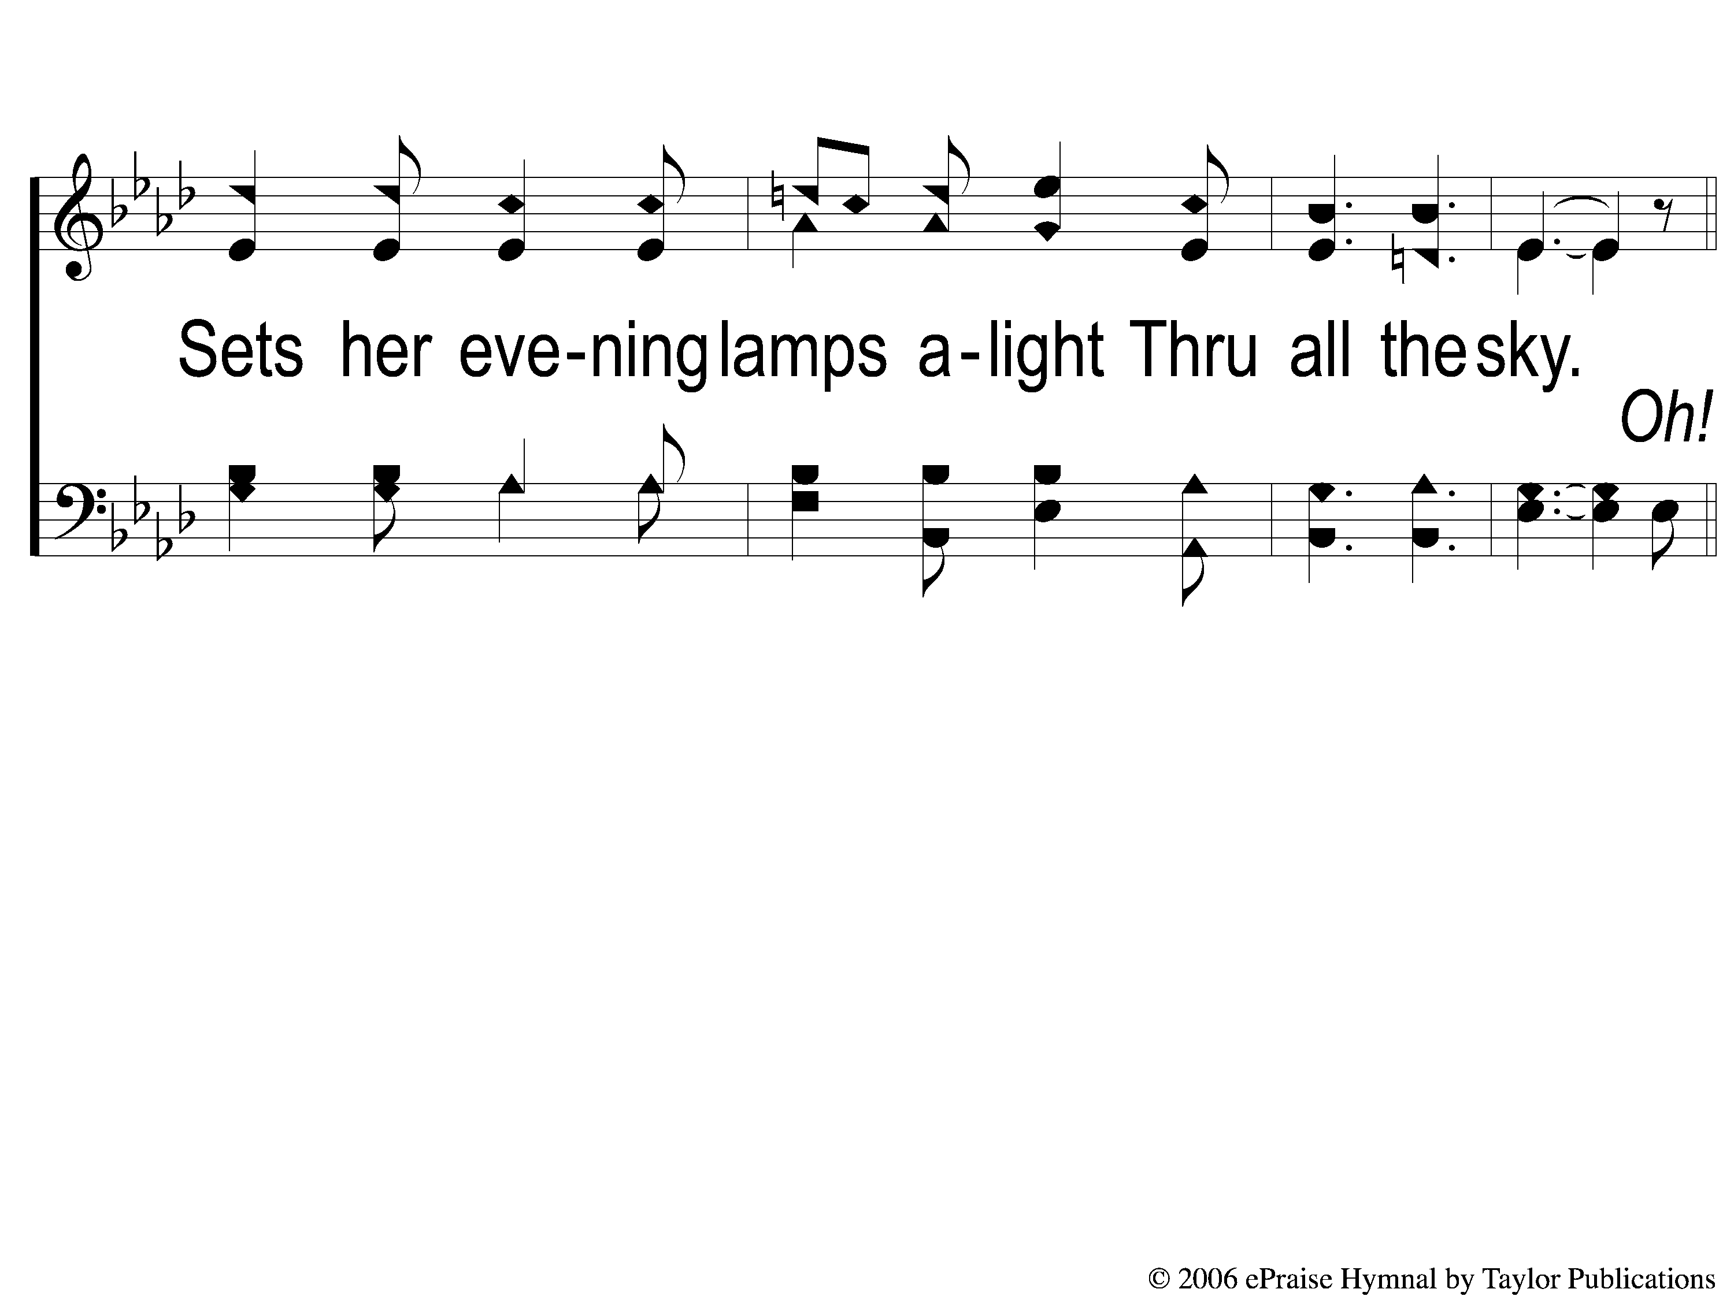
1-2 Day is Dying in the West
Day is Dying in the West
13

Slide 3
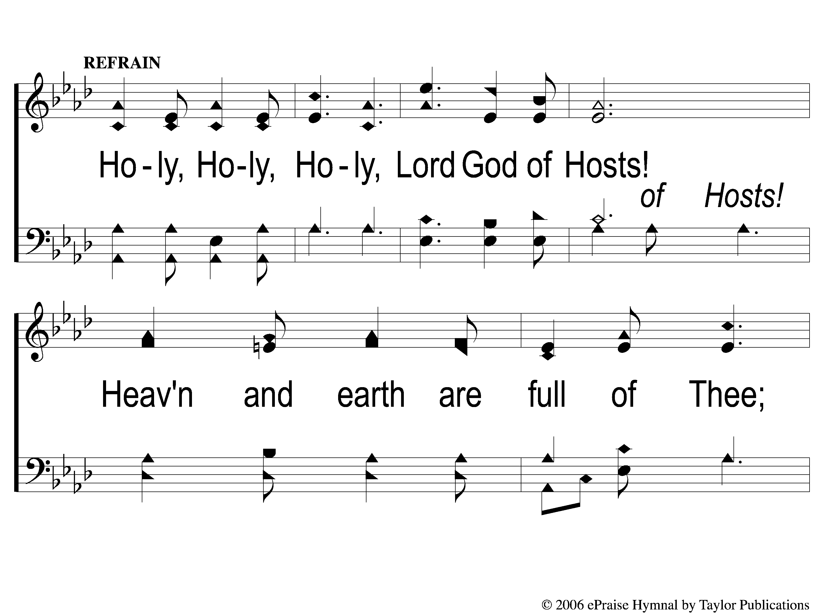
C-1 Day is Dying in the West
Day is Dying in the West
13

Slide 4
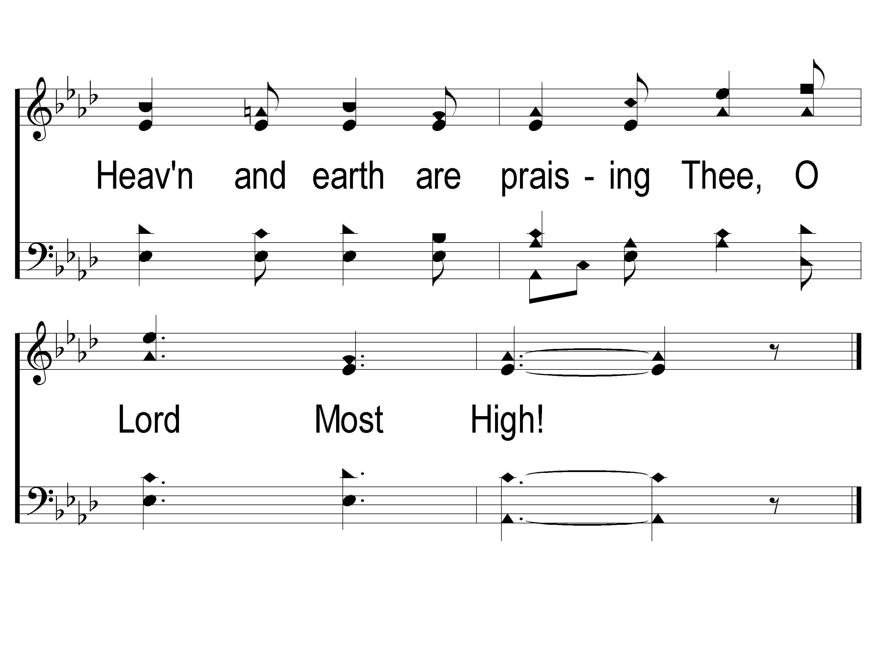
C-2 Day is Dying in the West
Day is Dying in the West
13

Slide 5
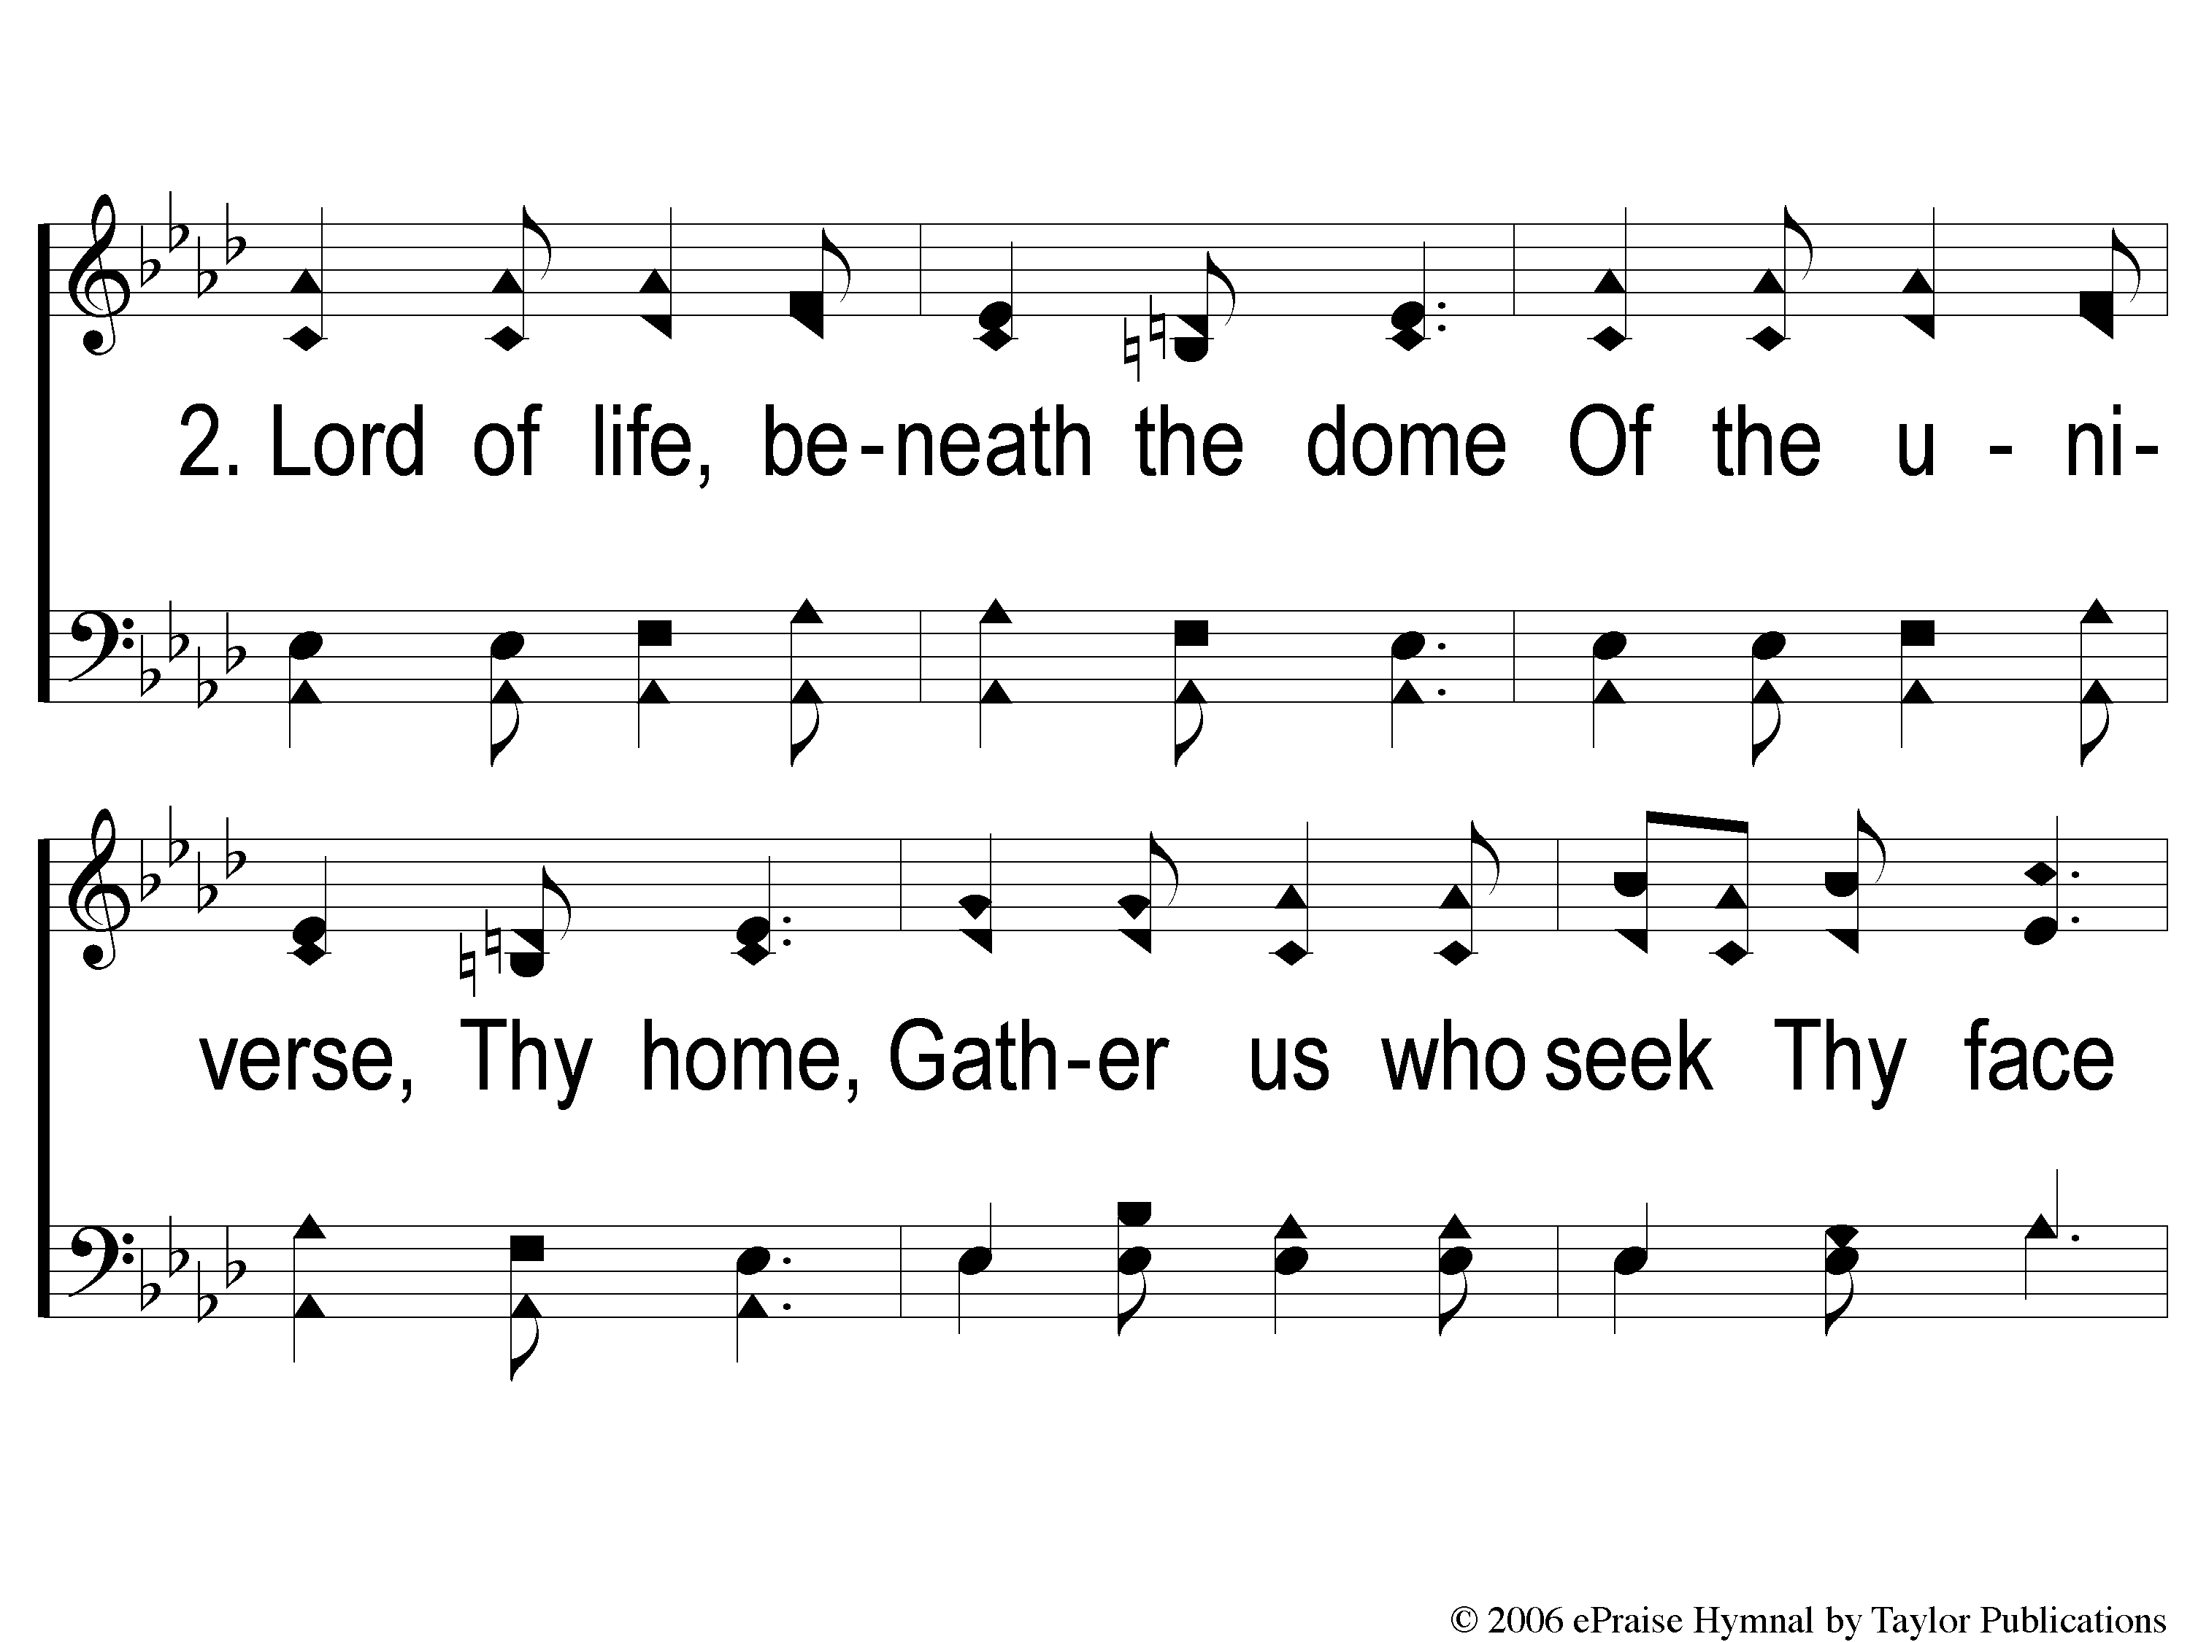
2-1 Day is Dying in the West
Day is Dying in the West
13

Slide 6
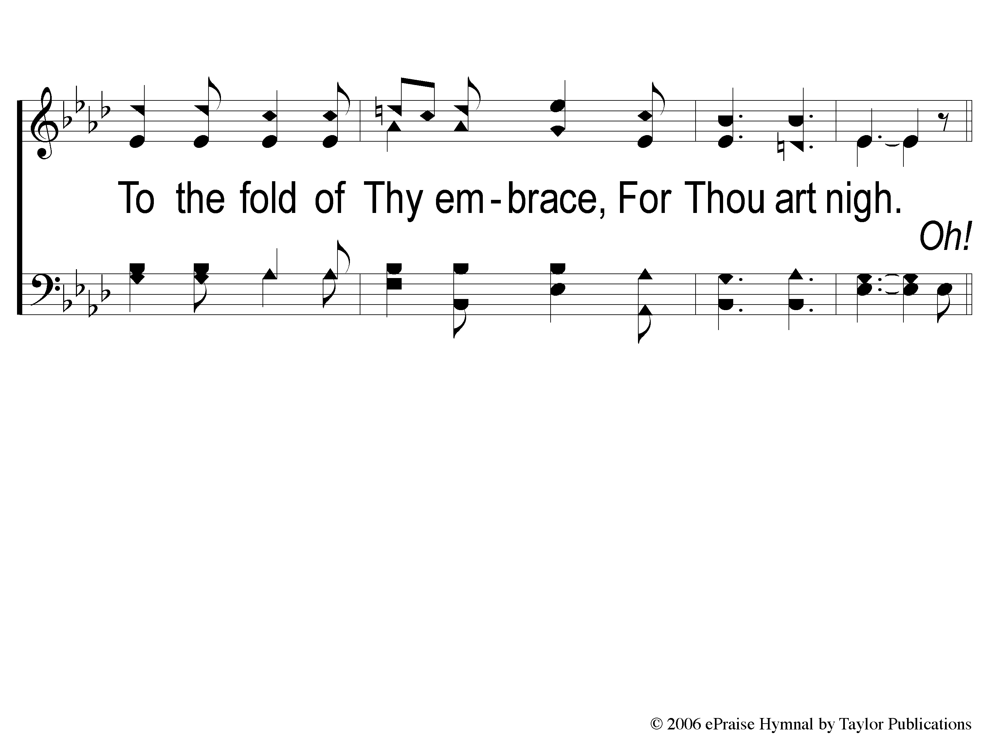
2-2 Day is Dying in the West
Day is Dying in the West
13

Slide 7
C-1 Day is Dying in the West
Day is Dying in the West
13

Slide 8
C-2 Day is Dying in the West
Day is Dying in the West
13

Slide 9
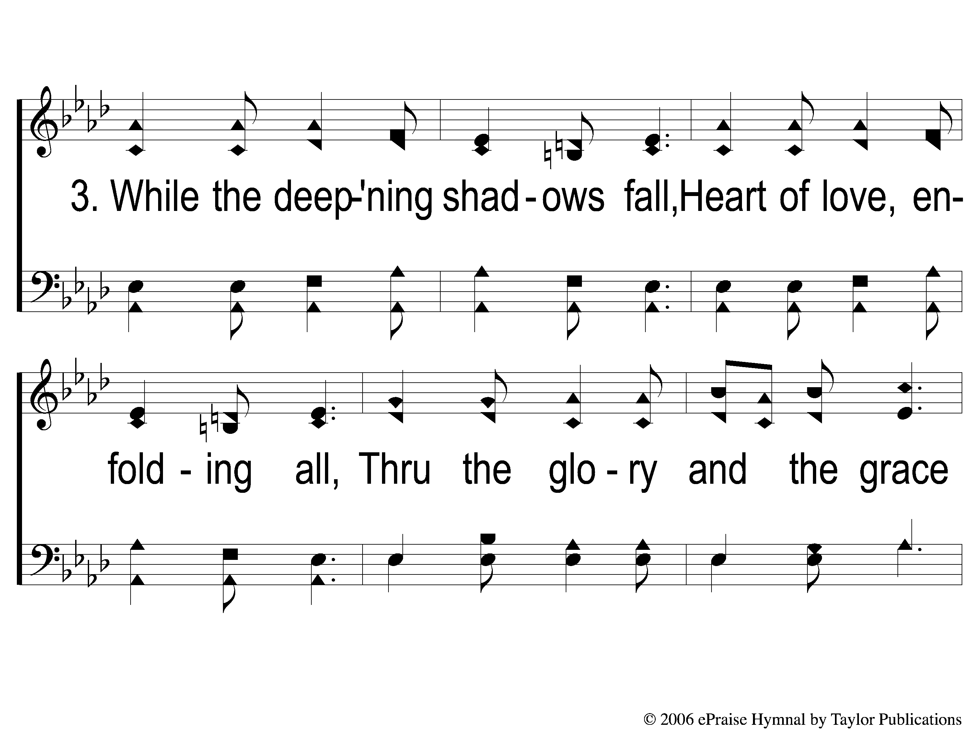
3-1 Day is Dying in the West
Day is Dying in the West
13

Slide 10
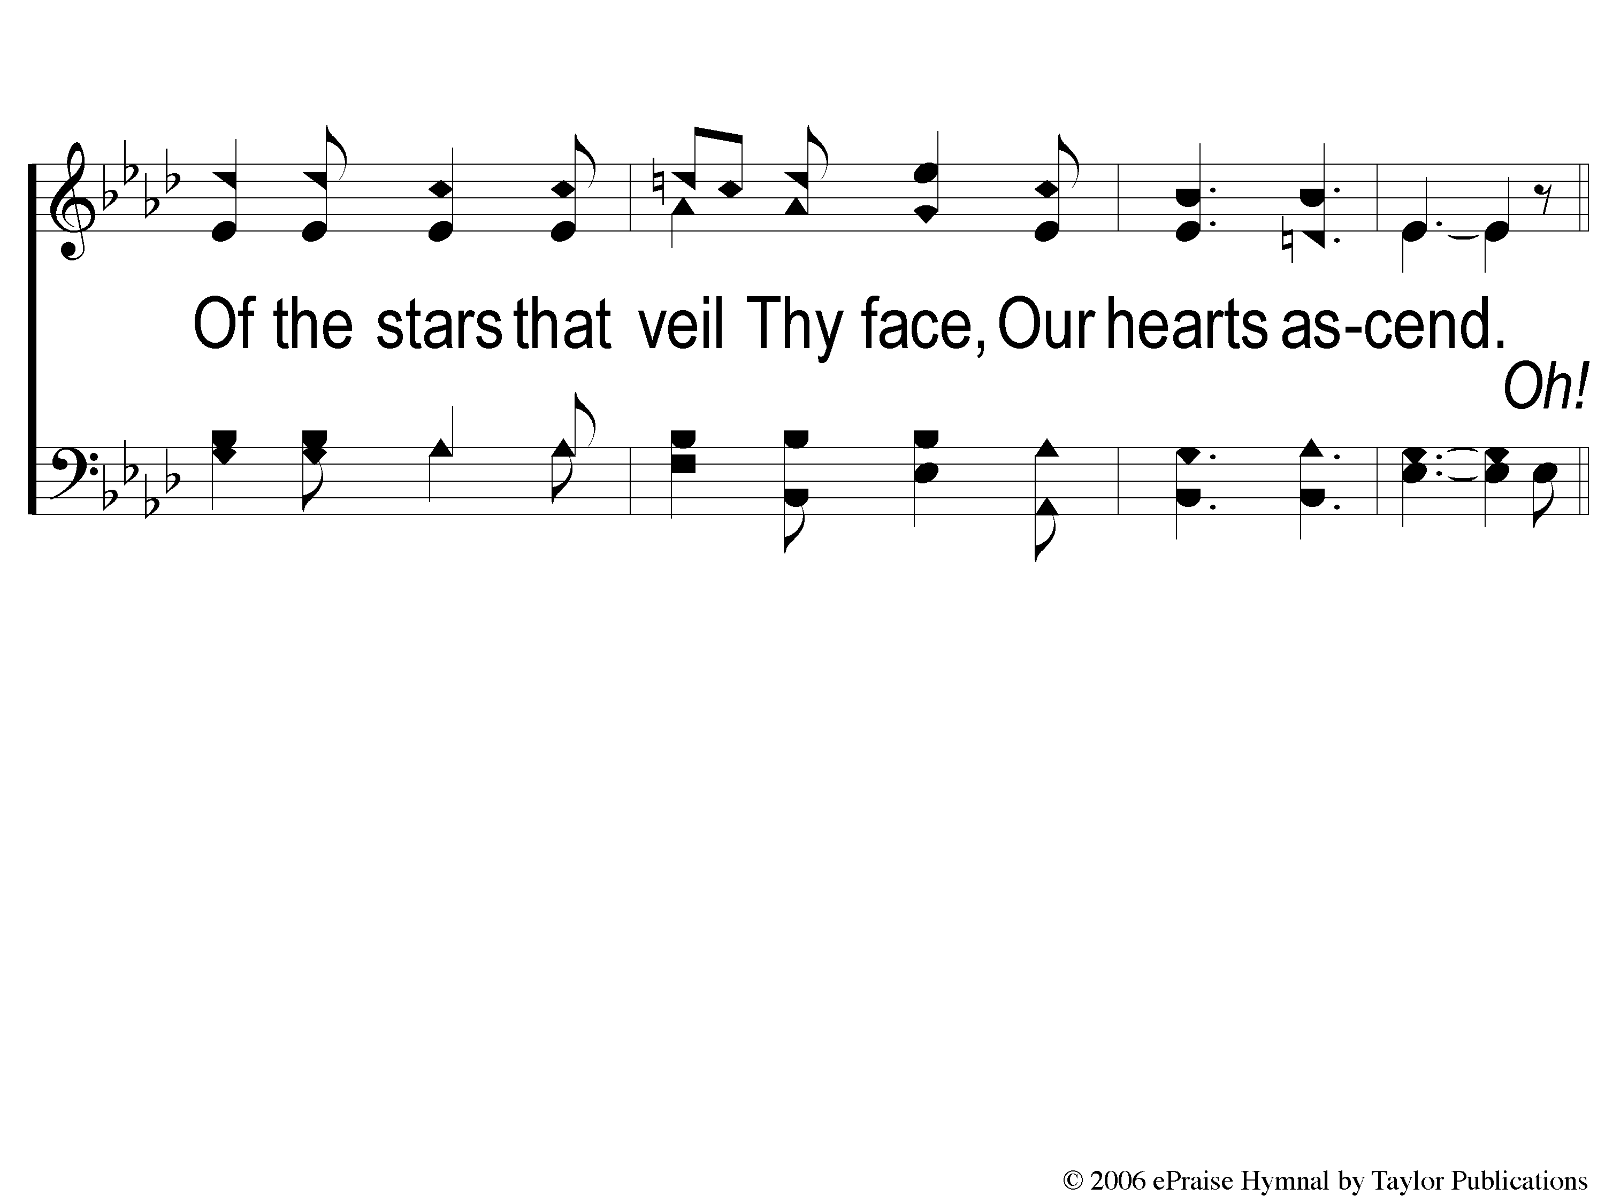
3-2 Day is Dying in the West
Day is Dying in the West
13

Slide 11
C-1 Day is Dying in the West
Day is Dying in the West
13

Slide 12
C-2 Day is Dying in the West
Day is Dying in the West
13

Slide 13
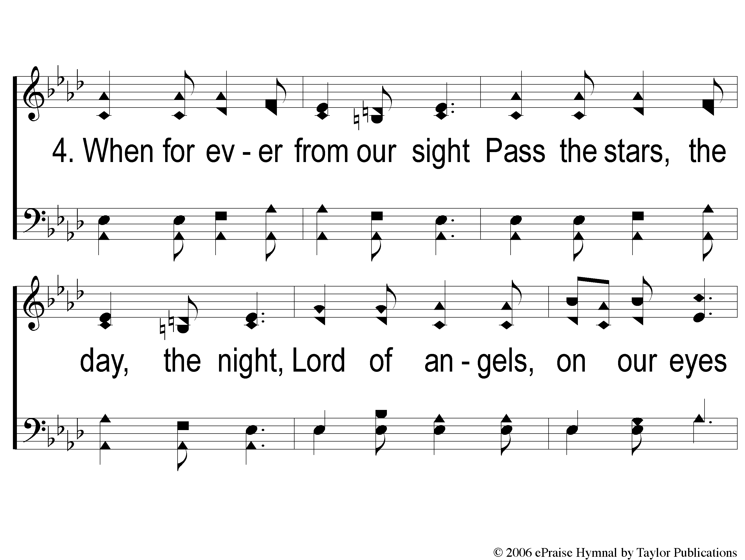
4-1 Day is Dying in the West
Day is Dying in the West
13

Slide 14
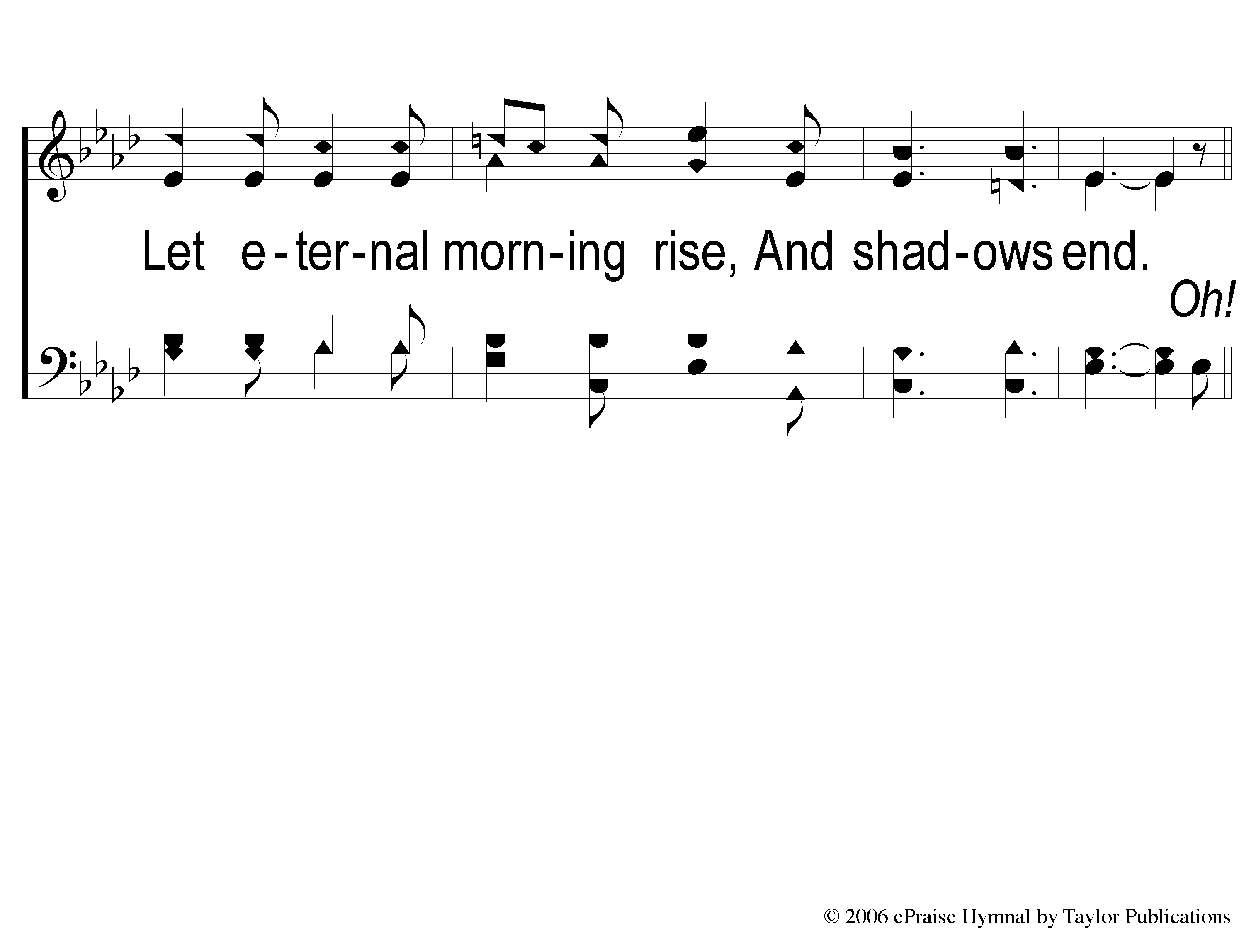
4-2 Day is Dying in the West
Day is Dying in the West
13

Slide 15
C-1 Day is Dying in the West
Day is Dying in the West
13

Slide 16
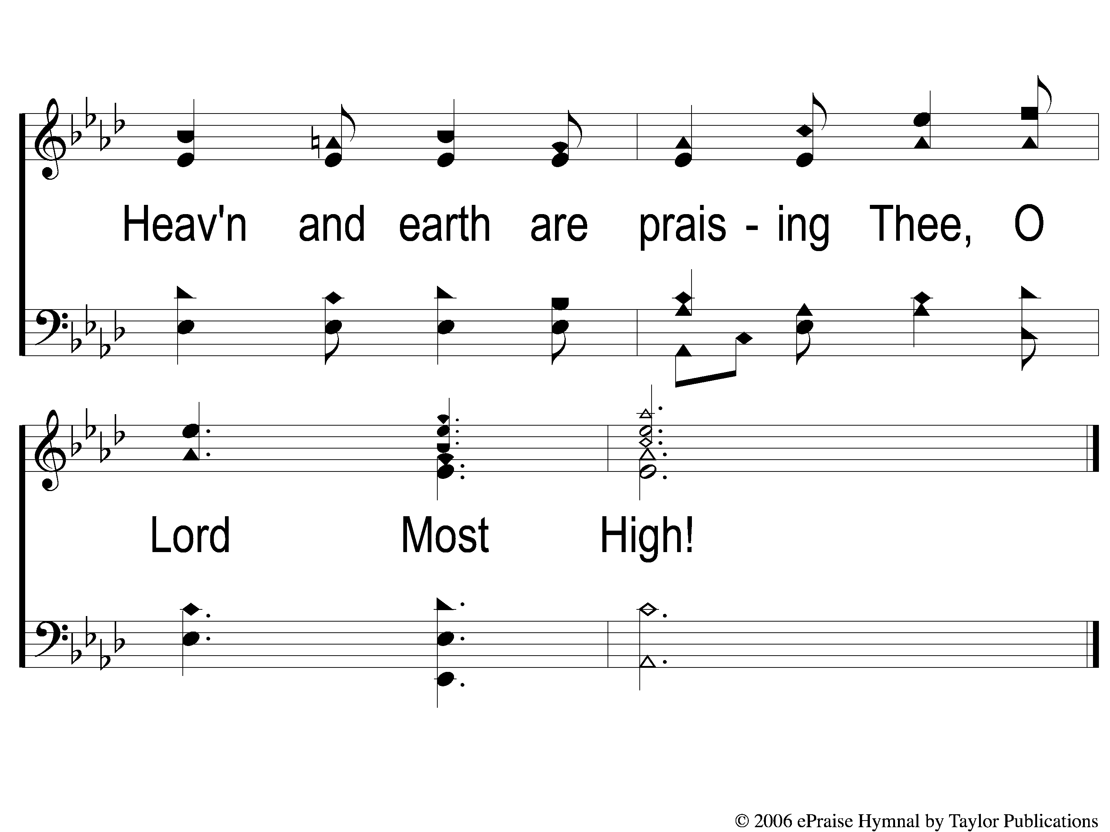
C-2 Day is Dying in the West
Day is Dying in the West
13

