Slide 1
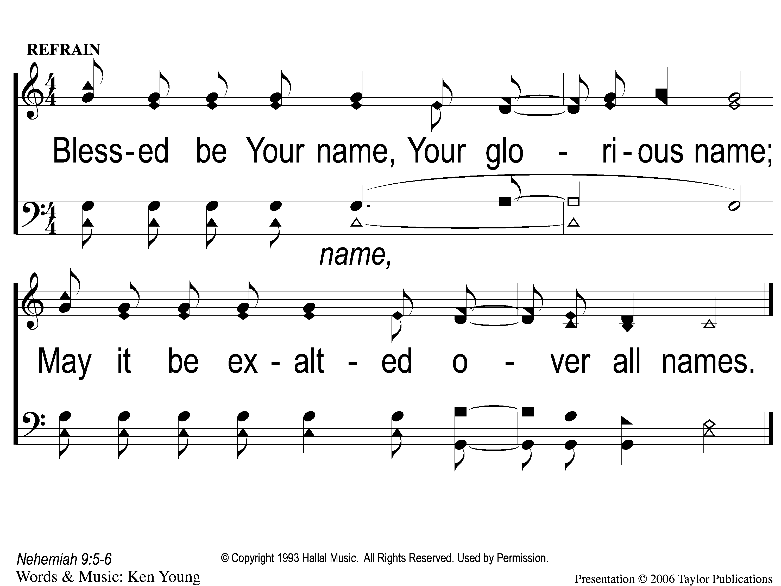
C-1 Blessed Be Your Name
Blessed Be Your Name
27

Slide 2
C-2 Blessed Be Your Name
Blessed Be Your Name
27

Slide 3
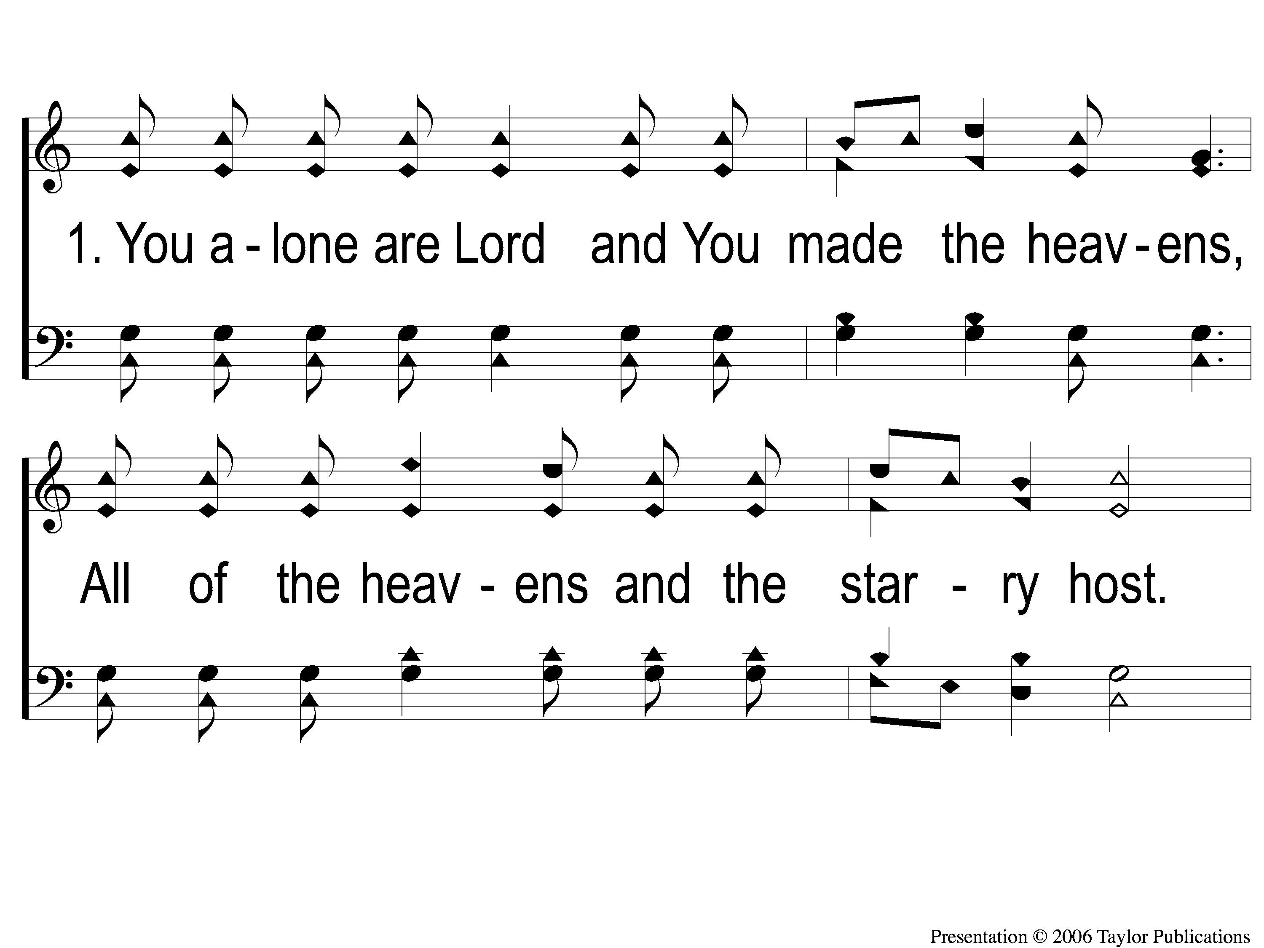
1-1 Blessed Be Your Name
Blessed Be Your Name
27

Slide 4
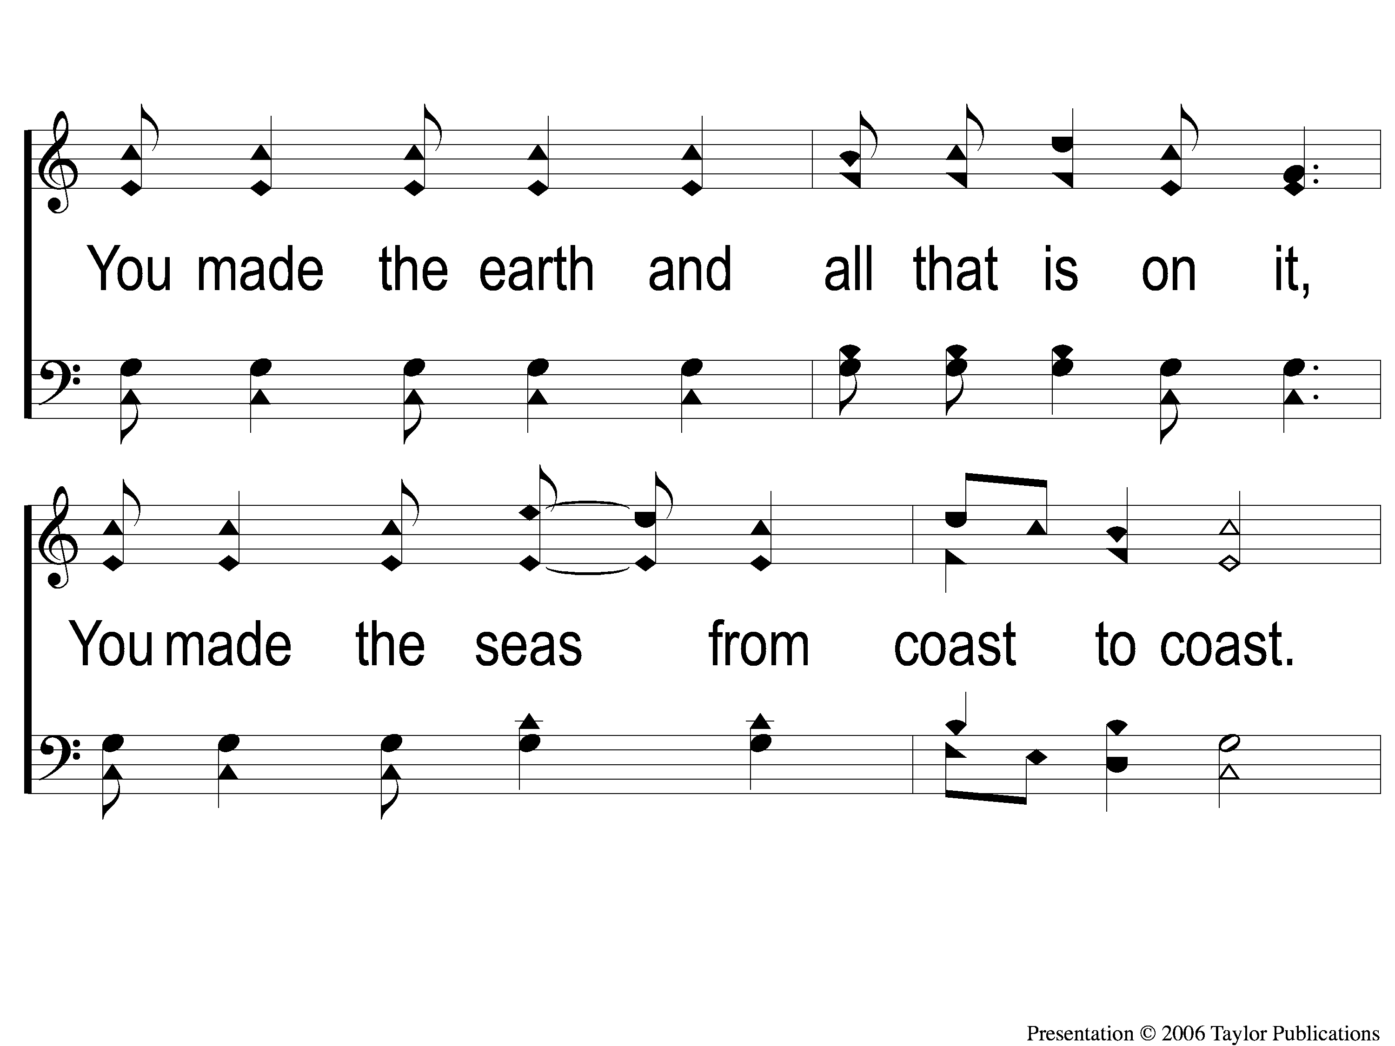
1-2 Blessed Be Your Name
Blessed Be Your Name
27

Slide 5
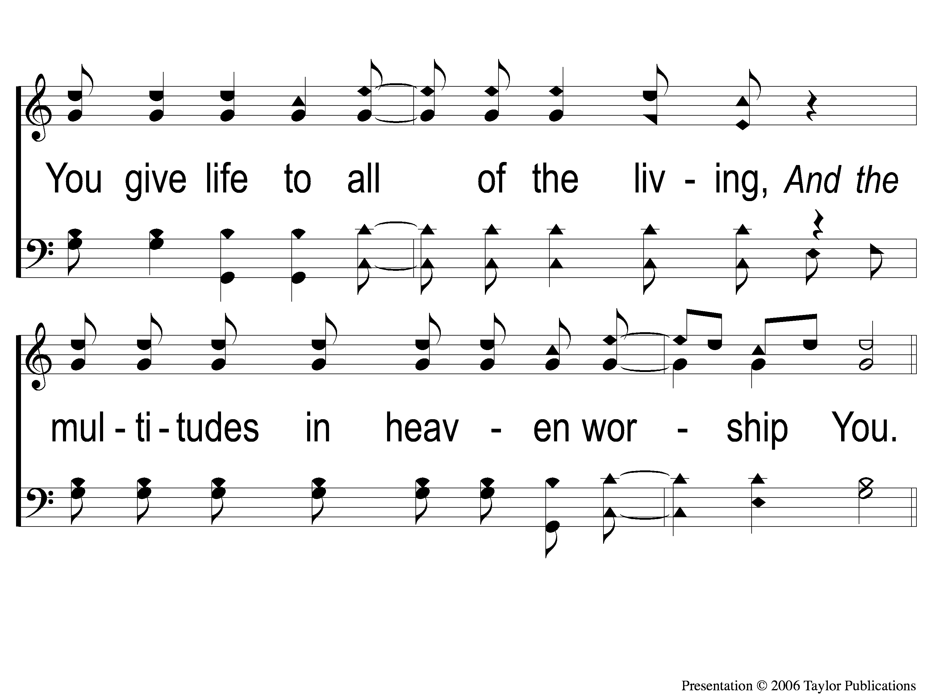
1-3 Blessed Be Your Name
Blessed Be Your Name
27

Slide 6
C-1 Blessed Be Your Name
Blessed Be Your Name
27

Slide 7
C-2 Blessed Be Your Name
Blessed Be Your Name
27

Slide 8
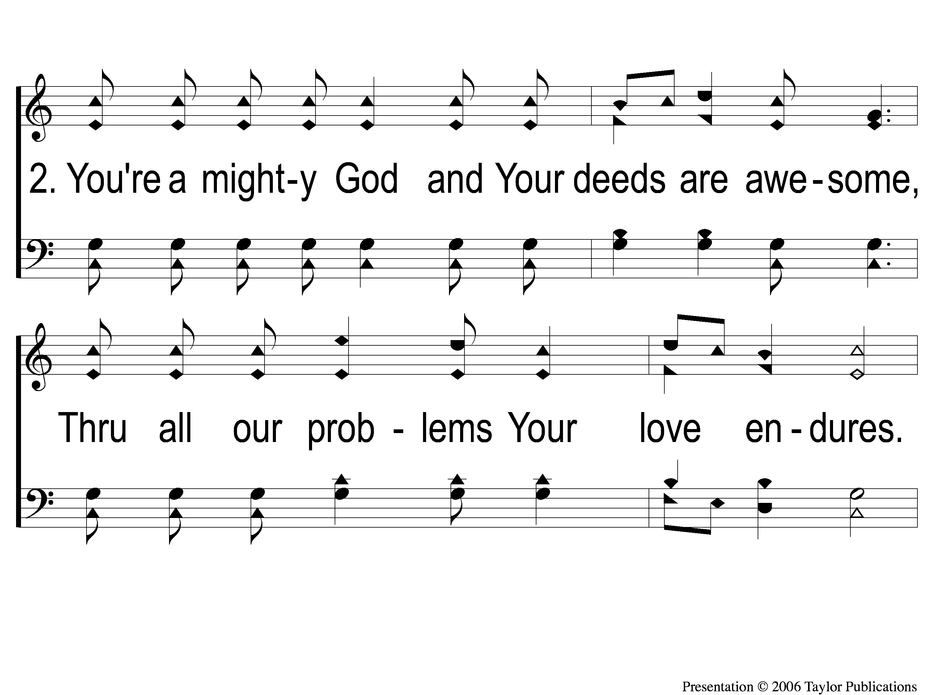
2-1 Blessed Be Your Name
Blessed Be Your Name
27

Slide 9
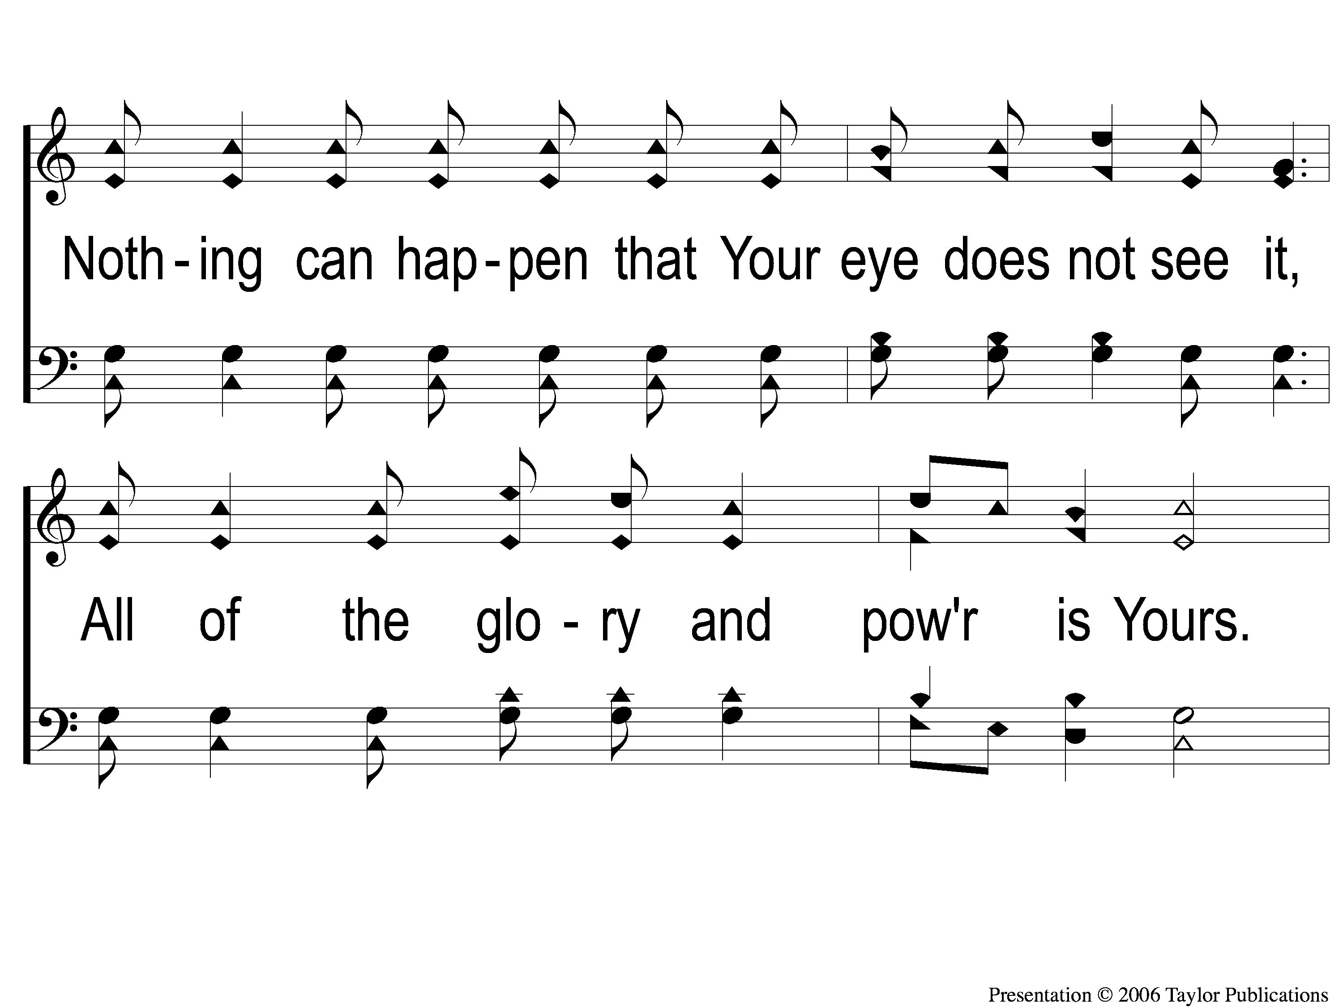
2-2 Blessed Be Your Name
Blessed Be Your Name
27

Slide 10
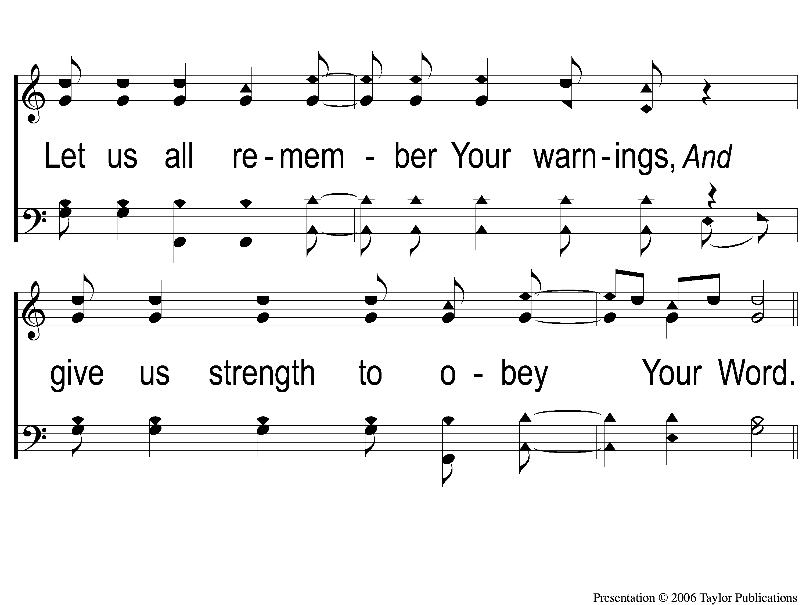
2-3 Blessed Be Your Name
Blessed Be Your Name
27

Slide 11
C-1 Blessed Be Your Name
Blessed Be Your Name
27

Slide 12
C-2 Blessed Be Your Name
Blessed Be Your Name
27

