Slide 1
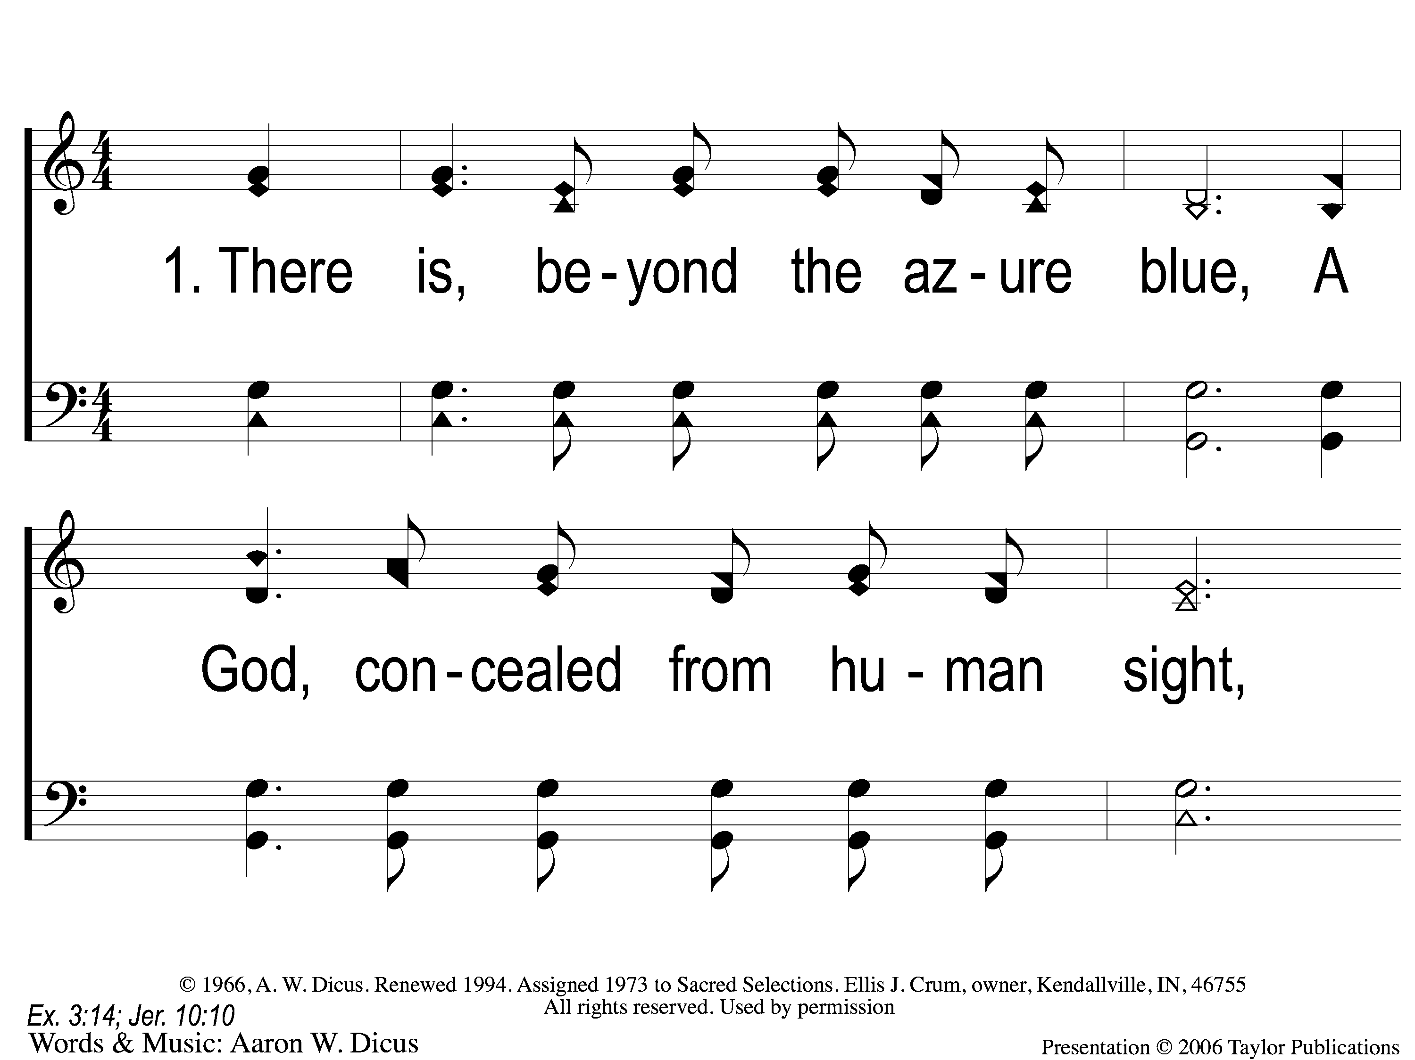
1-1 Our God He Is Alive
Our God, He Is Alive
23

Slide 2
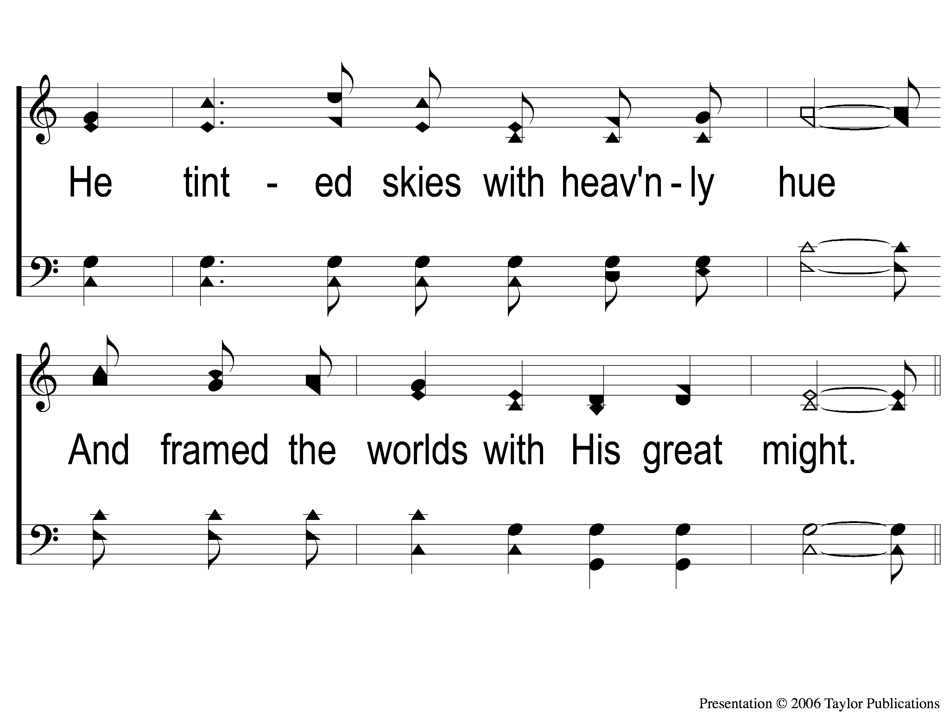
1-2 Our God He Is Alive
Our God, He Is Alive
23

Slide 3
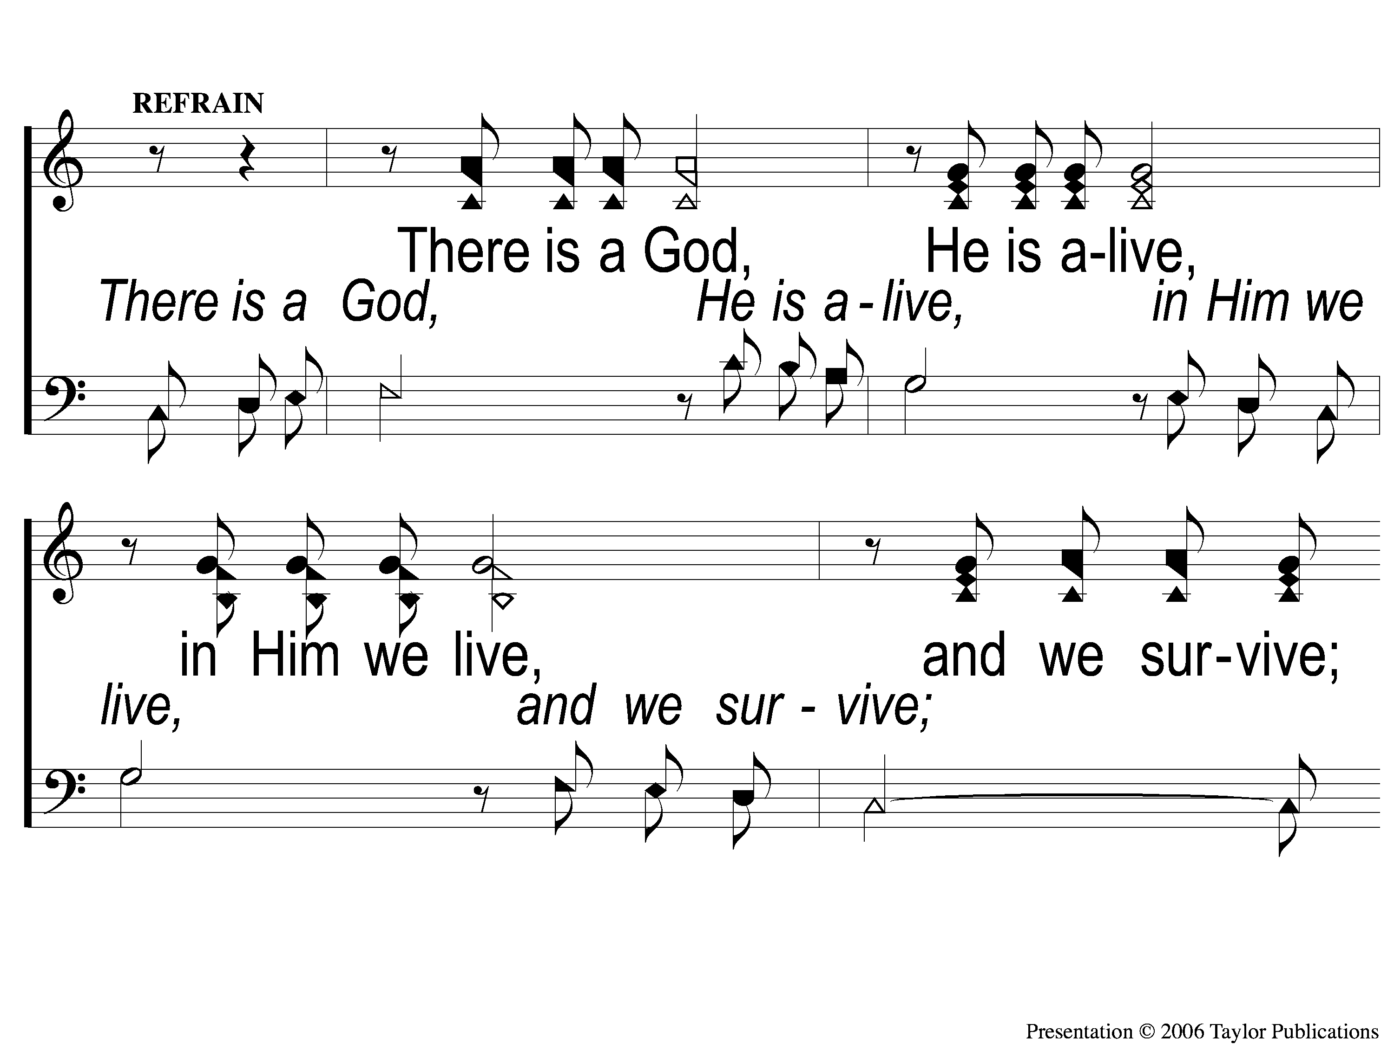
C-1 Our God He Is Alive
Our God, He Is Alive
23

Slide 4
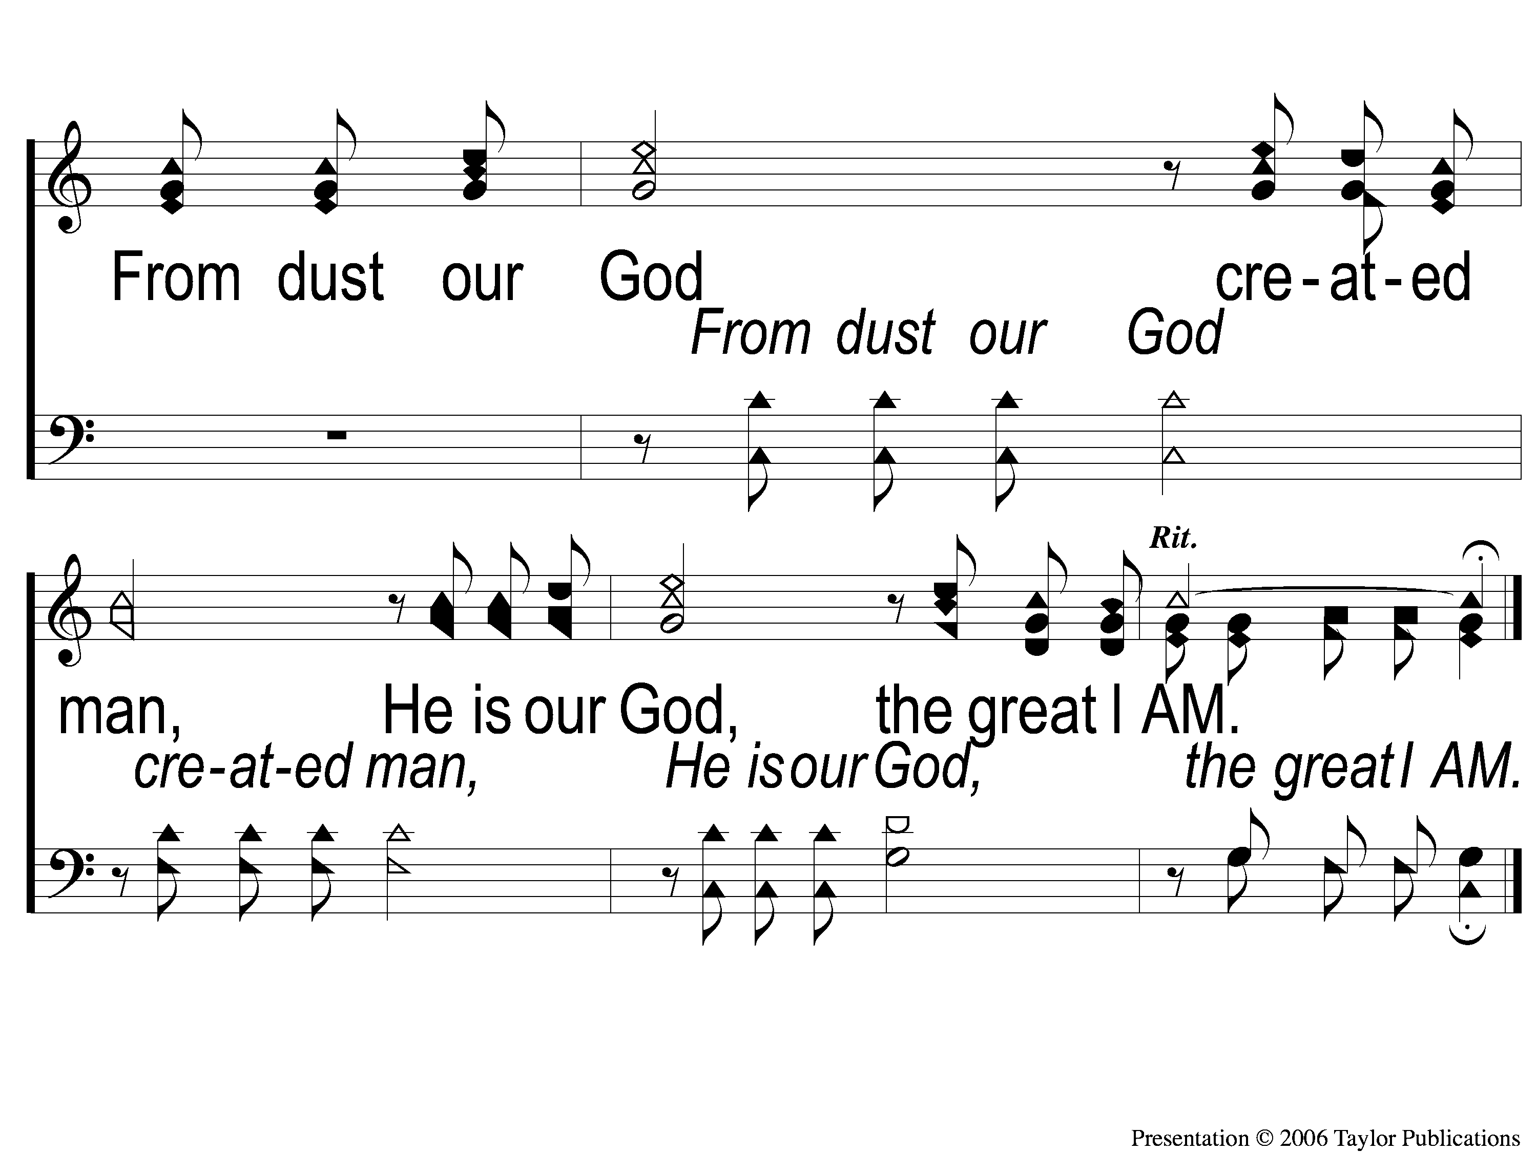
C-2 Our God He Is Alive
Our God, He Is Alive
23

Slide 5
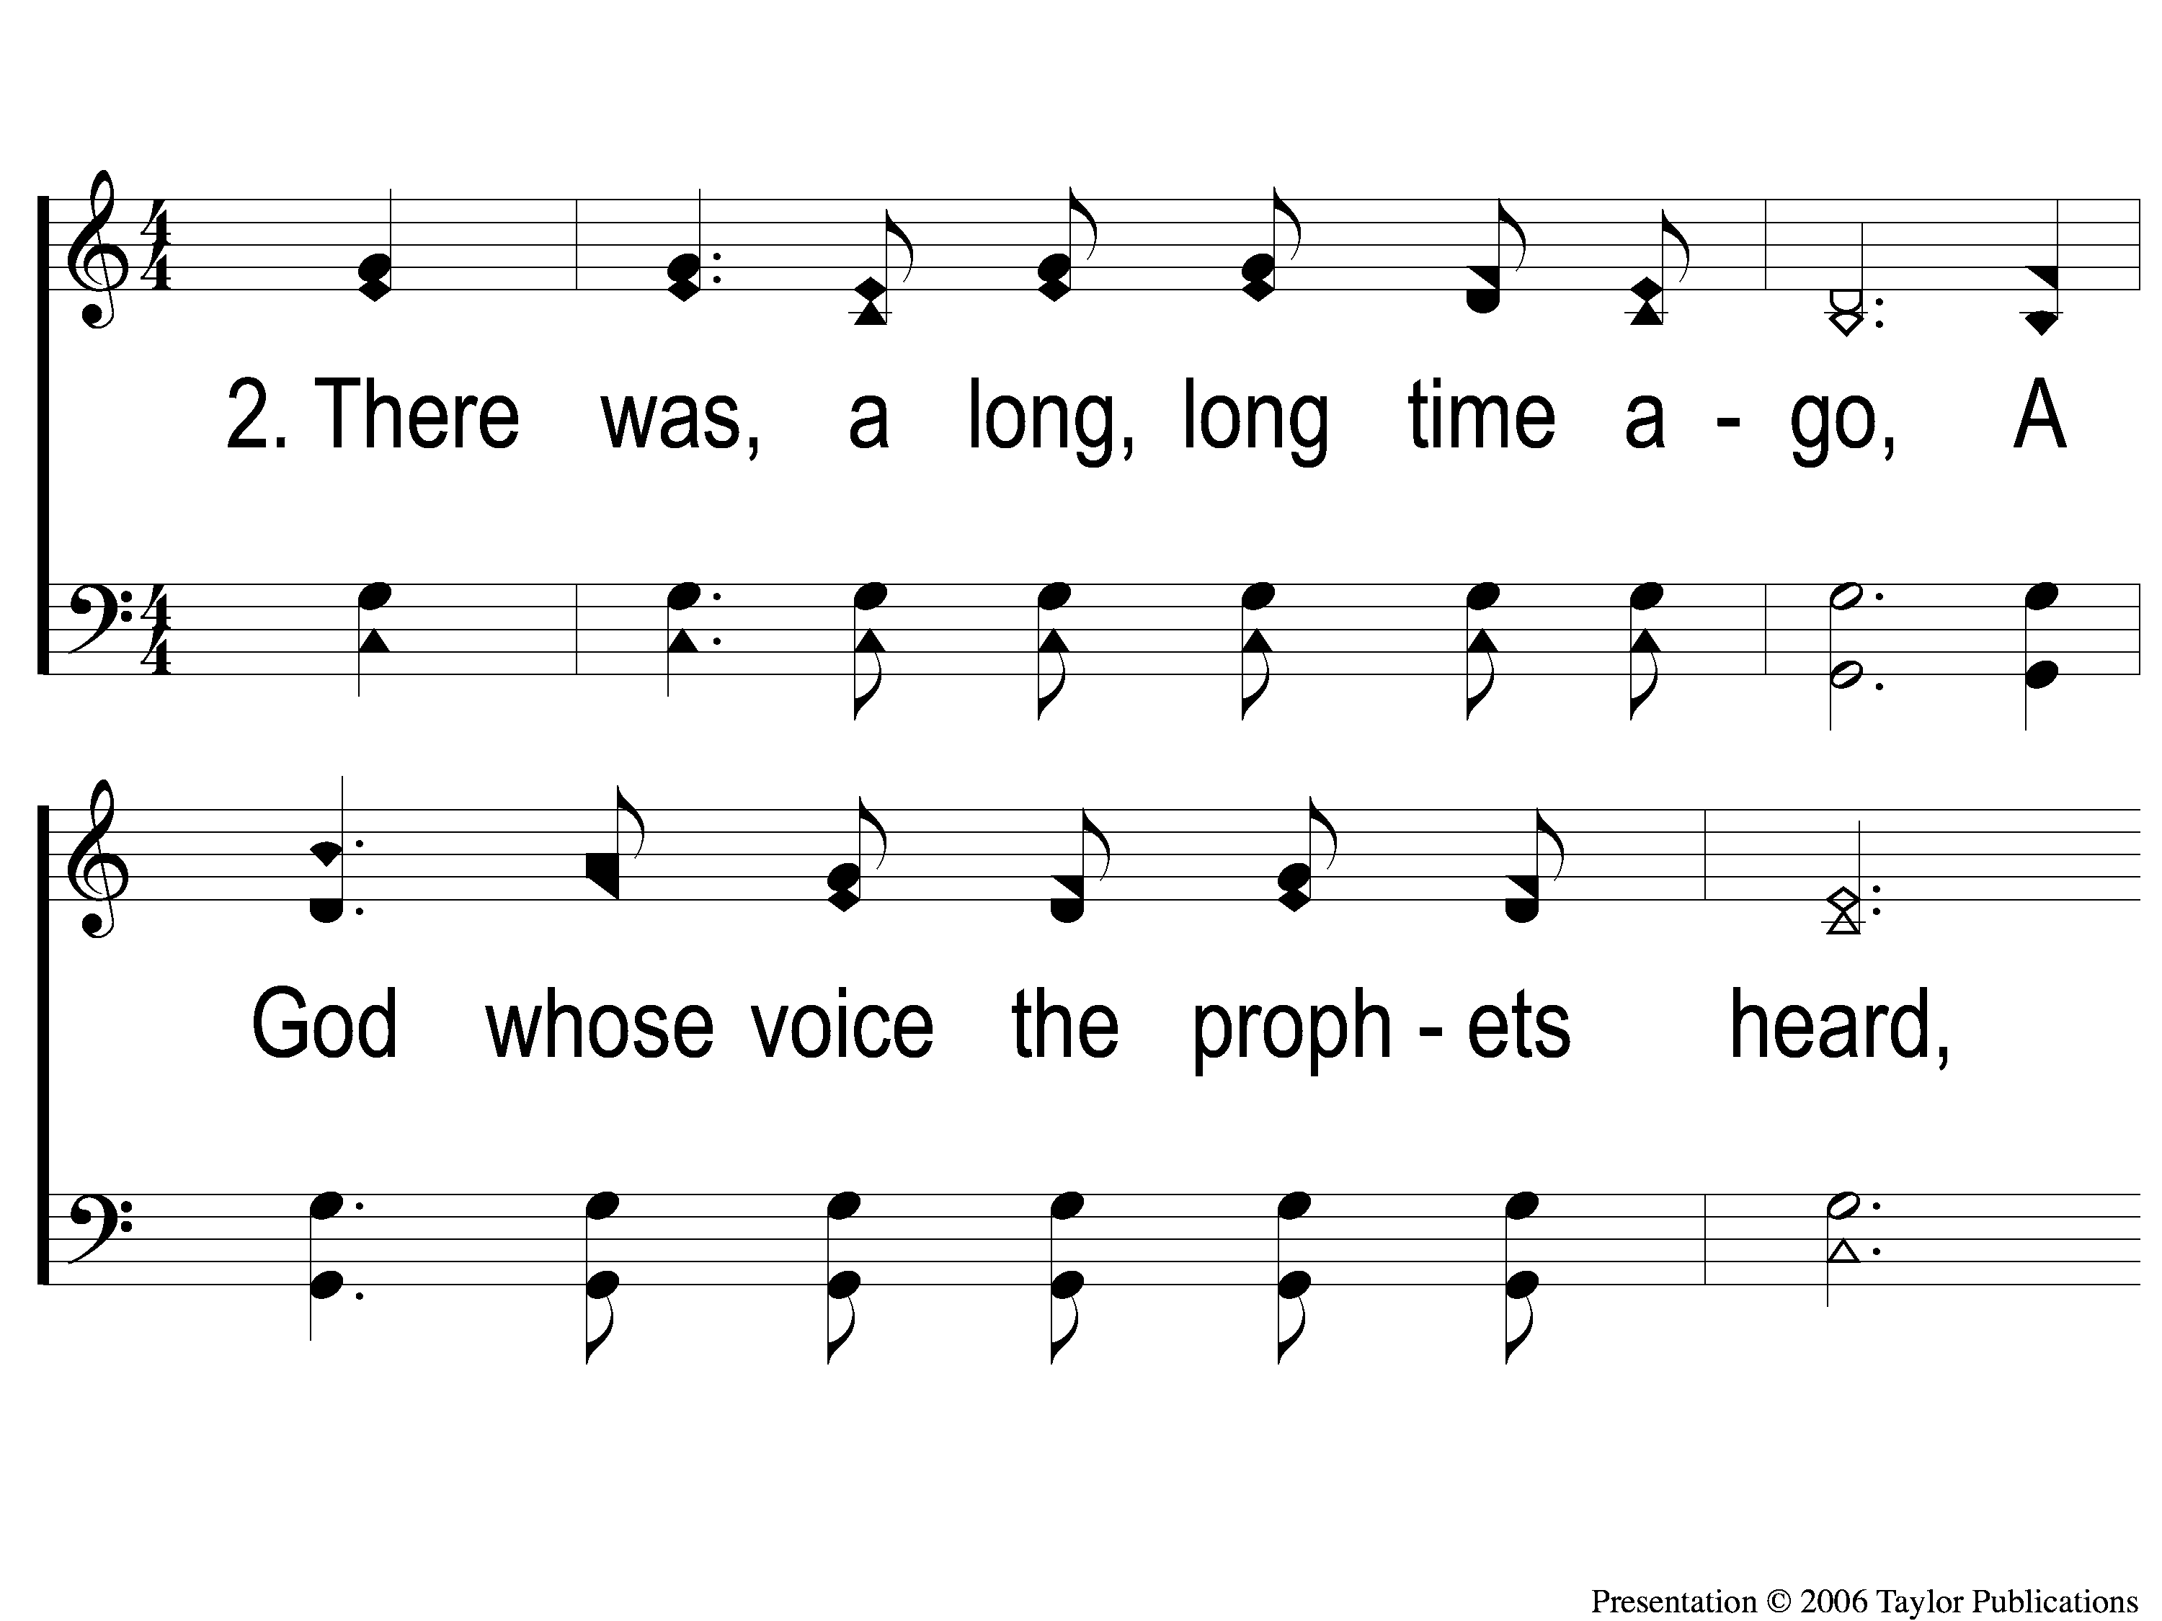
2-1 Our God He Is Alive
Our God, He Is Alive
23

Slide 6
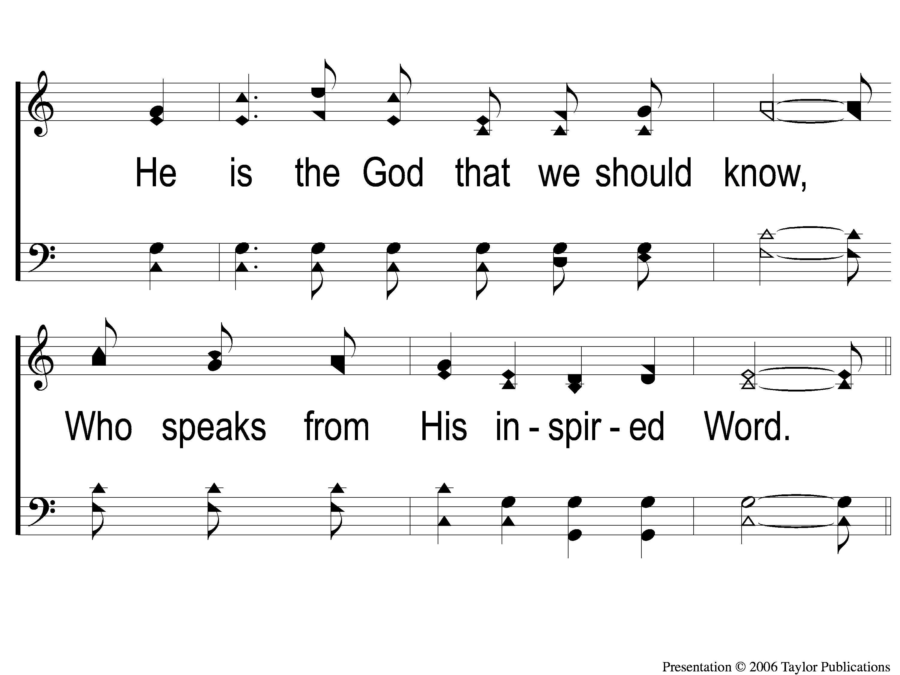
2-2 Our God He Is Alive
Our God, He Is Alive
23

Slide 7
C-1 Our God He Is Alive
Our God, He Is Alive
23

Slide 8
C-2 Our God He Is Alive
Our God, He Is Alive
23

Slide 9
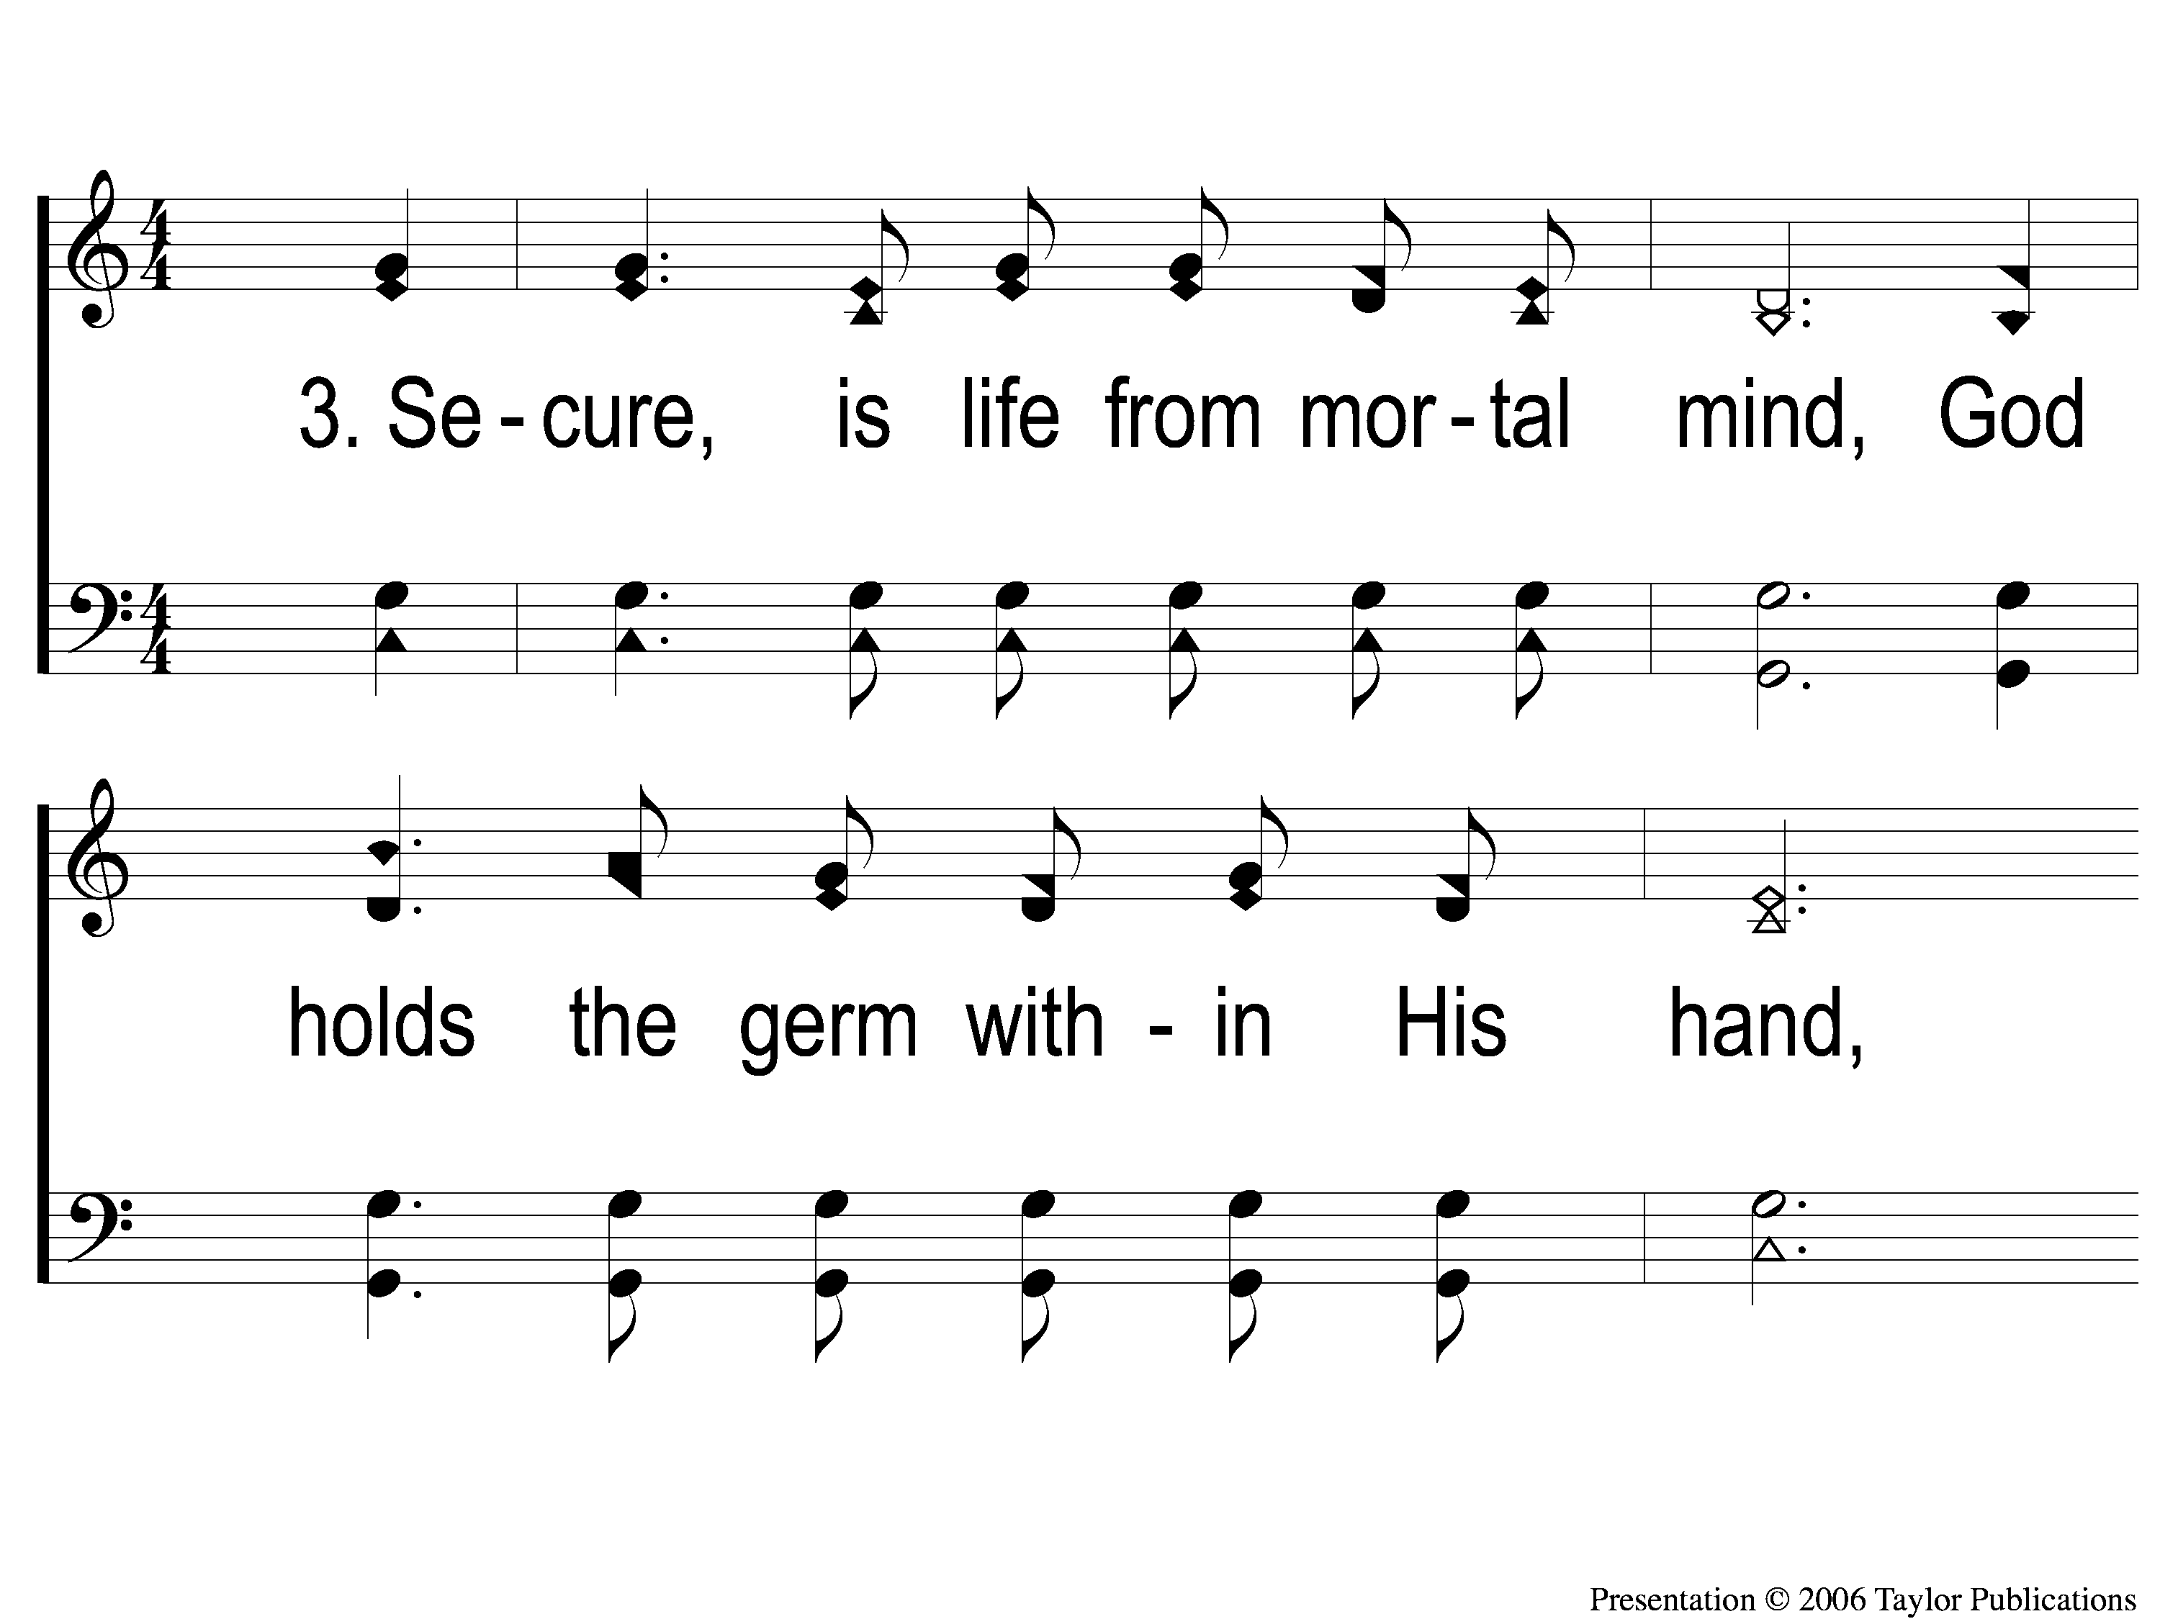
3-1 Our God He Is Alive
Our God, He Is Alive
23

Slide 10
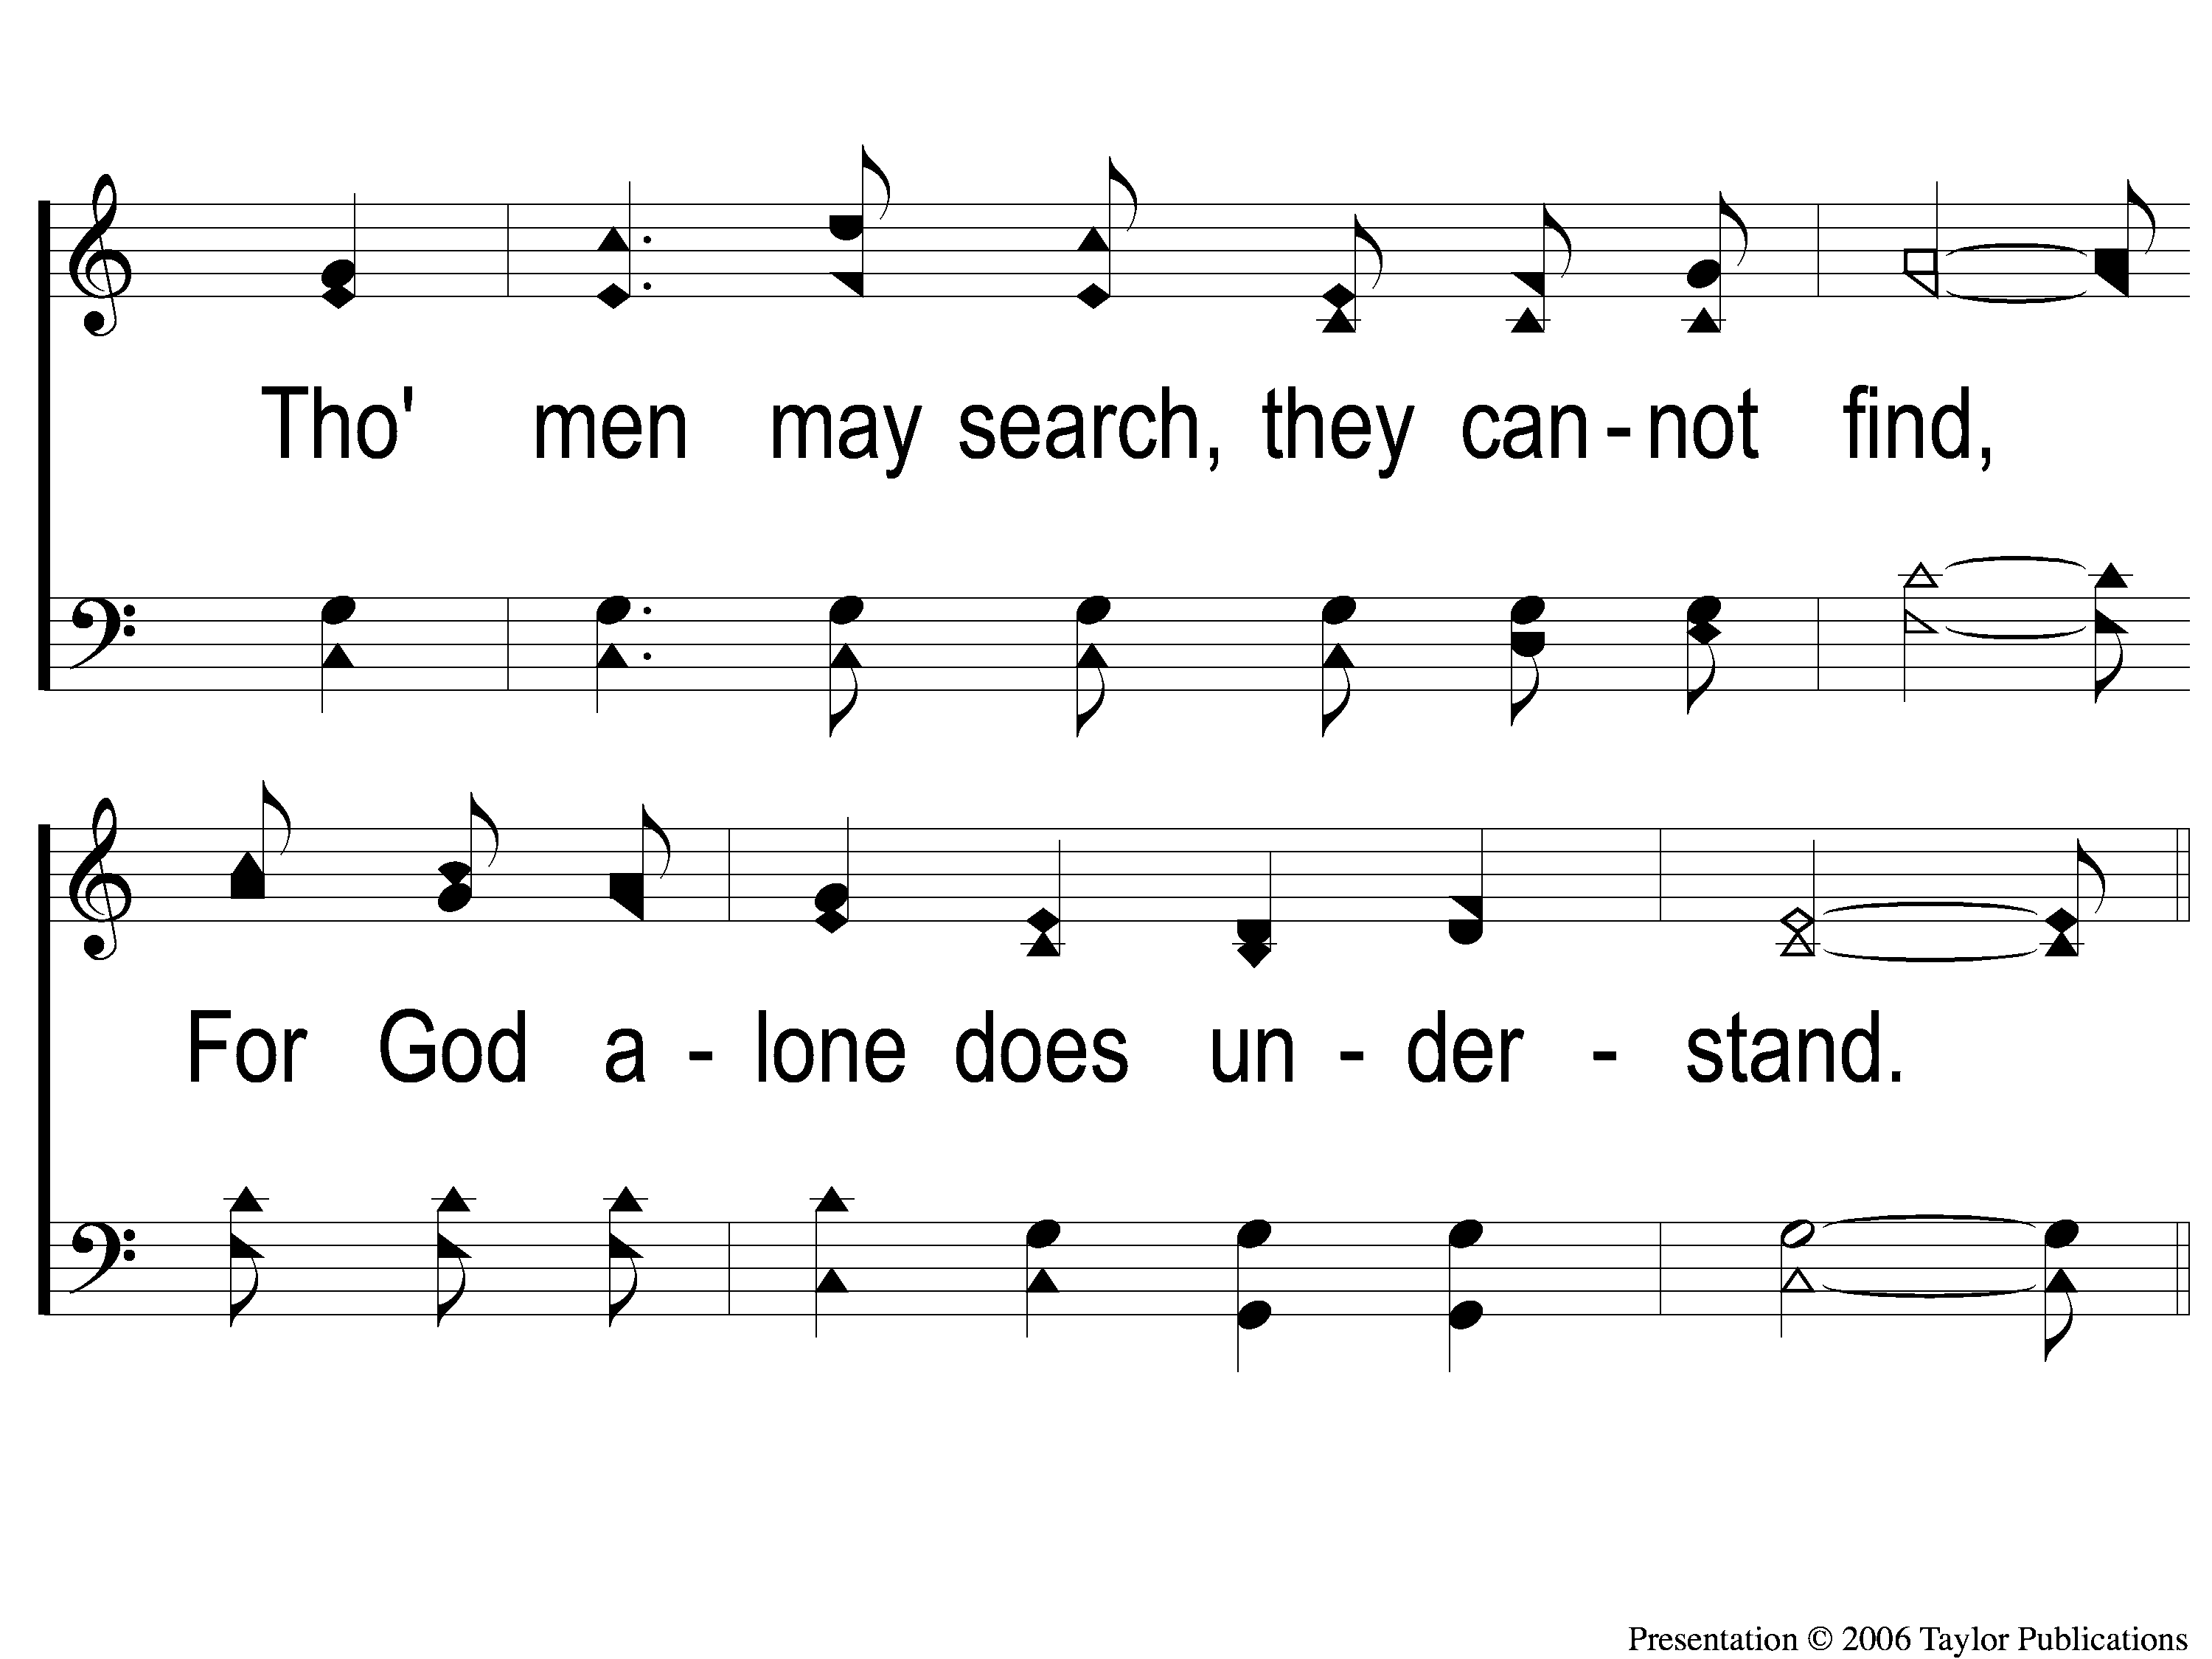
3-2 Our God He Is Alive
Our God, He Is Alive
23

Slide 11
C-1 Our God He Is Alive
Our God, He Is Alive
23

Slide 12
C-2 Our God He Is Alive
Our God, He Is Alive
23

Slide 13
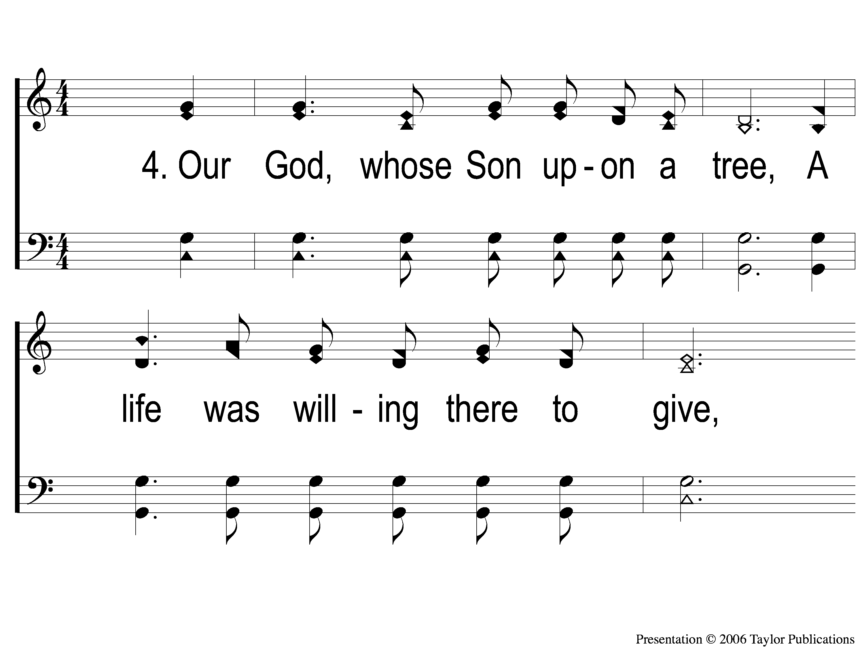
4-1 Our God He Is Alive
Our God, He Is Alive
23

Slide 14
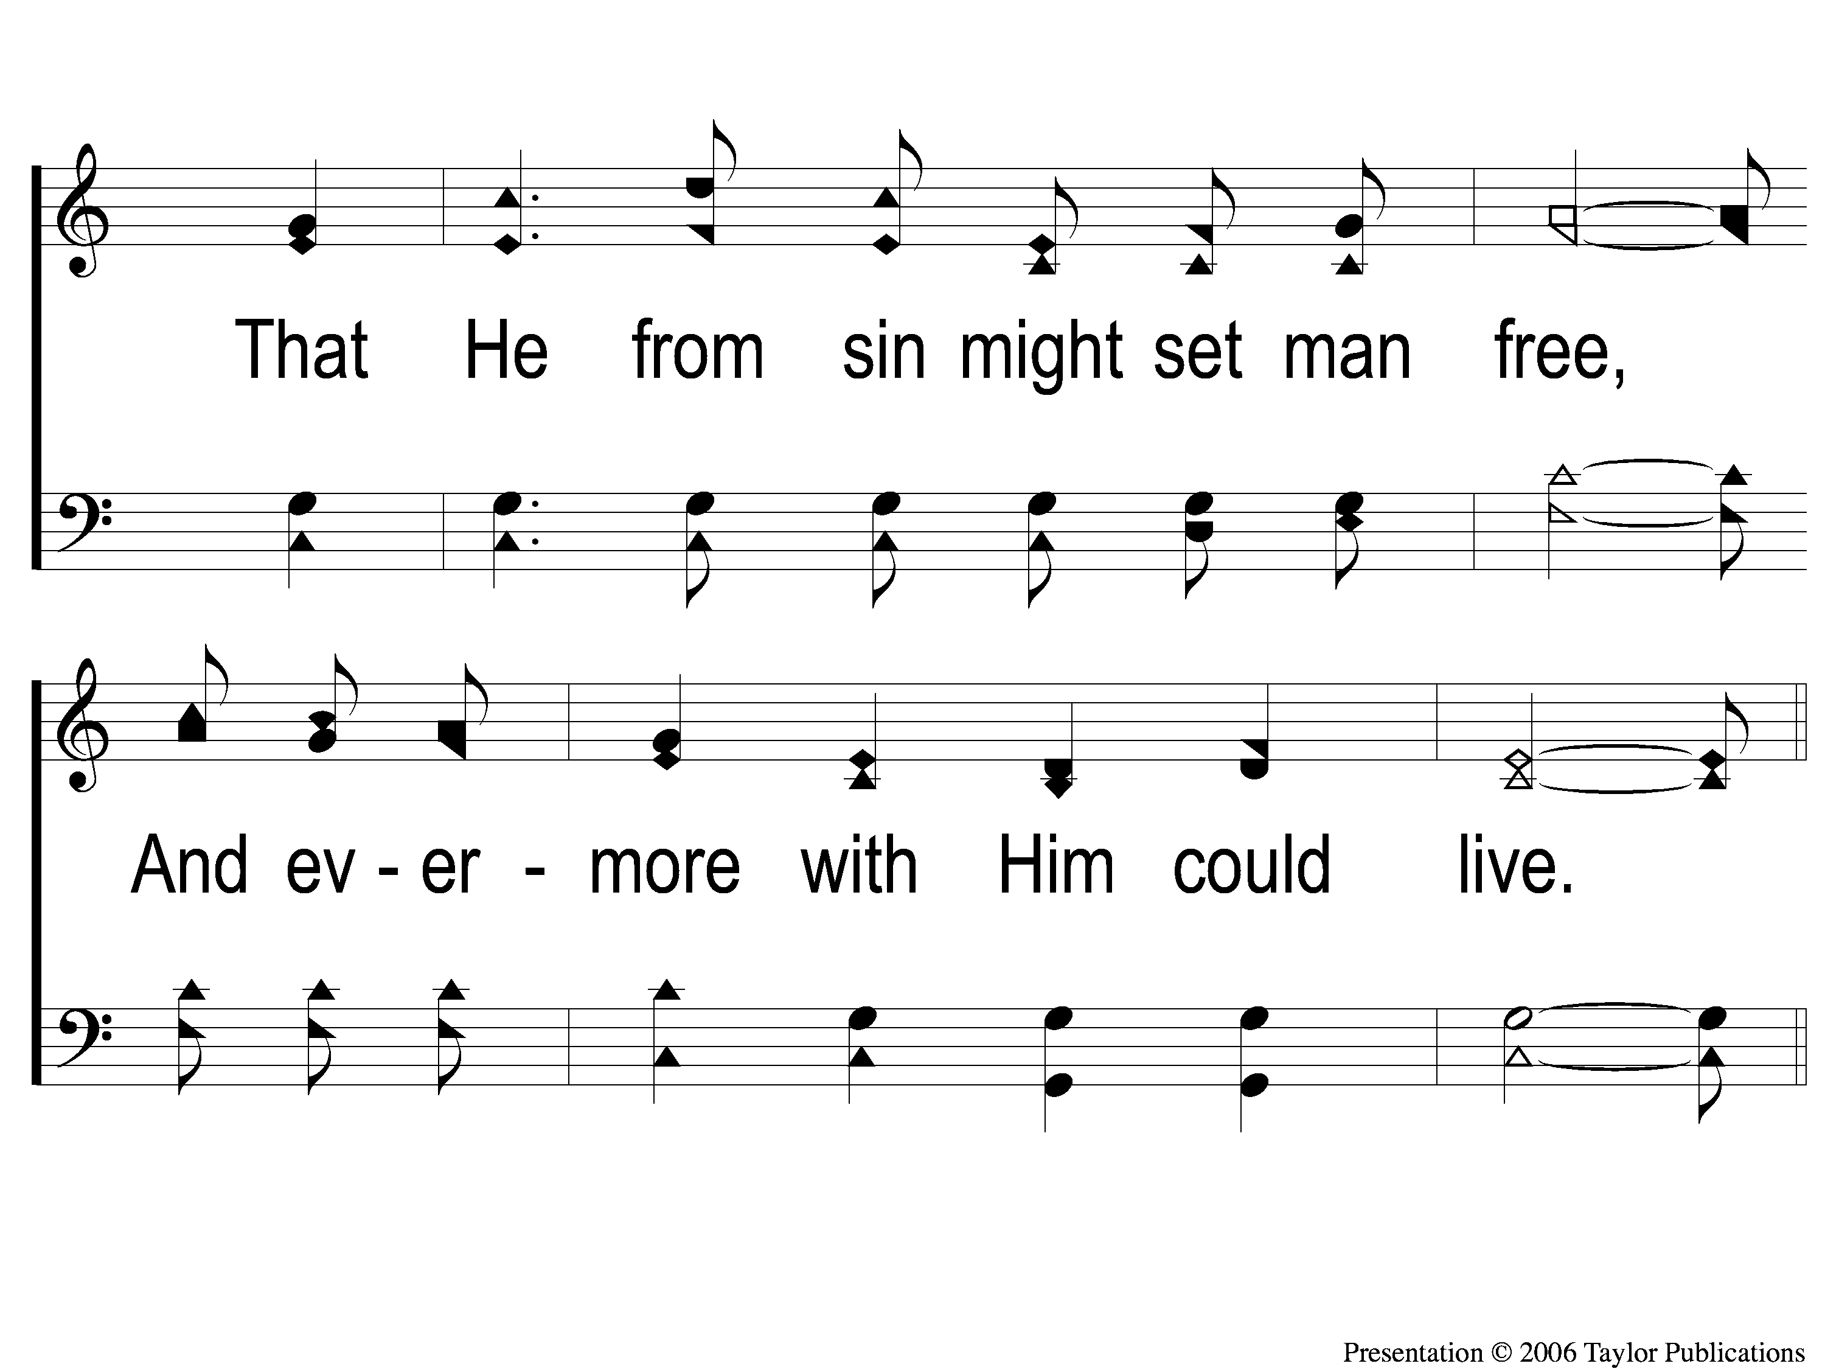
4-2 Our God He Is Alive
Our God, He Is Alive
23

Slide 15
C-1 Our God He Is Alive
Our God, He Is Alive
23

Slide 16
C-2 Our God He Is Alive
Our God, He Is Alive
23

