Slide 1
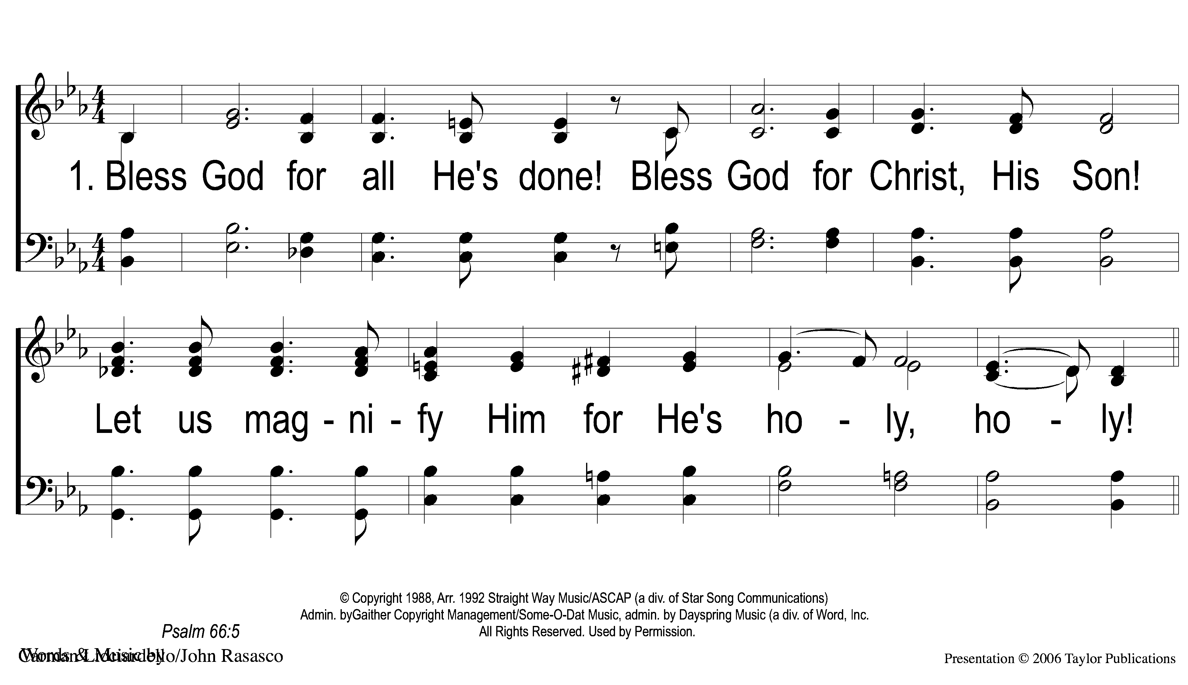
1-1 Bless God
Bless God
82

Slide 2
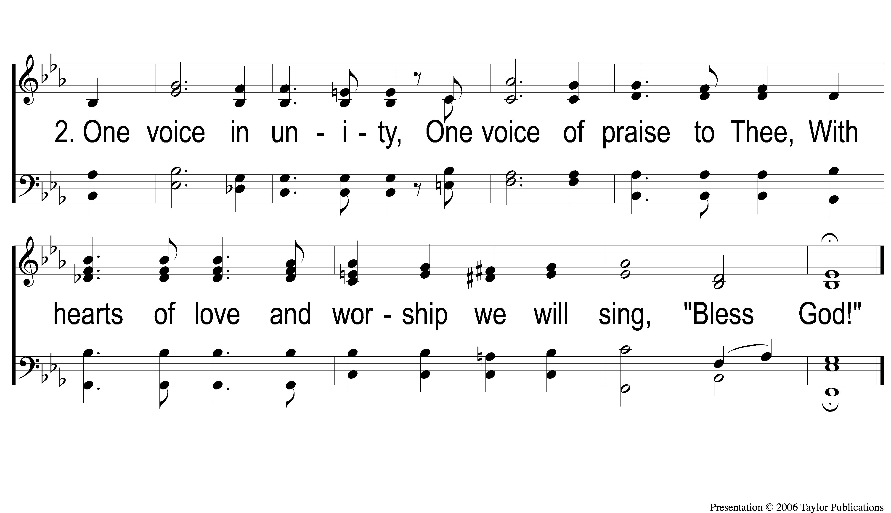
2-1 Bless God
Bless God
82

