Slide 1
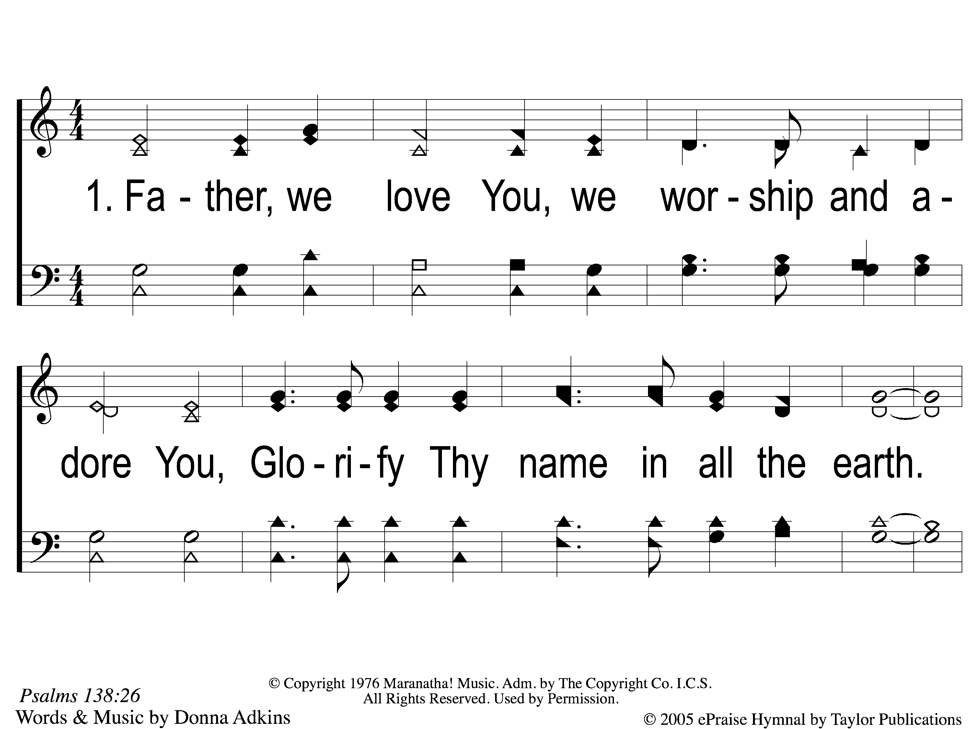
1 Glorify Thy Name
Glorify Thy Name
77

Slide 2
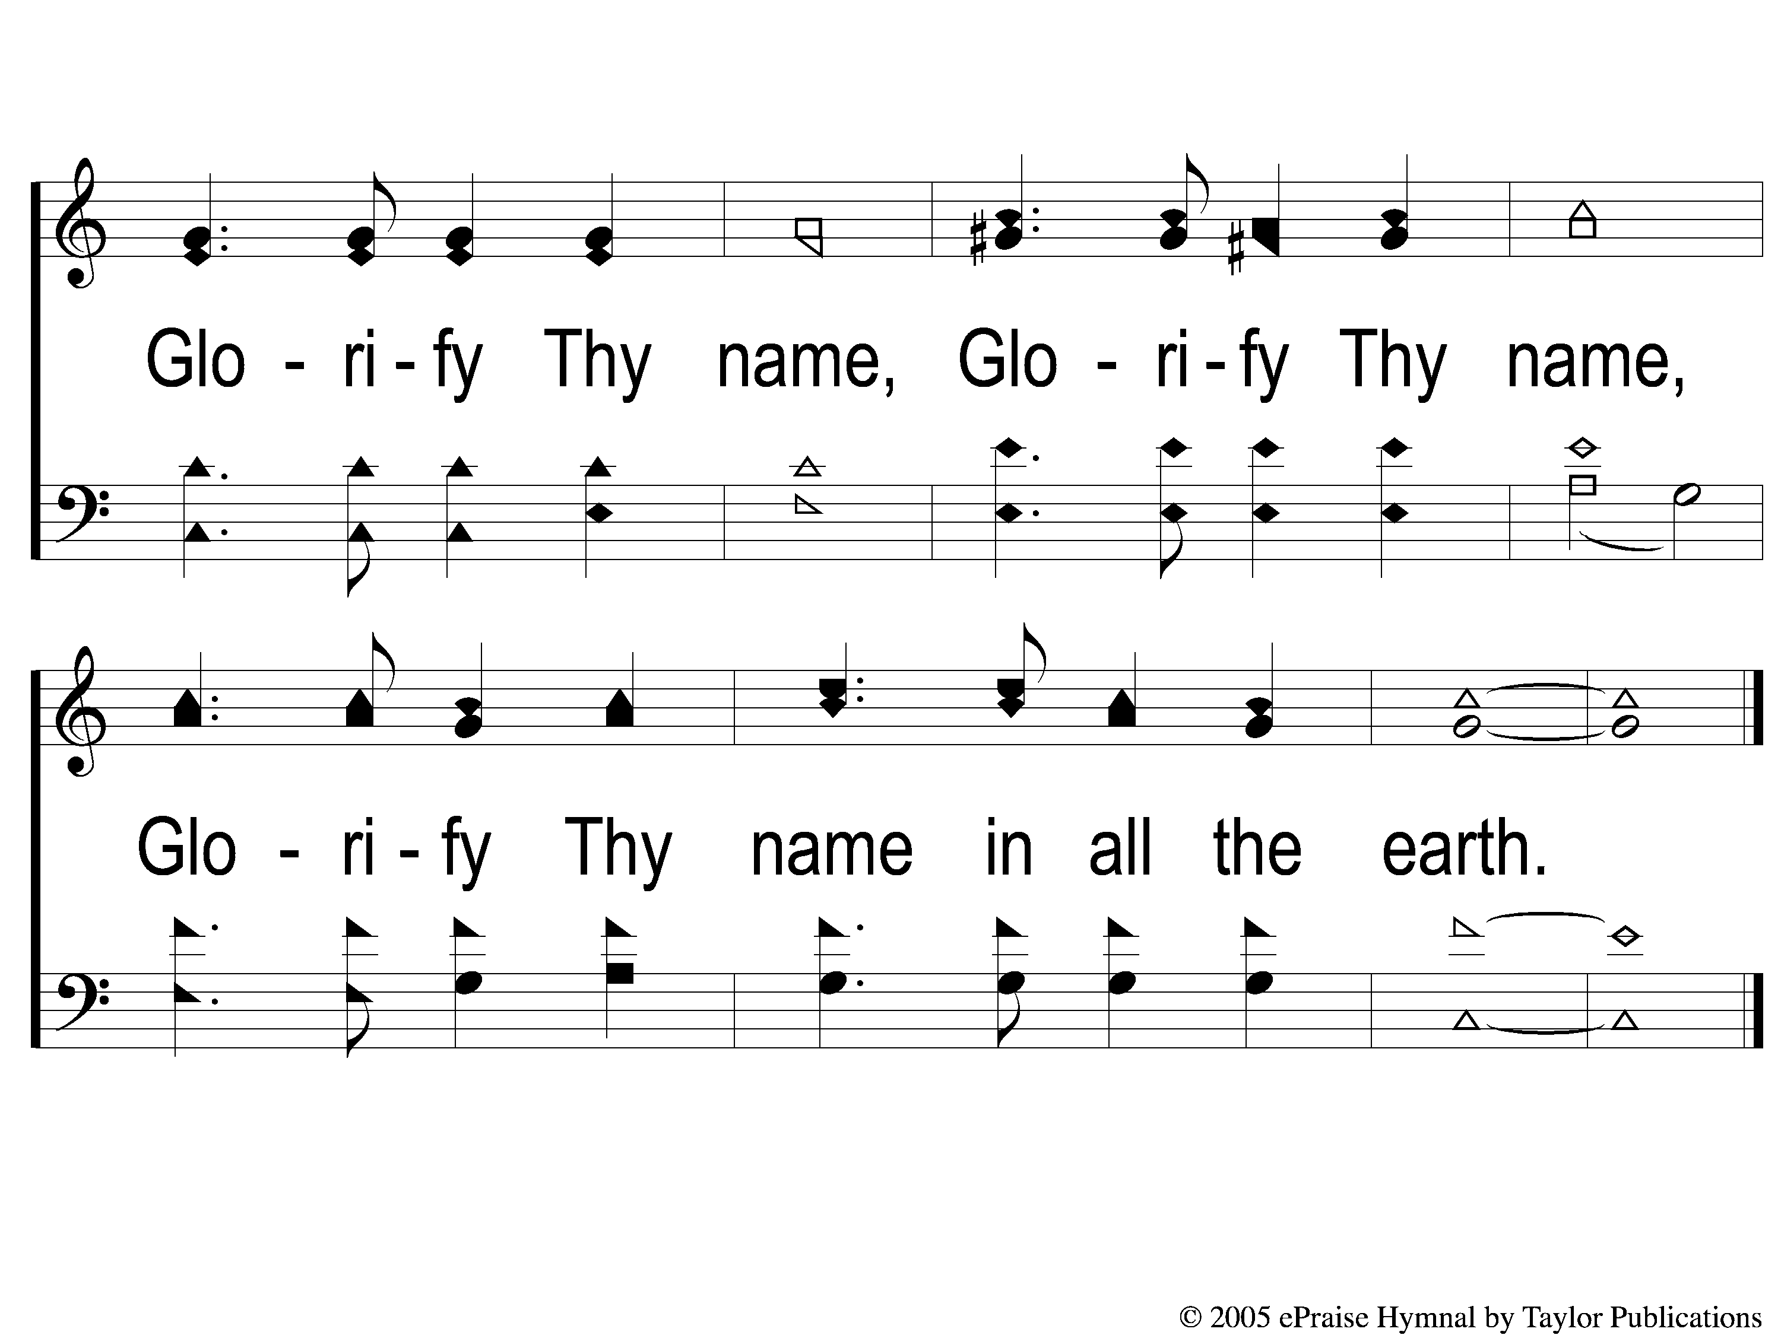
C Glorify Thy Name
Glorify Thy Name
77

Slide 3
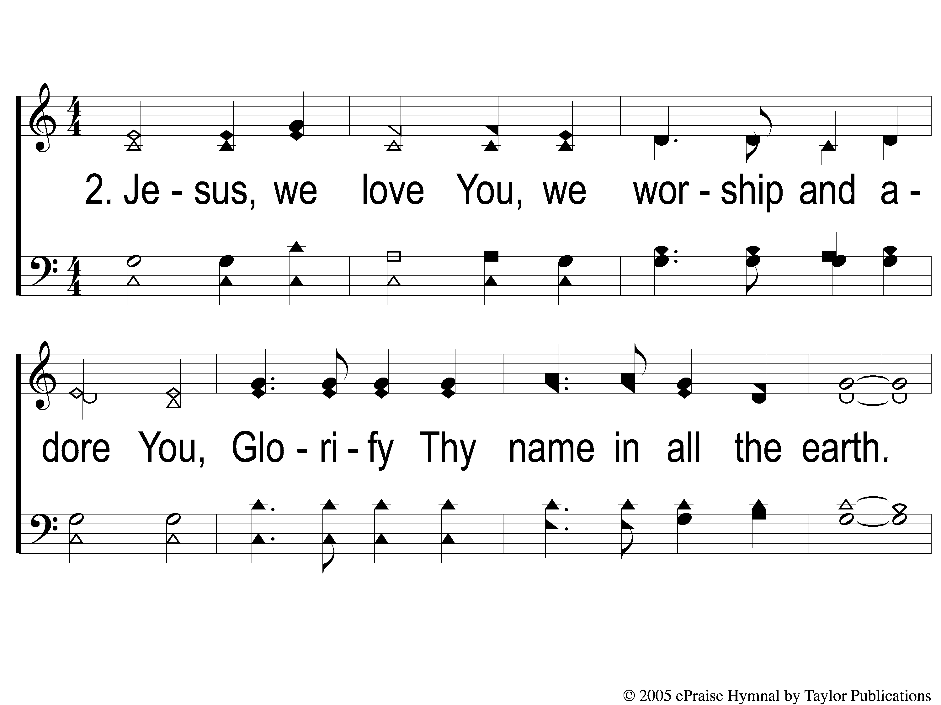
2 Glorify Thy Name
Glorify Thy Name
77

Slide 4
C Glorify Thy Name
Glorify Thy Name
77

Slide 5

3 Glorify Thy Name
Glorify Thy Name
77

Slide 6
C Glorify Thy Name
Glorify Thy Name
77

