Slide 1

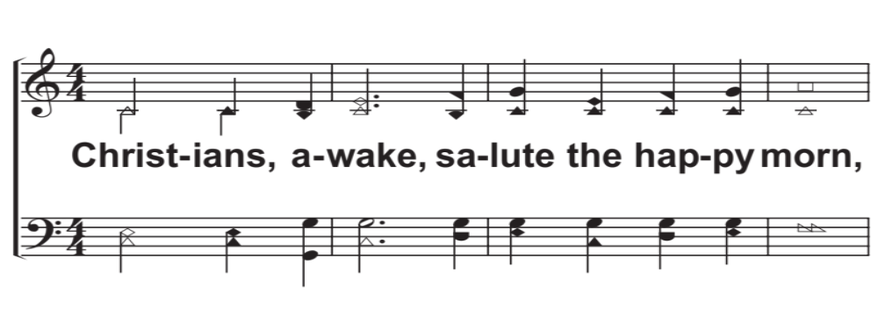
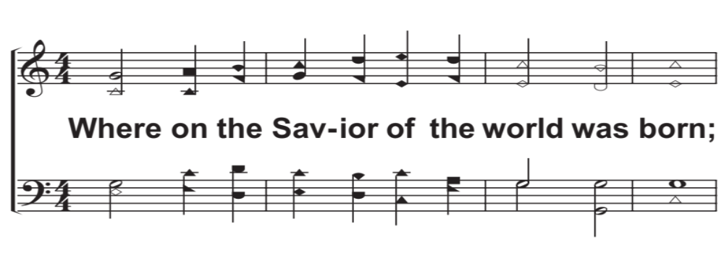
V1a – Christians, Awake, Salute The Happy Morn
Words: John Byrom (1692-1763)
Music: John Wainwright (1723-1768)
© 2017 The Acappella Company

Slide 2
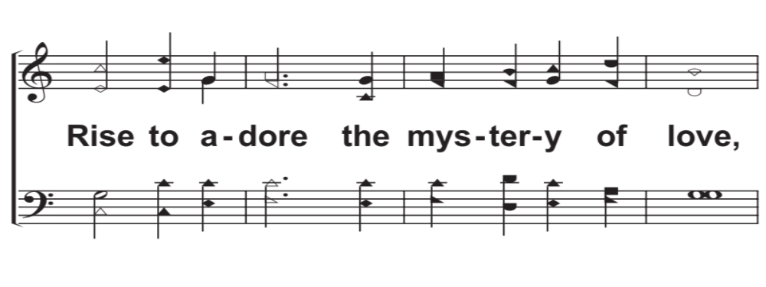
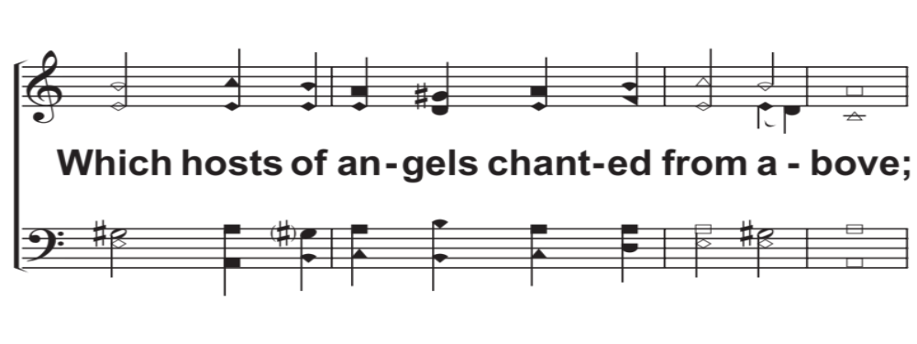
V1b – Christians, Awake, Salute The Happy Morn
© 2017 The Acappella Company

Slide 3
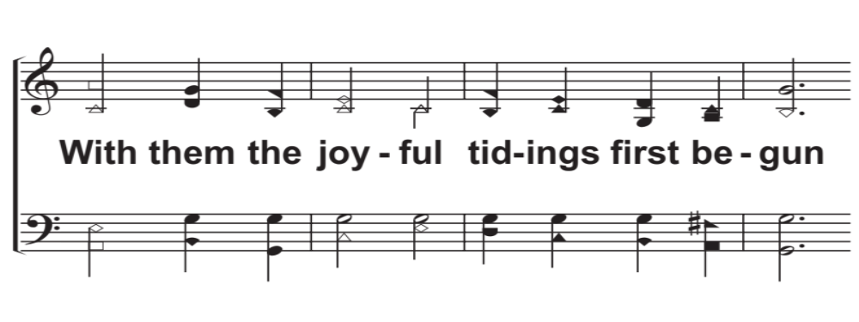
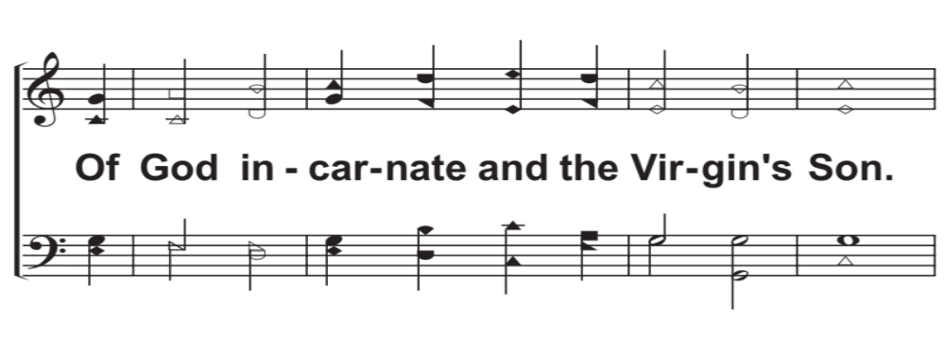
V1c – Christians, Awake, Salute The Happy Morn
© 2017 The Acappella Company

Slide 4
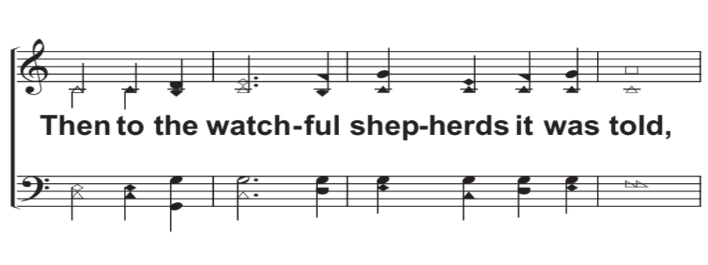
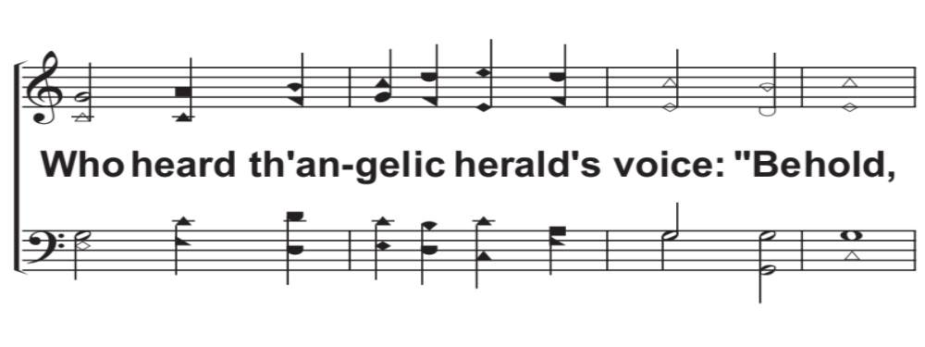
V2a – Christians, Awake, Salute The Happy Morn
© 2017 The Acappella Company

Slide 5
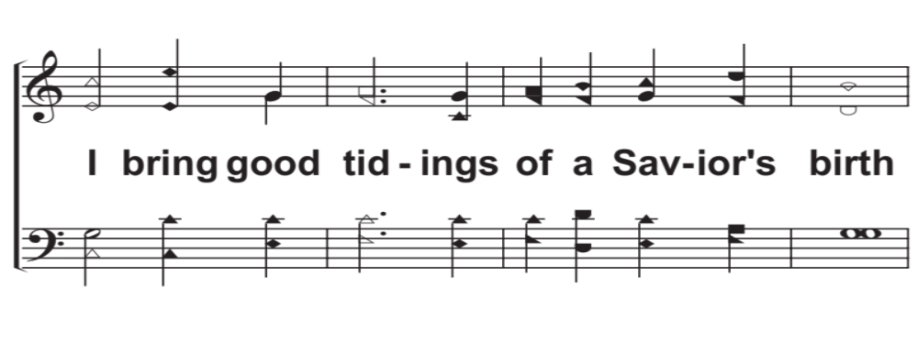
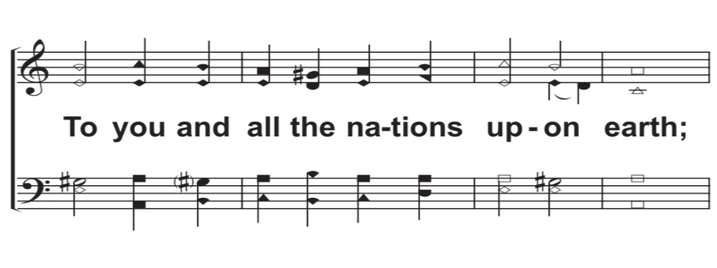
V2b – Christians, Awake, Salute The Happy Morn
© 2017 The Acappella Company

Slide 6
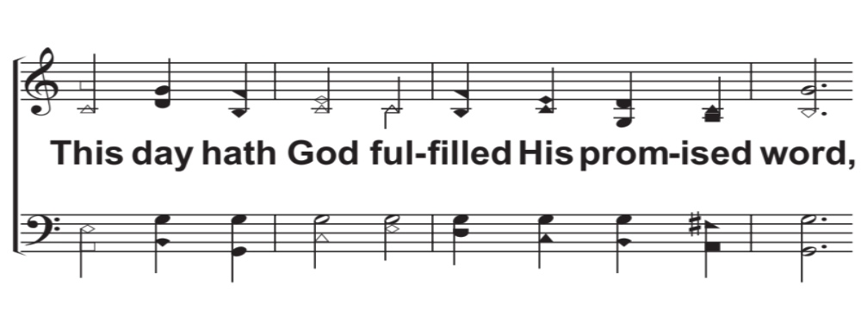
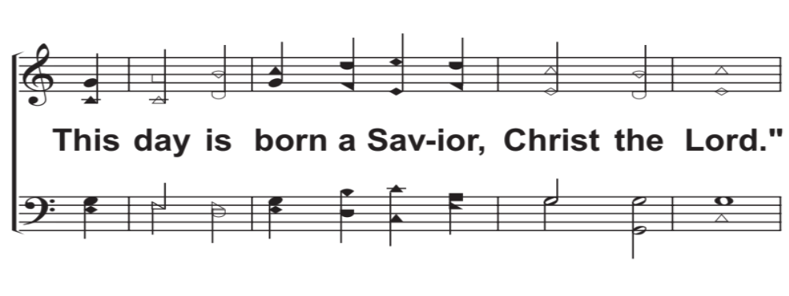
V2c – Christians, Awake, Salute The Happy Morn
© 2017 The Acappella Company

Slide 7
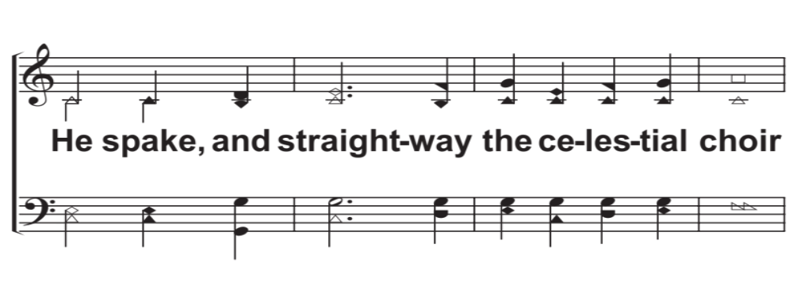
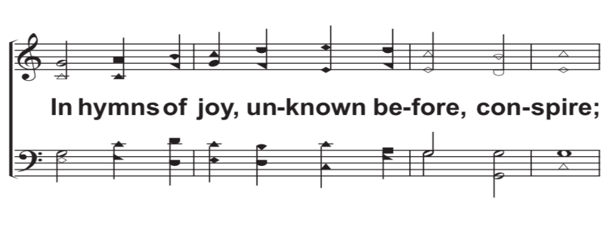
V3a – Christians, Awake, Salute The Happy Morn
© 2017 The Acappella Company

Slide 8
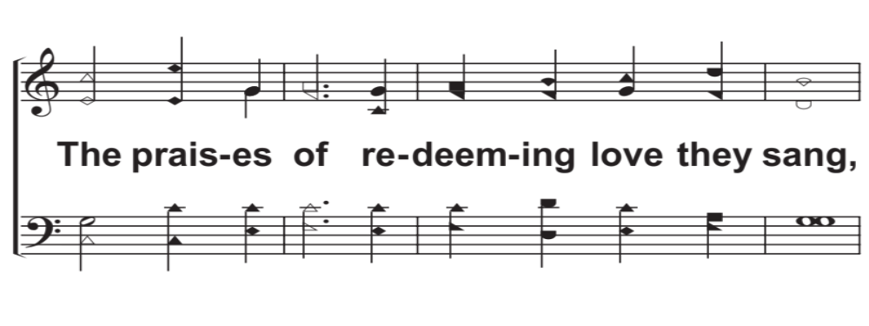
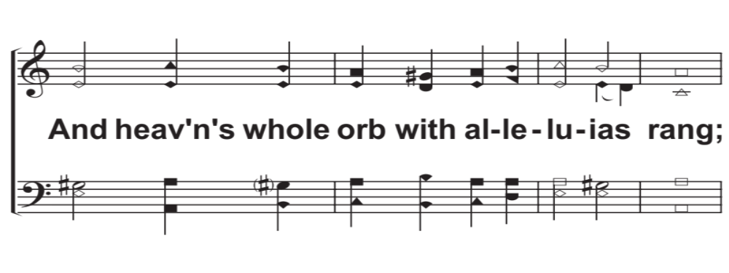
V3b – Christians, Awake, Salute The Happy Morn
© 2017 The Acappella Company

Slide 9
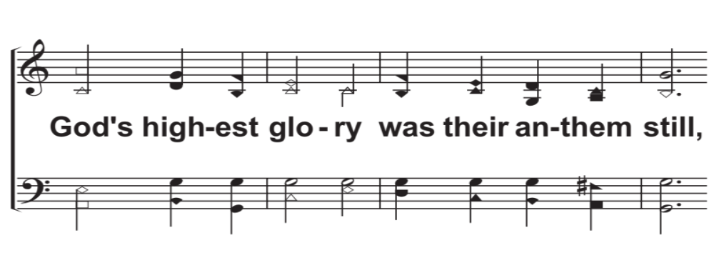
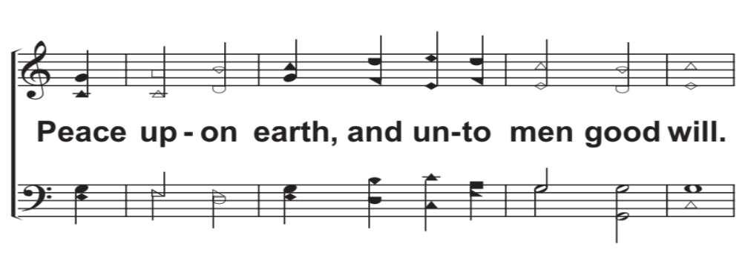
V3c – Christians, Awake, Salute The Happy Morn
© 2017 The Acappella Company

Slide 10
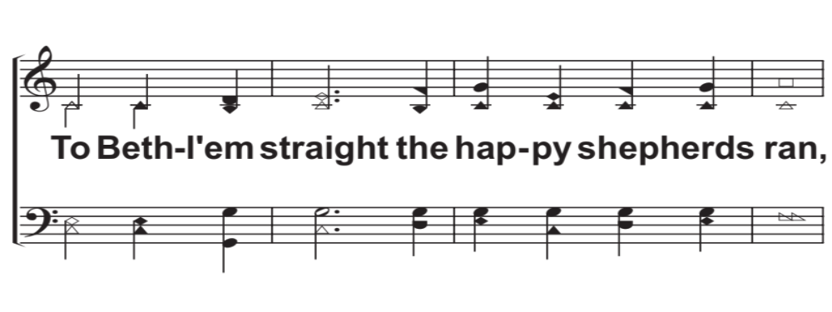
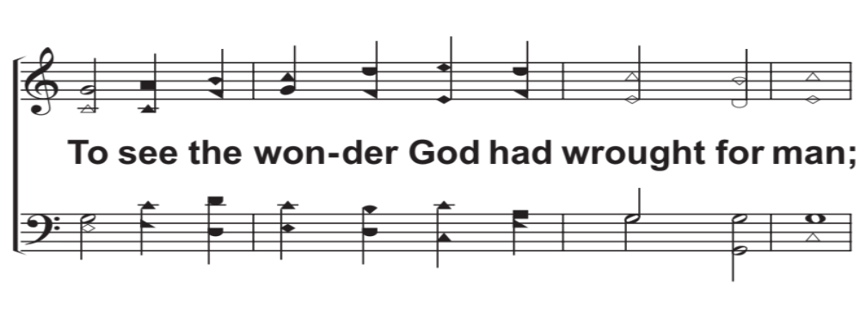
V4a – Christians, Awake, Salute The Happy Morn
© 2017 The Acappella Company

Slide 11
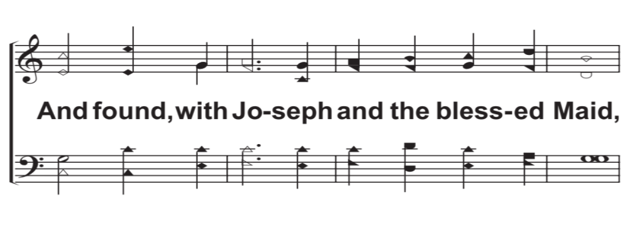
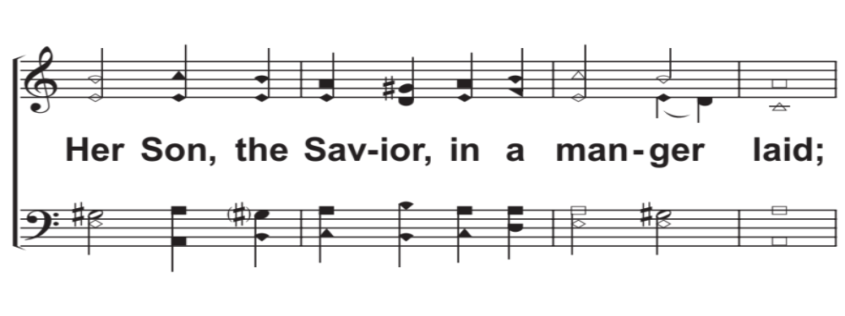
V4b – Christians, Awake, Salute The Happy Morn
© 2017 The Acappella Company

Slide 12
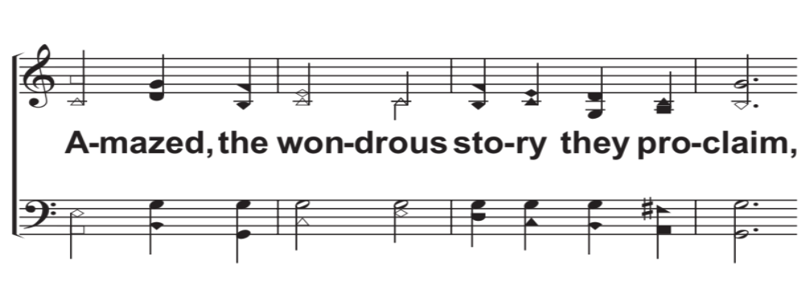
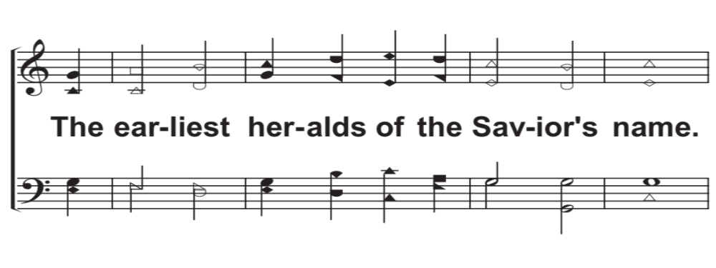
V4c – Christians, Awake, Salute The Happy Morn
© 2017 The Acappella Company

Slide 13
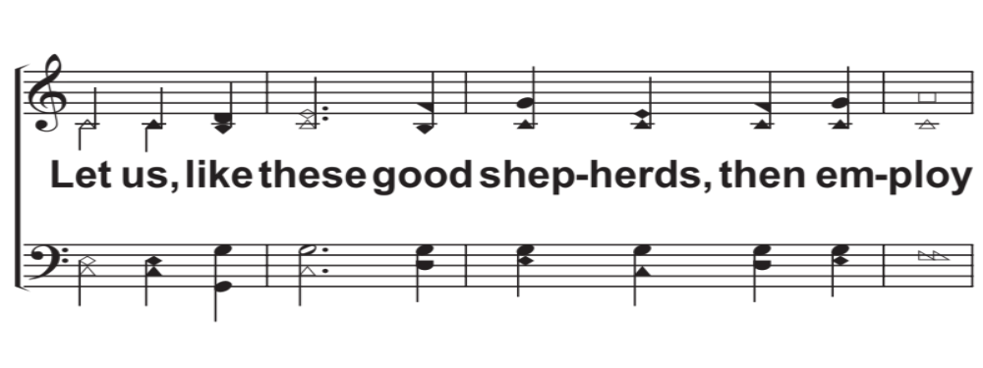
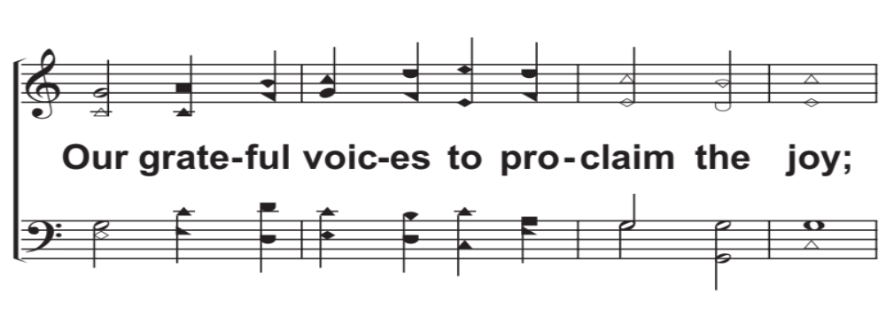
V5a – Christians, Awake, Salute The Happy Morn
© 2017 The Acappella Company

Slide 14
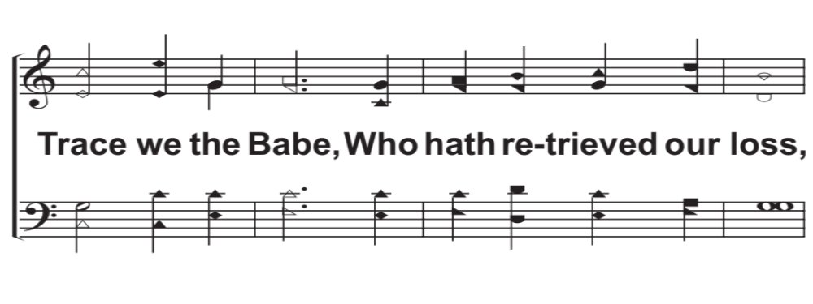
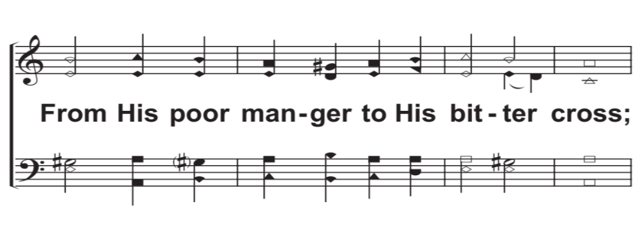
V5b – Christians, Awake, Salute The Happy Morn
© 2017 The Acappella Company

Slide 15
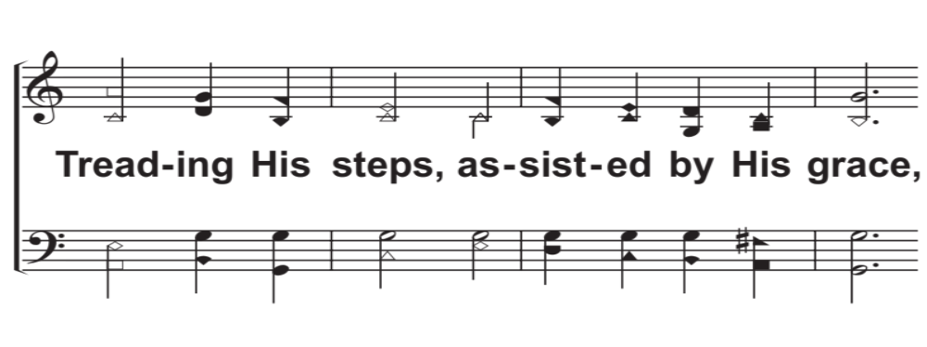
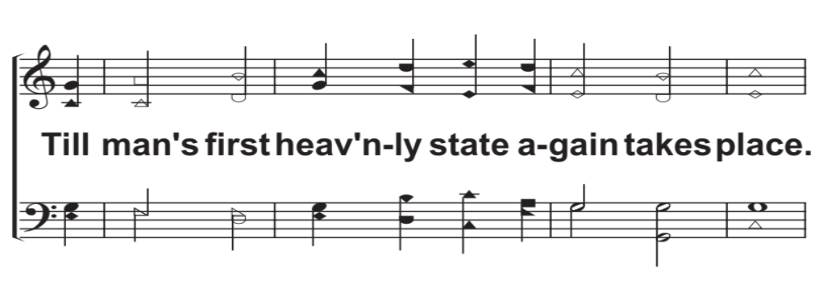
V5c – Christians, Awake, Salute The Happy Morn
© 2017 The Acappella Company

Slide 16
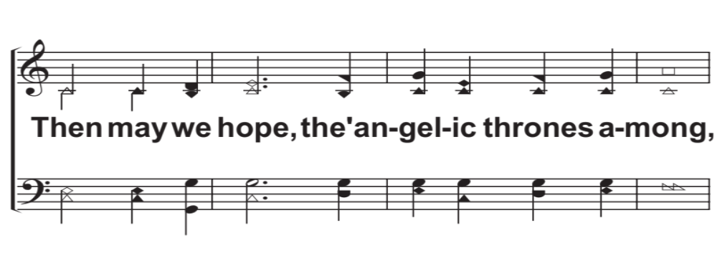
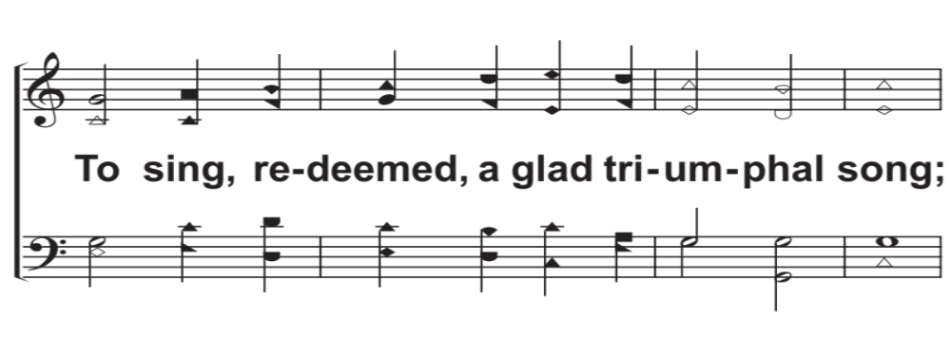
V6a – Christians, Awake, Salute The Happy Morn
© 2017 The Acappella Company

Slide 17
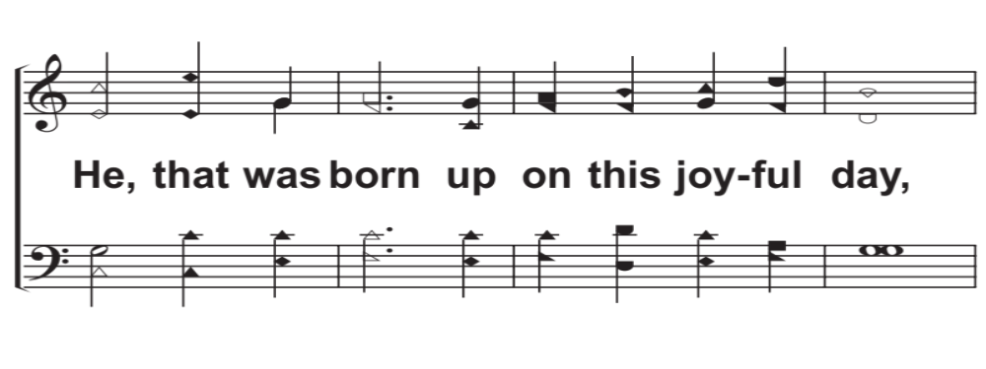
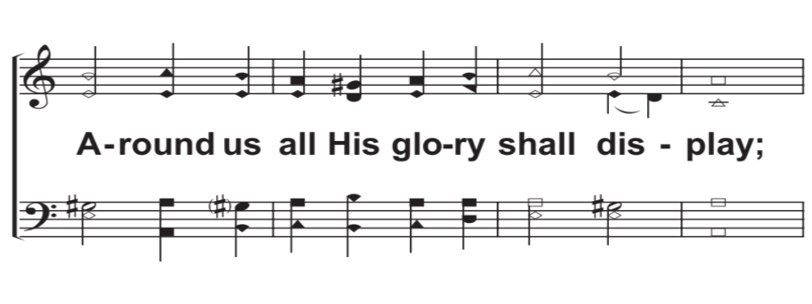
V6b – Christians, Awake, Salute The Happy Morn
© 2017 The Acappella Company

Slide 18
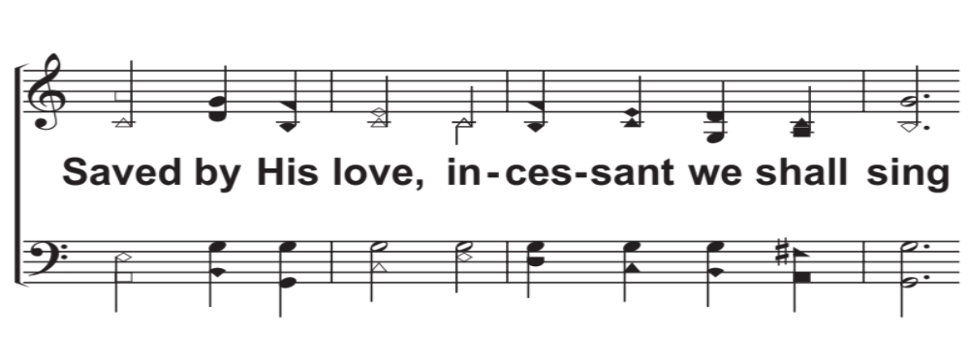
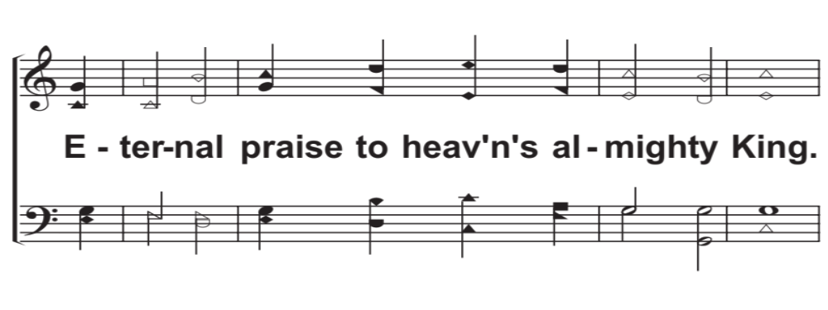
V6c – Christians, Awake, Salute The Happy Morn
© 2017 The Acappella Company

Slide 19
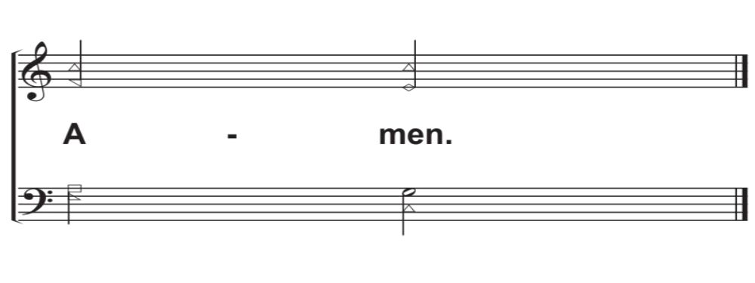
Amen – Christians, Awake, Salute The Happy Morn
© 2017 The Acappella Company

