Slide 1

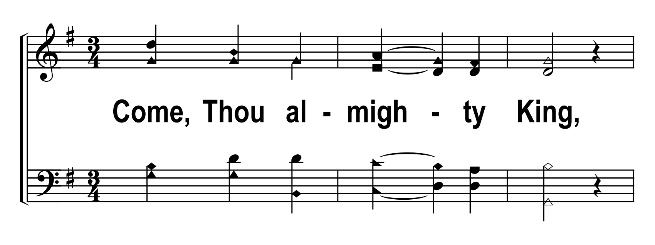
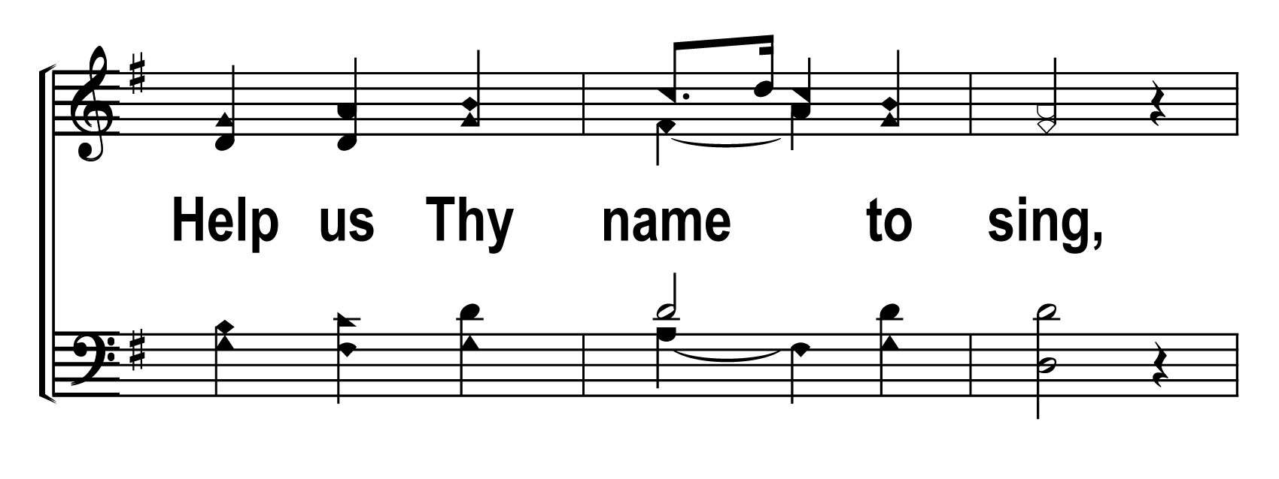
V1a – Come, Thou Almighty King
WORDS: Charles Wesley MUSIC: Felice de Giardint
Public Domain
© 2007 The Acappella Company

Slide 2
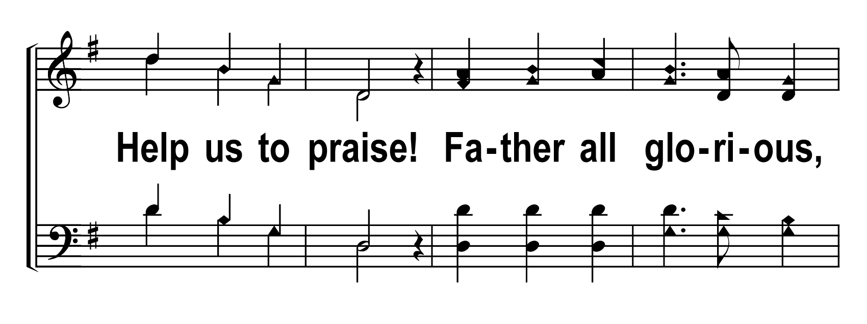
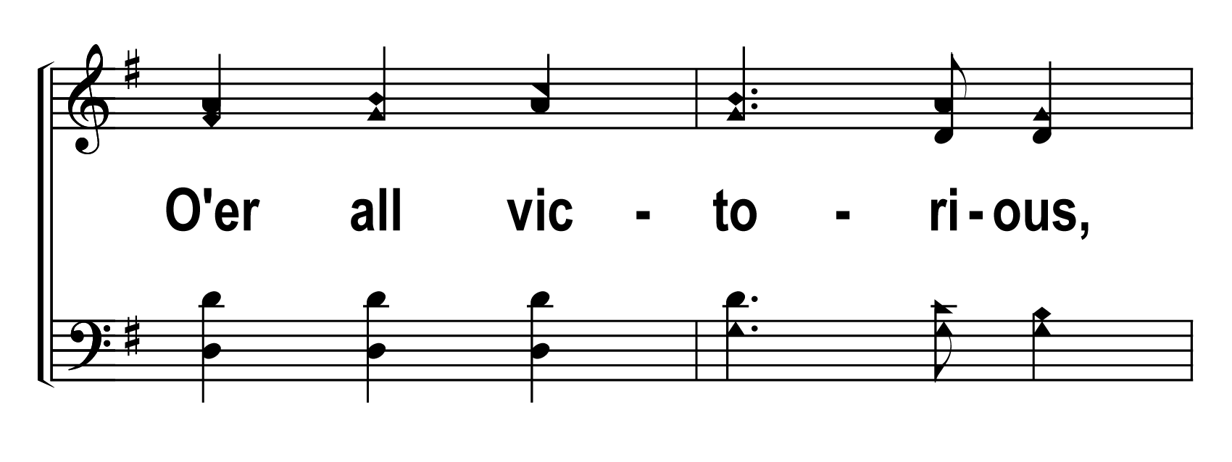
V1b – Come, Thou Almighty King
© 2007 The Acappella Company

Slide 3
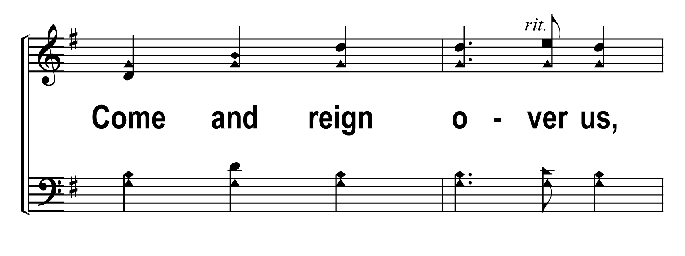
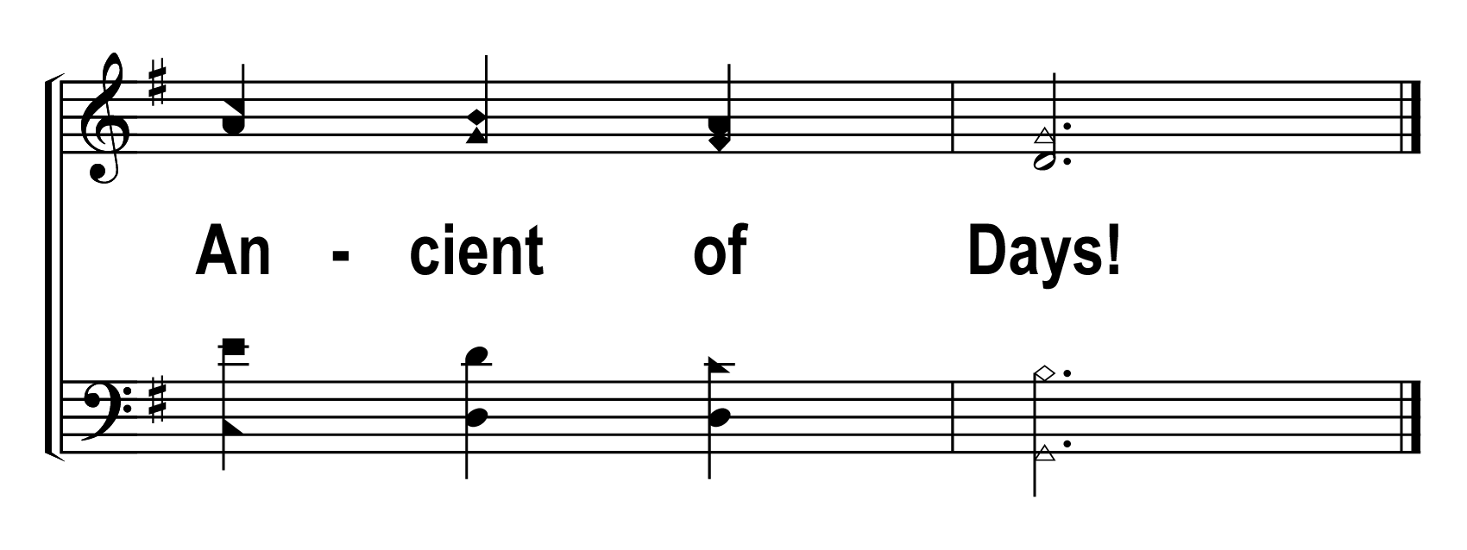
V1c – Come, Thou Almighty King
© 2007 The Acappella Company

Slide 4
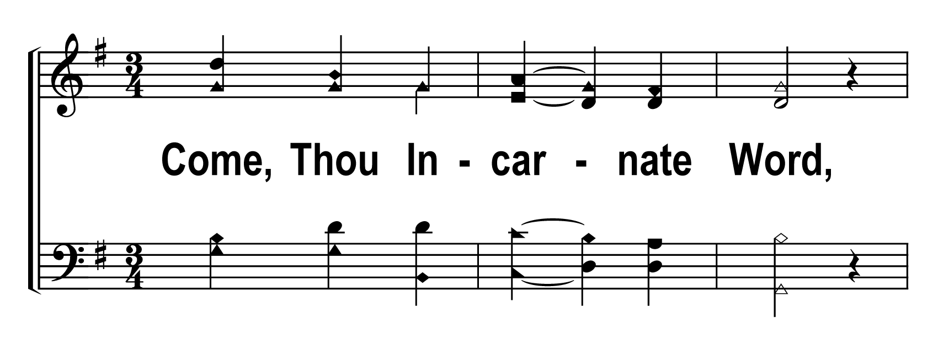
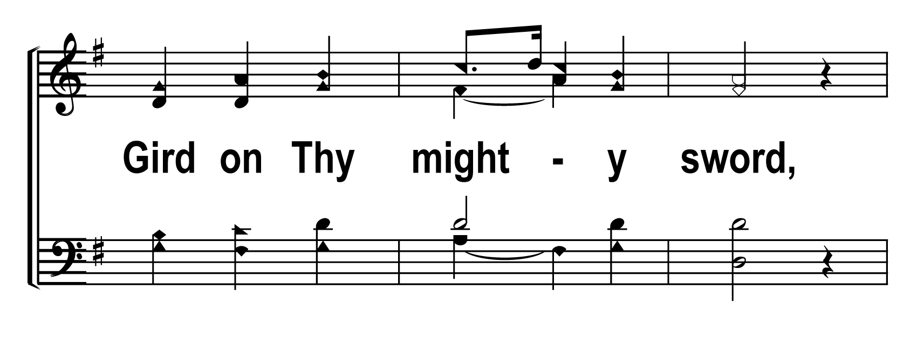
V2a – Come, Thou Almighty King
© 2007 The Acappella Company

Slide 5
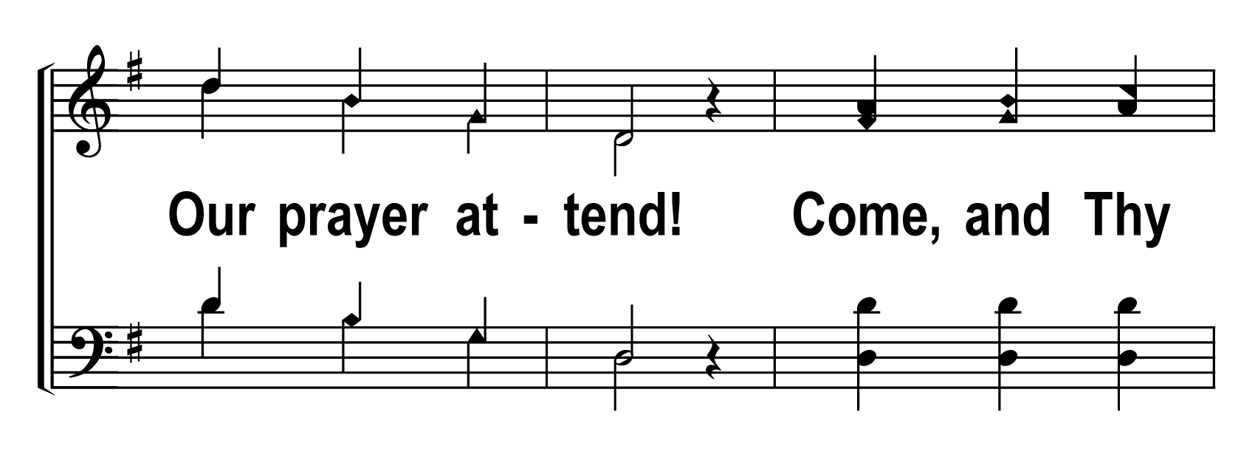
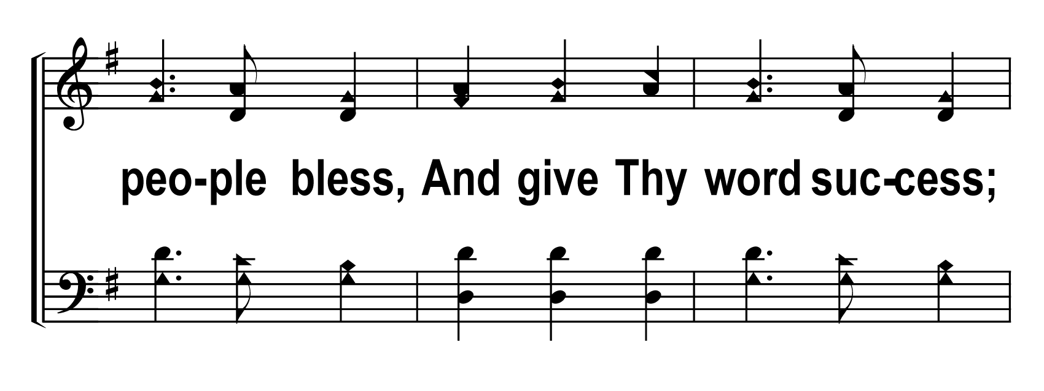
V2b – Come, Thou Almighty King
© 2007 The Acappella Company

Slide 6
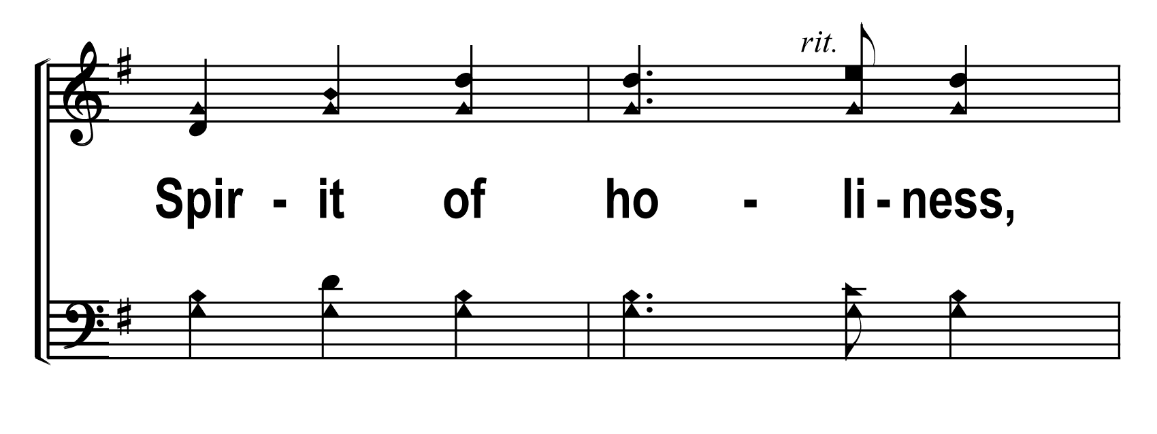
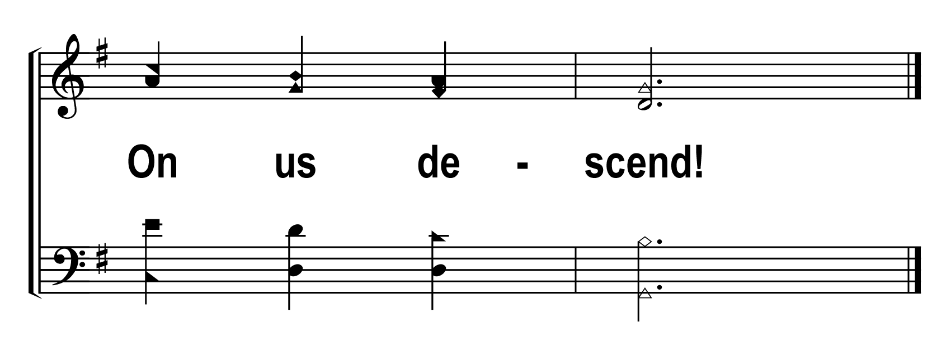
V2c – Come, Thou Almighty King
© 2007 The Acappella Company

Slide 7
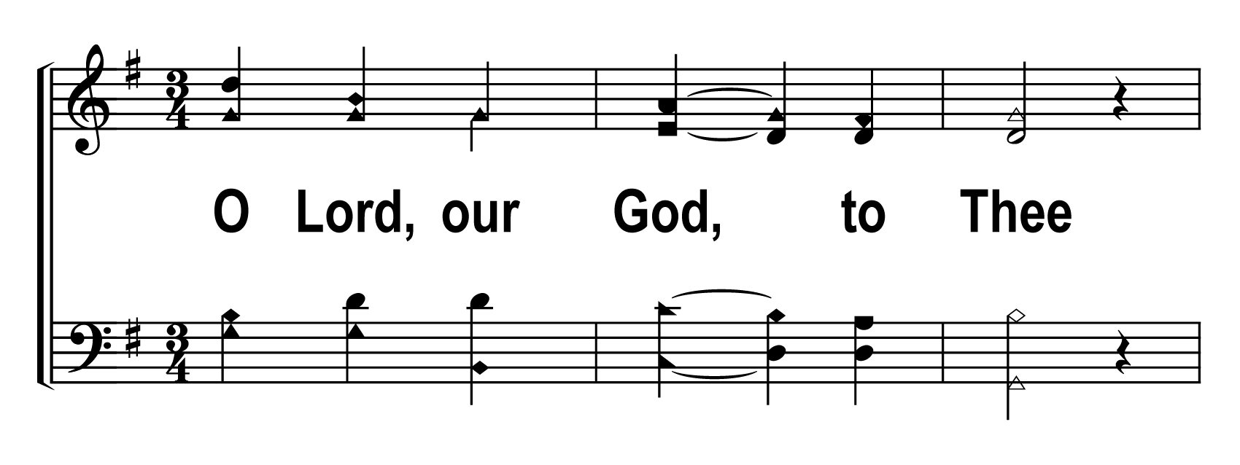
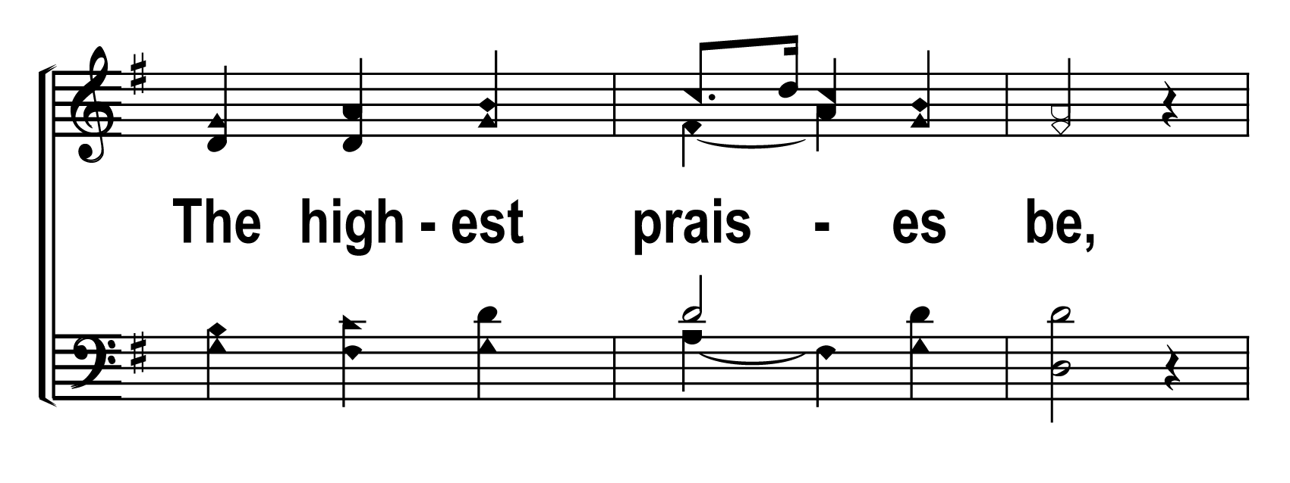
V3a – Come, Thou Almighty King
© 2007 The Acappella Company

Slide 8
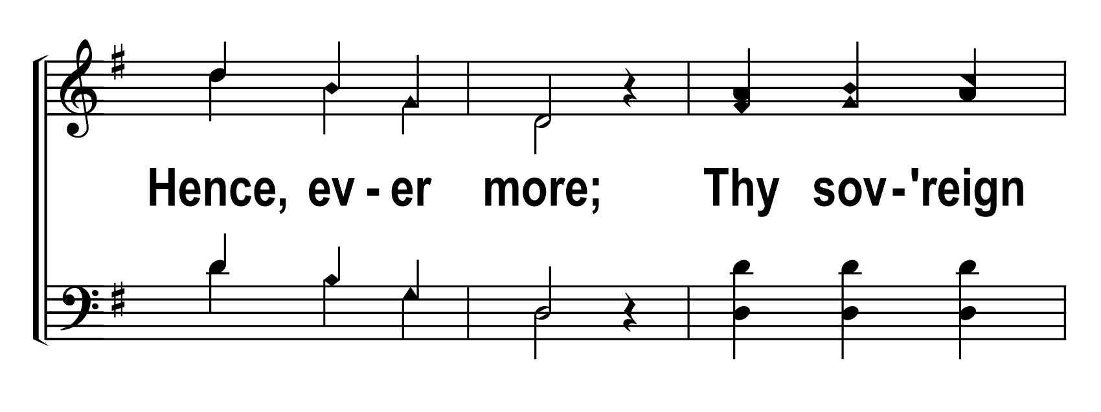
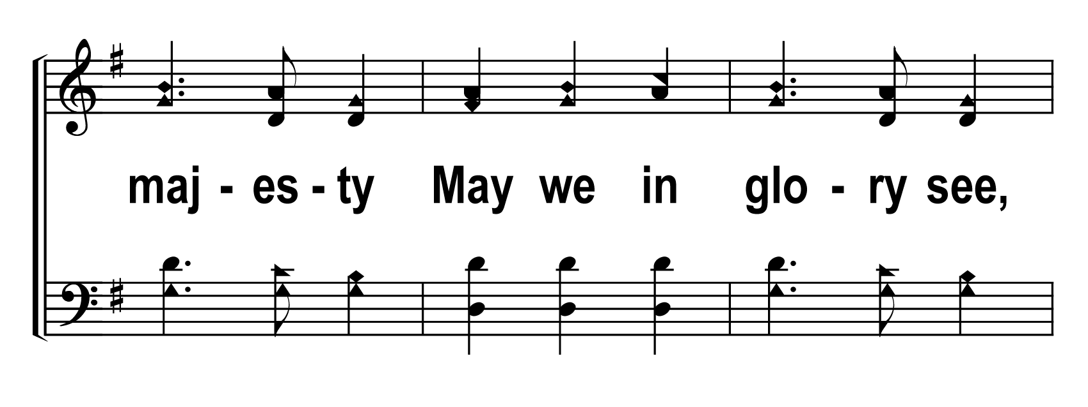
V3b – Come, Thou Almighty King
© 2007 The Acappella Company

Slide 9
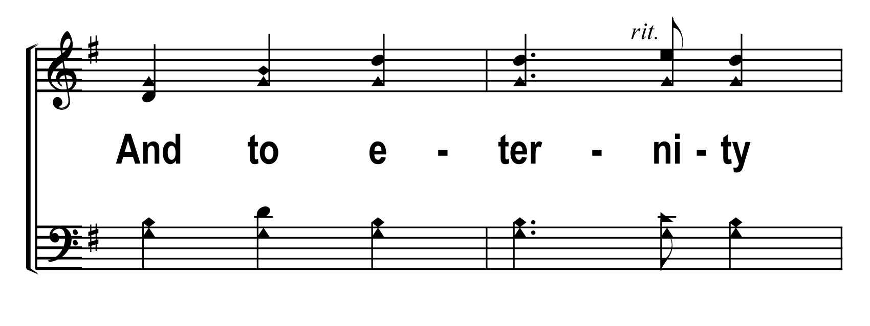
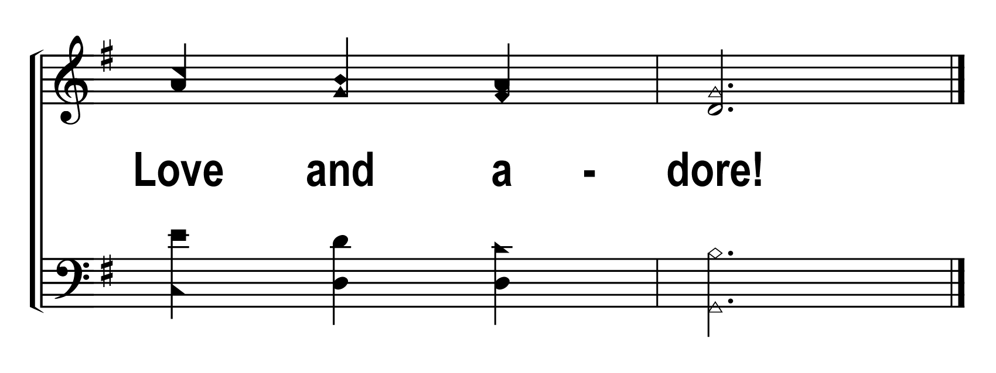
V3c – Come, Thou Almighty King
© 2007 The Acappella Company

