Slide 1

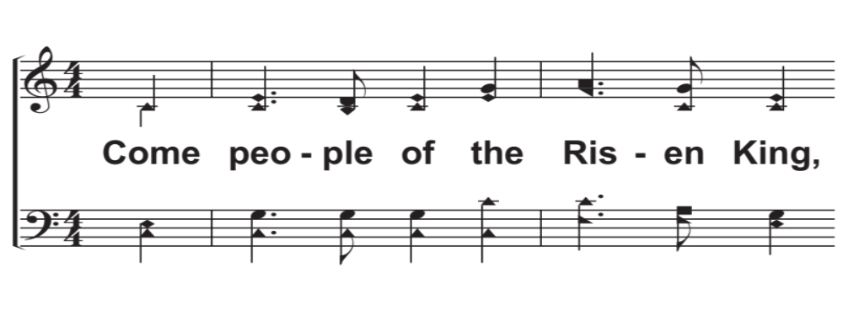
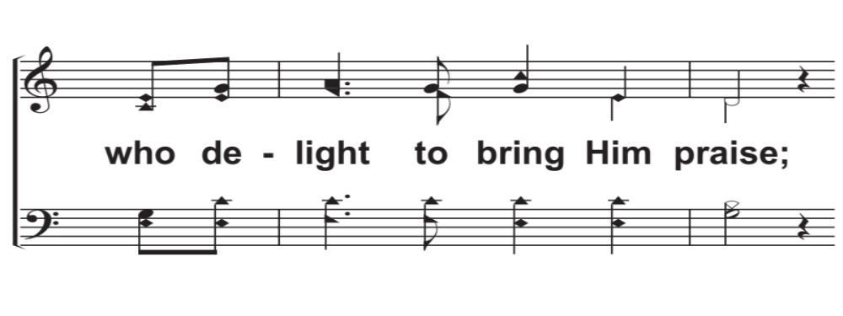
V1a – Come, People of the Risen King
Words and Music by: Keith Getty, Kristyn Lennox Getty, and Stuart Townend, Arr. D. J. Bulls
© 2009 Thankyou Music
© 2018 The Acappella Company

Slide 2
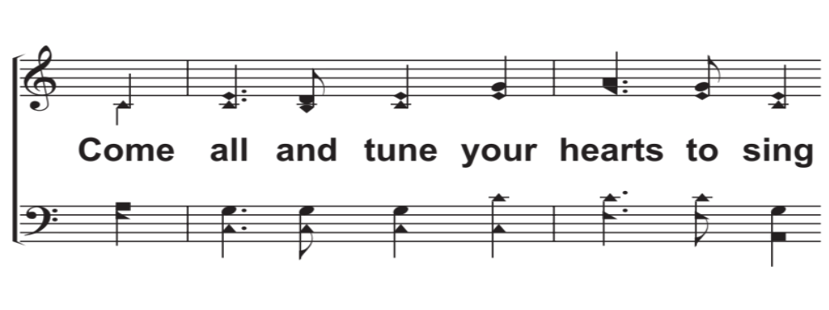
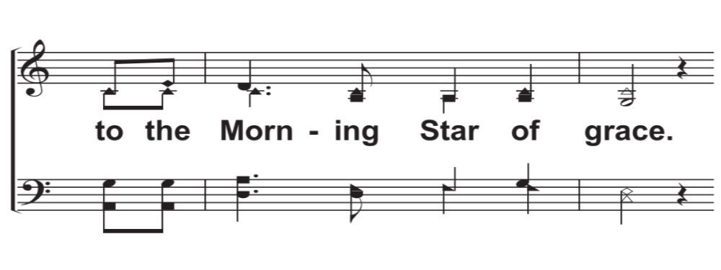
V1b – Come, People of the Risen King
© 2018 The Acappella Company

Slide 3
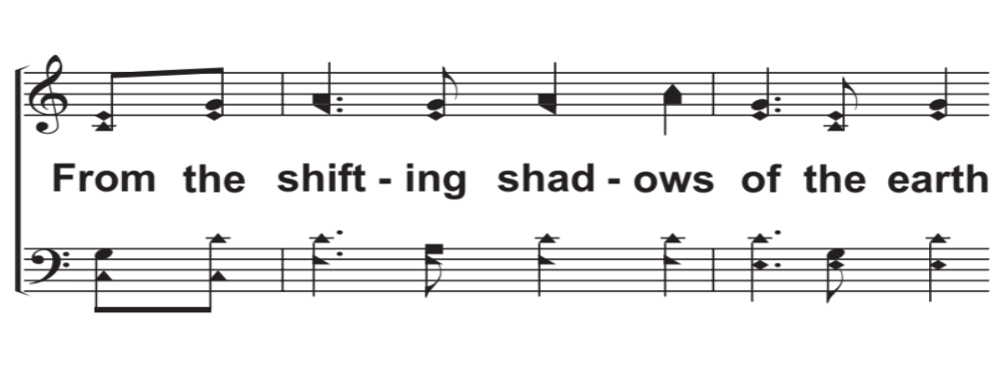
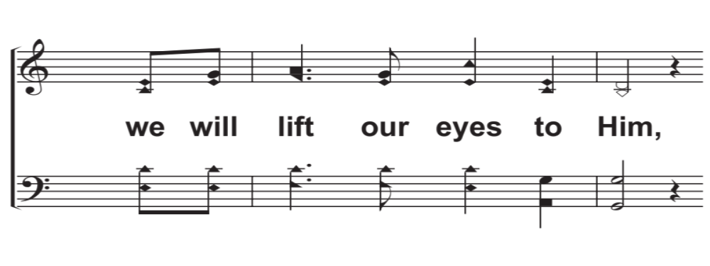
V1c – Come, People of the Risen King
© 2018 The Acappella Company

Slide 4
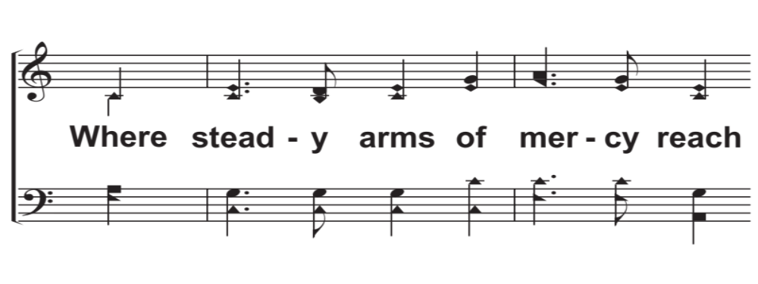
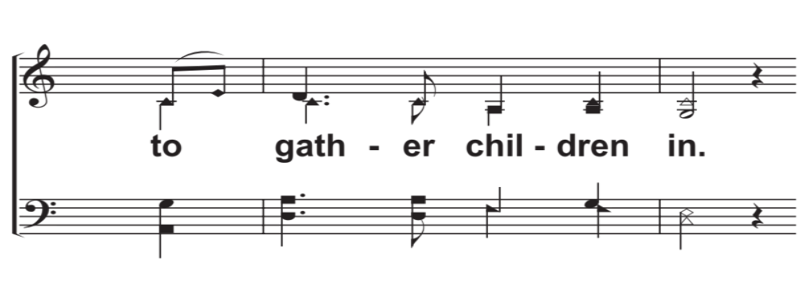
V1d – Come, People of the Risen King
© 2018 The Acappella Company

Slide 5
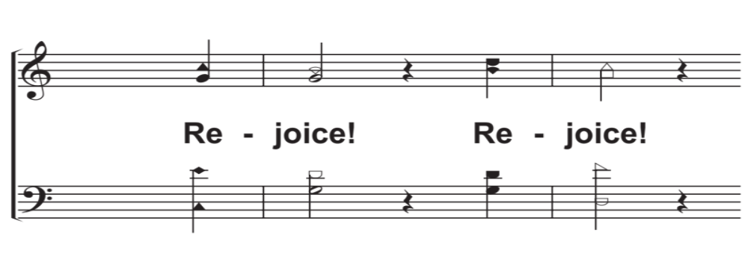
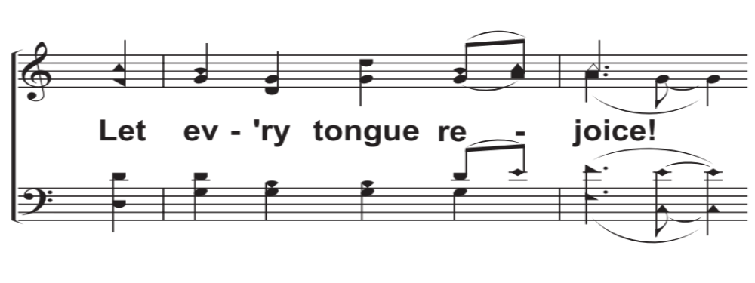
C1a – Come, People of the Risen King
© 2018 The Acappella Company

Slide 6
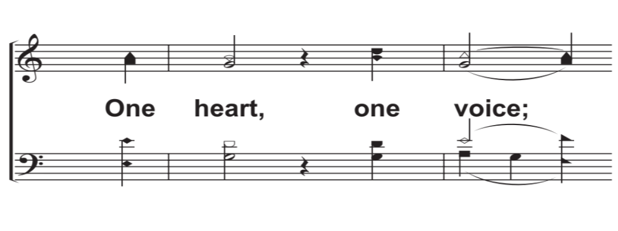
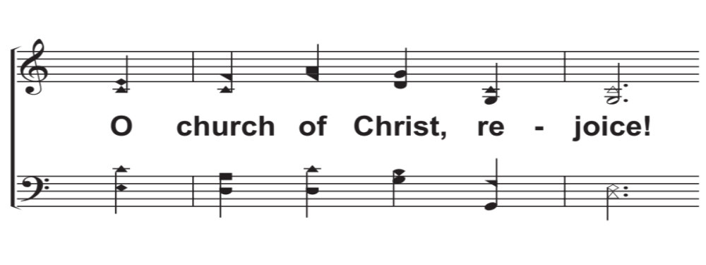
C1b – Come, People of the Risen King
© 2018 The Acappella Company

Slide 7
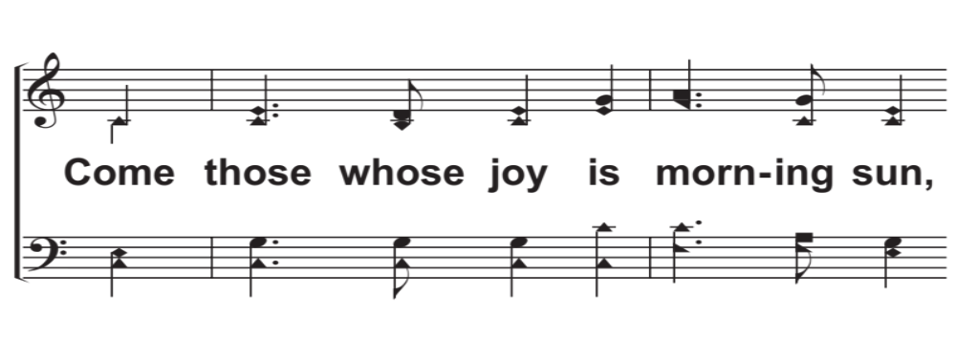
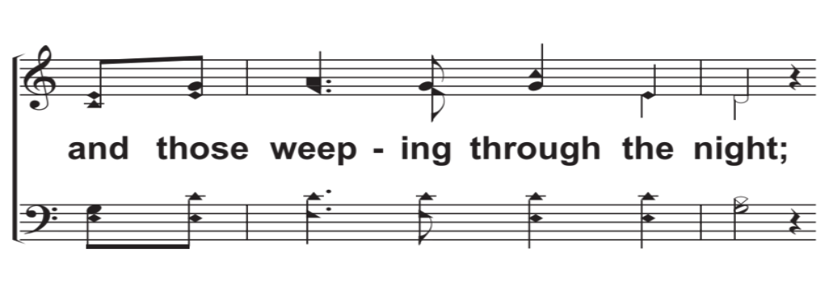
V2a – Come, People of the Risen King
© 2018 The Acappella Company

Slide 8
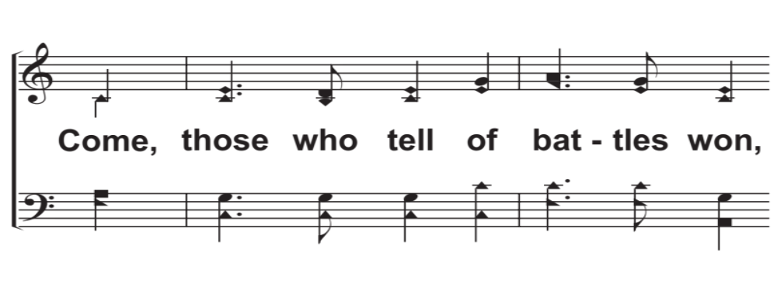
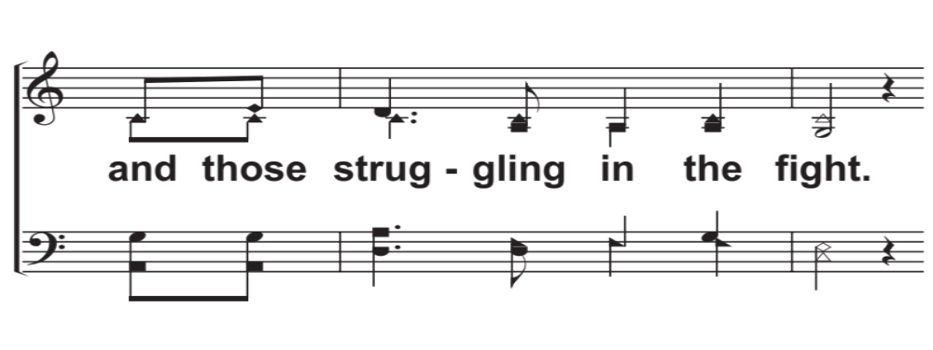
V2b – Come, People of the Risen King
© 2018 The Acappella Company

Slide 9
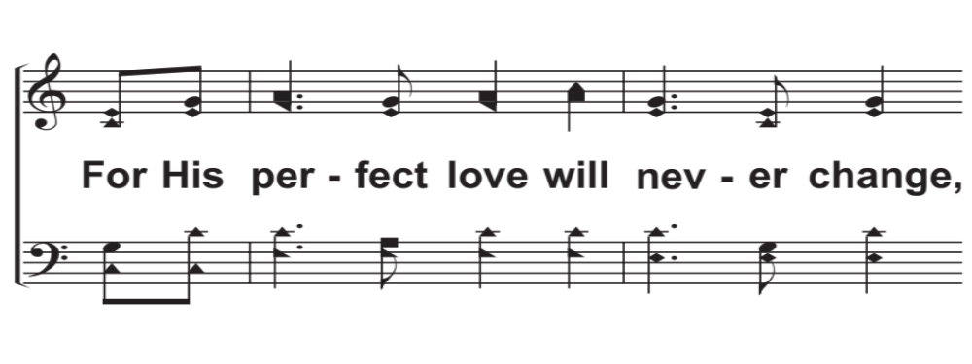
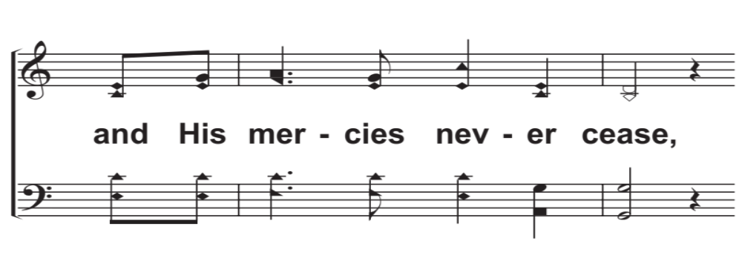
V2c – Come, People of the Risen King
© 2018 The Acappella Company

Slide 10
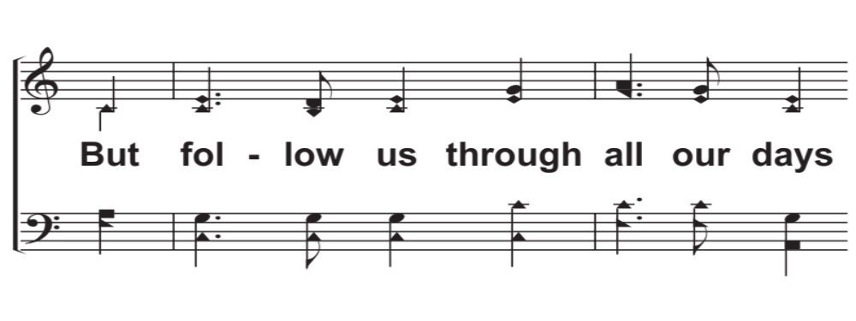
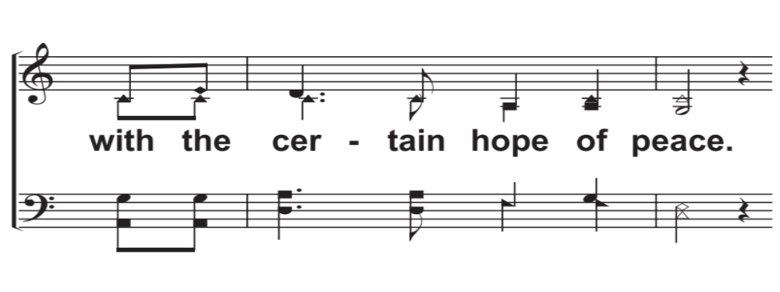
V2d – Come, People of the Risen King
© 2018 The Acappella Company

Slide 11
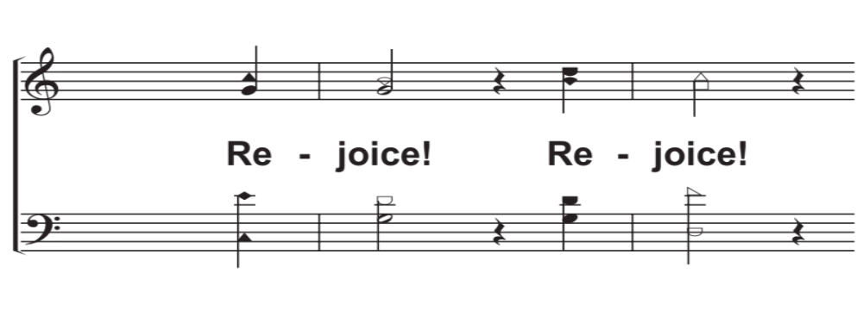
C2a – Come, People of the Risen King
© 2018 The Acappella Company

Slide 12
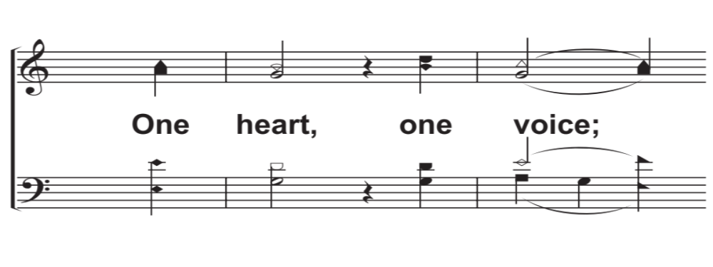
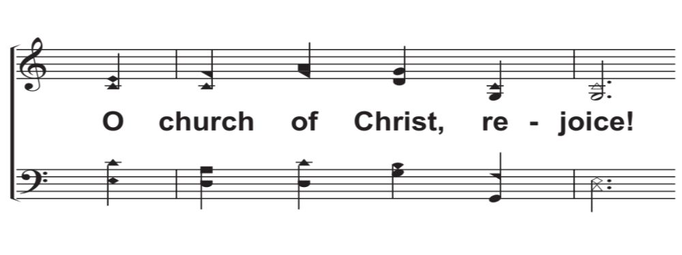
C2b – Come, People of the Risen King
© 2018 The Acappella Company

Slide 13
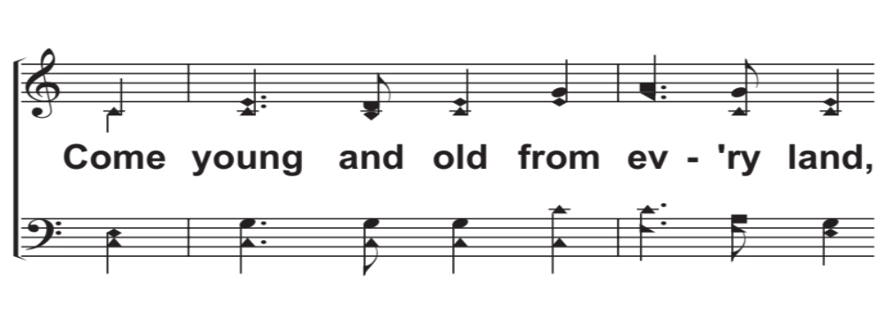
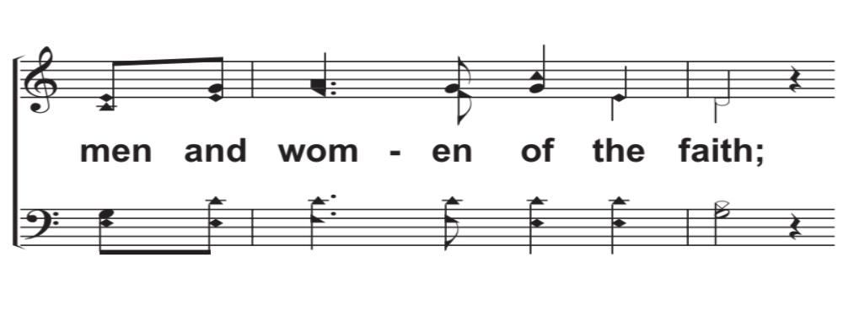
V3a – Come, People of the Risen King
© 2018 The Acappella Company

Slide 14
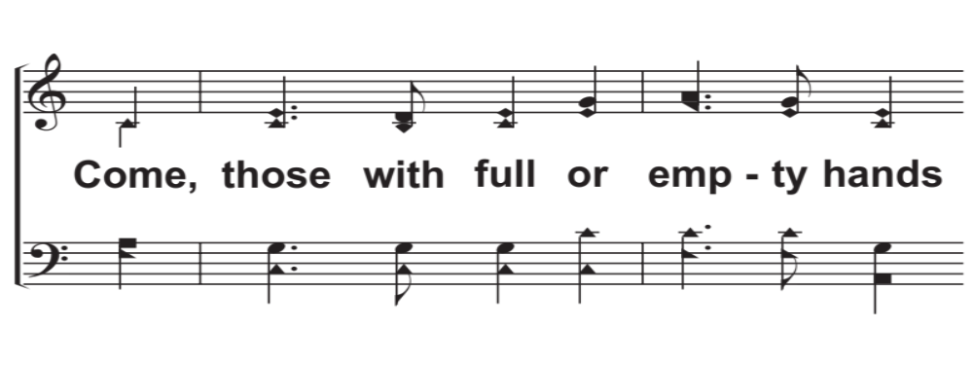
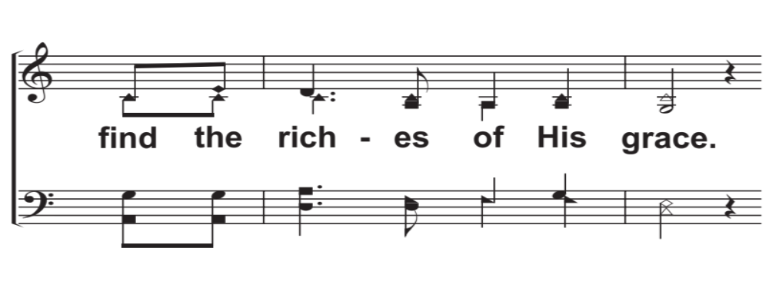
V3b – Come, People of the Risen King
© 2018 The Acappella Company

Slide 15
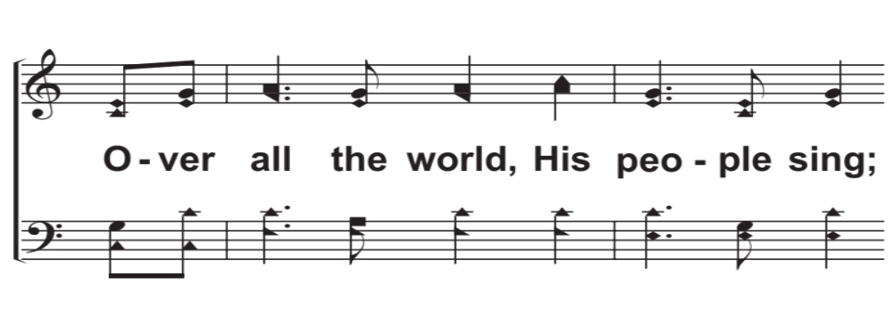
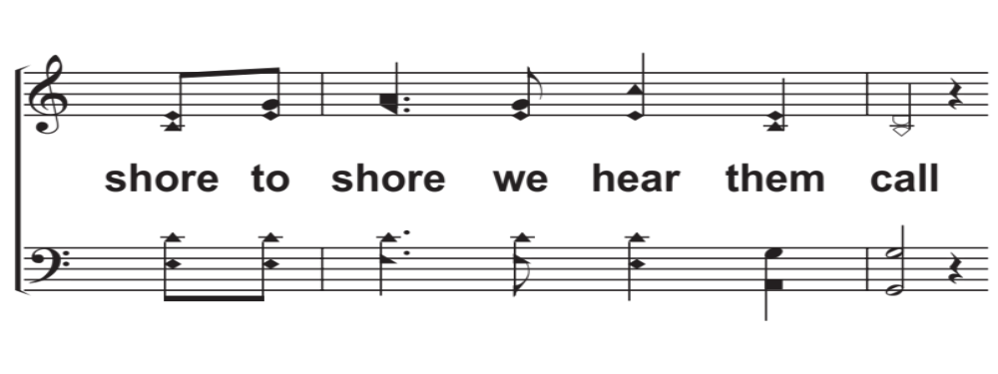
V3c – Come, People of the Risen King
© 2018 The Acappella Company

Slide 16
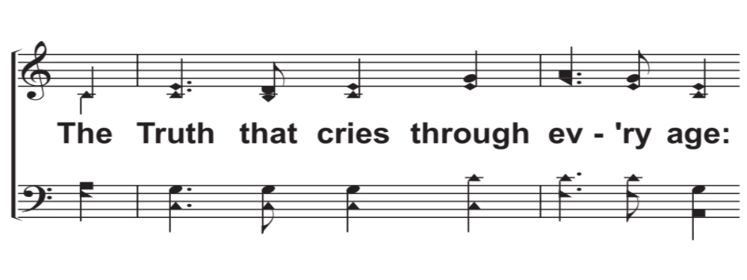
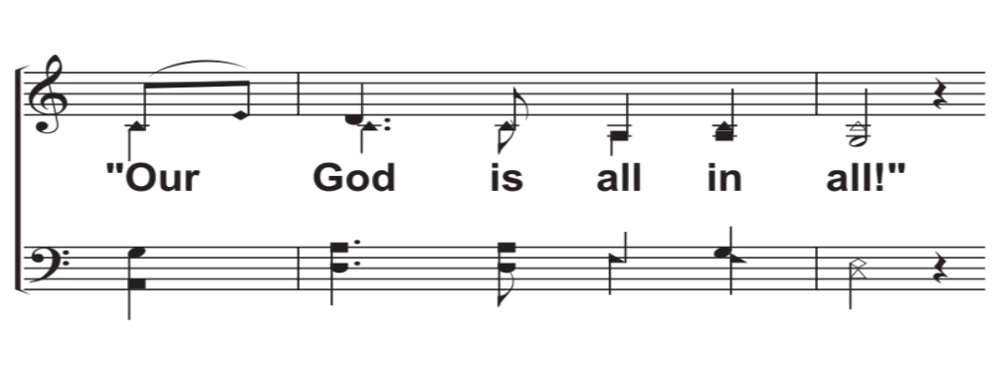
V3d – Come, People of the Risen King
© 2018 The Acappella Company

Slide 17
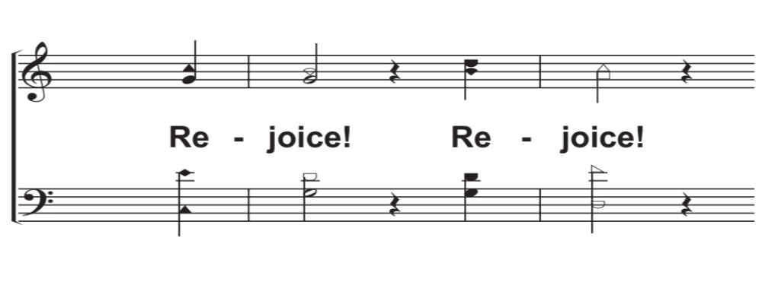
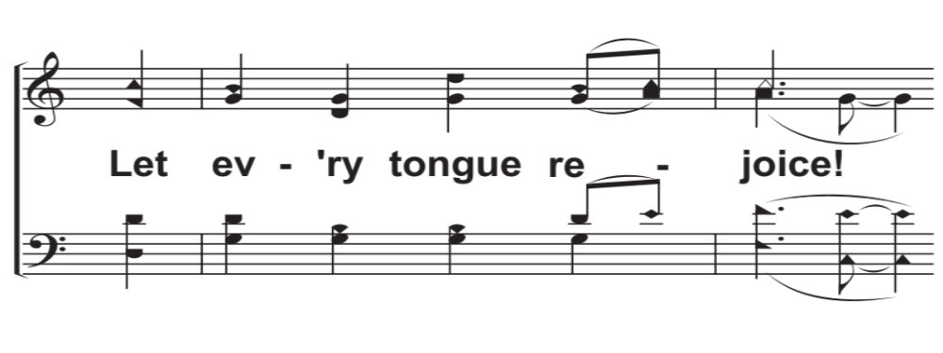
C3a – Come, People of the Risen King
© 2018 The Acappella Company

Slide 18
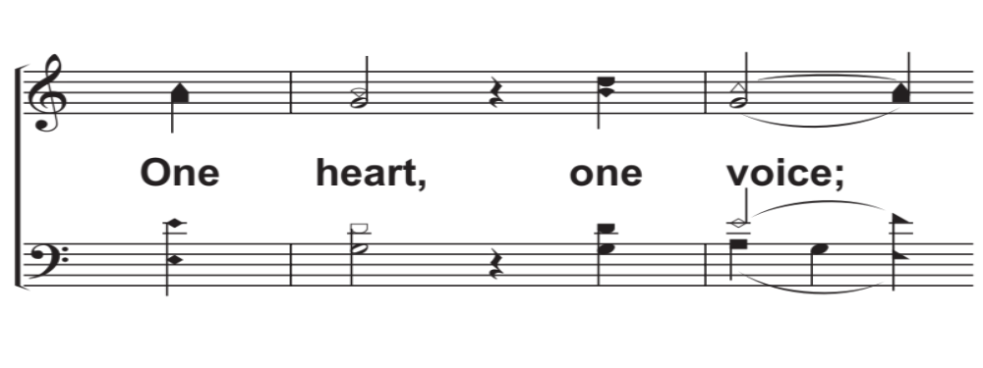
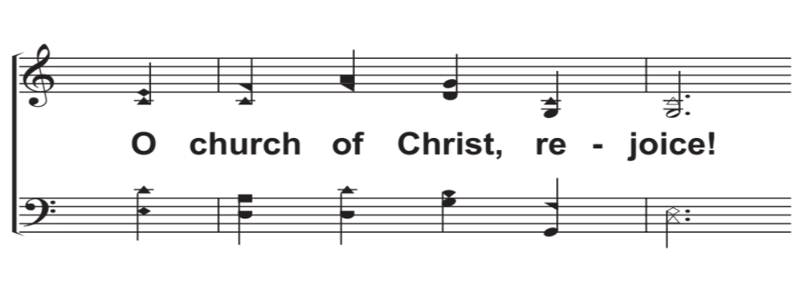
C3b – Come, People of the Risen King
© 2018 The Acappella Company

Slide 19

C4a – Come, People of the Risen King
© 2018 The Acappella Company

Slide 20
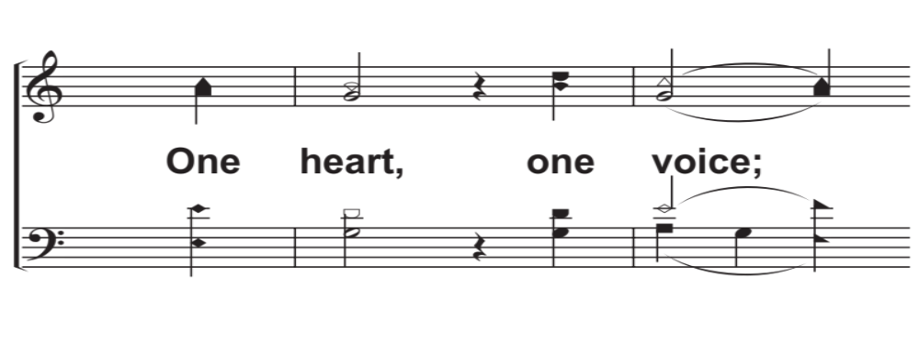
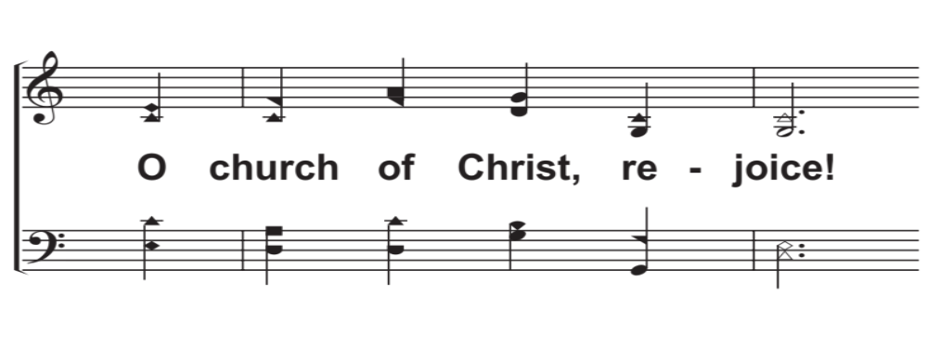
C4b – Come, People of the Risen King
© 2018 The Acappella Company

Slide 21
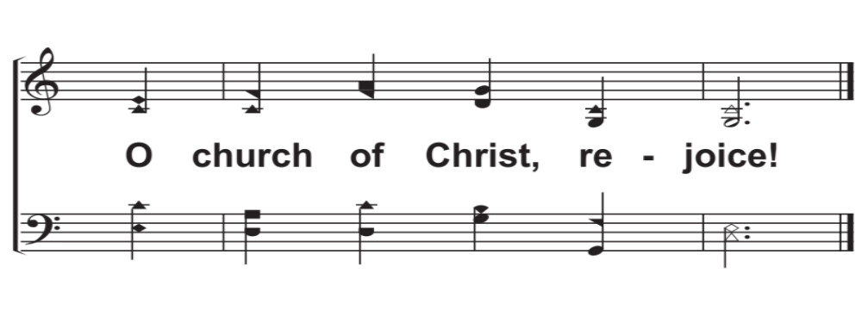
Tag – Come, People of the Risen King
© 2018 The Acappella Company

