Slide 1

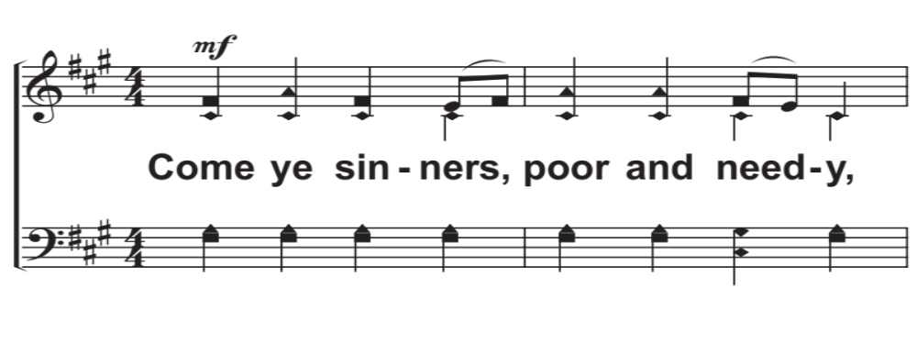
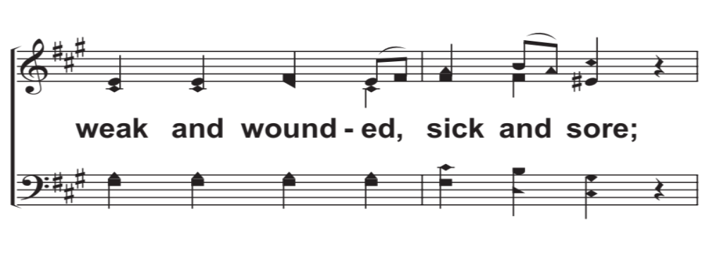
V1a – Come, Ye Sinners, Poor and Needy
Arr: Mike Rogers
Words by: Joseph Hart
Music by: Unknown
© 2018 The Acappella Company

Slide 2
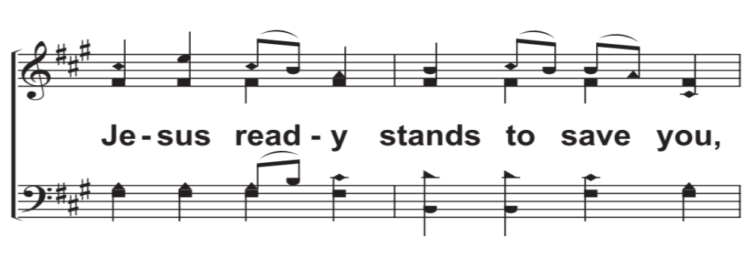
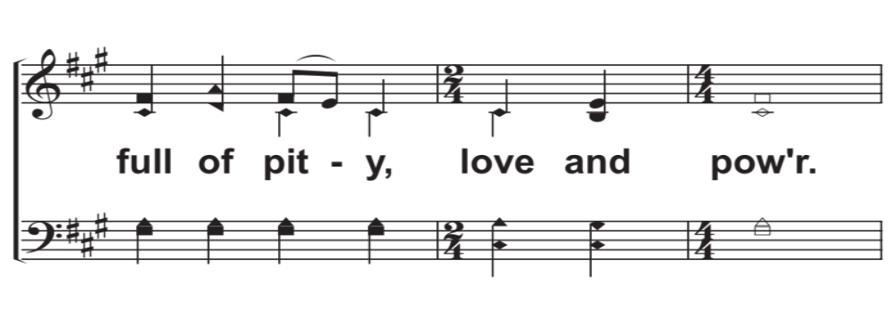
V1b – Come, Ye Sinners, Poor and Needy
© 2018 The Acappella Company

Slide 3
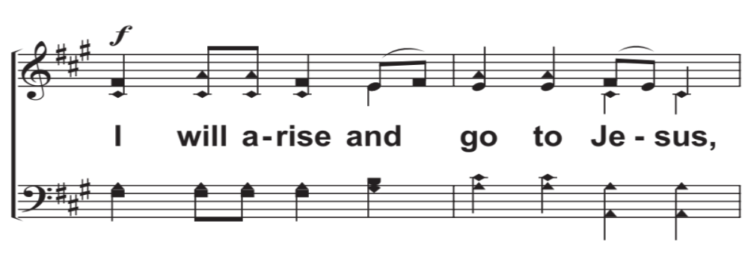
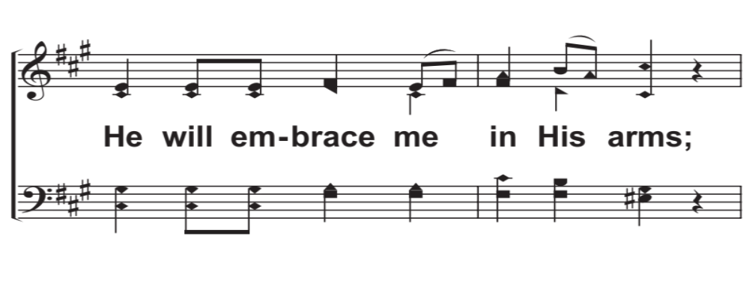
R1a – Come, Ye Sinners, Poor and Needy
© 2018 The Acappella Company

Slide 4
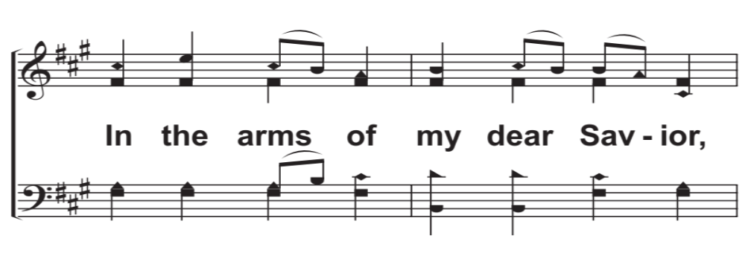
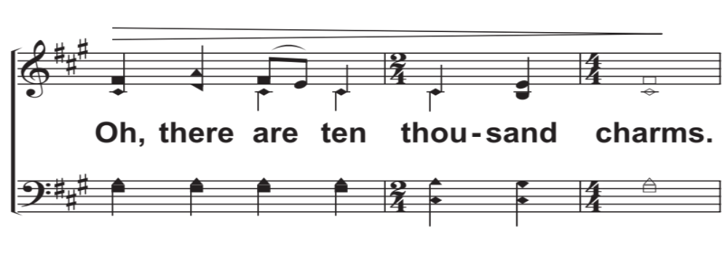
R1b – Come, Ye Sinners, Poor and Needy
© 2018 The Acappella Company

Slide 5
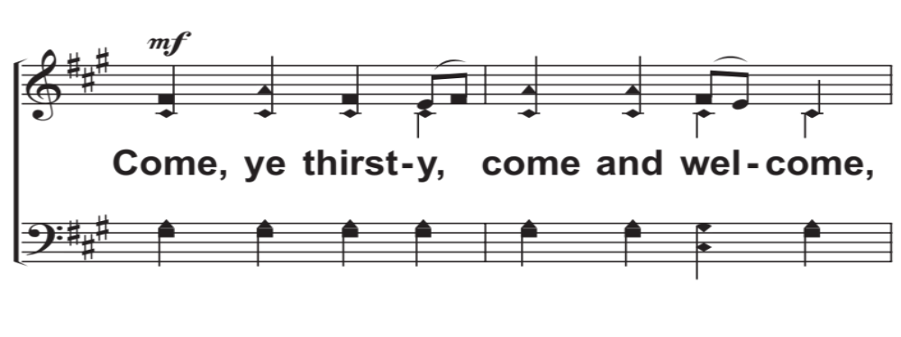
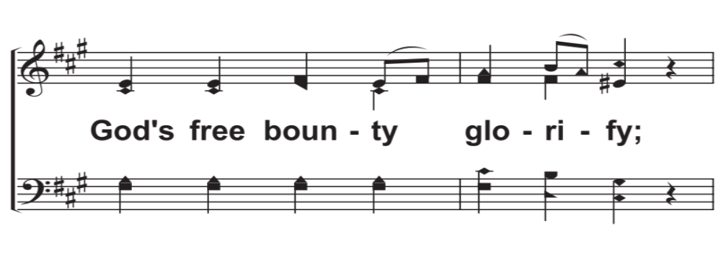
V2a – Come, Ye Sinners, Poor and Needy
© 2018 The Acappella Company

Slide 6
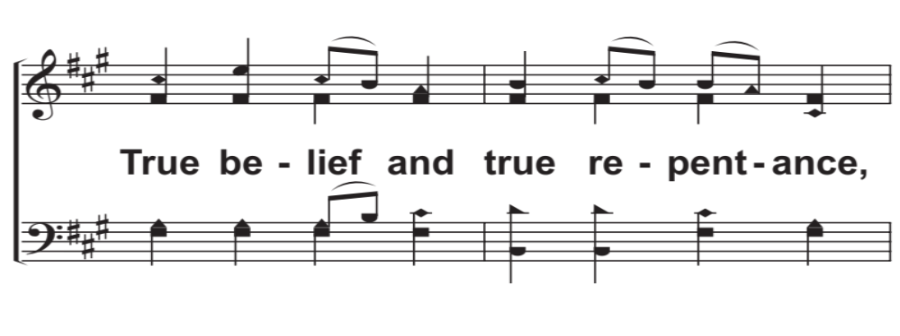
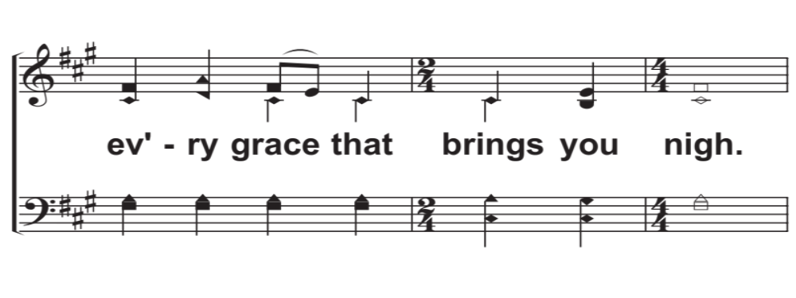
V2b – Come, Ye Sinners, Poor and Needy
© 2018 The Acappella Company

Slide 7
R2a – Come, Ye Sinners, Poor and Needy
© 2018 The Acappella Company

Slide 8
R2b – Come, Ye Sinners, Poor and Needy
© 2018 The Acappella Company

Slide 9
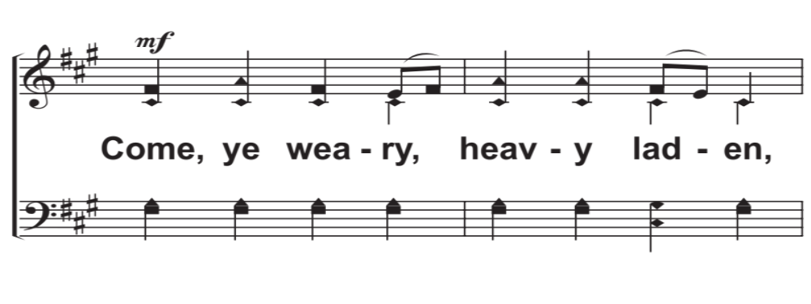
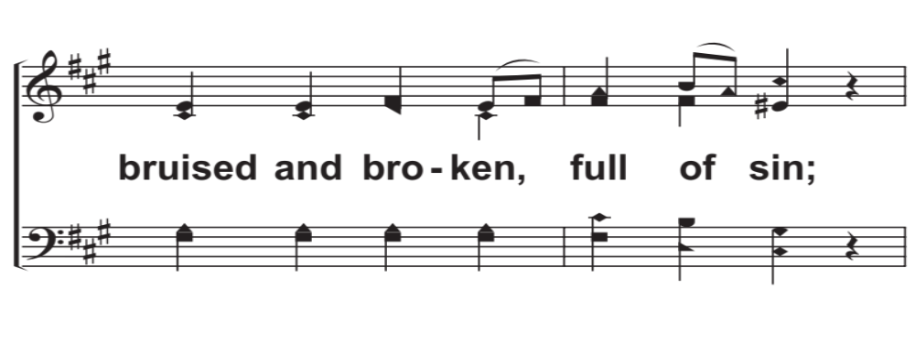
V3a – Come, Ye Sinners, Poor and Needy
© 2018 The Acappella Company

Slide 10
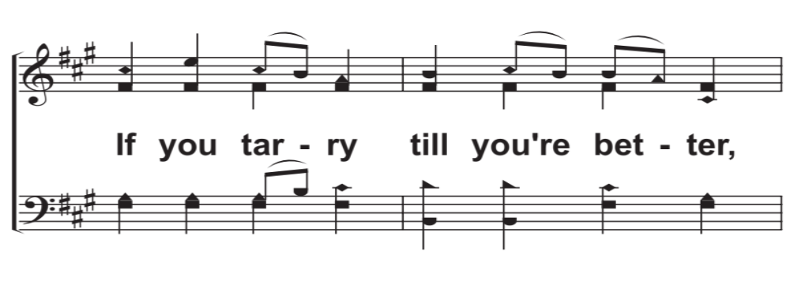
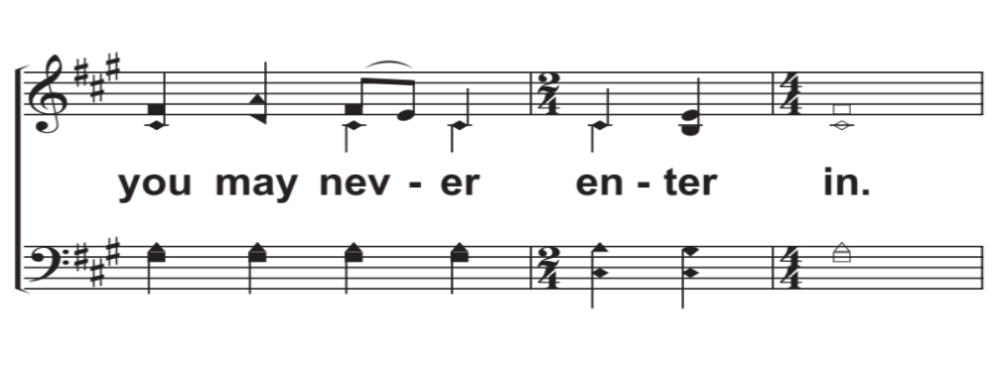
V3b – Come, Ye Sinners, Poor and Needy
© 2018 The Acappella Company

Slide 11
R3a – Come, Ye Sinners, Poor and Needy
© 2018 The Acappella Company

Slide 12
R3b – Come, Ye Sinners, Poor and Needy
© 2018 The Acappella Company

Slide 13
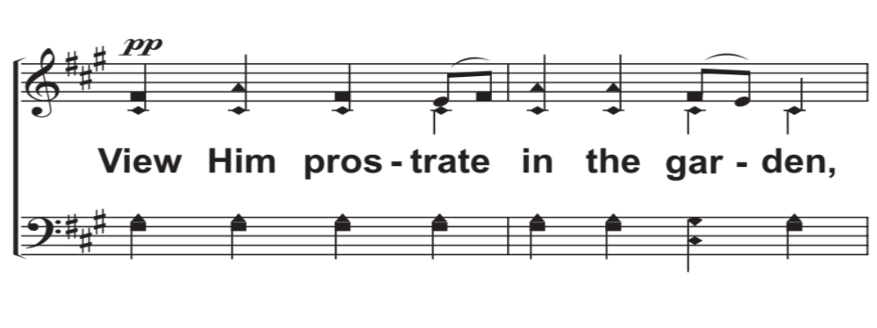
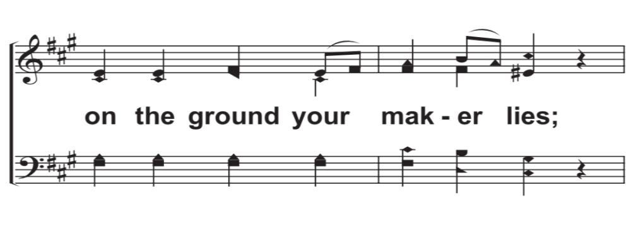
V4a – Come, Ye Sinners, Poor and Needy
© 2018 The Acappella Company

Slide 14
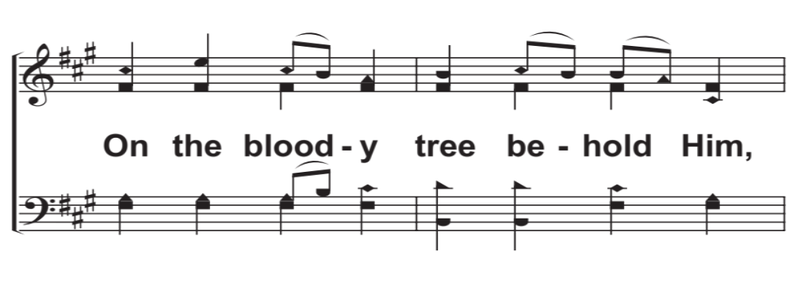
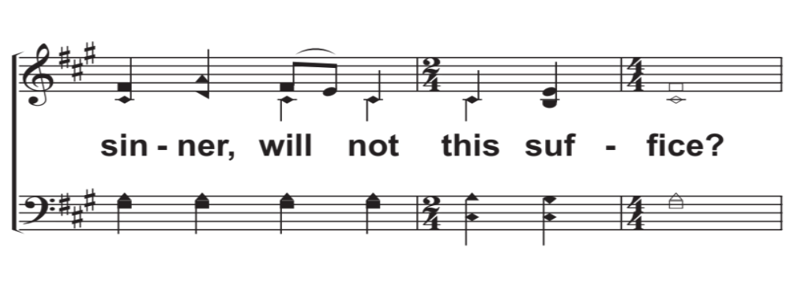
V4b – Come, Ye Sinners, Poor and Needy
© 2018 The Acappella Company

Slide 15
R4a – Come, Ye Sinners, Poor and Needy
© 2018 The Acappella Company

Slide 16
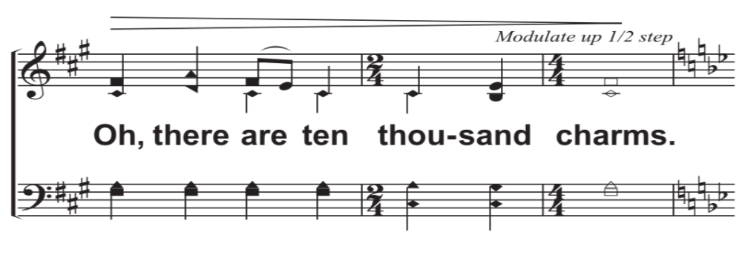
R4b – Come, Ye Sinners, Poor and Needy
© 2018 The Acappella Company

Slide 17
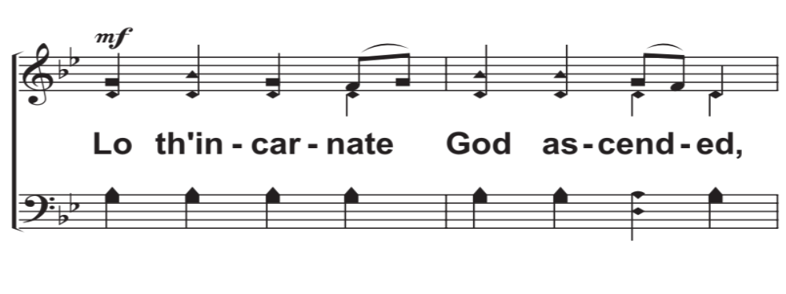
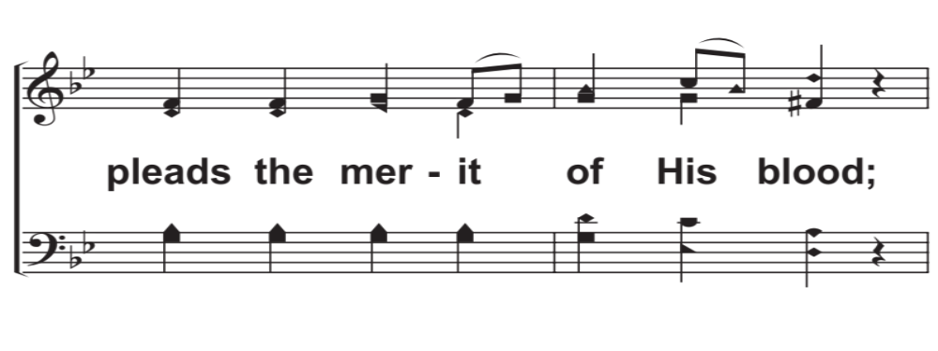
V5a – Come, Ye Sinners, Poor and Needy
© 2018 The Acappella Company

Slide 18
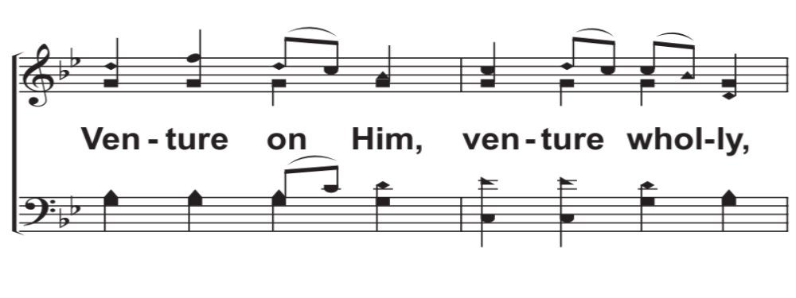
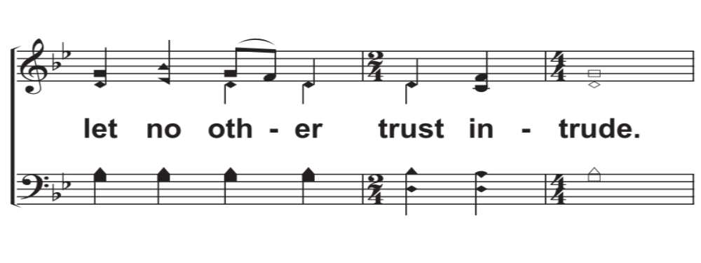
V5b – Come, Ye Sinners, Poor and Needy
© 2018 The Acappella Company

Slide 19
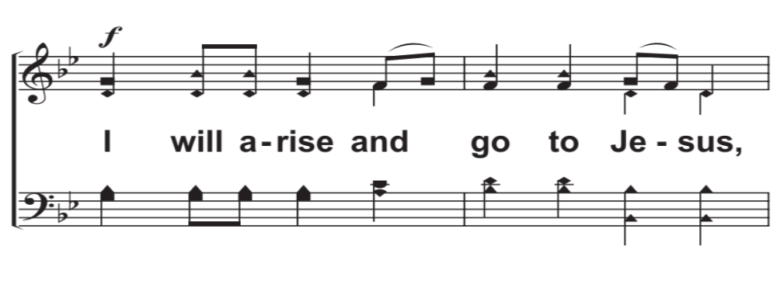
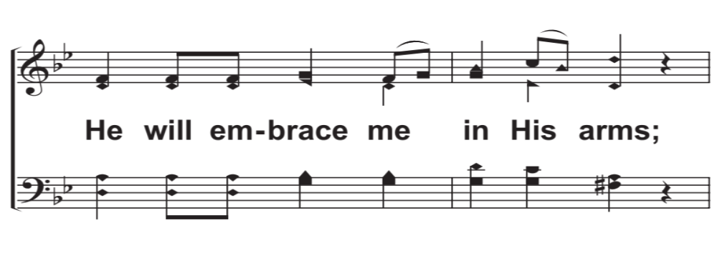
R5a – Come, Ye Sinners, Poor and Needy
© 2018 The Acappella Company

Slide 20
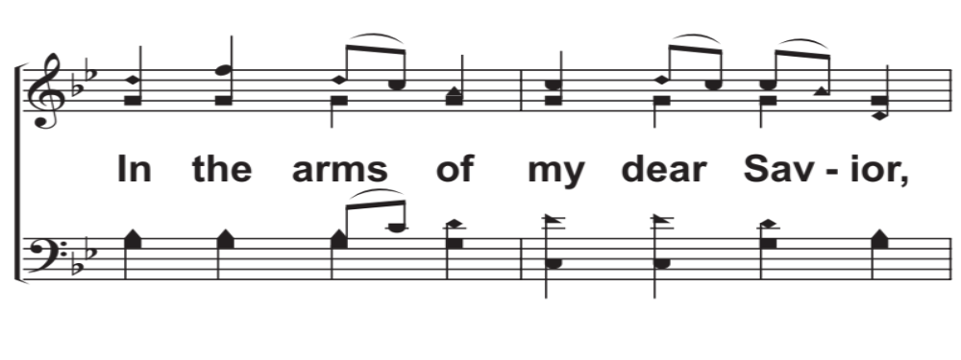
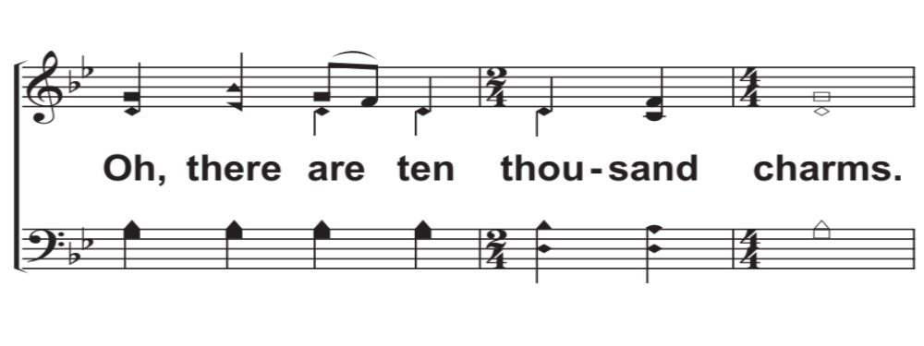
R5b – Come, Ye Sinners, Poor and Needy
© 2018 The Acappella Company

Slide 21
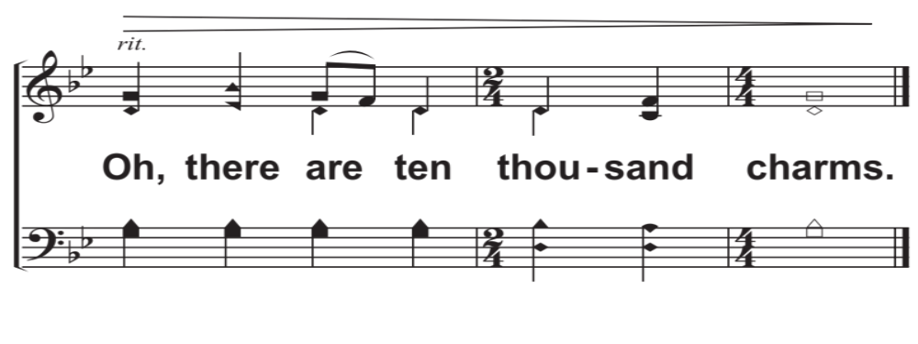
Tag – Come, Ye Sinners, Poor and Needy
© 2018 The Acappella Company

