Slide 1

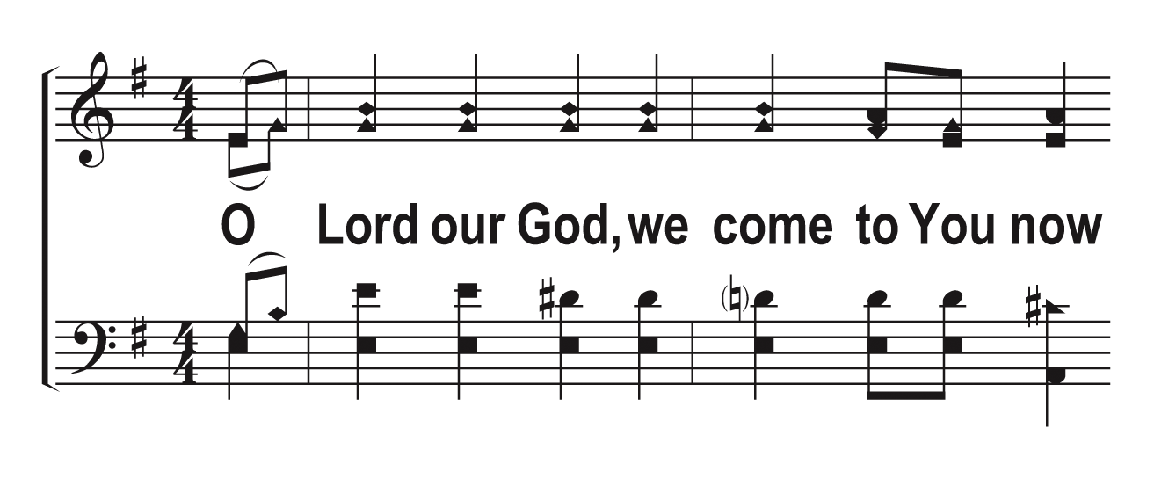
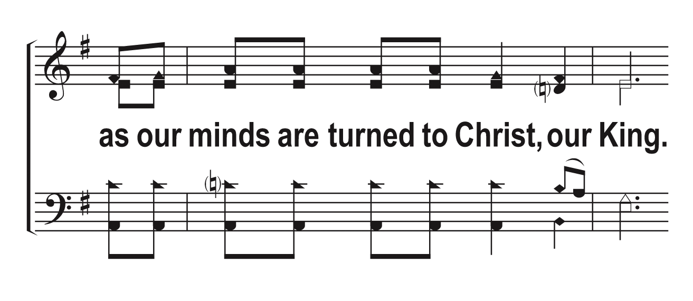
V1a – Communion Prayer
Words & Music: Gary L Bruce
© 2013 The Acappella Company

Slide 2
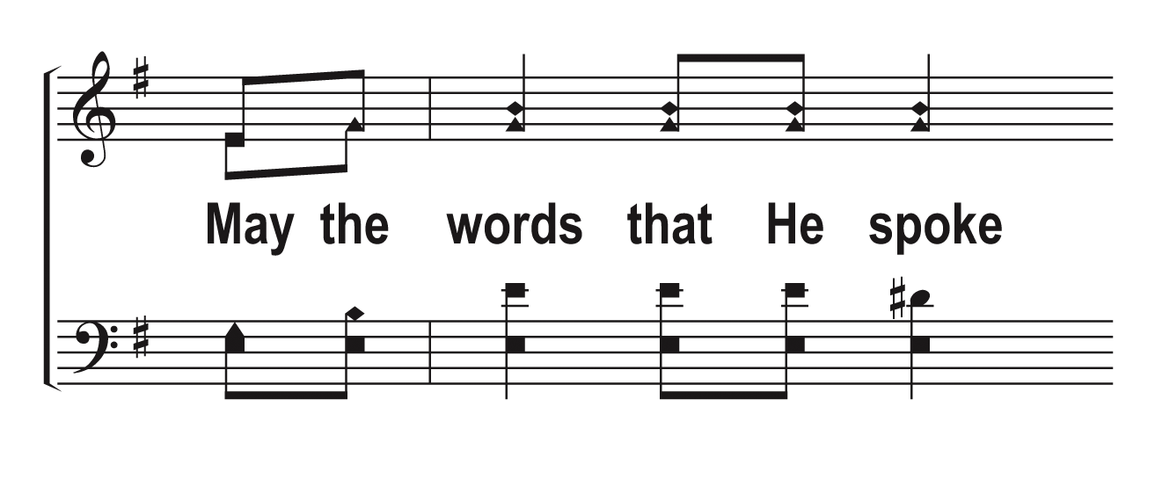
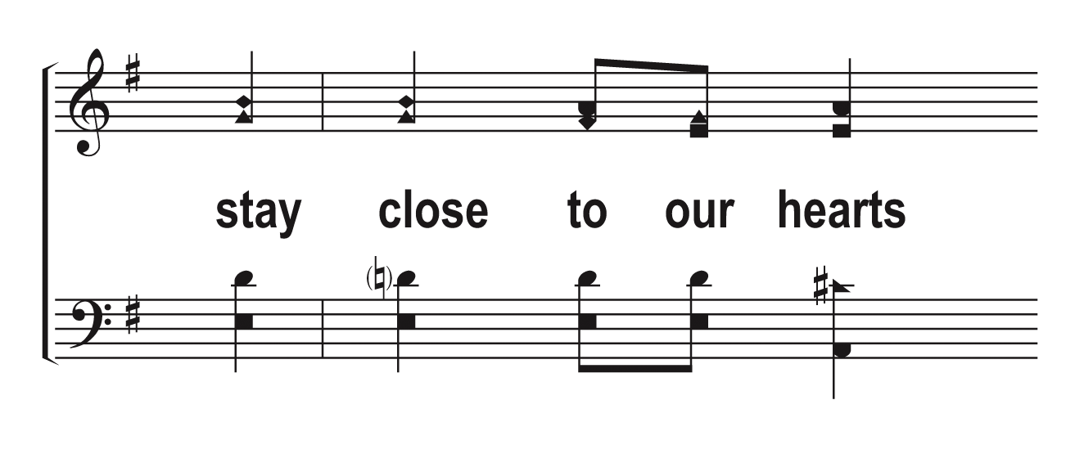
V1b – Communion Prayer
© 2013 The Acappella Company

Slide 3
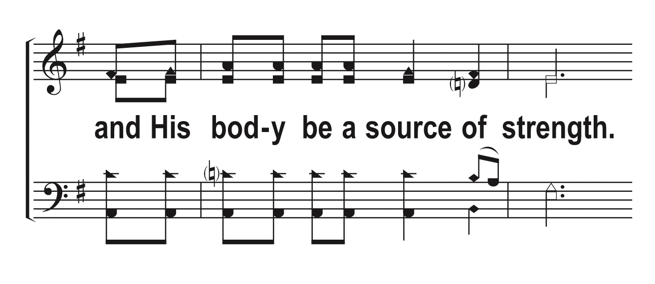
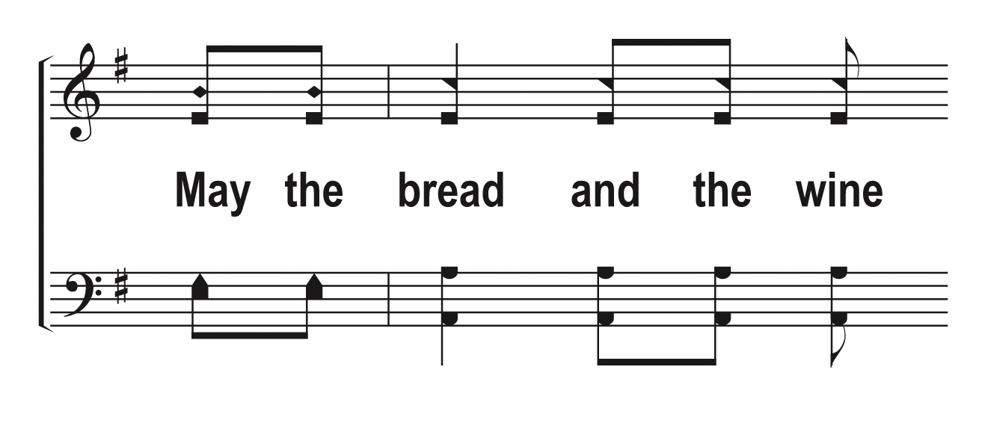
V1c – Communion Prayer
© 2013 The Acappella Company

Slide 4
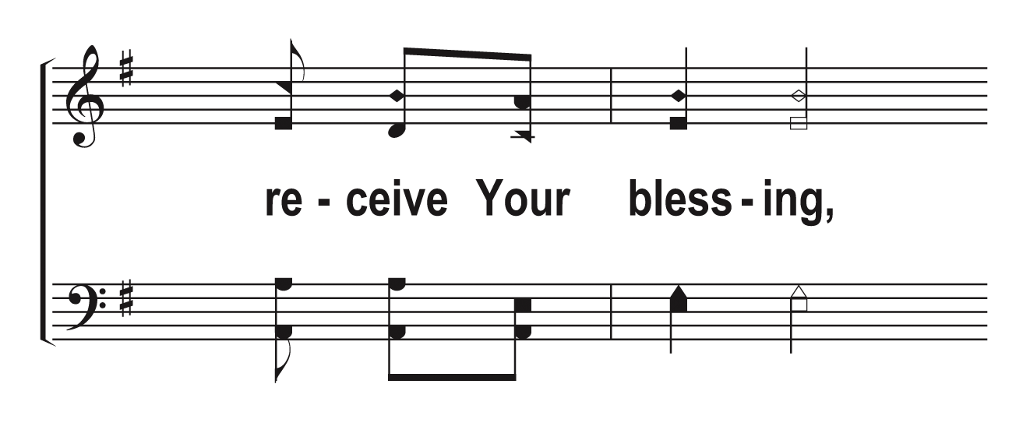
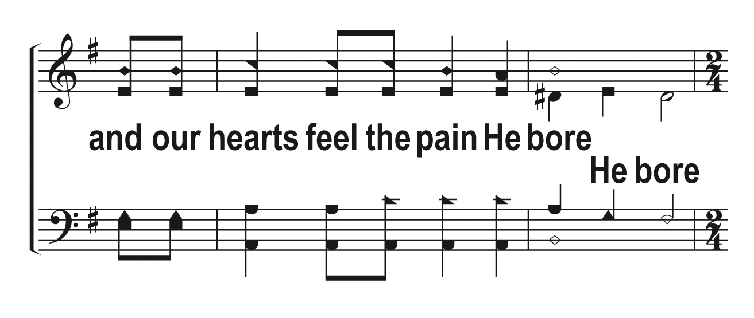
V1d – Communion Prayer
© 2013 The Acappella Company

Slide 5
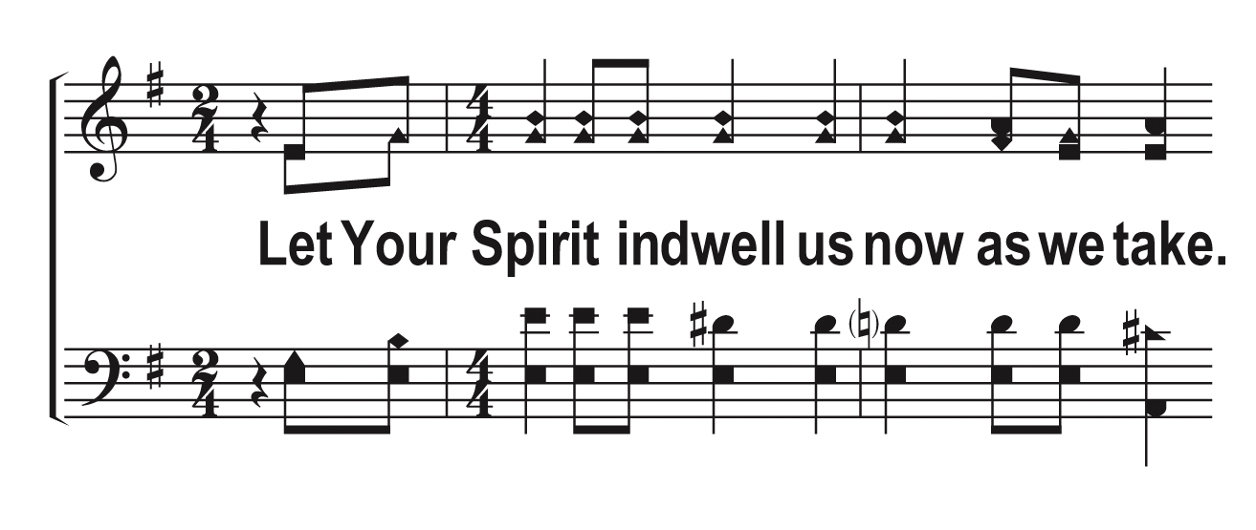
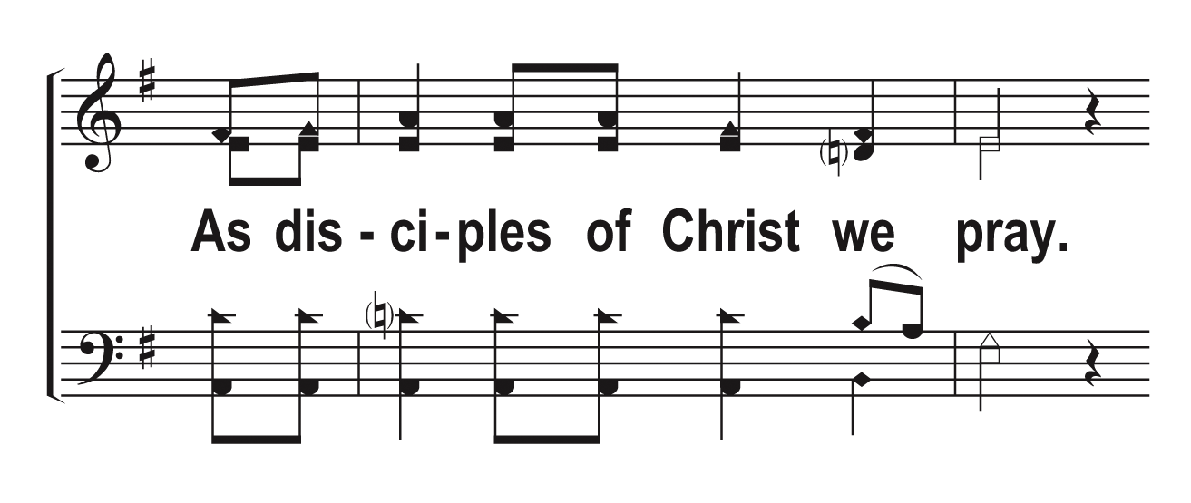
V1e – Communion Prayer
© 2013 The Acappella Company

Slide 6
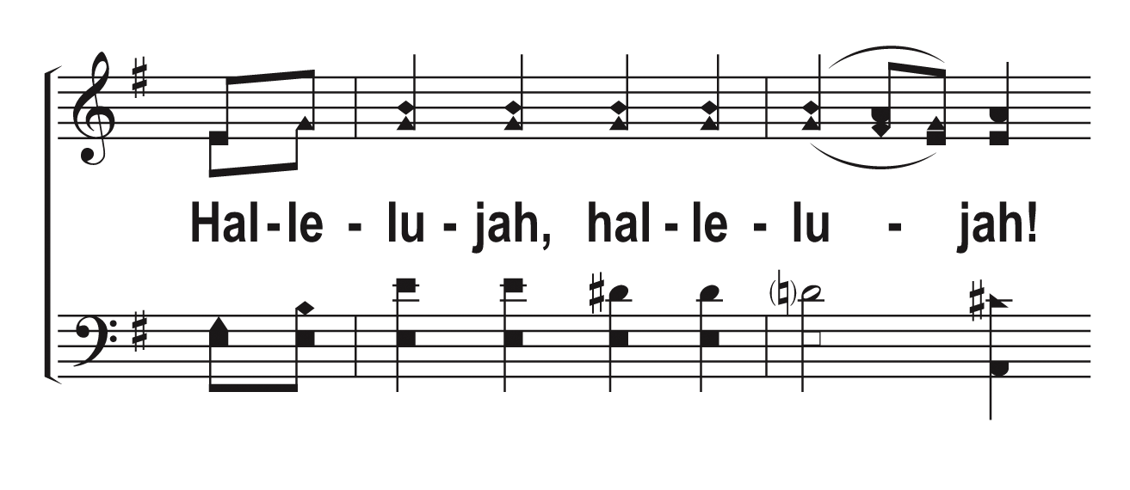
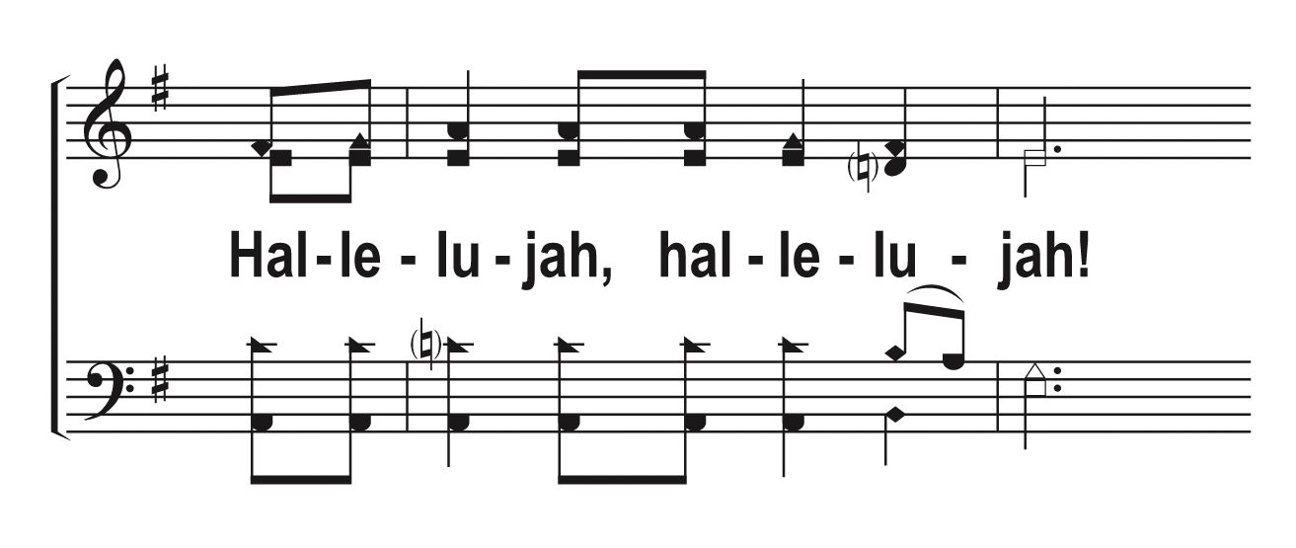
V2a – Communion Prayer
© 2013 The Acappella Company

Slide 7
V2b – Communion Prayer
© 2013 The Acappella Company

Slide 8
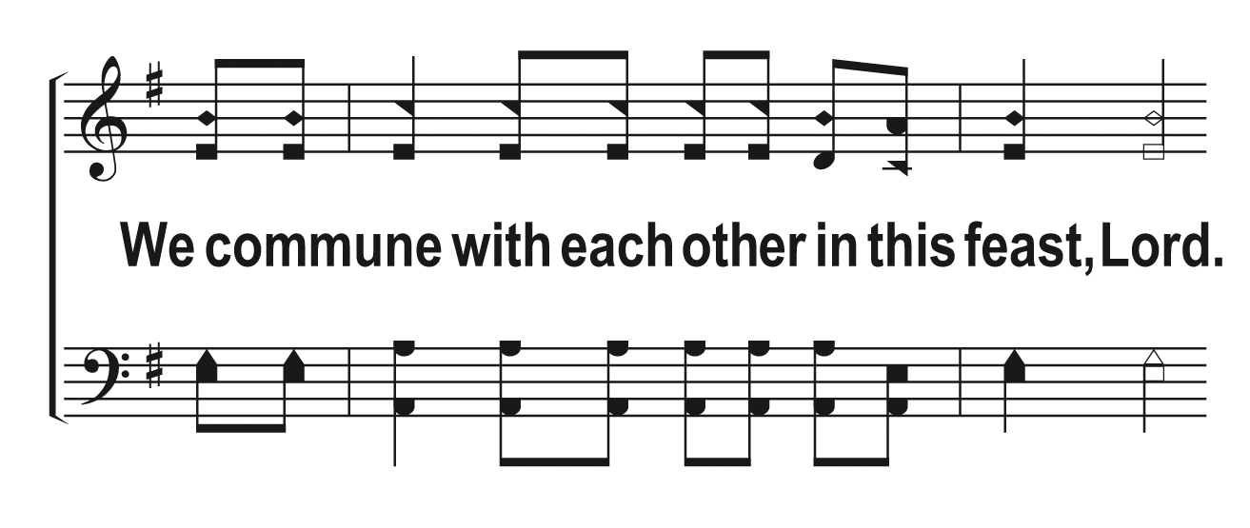
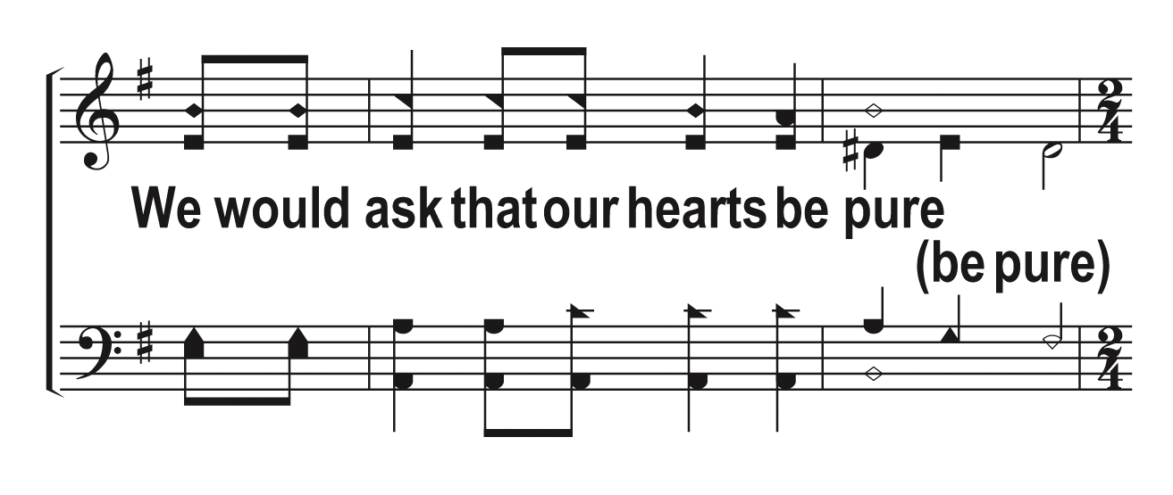
V2c – Communion Prayer
© 2013 The Acappella Company

Slide 9
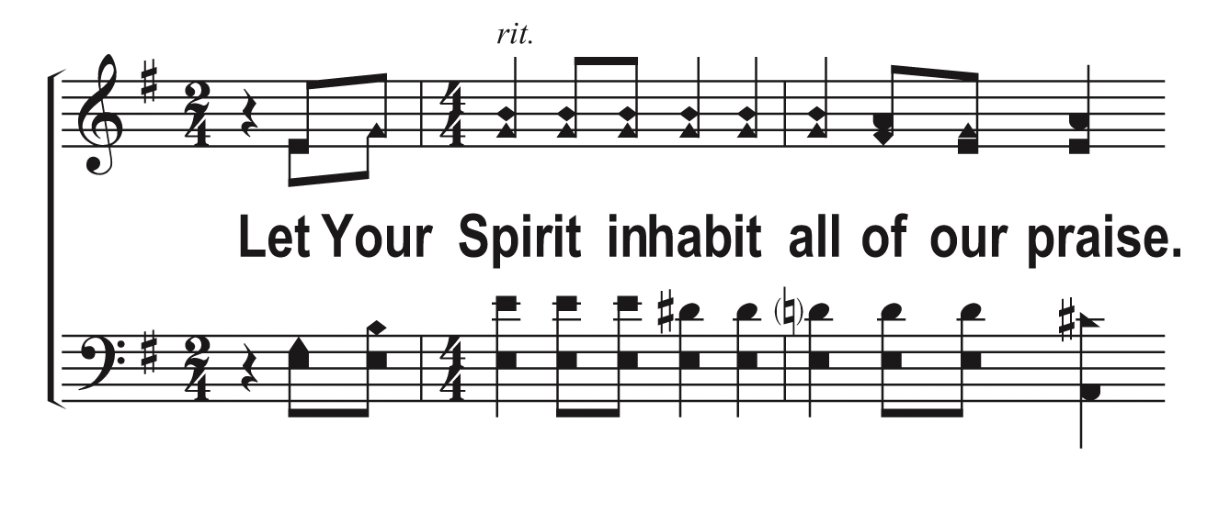
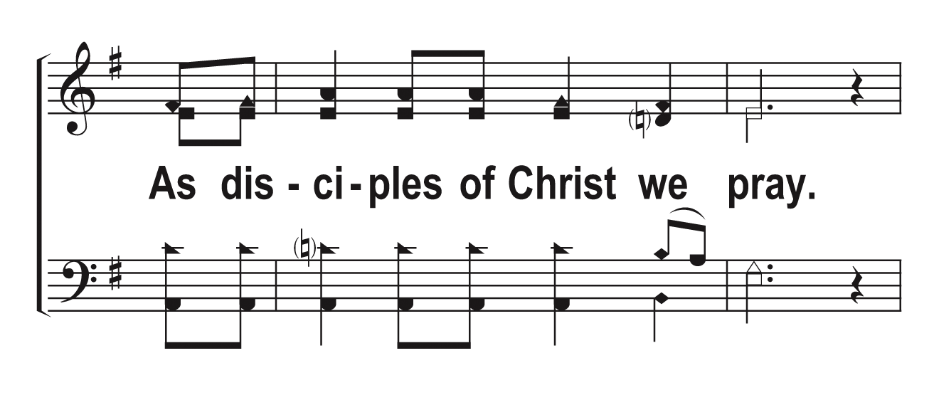
V2d – Communion Prayer
© 2013 The Acappella Company

Slide 10
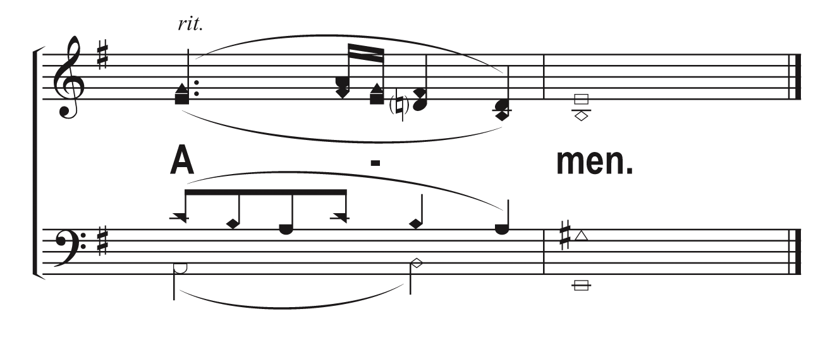
V2e – Communion Prayer
© 2013 The Acappella Company

