Slide 1

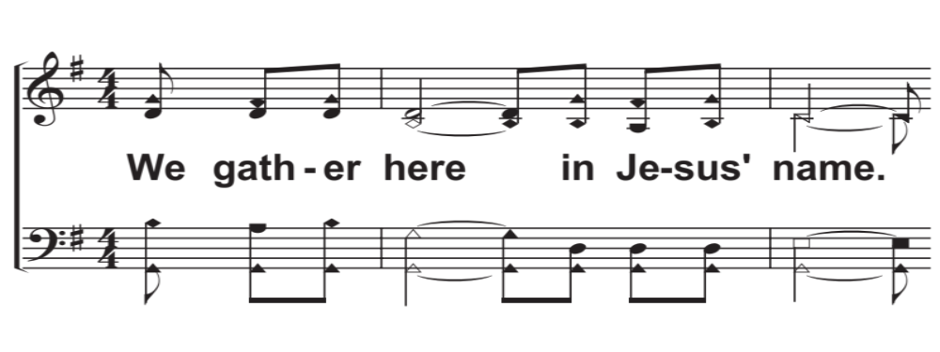
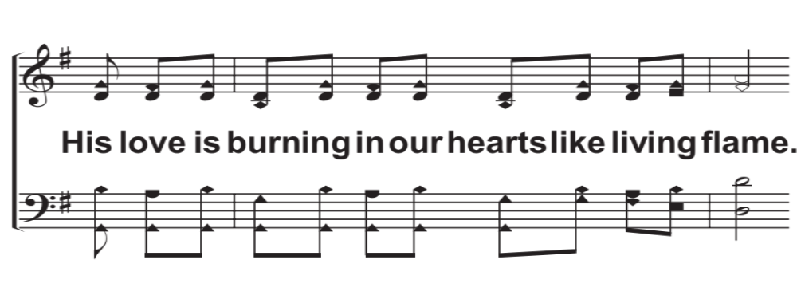
V1a – Come Share The Lord
Arr: Mike Rogers
Words and Music by: Brian Jeffery Leech
© 2014 The Acappella Company

Slide 2
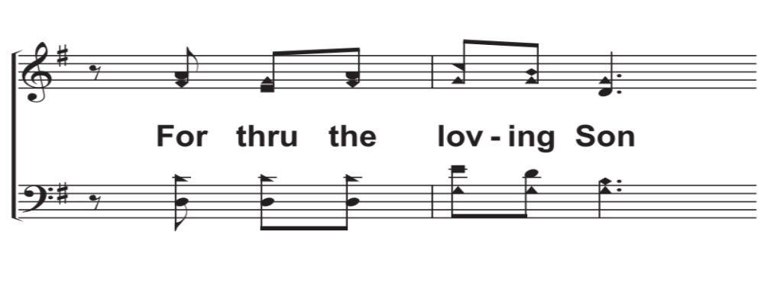
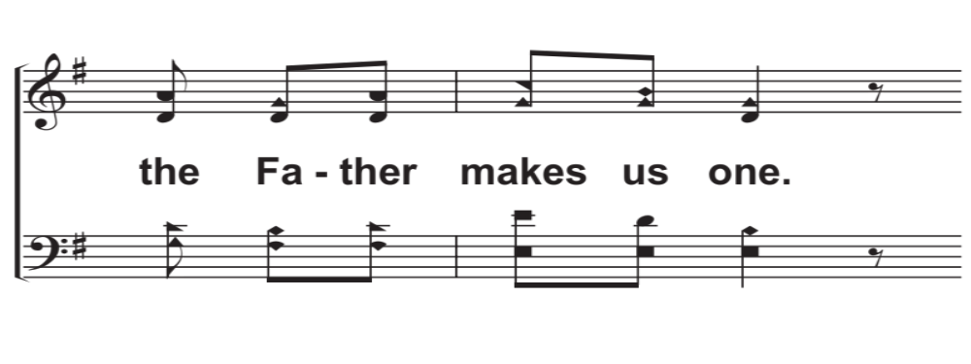
V1b – Come Share The Lord
© 2014 The Acappella Company

Slide 3
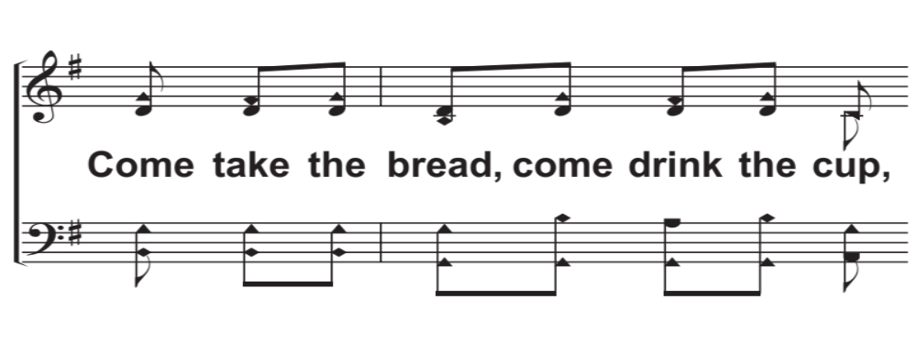
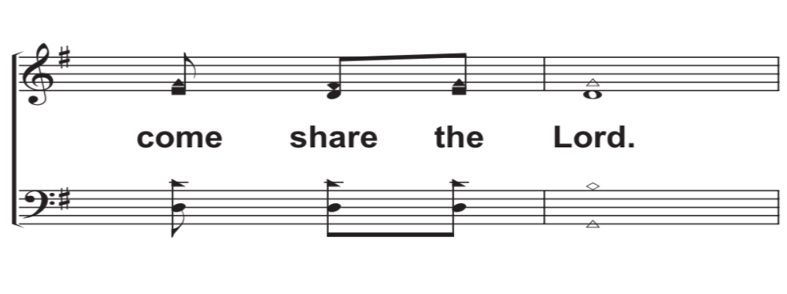
V1c – Come Share The Lord
© 2014 The Acappella Company

Slide 4
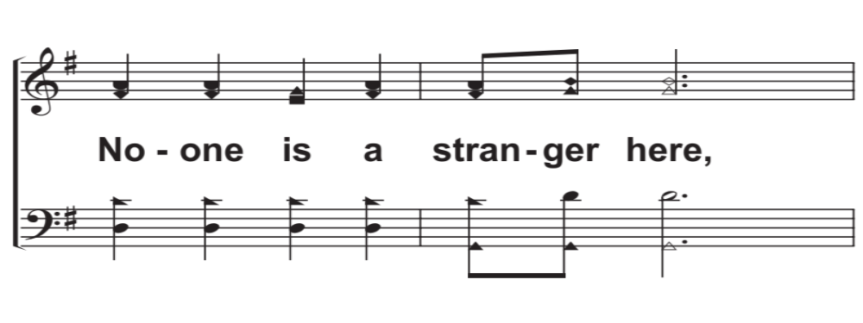
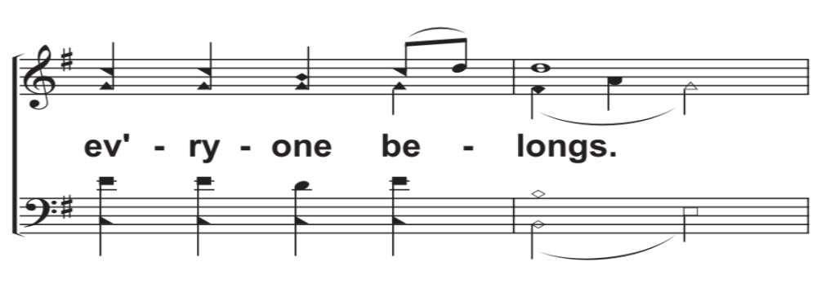
V1d – Come Share The Lord
© 2014 The Acappella Company

Slide 5
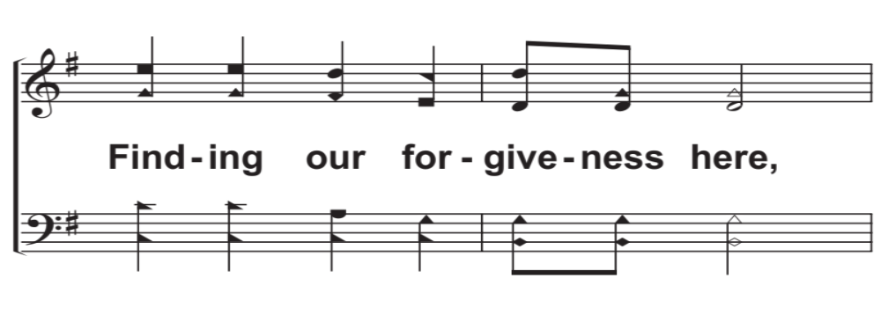
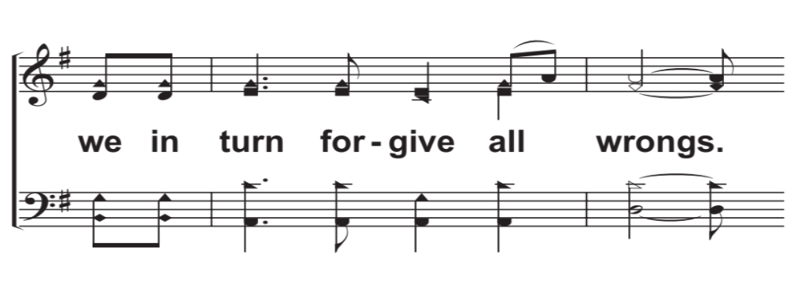
V1e – Come Share The Lord
© 2014 The Acappella Company

Slide 6
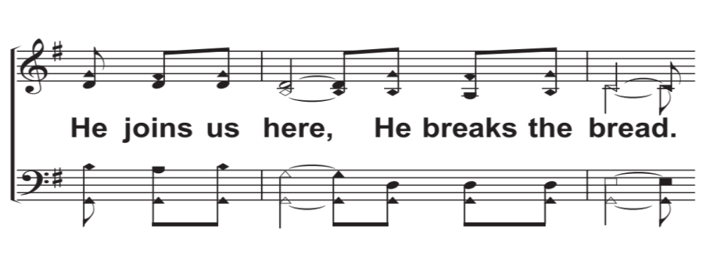
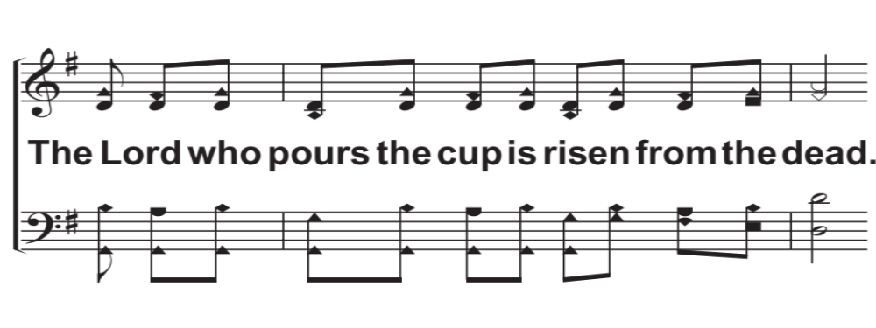
V2a – Come Share The Lord
© 2014 The Acappella Company

Slide 7
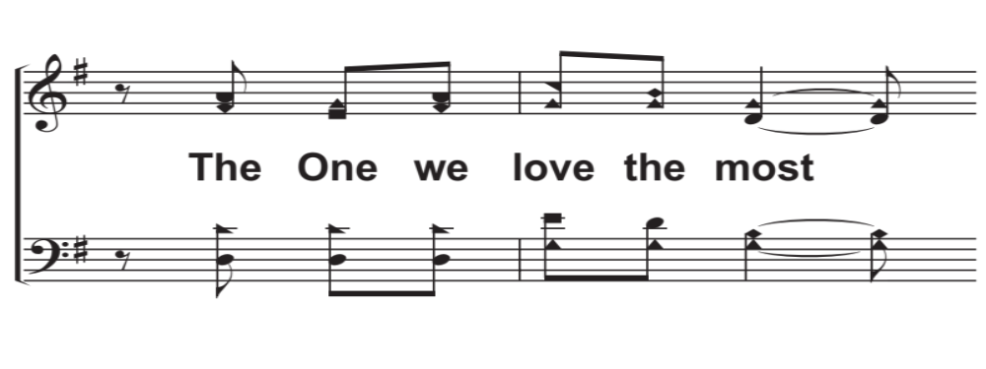
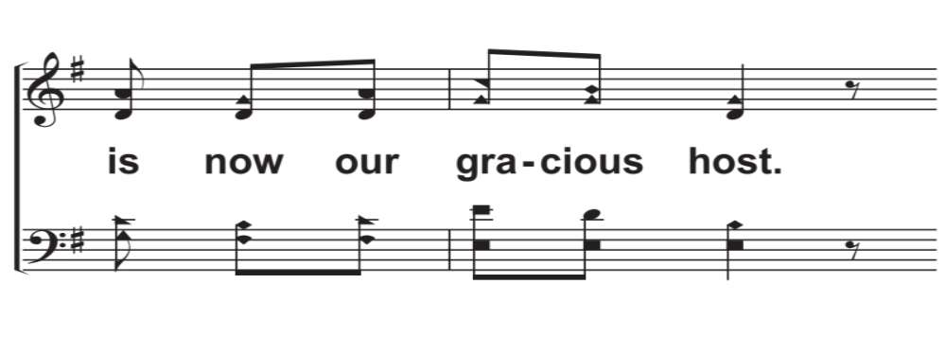
V2b – Come Share The Lord
© 2014 The Acappella Company

Slide 8
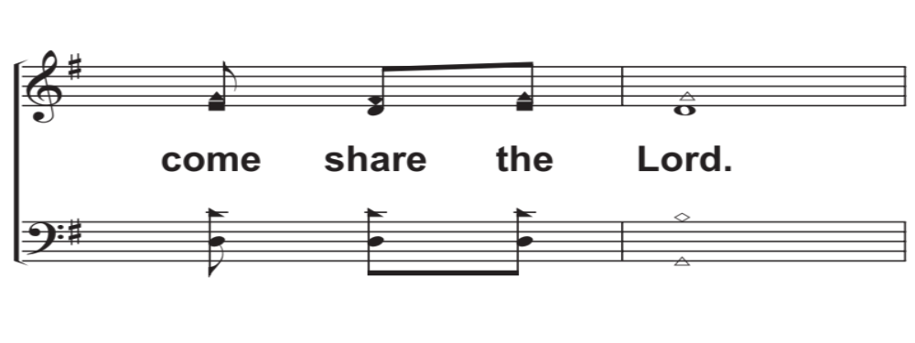
V2c – Come Share The Lord
© 2014 The Acappella Company

Slide 9
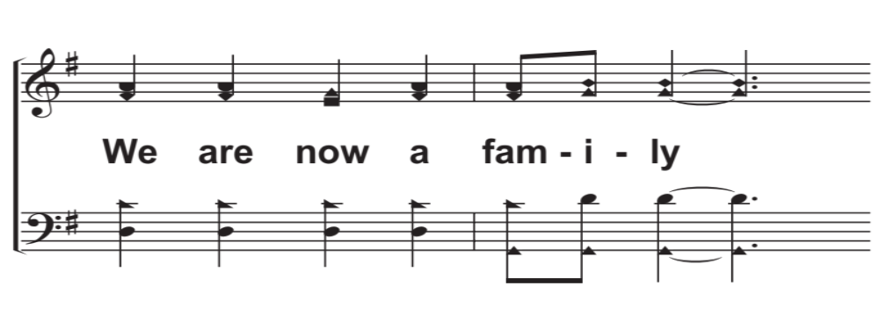
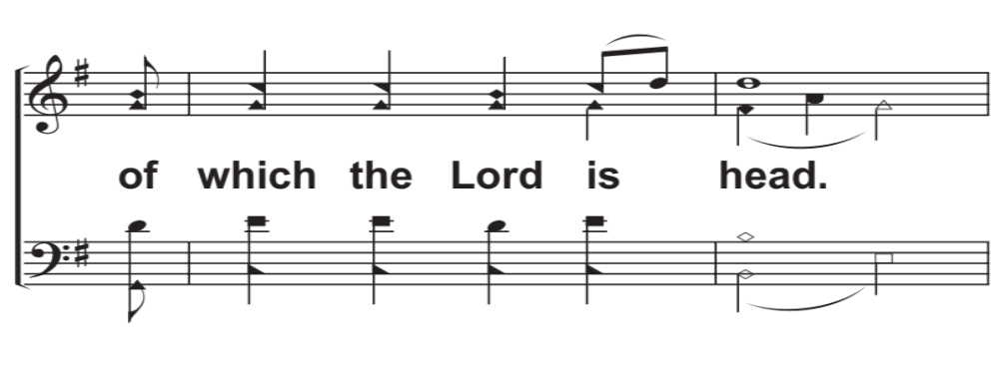
V2d – Come Share The Lord
© 2014 The Acappella Company

Slide 10
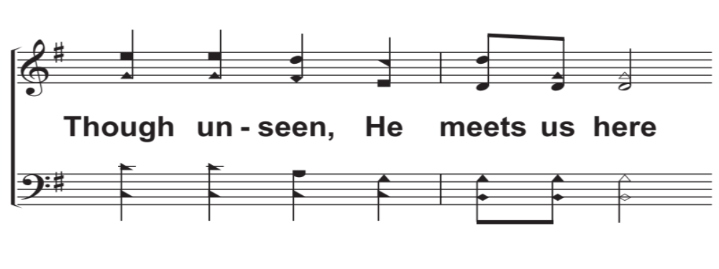
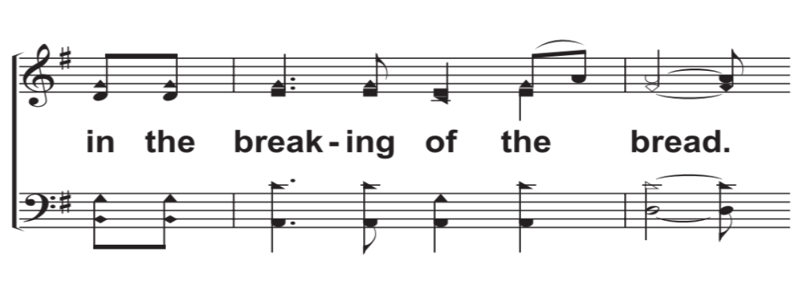
V2e – Come Share The Lord
© 2014 The Acappella Company

Slide 11
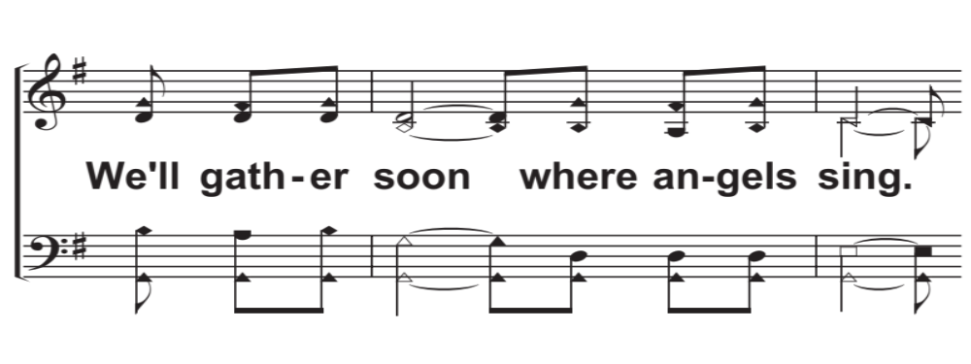
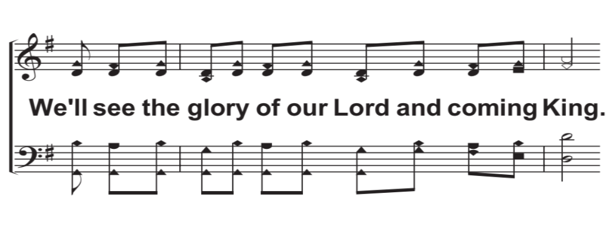
V3a – Come Share The Lord
© 2014 The Acappella Company

Slide 12
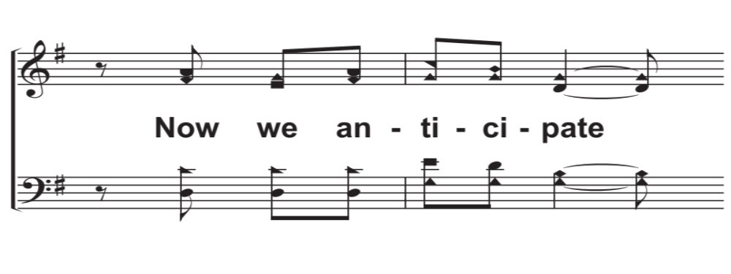
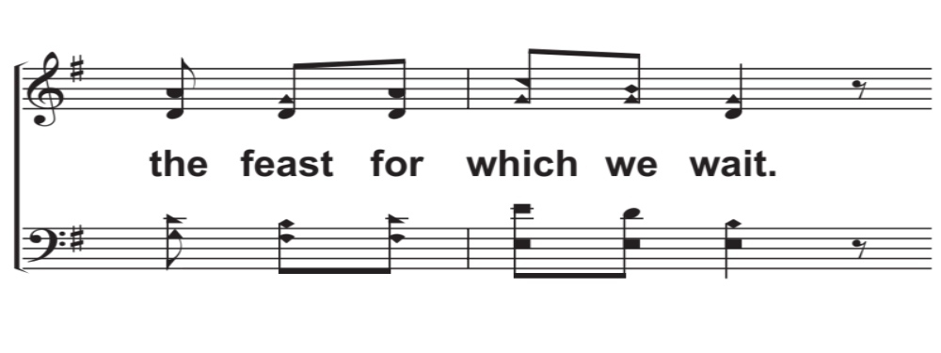
V3b – Come Share The Lord
© 2014 The Acappella Company

Slide 13
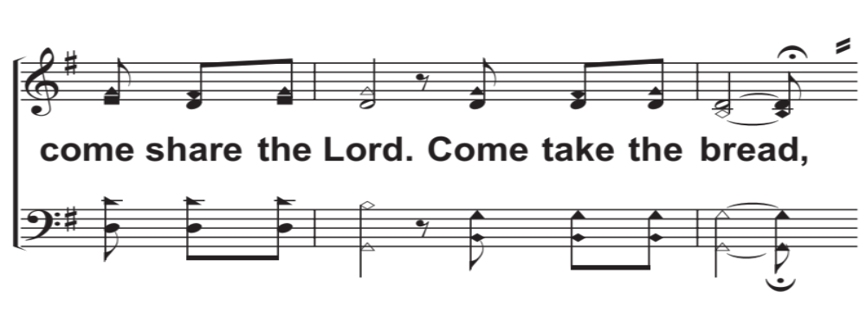
V3c – Come Share The Lord
© 2014 The Acappella Company

Slide 14
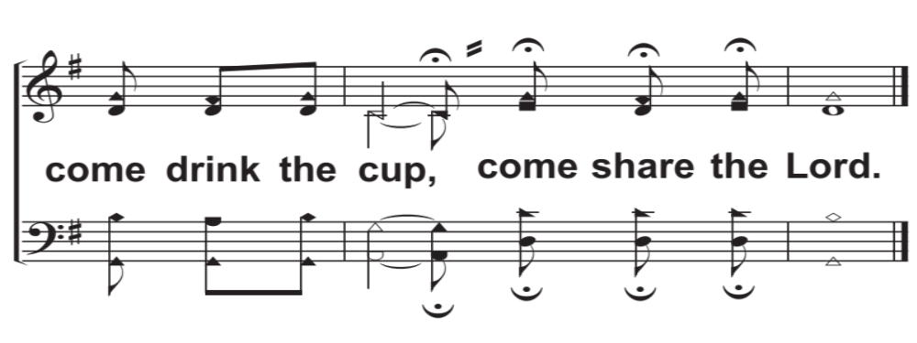
V3d – Come Share The Lord
© 2014 The Acappella Company

