Slide 1
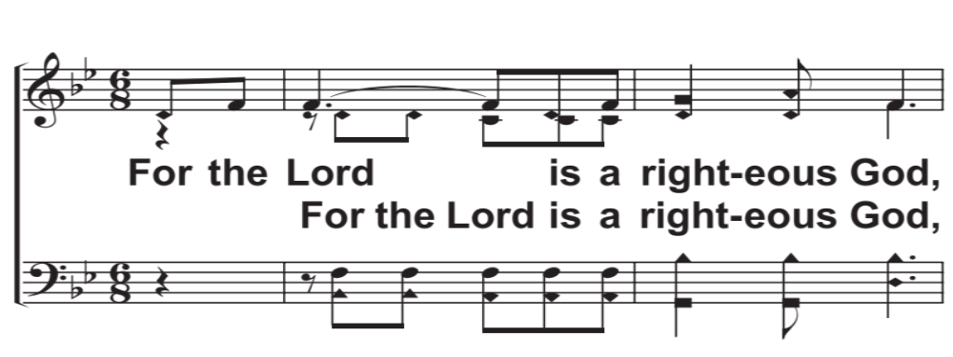

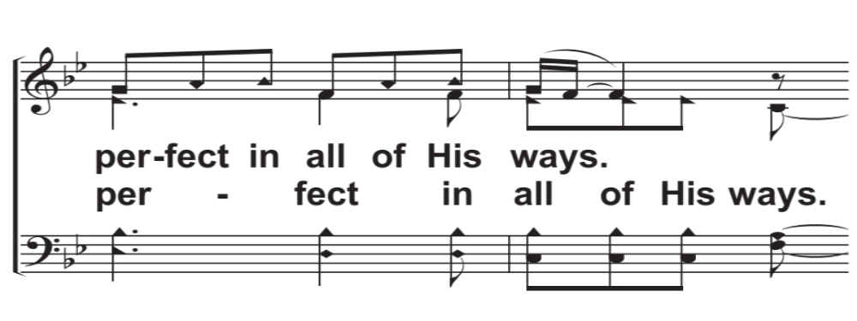
V1a – For The Lord Is A Righteous God
Arr: Mike Rogers
Words and Music by: Dennis Jernigan
© 2015 The Acappella Company

Slide 2
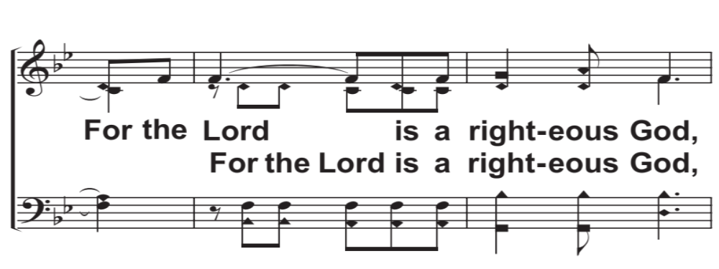
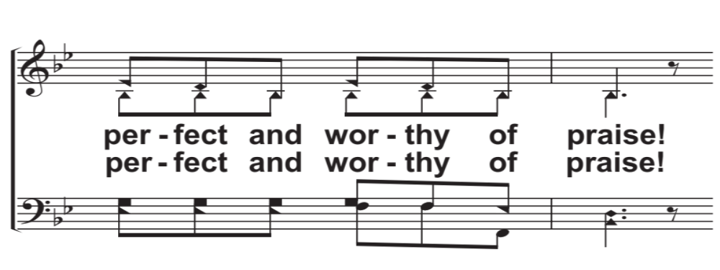
V1b – For The Lord Is A Righteous God
© 2015 The Acappella Company

Slide 3
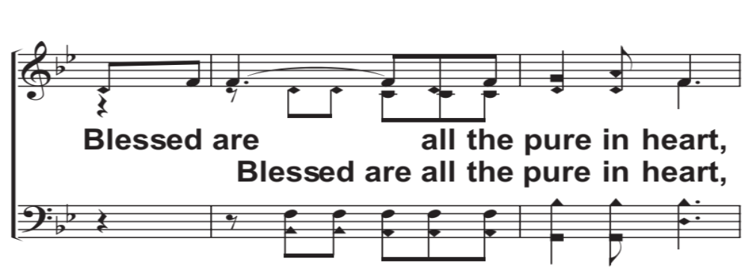
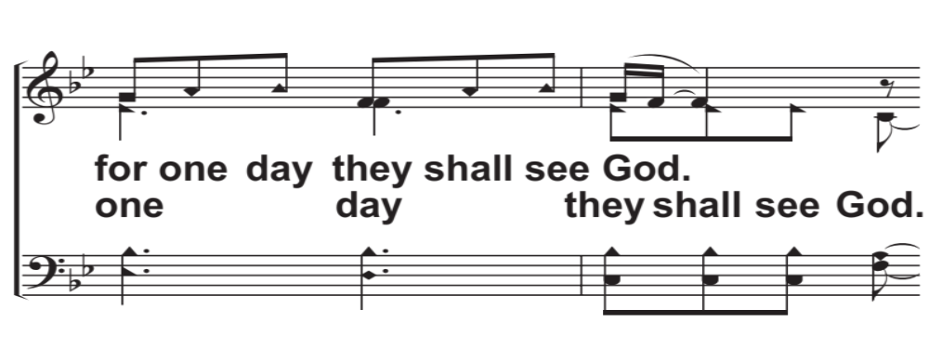
V1c – For The Lord Is A Righteous God
© 2015 The Acappella Company

Slide 4
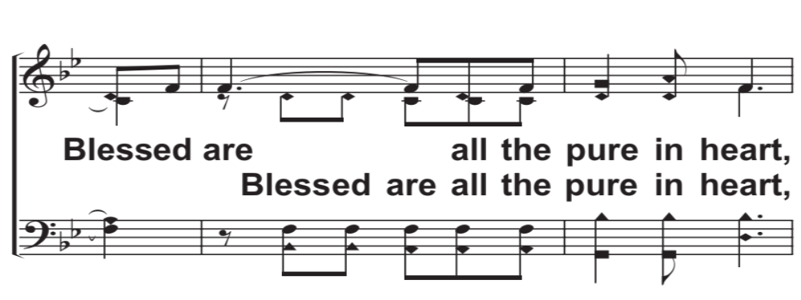
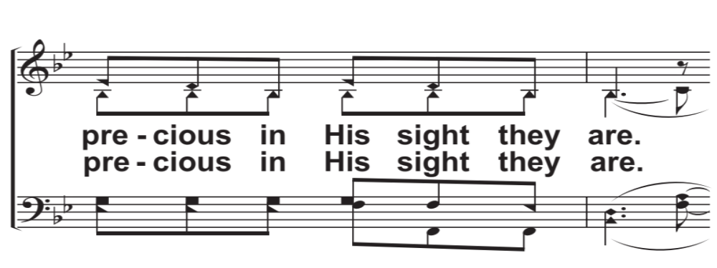
V1d – For The Lord Is A Righteous God
© 2015 The Acappella Company

Slide 5
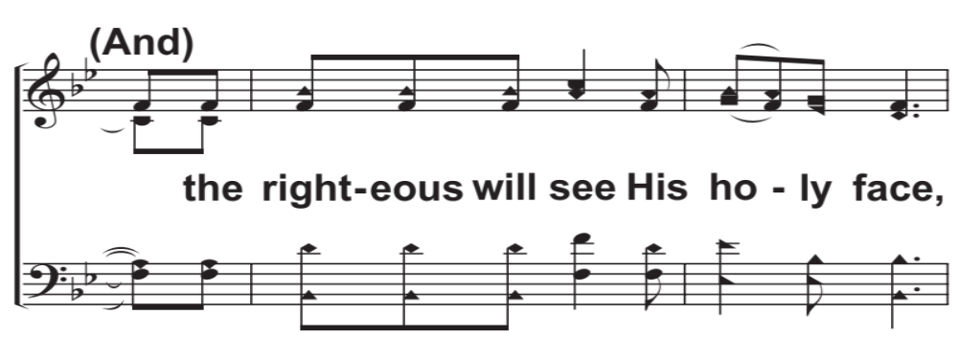
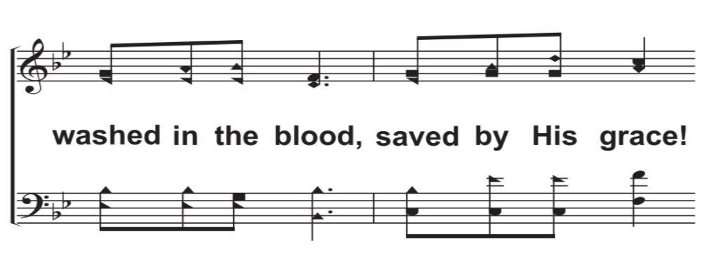
C1a – For The Lord Is A Righteous God
© 2015 The Acappella Company

Slide 6
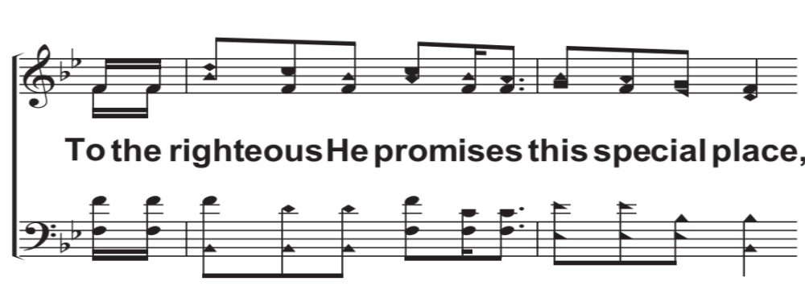
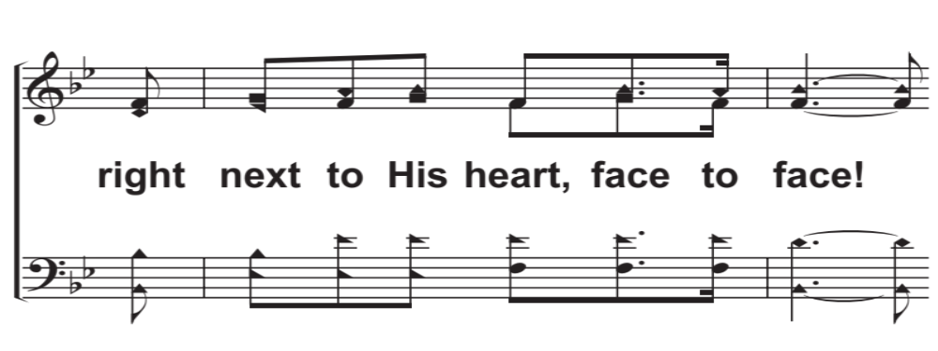
C1b – For The Lord Is A Righteous God
© 2015 The Acappella Company

Slide 7
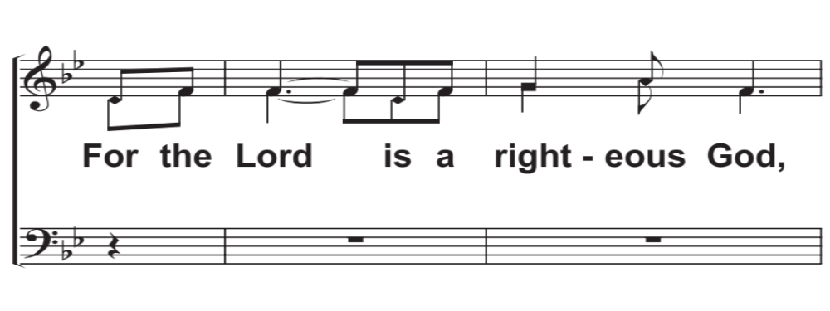
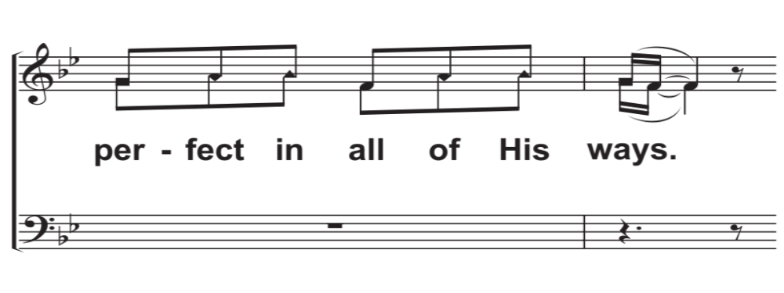
V2a – For The Lord Is A Righteous God
© 2015 The Acappella Company

Slide 8
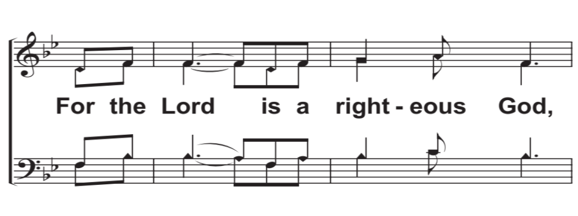
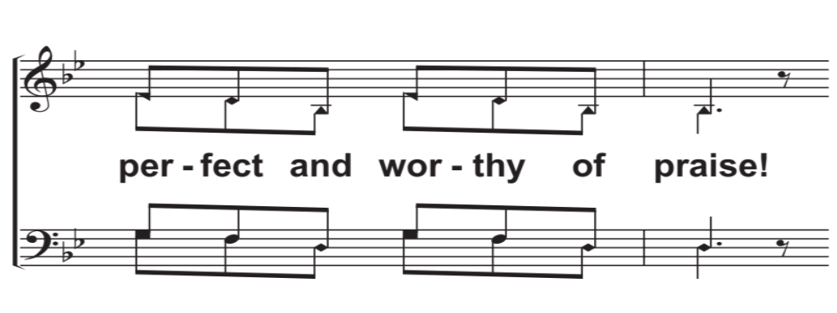
V2b – For The Lord Is A Righteous God
© 2015 The Acappella Company

Slide 9
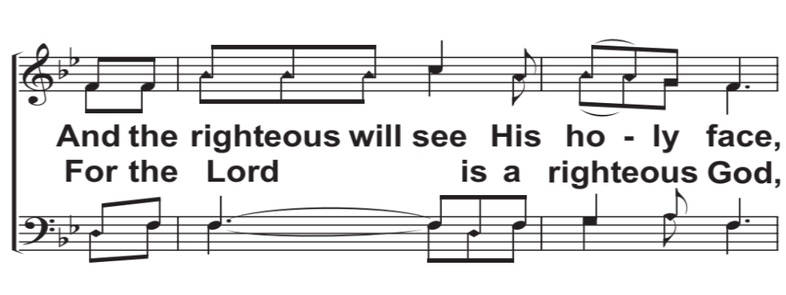
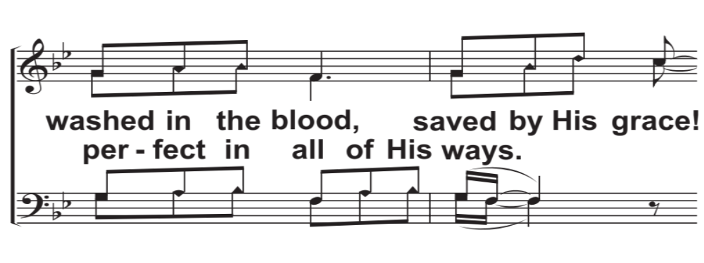
V2c – For The Lord Is A Righteous God
© 2015 The Acappella Company

Slide 10
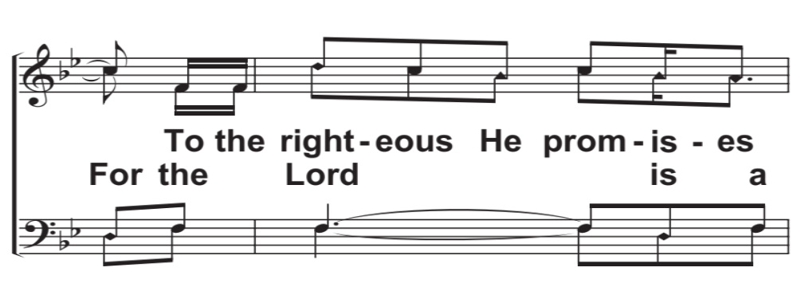
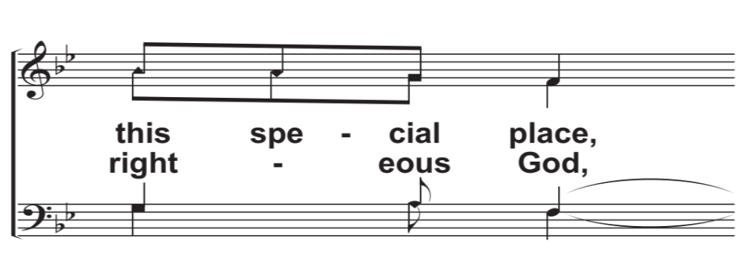
V2d – For The Lord Is A Righteous God
© 2015 The Acappella Company

Slide 11
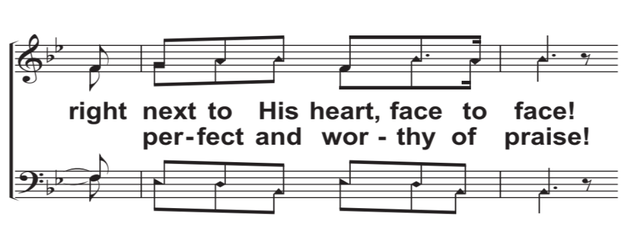
V2e – For The Lord Is A Righteous God
© 2015 The Acappella Company

Slide 12
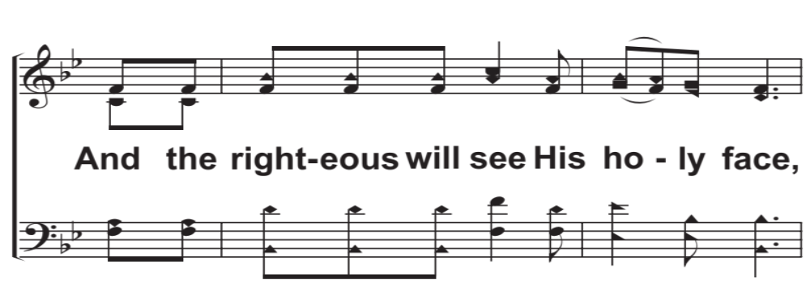
C2a – For The Lord Is A Righteous God
© 2015 The Acappella Company

Slide 13
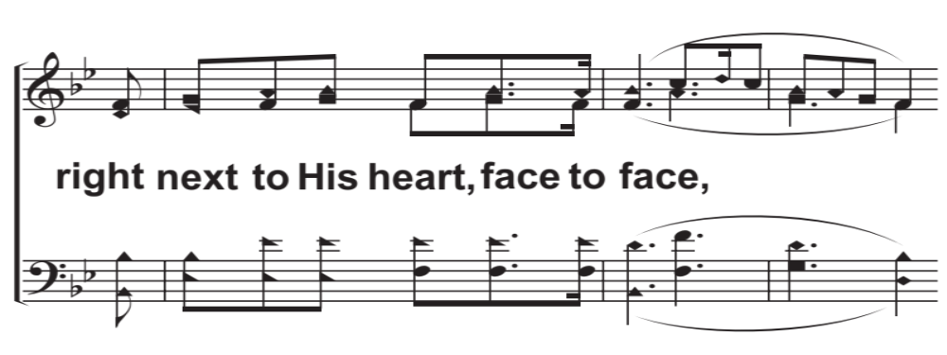
CODAa – For The Lord Is A Righteous God
© 2015 The Acappella Company

Slide 14
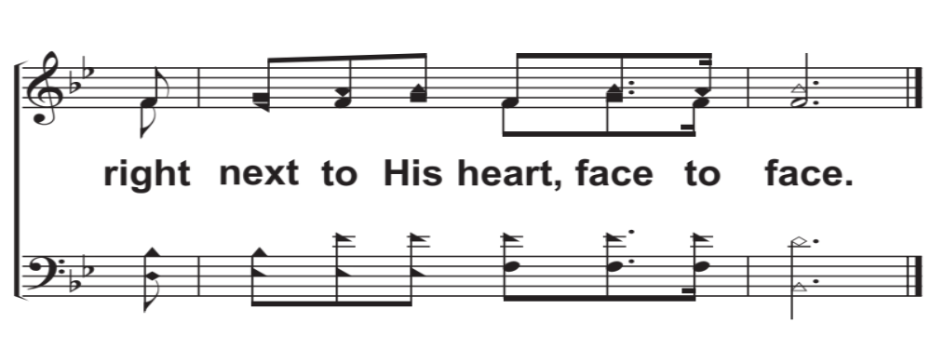
CODAb – For The Lord Is A Righteous God
© 2015 The Acappella Company

