Slide 1
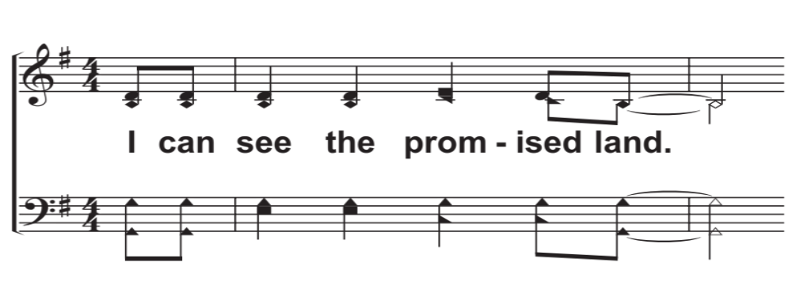
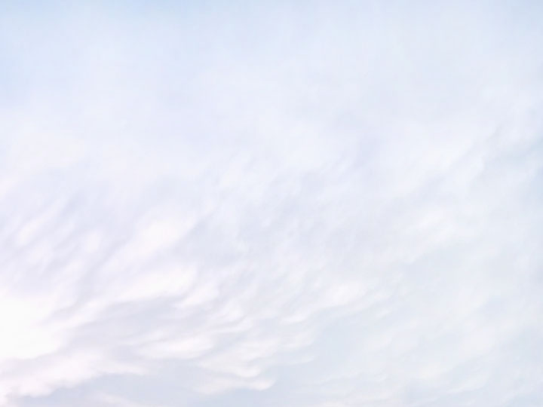
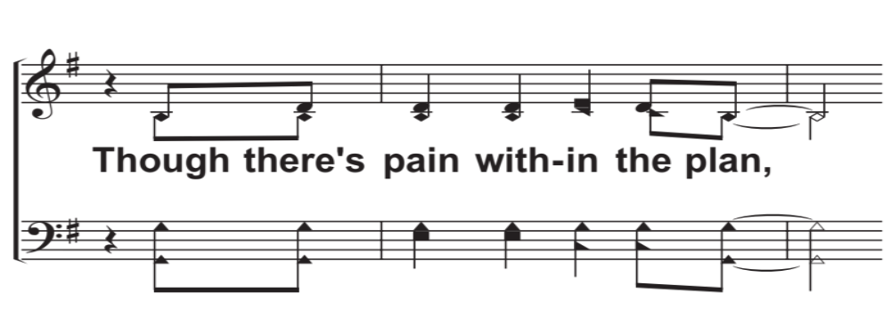
V1a – Every Giant Will Fall
Words and Music by: Chris Llewellyn and Gareth Gilkeson, Arr. Shane Coffman and Caleb Stewart
© 2015 Thankyou Music
© 2018 The Acappella Company

Slide 2
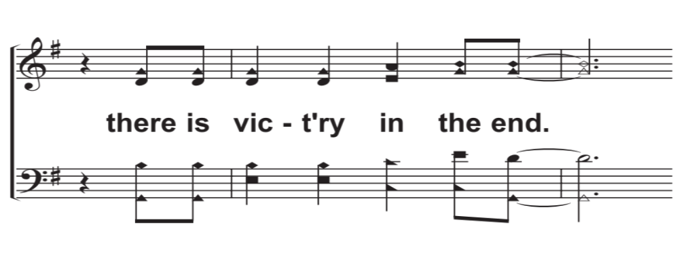
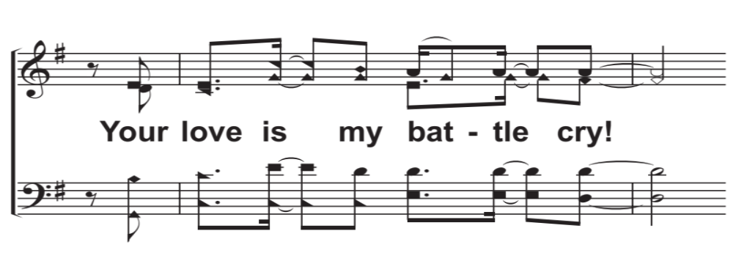
V1b – Every Giant Will Fall
© 2018 The Acappella Company

Slide 3
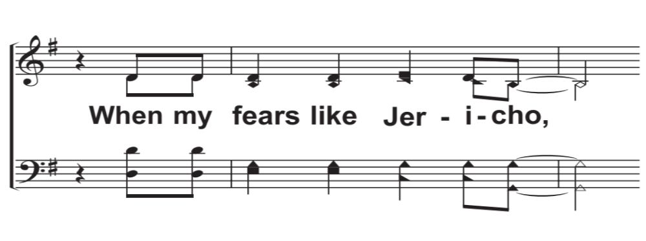
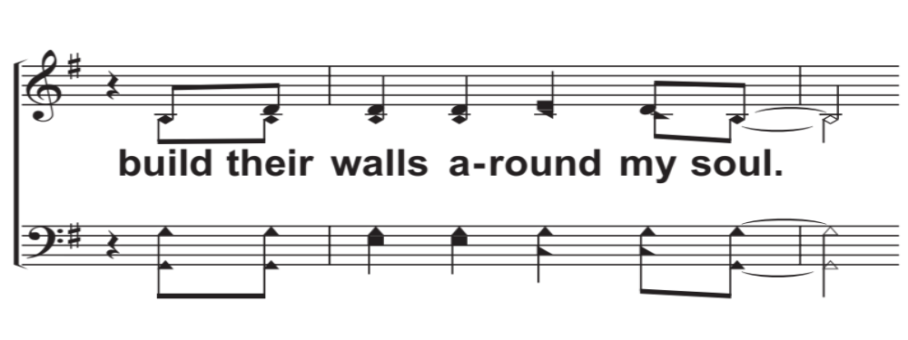
V2a – Every Giant Will Fall
© 2018 The Acappella Company

Slide 4
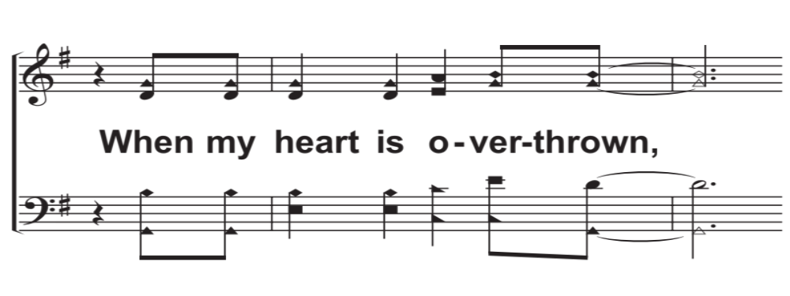
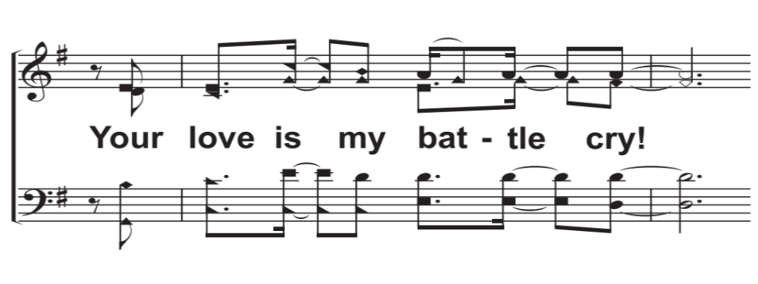
V2b – Every Giant Will Fall
© 2018 The Acappella Company

Slide 5
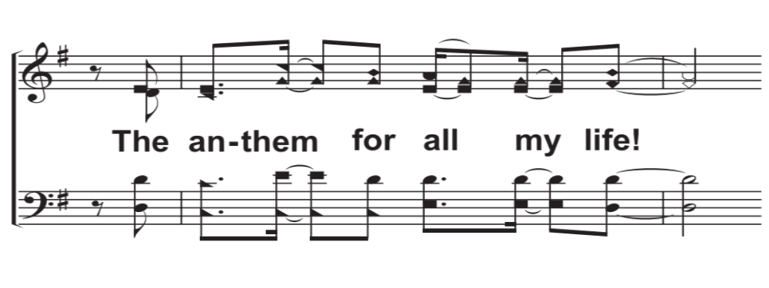
V2c – Every Giant Will Fall
© 2018 The Acappella Company

Slide 6
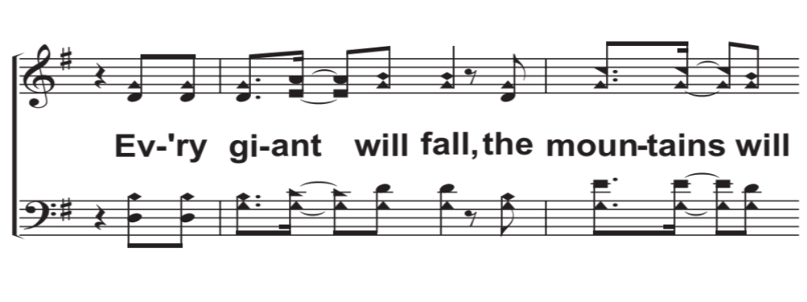
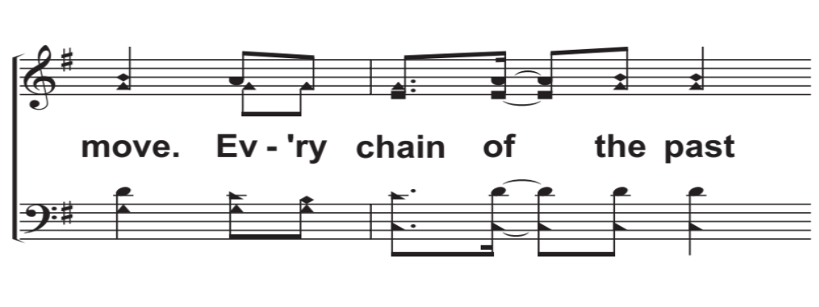
C1a – Every Giant Will Fall
© 2018 The Acappella Company

Slide 7
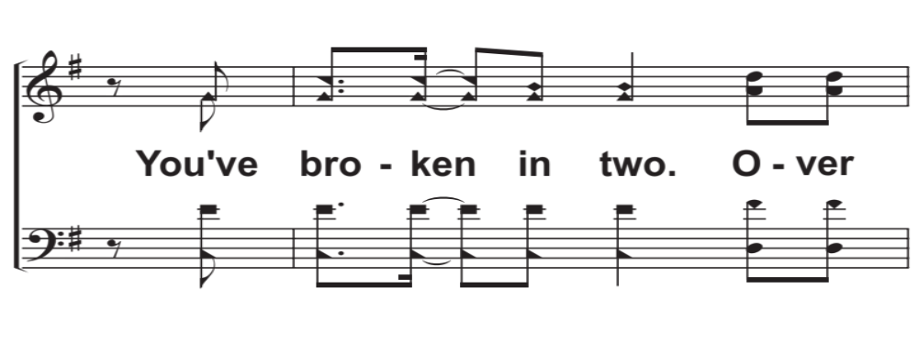
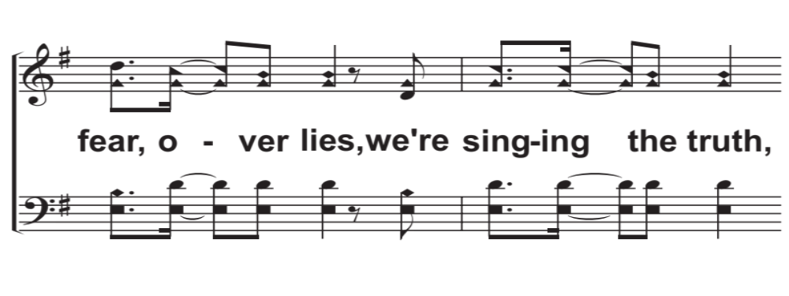
C1b – Every Giant Will Fall
© 2018 The Acappella Company

Slide 8
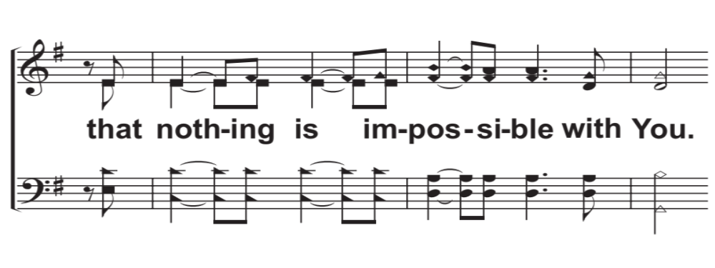
C1c – Every Giant Will Fall
© 2018 The Acappella Company

Slide 9
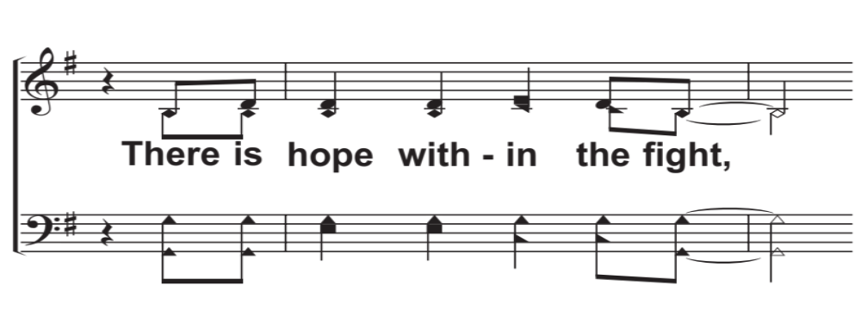
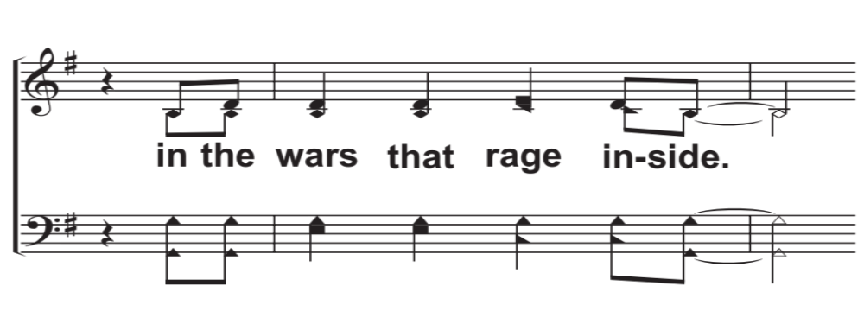
V3a – Every Giant Will Fall
© 2018 The Acappella Company

Slide 10
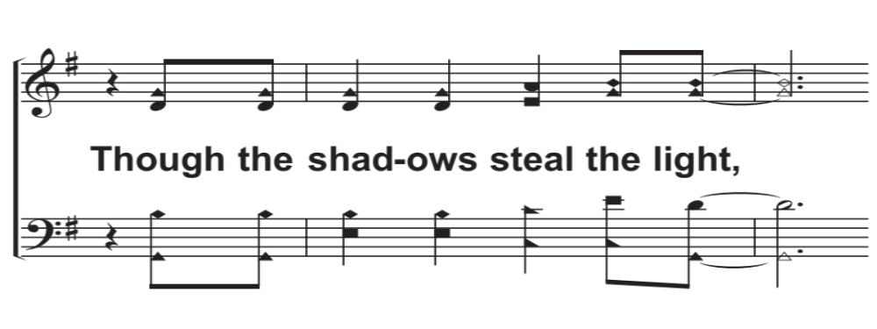
V3b – Every Giant Will Fall
© 2018 The Acappella Company

Slide 11
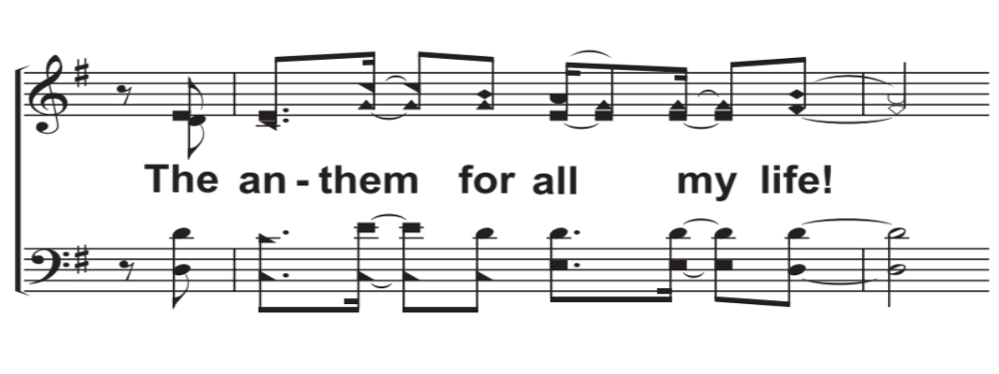
V3c – Every Giant Will Fall
© 2018 The Acappella Company

Slide 12
C2a – Every Giant Will Fall
© 2018 The Acappella Company

Slide 13
C2b – Every Giant Will Fall
© 2018 The Acappella Company

Slide 14
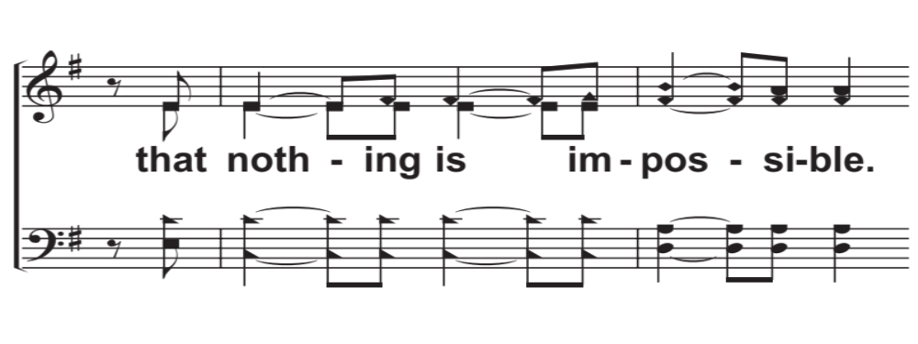
C2c – Every Giant Will Fall
© 2018 The Acappella Company

Slide 15
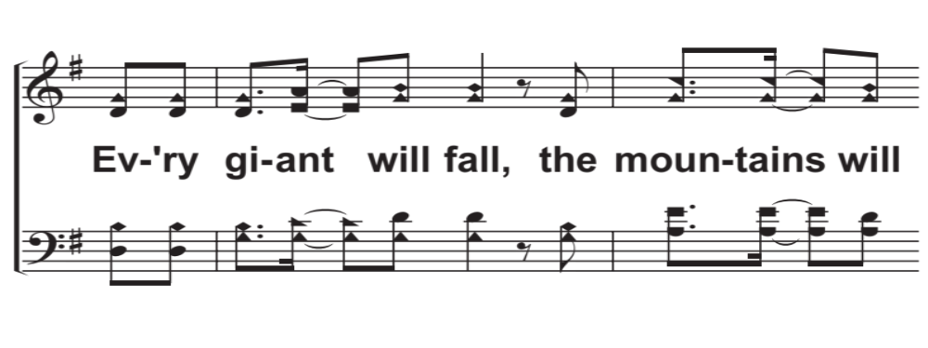
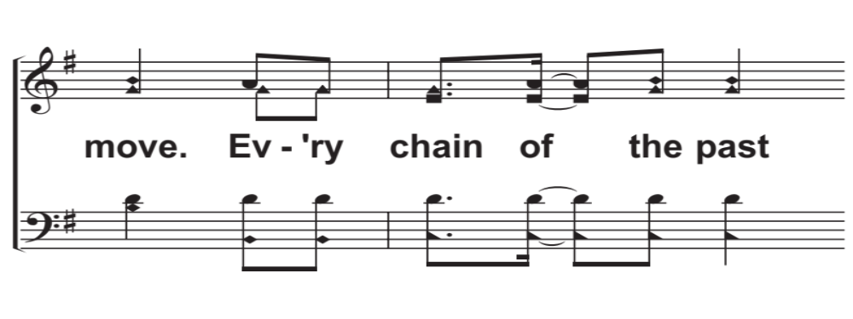
C3a – Every Giant Will Fall
© 2018 The Acappella Company

Slide 16
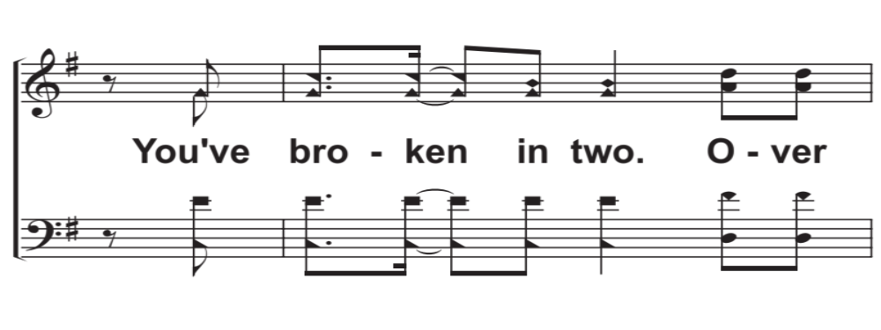
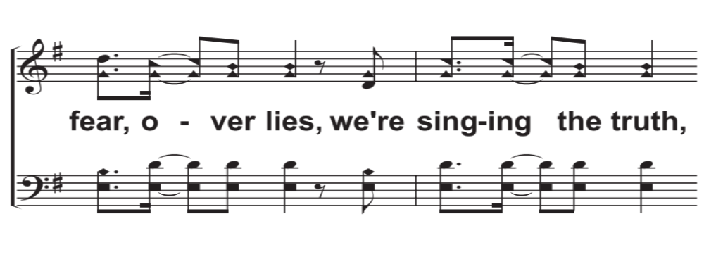
C3b – Every Giant Will Fall
© 2018 The Acappella Company

Slide 17
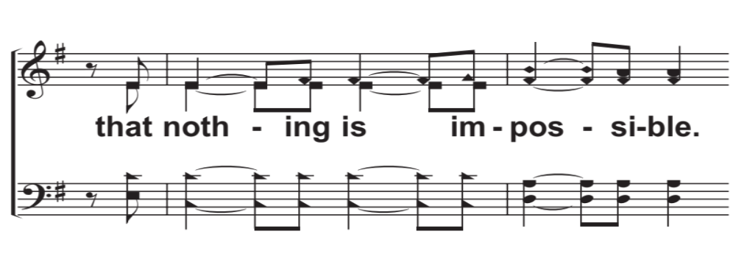
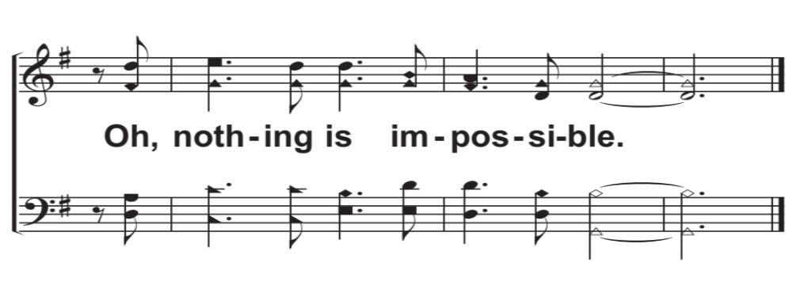
C3c – Every Giant Will Fall
© 2018 The Acappella Company

