Slide 1
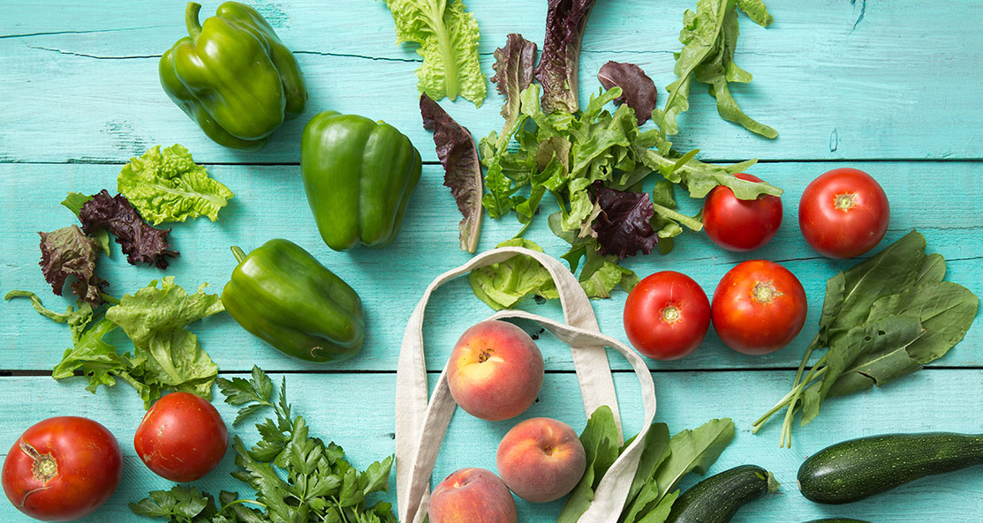
Seasonings 🥑
Recipe Recommender System
Notes:
Something I enjoy doing is trying out new restaurants, but also cooking at home
I spent a lot of time thinking about what to make for dinner
Solve a personal problem with machine learning.

Slide 2
Agenda
Intro
Demo
Process
Results
Notes:
Notes

Slide 3
01
What’s for dinner tonight? 🤔
Can’t decide
Same repetitive meals
Give up & order take-out
Discover personalized content & surface new recipes
Prepare for grocery runs
Notes:
This is a problem you have had too many times before: Imagine, you’re in the super market …

Slide 4



Machine Learning Problem
Given a person’s preferences in past recipes, could I predict other new recipes they might enjoy?
Use Recommender Systems
Notes:
Things you like, things you don’t like or dietary restrictions
Also peel back the curtain as to what a recommendation system does, as its pervasive in our daily lives
Cat seeing a reflection of itself with ears.

Slide 5
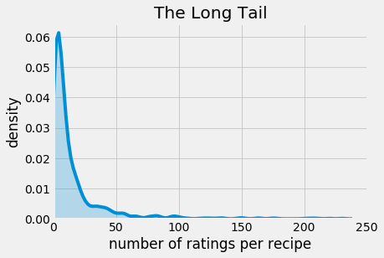

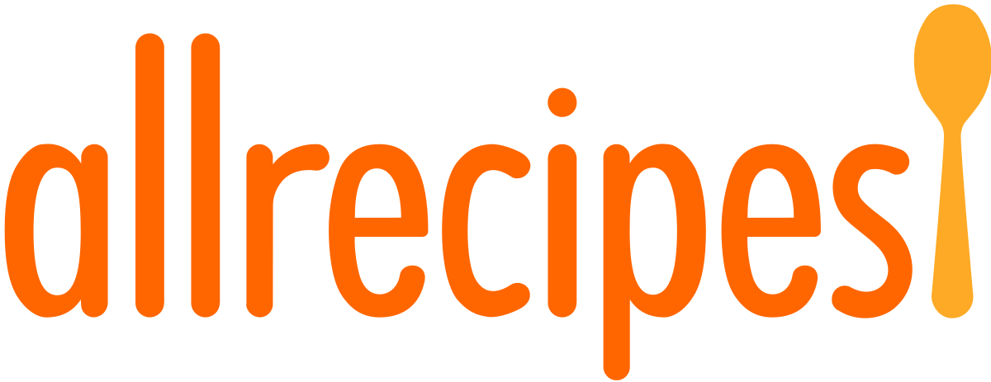
Data
460
Cuisines
55K
Users
1100
Recipes
73K
Ratings
⭐️ ⭐️ ⭐️ ⭐️ ⭐️
Notes:
What can we see here from these numbers?
Coined by the Wired in 2004, about Amazon … how there is more content than users, shifting away from hits and huge number of niches.

Slide 6
02
Live Demo

Slide 7
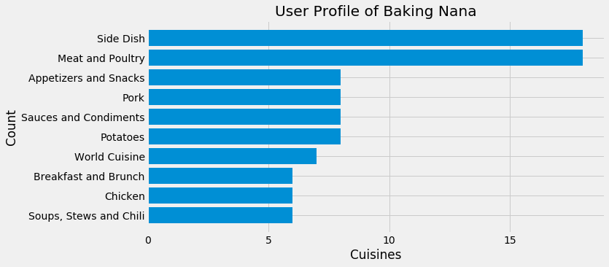
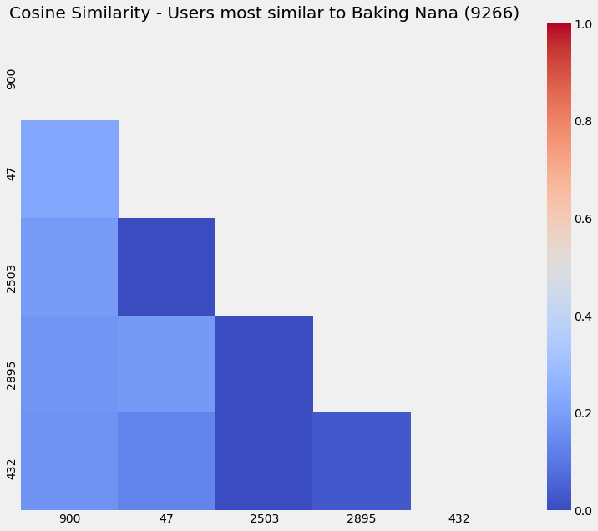
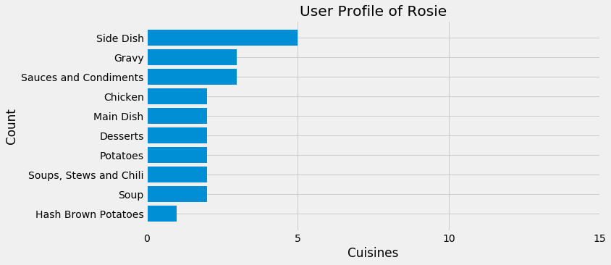
03
1A Collaborative Filtering
Cosine Similarity
Notes:
Before recommender systems, how did you get suggestions for new songs?
Your friends and family! Because you trusted them.
We measure this with something we call Cosine similarity. First off, Scale of -1 to 1.
We can recommend Rosie, recipes that Baking Nana liked, and vice versa. (Italian Meatballs)
Extra:
Rosie rated 5s for all recipes she tried. Baking Nana rating those items 5s as well.
If we were only considering these 8 items, the vectors are actually very close to each other (1.0!),
But because there are a lot of recipes that Rosie hasn't rated yet, so the similarity is only a 22%.
However, there is a silver lining!

Slide 8
1B Content Based Filtering
Solves cold start problem
But … curse of dimensionality
Dimensionality reduction to predict ratings with latent factors
1000 -> 100 components explains 55% of variance
2 Matrix Factorization
Notes:
Address: 1) The cold start problem is when there are new users and recipes in our matrix that do not have any ratings. 2 ) Curse of dimensionality. No users are similar to each other!
Latent factors - If we both like recipes that remind us that remind us of Thanksgiving, how do we pick up the underlying tastes?
SVD = Low rank matrix

Slide 9

Better than the sum of its parts
A hybrid model
Recipe 1
Collaborative Filtering
Recipe 1
Recipe 1
Content Filtering
Recipe 1
Hybrid
Ranked Predictions
Recipe 1
Recipe 1
Matrix Factorization
Recipe 1
Recipe 1
Recipe 1
Notes:
Ensemble methods use multiple learning algorithms to obtain better predictive performance, than could be obtained from any of the constituent learning algorithms alone.
Better than the sum of its parts

Slide 10
04
Model Evaluation
 | Naïve Model | 1. User-Based | 2. Item-Based | 3. Factorization
Test RMSE | 4.6 | n/a | n/a | 0.30
Precision at 6 | 0% | 33% | 17% | 80%
Recall at 6 | 0% | 3% | 2% | 4%
What fraction of recommended
items did user consumed?
“Out of all items the user consumed,
what was recommended?
Notes:
Factorization was performant, but tended to return items that the user has already tried before or the predicted rating was < 3, so I didn’t want to return it.
Performs better when more data is given

Slide 11
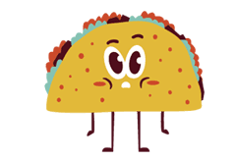
Thanks! That’s a wrap. I really hope this inspires you to try something new.
Notes:
To recap, my app, Seasonings, helps you discover personalized and new recipes, so you’re better prepared for your next grocery run.
I had a lot of fun making this.
You might just find your next favourite recipe.

Slide 12
Challenges
Version 2.0
🐌
More compute
No Public API
NLP on user reviews & topic modeling
More user testing
😭
Notes:
Matrix factorization and cross validation is slow

